Slide 1
UKUKHANYA OKUKHANYISA EBUNYAMENI
Isifundo sesithathu kuMabasa ilanga amatshumi amabili ku, 2024

Slide 2
“Khona-ke uJesu wathi kubo: Lizakubalokukhanya okwesikhatshana esengeziweyo. Hambani liseselokukhanya,ubunyama bungakalidluli. Ohamba ebumnyameni akazi lapho aya khona.
( Johane 12:35 )

Slide 3
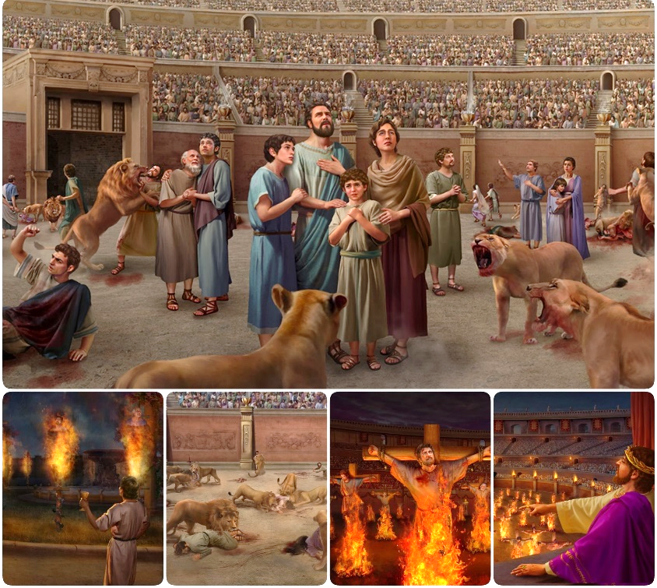
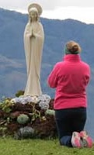
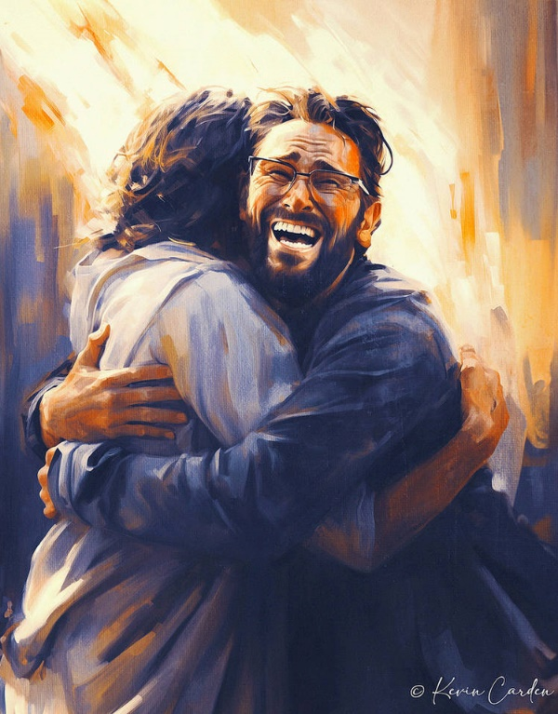
Impi iyanqotshwa loba ayinqotshwa ngokulwa..
Wathi uSathane esehlulwe empini yotshutshisa wakha icebo elitsha: lokuvumelana. Ukuhlanganisa kweqiniso lamanga kuye kwaadonsa izigidi ukuba zamukele iqiniso eliphingiweyo, elingaphiliyo.
Kuphela isivikelo sethu kule mpi yikunamathela kuJesu, oliQiniso lokuPhila, leZwi lakhe eliNgcwele.
Ukulwela iqiniso:
Iqiniso limisana lamanga.
Ukuyekethisa kwebandla.
Impi Yezwi likaNkulunkulu:
Ukuvikeleka eBhayibhelini.
Ukucabanga kwabantu.
Impi yenqondo..

Slide 4
IMPI YEQINISO

Slide 5
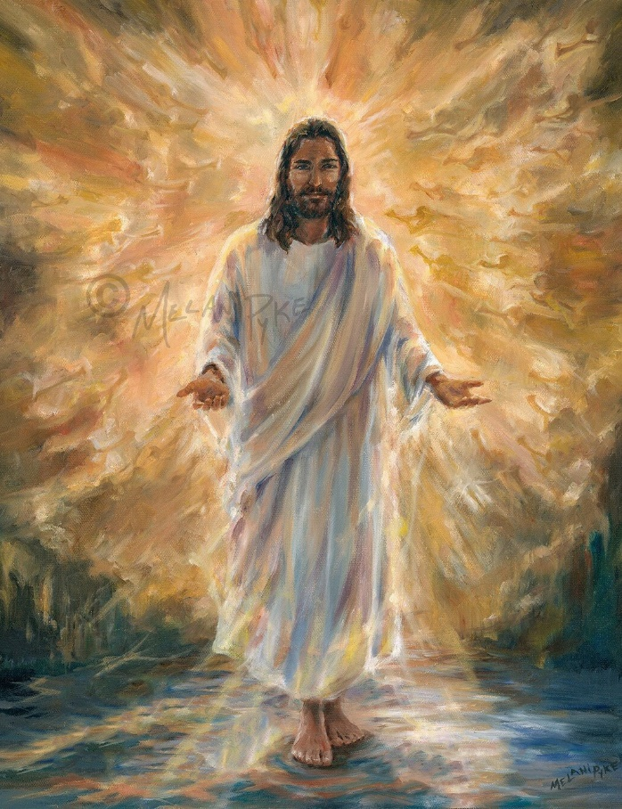
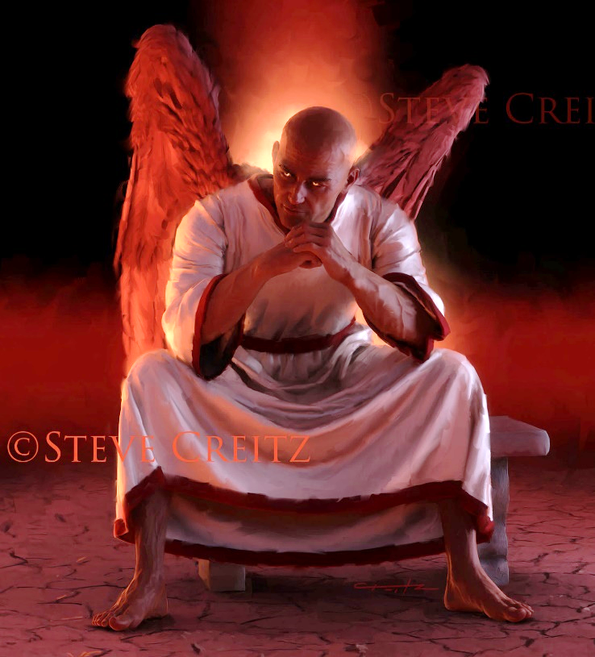
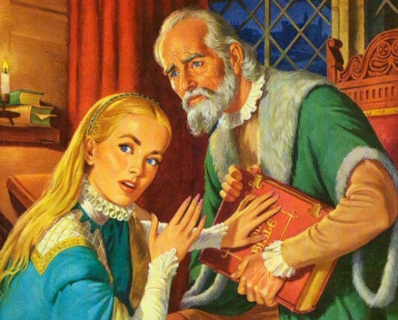
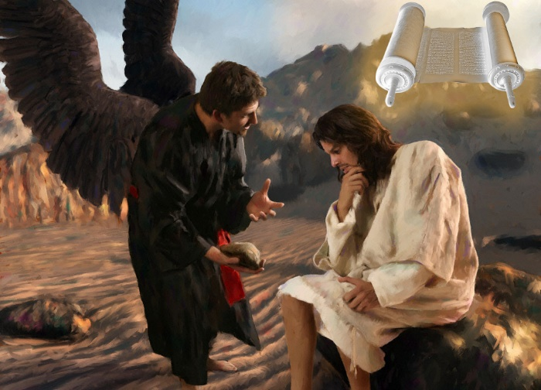
IQINISO LIMISANA LAMANGA
“UJesu waphendula: “Mina ngiyindlela leqiniso lokuphila. Akekho oza kuBaba ngaphandle kokuba eze ngami” (Johane 14:6).
UJesu uliQiniso ngakhoke unguyise walo lonke iqiniso (Johane 14:6). Konke okuliqiniso, konke okuthembekileyo, konke okuliqiniso, kuvela kuYe. Futhi iqiniso Lakhe liletha ukuphila kithi.
Ngokuphambene, uSathane unguyise wamanga ( Johane 8:44 ). Yonke inkohliso, bonke ubuqili obunonya, lonke iqiniso elonakeleyo, livela kuye. Futhi amanga abo aveza ukufa kithi.
Lapho ekhangekana lesitha, uJesu wasebenzisa iBhayibheli njengomthombo walo lonke iqiniso: “Kulotshiwe ukuthi” ( Math. 4:4; 21:13 ) Ngakho, iBhayibheli litsho ukuthi:
Ngakho-ke, usathani usebenzele ukubhubhisa iBhayibheli, ngokulifihla loba ukuliphendulela. Futhi wakufeza (loba nje engenzanga ngokuphelele) ngebandla LamaRoma, phakathi kweNkathi Ephakathi (ebizwa langokuthi “iSikhathithi Sobumnyama”).

Slide 6
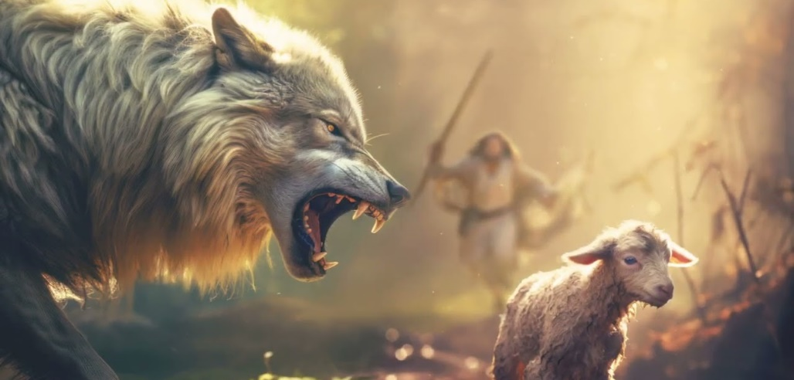
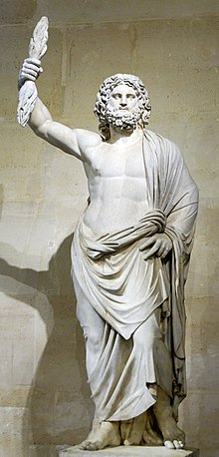
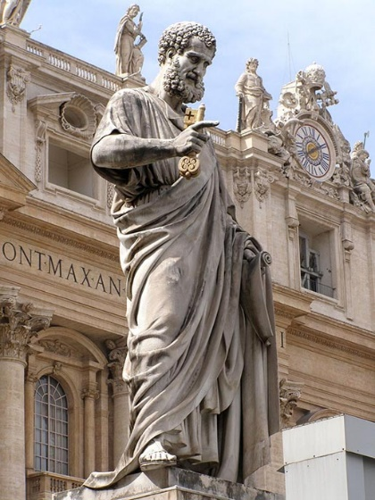
UKUYEKETHISA KWEBANDLA
““Ngiyazi ukuthi emva kokuhamba kwami, kuyofika phakathi kwenu izimpisi ezilomona, aziyikuwuyeka umhlambi wami. 30 Ngitsho laphakathi kwenu kuyovela amadoda aphendulela iqiniso ukuze adonsele abafundi ngemva kwabo.”— IzEnzo 20:29-30;
Njengoba uPawulu evalelisa kubadala base-Efesu, waveza ukukhathazeka kwakhe ngezindubo zangaphandle lezangaphakathi ababezabhekana lazo esikhathini esizayo ( IzEnzo 20:29-30 ).
Impisi ezinyenyelayo . Kusukela ngonyaka wama-64 kuya ku-311 (isimiso seSerdica sokubekezelelana), ibandla labhekana lokutshutshiswa okunzima okuvela eMbusweni WaseRoma
Amadoda akhohlakeleyo. Kusukela ekhulwini lesi-4, amadoda angakaphendukanga angeniswa eBandleni ahlanganisa ubuhedeni bawo leqiniso.
Umfanekiso kankulunkulu wamaRoma uJupiter oseCapitoline Hill eRoma waphinda wasetshenziswa futhi waphendulwa waba ngumfanekiso kaSaint Peter.
USathane wasebenzisa isu lakhe “langaphakathi” ukonakalisa iqiniso futhi angenise ukukhonza izithombe lokugcinwa kweSonto eBandleni.
Njengoba uPawulu aprofetha, lawa maphutha amukelwa, futhi ayohlala kuze kube sekugcineni phakathi kwalabo abangafuni ukwazi iqiniso (2 Thes. 2:7-12). Impi yokugcina iyobe isekelwe ekuyekethiseni iSabatha.

Slide 7
IMPI YEZWI LIKANKULUNKULU

Slide 8
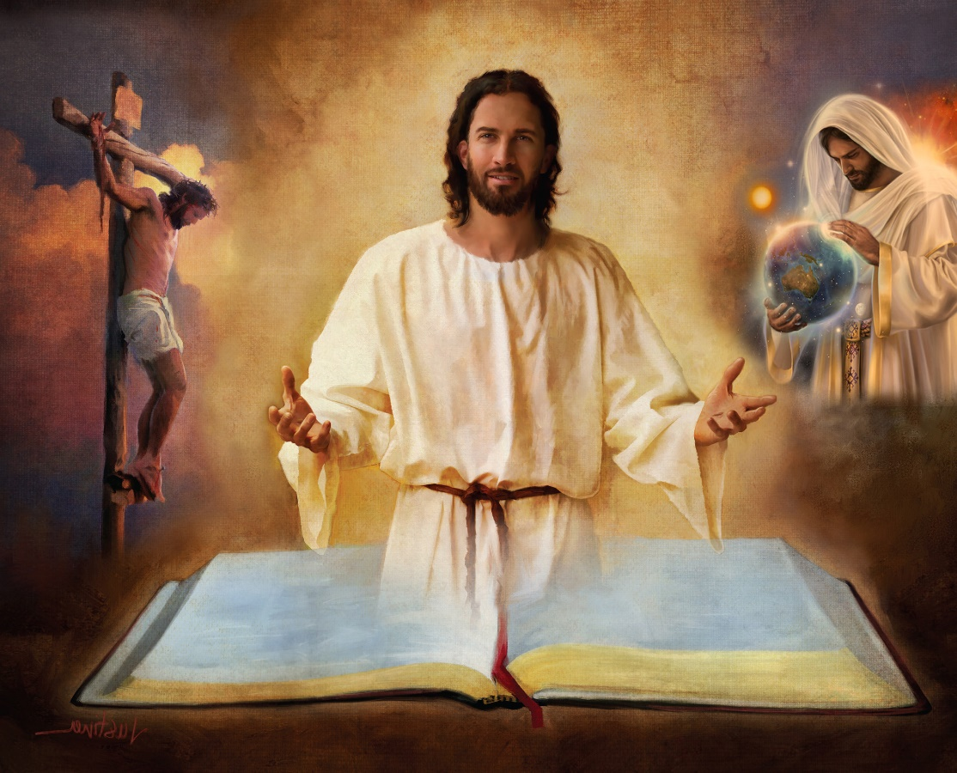
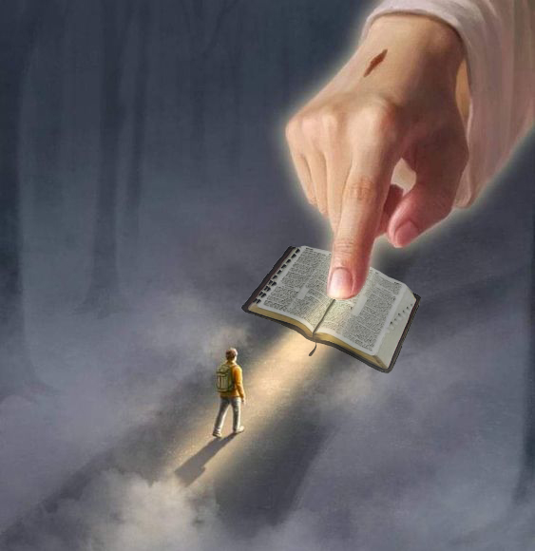
UKUVIKELEKA EBHAYIBHILINI
“Bangcwelise ngeqiniso lakho; Izwi lakho liyiqiniso” (Johane 17:17).
IBhayibheli liyisambulo esingelaphutha sentando kaNkulunkulu. Iveza icebo lasezulwini lokusindiswa kwabantu.
Ngakho-ke, ukuvikeleka kwethu kutholakala eBhayibhelini kuphela, futhi encwadini ngayinye, izahluko lamavesi ( 2Tm. 3:16 ).
Kuyo sithola iqhinga likasathane; indalo; ukuzalwa, ukuphila, ukufa, ukuvuka lokuncenga kukaJesu; ukuthethelelwa kwezono; ukuZa kwesibili; ukuphila okuphakade Emhlabeni Omutsha... …
“Izwi lakho liyisibani ezinyaweni zami; ukukhanya endleleni yami” ( IHu. 119:105 )
Aluba sisala ingxenye yayo (ngokwesibonelo, ukulandisa kweNdalo kaGenesise 1 no-2), singahle sale loba yiziphi izimfundiso elizifundisayo. Bese-ke... yikuphi ukuvikeleka esingaba lakho ukuze sithembele lonke iBhayibheli?
“Ukwambulwa kwamazwi akho kuyakhanyisa; kupha ukuqonda kwabangelalwazi” ( IHu. 119:130 )

Slide 9
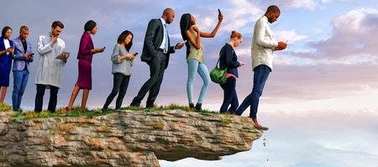
UKUCABANGA KWABANTU
Kukhona indlela ebonakala ilungile, kepha ekugcineni iholela ekufeni” ( IzAga 16:25 )“
Aluba uNkulunkulu kunguye owaphefumulela iBhayibheli, ngubani ongalichaza ( 2 Pet. 1:20; Johane 14:26 )?
“Umuntu ongelaye uMoya akazamukeli izinto ezivela kuMoya kaNkulunkulu, kepha uzikhangela njengeziyibuwula, futhi akangeke ukuzizwisise, ngokuba zizisiswa ngoMoya kuphela”
( 1Ko 2:14 ).
Isibonelo sokucabanga kwabantu ukusola okuphakemeyo okuye kwasikisela ukuchazwa kweBhayibheli “kwezemfundo” kusukela ekhulwini le-18.
An
Indlela yayo eyisisekelo ukuphika izimangaliso kanye lokungenzeki kokubikezela ikusasa. Ngaphansi kwale ndlela, iyiphi inzuzo esingayithola ezwini likaNkulunkulu uma siphika amandla alo loba ukwanelisa ukwazi ikusasa elisilindileyo?s
Ngaphandle kokuthandabuza, isitha siqamba izindlela ezibonakala zilungile, kepha isiphetho sazo yikufa (IzA. 16:25).

Slide 10
EGW (Selected Messages, volume 1, page 17)
“Ubumnyama bakomoya busibekele umhlaba labantu. Kukhona emabandleni amanengi ukuthandabuza lokungathembeki ekuchazeni imiBhalo. Abaningi, abaningi kakhulu, bayabuza ubuqiniso nlobuqotho bemiBhalo. Imicabango yomuntu lemicabango yenhliziyo yomuntu ibukela phansi ukuphefumlelwa kweZwi likaNkulunkulu […]
Le Ncwadi Engcwele imelane lokuhlasela kukaSathane, ohlangene labantu ababi ukwenza yonke into yobuNkulunkulu igubuzelwe ngamayezi lobumnyama. Kodwa iNkosi iye yalondoloza leNcwadi Engcwele ngamandla aYo siqu amangalisayo esimweni sayo samanje—iphepha noma incwadi yokuqondisa emhulini yoluntu ukuze ibabonise indlela eya ezulwini.

Slide 11
IMPI YENQONDO

Slide 12
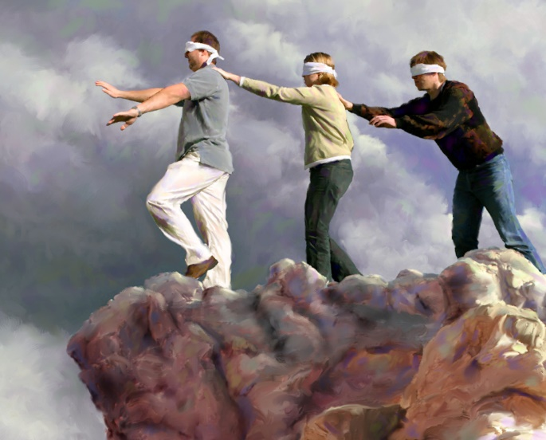
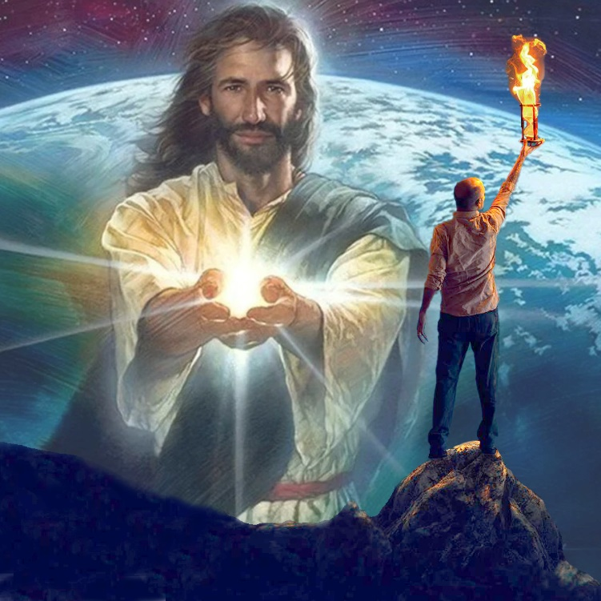
“Unkulunkulu walesisikhathi uphuphuthekisile izingqondo zabangakholwayo, ukuze bangaboni ukukhanya kwevangeli, okuveza inkazimulo kaKristu, ongumfanekiso kaNkulunkulu” (2 Korinte 4:4)
Isitsho seSpanishi sithi: “Ayikho impumputhe embi kakhulu kulaleyo engafuni ukubona.” Okutsho ukuthi, akusizi ukwenza umuntu akholwe lokuthi abone yena angafuni ukukubona. Kunjalo ngalabo “unkulunkulu walelizwe” abaphuphuthekise (2Kor. 4:4).
Ukungabi lolwazi kwalabo abalahlekileyo akubangelwa yikuthi abanawo amandla okwazi. Yingoba abafuni ukwazi. Usathane ugxilise izingqondo zabo ngezinto ezinengi ezibavimbela ukuba bacabange ngalokho okuuqakathekileyo ngempela: insindiso yabo.
Kodwa akekho odinga ukuhlala kulesi simo. Lapho ingqondo isebunyameni obungo komoya, kuba khona ukukhanya okungakhanya futhi okuzokhanya kuwo: “Ukukhanya [uJesu] kukhanya ebumnyameni, futhi ubumnyama abuzange bunqobe.” ( Johane 1:5 ).
Laba phakathi kwethu abamukela lokhu kukhanya bangahlehlisa umsebenzi wesitha, futhi benze ukukhanya kukaJesu kukhanye ebumnyameni.

Slide 13
“lBonke abahamba endleleni eya ezulwini badinga ubuholi obuthembekileyo. Akumelanga sihambe ngokuhlakanipha kwabantu. Kuyinhlanhla yethu ukulalela izwi likaKristu likhuluma lathi njengoba sihamba ohambweni lwempilo, futhi amazwi Akhe angamazwi okuhlakanipha ngaso sonke isikhathi. ...
Ukuphepha kwethu kuphela kusekulandeleni uKristu eduze, ukuhamba ngokuhlakanipha Kwakhe, lokwenza iqiniso Lakhe. Asikwazi njalo ukukubona kalula ukusebenza kukaSathane; asazi lapho ebeka khona imijibila yakhe. Kodwa uJesu uyabuqonda ubuciko besitha obucatshileyo, futhi angakwazi ukugcina izinyawo zethu ezindleleni eziphephileyo.”
EGW (Our High Calling, January 10)

