Slide 1
“Zitatero, kumwamba kunayambika nkhondo. Mikayeli ndi angelo ake kumenyana ndi chinjoka chija. Chinjokacho ndi angelo ake anabwezeranso. Koma analibe mphamvu ndipo anagonjetsedwa nathamangitsidwa kumwambako” (Chivumbulutso 12:7, 8, CCL)

Slide 2
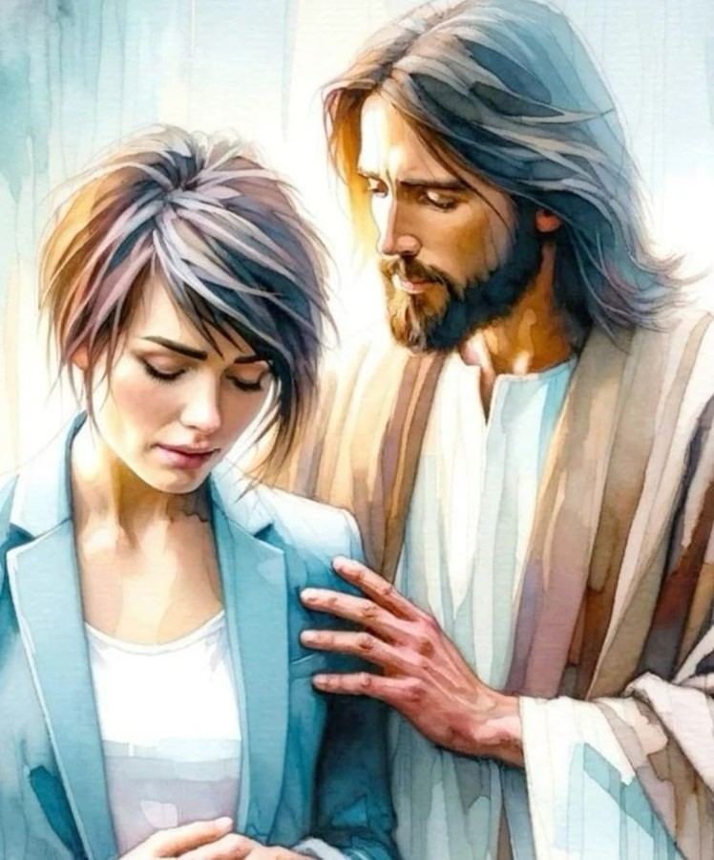
“Tsono usaope, pakuti Ine ndili nawe; usataye mtima chifukwa Ine ndine Mulungu wako. Ndidzakupatsa mphamvu ndipo ndidzakuthandiza, ndidzakutchinjiriza ndi dzanja langa lamanja logonjetsa” (Yesaya 41:10, CCL)

Slide 3
“Kenaka Yesu anawawuza kuti, “Inu mukhala ndi kuwunika kwa nthawi pangʼono. Yendani pamene mukanali ndi kuwunika, kuti mdima usakupitirireni. Munthu amene amayenda mu mdima sadziwa kumene akupita’ ”
(Yohane 12:35, CCL)

Slide 4
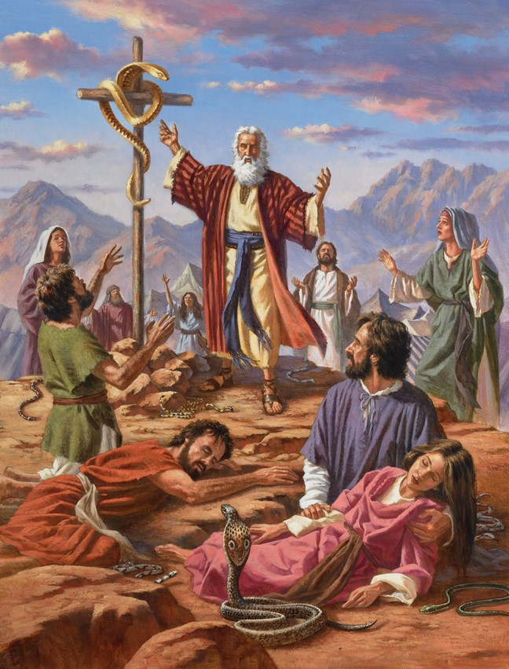
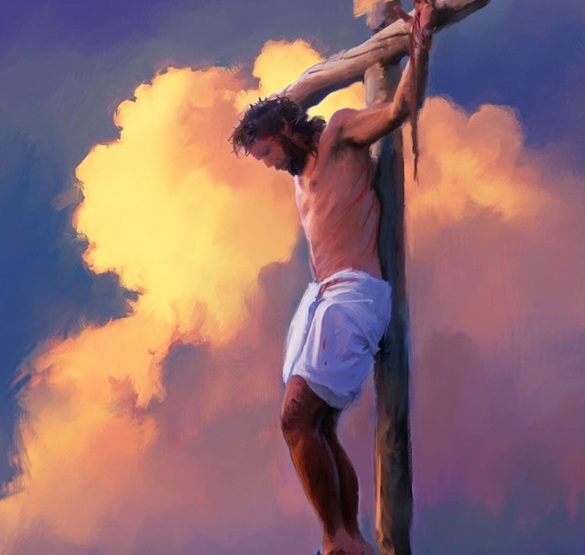
“Tsono monga Mose anapachika njoka mʼchipululu, moteronso Mwana wa Munthu ayenera kupachikidwa, kuti aliyense amene akhulupirira Iye akhale ndi moyo wosatha” (Yohane 3:14, 15)

Slide 5
“Ndasunga mawu anu mu mtima mwanga
kuti ndisakuchimwireni”
(Masalimo 119:11, CCL)

Slide 6
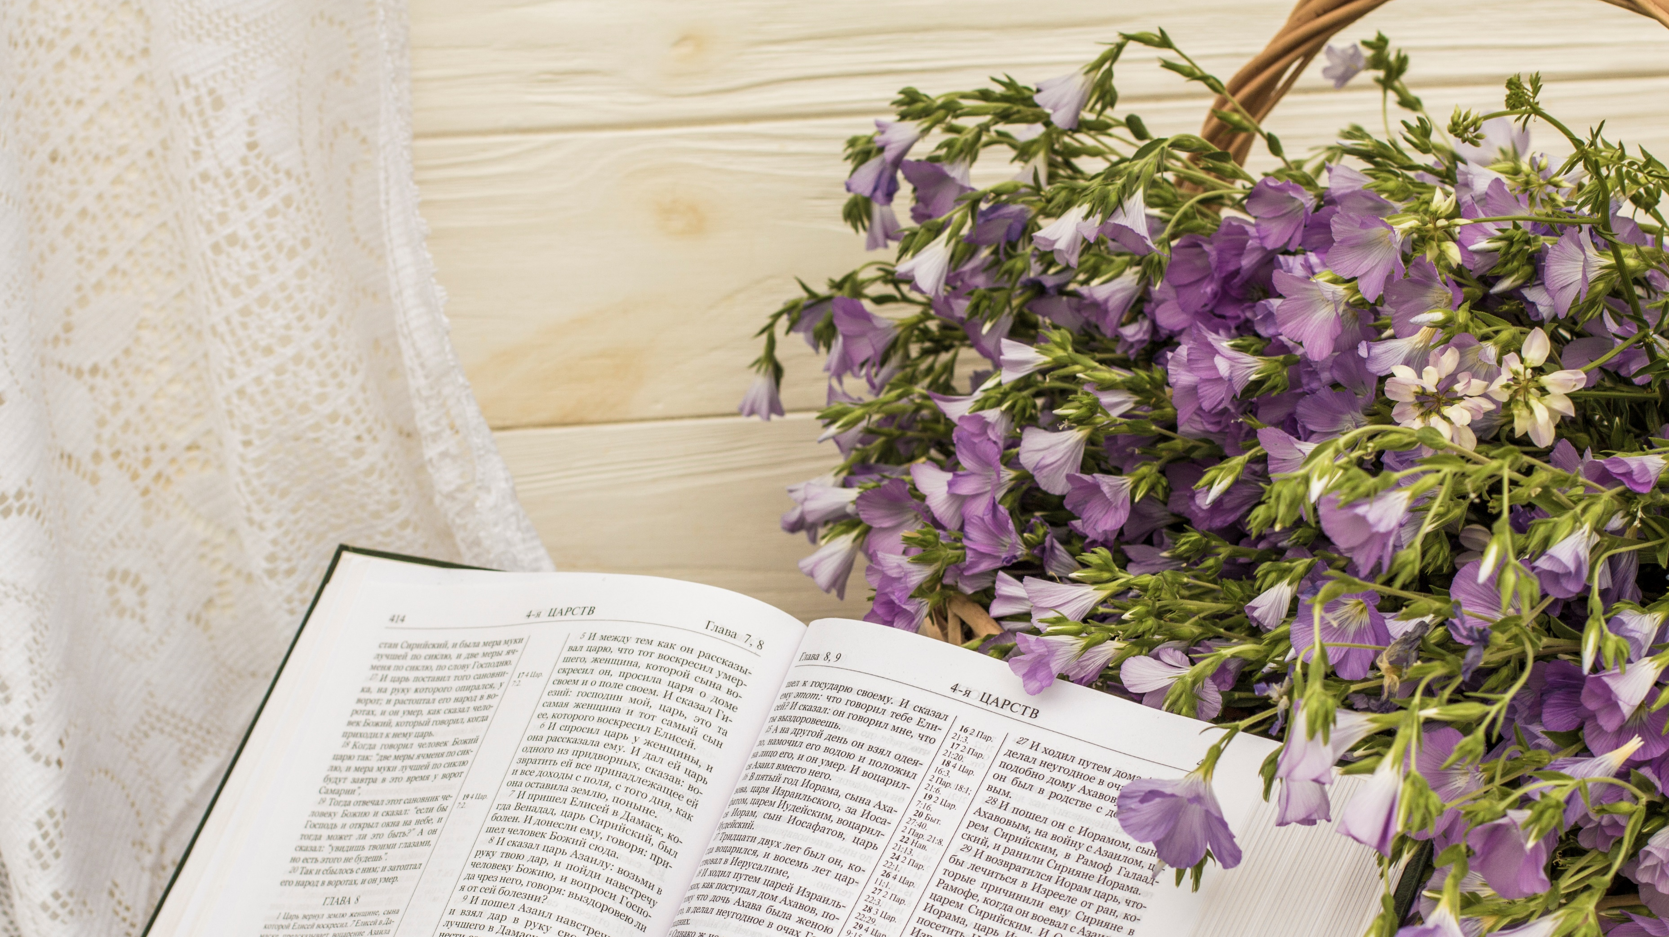
“Udzu umanyala ndipo maluwa amafota, koma mawu a Mulungu wathu adzakhalapo mpaka muyaya” (Yesaya 40:8, CCL)

Slide 7
“Tsiku limenelo iwo adzati, ‘Ndithudi, uyu ndiye Mulungu wathu; ife tinamudalira ndipo anatipulumutsa. Uyu ndiye Yehova, ife tinamudalira; tiyeni tikondwe ndi kusangalala chifukwa watipulumutsa.’ ” (Yesaya 25:9, CCL)

Slide 8
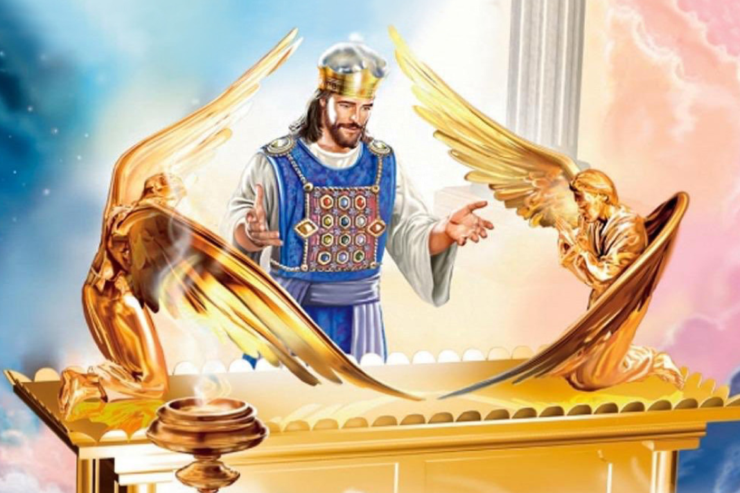
“Fundo yayikulu pa zimene tikunenazi ndi iyi: Tili naye ife Mkulu wa ansembe, amene anakhala ku dzanja lamanja la mpando waufumu wa Mulungu Waulemerero kumwamba. Ndipo akutumikira mʼmalo opatulika, mu Tenti yeniyeni yoyikidwa ndi Ambuye, osati ndi munthu”
(Ahebri 8:1, 2, CCL)

Slide 9
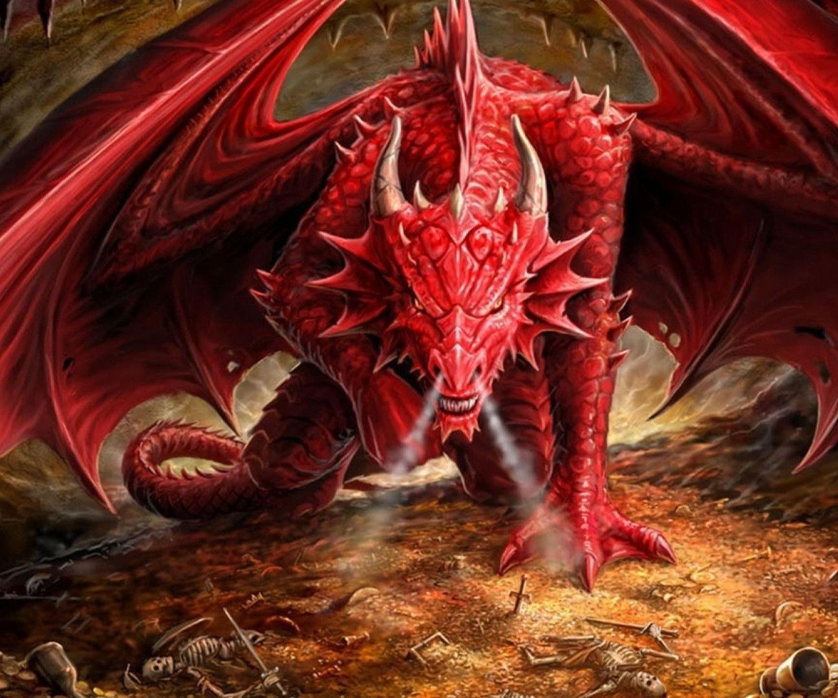
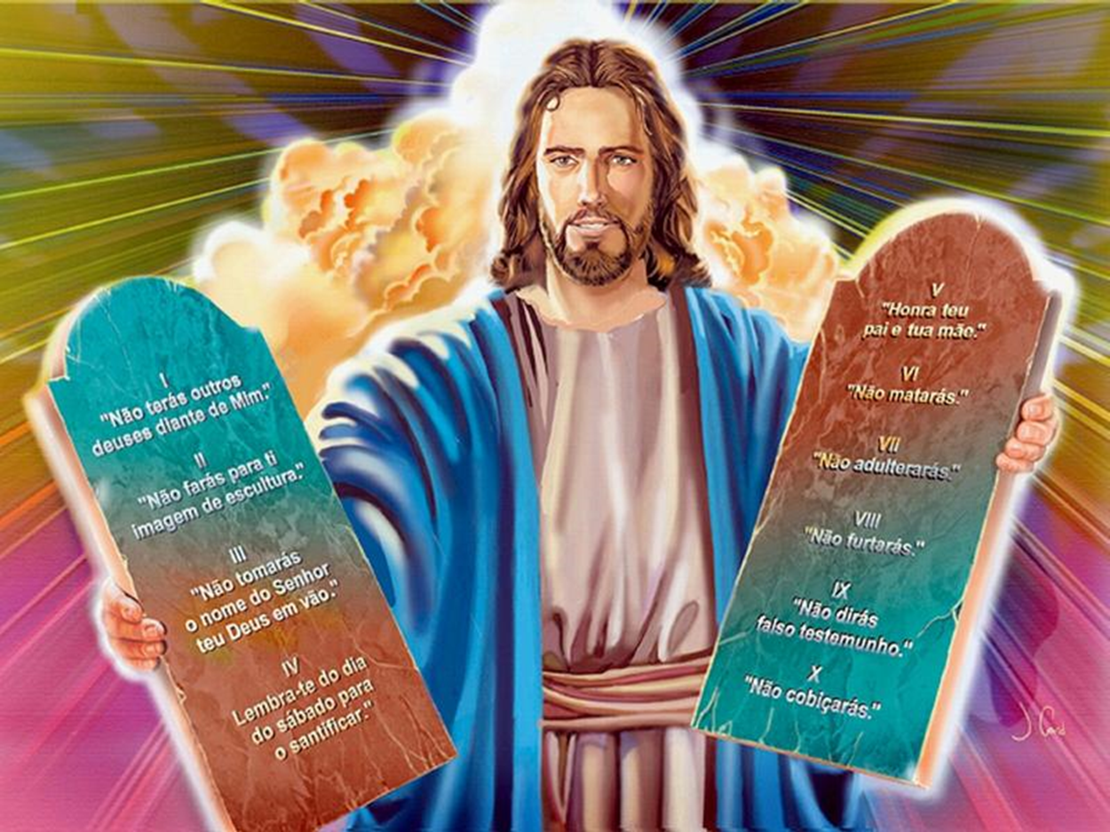
“Pamenepo chinjokacho chinamupsera mtima mayiyo ndipo chinachoka kupita kukachita nkhondo ndi ana ena onse a mayiyo, ndiye kuti anthu amene anasunga malamulo a Mulungu ndi kuchitira umboni za Yesu”
(Chivumbulutso 12:17, CCL)

Slide 10
“Pakuti Ambuye mwini adzatsika kuchokera kumwamba, ndi mfuwu waulamuliro, ndi liwu la mngelo wamkulu, ndi kulira kwa lipenga la Mulungu, ndipo akufa amene ali mwa Yesu adzauka poyamba. Kenaka, ife amene tili ndi moyo, otsalafe, tidzakwatulidwa pamodzi ndi iwo mʼmitambo kukakumana ndi Ambuye mlengalenga. Tsono ife tidzakhala ndi Ambuye mpaka muyaya”
(1 Thessalonians 4:16, 17, CCL)

Slide 11
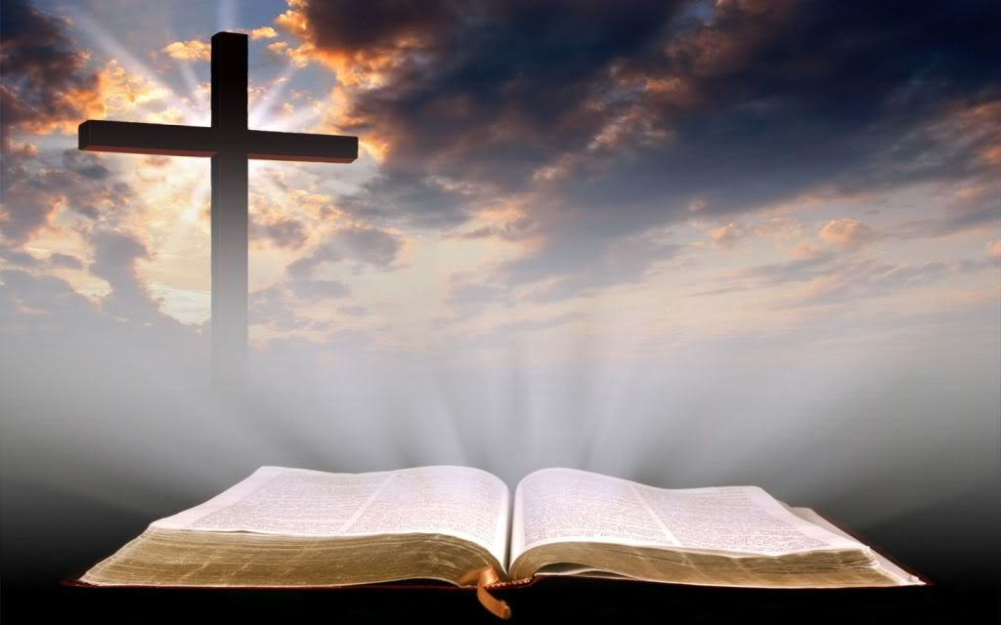
“Ayeretseni ndi choonadi chanu. Mawu anu ndiye choonadi” (Yohane 17:17, CCL)

Slide 12
“Gula choonadi ndipo usachigulitse; ugulenso nzeru, mwambo ndiponso kumvetsa zinthu bwino.” (Miyambo 23:23, CCL)

Slide 13
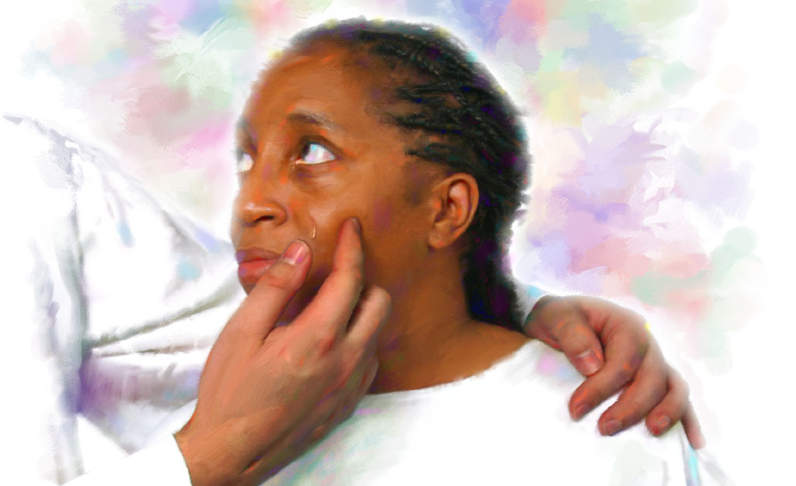
“Ndipo ndinamva mawu ofuwula kuchokera ku Mpando Waufumu kuti, “Taonani! Malo wokhalapo Mulungu ali pakati pa anthu, ndipo Iye adzakhala ndi anthuwo. Iwo adzakhala anthu ake ndipo Mulungu mwini adzakhala nawo nakhala Mulungu wawo.‘Mulungu adzapukuta misozi yonse mʼmaso mwawo. Sikudzakhalanso imfa kapena kukhuza maliro kapena kulira kapena ululu popeza zakale zapita.’ ” (Chivumbulutso 21:3, 4, CCL)

