Slide 1
UMUCYO UMURIKIRA MU MWIJIMA
Icyigisho cya 3 cyo ku wa 20 Mata 2024

Slide 2
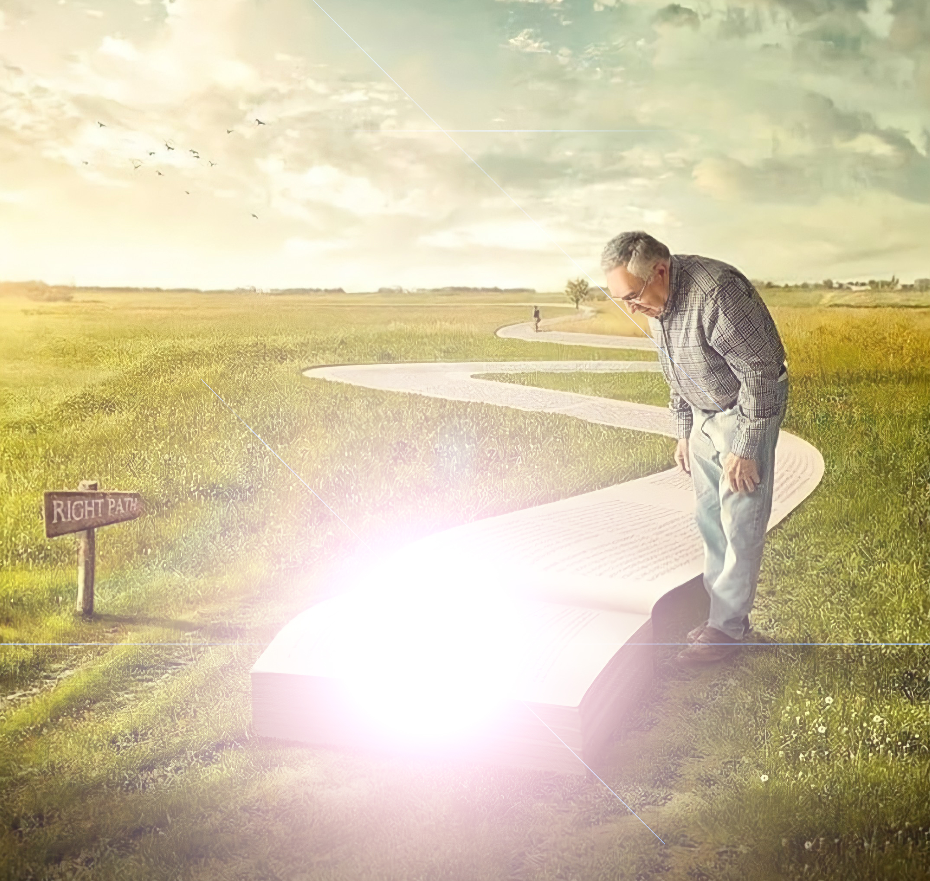
“Yesu arababwira ati ‘Hasigaye umwanya muto, umucyo ukiri muri mwe. Nimugende mugifite umucyo butabiriraho mukiri mu nzira, kuko ugenda mu mwijima atamenya iyo ajya’ ”
(Yohana 12:35)

Slide 3
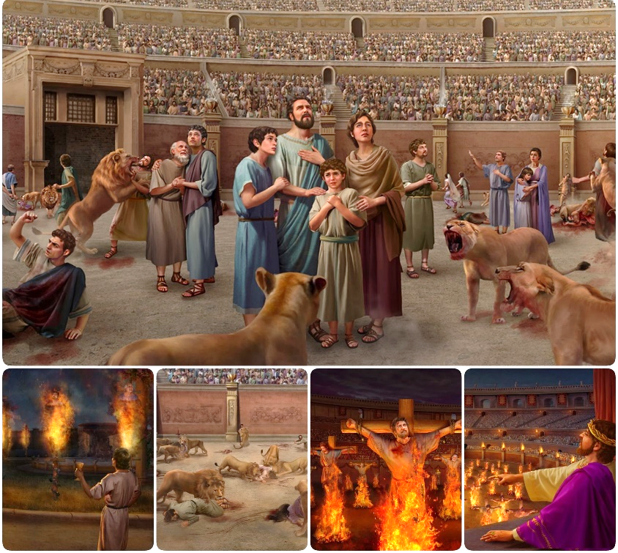
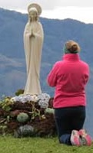
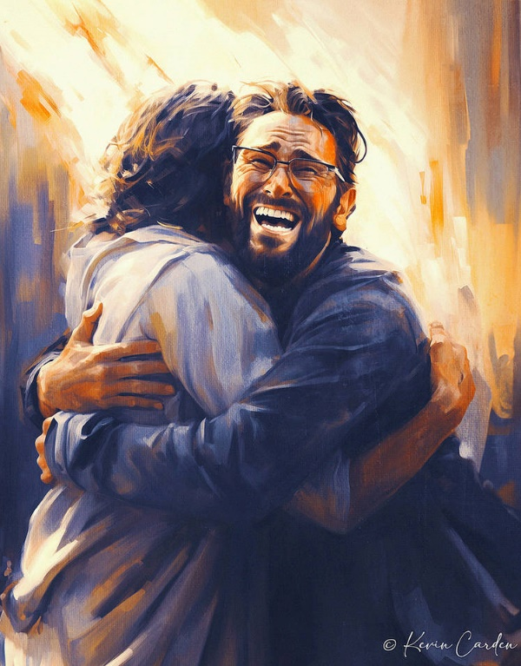
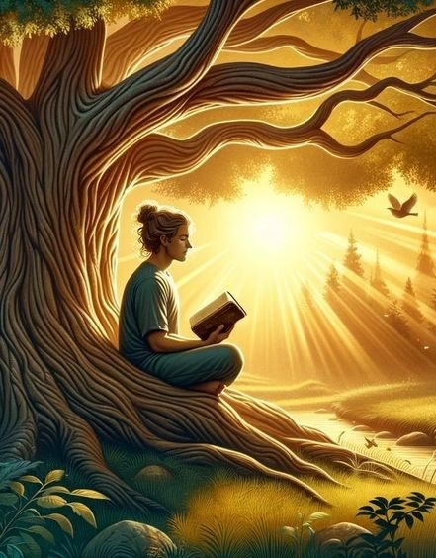
Kunesha cyangwa kuneshwa mu ntambara bituruka ku kunesha cyangwa kuneshwa muri buri rugamba.
Igihe Satani yaneshwaga mu rugamba rwo kurenganya, yateguye umugambi mushya: uruvange. Uruvange rw’ukuri n’ikinyoma rwakururiye za miliyoni z’abantu mu kwakira ukuri kwa maraya, kudafite ubugingo.
Muri uru rugamba, umutekano wacu uri gusa mu kwikomeza kuri Yesu, We Kuri n’Ubugingo, ndetse n’Ijambo Rye ryera.
Urugamba rwo kurwanira ukuri:
Ukuri n’ikinyoma.
Uruvange mu itorero.
Urugamba rwo kurwanira Ijambo ry’Imana:
Kwiringira Bibiliya.
Ubwenge bwa muntu.
Urugamba rwo kurwanira intekerezo.

Slide 4
URUGAMBA RWO KURWANIRA UKURI

Slide 5
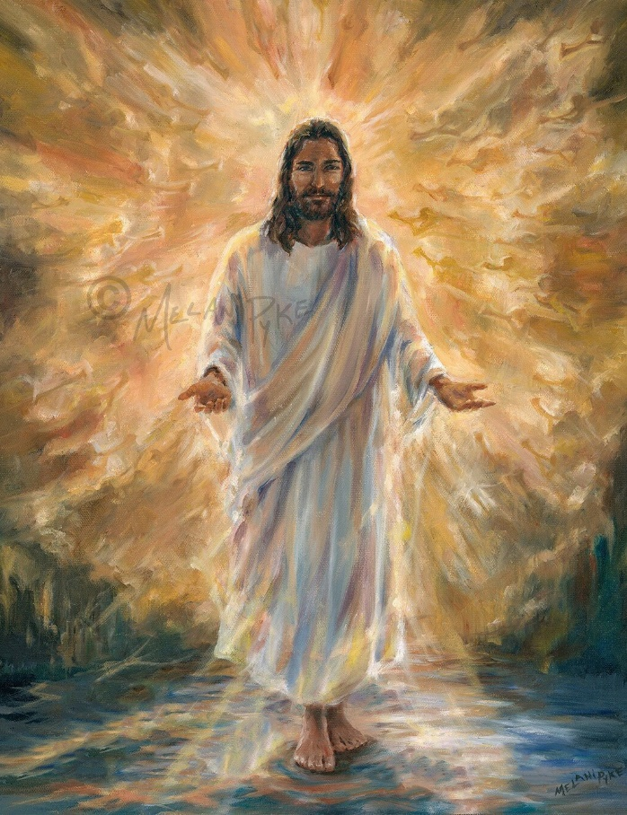
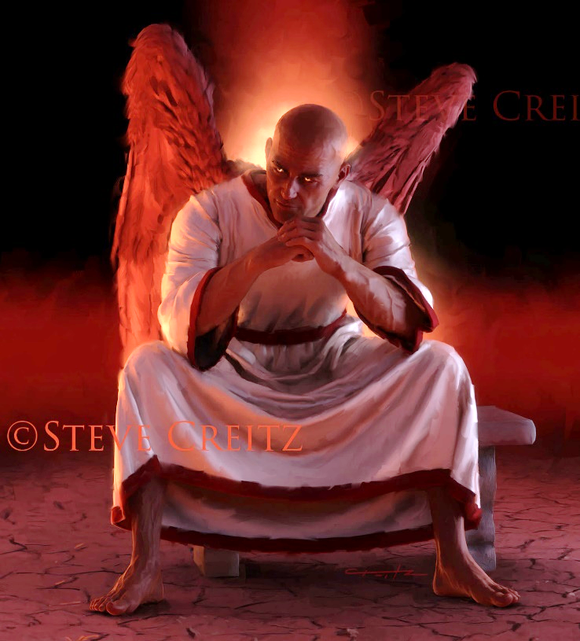
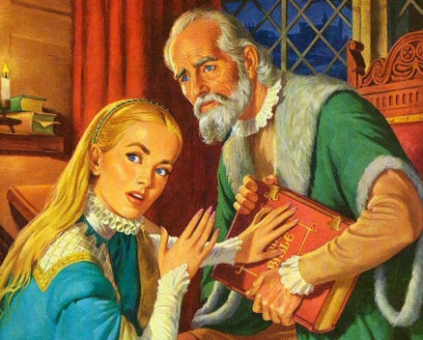
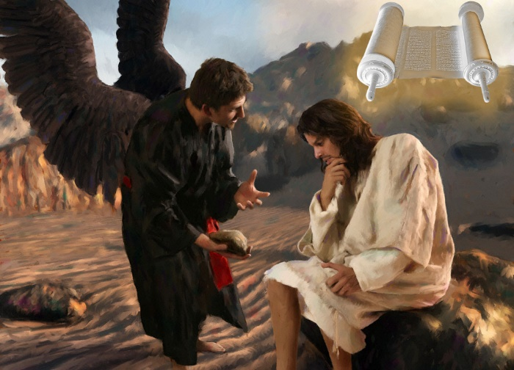
UKURI N’IKINYOMA
“Yesu aramubwira ati ‘Ni jye nzira n’ukuri n’ubugingo: nta wujya kwa Data ntamujyanye’ ” (Yohana 14:6)
Yesu ni Ukuri bityo akaba Se w’ukuri kose (Yohana 14:6). Iby’ukuri byose, ibyiringirwa byose, ibintu byose by’ukuri, biva kuri We. Kandi ukuri Kwe gutanga ubugingo muri twe.
Ibihabanye n’ibyo, Satani ni we se w’ikinyoma (Yohana 8:44). Uburiganya bwose, ubuhendanyi bwose, kugoreka ukuri kose, kumukomokaho. Kandi ibinyoma bye bitera urupfu muri twe.
Igihe Yesu yari ahanganye n’umwanzi, yakoresheje Bibiliya nk’isōko y’ukuri kose: “Handitswe ngo” (Matayo 4:4; 21:13).
Kubw’ibyo, Satani yakoze uko ashoboye kugira ngo arimbure Bibiliya, haba mu kuyihisha cyangwa kuyigoreka. Kandi yabigezeho (nubwo atari burundu) abinyujije mu Itorero ry’i Roma, mu “Bihe by’Umwijima w’Icuraburindi”.

Slide 6
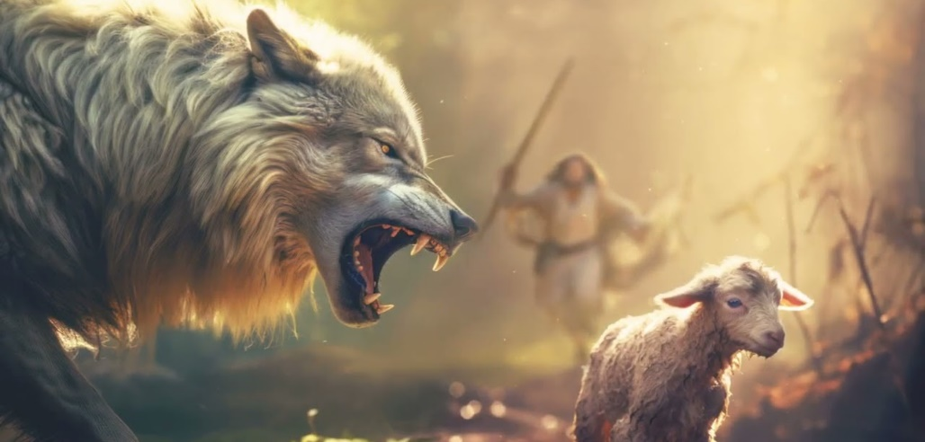
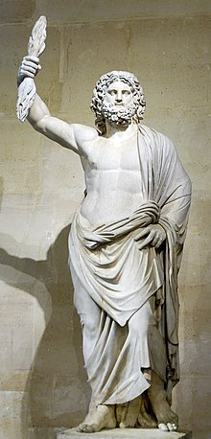
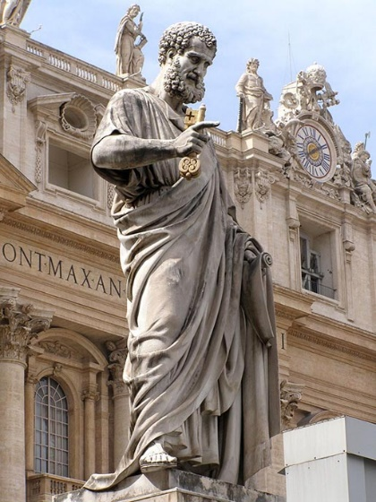
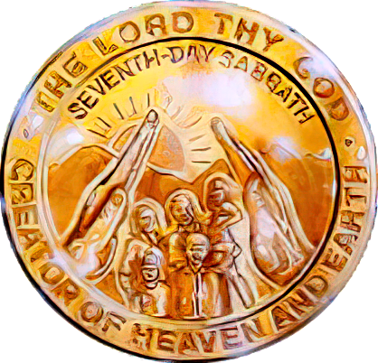
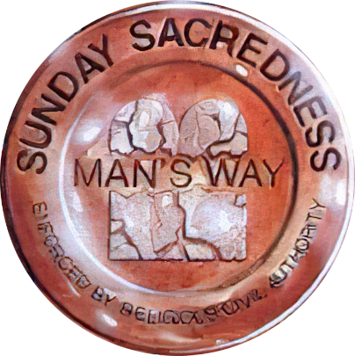
URUVANGE MU ITORERO
“Nzi yuko nimara kuvaho, amasega aryana azabinjiramo ntababarire umukumbi. Kandi muri mwe ubwanyu hazaduka abantu bavugira ibigoramye, kugira ngo bakururire abigishwa inyuma yabo” (Ibyakozwe 20:29–30).
Pawulo asezera ku bakuru bo muri Efeso, yagaragaje ko ahangayikishijwe n’ibibazo bituruka hanze ndetse n’ibituruka imbere bajyaga guhura nabyo mu gihe kizakurikiraho (Ibyakozwe 20:29–30).
Amasega aryana. Kuva mu mwaka wa 64 kugeza 311 (Iteka ry’ubworoherane rya Seridika), Itorero ryarenganyijwe bikabije n’Ingoma y’Abaroma.
Abantu bavuga ibigoramye. Guhera mu kinyejana cya 4, abantu batahindutse binjijwe mu Itorero bavanga ubupagani bwabo n’ukuri.
Igishusho cya Yupiteri (iimana y’Abaroma) ku musozi wa Kapitolina i Roma cyaje gukoreshwa nk’igishusho cya Mutagatifu Petero
Satani yakoresheje amayeri y'“imbere” ngo agoreke ukuri kandi yinjize mu Itorero kuramya ibigirwamana no kuziririza umunsi wo kuramya izuba.
Nkuko Pawulo yahanuye, ubwo bushukanyi bwaremewe, kandi buzakomeza kuba mu badashaka kumenya ukuri kugeza ku ndunduro (2 Abatesalonike 2:7–12). Urugamba ruheruka ruzaba rushingiye ku ku ruvange ku byerekeranye n’Isabato.

Slide 7
URUGAMBA RWO KURWANIRA IJAMBO RY’IMANA

Slide 8
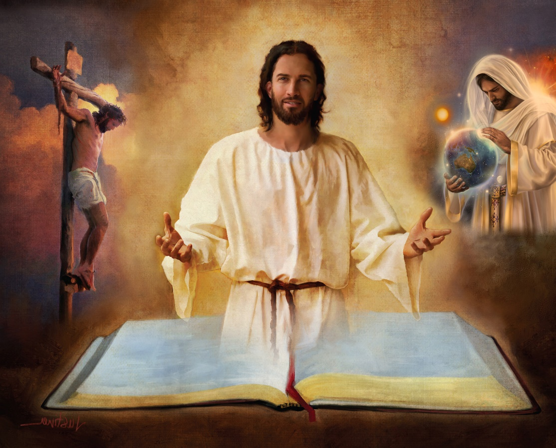
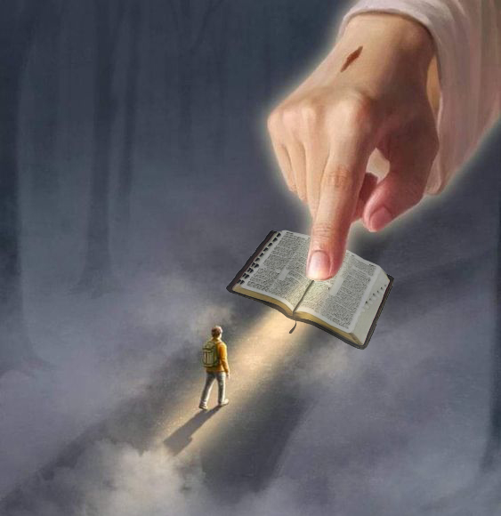
KWIRINGIRA BIBILIYA
“Ubereshe ukuri: ijambo ryawe ni ryo kuri” (Yohana 17:17)
Bibiliya ni ihishurwa ritibeshya ry’ubushake bw’Imana. Yerekana gahunda y’Ijuru yo gukiza umuntu.
Kubw’ibyo, umutekano wacu uboneka muri Bibiliya gusa, no muri buri gitabo cyayo, buri gice na buri murongo (2Timoteyo 3:16).
Muri yo dusangamo amayeri ya Satani; irema; kuvuka, imibereho, urupfu, kuzuka kwa Yesu n’uburyo adusabira; kubabarirwa ibyaha; Kugaruka kwa Yesu; ubugingo buhoraho mu Isi Nshya …
“Ijambo ryawe ni itabaza ry’ibirenge byanjye, Ni umucyo umurikira inzira yanjye” (Zaburi ya 119:105)
Iyo twanze umugabane wayo (urugero: inkuru y’Irema yo mu Itangiriro 1 na 2), bishobora kutujyana mu kwanga inyigisho zose yigisha. Nonese ubwo ... twakwiringira dute umugabane usigaye wa Bibiliya?
“Guhishurirwa amagambo yawe kuzana umucyo, Guha abaswa ubwenge” (Zaburi ya 119:130)

Slide 9
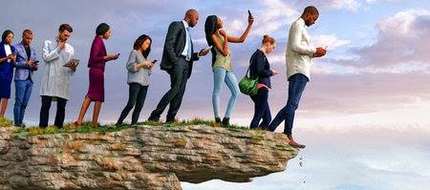
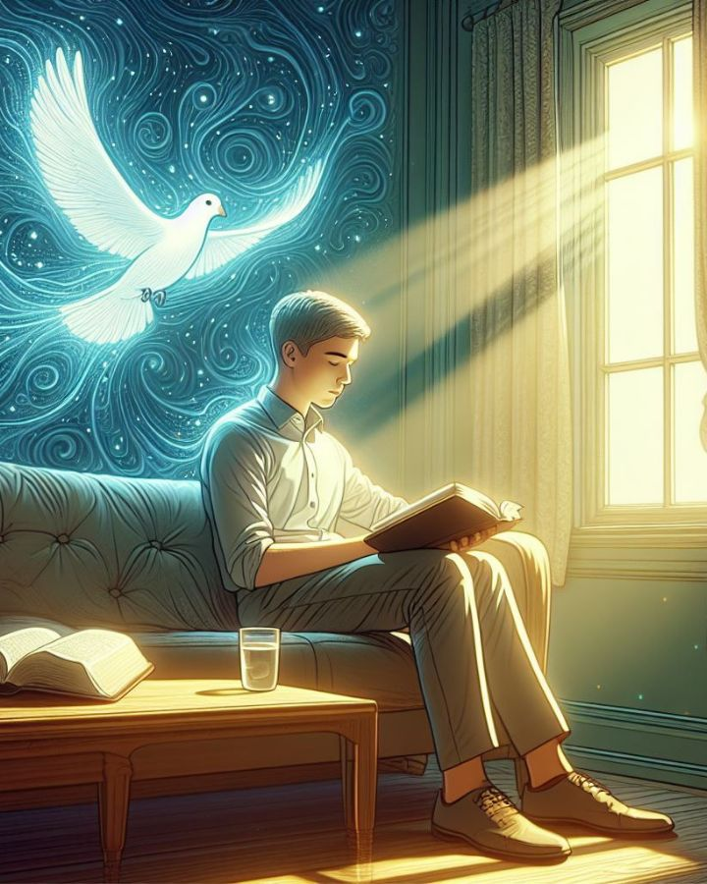
UBWENGE BWA MUNTU
“Hariho inzira umuntu yibwira ko ari nziza, Ariko iherezo ryayo ni inzira z’urupfu” (Imigani 16:25)
Niba Imana ari yo yahumetse Bibiliya, ni nde ushobora kuyisobanura (2 Petero 1:20; Yohana 14:26)?
Umuntu udafite Umwuka ntabwo yemera ibintu biva kuri Mwuka w’Imana ahubwo abibona nk’ubupfu, kandi ntashobora kubyumva kuko bisobanurwa na Mwuka gusa (1Abakorinto 2:14 ).
Urugero rw’aho ubwenge bwa muntu bwagera ni ukujōra guhanitse, aho kuva mu kinyejana cya 18, bwatanze igitekerezo cyo gusobanura Bibiliya hagendewe ku “bumenyi bwo mu ishuri”.
Ibyo bushingiyeho ni uguhakana ibitangaza n’ubuhanuzi bw’ibizaza. Muri ubu buryo, ni iki kindi dushobora gukura mu ijambo ry’Imana niba duhakanye imbaraga zaryo cyangwa ubushobozi bwayo bwo kumenya icyo ejo hatubikiye?
Nta gushidikanya, umwanzi acura inzira zisa nk’aho ari ukuri, ariko iherezo ryazo ari urupfu (Imigani 16:25).

Slide 10
E.G. White, Ubutumwa Bwatoranijwe, umuzingo wa 1, p. 11.
“Umwijima mu by’Umwuka watwikiriye isi kandi umwijima w’icuraburindi ugose abantu. Gushidikanya n’uburiganya mu gusobanura Ibyanditswe biri mu matorero menshi. Abantu benshi ndetse benshi cyane barashidikanya bakibaza ku kuri kw’Ibyanditswe. Gutekereza kwa muntu n’ibyo umutima we wibwira bikerensa guhumekwa kw’Ijambo ry’Imana[…]
Iki Gitabo Cyera cyatsinze ibitero bya Satani wifatanyije n’abanyabyaha ngo atume ikintu cyose gifite kamere mvajuru kibundikirwa n’ibicu n’umwijima. Nyamara Uhoraho yarinze iki Gitabo Cyera akoresheje imbaraga Ye bwite y’igitangaza mu buryo kiri n’ubungubu. Iki gitabo ni ikarita cyangwa igitabo kiyobora cyahawe abantu kugira ngo kibereke inzira igana mu ijuru.

Slide 11
URUGAMBA RWO KURWANIRA INTEKEREZO

Slide 12
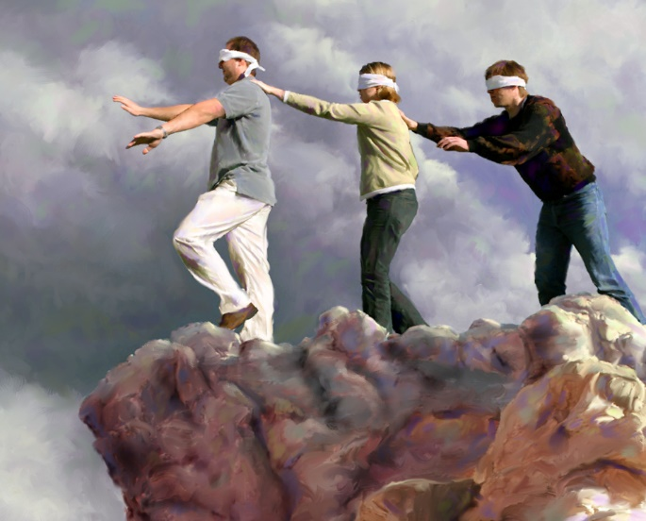
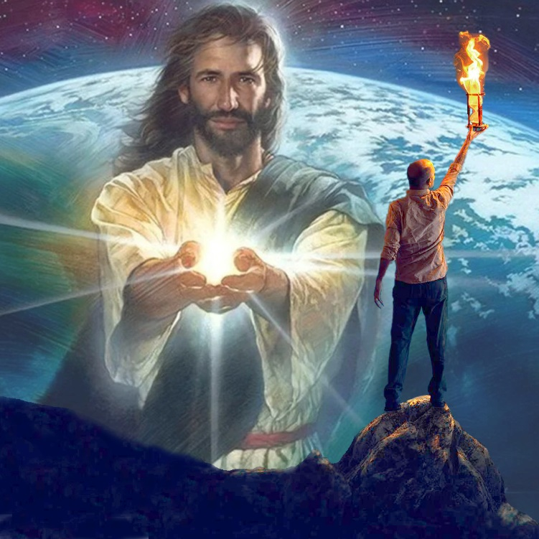
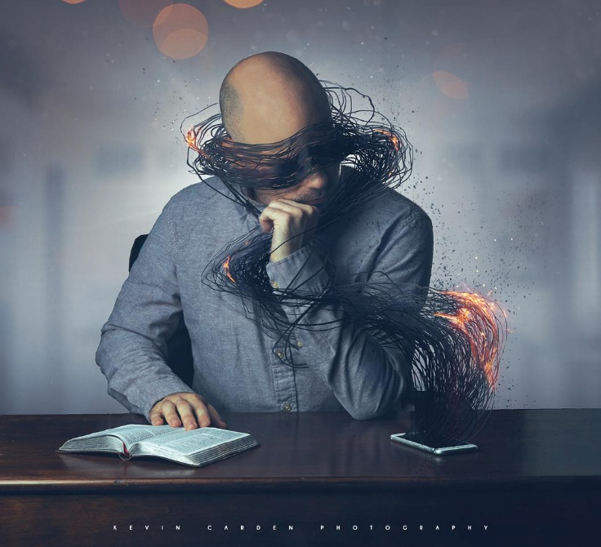
“ari bo batizera, abo imana y’iki gihe yahumiye imitima, kugira ngo umucyo w’ubutumwa bw’ubwiza bwa Kristo, ari we shusho y’Imana utabatambikira” (2 Abakorinto 4:4)
Umugani wo mu Runyesipanyoli ugira uti “Nta buhumyi bubi nko kudashaka kubona”. Ni ukuvuga ko ntacyo bimaze kumvisha umuntu kubona ibyo adashaka kubona. Ni ko bimeze no ku bo “imana y'iyi si” yahumye (2Abakorinto 4:4).
Kubura ubumenyi ku barimbuka si ukubera ko badafite ubushobozi bwo kumenya. Ni ukubera ko badashaka kumenya. Satani yigaruriye intekerezo zabo ababuza gutekereza kuby’ingenzi: agakiza kabo.
Ariko nta muntu ugomba kuguma atyo. Mu gihe intekerezo ziri mu mwijima wo mu bya mwuka, hari umucyo ushobora kandi ushaka kuzimurikira: “Uwo Mucyo [Yesu] uvira mu mwijima, ariko umwijima ntiwawumenya” (Yohana 1:5).
Abo muri twe twemera uyu mucyo dushobora gutamurura umurimo w’umwanzi, maze umucyo wa Yesu ukamurikira mu mwijima.

Slide 13
“Abantu bose bari mu nzira igana mu mu ijuru bakeneye umuyobozi utayobya. Ntidukwiriye kugendera mu bwenge bwa muntu. Ni amahirwe yacu kumva ijwi rya Kristo atuvugisha muri uru rugendo rw’ubuzima, kandi amagambo Ye ahora ari amagambo y’ubwenge. ...
Umutekano wacu wonyine ni ugukurikira Kristo by’ukuri, kugendera mu bwenge Bwe, no gushyira mu ngiro ukuri Kwe. Ntidushobora guhora tumenya imikorere ya Satani; ntituzi aho ashyira imitego ye. Ariko Yesu asobanukiwe neza ubucakura bw’umwanzi, kandi ashobora kugumisha ibirenge byacu mu nzira nziza."
E.G. White, Our High Calling, January 10

