Slide 1
CHIEDZA CHINOPENYA
MURIMA
Chidzidzo 3 cha Kubvumbi 20, 2024

Slide 2
“Ipapo Jesu akati kwavari, ‘Muchava nechiedza kwechinguva chiduku. Fambai muchine chiedza, rima risati rasvika. Munhu anofamba murima haazivi kwaanoenda’ ”
(Johani 12:35)

Slide 3
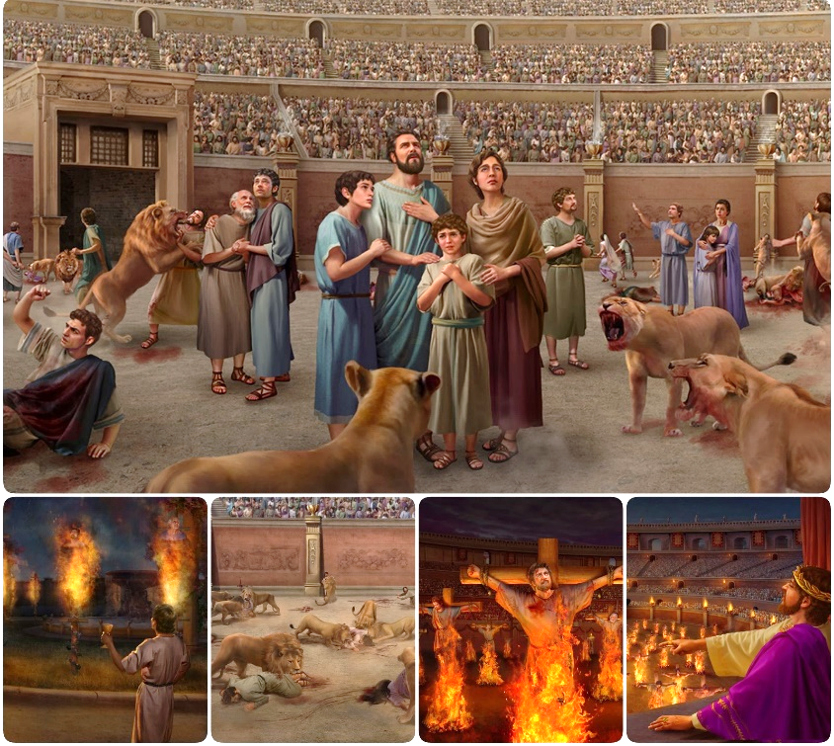
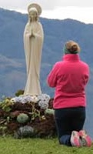
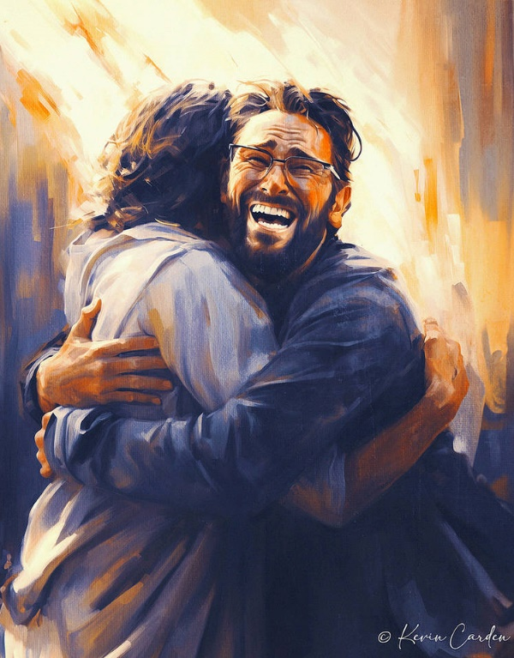
Satani paakarasikirwa nehondo yekutambudza akaronga zano idzva: kusanganisa chokwadi nenhema. Muvhenganiswa wezvokwadi nenhema wakakwevera mamiriyoni kuti agamuchire zvokwadi yakashatiswa, chokwadi chisina upenyu.
Chengetedzo yedu bedzi muhondo iyi kunamatira kuna Jesu, uyo ari Chokwadi noUpenyu, neShoko Rake Dzvene.
Hondo yechokwadi:
Chokwadi vs. nhema.
Panosanganiswa chokwadi nenhema.
Hondo yeShoko raMwari:
Kuchengeteka muBhaibheri.
Kufunga kwevanhu.
Hondo yepfungwa.

Slide 4
HONDO YECHOKWADI

Slide 5
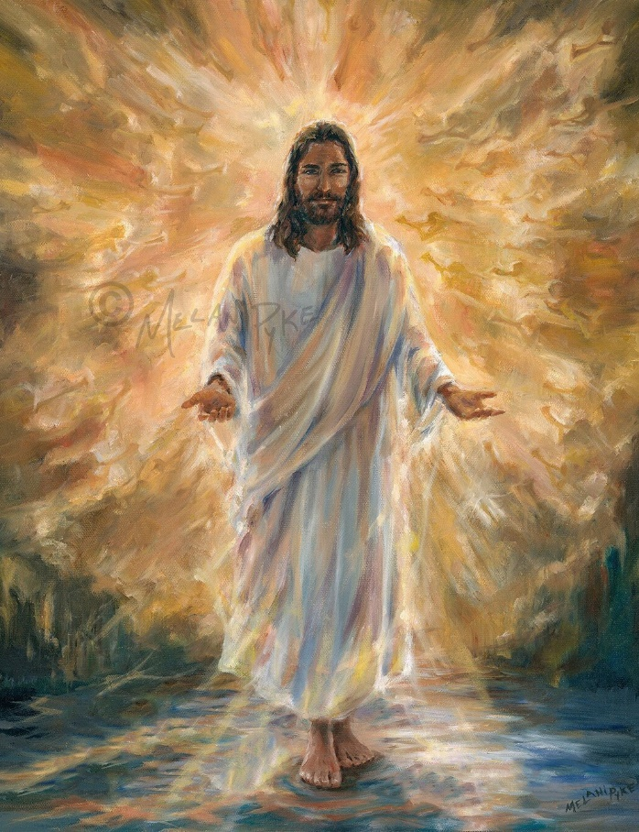
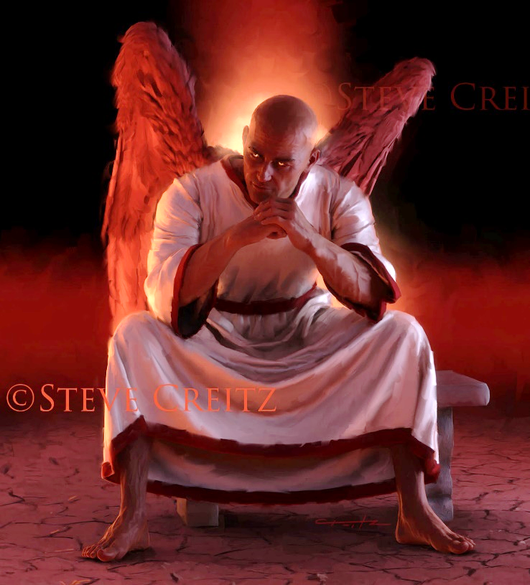
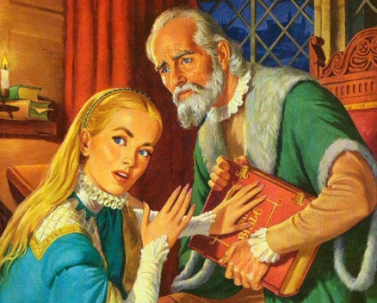
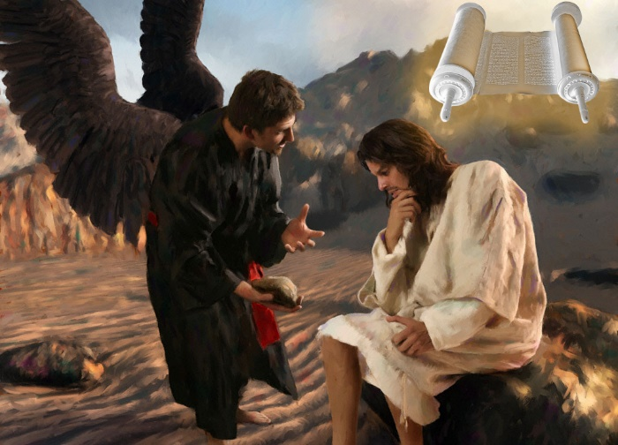
CHOKWADI VS. NHEMA
“Jesu akapindura akati, ‘Ndini nzira nechokwadi uye noupenyu. Hakuna munhu angauya kuna Baba kana asina kupfuura napandiri’ ” (Johani 14:6)
Jesu ndiye Zvokwadi uye naizvozvo ndiye Baba vezvokwadi yose (Johani 14:6). Zvinhu zvose zvechokwadi, zvose zvinovimbika,zvinobva kwaari. Uye chokwadi chake chinobereka hupenyu matiri.
Mukupesana, Satani ndiye baba venhema ( Joh. 8:44 ). Unyengeri hwose, chokwadi chose chakasvibiswa, zvinobva kwaari. Uye nhema dzavo dzinobereka rufu matiri.
Mukurwisana kwake nomuvengi, Jesu akashandisa Bhaibheri samanyuko ezvokwadi yose: “Kwakanyorwa kuchinzi” (Mt. 4:4; 21:13).
Naizvozvo, dhiyabhorosi akashanda kuti aparadze Bhaibheri, nekurivanza kana kurikanganisa. Uye akazviwana (kunyangwe zvisiri zvachose) kuburikidza neChechi yeRoma, mukati meMiddle Ages (inonziwo iyo“Dark Ages”).

Slide 6
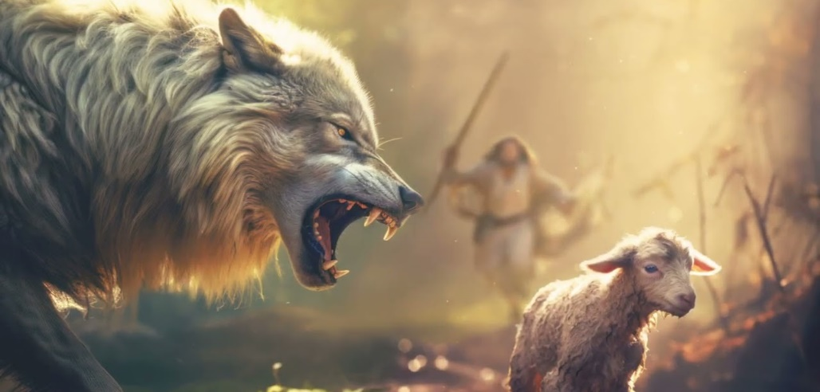
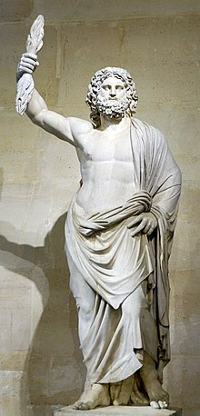
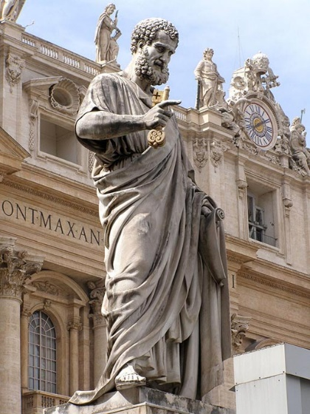
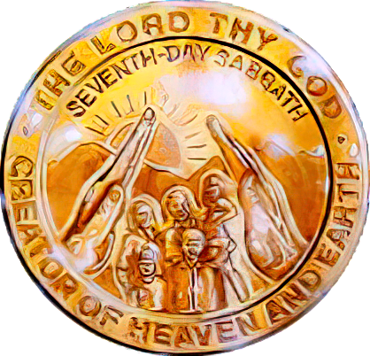
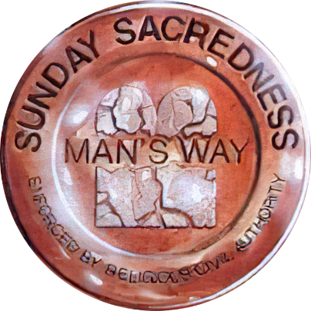
PANOSANGANISWA CHOKWADI NENHEMA
“Ndinoziva kuti kana ndabva, mapere achapinda pakati penyu asingaregi boka. Kunyange pakati penyu iyemi vanhu vachamuka vachiminamisa chokwadi vachiitira kuti vatape vadzidzi kuti vavatevere” (Mabasa 20:29-30).
Mukuonekana nevakuru veEfeso, Pauro akaratidza itiro hanya yake nokuda kwezvinetso zvokunze nezvomukati izvo vaizotarisana nazvo munguva yemberi ( Mabasa 20:29-30).
Mapere anoparadza. Kubva mugore 64 kusvika 311 ( Serdica edict of tolerance-mutemo waibvumira zvimwe zvitendero), Sangano rakatambudzwa neUmambo hweRoma zvinotyisa.
Varume vakarasika. Kutanga muzana remakore rechina, varume vasina kutendeuka vakapinzwa muSangano vakavhenganisa chihedheni chavo nechokwadi.
Chifananidzo chamwari weRoma Jupiter paCapitoline Hill muRome chakashandiswazve chikaitwa chifananidzo chaSaint Peter
Satani akashandisa nzira yake “yemukati” kushatisa chokwadi uye kupinza kunamata zvifananidzo nokuchengeta Svondo muSangano.
Sezvakaporofitwa naPauro, zvikanganiso izvi zvakagamuchirwa, uye zvicharamba zviripo kusvikira kumagumo pakati peavo vasingadi kuziva chokwadi (2 VaT. 2:7-12). Hondo yekupedzisira ichabva pakusanganiswa kwechokwadi nenhema pamusoro peSabata.

Slide 7
HONDO YESHOKO RAMWARI

Slide 8
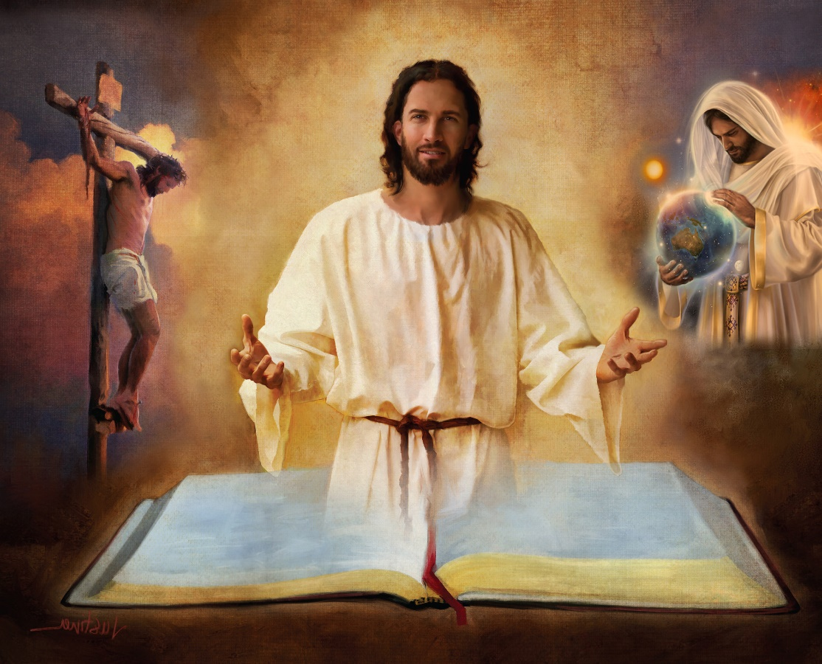
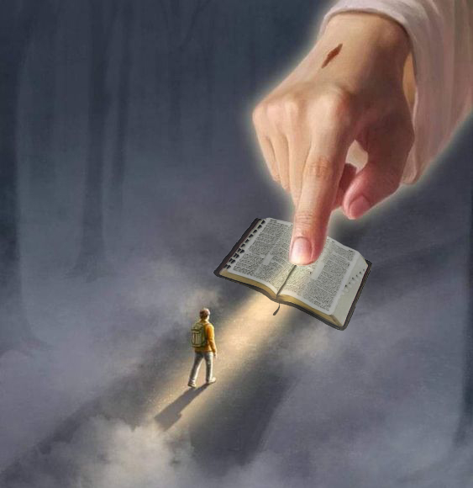
KUCHENGETEKA MUBHAIBHERI
“Vaitei vatsvene nechokwadi chenyu; shoko renyu ndiro chokwadi” (Johani 17:17)
Bhaibheri ndiro chizaruro chisingakanganisi chekuda kwaMwari. Rinopa zano reKudenga reruponeso rwevanhu.
Nokudaro, kuchengeteka kwedu kunowanikwa muBhaibheri chete, uye mune rimwe nerimwe remabhuku aro, zvitsauko nendima(2Tim. 3:16).
Mariri tinowana zano radhiabhorosi; kusika; kuzvarwa, hupenyu, rufu, kumuka nekureverera kwaJesu; kuregererwa kwezvivi; Kuuya Kwechipiri; hupenyu husingaperi muNyika Idzva…
“Shoko renyu ndiwo mwenje wetsoka dzangu, nechiedza chenzira yangu” (Mapis. 119:105)
Kana tikaramba rutivi rwaro (somuenzaniso, nhoroondo yeKusika yaGenesisi 1 na2), tingasvika pakuramba ipi neipi yedzidziso dzarinodzidzisa. Saka... kuchengeteka kwakadini kwatingava nako kuvimba neBhaibheri rose?
“Kuzarurwa kweshoko renyu kunopa chiedza;
kunopa kunzwisisa kuna vasina mano” (Mapis. 119:130)

Slide 9
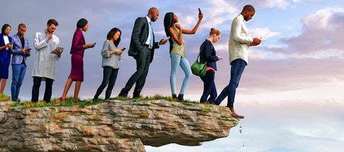
KUFUNGA KWEVANHU
“Munhu unoʋona nzira aciti yakarurama;
Asi kuguma kwayo inzira dzorufu” (Zvirevo 16:25)
Kana Mwari ari iye akafemera Bhaibheri, ndiani anogona kuridudzira(2 Pet. 1:20; Johani 14:26)?
Munhu asina Mweya haagamuchiri zvinhu zvinobva kuMweya waMwari, asi anozviona zviri zvoupenzi, uye haagoni kuzvinzwisisa, nokuti zvinonzwisiswa chete noMweya(1VaKo. 2:14 ).
Muenzaniso wokufunga kwomunhu kutsoropodza kwakakwirira uko, kubvira muzana ramakore rechi 18, kwakakarakadza kududzirwa kwe“dzidzo” yeBhaibheri.
Nzira yaro huru ndeyekuramba zvishamiso uye kusakwanisa kufanotaura ramangwana. Munzira iyi, tingawanei kubva mushoko raMwari kana tikaramba simba raro kana kukwanisa kwaro kuziva ramangwana rakatimirira?
Pasina kupokana, muvengi anogadzira nzira dzinoita sedzakanaka, asi magumo adzo rufu (Zvi. 16:25).

Slide 10
EGW (Selected Messages, volume 1, page 17)
“Rima romweya rakafukidza pasi uye rima guru rakafukidza vanhu. Mumasangano mazhinji mune kukahadzika nekusavimbika mukududzirwa kweMagwaro. Vazhinji kwazvo, vari kukahadzika nehuchokwadi hweMagwaro. Mafungiro evanhu nekufungidzira kwemoyo wemunhu zviri kukanganisa kufemerwa kweShoko raMwari[…]
Bhuku Dzvene iri rakakunda kurwiswa naSatani, uyo akabatana nevanhu vakaipa kuita kuti zvinhu zvese zveumwari zvifukidzwe nemakore nerima. Asi Ishe akachengeta iri Bhuku Dzvene nesimba Rake amene rinoshamisa muchimiro charo chazvino—chati kana kuti bhuku renhungamiro kumhuri yavanhu kuvaratidza nzira yokuenda kudenga. -Non Official Translation by Gift Mawoyo

Slide 11
HONDO YEPFUNGWA

Slide 12
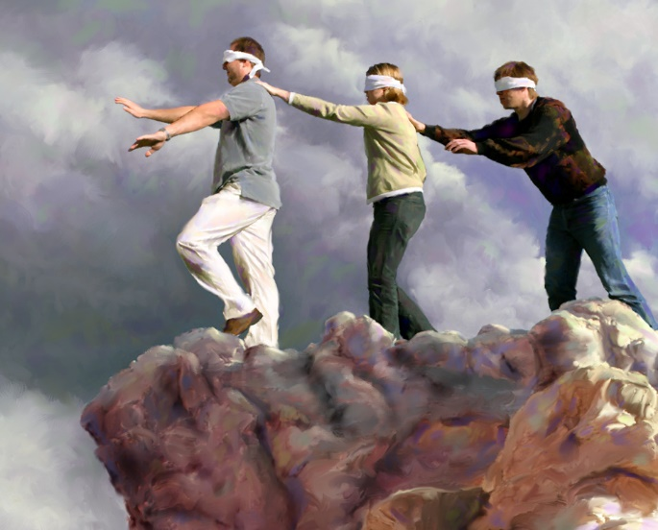
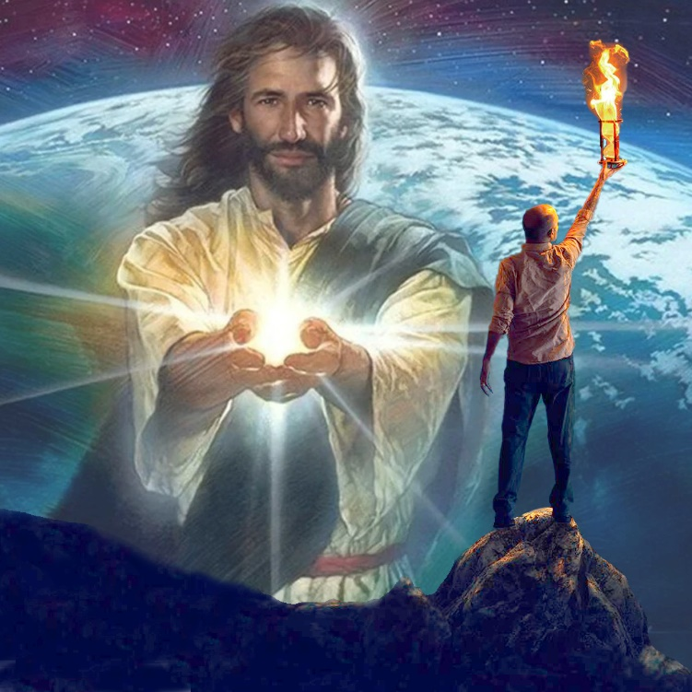
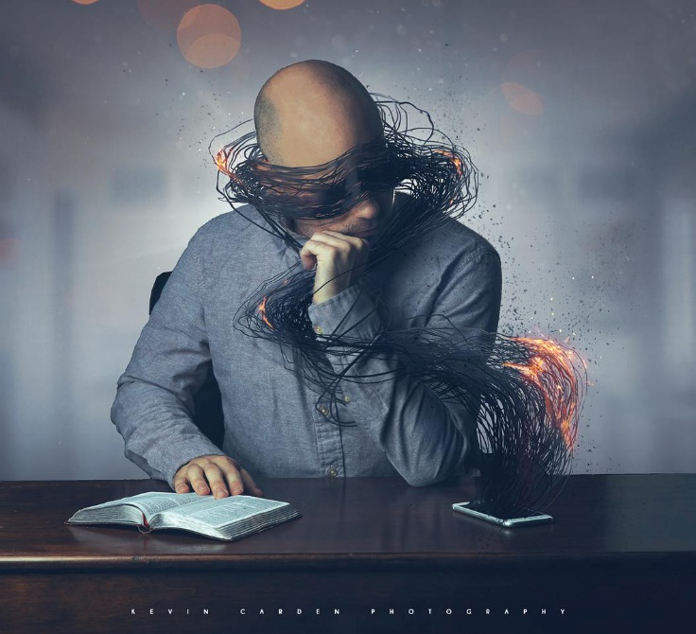
“kunaʋasiŋgatendi ʋakapofumadzirwa ndaŋgariro namŋari wenyika ino, kuti ʋarege kuvenekerwa neciedza ceEvaŋgeri yokubginya kwaKristu, uri mufananidzo waMŋari” (2 VaKorinte 4:4)
Chimwe chirevo chechiSpanish chinoti: “Hakuna bofu rakaipisisa kupfuura riya risingadi kuona.” Kureva kuti hazvibatsiri kugutsa munhu kuti aone zvaasingadi kuona. Ndizvo zvakaita avo vakapofumadzwa na“mŋari wenyika ino” (2VaKo. 4:4).
Kushaikwa kweruzivo kune avo vakarasika hakusi nekuti ivo havana hugoni hwekuziva. Imhaka yekuti havadi kuziva. Dhiabhorosi akazadza pfungwa dzavo nezvinhu zvakawanda zvinovadzivisa kufunga pamusoro pezvinonyanya kukosha: ruponeso rwavo.
Asi hapana anofanira kuramba ari muchimiro ichi. Kana pfungwa dziri murima romweya, pane chiedza chinogona uye chichapenya madziri: “Ciedza[Jesu] cinovenekera murima; asi rima harina‐kucikunda” (Johani 1:5).
Avo vedu vanogamuchira chiedza ichi vanogona kubvisa basa romuvengi, uye kuita kuti chiedza chaJesu chipenye nomurima.

Slide 13
“Vose vari kufamba munzira inoenda kudenga vanoda mutungamiriri anochengetedza. Hatifaniri kufamba muuchenjeri hwevanhu. Iropafadzo yedu kuteerera kuizwi raKristu richitaura kwatiri apo tinofamba rwendo rwehupenyu, uye mazwi Ake anogara ari mazwi euchenjeri. ...
Kuchengeteka kwedu kuri pakunyatsotevera Kristu, kufamba muuchenjeri Hwake, uye kuita chokwadi Chake. Hatigoni nguva dzose kuona kushanda kwaSatani zviri nyore; hatizivi kwaanoteya misungo yake. Asi Jesu anonzwisisa manomano emuvengi, uye anogona kuchengeta tsoka dzedu munzira dzakachengeteka."-Non Official Translation by Gift Mawoyo
EGW (Our High Calling, January 10)

