Slide 1
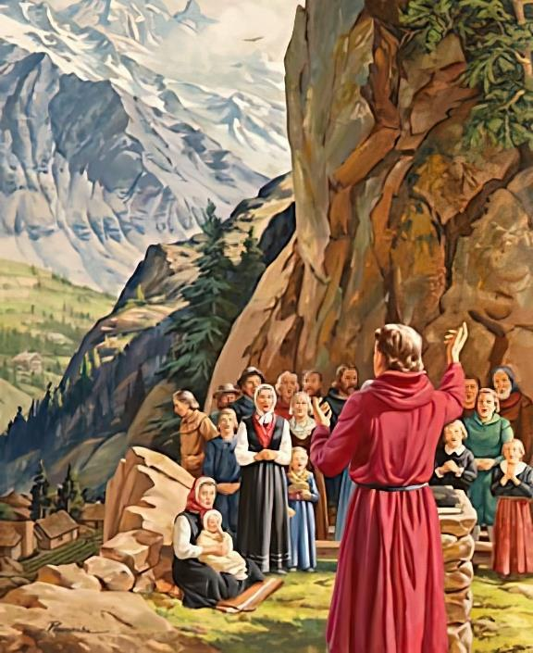
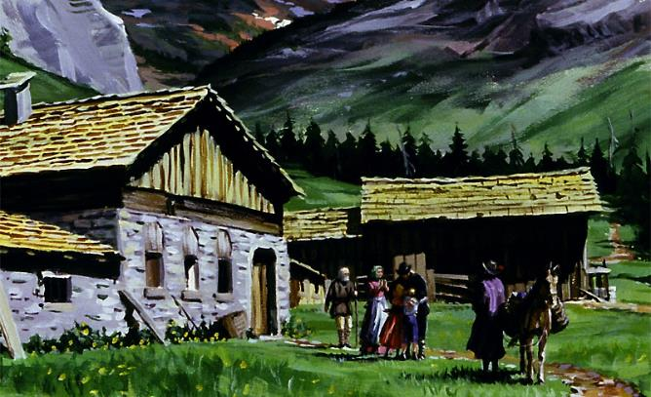
TU'U MA'AE MO'ONI
Lesoni 4 ki he ʻaho 27 ʻo ʻEpeleli 2024

Slide 2
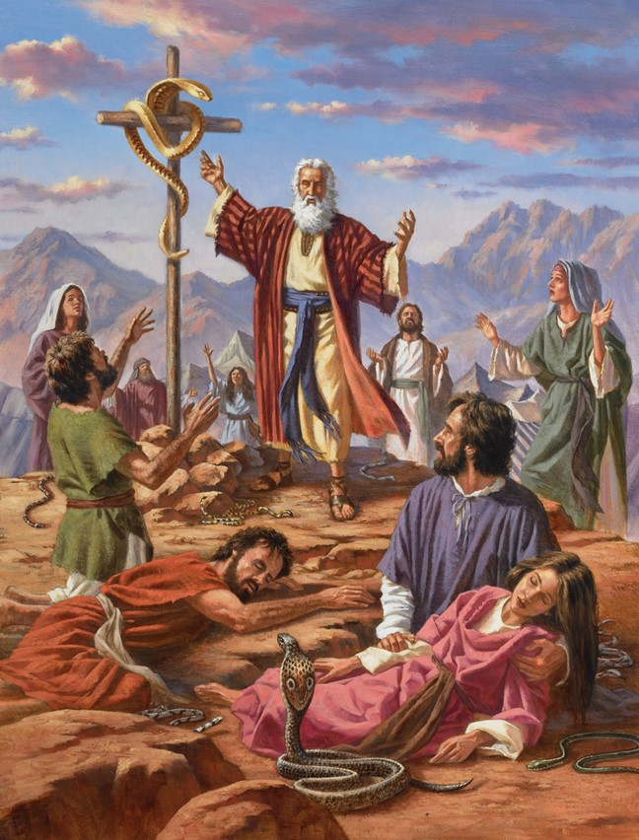
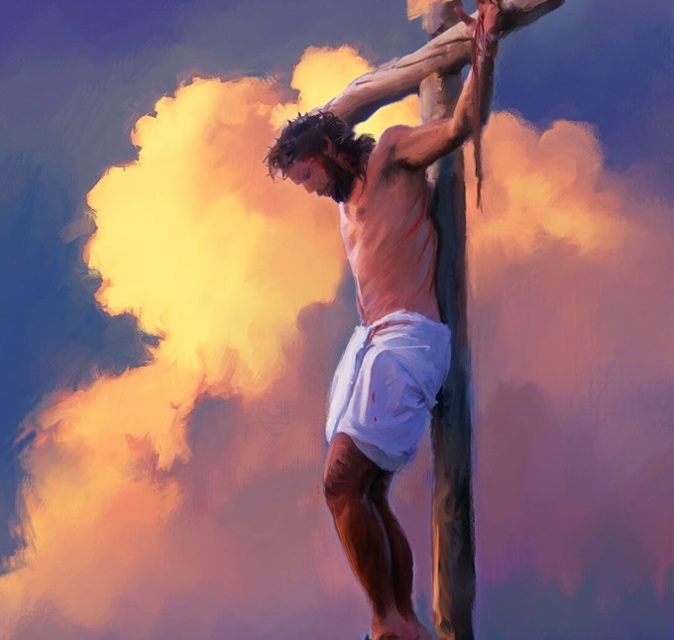
“Pea hangē naʻe hiki hake ʻe Mōsese ʻae ngata ʻi he toafa, ʻe pehē hono hiki ʻae Foha ʻoe tangata ki ʻolunga:Koeʻuhi ko ia kotoa pē ʻoku tui kiate ia ke ʻoua naʻa ʻauha ia, kae maʻu ʻae moʻui taʻengata.” (Sione 3:14, 15)

Slide 3
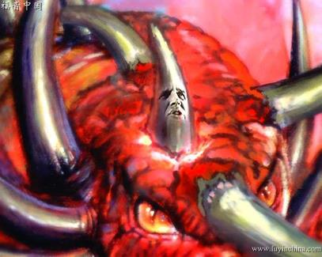
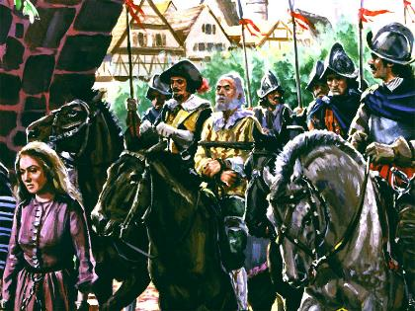
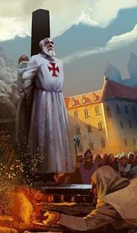
ʻOku talaki ʻe Taniela mo Fakahaa ha taimi ʻe fakaʻaongaʻi ai ʻe Setane ʻa e malohi fakalotu fakapolitikale ke fakatangaʻi mo fakaʻauha ʻa kinautolu naʻe tuʻu maʻu ʻi he moʻoni.
Naʻe hanga ʻe he mālohi ko ʻení ʻo "kapusi hifo ʻa e moʻoní" (Taniela 8:12). ʻI he taimi ko iá "ʻE humu ha niʻihi ʻo e kau potó, koeʻuhí ke fakamaʻa, fakamaʻa mo ngaohi kinautolu ke taʻe-ha-mele kae ʻoua ke aʻu ki he taimi ʻo e ngataʻangá, he ʻe kei hoko mai ia ʻi he taimi kuo kotofá." (Taniela 11:35)
Lolotonga e vahaʻataimi ko ʻeni – ko e kuonga fakapoʻuli – naʻe fehuʻia ʻa e moʻoni. Ka naʻe ʻi ai ha kakai naʻa nau haʻu ʻo taukapoʻi ʻa e moʻoni, pea naʻa nau loto fiemalie ke foaki ʻenau moʻui koeʻuhi ko ia.
Ko e moʻoni ʻi he fehuʻi:
Taimi ʻo e fakatangá.
Anganofo ʻi he tulifua.
Ko hono maluʻi ʻo e moʻoní:
Vahevahe ʻ a e Tohi Tapú: Ko e toafa
Ko e fetuʻu ʻo e liliu: Sione Wycliffe.
Fakamālohia ʻe he tuí: John Huss mo e niʻihi kehé.

Slide 4
KO E MOʻONI ʻI HE FEHUʻI

Slide 5
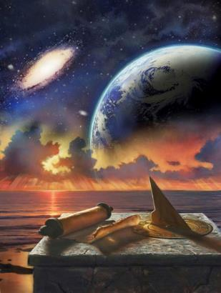
TAIMI ʻO E FAKATANGA
"Te ne folofola ʻo fakafepakiʻi ʻa e Fungani Māʻolungá pea ngaohikoviʻi hono kakai māʻoniʻoní mo feinga ke liliu ʻa e ngaahi taimi kuo fokotuʻú mo e ngaahi laó. ʻE tukuange ʻa e kakai māʻoniʻoní ki hono nimá ʻi ha vahaʻa taimi, mo e kongaʻi taimi" (Taniela 7:25)
ʻOku fanongonongo ʻa e vahaʻataimi ʻo e fakatangá ʻi ha founga kehekehe ʻe tolu
"taimi, taimi mo e konga ʻo e taimi" (Taniela. 7:25; 12:7; Fakaha. 12:14)
‘Aho 1,260 (Fakaha. 11:3; 12:6)
Mahina 42 (Fakaha 11:2; 13:5)
Ko e foʻi lea ko e "taimi" ʻoku fekauʻaki ia mo e "taʻu," ka ko e foʻi lea ko e "taimi" ʻoku fakaʻaongaʻi ʻe Taniela ʻoku ʻuhinga moʻoni ia ko e "tuʻo ua".
ʻI he kuonga muʻá mo e ʻahó ni fakatouʻosi, ko e lōloa angamaheni ʻo e māhiná ko e ʻaho ʻe 30:
Mahina 42
‘Aho 30
‘Aho 1.260
Ta’u 1
Ta’u 2
Ta’u ½
Ta’u 3 ½
ʻOku fakahaaʻi ʻe he ngaahi lea kotoa pe ha vahaʻataimi ʻe taha: ʻaho ʻe 1,260.
Mahina 12
Mahina 24
Mahina 6
Mahina 42
ʻI he tefitoʻi moʻoni ʻo e "ʻaho ki he taʻu" (Isikeli 4:6; Nomipa 14:34), ʻoku mafola ʻa e vahaʻataimi ko ʻeni ʻo e fakatanga ʻi he taʻu ʻe 1,260 ʻo e hisitolia.
Mahina 42
‘Aho 30
‘Aho 1.260

Slide 6
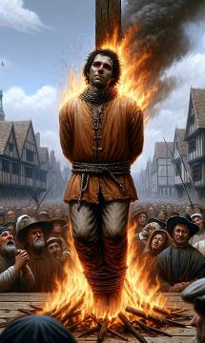
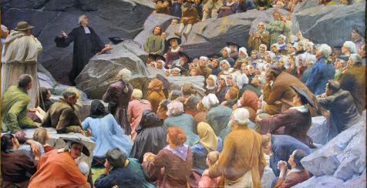
TAIMI ʻO E FAKATANGA
"Te ne folofola ʻo fakafepakiʻi ʻa e Fungani Māʻolungá pea ngaohikoviʻi hono kakai māʻoniʻoní mo feinga ke liliu ʻa e ngaahi taimi kuo fokotuʻú mo e ngaahi laó. ʻE tukuange ʻa e kakai māʻoniʻoní ki hono nimá ʻi ha vahaʻa taimi, mo e kongaʻi taimi" (Taniela 7:25)
Ko e hā ʻa e vahaʻa taimi fakahisitōlia ʻoku fanongonongo ʻe Taniela mo e Fakahaá ʻi he taʻu ʻe 1,260?
Ta’u 538
Ta’u 1798
Naʻe maʻu ʻe he Siasi Loma ha malohi fakapolitikale ʻi he taimi naʻe ikunaʻi ai ʻa e faʻahinga ʻe tolu naʻa nau tali ʻa e Arianism: Heruli, Vandals mo Ostrogoths
ʻOku ʻave popula ʻe he Berthier lahi ʻo Falanisee, ʻi he malumalu ʻo e ngaahi tuʻutuʻuni ʻa e Kau Tuʻi ko Poupi, ʻo fakaʻosi ʻa e supremacy ʻo e Siasi Loma
ʻI he taimi naʻe tuʻu hake ai ha ngaahi puleʻanga fakapolitikale ʻe hongofulu mei Loma (ʻa e faʻahinga naʻa nau kapu ʻa e puleʻanga), ʻe ha mai ha puleʻanga ʻe taha ʻo liua ha puleʻanga ʻe tolu ʻo e ngaahi puleʻanga ʻe hongofulu (Taniela 7:23-25).
Hangē ko ia naʻe kikiteʻí, naʻe teuteuʻi ʻe he ʻOtuá ha feituʻu ke tokoniʻi ai ʻa e siasi faivelengá: ʻa e feituʻu maomaonganoá, ʻa ia ko e ngaahi feituʻu ʻoku ʻikai ke nofoʻi (Fakahā 12:6, 14).
ʻI he taimi ʻo e ngaahi faingataʻá mo e fakatangá, naʻe tuʻu maʻu ʻa e kau tui faivelengá ʻi hono taukapoʻi ʻo e moʻoní, ʻo maʻu ha hūfangaʻanga ʻi he ʻofa mo e tokanga ʻa e ʻOtuá (Saame 46:1-3).
Meʻapango, he naʻe pau ke totongi ʻe ha tokolahi ʻenau mateaki ʻaki honau toto.

Slide 7
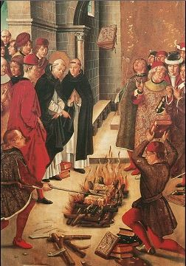
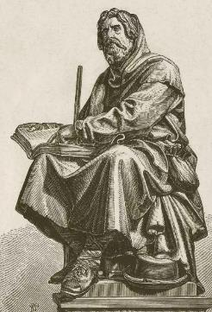
IKUNAʹI ‘E HE MAAMA ‘A E PO’ULI
"Siʻi ngaahi kaungāmeʻa, neongo naʻá ku fuʻu vēkeveke ke tohi atu ʻo kau ki he fakamoʻui ʻoku mau vahevahé, ka naʻá ku ongoʻi kuo pau ke u tohi mo tapou atu ke mou fakakikihiʻi ʻa e tui naʻe fakafalala ki he kakai māʻoniʻoni ʻo e ʻOtuá" (Sute 1:3)
ʻI heʻene maʻu pē ʻa e mālohi fakapolitikalé, naʻe kamata ke ngāueʻaki ʻe he Siasi Lomá ʻa hono mālohí ke fiemaʻu ke talangofua ʻa e tokotaha kotoa ki heʻene ngaahi akonaki fakalotú, ʻa ia ko e tokolahi ai naʻe fakakeheʻi.
Naʻe tanaki atu ki he meʻa ni ʻa e fakautuutu ʻo e faihala ʻi he kau taki fakalotu. Ke taʻofi ʻ a e fuʻu kakaí mei he angatuʻu ki hono mafaí, naʻá ne toʻo meiate kinautolu ʻ a e meʻa mahuʻinga tahá: Ko e Folofola ʻ a e ʻ Otuá.
Ka naʻe ʻikai ke ne lava ʻo fakaʻauha fakaʻaufuli ia. Naʻe tuʻu hake ʻ a e kau faitōnungá, ʻ a ia naʻe tataki ʻ e he ngaahi akonaki fakatohitapú pea muimui ʻ i he faleʻi ʻ a Siutasí, naʻa nau tau mālohi ke maluʻi ʻ enau tuí (Sute 1:3).
ʻI hono fakaivia ʻe he mālohi ʻo e Folofolá, naʻa nau fakamafola taʻemanavahē ai ʻa ʻene ngaahi akonakí. ʻI hono fakamālohia kinautolu ʻe he ngaahi talaʻofa hangē ko e Fakahā 2:10, naʻa nau faivelenga ʻo aʻu ki he maté, ʻi heʻenau ʻilo te nau maʻu ʻa e kalauni ʻo e moʻuí.

Slide 8
KO HONO MALUʻI ʻO E MOʻONÍ

Slide 9
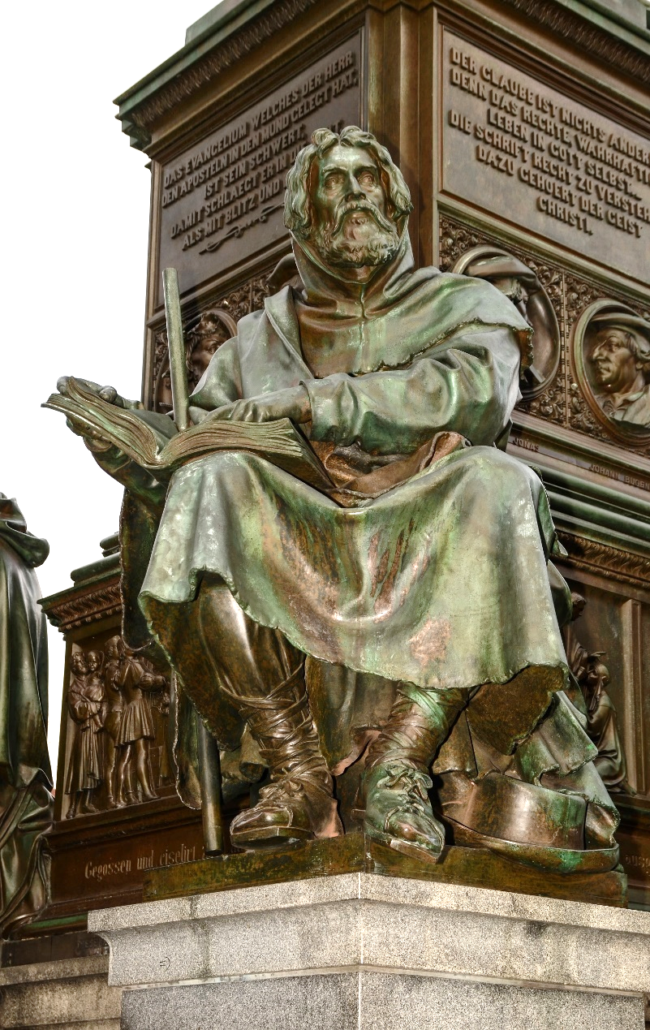
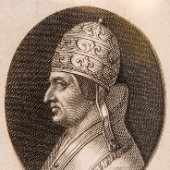
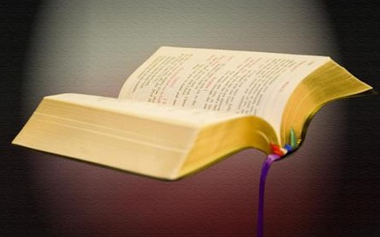
LOTOTO'A KE TU'U
“"Naʻe tali ange ʻe Pita mo e kau ʻaposetolo kehé: ʻKuo pau ke mau talangofua ki he ʻOtuá ʻi he kakai kotoa pēʻ " (Ngāue 5:29)
Naʻe fokotuʻu ʻe Pita Uoloto (1140-1218), ko ha tangata pisinisi Falanise tuʻumalie naʻa ne renounced ʻene koloa ke malanga ʻaki ʻa Kalaisi, ʻa e "masiva ʻo Lioni", ʻa ia naʻe ʻiloa ko e "Waldenses." Naʻe tali ʻ e Tuʻitapu ʻ Alekisānita III ʻ a ʻ ene fuakava ʻ o e masivá.
Hili ha taimi nounou mei ai, naʻe fokotuʻu ʻe Falanisisi ʻo ʻAsisi (1181-1226), ʻa ia naʻa ne fai foki ha fuakava ʻo e masiva, ʻa ia naʻe fakangofua ʻe Tu'iTapu taʻehalaia III, ʻa e ngaue Franciscan.
ʻI he taimi ko iá, naʻe fakahalaiaʻi ai ʻ e Tuʻitapu Lusiasi III ʻ a e kau muimui ʻo Pita Uoloto ʻi he tuʻunga ko e kau lotu. Kae kehe, naʻe hoko ʻa e kau Franciscans ko ha pou ʻo e Siasi Lomá lolotonga ia naʻe fakatangaʻi ʻa e kau Uolotenisesí ke nau ofi ki he ʻ auhá. Ko e ha hono ʻuhinga?
ʻI heʻene anganofo. Ko e ʻ uluakí naʻa nau faitōnunga ki he Tuʻitapú, lolotonga ia naʻe faitōnunga ʻ a e ngaahi meʻá ni ki he ngaahi akonaki ʻ a e Tohi Tapú.

Slide 10
LOTOTOʹA KE TUʹU
Ko e hā naʻá ne fakatātāʻaki ʻ a e kau waldeness?
Ko kinautolu naʻe fuofua maʻu ʻ a e Tohi Tapú ʻi heʻenau lea pē ʻ anautolú (ʻ o aʻu mai ki he taimi ko iá, naʻe ala maʻu pē ia ʻi he lea faka - Latiná, faka - Kalisí pe faka - Hepeluú).
Koeʻuhi ko ha tohi tapu ia, naʻa nau hiki ia ʻ i he ngaahi ʻ ana, ʻ o toitoi mei he kau papists naʻa nau fakaʻaiʻai kinautolú.
Naʻa nau toʻotoʻo maʻu pē ha ngaahi konga ʻo e Tohi Tapú, ʻa ia naʻa nau vahevahe mo e niʻihi kehé ʻi ha ngaahi momeniti faingamālie, ʻo ʻoange kiate kinautolu ha ʻamanaki lelei mo ha fakalotolahi ʻi he ʻEikí.
.
Naʻa nau fakatolonga ʻ a e ngaahi moʻoni fakatohitapu naʻa nau ʻ iloʻi ʻ i he laui senituli. Naʻe ʻiloa kinautolu ʻi heʻenau anganofó mo e mateakí.
Naʻe ului ʻa e ngaahi kolo kotoa ʻi he fakatonga ʻo Falanisee pea ʻi he fakatokelau ʻo ʻItali, Pitimoni.
Ko e lahi taha ʻo e ngaahi kolo ko ʻeni naʻe razed ki he kelekele ʻe he Papacy, pea massacred honau kakai.

Slide 11
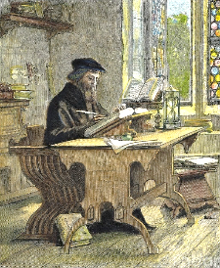
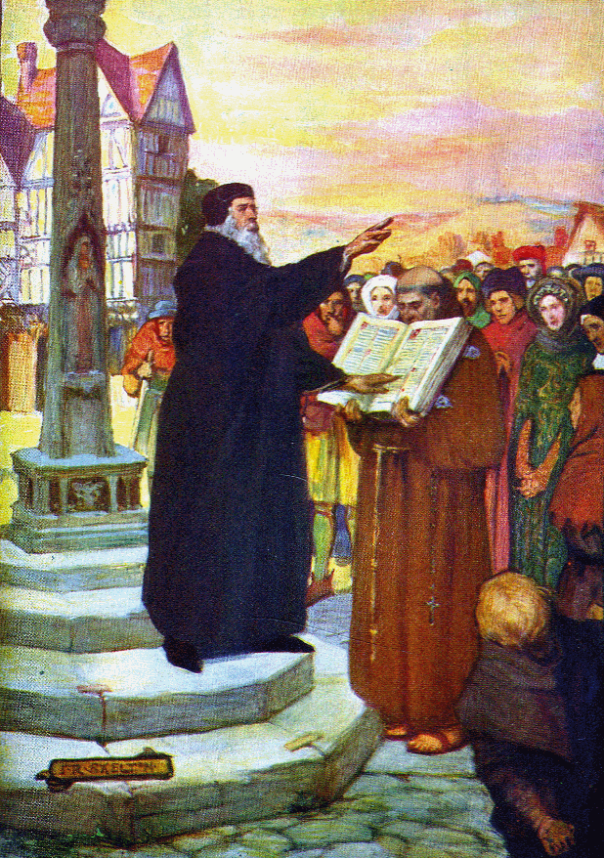
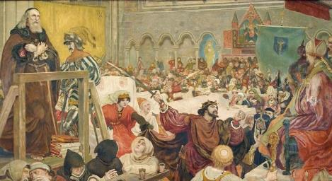
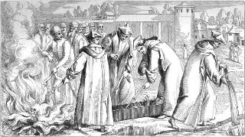
KO E MAAMA ʻO E LILIU: SIONE WICLEF
"Ko e hala ʻo e maʻoniʻoni ʻoku tatau ia mo e laʻa ʻo e pongipongi, ʻoku ulo ʻo ulo lahi ange kae ʻoua ke kakato ʻa e maama ʻo e ʻaho" (Lea Fakatata 4:18)
Naʻe fakatapui ʻe Sione Wycliffe (1324-1384) ʻa e konga lahi ʻo ʻene moʻuí ki hono liliu ʻo e Tohi Tapú ki he lea faka-Pilitāniá. Ko e hā naʻá ne ueʻi ia ke ne fai ení? ʻUhinga ʻe ua: Kuo liliu ia ʻe Kalaisi ʻo fakafou ʻi he Folofola; pea naʻá ne fie vahevahe ʻa e ʻofa ʻa Kalaisí mo e niʻihi kehé.
Ko ia, ʻ okú ne ako loto - moʻoni ʻ a e Tohi Tapú, pea fakaava hono lotó ki he tākiekina ʻ a e Laumālie Māʻoniʻoní, ʻ okú ne liliu (Hep. 4:12).
Ko e moʻoni, naʻe fepaki ʻeni mo e Siasí. Mālō mo ʻene fetuʻutaki mo e kau ʻōfisa māʻolunga ʻi ʻIngilaní, naʻe fakaʻehiʻehi ai ʻa Sione mei he maté ʻi he nima ʻo e Siasí.
ʻI he 1428 naʻe tutu ai ʻ a e tokotaha fokotuʻu lotu foʻoú, pea naʻe lī hono efué ki he vaitafé. Naʻe hoko hono efuefu kuo fakamoveteveteʻí ko ha fakaʻilonga ʻo hono tukufakaholó.
Ko e kiʻi maama siʻisiʻi ʻ o e moʻoni naʻe tutu ʻ e John Wycliffe naʻe aʻu ia ki Bohemia, ʻ a ia naʻe ʻ ave ai ʻ e Sione Hus ʻ a hono tukufakaholó. ʻ I he foungá ni, naʻe fononga ai ʻ a e moʻoní ʻ o aʻu ki he kamataʻanga ʻ o e liliú. Naʻe kamata ke fakamaʻamaʻa ʻa e ʻahó.

Slide 12
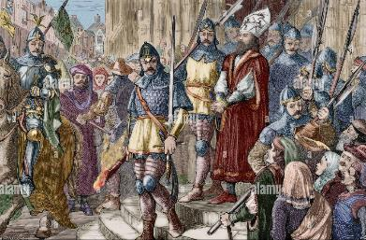
FAKAMALOHIA ʻE HE TUI: SIONE HUSS MO E NIʻIHI KEHE
Ko ia ʻokú ne maʻu ʻa e ʻAló ʻokú ne maʻu ʻa e mo ʻilonga ia ʻoku ʻikai maʻu ʻa e ʻAlo ʻo e ʻOtuá ʻoku ʻikai te ne maʻu ʻa e moʻuí" (1Sione5:12)
Hili ʻ a e tuʻu hake ʻ a John Wycliffe, naʻe malanga hake ʻ a e kau fokotuʻu lotu kehé:
John Huss (1370-1415)
Jerome (1360-1416)
Tyndale (1494-1536)
Hugh Latimer (1490-1555)
Ko e hā naʻá ne ʻ oange kia kinautolu ʻ a e loto - toʻa ke fakahoko ʻ enau ngaahi liliú pea fehangahangai mo e ngaahi palopalemá mo e maté?
Naʻa nau tui ki he ngaahi talaʻofa ʻa Kalaisí
Naʻe feʻunga pē ʻa e mālohi ʻo Kalaisí ke nau ikunaʻi ai ʻa e ngaahi ʻahiʻahí
Naʻa nau maʻu ʻa e fiefia ʻi he kau ʻi he ngaahi mamahi ʻa Kalaisí
Naʻe hoko ʻene faivelengá ko ha fakamoʻoni mālohi ki he māmaní
Naʻa nau sio fakalaka atu ʻi he lolotongá, ki he kahaʻu nāunauʻiá
Naʻa nau ʻilo ko e maté ko ha fili kuo ikunaʻi
Naʻa nau pīkitai ki he ngaahi talaʻofa ʻ a e Folofola ʻ a e ʻ Otuá
Naʻe tuku popula ʻa Sione Hus pea iku ʻo tutu ʻi he ʻakau. Naʻa ne tohi mei he fale fakapopula ʻo pehe: "hono ʻikai ʻaloʻofa ʻa e ʻOtua kiate au, pea mo e admirably kuo ne poupouʻi au." Hangē pē ko hono poupouʻi ʻ e he ngaahi talaʻofa ʻ a e ʻ Otuá ʻ a hono kakaí ʻ i he kuohilí, ʻ oku nau poupouʻi kitautolu he ʻ ahó ni.

Slide 13
“Ko kinautolu kotoa pē ʻi he ʻaho kovi ko iá te nau tauhi taʻemanavahē ki he ʻOtuá ʻo fakatatau mo e ueʻi ʻa e konisēnisí, te nau fie maʻu ʻa e loto-toʻá, tuʻumaʻú, mo ha ʻilo ki he ʻOtuá mo ʻEne folofolá; he ko kinautolu ʻoku tauhi moʻoni ki he ʻOtuá ʻe fakatangaʻi kinautolu, ʻe taʻofi ʻenau ngaahi taumuʻá, fakaʻuhingaʻi hala ʻenau ngaahi ngāue lelei tahá, pea kapusi ki tuʻa honau hingoá ko e kovi. ʻE ngāue ʻa Sētane ʻaki hono mālohi kākā kotoa ke tākiekina ʻa e lotó mo fakaʻaiʻai ʻa e mahinó. [...] Ko e mālohi mo haohaoa ange ʻa e tui ʻa e kakai ʻo e ʻOtuá, pea mo e mālohi ange ʻenau fakapapau ke talangofua kiate Iá, ko e lahi ange ia e feinga ʻa Sētane ke fakafepakiʻi kinautolu ʻi he ʻita ʻa kinautolu ʻoku nau kei tala ʻoku nau māʻoniʻoní, ʻo molomoloki e fono ʻa e ʻOtuá. ʻE fie maʻu ki ai ʻa e falala mālohi tahá, ʻa e taumuʻa toʻa tahá, ke piki maʻu ki he tui naʻe ʻoange ki he kāingalotú"
EGW (Ko e Ngāue ʻa e Kau ʻAposetoló, pg. 431.1)

