Slide 1
GAL KHEMPEUH A PIANGSAK GALPI
Lesson 1 ading April 6, 2024

Slide 2
“Tu-in vantungah galkidona hong om a, Mikhael le a vantung mite in gulpi le a vantung mite a do uh hi. Ahi zongin tua gulpi guallel ahih manin tua gulpi le a vantung mite, vantungah ki-om sak nawnlo hi.” (Mangmuhna 12:7, 8)

Slide 3
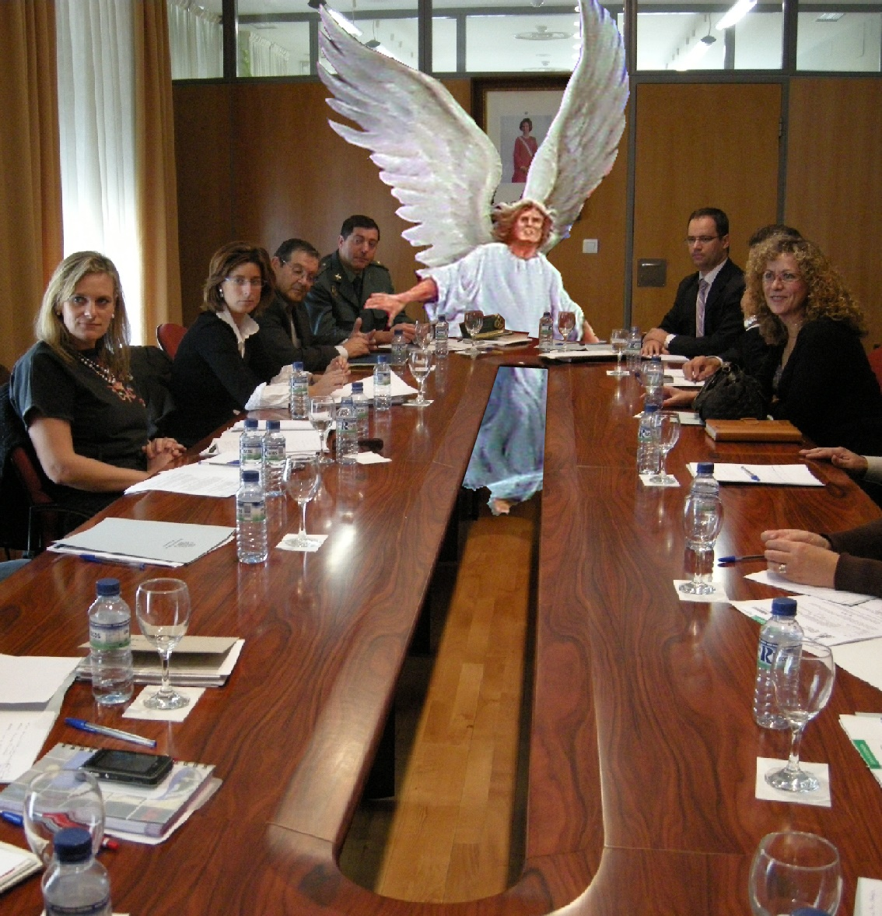
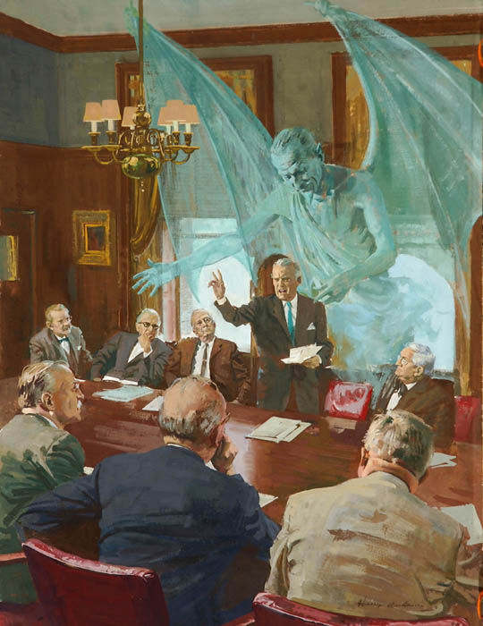
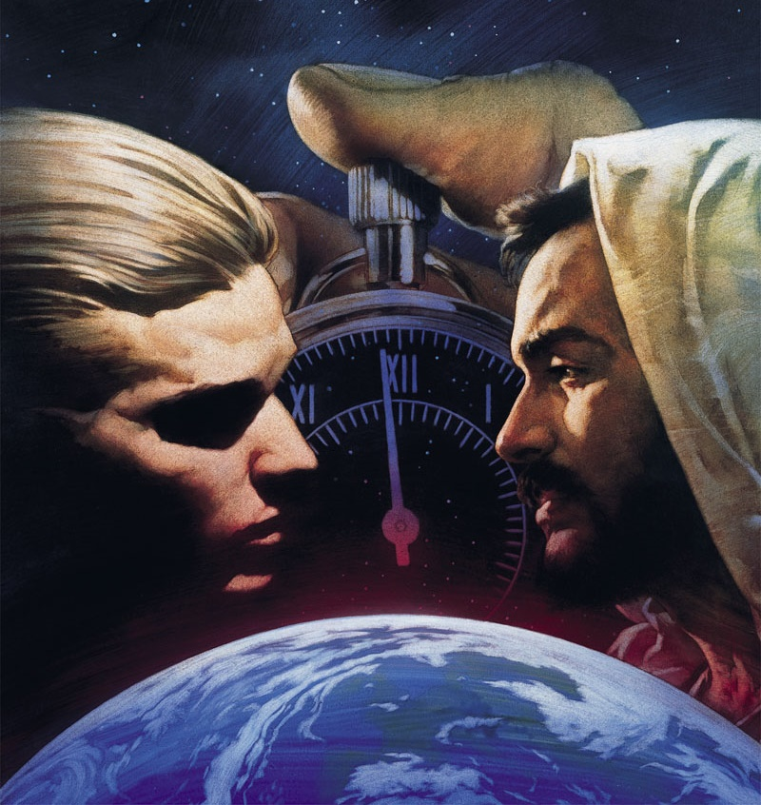
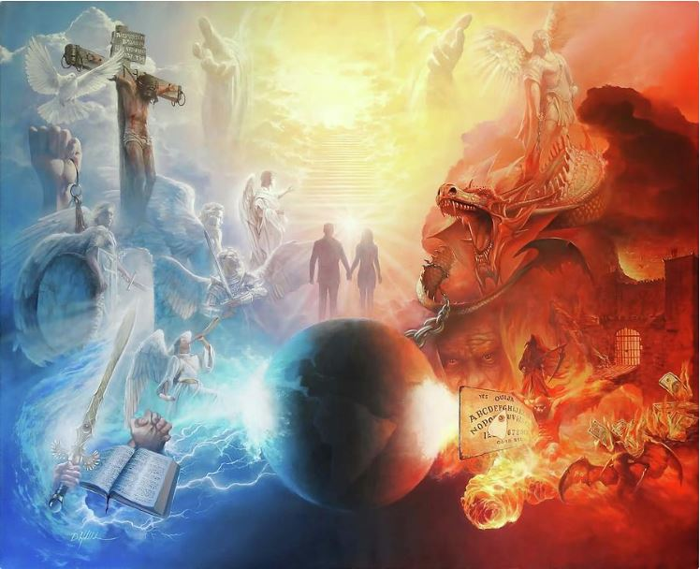
Eite-in khuavan buppi buaina lak ah i nungta hi. Ih phawk khakloh ahihkeileh piang thei dingin i uploh hangin, hih buai na pen a om takpi hi.
A kibanglo thahatnate in eite adingin, a kimu theilo kha lam thu hi (Efe. 6:12). Ahizongin, kidona i huzap’ pen ih thuak kha hi. Siatna lianpi, gamtat hoihlohna, sihna…
Vantung mite’ cihtakna le mawhna sung ah a kialo leitungte in, Pasian’ ukna hi. Tuni in note cihtakna le lungsim in hong ziakaai sak hi.
Buaina kipatna
Vantung ah langpan’na
Leitung ah langpan’na
Itna thuk kikna
Tuni-a buaina

Slide 4
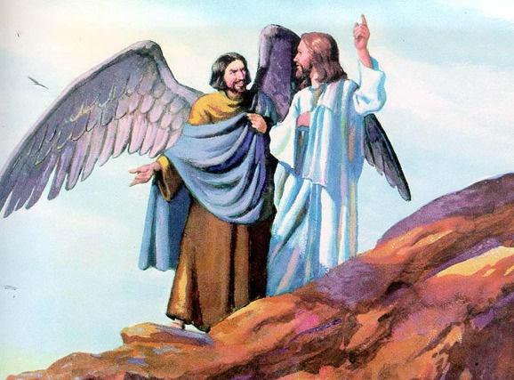
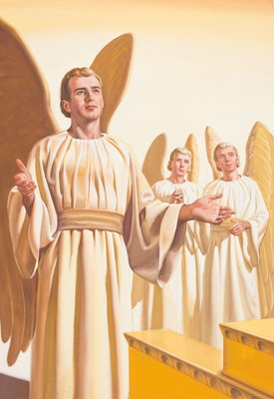
BUAINA KIPATNA
“Gamtatsiat ding na kipatma hun ciang dong, na suah tunga kipanin na gamtatna khempeuh paubaan’na khatbeek omlo hi.” (Ezekiel 28:15)
Eden huan ah, Pasian uploh ding Eve a tawsawn khat om khin cihthu in mihingte’ pian’ma pekin Pasian kilang pan khin cihna hi (Pian. 3:1).
Zeisu in Pasian le mihingte kikaal ah tua uplohna khai’ci a vawhpa “galpa” pen dawimangpa ahihna teltakin hong gen hi (Matt. 13:39).
Ei le ei kidot ding dotna masa in: Pasian in dawimangpa piangsak hiam, cihnop na-ah, Pasian in a hoihlo/git’lohna piangsak a hiam?
Dawimangpa pen Lucifer a kici vantungmi khat hi ci-in Lai Siangtho in gen hi (Is. 14:12). Hih vantungmi in kicin’na le hoihna tawh kidim in kibawl hi (Eze. 28:12). Vantungmi a kem’ cing cherub pen a sangpen mun dong pahtawi a ngah hi (Ez. 28:13-14).
Lucifer in pauban’ neilo himahleh koici bangin dawimang pa suak hiam? Pasian le amah kikaal koi bangin buaina kipan hiam? Pasian in a piansak dangte mah bangin suak ta takin deihteel theihna a piakna zui-in, Pasian tokhom luah dingin langpan na kipan hi (Ez. 28:15; Is. 14:13-14).

Slide 5
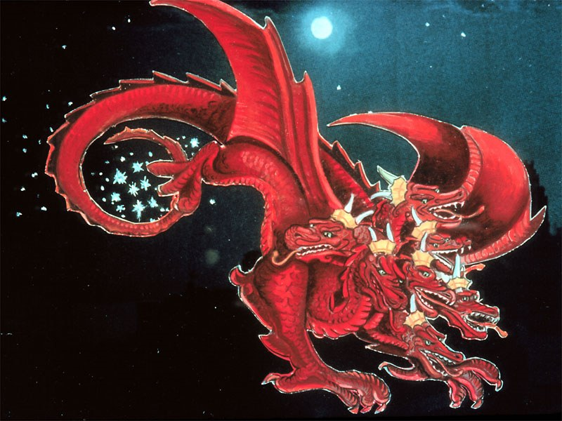
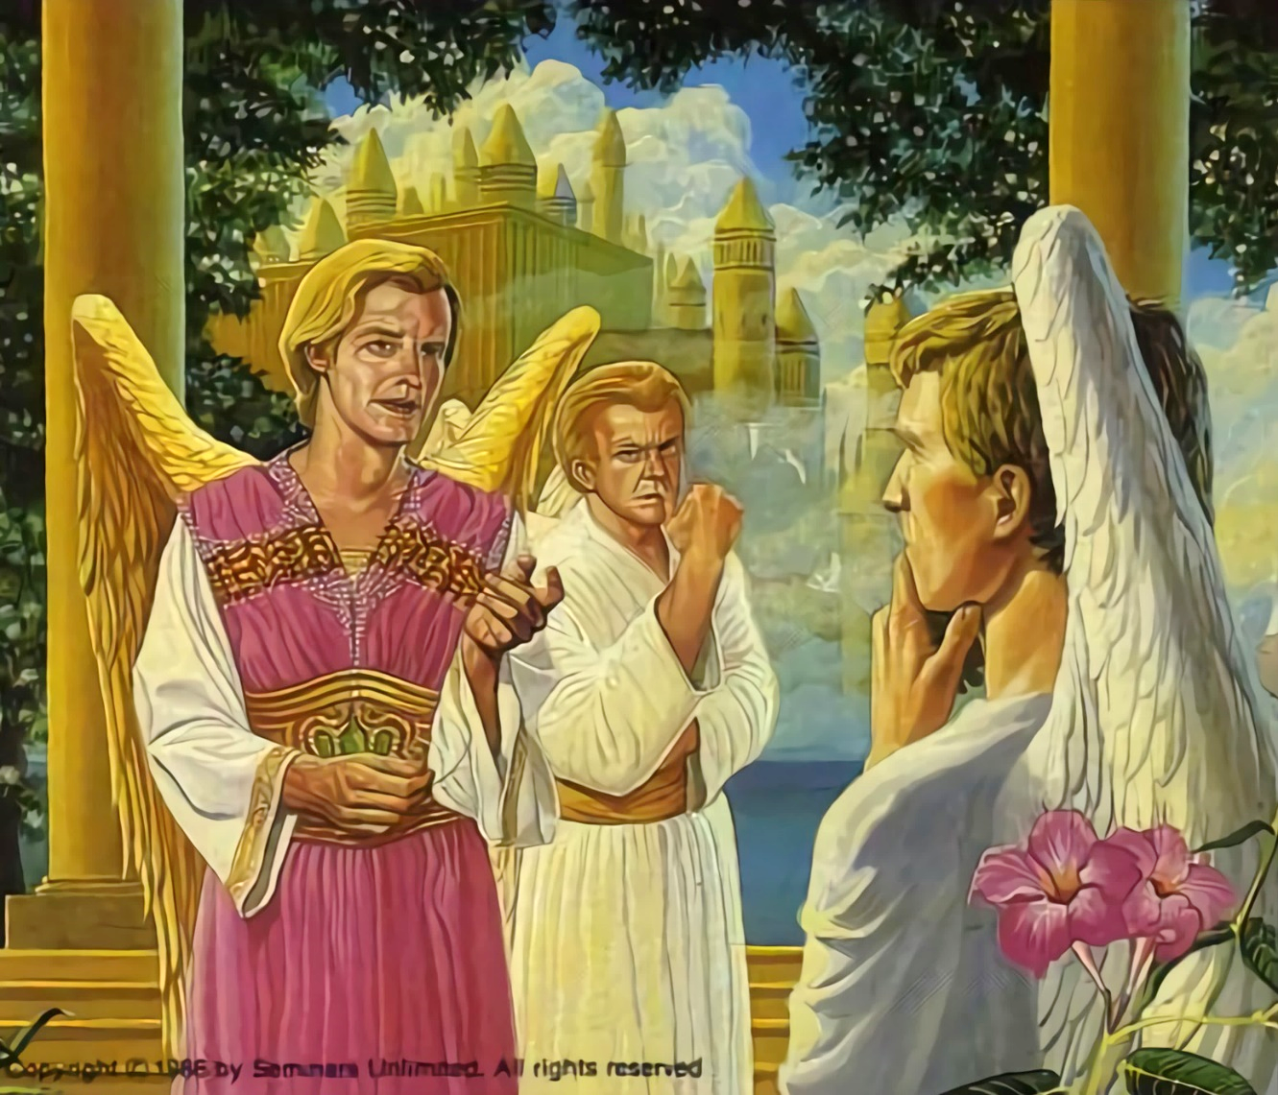
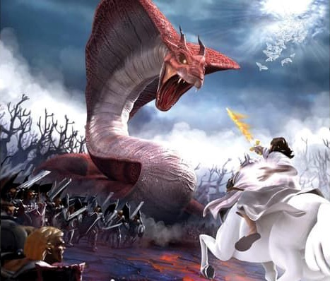
VANTUNG AH LANGPAN’NA
“Amei tawh vanah a ome aksi sehthum suah sehkhat vatkhia-in leilak a den’na hi…” (Mangmuhna 12:4a)
Vantung tokhom luah nuam ahihmanin, Lucifer vantungmite lakah thumanna tawh kisai lung hian nading a bawl hi. Amaute khempeuh a mawknapi hilo hiam? A khauh mahmah thukhun nuai le thumanloh sungah bang hangin ki-ap ding ihi hiam? a ci hi.
Lucifer in Satan hongsuak hi (Mang. 12:10; Job 1:6, 9-10). Ama dinmun khel na dingin Pasian i itna tawh a sapna khem peuh nial hi.
Langpanna in kilangh takin buaina hong suak a, vantungmi khatsim i khensat ding kidona hong suak hi. 1/3 te-in Satan nungzui-in, a dangte in Pasian tungah citakna nei uh hi (Mang. 12:4a).
Tuni dongin kidona kizomlai hi. Satan pen lawp mahmah lai hi. Pasian langpang dingin mi kim kaih ding hanciam hi. Namnih bek om hi. Pasian thukham a zui, ahihkeileh a nial ding. Ei’ khensat ding ahi hi (Thlkna. 30:11, 16, 19; Josh. 24:15).

Slide 6
“A vanglian Pasian in hih a kheem’ pa vangtung pan hawl khia pah hi; ahizongin hih thu in Ama geelna hilo hi. Amah in lang pangte a Tapa neihsun le Ama tung a citak vantung mite tawh a hatna tehding in a kibangin deihtel theihna pia hi. Hih kidona ah Vantungmi khempeuh in amau lam ding teel in mite kiang kilangh sak ding hi. […] A zenzen in Pasian in hih langpangpa pen mawh pia dingin a vang’liatna a zangh hileh, gimna thuak vantungmite tung ah hong kilangh lo ding hi; tua ahihmanin, Pasian in Ama’ thuman’na le thukhenna pen vantung khempeuh ah kician takin kilangh khiasak ahih manin, Pasian in lampi dang angh hi.”
EGW (The Story of Redemption, pg. 17)

Slide 7
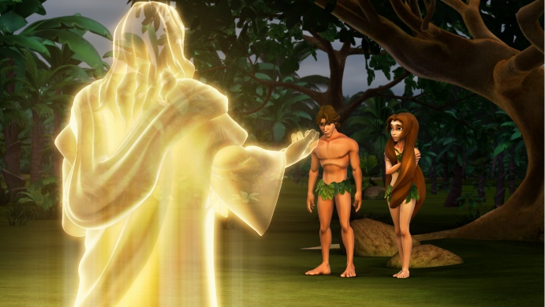
LEITUNG AH LANGPAN’NA
Amah in, “Na guaktanga na omna kua in hong gen ahi hiam? Na nek loh dinga kong thupiak singgah ne kha na hi hiam? ci hi. (Piancil 3:11)
Pasian in mawh baanglo, a kicing dinmun ah vantungmite piang sak hi. Tua mah bangin, Pasian in kawk baanglo, a kicing in mihing te piangsak hi (Pian.1:31).
Vantungmite mah bangin, Pasian in eite tungah ong deihteel theih na hongpia in hong piangsak hi. Tua ahihmanin, Adam le Eve tungah zong deihteelna zangh sak in, amaute tungah thu pia hi: “Ahih hang in a pha le a sia theihna singkung gah pen na ne kei ding hi” (Pian. 2:17).
Amaute lung a hiang sak thei pipen in Satan bek hi. Lungsim poi takin, ama ngiimna a tun hi. Adam le Eve in Pasian hong muangmawh in, Ama thu manglo-in, nuntak na bulpi pan in lampial in paikhia uh hi (Pian.3:6, 9-13, 19). Adam in mawhna sung lut nading kongkhak hong ahihman in mi khempeuh sihna ngah hi (Rom. 5:12).
Tua hun a kipan in, eite-in gen’theihna, damlohna le sihnate tawh kiciamteh leitung ah i nungta hi. Eite-in Adam’ mawhna thaman’ a pia i hiam?
Ei’ mawhna thaman’ ciat i pia hi: “mi khempeuh in git’loh gamtatna tawh Pasian vang’liatna i kiam sak khin hi” (Rom 3:23).

Slide 8
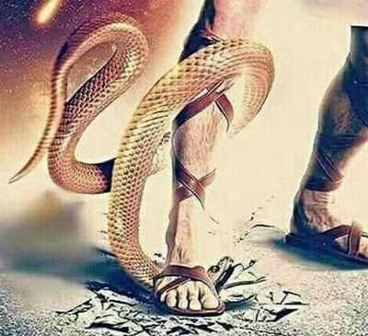
ITNA THUK KIKNA
“Hih ka gen itna pen: eite in Pasian i itna thu hilo-a, Pasian in eite hong it in, i mawhna a maai theihna dingin a Tapa a hong paisakna thu ahi hi.” (1Johan 4:10)
Thu man’lohna thamante a sawtlo-in, Pasian in Adam le Eve pen amaute’ tatkhiatna ding geelna khat om khin hi (Pian.3:15).
Mihingte in Piangsakpa deihna panin amau thu-in lampial khin uh hi. Ahi zongin Pasian in a itna a theilo a tate nusialo-in, tehpih ding omlo Ama’ itna diktak honglak khia hi (Johan 3:16).
Sihna pen mawhneite adingin tawntung hi nawnlo hi. Zeisu in mawhna thaman in a nuntakna pia in a itna honglak hi (Rom. 5:8).
Eite-in Pasian itna tawh kituak ding na khat beek i nei kei hi. Ahizongin, Kalvary ah Zeisu sisan malte in eite tungah Pasian in “nang kong it hi” a ci hi.

Slide 9
ITNA THUK KIKNA
“Hih ka gen itna pen: eite in Pasian i itna thu hilo-a, Pasian in eite hong it in, i mawhna a maai theihna dingin a Tapa a hong paisakna thu ahi hi.” (1Johan 4:10)
Zeisu in eite’ tungah a itna koi bangin honglak hiam?
Zeisu in na khempeuh piangsak (Johan 1:3)
Amah piansak na hong suak (John 1:14)
Ei mah bangin gen’theihna, gilkial dangtakna, bawlsiatna, nat le sat thuak (Is. 53:3; Marka 11:12)
Amah ei mah bangin ze-et thuak (Heb. 4:15)
Thuman’ mite mawhna tang’in lungkim takin sihna hong thuak (1 Pet. 3:18; John 10:17-18)
Sihna thuak in a thawh kik na hangin a mite in tawn tung nuntakna ading lung muanna ngah (Rom. 6:3-4)
Hih khempeuh in itna hang bekhi (1Jn. 4:10)

Slide 10
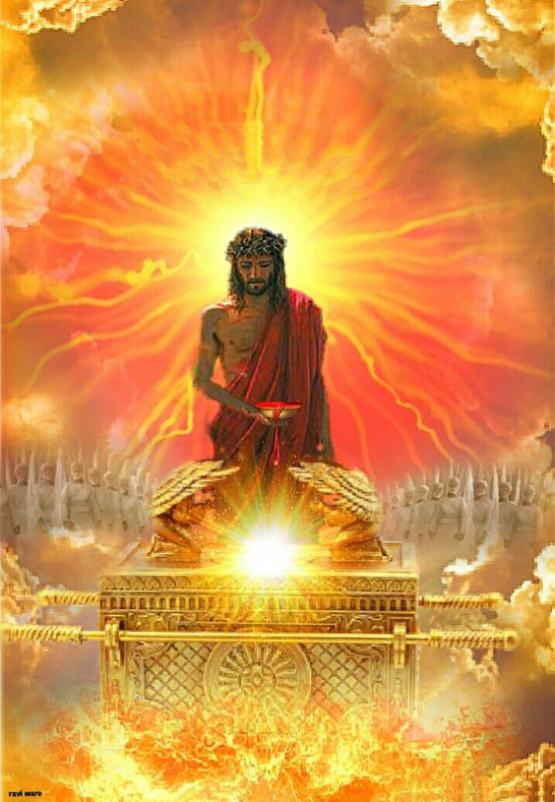
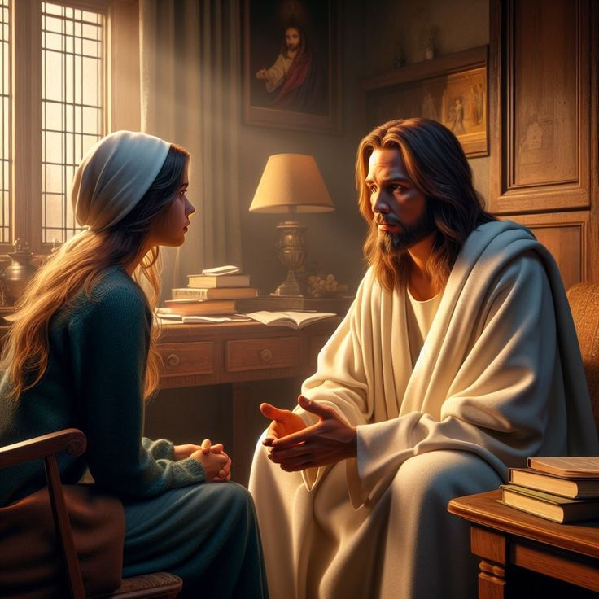
TUNI-A BUAINA
Tua hi-a, mite-a’ dingin a thumsak thei dingin amah nungta tawntung ahih manin ama tung tawnin Pasian kiang a zuante khempeuh, tu-a kipanin a tawntungin a honkhia thei ahi hi. (Hebru 7:25)
Tuni-in, Zeisu in Vantung Biakbuuk ah eite adingin thu hong nget sak hi (Heb. 9:24; 7:25).
Singlamteh tungah hong buahkhiat a itna sisan hangin, Zeisu eite pen Pa’ Pasian mai ah ahi-a – khuavan bup khempeuh mai ah hi zongin – vantung ah mun ngah huai, a kicing mi hong suak sak hi.
Tua ahihmanin, Zeisu hangin upna tawh Pasian kiang a zuan ding in sapna i ngah hi (Heb. 4:15-16).
Zeisu in i nuntakna sunga kisapna khempeuh ah amah i muan ding deih hi (Jn. 14:13-14). Lauhuai na mun ah daih na hongpia hi; mawh khialhna munpan, mawhmai na hong pia; thaneemna pan, tha hong khauh sak hi.
Zeisu ii a lian pen lunggulh in eite tawh a tawntung in nungta khawm ding hi (Jn. 17:24). Tua in na lunggulh lianpen hiam?

Slide 11
“Mawh zawlnate in nang hong do ciangin, awlmawhna, lungbuaina, khuamialpi in na lungsim hong tuamcip ciangin, a nunung khuavak na muhna mitsuan kik in. Khris i hong itna tawh hong kepna nuai-ah tawlnga in. Mawhna in lungsim hong gimsak in ei le ei kitheihna lungsim in vangik hong suak ciangin, up theih na lungsim a bei ciangin, Khris hong hehpihna in mawhna sumaai ding le khuamialpi hemkhia zo cih phawk in. Tankhiapa tawh kipawl khopna hangin eite in daihna kuam sung ah a lut ihi hi.”
EGW (The Ministry of Healing, pg. 193)

