Slide 1
A PIANNA BULPI
ITNA MAW, AANGSUNG KHUALNA?
Lesson 2 ading April 13, 2024

Slide 2
“Nang hong ompih kahih manin lau kei-in. Na Pasian kahih manin lungkia kei in. Nang hong thakhauhsakin ka hong huh ding a, nang hong huhin ka hong honkhia ding hi.” (Isaiah 41:10)

Slide 3
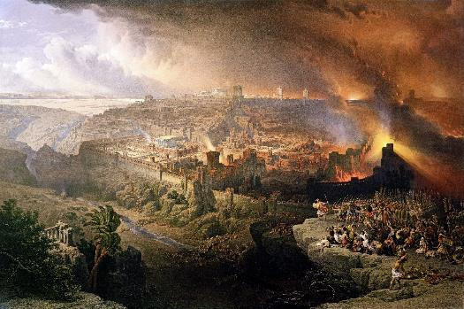
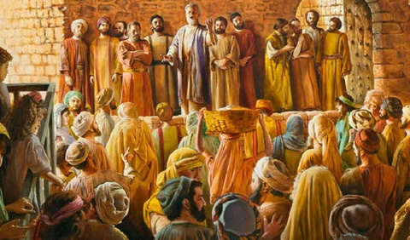
Kum 70 in Israel gam beihun ah minam khatin kiciamteh hi. Rome in Jerusalem le Biakinn te a suksiat hangin, kidona ah ading a thahat gamte zong kihel hi.
Lamkhat panin, Satan in Israel mite in Messiah nial ding in a tawsawn khitciangin, a minam bawlsiat ding ngen hi.
A dang khat pan cileng, Pasian in amah a nial man un a thuak dingte uh gen phapha hi; thukhena thuak ding zekai sak; cihtakna meivak tawi in Pasian’ hong itna tawh leitung vaak sak ding in mite le pawlpi kiging sak hi.
Jerusalem kisuksiatna panin sinnate:
Pasian hong itna nialna
Pasian in a mite lunghihmawh
Khristian masate tungpan sinnate:
Bawlsiatna sungah cihtakna
Tasamte’ tungah huhna
Itna, eite hihna lim’

Slide 4
JERUSALEM KISIATNA PANIN SINNATE

Slide 5
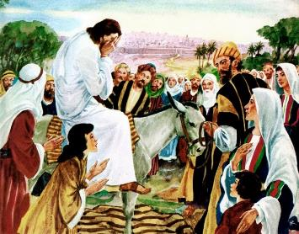
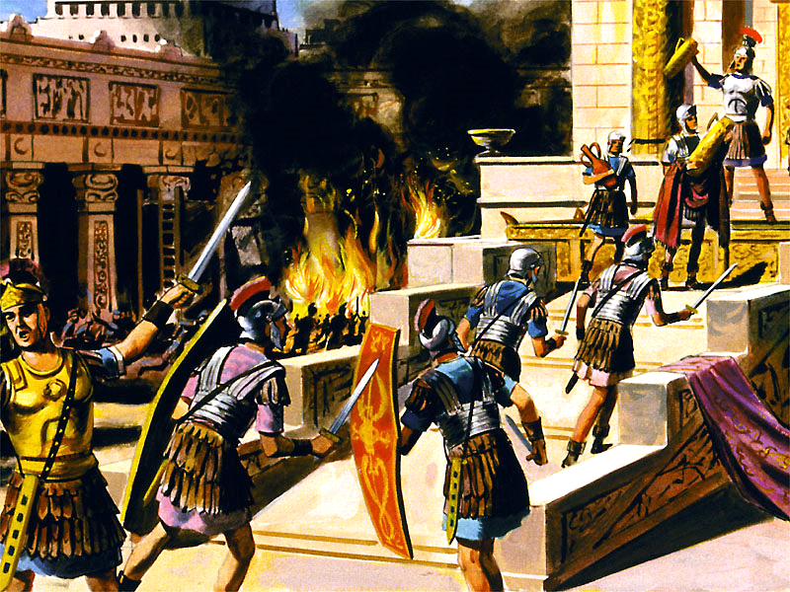
PASIAN HONG ITNA NIALNA
“Jerusalem, Jerusalem aw, kamsangte na that a, Pasian’ sawl kamtaite na denglum hi. Akpi in a kha tawh a note a huai mah bangin na mite kha huainuam tawntung a, ahizongin na ut kei hi!” (Matthai 23:37)
Zeisu in Jerusalem a tun’ kuan ciang in kap hi (Luka 19:41-44). Pasian in itna tawh a sapnate amaute in lung khauh takin a nial manun a kituak tha man thuak ding ahihna thei hi (Matt. 23:37).
Siathuainate thei ahihmanin a kap hi. Bang hanghiam cihleh Pasian in eite hong itlua ahihmanin kua mah hong si sak nuamlo in, mi khempeuh tawntung nuntakna ngah sak suam hi (Jn. 5:39-40; Ezek. 18:31-32).
Kum 66 sung Jew te in Rome te bawlsiat langpanna thuak ahihna tangthu in pulak hi. Rome te’n khuapi a umcih hun sungin Jew te-in amau le amau kido uh hi. Kum 70 ah vai khempeuh zo siang hi. Titus in Jerusalem le Biakinnpi susia hi. Jew mite awn khat bang sihna thuak hi.
Ahizongin Satan in Jewte pen koi bangin tawsawn cih tangthu in pulaak lo hi. Langpan na tawh Rome te kik ding sawm hi. Jerusalem kisiatna ah gilopa nasep hi. Nuntak na bulpi pan lampial na hangin, Israel te kisiatna, sihna ding bek a zong galpa in hehpih ngah hi.

Slide 6
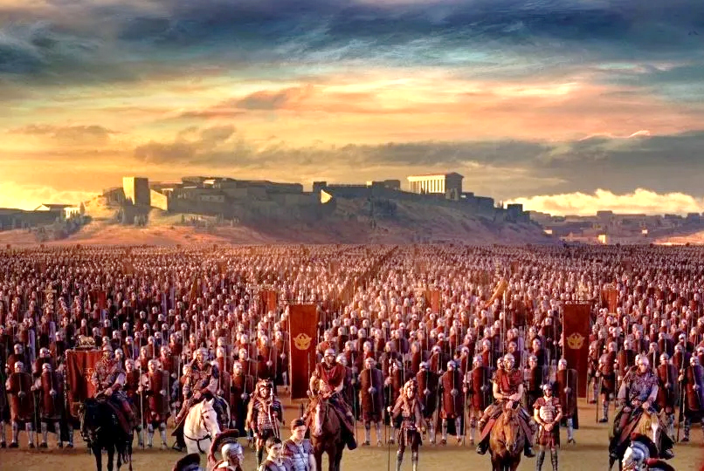
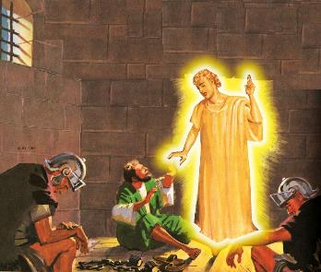
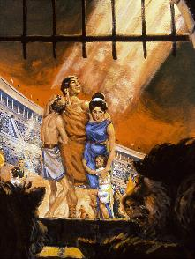
PASIAN IN A MITE LUNGHIHMAWH
“Nang hong ompih ka hih manin lau kei in. Na Pasian ka hih manin lungkia kei in. Nang hong thakhauh sakin ka hong huhding a, nang hong huhin ka hong huhin ka hong honkhia ding hi.” (Isaiah 41:10)
Ama hong itna sungah, Pasian in siatna pan a suakta nuam khempeuh lam honsak hi. Amahin lim’ khat pia hi: Jerusalem pen vanglian galkap te-in um’cih hi (Luka 21:20).
Gaius Cestius Gallus in kum 66 sungin tua genkholhna lim’te kicing sak hi. Um’cih nate hemkhia in, Zealot makai Eleazar ben Simon in Rome galkapte tungah zawhna a la hi.
Zeisu’ kammal a umte in Jerusalem in taikhia ding kiginloh laitak in hun hoih ngah uh hi.
A sawtlo kha khitciangin, Nero in langpan nate a do dingin Vespasian a sawl hi. Kum 67 pan 70 sung, a um’cih uh hi.
Haksat pen hunsung nangawn’ ah zong Pasian in a tate keem’ bit hi (Late 46:1; Is. 41:10). Ahizongin, mi tampite-in Pasian tungah a cihtakna uh hangin nuntakna beilawh uh hi (Heb. 11:35-38).
Mi pawlkhatte bang hangin kikembit a, pawl khatte kinawl khiin hiam?

Slide 7
“Migilote in midikte a bawlsiat gawpgawp theih pen upna neu pawl khatte in lamdang sa in lung buai lawh uh hi. Tua banga migilote a gualzawh ciangin pawl khatte in Pasian a muanna uh nusiat lawh dek phial in, bang hangin a thumaan migitna tawh a kidimpa in mong neilo vangliatna nei napi, thumaanlopi-a netniamnate enkhong thei mawk hiam? a ci uh hi. Tua dotna pen ei’ dawn sak theih ahihloh hangin, Pasian in eite hong it takpi ahihna teltheih tham cing dingin teci a om hi. Ama vaihawmna i theihpih loh hangin Ama migit’na pen muan lah ding hilo hi.”
EGW (The Great Controversy, pg. 47)

Slide 8
KHRISTIAN MASATE TUNGPAN SINNATE

Slide 9
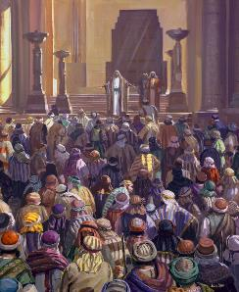
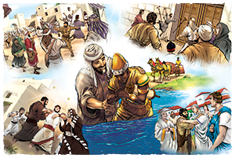
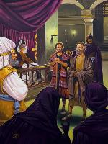
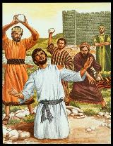
BAWLSIATNA SUNGAH CIHTAKNA
“Ahizongin Saul in pawlpi suksiat ding hanciam a, inn khat pan inn khatah pai kawikawi-in, thu um numei le pasalte kai-in thong sungah a khia hi.” (Sawl. 8:3)
Akipat tung’ in lametna om takpi hi: tul tampi kikheel in (Sawl. 2:41; 4:4); thu um mite in vang’liatna tawh kidim in thugen uh hi (Sawl. 4:31; 5:42).
Ahizongin galpa in tawlnga lo hi. Amasa in vau’na (Sawl. 4:17-18); tua khit ciangin, mawh piakna (Sawl. 5:40); a tawpna ah, sihna (Sawl. 7:59).
Saul i bawlsiatna hangin nungzuite in kitheh thaang hi (Sawl. 8:1). Ahi zongin, thu-um mite cihtakna hangin tua khuavak beimang’ lo-in, leitung mun khempeuh ah a taang’ pha mahmahin kizel hi (Sawl. 8:4; 11:19-21; Rom. 15:19; Kol. 1:23).
Zeisu in a Pawlpi tungah vaipuak khat pia in tua pen mainawt nading vang’liatna pia hi (Sawl. 1:8). Hatna omlo, taksa ahihkeileh kha lam, lungdamna thu khantoh nading khaktan zolo ding (Matt. 16:18). “Pasian ei’ lamah hong omleh kua mahin hong langpan’ zolo ding hi!” (Rom. 8:31)

Slide 10
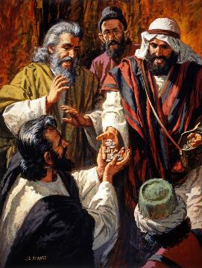
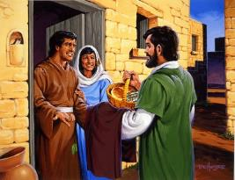
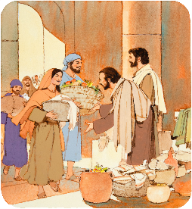
TASAMTE’ TUNGAH HUHNA
“Amaute in a neih a lamh tenguh zuak uh a, a sumte pen amau kisapna tawh kizui-in amaute lakah a hawm uh hi.” (Sawl. 2:45)
Lungdamna thu in Khristian masate tungah koi bang huzaap nei hiam? Sawl. 2:42-47
Amaute in Zeisu thuletpite um uh hi
Silpiak a ngah mi in cinate damsak uh hi
Amau’ sungah kibatnate om hi
A tasamte’ tungah amau’ neihsa hawm khia uh hi
Amaute-in kimuh khopnate nei uh hi
Innte ah kimuh khopnate nei-in, Topa’ tawh nitak an nekkhopna pawibawl
Amaute-in nuamna le lungsim siangtak tawh om khawm uh hi
Pasian phat uh hi
Khris sawltakte in, Zeisu limciing uh hi. A kiim-a tasam mite a panpih manun khua bup ii maipha ngah uh hi.
Tua manin, Pawlpi in Khristian khat le khat tungah ki-itna le amaute’ kiim’le paam adingin lunglutna lim’ khat a suak kul hi.

Slide 11
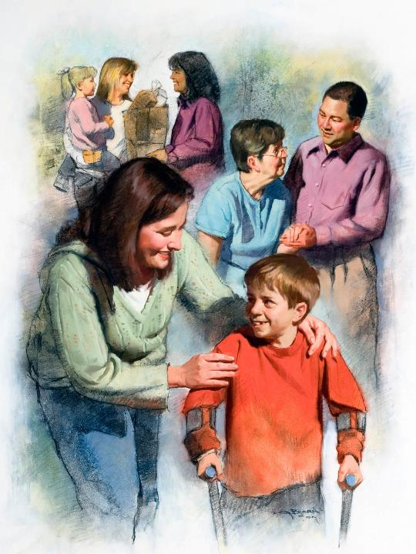
ITNA, EITE HIHNA LIM’
“Note khat le khat ki-it le uh cin keima nungzuite na hihna uh mi khempeuh in hong thei ding uh hi,” a ci hi. (Johan 13:35)
Khuavan bup buai na ah kihel khempeuh in amau’ ii lim’ nei ciat uh hi: Satan in muhdahna tawh susia hi; Pasian in itna tawh puahpha hi.
Kipawlna khat ahihkeileh a dang khat ii nungzuite-in tua bang mah zui-in sem uh hi. Eite-in Pasian nung i zuih leh, mi dangte tungah itna i lak khia ding hi (1Johan 4:20-21).
Kum zalom 2 na le 3 na hun a Khristiante in aangsung khual na neilo-in itna lakkhia uh hi. Pulnatnapi hun (kum 160 le 265 sungin ), amaute in amau’ bit nading ngaihsunlo-in liam le baai mite don’ dingin amau’ mahmah kipiakhia uh hi.
Amau le amau ki-itna nusia in, mi awn tampite’ phattuam nading semkhia uh hi. Ahizongin amaute in amau le amau kidon’lo-in, Ama’ nuntakna phal takin a piakhia Honpa: Zeisu bek mit suan uh hi.

Slide 12
“Pasian in a man nei Ama hehpihnate, zontheih ahilo Pasian’ neihsate, leitung tawh hong zopsak nuntak theih na lampi khat ahi dingin thu khat hong suak hi. Khris in Ama’ Kha le gamtat luheekziate ah a ai-awh ding taang’mi sangin a kisap zawk hih leitung ah adang omlo hi. Honpa’ hong itna pen mite’ tung tawn in kilangh sak ding sangin leitung mite in kisap dang omlo hi. Vantung in mihingte lungsim kipaak sakin thupha ahi dingin sathau siangtho nilh theih nading lampite a lam en uh hi.”
EGW (God's Amazing Grace - Unsearchable Riches, June 28)

