Slide 1
KHUAMIAL SUNGAH
KHUAVAK TAANG
Lesson 3 ading April 20, 2024

Slide 2
Zeisu in, “Note kiangah tawmvei sung khuavak hong omlai ding hi. Khuamial sungah a pai mi in a paina mun theilo ahih manin khuamial in note hong phaklohna dingin khuavak na neih sungun na gamtat ngei uh zom paisuak un.”
(Johan 12:35)

Slide 3
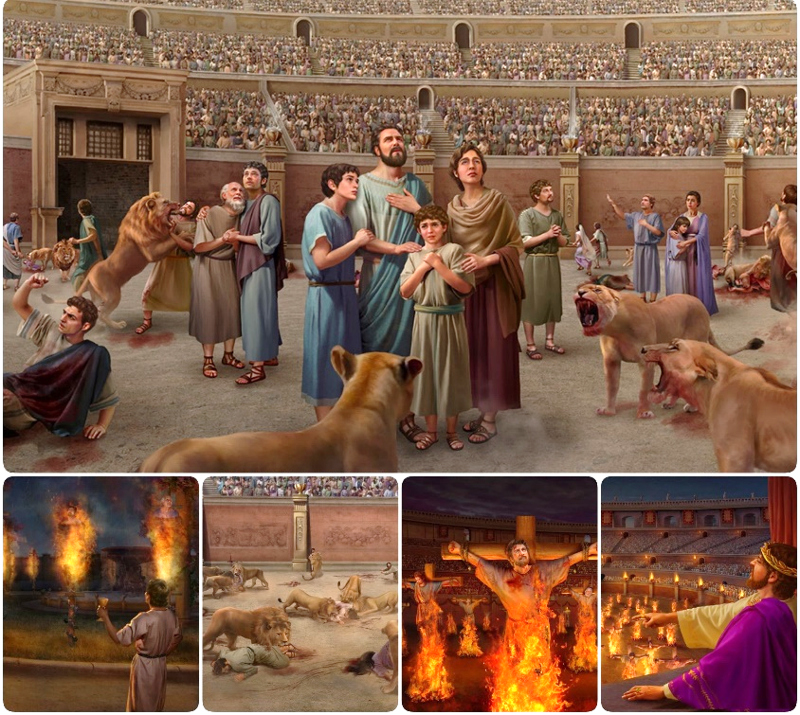
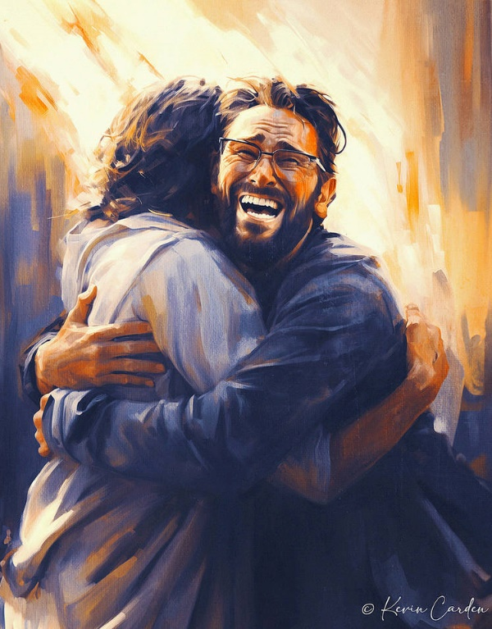
Galpi khat ah kidona tawh zawhna ngah/ gal lel hi.
Satan in bawlsiat kidona ah a guallelh ciangin amah in kiholemna bawl dingin geelna khat hong nei hi. Thuman’ le zuau thu helzau in diklohna, a nungtalo thuman’ sang dingin mak tampi kheem ding hi.
Hih kidona ah eite’ kidal theihna in thuman’ thu tak nuntakna le a siangtho Pasian kammal ahi Zeisu tung ah kingak ding ahi hi.
Thuman’ ading kidona:
Thuman’na le zuau thu
Pawlpi kiholemna
Pasian kammal ading Kidona:
Lai Siangtho sungah lungmuanna
Mihing’ Ngaihsutna
Lungsim Galdona

Slide 4
THUMAN’ ADING KIDONA

Slide 5
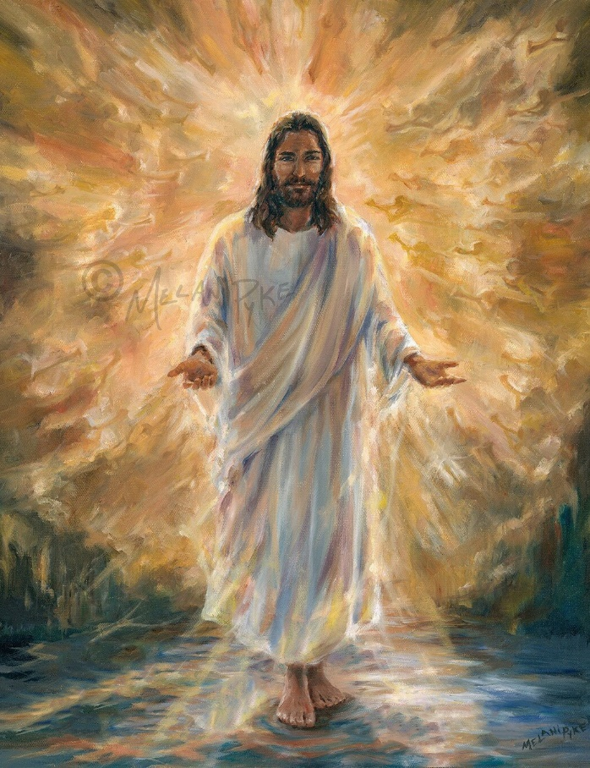
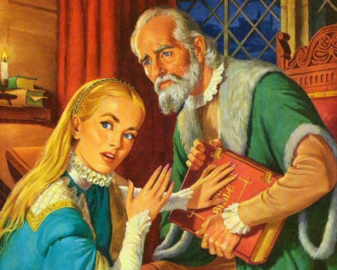
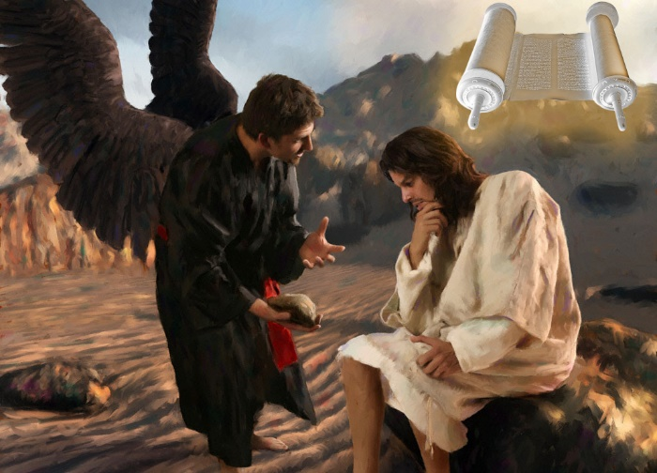
THUMAN’NA LE ZUAU THU
Zeisu in ama kiangah, “Keimah in Lampi ka hi-a, Thuman le Nuntakna zong ka hi hi. Kei hong suanglo-in Pa kiangah kuamah tung theilo ding hi.” (Johan 14:6)
Zeisu in thuman’na ahih mah bangin dikna khempeuh ii Pa ahi hi (Johan 14:6). Na khem peuh man’ hi, na khempeuh up huai hi, thuman na khempeuh Ama’ kiangpan hi. A thuman’ nate ei’ sungah hong nungta sak hi.
Alehlam khat ah, Satan pen zuau khempeuh ii pa hi (Jn. 8:44). Khem’na khempeuh, hazatna khempeuh, thuman’ a kineih zuau khempeuh ama kiangpan hi. Zuau kampau na in eite sihna hong tun hi.
Galpa tawh a kituah ciangin Zeisu in thuman’ khempeuh i bulpi ahi Lai Siangtho zangh hi: “Hih in a kigelh hi” (Matt. 4:4; 21:13).
Tua ahihmanin, dawimangpa in Lai Siangtho pen selcip ding ahihkeileh zuau khemna tawh susia dingin hanciam hi. Middle Ages (“khua mial hun” zong kici), Rom pawlpi kang sungin (a vekpi ahihloh hang) susia zo hi.

Slide 6
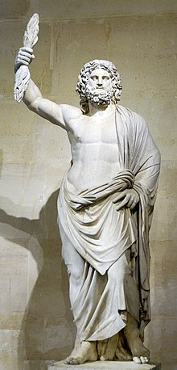
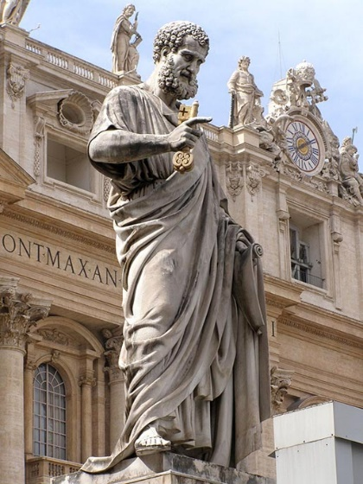
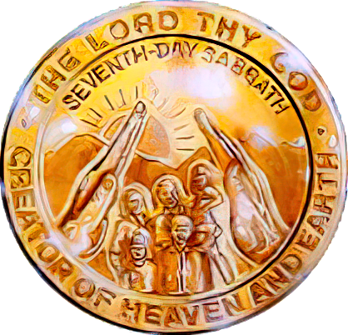
PAWLPI KIHOLEMNA
“Kei ka om nawnloh ciangin, sa gilote in gannote a phialgawp bangin, mi pawlkhat in thu um mite hong phialgawp ding lamtak kathei hi. Note sung mahmah panin zong mi pawlkhat in thu um mite khemin a zolkhiat hun hong tung ding hi.” (Sawl. 20:29-30).
Efesa khua upate’ a thupatna ah, Paul in mailam ah a tuah ding uh a puapan le a sung lampan buai nate adingin a lunghimawh na pulaak hi (Sawl. 20:29-30).
A gamhtat Ngia: Kum 64 pan 311 ( Serdica i thuakzawhna lai ), Pawlpi in Roman Empire ii nasia takin bawlsiatna a thuak hi.
A Citaklo mi’pa: Kum zalom 4 hun kipat in a kikheello pasalte in amau ngaihsut khialh nate thuman’ tawh helzau in pawlpi ah hong pulaak uh hi.
Rome khua a om Capitoline mualtung a om Romte pasian Jupiter i milim pen zang kikin Saith Peter lim in a khel kik uh hi.
Satan in thuman’ beisak ding le milim biak ding le Sunday ni ta’n ding pawlpi ah zat ding ama “sunglam” geelna hong zangh hi.
Paul genkholhna bangin, hih khialhnate sang in thuman’ a thei nuamlote lak ah a tawp dongin a om ding hi (2 Thes. 2:7-12). Kidona nunung pen in Sabbath le kiholemna tungah kinga ding hi.

Slide 7
PASIAN KAMMAL ADING KIDONA

Slide 8
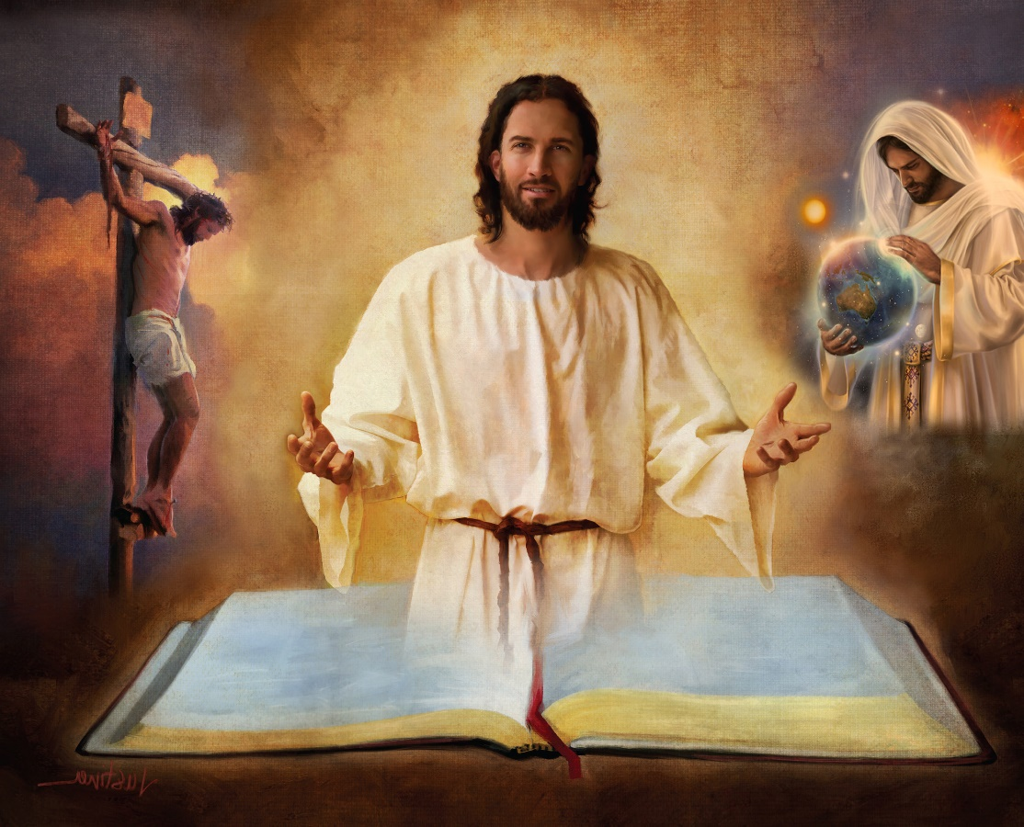
LAI SIANGTHO SUNGAH LUNGMUANNA
“Nangma thuman hilhna tawh amaute a siangtho nangma zat dingin na bawl in.” (Johan 17:17)
Lai Siangtho in Pasian’ deihna khialh loh na dingin muhkhoh na hi. Tua in mihingte tatkhiat nading vantung geelna lakna hi.
Tua ahihmanin, eite’ bitna ding Lai Siangtho bek hilo in, tua laibu siim ii a lian, a neu khat sim ah kimu thei hi (2Tim. 3:16).
Tua sungah dawimangpa geelnate kimu thei hi; piansakna; Zeisu hong suahna, nuntakna, sihna, thawhkikna le palai hong sepna; mawhnate maisakna; Nihvei hong paikikna; Leitung thak ah tawntung nuntakna…
“Na kammal in ka khe adingin meivak hi-a, ka pai na lampi hong taang sak hi” (Late 119:105)
Eite-in tuate neu no khat i nial khakleh (gtn. Pian. 1 le 2 ii Piansakna ciaptehna), eite-in tua hilhna thu guipite nial ding hi. Tua khit ciangin... a omlai Lai Siangtho te up theih nadingin koi bangin muanna ngah theih ding i hiam?
“Na thute gentelna in khua vak sak a, thu theilote tungah thu theihtelna a guan’ hi.” (Late 119:130)

Slide 9
MIHING’ NGAIHSUTNA
“Hoih hi, ci-in i ngaihsut thu khat pen sih theihna ding thu na hi zawsop thei hi.” (Paunak 16:25)
Pasian in Lai Siangtho pen a hu mup pa ahihleh tua pen kua in a khiatna hilhcian ding hiam? (2Pet. 1:20; Johan 14:26)?
Kha a neilo mi in Pasian’ Kha kiang pan hongpai nate sanglo-in hai gamtat hi cih ngaihsun in Kha hang bekin khentel thei ahih manin tua thute tel’ zolo uh hi (1 Kor. 2:14 ).
Mihing ngaihsutna i gentehna khat in kum zallom 18 hun pan kipan in Lai Siangtho i “pilna lam tawh kisai” a khiatna genkhiat na pen a sangpen pulaak khiatna hi.
Tua a thubul zuatna ah a lamdang vaite in nial na tawh mailam ding genkholh ding hitheilo hi. Hih zuatna nuai-ah, eite-in tua ii vaang’ ahihkeileh eite ngak mailam hun theih theihna i nial aleh Pasian’ thu nungta pan in bang phat tuamna ngah thei ding hiam?
Galpa in lung hianna neilo-in lampi man hi ci-in a ngahsut hang in ama lam tawp in sihna hi (Paunak 16:25).

Slide 10
EGW (Selected Messages, volume 1, page 17)
“Kha lam khuamial in leitung tuam in mihingte mial sak hi. Pawlpi tampite ah Lai Siangtho deihna genkhiatna ah lung hihmawhna le up zawh lohna om hi. Mi tampi takte in, Lai Siangtho i thuman’na le thuman tungah dotna tampi nei uh hi. Mihingte i ngaihsut siam na le mihing lungsim lunggeelnate in Pasian’ kammal humopnate ah thaneem sak hi […]
Hih a Siangtho Laibu in dawi gilote kipawl khawm in meiipi le khuamialpi sungah kituamcip dingin a bawl Satan i bawlsiatnate ah thuak zawhna a nei hi. Ahizongin Topa in vantung lam zuat nading lampi a hilh dingin mihing innkuante adingin geelna ahih keileh lamlakna laibu, tua i tu laitak a om dan ah ama a lamdang vaang tawh hih a Siangtho Laibu pen a keem’ ding hi.

Slide 11
LUNGSIM GALDONA

Slide 12
“Tua bang mite pen hih leitung pasian gilote in a lungsim mit uh tawsak ahih manin umlo uh a, Pasian tawh a kibang teekteek Khris minthan’na hangin amaute tungah a hong taang lungdamna thu khuavak mu theilo uh hi.” (2 Korin 4:4)
Spanish kampau khat ah hibangin ci hi: “Amu nuamlo pa sangin a sia huai zaw mit taw omlo hi” a ci hi. Cihnopna ah, mi khat in a muh noploh na khat a muh nadingin sapna in kimanna neilo hi. Tua ahihmanin “hih leitung pasian” in mittawte tawh a om khawm hi (2Kor. 4:4).
A guallel mite lam pan in theihna a tawmna in theih theihna a neihloh man hilo hi. Ahang in, amaute-in a theih noploh man hizaw hi. Dawimangpa in a thupi nate ngaihsut nading tampi daal in amaute lungsim a luah hi: amaute gupkhat ngah nading.
Kua mah hidinmun ah om ding hilo hi. Kha lungsim khuamial sungah a om ciangin, khua vak in tua sungah a taang khia ding hi: “Khua vak [Zeisu] in khuamail sungah a taang khiat ciangin tua khuamial in a zo kei hi” (John 1:5).
Hih khuavak a sang eite in galpa ii sepnate nang kik zo in Zeisu khuavak tawh khuamial mun taang sak zo ding hi.

Slide 13
“Vantung lam zuan-a a pai mi khempeuh in a muan huai lamlak kisam hi. Eite-in mihing’ pilna tawh kikalsuan theilo hi. Ih nuntak khualzin na lampi ah i kalsuan laitak in Khirs kammalte ngaihna in eite’ hamphatna hi-a, Ama’ kammalte in a tawntung in pilna tawh kidim kammalte ahi hi. ...
Eite ii lungmuanna khatbek ahi Zeisu’ nung ah naitak in zuihna, Ama pilna sungah kalsuanna le Ama’ cihtakna nuntakpih na ahi hi. Satan’ sepnate eite-in awlno takin kiphawk khalo hi; ama thaang’ kamte koi-ah koih cih i thei kei hi. Ahizongin Zeisu in gaalpa i ngiankawite pilvang takin thei ahihmanin, i kalsuanna khempeuh lungmuan na sungah hong kembit thei hi."
EGW (Our High Calling, January 10)

