Slide 1
UKUKHANYA
KUKHAZIMULA EBUMNYAMENI
Isifundo 3 ukulungiselela uMbasa 20, 2024

Slide 2
“Wayesethi kubo uJesu, Kuseyisikhashana ukukhanya kukhona kini. Hambani nise nokukhanya, ukuze ubumnyama bunganehleli. Ohamba ebumnyameni akazi ukuthi uya ngaphi.”
(Johane 12:35)

Slide 3
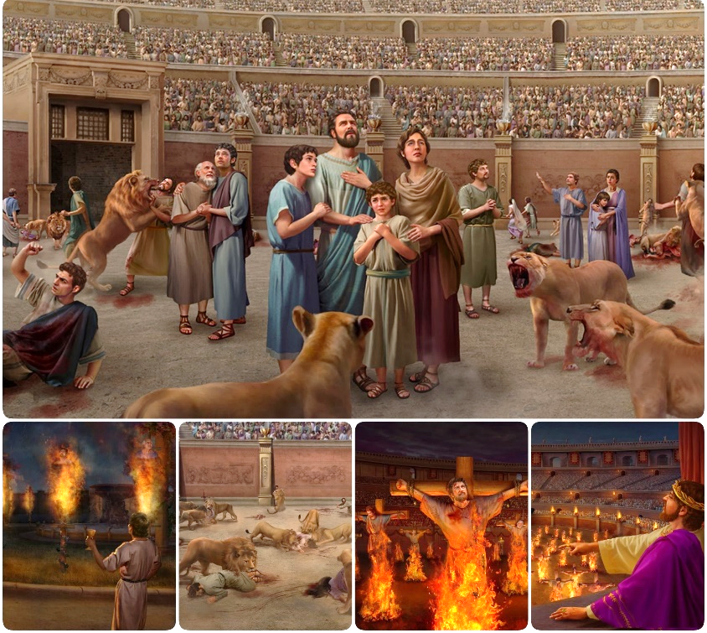
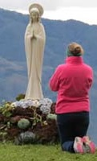
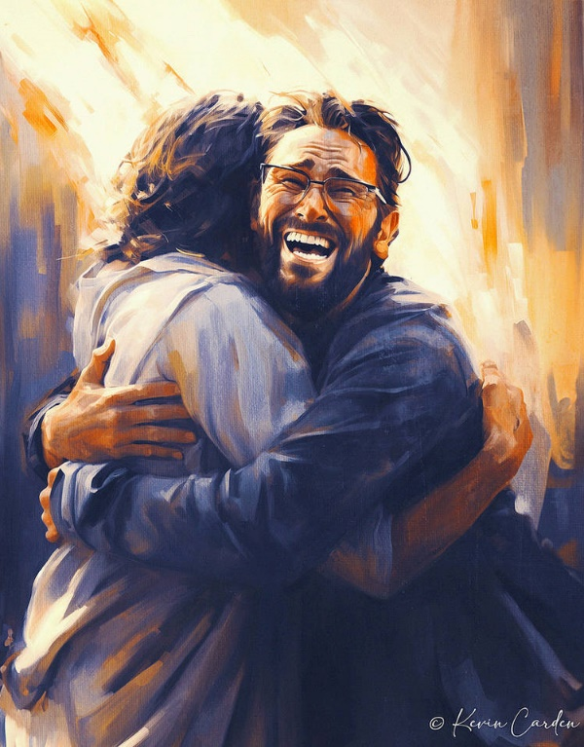
Impi inqotshwa noma wahlulwe nsuku zonke.
Lapho uSathane ehlulwa empini yenshushiso wenza icebo elisha: elokudebesela. Inhlanganisela yeqiniso namanga seyiholele abaningi ekwamukeleni ukungabi naqiniso, neqiniso elifile.
Ukuphela kwento engasisiza kulempi wukubambelela kuJesu, oyiqiniso kanye nokuphila, kanye nezwi lakhe elingcwele.
Ukulwela iqiniso:
Iqiniso limelene namanga.
Ubuthakathaka bebandla.
Ukulwela izwi likaNkulunkulu:
Ukuphepha okuseBhayibhelini.
Ukucabanga komuntu.
Ukulwela ingqondo.

Slide 4
UKULWELA IQINISO

Slide 5
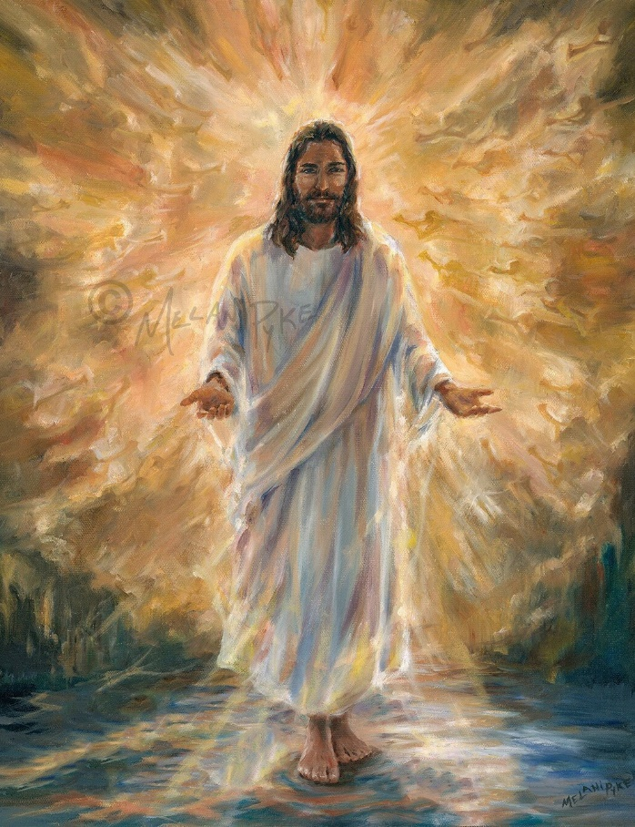
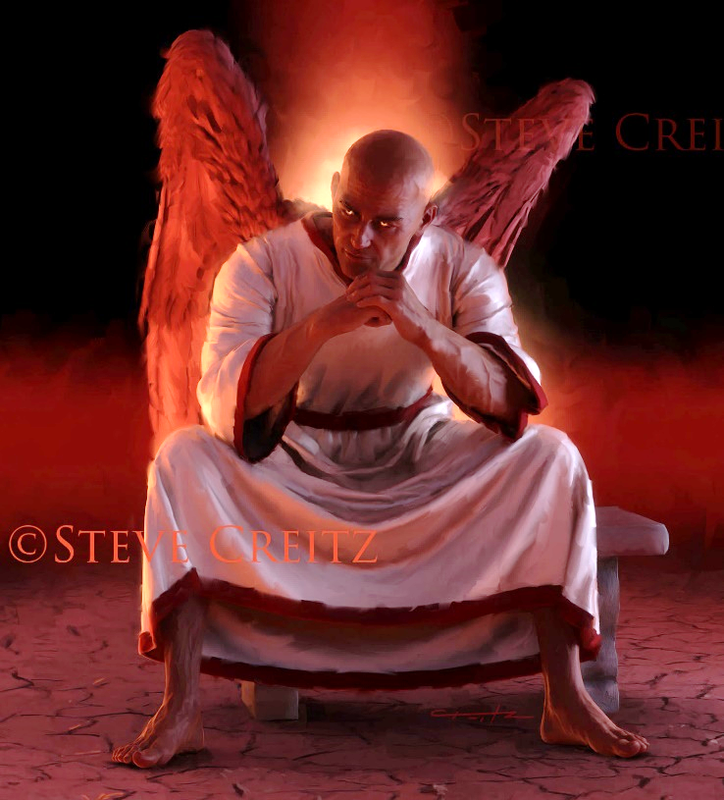
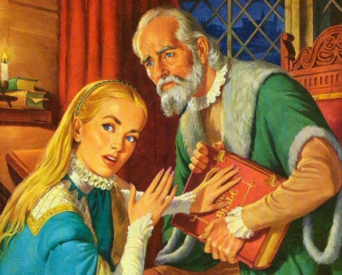
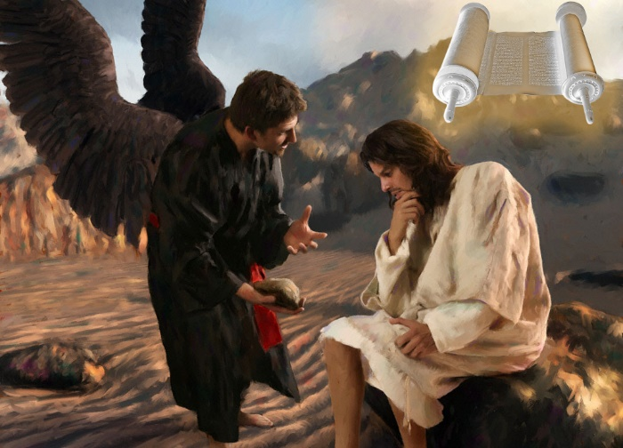
IQINISO LIMELENE NOBUMNYAMA
UJesu wathi kuye, “Mina ngiyindlela, neqiniso, nokuphila. Akakho oza kuBaba ngaphandle kwami” (Johane 14:6)
UJesu uyiqiniso ngakho-ke unguyise weqiniso lonke (Johane 14:6). Konke okuqinisekile, konke okuthembekile, konke okuyiqiniso, kuvela kuye. Neqiniso lakhe liletha ukuphila kithi.
Okuphambene nalokho, uSathane unguyise wamanga (Johane 8:44). Yonke inkohliso, bonke ubuqili, lonke iqiniso elixutshiwe, livela kuye. Namanga akhe aletha ukufa kithi.
Ekubhekaneni kwakhe nesitha, uJesu wasebenzisa iBhayibheli njengomsuka walo lonke iqiniso: “Kulotshiwe” (Mt. 4:4; 21:13).
Ngakho-ke, uSathane usebenzele ukubhubhisa iBhayibheli, ngokulifihla noma ukuliguqula. Futhi uphumelele (yize engaqedanga) yize ibandla laseRoma, ezinkathini ezimaphakathi (ezibizwa nge “Dark Ages”).

Slide 6
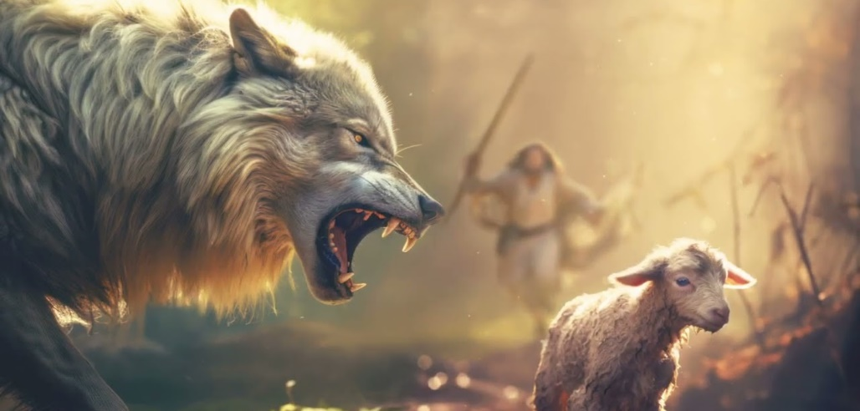
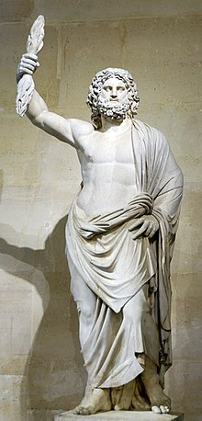
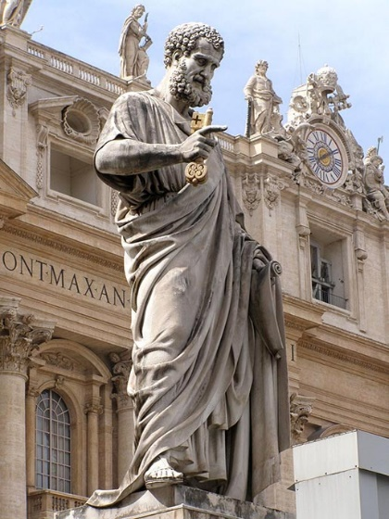
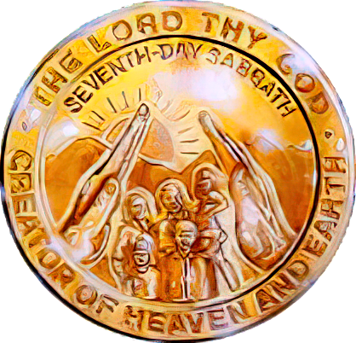
UBUTHAKATHAKA BEBANDLA
“Mina ngiyazi ukuthi emva kokumuka kwami kuzakungena kini izimpisi ezihahayo zingawuhawukeli umhlambi. Naphakathi kwenu kuzakuvuka amadoda akhuluma okudukisayo, ahunge abafundi ukubalandela” (Izenzo 20:29-30).
Lapho uPawule evalelisa abadala base-Efesu, wezwakalisa ukukhathazeka kwakhe mayelana nezinkinga ezingaphandle nezingaphakathi ababeyobhekana nazo ngokuzayo (Izenzo 20:29-30).
Isithombe sikankulunkulu wamaRoma uJupiter ose Capitoline Hill eRoma sasetshenziswa kabusha futhi saguqulwa saba ngesikaPetro
Izimpisi ezihahayo. Kusuka ngomnyaka ka 64 ukuya ku 311 (iSerdica edict of tolerance), ibandla lashushiswa kakhulu ngumbuso wamaRoma.
Abantu abonakele. Ukuqala ekhulwini le 4th, abantu abangaphendukile bangena ebandleni abahlanganisa ukukhonza izithombe neqiniso.
USathane wasebenzisa abantu bakhe “abangaphakathi” ukonakalisa iqiniso kanye nokungenisa ukukhonza izithombe kanye nokugcinwa kweSonto ebandleni.
Njengoba uPawule aprofetha, lawo maphutha amukeleka, futhi ayohlala kuze kube sekupheleni kulabo abangafuni ukwazi iqiniso (2 Thes. 2:7-12). Impi yokugcina iyobe isekelwe ekungamukelini iqiniso leSabatha.

Slide 7
UKULWELA IZWI LIKANKULUNKULU

Slide 8
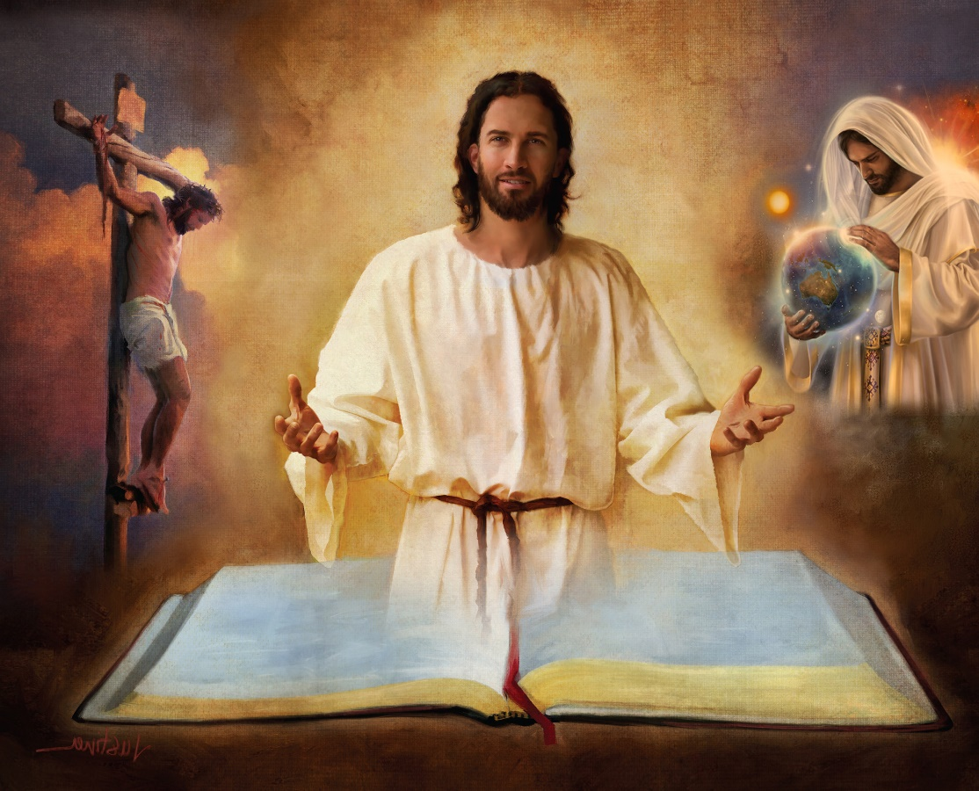
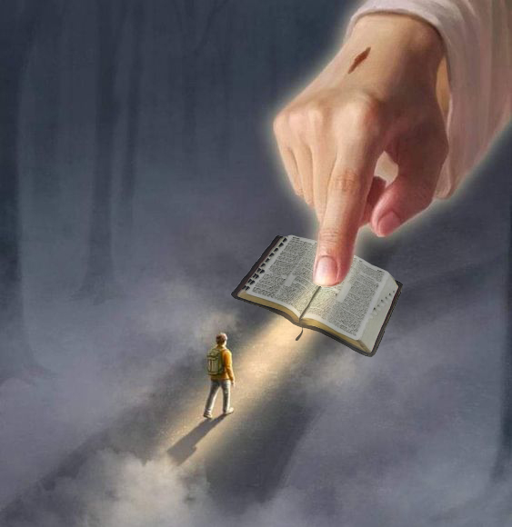
UKUPHEPHA OKUSEBHAYIBHELINI
“Bangcwelise ngeqiniso; izwi lakho liyiqiniso” (Johane 17:17)
IBhayibheli liyisambulo esingenaphutha sentando kaNkulunkulu. Lisethulela uhlelo lukaNkulunkulu lokusindisa abantu.
Ngakho-ke, ukuvikeleka kwethu kutholakala kuphela eBhayibhelini, nakulelo nalelo lamabhuku alo, izahluko namavesi (2Tim. 3:16).
Kulona sithola amaqhinga kaSathane; indalo; ukuzalwa, impilo, ukufa, ukuvuka kanye nokusinxusela kukaJesu; ukuxolelwa kwezono; ukubuya kwesibili; ukuphila okuphakade emhlabeni omusha…
“Izwi lakho liyisibani ezinyaweni zami nokukhanya endleleni yami” (IHubo 119:105)
Uma senqaba ingxenye yalo (isibonelo, umlando wendalo kuGenesise 1 no 2), singabuye siphike noma yiyiphi yezimfundiso zalo. Lapho ... sinakuphi ukuphepha esingaba nakho ukuba sithembe lonke iBhayibheli?
“Ukwambulwa kwamazwi akho kuyakhanyisa; yebo, kuyabaqondisa abangenalwazi” (IHubo 119:130)

Slide 9
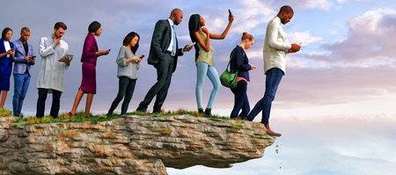
UKUCABANGA KOMUNTU
“Kukhona indlela eqondile phambi komuntu, kepha ukuphela kwayo kuyizindlela zokufa” (Izaga 16:25)
Uma kunguNkulunkulu owaphefumulela iBhayibheli, ngubani ongalichasisa (2 Pet. 1:20; Johane 14:26)?
“Umuntu wemvelo kakwamukeli okukaMoya kaNkulunkulu, ngokuba ngubuwula kuye; angekuqonde, ngokuba kubonisiswa ngokomoya” (1Co. 2:14).
Isibonelo sokucabanga komuntu yi [higher criticism] okwathi, kusukela ngomnyaka wekhulu le 18th, yahlongoza indlela “yezemfundo” yokuchasisa iBhayibheli.
Indela yalo esemqoka iwukuphika izimangaliso kanye nokuthi akunakwenzeka ukuba kuprofethwe ngekusasa. Kuleyo ndlela, yiyiphi inzuzo esingayithola ezwini likaNkulunkulu uma siphika amandla alo noma ikhono lalo lokwazi ikusasa elisilindile na?
Ngokungangabazi, isitha senza izindlela ezibukeka zilungile, kepha ukuphela kwazo kungukufa (Izaga 16:25).

Slide 10
EGW (Selected Messages, volume 1, page 17)
“Ubumnyama bukamoya bamboze umhlaba nobumnyama obunzulu abantu. Kunokungabaza emabandleni amaningi kanye nokungathembeki ekuchasiseni imiBhalo. Abaningi, abaningi kakhulu, bangabaza ubunjalo kanye neqiniso lemiBhalo. Ukucabanga komuntu kanye nokuzindla kwenhliziyo yomuntu kubukela phansi ukuphefumulelwa kwezwi likaNkulunkulu […]
Lena ncwadi engcwele yamelana nezishayo zikaSathane, owayehlangene nabantu ababi ukuba bafihle konke okukaNkulunkulu efwini lobumnyama. Kodwa uNkulunkulu uligcinile izwi lakhe ngamandla akhe amangalisayo ngesimo elikuso namhlanje—liyisithombe noma incwadi esiholayo singumndeni wabantu ukusibonisa indlela eya ezulwini.

Slide 11
UKULWELA INGQONDO

Slide 12
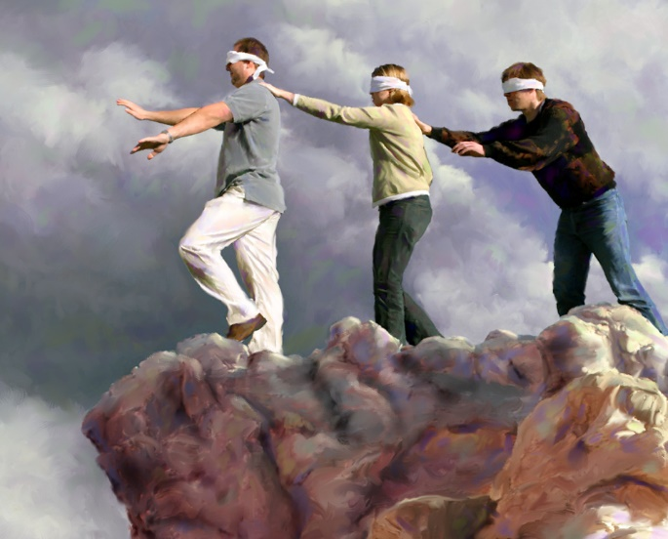
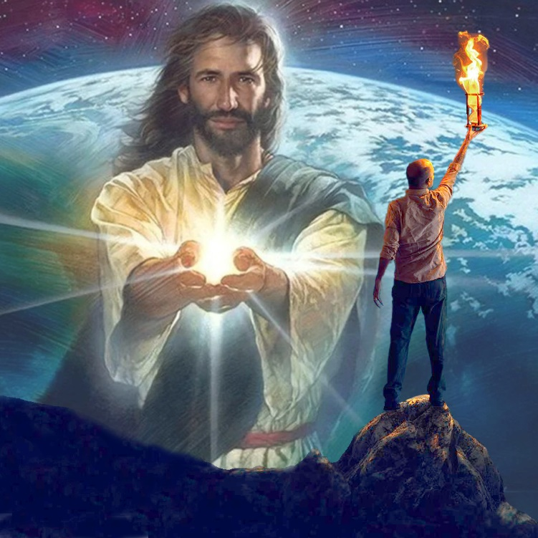
“UNkulunkulu walelizwe uphuphuthekisile ingqondo yabo, ukuze kungasi kubo ukukhanya kwevangeli lenkazimulo kaKristu ongumfanekiso kaNkulunkulu” (2 Korinte 4:4 )
Isisho sesiSpanish sithi: “Ayikho impumputhe endlula umuntu, ongafuni ukubona.” Okungukuthi, akusizi ukubonisa umuntu ukuba abone lokho angafuni ukukubona. Kunjalo nakulabo “unkulunkulu walomhlaba” abaphumputhekisile (2Co. 4:4).
Ukweswela ulwazi kwalabo abalahlekile akuyi ngokuthi abanalo ikhono lokwazi. Kepha kungenxa yokuthi abafuni ukwazi. USathane uthumbe izingqondo zabo ngezinto eziningi ezibavimba ukuba bangacabangi ngalokho okubaluleke ngempela: usindiso lwabo.
Kodwa akakho okufanele ahlale anjalo. Uma ingqondo isebumnyameni ngokomoya, kunokukhanya okungakwazi futhi okuyokhanya kuyo: “Ukukhanya [uJesu] kukhanya ebumnyameni, kepha ubumnyama abukwamukelanga” (Johane 1:5).
Labo bethu abamukela lokhu kukhanya bangawuguqula umsebenzi wesitha, benze ukukhanya kukaJesu kukhanye ebumnyameni.

Slide 13
“UNkulunkulu walelizwe uphuphuthekisile ingqondo yabo, ukuze kungasi kubo ukukhanya kwevangeli lenkazimulo kaKristu ongumfanekiso kaNkulunkulu” (2 Korinte 4:4)
Isisho sesiSpanish sithi: “Ayikho impumputhe endlula umuntu, ongafuni ukubona.” Okungukuthi, akusizi ukubonisa umuntu ukuba abone lokho angafuni ukukubona. Kunjalo nakulabo “unkulunkulu walomhlaba” abaphumputhekisile (2Co. 4:4).
EGW (Our High Calling, January 10)

