Slide 1
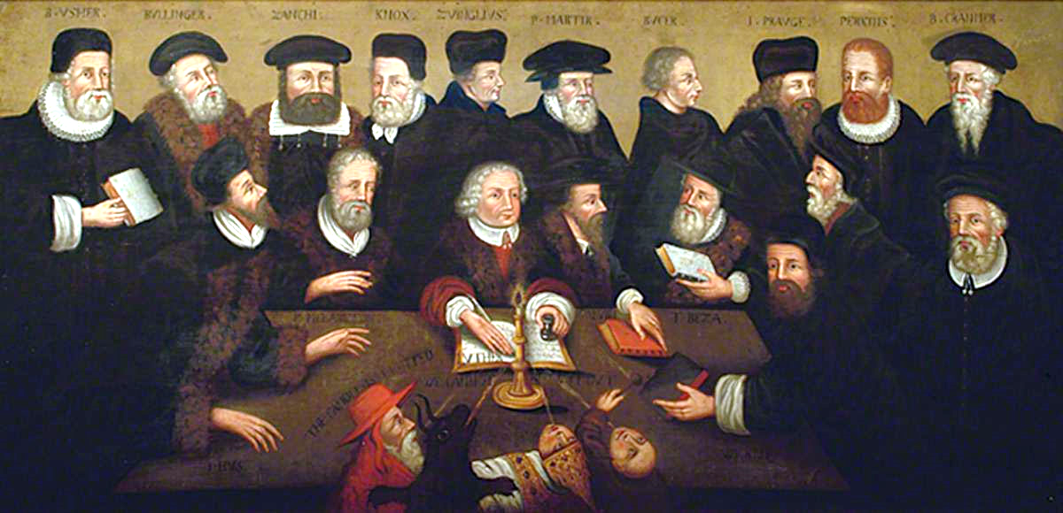
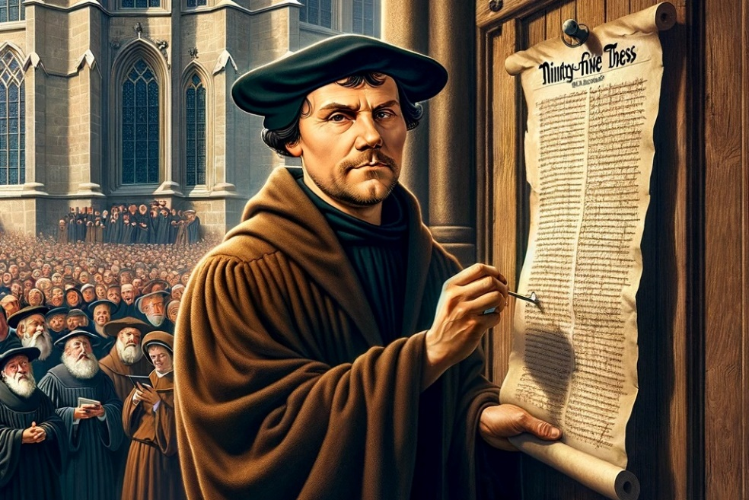
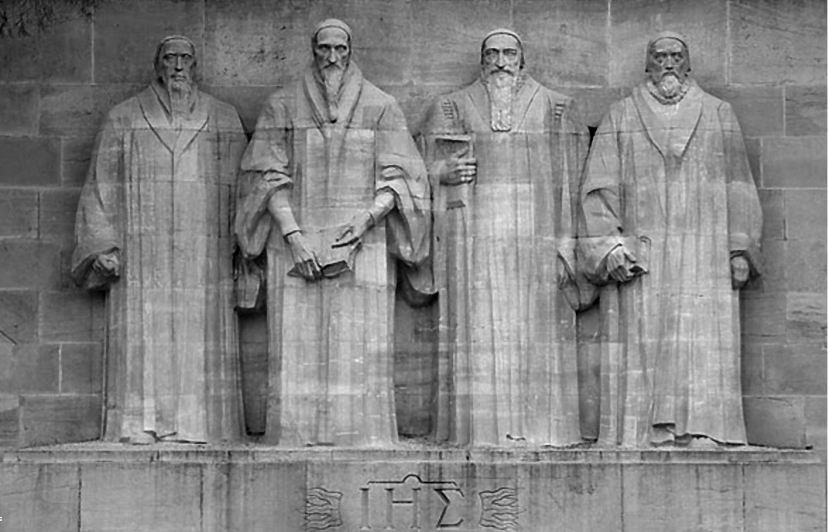
FAITH AGAINST ALL ODDS
Lesson 5 for May 4, 2024

Slide 2


“Your word I have hidden in my heart, that I might not sin against You”
(Psalm 119:11, NKJV)

Slide 3

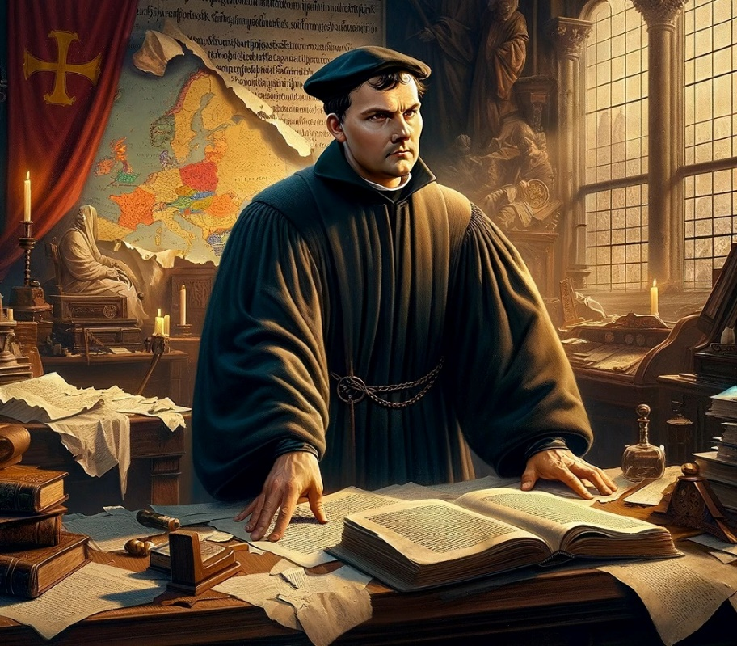
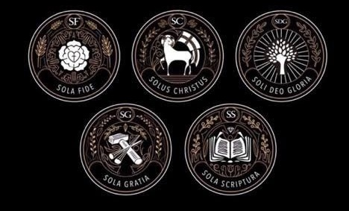







In the 16th century, the work begun 200 years earlier by Wycliffe, “the star of the Reformation,” began to shine brightly. The splendor of the reform had arrived.
This reform was based on five fundamental points:
Sola Scriptura (Scripture alone)
Sola gratia (only grace)
Sola fide (faith alone)
Solus Christus (Christ alone)
Soli Deo gloria (to God alone the glory)
The foundation of faith:
  Sola Scriptura / soli Deo gloria.
  The Bible available to everyone.
  The Bible Interpreter.
The foundation of salvation:
  Sola gratia / sola fide / solus Christus.
  Grow in grace.

Slide 4

THE FOUNDATION OF FAITH

Slide 5


SOLA SCRIPTURA / SOLI DEO GLORIA
“When your words came, I ate them; they were my joy and my heart’s delight, for I bear your name, Lord God Almighty” (Jeremiah 15:16)
The reformers of the 16th century literally changed the world. But they made it clear that there was nothing special about them. They were people transformed by God. For this reason, they declared: “To God alone the glory”.
How was this transformation carried out in them? It was the reading of the Word of God that performed the miracle.
What did the Bible do for them, and what can it do for us?
It is the foundation of faith
By believing in his promises we renew our faith and courage
Its leaves are like the fruit of the tree of life
Radiate joy, hope and light
It gives us direction, certainty, strength and wisdom
Livens our being physically, mentally, emotionally and spiritually
In those dark times, the Bible saturated their lives to the point of giving their lives to remain faithful to its teachings. And today, does it also saturate your life?

Slide 6

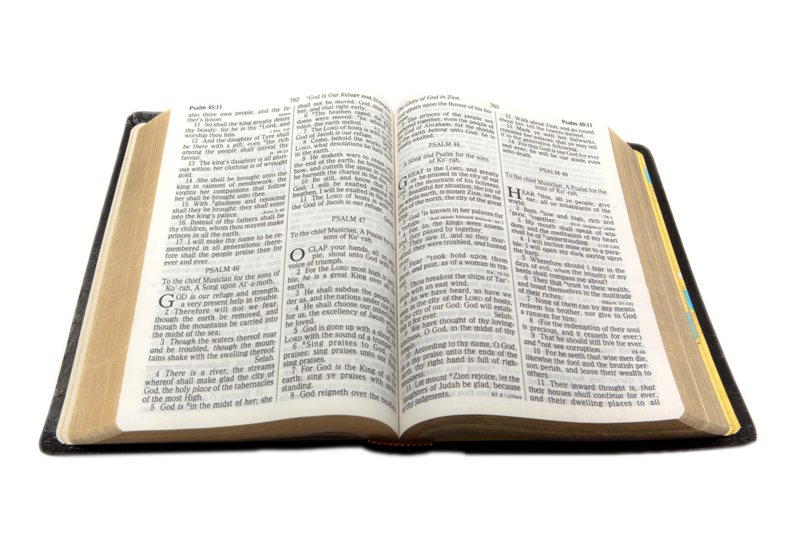
THE BIBLE AVAILABLE TO EVERYONE
“But the word of God continued to spread and flourish” (Acts 12:24 NIV)
Tyndale (1494-1536) set out to correct the errors of Wycleffe's Bible (translated from Latin), making a direct translation from the original languages. He published the New Testament translated from Greek.
Miles Coverdale continued and complemented Tyndale's work with the translation of the Old Testament from the Hebrew originals. Thus, in 1535, the first printed Bible in English was published.
This version served as the basis for the most widely used Bible translation among English speakers: the King James Version, published in 1611. The work of Tyndale, Coverdale, and the scholars who prepared the KJV has impacted millions of people, bringing them to the knowledge of God.
Curiously, a man who never openly embraced the Reformation was an indispensable help in these translations: Erasmus of Rotterdam, who published at that time the New Testament in Greek (which served as the basis for all the translations of the Reformers).

Slide 7
THE BIBLE AVAILABLE TO EVERYONE
While the English versions of the Bible were being prepared and published, other reformers also translated the Bible into their native language. In this way, the Bible could be read directly by the inhabitants of Europe, and the newly discovered “New World”.
Martín Luther
Pierre Robert Olivétan
French (1535)
Kralice Bible
Czech (1579)
Jonas Bretkunas
Lithuanian (1579)
Jurij Dalmatin
Slovenian (1584)
Italian (1607)
Giovanni Diodati
João Ferreira de Almeida
Portuguese (1691)
Spanish (1569)
Brest Bible
Polish (1563)
Casiodoro de Reina
German (1534)

Slide 8

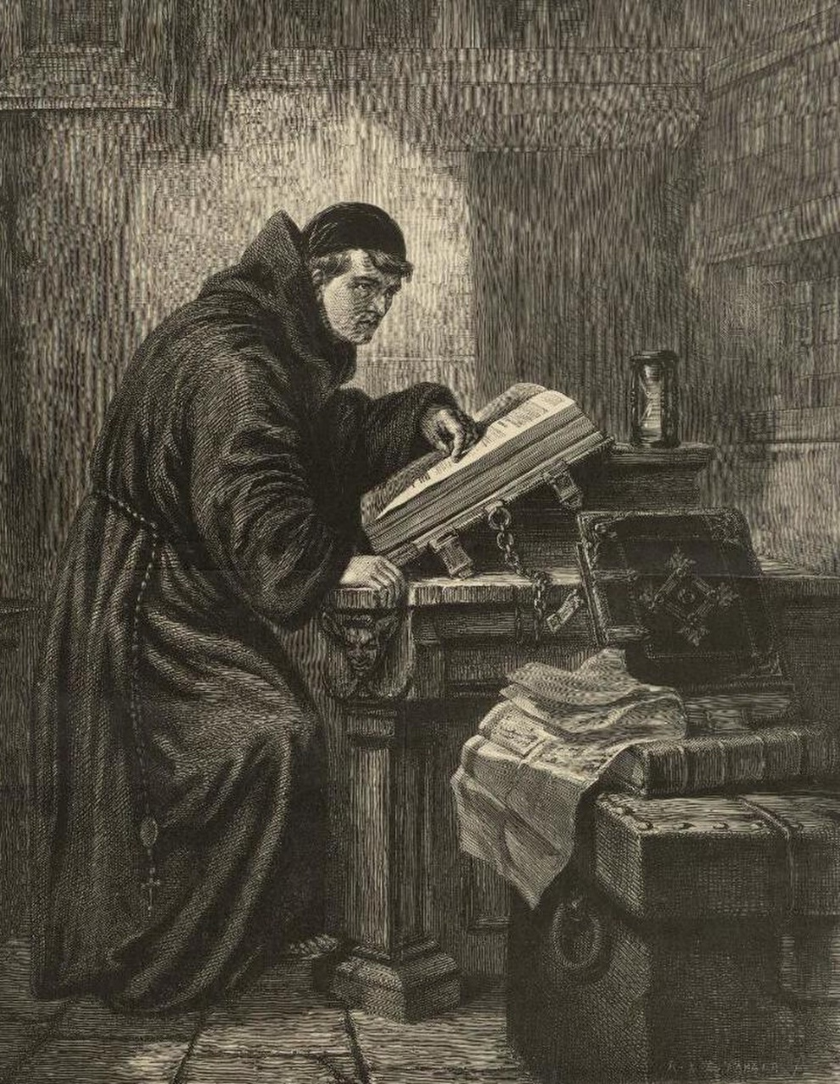

THE INTERPRETER OF THE BIBLE
“Above all, you must understand that no prophecy of Scripture came about by the prophet’s own interpretation of things” (2 Peter 1:20 NIV)
When Martin Luther first read the Bible in Latin, his life was transformed.
As he flipped through its pages, he was aware that a higher power was illuminating his mind. The Gospel became alive and effective. The dark traditions faded away, and the grace of Christ arose. What power illuminated his mind?
The Holy Spirit, the only authorized interpreter of the Bible, was the one who revealed the truths contained in it. And the same Holy Spirit is given to us so that we can understand it too!
(John 14:26; 16:13).
From that moment it was evident that there could be no harmony between the traditions taught by the official church and the truths contained in the Bible. The only rule of faith and conduct is contained in the Bible, and is revealed to us by the Holy Spirit.

Slide 9

“The preaching of the word will be of no avail without the continual presence and aid of the Holy Spirit. This is the only effectual teacher of divine truth. Only when the truth is accompanied to the heart by the Spirit will it quicken the conscience or transform the life. One might be able to present the letter of the word of God, he might be familiar with all its commands and promises; but unless the Holy Spirit sets home the truth, no souls will fall on the Rock and be broken”
EGW (The Desire of Ages, pg. 671)

Slide 10

THE FOUNDATION OF SALVATION

Slide 11

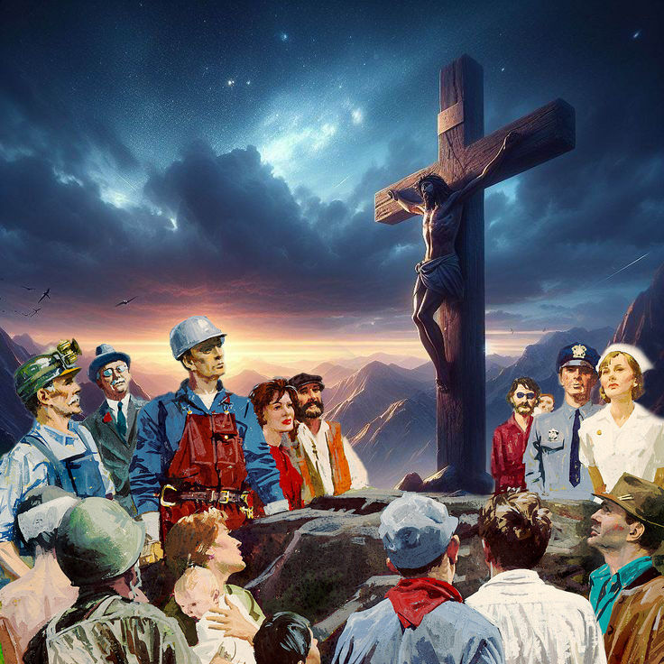
SOLA GRATIA / SOLA FIDE / SOLUS CHRISTUS
“For it is by grace you have been saved, through faith—and this is not from yourselves, it is the gift of God—” (Ephesians 2:8)
Three fundamental truths emerge from Ephesians 2:8.
We are saved by grace alone
The means to achieve grace is by faith alone
This is the gift of God, the gift of his Son: Christ alone
Because of our sin, we are condemned to eternal death (Rom. 6:23a). However, God has provided a way to pay our debt and give us eternal life (Rom. 6:23b).
And why do we need God to pay our debt? Because we cannot pay it in any way (Ps. 49:8; Eph. 2:9).
When Martin Luther discovered that Christ was his only source of salvation, he began to preach that truth. Thousands, who had been chained by the deceptions of the enemy, were freed and transformed.
Although salvation is free, its cost was infinite, and sufficient for all (John 3:16; Rom. 8:32).

Slide 12


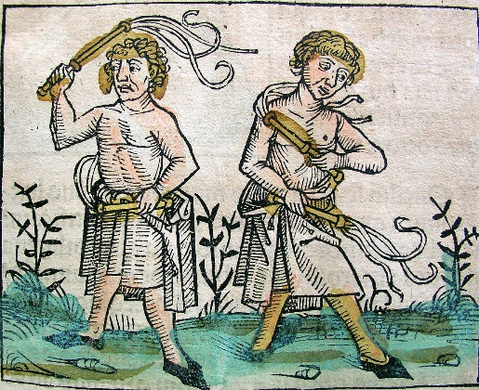
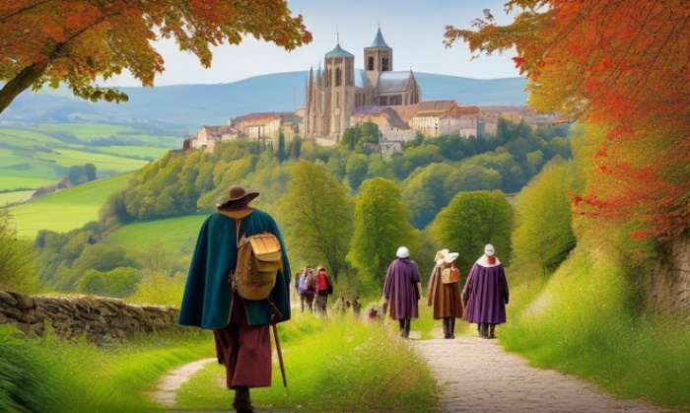
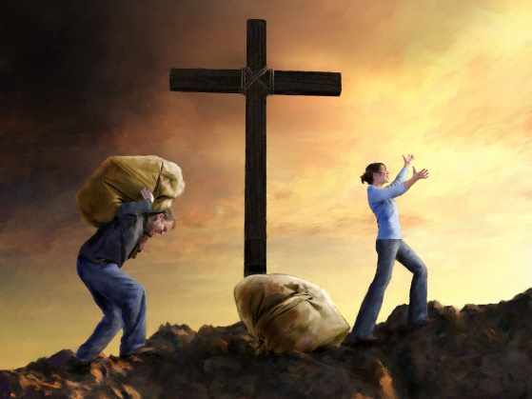
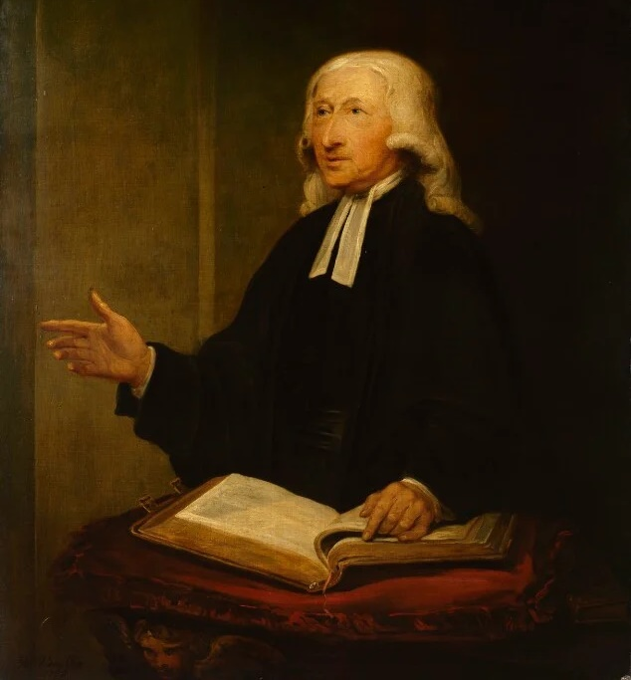
GROW IN GRACE
“But grow in the grace and knowledge of our Lord and Savior Jesus Christ. To him be glory both now and forever! Amen” (2 Peter 3:18)
During the Middle Ages, people thought about earning their salvation (and that of their ancestors) through masses, bulls, lacerations, pilgrimages…
All of this was distressing. It was never enough. Until they discovered the grace of Christ. From that moment on they felt truly free.
Did that freedom lead them to despise the Law, or to obey it?
John Wesley (1703-1791), one of the founders of the Methodist movement, was moved by reading Luther's introduction to Romans. His new faith led him to seek growth in grace.
Knowing himself saved by grace did not lead him to despise the Law, but to study it more carefully, so that his life would be increasingly in harmony with the life that Christ expected of him.

Slide 13

“The grand principle maintained by these Reformers—the same that had been held by the Waldenses, by Wycliffe, by John Huss, by Luther, Zwingli, and those who united with them—was the infallible authority of the Holy Scriptures as a rule of faith and practice. They denied the right of popes, councils, Fathers, and kings, to control the conscience in matters of religion. The Bible was their authority, and by its teaching they tested all doctrines and all claims. Faith in God and His word sustained these holy men as they yielded up their lives at the stake. “Be of good comfort,” exclaimed Latimer to his fellow martyr as the flames were about to silence their voices, “we shall this day light such a candle, by God's grace, in England, as I trust shall never be put out.”—Works of Hugh Latimer 1:8”
EGW (The Great Controversy, pg. 249)

