Slide 1
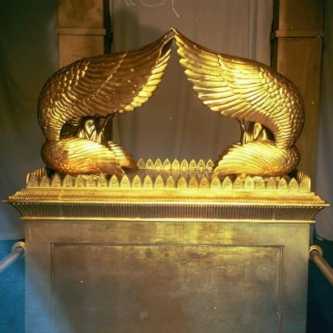
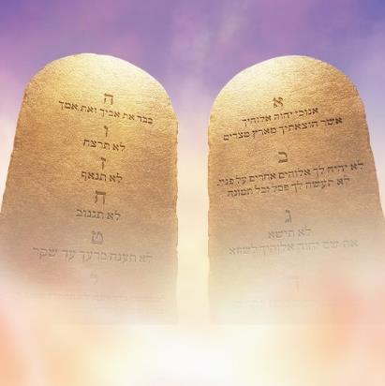
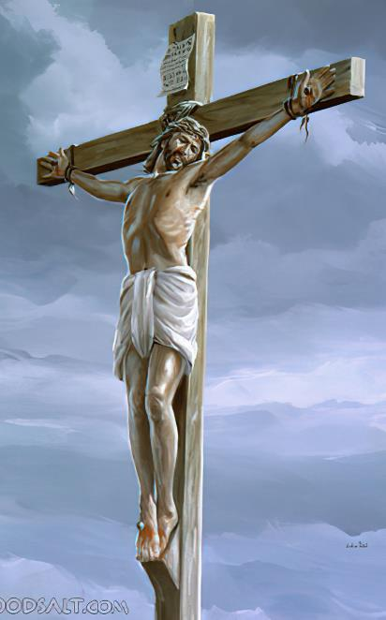
THE FOUNDATION OF GOD’S GOVERNMENT
Lesson 9 for June 1, 2024

Slide 2
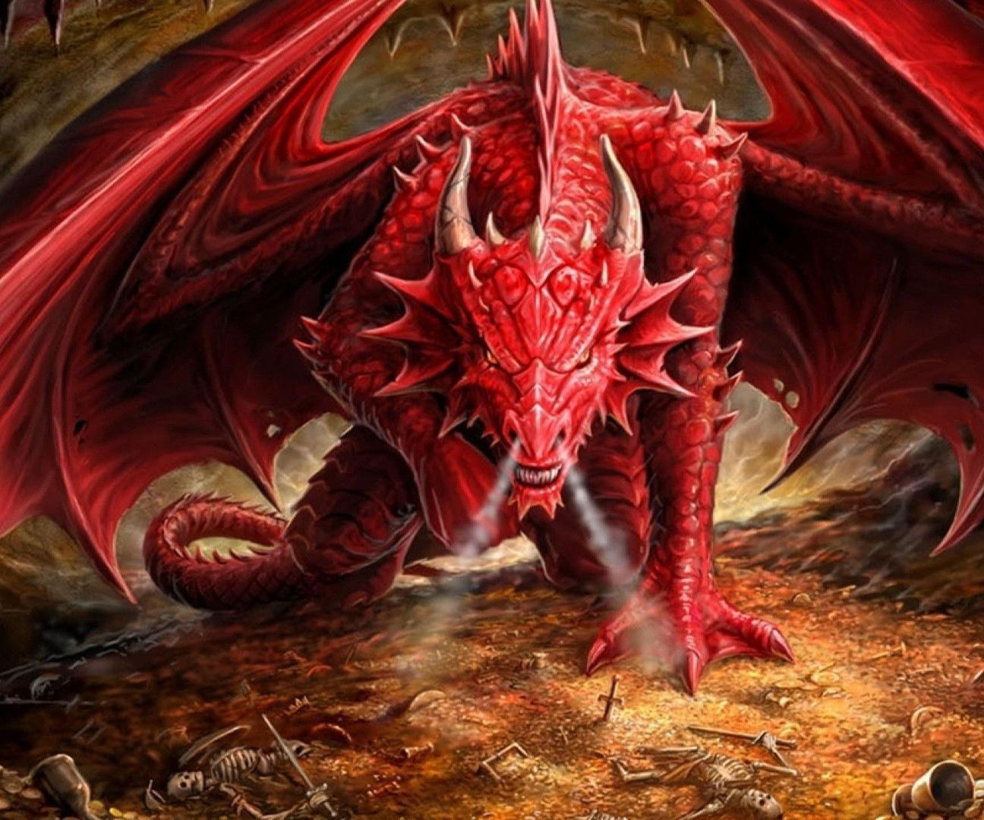
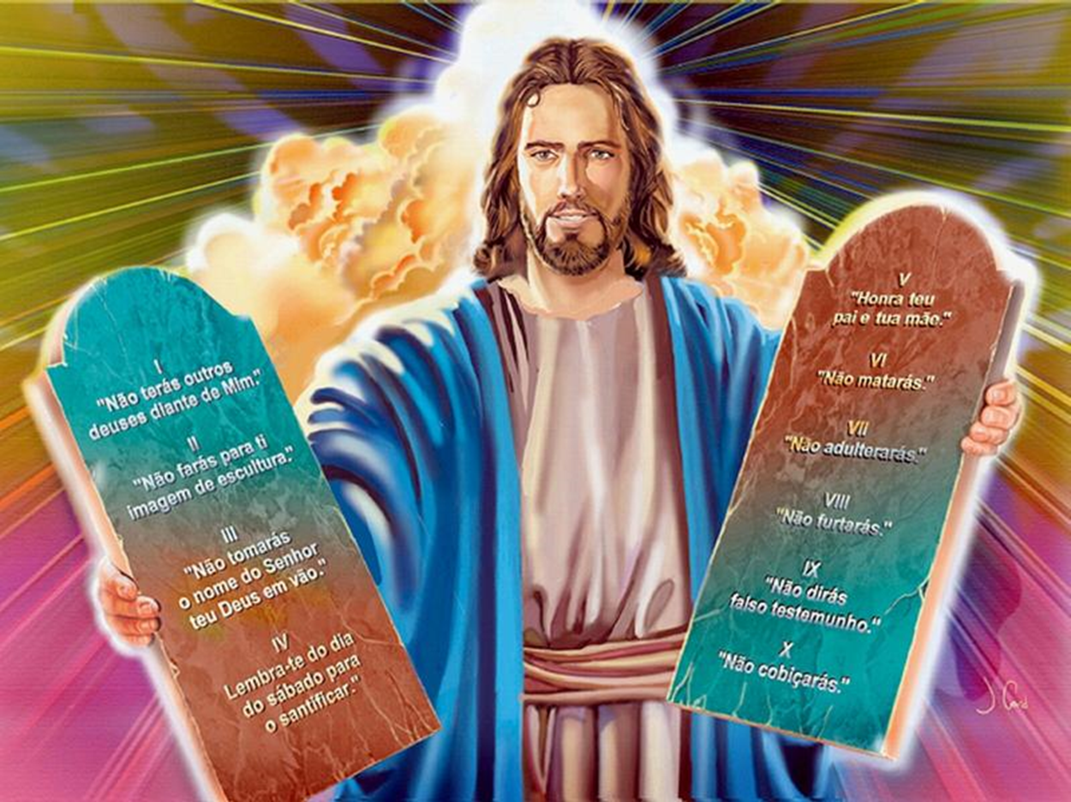
“And the dragon was enraged with the woman, and he went to make war with the rest of her offspring, who keep the commandments of God and have the testimony of Jesus Christ”
(Revelation 12:17, NKJV)

Slide 3
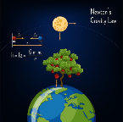
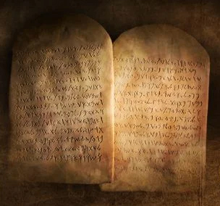
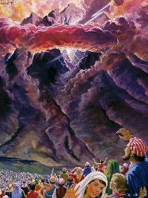
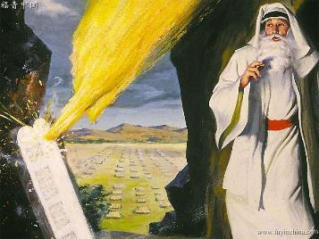
By observing the world around us we can see that God created laws that govern it. Laws that determine, for example, the way in which a living being grows and develops. There is a law that prevents us from being thrown off while the Earth rotates at high speed on its fixed path around the sun.
God also created a Law that indicates how we should act, and by which both the inhabitants of this world and the inhabitants of other worlds, including angels, are governed.
God implants this Law in every intelligent being in the universe (Rom. 2:15). However, sin has distorted the Law in us. Therefore, God himself had to transmit it to us by voice and in writing (Deut. 4:13).
The Law:
The Law in the Celestial Sanctuary.
The Eternal Law.
The Sabbath:
The meaning of Sabbath.
The Sabbath and the time of the end.
The Law, the Sabbath and worship.

Slide 4
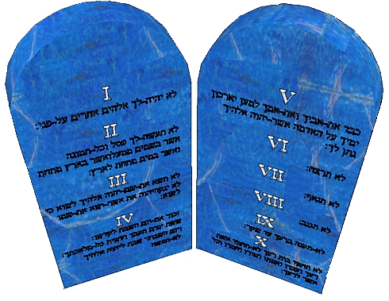
THE LAW

Slide 5
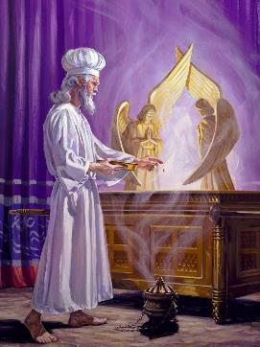
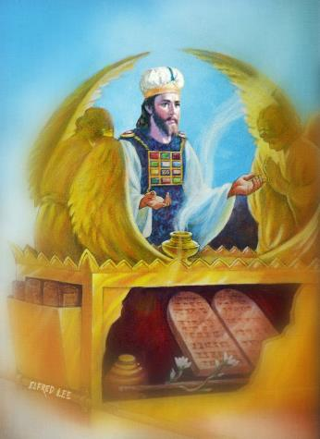
THE LAW IN THE CELESTIAL SANCTUARY
“Then God’s temple in heaven was opened, and within his temple was seen the ark of his covenant” (Revelation 11:19a)
John saw the heavenly sanctuary open and, in it, the ark of the covenant “was seen” (Rev. 11:19). Had the ark of the heavenly sanctuary been hidden until then? What did this vision represent?
In order to understand this vision, we must look at the earthly sanctuary, and the rites that were celebrated there.
The ark remained “hidden” throughout the year, and could only be “seen” on the Day of Atonement (Lev. 16:2, 12-13). That day the judgment was held, and sins were definitively eliminated (Lev. 16:30).
The vision given to John indicates that, shortly after the visions of chapter 11 (i.e., when the Bible spread massively in the early 19th century), the Judgment in Heaven began.
Like its earthly copy, the ark contains the 10 commandments, by which we will be judged. It also contains the mercy seat, a symbol of divine mercy, where the blood of Jesus covers our sins (1Pt. 1:18-19; 1Jn. 2:2; Ps. 85:10).

Slide 6
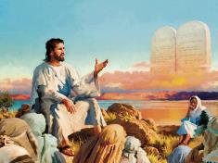
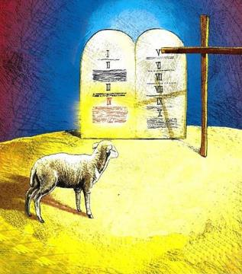
THE ETERNAL LAW
“Do not think that I have come to abolish the Law or the Prophets; I have not come to abolish them but to fulfill them” (Matthew 5:17 NIV)
Although it is now very common to hear that Jesus abolished the 10 commandments on the cross, that was not the teaching of the reformers, nor is it what the Bible teaches.
The character of God
“Righteousness and justice are the foundation of your throne” (Ps. 89:14a)
“Mercy and truth go before your face” (Ps. 89:14b)
The law
“For all your commandments are righteousness” (Ps. 119:172b)
“thy law is truth” (Ps. 119:142b)
While it is true that, on the cross, the laws and ceremonies related to the earthly sanctuary ceased to be valid, this was not the case with the moral Law (Eph. 2:15).
The Law of God is eternal, timeless, perfect, and governs the behavior of every intelligent being created by God (Ps. 19:7; 119:142; Rom. 7:7, 12, 16, 22, 25; 1Jn. 3 :4).
In reality, the Law is eternal because it is a reflection of the very character of God.

Slide 7
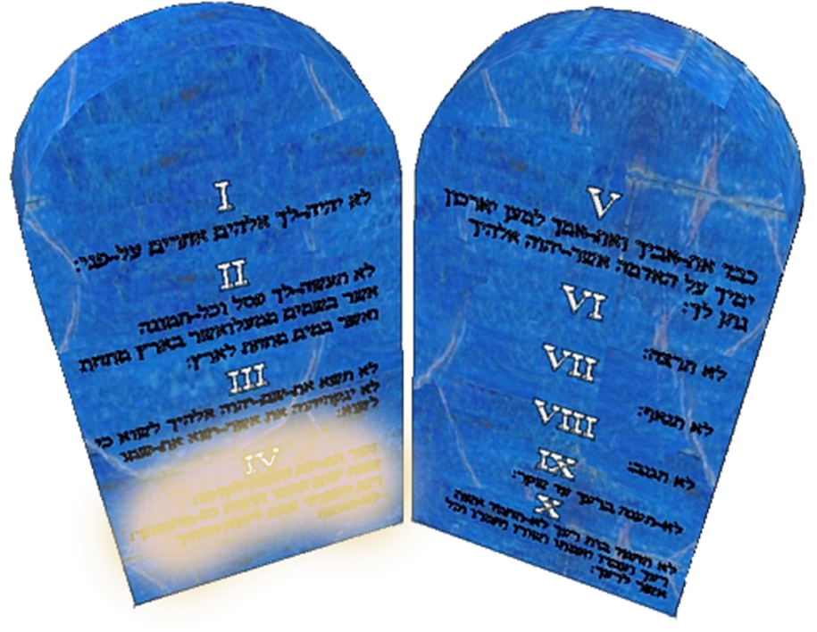
THE SABBATH

Slide 8
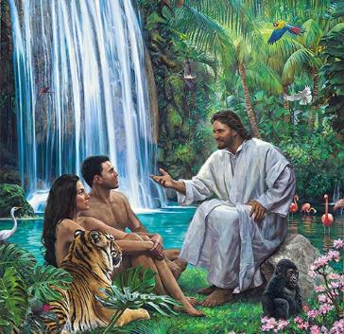
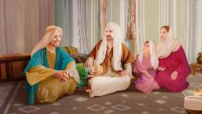
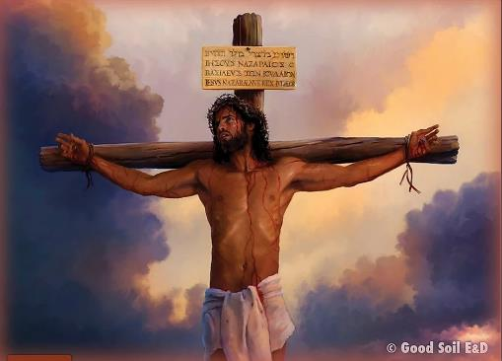
THE MEANING OF SABBATH
“Remember the Sabbath day by keeping it holy” (Exodus 20:8)
The fourth commandment requires observance of the Sabbath for two reasons: because God created us (Ex. 20:8-11); and because he redeemed us (Deut. 5:12-15).
For us, Sabbath constitutes a pause in the week to praise our Creator; meditate on his redeeming love; and remember his promise to live with Him in the New Creation. Understood this way, the Sabbath is for us a special blessing from our God.
On the other hand, it reminds us that God loved us too much to abandon us when we separated from Him. It is a symbol of rest, not works; of grace, not legalism; of security, not of condemnation; of dependence on God to save us, not on our own efforts to do so.
By keeping the Sabbath, we manifest our loyalty to God, and our desire to worship Him alone.

Slide 9
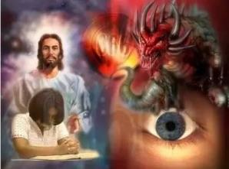
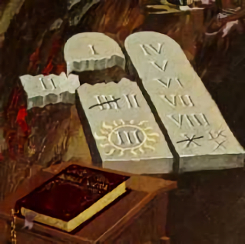
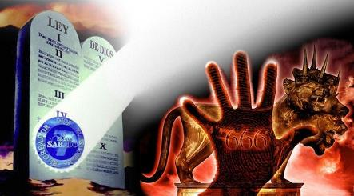
THE SABBATH AND THE TIME OF THE END
“The second beast was given power to give breath to the image of the first beast, so that the image could speak and cause all who refused to worship the image to be killed” (Revelation 13:15)
Revelation 13 describes different powers used by Satan to deceive the world away from God. Everything in this chapter relates to worship (Rev. 13:4, 8, 12, 15).
One of the powers mentioned relates directly to the little horn of Daniel 7, which seeks to change the times and the law (Rev. 13:5; Dan. 7:25 – the period of 42 months is the same as time, times and halftime).
This power annulled the second commandment (worshiping images), and transformed the fourth (the time of worship), transferring the sanctity of Saturday to Sunday.
In the final moments, he will be force to worship an “image” by prohibiting buying and selling [activities prohibited on the Sabbath] (Rev. 13:14-17). This “mark of the beast” is a symbol that tells us about those who will accept the Sunday instituted by man as a day of worship, instead of the Saturday instituted by God.

Slide 10
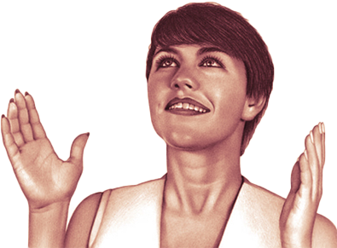
THE LAW, THE SABBATH AND WORSHIP

Slide 11
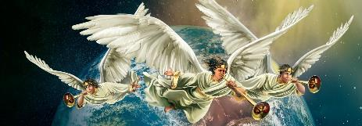
«He said in a loud voice, “Fear God and give him glory, because the hour of his judgment has come. Worship him who made the heavens, the earth, the sea and the springs of water”» (Revelation 14:7)
The threefold message that is proclaimed during the time of the end is linked to worship and, therefore, to the Sabbath and the Law of God.
First message
Revelation 14:6-7
Prepare for judgment (whose standard is the Law), and worship the Creator (as the Sabbath reminds us)
Second message
Revelation 14:8
Turn away from religious systems that give false worship to God
Third message
Revelation 14:9-11
Decide who and how to worship: God, observing the Sabbath; or the enemy, accepting his mark
Two characteristics are given of those who stand firm in the time of the end: “they keep the commandments of God and the faith of Jesus” (Rev. 14:12).
In order to keep the commandments in those critical moments, they need to receive the faith of Jesus: unshakable; deep; engaged; invincible.

Slide 12
“Had the Sabbath been universally kept, man's thoughts and affections would have been led to the Creator as the object of reverence and worship, and there would never have been an idolater, an atheist, or an infidel. The keeping of the Sabbath is a sign of loyalty to the true God, “Him that made heaven, and earth, and the sea, and the fountains of waters.” It follows that the message which commands men to worship God and keep His commandments will especially call upon them to keep the fourth commandment”
EGW (The Great Controversy, pg. 437)

