Slide 1
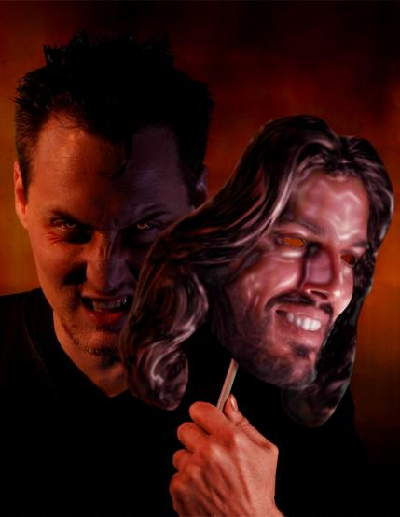
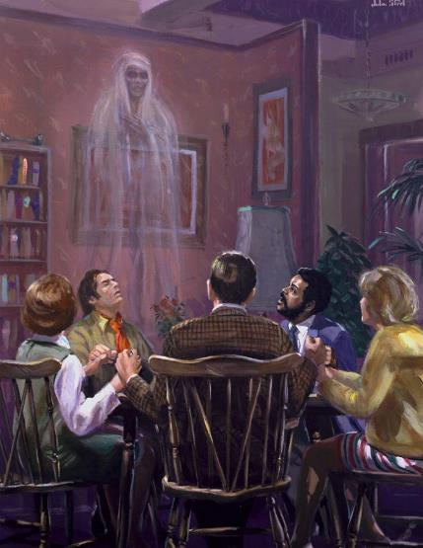
SPIRITUALISM EXPOSED
Lesson 10 for June 8, 2024

Slide 2
“For the Lord himself will come down from heaven, with a loud command, with the voice of the archangel and with the trumpet call of God, and the dead in Christ will rise first. After that, we who are still alive and are left will be caught up together with them in the clouds to meet the Lord in the air. And so we will be with the Lord forever."
(1 Thessalonians 4:16, 17)

Slide 3
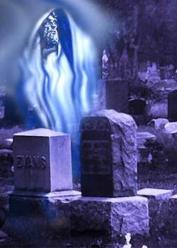
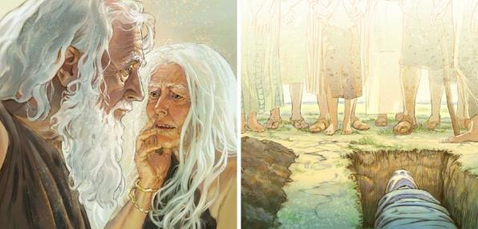
The first lie the devil told us was: “You will not die” (Gen. 3:4). And we believed it!
Almost all of humanity has believed – and continues to believe – that we have an immortal soul or, in some way, some conscious part of our being survives death.
The Bible, on the contrary, is clear and emphatic: “The soul that sins will die” (Ez. 18:20). The cosmic conflict revolves around a key question: Who are you going to believe, the devil or God?
Spiritualism and death:
An immortal soul.
Death in the Old Testament.
Death in the New Testament.
Spiritualism in the last days:
Signs and wonders.
The objective of spiritualism.

Slide 4
SPIRITISM AND THE
DEATH

Slide 5
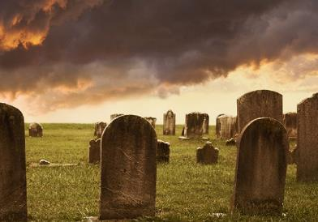
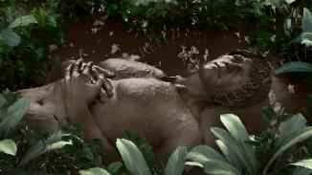
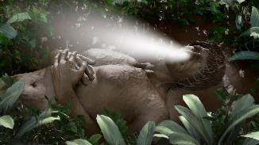
AN IMMORTAL SOUL
“As a cloud vanishes and is gone, so one who goes down to the grave does not return.” (Job 7:9 NIV)
In general, it is believed that the human being has a double nature: body and spirit (or soul). It is believed that these two parts can live independently.
BODY
But the Bible teaches that we are made up of three “parts”: “spirit, soul, and body” (1Thes. 5:23). It also teaches that these parts are interdependent. Genesis 2:7 teaches us that God creates a body, infuses it with life (spirit), and becomes a living being (“being,” in Hebrew, is nefesh = “soul”).
SPIRIT
The soul is, therefore, the union of the body and the spirit. We do not have a soul, we ARE a soul.
SOUL
When the breath of life leaves us, we cease to exist. No part of our being has conscious existence after death. The body dies, the spirit (the life force) returns to its Giver, and the soul, the product of the union of body and spirit, ceases to exist ( Eccl . 12:1-7; Ezek. 18:20; Job 7 :7-9).

Slide 6
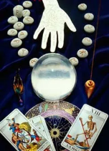
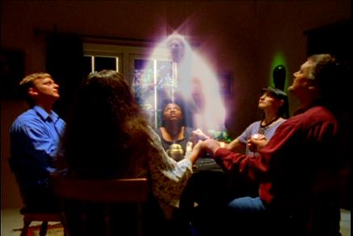
AN IMMORTAL SOUL
“As a cloud vanishes and is gone, so one who goes down to the grave does not return” (Job 7:9 NIV )
Since sin entered our world, Satan has used people who have sought to communicate with the dead and gain from them special knowledge of the present or the future.
These types of people, who also use other means such as incantations, magic or astrology, are currently known as spiritualists.
The Bible teaches that “anyone who practices these customs will become abominable to the LORD” ( Deut. 18:10-12 NIV). The penalty for this crime was death ( Lev. 20:27).
“When someone tells you to consult mediums and spiritists, who whisper and mutter, should not a people inquire of their God? Why consult the dead on behalf of the living? Consult God’s instruction and the testimony of warning. If anyone does not speak according to this word, they have no light of dawn” (Is. 8:19-20 NIV).

Slide 7
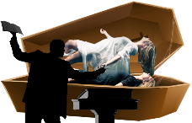
DEATH IN THE OLD TESTAMENT
“It is not the dead who praise the Lord, those who go down to the place of silence” (Psalm 115:17)
Although no one says at a funeral “our relative is traveling directly to hell,” many confessions teach that, upon death, the “good” ascend directly to Heaven to be with Jesus, and the “bad” are punished or simply wander. But what does the Bible teach about this?
Can we praise God after dying?
Psalm 115:17
Do those who die know what happens to their family or friends?
Job 14:21
Can the dead interact with the living?
Ecclesiastes 9:6
Can we continue thinking after dying?
Ecclesiastes 9:5
Will we be able to carry out any type of activity after death?
Ecclesiastes 9:10
The Old Testament teaches that death is a dream. Sleep to wake up only when God calls us back to life (1 Kings 2:10; 14:20; Dan. 12:13).

Slide 8
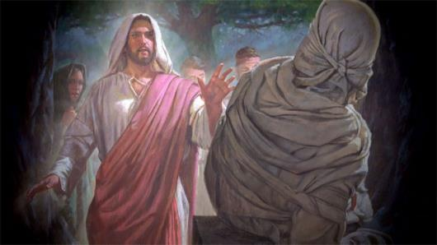
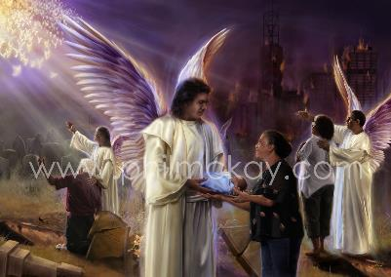
DEATH IN THE NEW TESTAMENT
“Our friend Lazarus has fallen asleep; but I am going there to wake him up” (John 11:11)
The New Testament teaches, like the Old, that death is a sleep from which only Jesus can awaken us (Jn. 11:11-14; Jn. 5:28-29).
When writing to the Thessalonians, Paul spoke to them about “those who sleep,” that is, those who had already died, and told them that they would be resurrected to go with Jesus at his Second Coming (1Thes. 4:13-18). If Paul had believed that believers go directly to Jesus when they die, he would have told them that instead of what he told them.
When speaking of the dead, Paul says that they will be made alive “at his coming,” and not before (1Co. 15:22-24). He also tells us that “not all of us will sleep.” The living will be transformed in a moment, but the dead will rise already transformed (1Co. 15:51-52).
The resurrection is key to being with Jesus. Without resurrection, there is no salvation (1Co. 15:13-18). It will be in the resurrection when we will receive our inheritance, and we must therefore wait for that moment (1P. 1:3-5).

Slide 9
SPIRITISM IN THE LATEST
DAYS

Slide 10
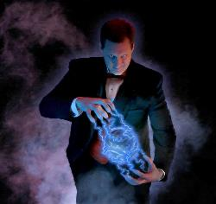
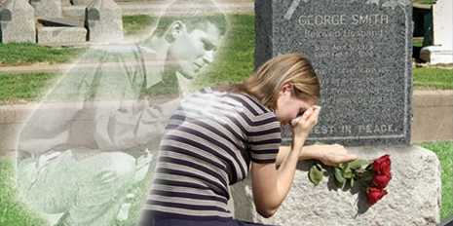
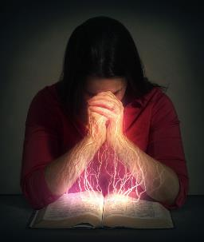
SIGNS AND WONDERS
or false messiahs and false prophets will appear and perform signs and wonders to deceive, if possible, even the elect.” (Mark 13:22)
Spiritualism is a movement led directly by Satan, and its foundation is the immortality of the soul. Its followers believe they can communicate with the dead, and claim to receive supernatural powers from them.
Although they are limited by God now, the time will come when He will allow them to perform irrefutable miracles that will amaze those who behold them (Mk. 13:22; 2Thes. 2:9; Rev. 7:1 ; 13:13-14 ).
After seeing the complete restoration of a terminally ill person; a vehicle stopped dead so as not to run over us; or our dear mother, now deceased, speaking to us tenderly before our very eyes... will we not believe the one who performs such wonders? We will not be able to trust our senses or our feelings.
Only security in what we know of God's Word, and complete trust in Jesus, will allow us to resist the last temptations of the enemy (Is. 8:20; Eph. 6:13).

Slide 11
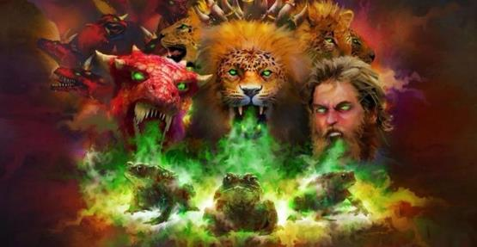
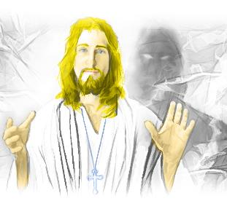
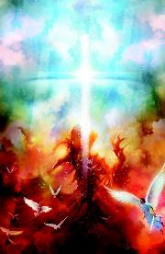
THE OBJECTIVE OF SPIRITISM
“They are demonic spirits that perform signs, and they go out to the kings of the whole world, to gather them for the battle on the great day of God Almighty” (Revelation 16:14)
Satan's intention is to win the war against God, overthrow His government, and occupy His throne (Isa. 14:13-14). To do this, he will use any strategy to win over everyone, starting with the political powers that govern us (Rev. 16:12-14).
“As the crowning act in the great drama of deception, Satan himself will personate Christ” (EGW “The Great Controversy”, Chapter 39 p. 625.)
But it will be at that moment when Jesus will put an end to the story (Rev. 16:15). Satan is a defeated enemy. Defeated by Christ, and defeated by those who cling to His blood (1Jn. 2:14; 4:3-4; Rev. 3:21; 5:5; 12:11).
The distinctive sign of those who confront spiritualist deceptions is: “they obey the commandments of God and remain faithful to Jesus” (Rev. 14:12 NIV).

Slide 12
“I saw that the saints must have a thorough understanding of present truth, which they will be obliged to maintain from the Scriptures. They must understand the state of the dead; for the spirits of devils will yet appear to them, professing to be beloved relatives or friends, who will declare to them unscriptural doctrines. They will do all in their power to excite sympathy and will work miracles before them to confirm what they declare. The people of God must be prepared to withstand these spirits with the Bible truth that the dead know not anything, and that they who thus appear are the spirits of devils."
EGW (Early writings, p. 262)

