Slide 1
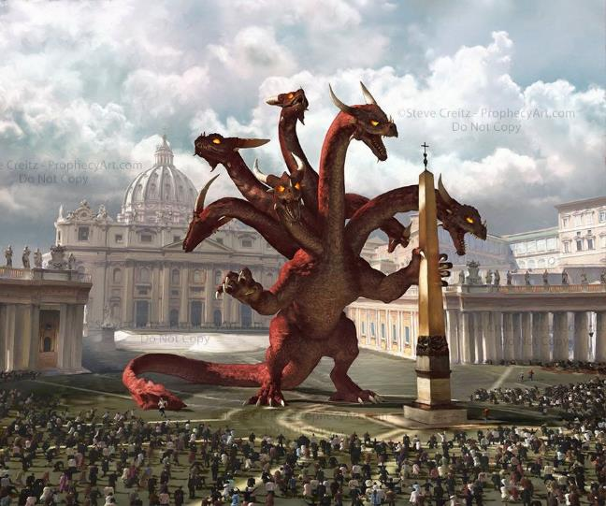
THE IMPENDING CONFLICT
Lesson 11 for June 15, 2024

Slide 2
“Sanctify them by Your truth. Your word is truth”
(John 17:17, NKJV)

Slide 3
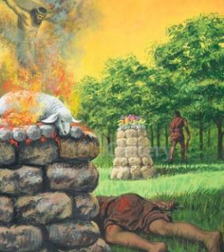
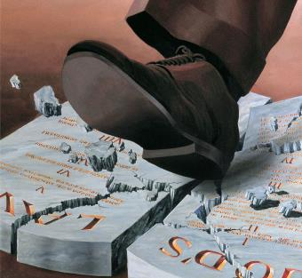
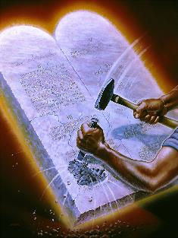
For centuries, the war between Christ and Satan has centered on worship. Worshiping God, or worshiping anything else that disfigures the concept of God's character.
By presenting a false concept of God, Satan has managed to use people, churches and states to destroy anyone who wishes to worship the Creator.
Fundamental truths, such as God's Law, have been distorted or even (in the case of the Sabbath) almost forgotten. The last battle will revolve around true worship on the true day. Let's meet the powers that Satan will use for this last battle.
The conflict:
The worship.
The intolerance.
The enemy:
The dragon throne.
A healed wound.
Lamb and dragon.

Slide 4
THE CONFLICT

Slide 5
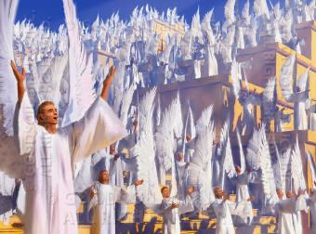
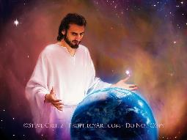
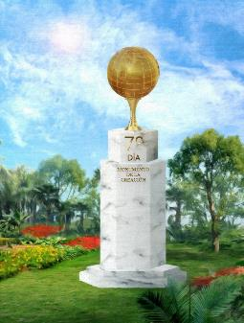
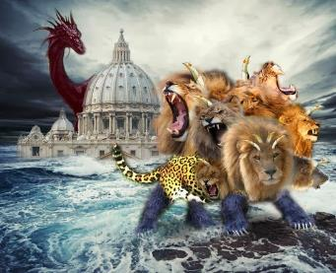
THE WORSHIP
“You are worthy, our Lord and God, to receive glory and honor and power,
for you created all things, and by your will they were created and have their being” (Revelation 4:11)
Heavenly beings worship God for his creative power (Rev. 4:11; Job 38:6-7).
God presents himself as Creator and Redeemer to receive our worship (Is. 45:6-7, 18-20; 65:18).
The message proclaimed to the last generation invites the world to worship God as Creator (Rev. 14:7).
For his part, Satan desires to obtain the worship of the world with “beasts” to which he grants power to “create” an image through which he can receive universal worship (Rev. 13:2, 4, 14-15).
It is not surprising that Sabbath is the point of controversy at such times. Those who “keep the commandments of God and the faith of Jesus” (Rev. 14:12) worship Him on the day that commemorates His Creation.

Slide 6
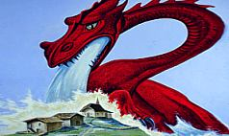
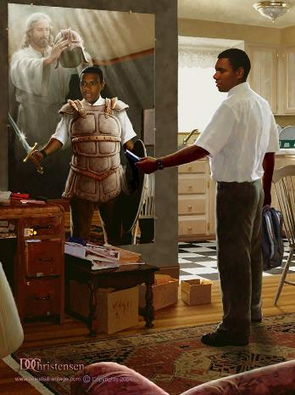
THE INTOLERANCE
“They will put you out of the synagogue; in fact, the time is coming when anyone who kills you will think they are offering a service to God” (John 16:2).
Our struggle is not physical, but spiritual (Eph. 6:12). We do not use physical weapons, but spiritual ones (2Co. 10: 3-5). However, the enemy does not hesitate to use physical weapons against us.
Not in vain is there a “woe” for the faithful, due to Satan's fierce attack against the faithful church (Rev. 12:12). For him, any weapon is valid.
He tempts us through our inclinations (James 1:14)
He convinces us with subtleties (2Co. 4:3-4)
Use close people (Mt. 10:34-36)
He strikes and threatens (Acts 5:40)
Use extreme violence (John 16:2)
This is how he has acted in history, and this is how his last attack will be: deceptions and subtleties (Rev. 13:13-14); imposition of economic sanctions (Rev. 13:16-17 ); decree of death for those who do not worship him (Rev. 13:15).

Slide 7
THE ENEMY

Slide 8
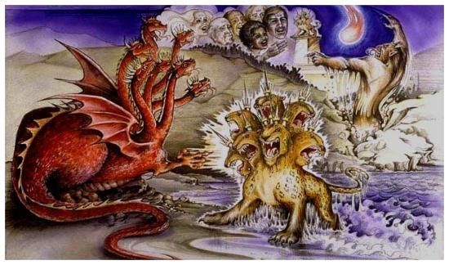
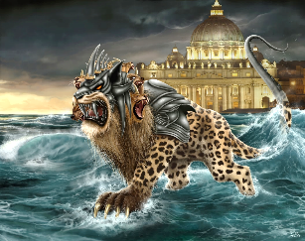
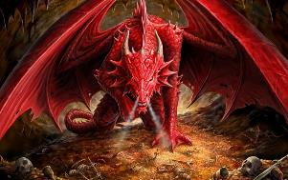
THE DRAGON THRONE
“The dragon gave the beast his power and his throne and great authority” (Revelation 13:2b NIV )
The dragon is identified as Satan (Rev. 12:9), while the beast, through which he exercises his power, is identified with the 4th beast of Daniel 7 (which follows the lion, the bear and the leopard, cf. Rev. 13:2).
Revelation 13 is an expanded explanation of chapter 12. It begins after the attempt to kill Jesus, and his subsequent ascension (Rev. 12:3-5). The first verses expand on the attack on the church over the 1,260 years, while the rest focus on the events that occur when “the dragon was filled with wrath against the woman; and he went to make war against the rest of her descendants” (Rev. 12:17).
After the invasion of the barbarian tribes, the Roman Empire was divided. Little by little, the see of Rome was left in the hands of the church, which thus acquired the political power that allowed it to become the blasphemous power that persecuted the faithful church (Rev. 13:4-8).

Slide 9
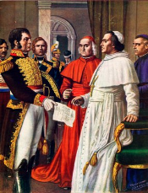
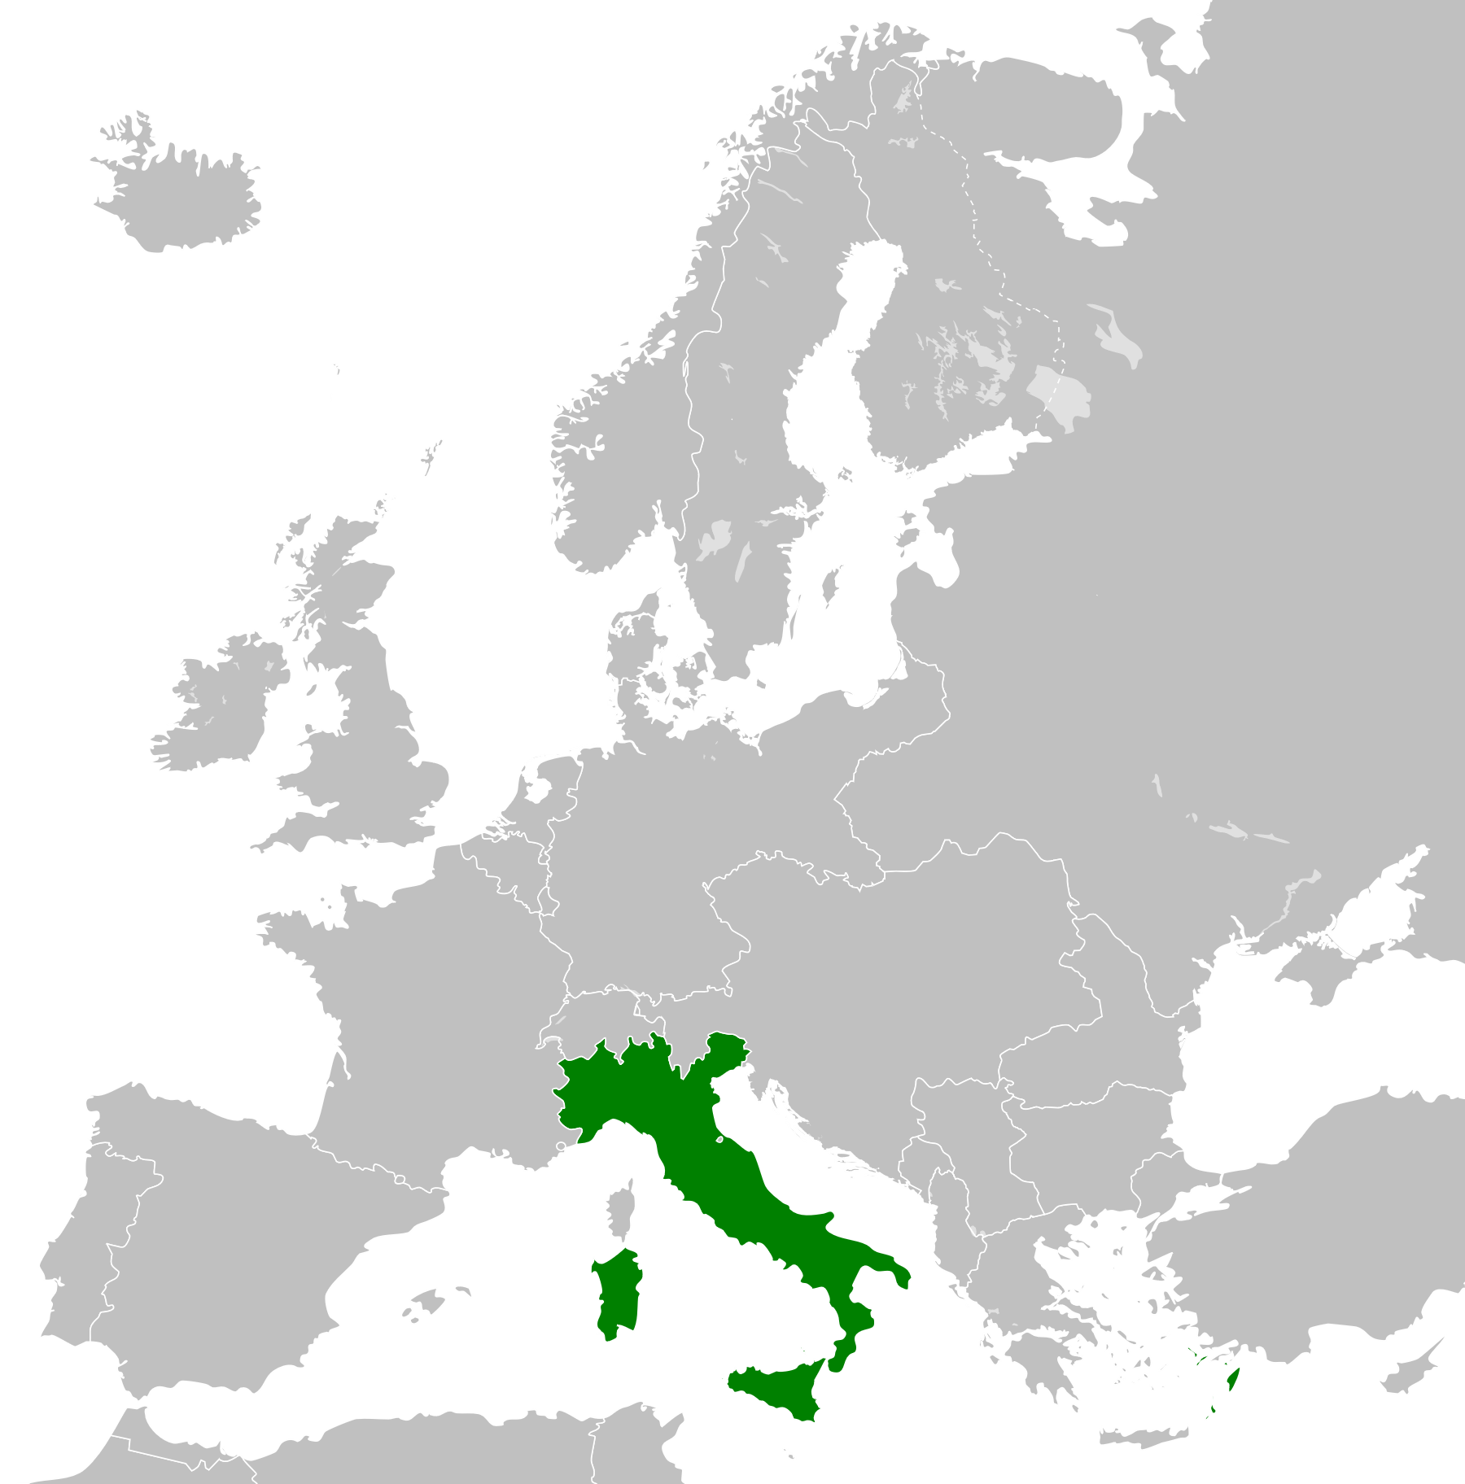
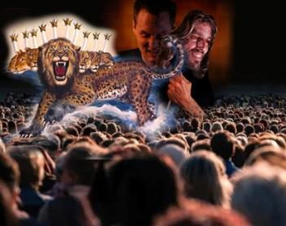
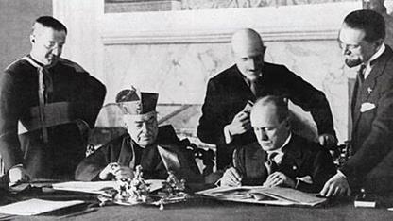
A HEALED WOUND
“He who leads into captivity shall go into captivity; he who kills with the sword must be killed with the sword. Here is the patience and the faith of the saints” (Revelation 13:10)
After centuries of using its power to “lead into captivity” and “kill with the sword” (Rev. 13:10), the Roman Church itself was led into captivity (in the figure of its head, Pius VI) and suffered a “deadly wound” (Rev. 13:3).
Although the Pope maintained ownership of the Papal States until 1870, he finally lost all of his territory when the Kingdom of Italy was created. At that time, it seemed that the Church would never regain its former power.
KINGDOM OF ITALY
1861-1946
In 1929, Vatican City was recognized as an independent state. The wound was beginning to heal. And what is going to happen from now on?
As the final events unfold, a world leader will be sought to propose solutions to the global crisis. Among the package of solutions offered by the Papacy will undoubtedly include Sunday rest as a strong point for the union of families, peoples and nations.
SUNDAY
LATERAN COVENANT

Slide 10
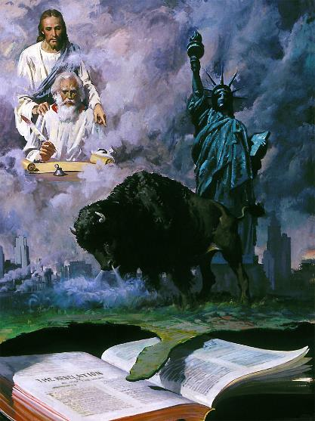
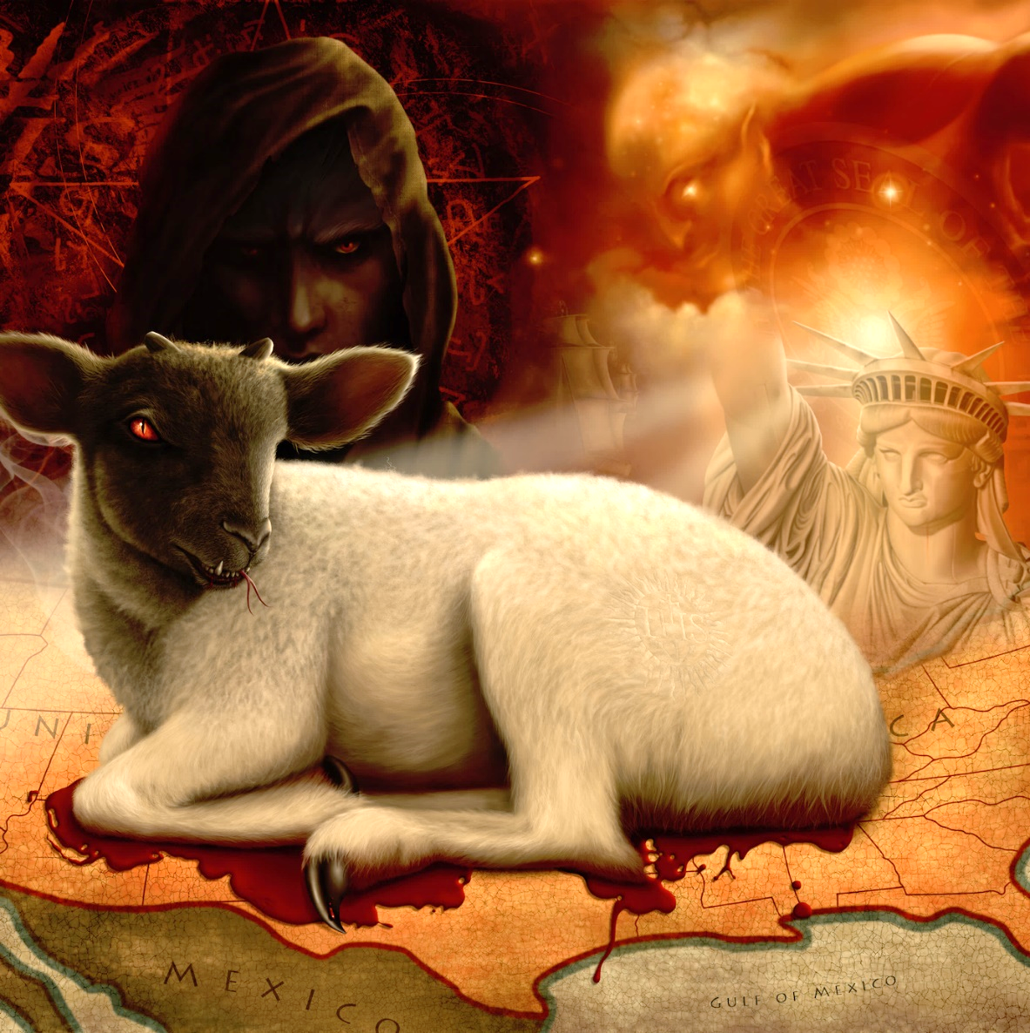
LAMB AND DRAGON
“Then I saw a second beast, coming out of the earth. It had two horns like a lamb, but it spoke like a dragon” (Revelation 13:11)
The first beast arose from the corruption of the Church that Jesus had established. When she received the wound, Satan looked for a “false prophet” to take her place and help her heal (Rev. 13:11; 16:13 ). Again, he found his ally from a nation that had emerged based on the pure principles of Christianity: North America.
He began by imitating Jesus (the Lamb). It is a republican nation (without kings, without crowns), and based on the separation of two powers (horns): the civil and the religious.
As the first world power, it has already begun to speak like a dragon. Soon he will begin to generate laws on religious matters that, supporting the Papacy, will create an “image of the beast” (Rev. 13:12-14).

Slide 11
“The image to this beast represents another religious organization having similar powers. The image is made by a lamblike beast. This lamblike beast is a symbol of the United States, which looks peaceful and gentle. The churches of the United States will unite on common interests of faith. Then these churches that have united will influence the government to enforce religious laws and support church organizations. When this happens, Protestant America will have formed an image of the papacy. Then the true church will be persecuted the same as God's people in the past."
EGW (History of Redemption, p. 381)

