Slide 1
EARTH'S CLOSING EVENTS
Lesson 12 for June 22, 2024

Slide 2
“ Buy the truth, and do not sell it, also wisdom and instruction and understanding ” (Proverbs 23:23)

Slide 3
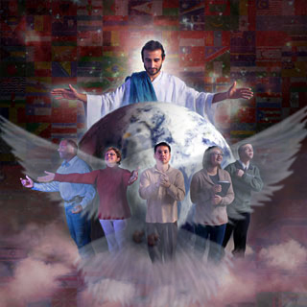
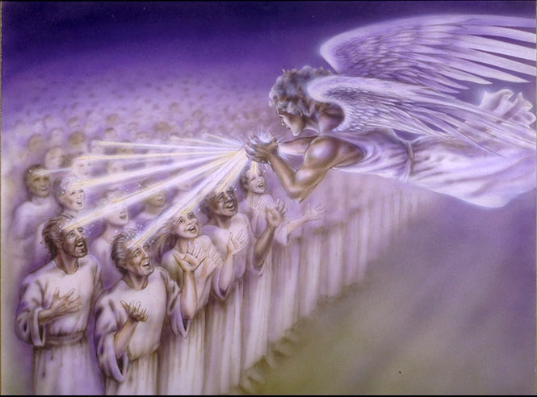
The climax that will mark the end of history is the preaching of the Gospel throughout the world (Matthew 24:14).
This preaching will be preceded by the outpouring of the Holy Spirit, with the same power that descended at Pentecost. This event is known as the “latter rain”.
Who will receive the latter rain? Those who have decided to be faithful to God, obeying His commandments, and praising Him accordingly. These will be marked with the “seal of the living God” (Rev. 7:2).
Preparation for the final crisis:
Directed by the Word.
Sealed on the foreheads.
Loyal in worship.
Power from above:
The latter rain.
The preaching of the Gospel.

Slide 4
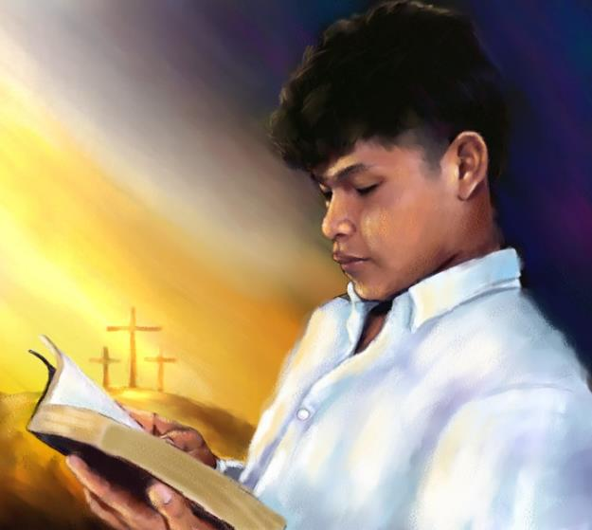
PREPARATION FOR THE FINAL CRISIS

Slide 5
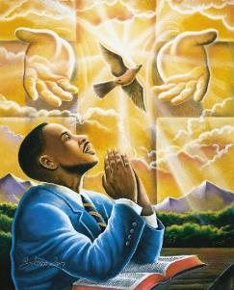
DIRECTED BY THE WORD
“Thy word is a lamp unto my feet, and a light unto my path” (Psalms 119:105)
Do you know where to find the truth about the end of the world? This is the way:
“Buy the truth, and do not sell it” (Prov. 23:23)
“and you will know the truth” (John 8:32)
“Your word is truth” (John 17:17)
“The exposition of your words illuminates; makes the simple understand” (Ps. 119:130)
In the final moments Satan will be allowed to perform real wonders and pose deceptions so subtle that they will be irrefutable (Rev. 13:13-14; Mt. 24:24).
Only a thorough knowledge of the Bible, with the help of the Holy Spirit, will allow us to remain firm in the truth (2 Pet. 1:19-21).

Slide 6
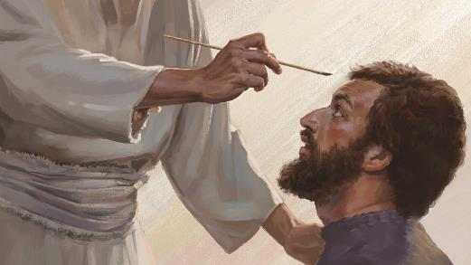
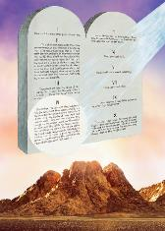
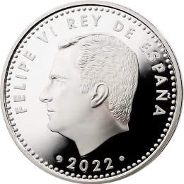
SEALED ON THE FOREHEADS
“And I looked, and, lo, a Lamb stood on the mount Sion, and with him an hundred forty and four thousand, having his Father's name written in their foreheads” (Revelation 14:1)
The seal of God is identified in three different ways:
The Holy Spirit. Believers of all ages are sealed with him (Eph. 4:30).
The name, or character of God. All who achieve victory will possess it (Rev. 14:1; 22:4).
A recognizable sign (Rev. 9:4; Ez. 9:4).
God left his seal on one of the 10 commandments, as a distinctive sign of those who worship him (Ez. 20:20).
Components of a seal | Example: euro coin (Spain) | The Sabbath (Exodus 20:8-11)
Name | Philip VI | Jehovah
Qualification | King | Creator
Territory | Spain | Skies, land and sea

Slide 7
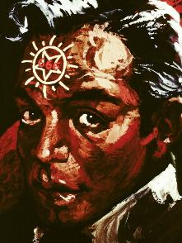
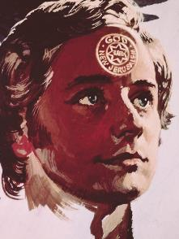
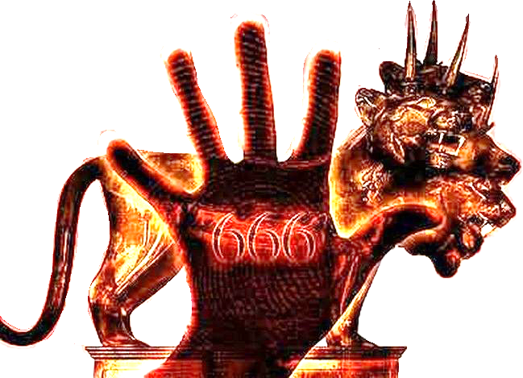
SEALED ON THE FOREHEADS
“And I looked, and, lo, a Lamb stood on the mount Sion, and with him an hundred forty and four thousand, having his Father's name written in their foreheads” (Revelation 14:1)
The seal, mark or sign can be received in two different ways: on the forehead or on the hand. While the faithful will receive it on their foreheads, the unbelievers will receive it on their foreheads or in their hands (Rev. 13:16). What is the difference?
Forehead
INTELLECTUAL CONVICTION
Believe in the one we worship
Hand
INTEREST (profit making)
We worship for fear of the consequences
While Satan does not care about the reasons for worship, God only accepts sincere and complete worship (Rom. 12:1).

Slide 8
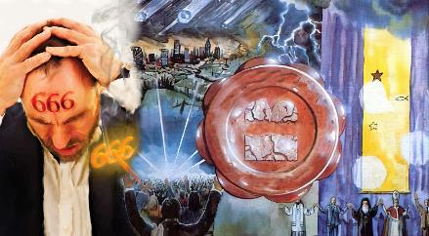
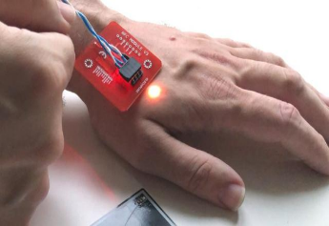
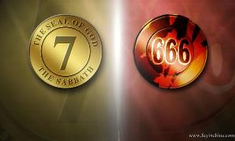
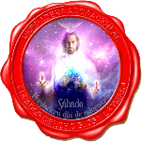
LOYAL IN WORSHIP
“so that they could not buy or sell unless they had the mark, which is the name of the beast or the number of its name” (Revelation 13:17 NIV )
Those who refuse to receive the mark of the beast cannot buy or sell, and are threatened with death (Rev. 13:15-17). On the other hand, if they receive it they will suffer the last plagues and the “second death”, losing eternal life (Rev. 16:2 ; 14:9-11; 20:4, 13-15).
But what is the mark of the beast? A chip, a barcode, some type of physical control?
If the Sabbath is the visible sign (mark) of the faithful, will not the mark of the beast have the same nature?
Since the Bible does not speak of any change in the day of worship, accepting Sunday as a day of worship is accepting the authority of the Church that made the change (identified as 666).
What authority then shall we accept? The authority of a human institution or the authority of God, clearly manifested in His Word?

Slide 9
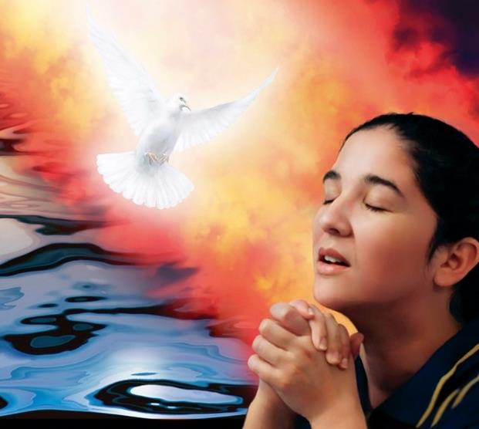
POWER FROM ABOVE

Slide 10
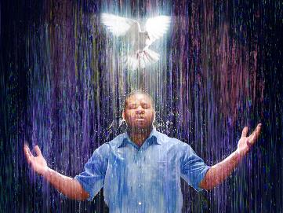
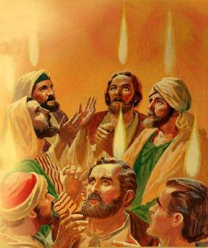
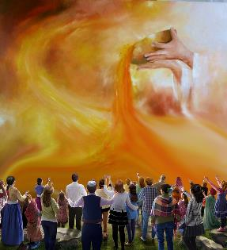
THE LATER RAIN
“Be glad, people of Zion, rejoice in the Lord your God, for he has given you the autumn rains because he is faithful. He sends you abundant showers, both autumn and spring rains, as before” (Joel 2:23).
The prophet Joel uses rain as a metaphor for the outpouring of the Holy Spirit (Joel 2:23, 28). This is how Peter applied it in his speech on the day of Pentecost (Acts 2:14-17).
This “rain” brings with it the knowledge of God (Hos. 6:3). In his time, he converted thousands in a single day (Acts 2:41).
In the Mediterranean climate where Israel lived, the early rain (around October) prepared the land to be planted. A second rain, known as “late” (around April), gave the earth strength to ripening cereals.
Just as the Church began with a rain of the Holy Spirit, the final proclamation of the gospel, the last harvest, will occur after the outpouring of the latter rain: the Holy Spirit poured out in power on the believers of the last generation (Rev. 18 :1).

Slide 11
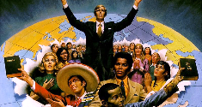
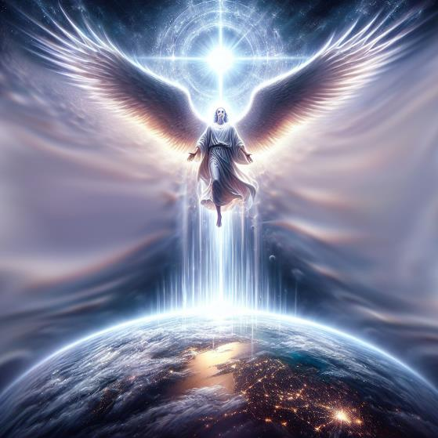
THE PREACHING OF THE GOSPEL
“After this I saw another angel coming down from heaven. He had great authority, and the earth was illuminated by his splendor” (Revelation 18:1)
John saw “another angel” descending with power. The glory of this angel fills the entire earth (Rev. 18:1). What is the message this angel proclaims?
His message is the same as the second angel's message: Babylon has fallen and has defiled all nations (Rev. 18:2-3; 14:8).
The Holy Spirit will descend with power on the faithful “who keep the commandments of God and the faith of Jesus” (Rev. 14:12), and who are already proclaiming the gospel, along with the warning of the beginning of judgment, and the invitation to worship the Creator (Rev. 14:6-7).
Faced with these messages, and thanks to the power of the latter rain, humanity will be faced with choosing between two possibilities: accepting the seal of God or the mark of the beast (Rev. 14:9-11).
Many voices will proclaim the last message. Many will decide to be faithful to the end.

Slide 12
“The descent of the Holy Spirit upon the church is looked forward to as in the future, but it is the privilege of the church to have it now. Seek for it, pray for it, believe for it. We must have it, and Heaven is waiting to bestow it."
EGW (Last Days Events, pg. 189)
“But not one is made to suffer the wrath of God until the truth has been brought home to his mind and conscience, and has been rejected. There are many who have never had an opportunity to hear the special truths for this time. The obligation of the fourth commandment has never been set before them in its true light. He who reads every heart, and tries every motive, will leave none who desire a knowledge of the truth, to be deceived as to the issues of the controversy. The decree is not to be urged upon the people blindly. Everyone is to have sufficient light to make his decision intelligently.”
EGW (The Great Controversy, pg. 605)

