Slide 1
Lesson 13 for June 29, 2024
THE TRIUMPH OF GOD’S LOVE

Slide 2
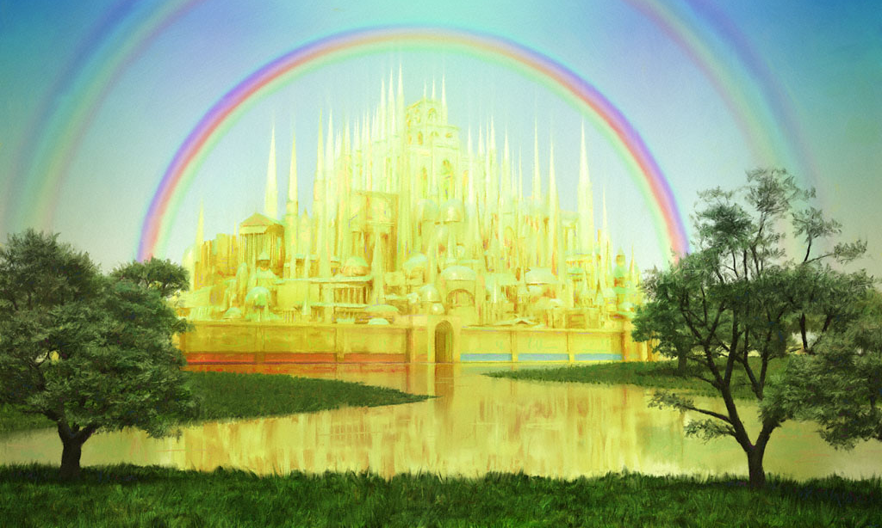
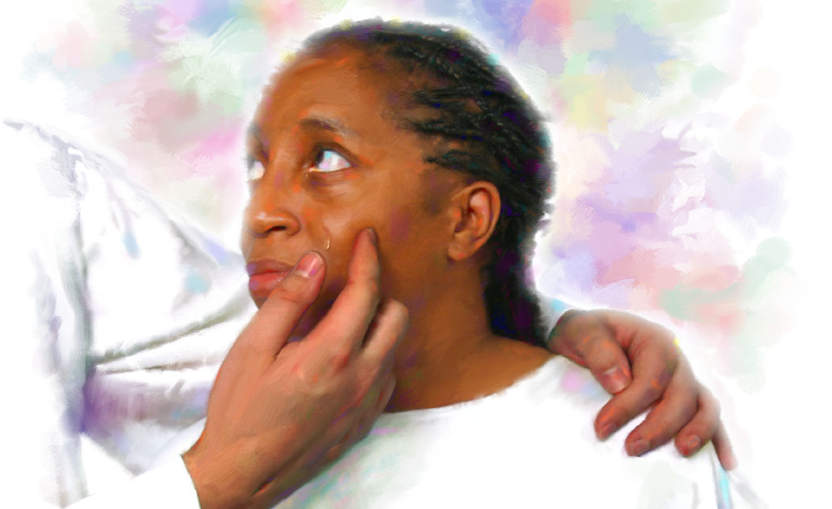
“And I heard a loud voice from heaven saying, ‘Behold, the tabernacle of God is with men, and He will dwell with them, and they shall be His people. God Himself will be with them and be their God. And God will wipe away every tear from their eyes; there shall be no more death, nor sorrow, nor crying. There shall be no more pain, for the former things have passed away’ ” (Revelation 21:3, 4, NKJV)

Slide 3
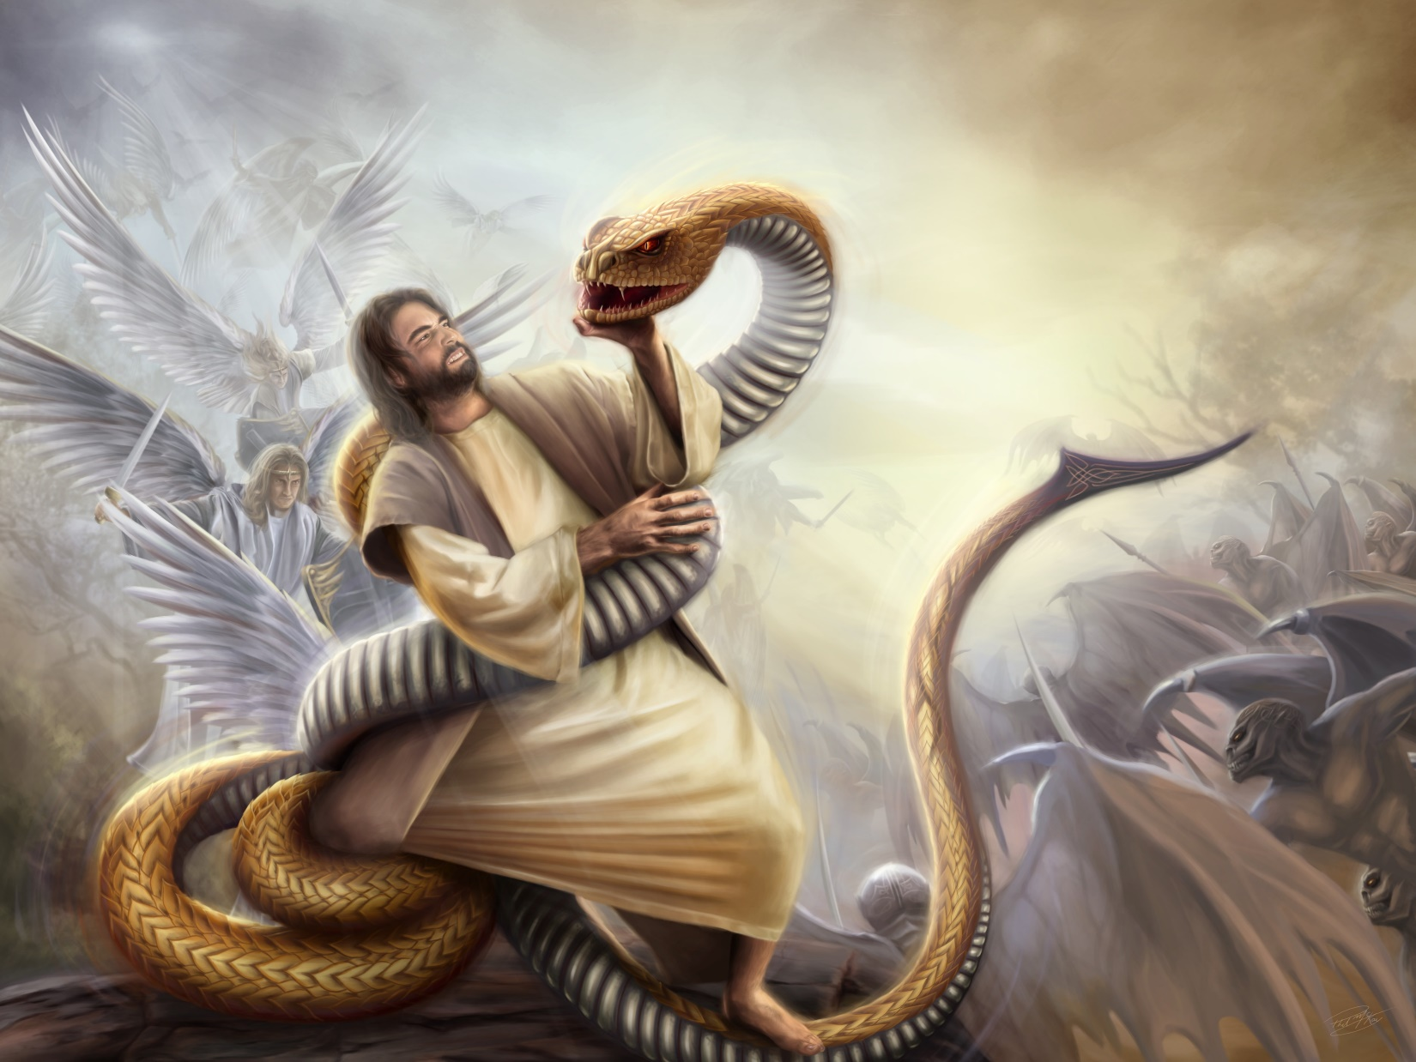
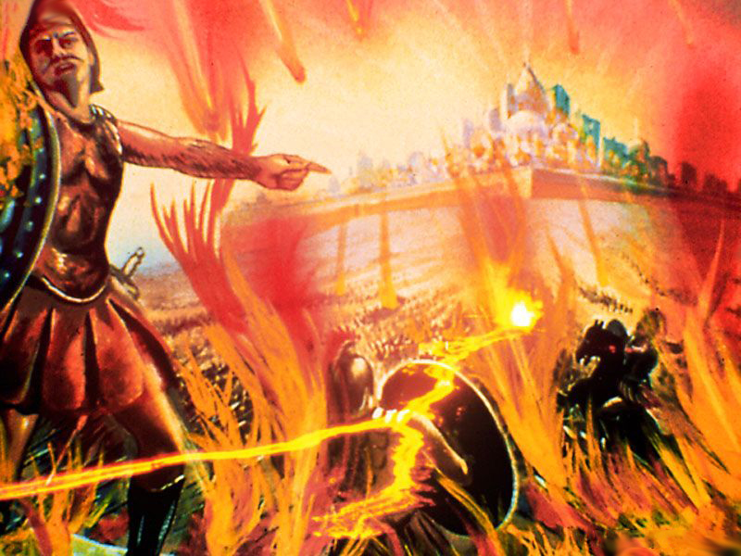
The great controversy, Satan's rebellion against the government of God, is rapidly coming to an end.
We have not been left in the dark as to how the conflict will end: God wins, Satan loses.
Even the details of the last battles are clearly described in the Bible.
Time of anguish and liberation.
Time of terror and joy.
Time of desolation and judgment.
Time of life and death.
Time to love and be loved.

Slide 4
TIME OF ANGUSTY AND DELIVERANCE
“Alas! for that day is great, so that none is like it: it is even the time of Jacob's trouble, but he shall be saved out of it” (Jeremiah 30:7)
“We are living in the time of the end. The fast-fulfilling signs of the times declare that the coming of Christ is near at hand. The days in which we live are solemn and important.” (EGW, TI9, 11) . What will these events be?
Rev. 22:11
The trial ends and every case is decided. The door of grace closes.
Is. 8:21-22; Jer. 30:7
Time of anguish. The wicked act without moral restraint, and the righteous do not know if they have been forgiven.
Rev. 15:7-8; Ps. 27:5
The last 7 plagues fall on the unrepentant. God's people are guarded and protected.
Rev. 16:14; 1Jn. 3:2-3
Each group prepares to meet Jesus. Some to fight against Him; the others to receive him with joy.
When Jesus concludes his work of mediation and the Holy Spirit withdraws from the unrepentant, each person's fate will be sealed. The faithful will continue to have divine help and protection, while the wicked will be at the mercy of Satan. Each one will show with his character who he has decided to serve.

Slide 5
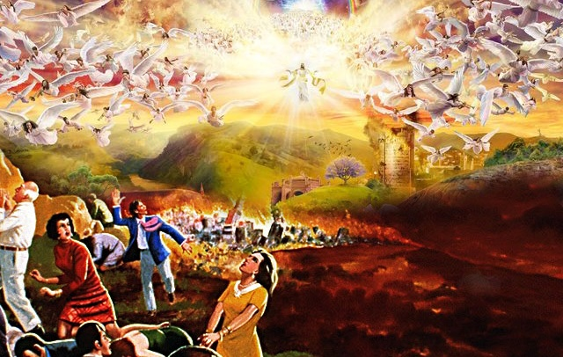
TIME OF TERROR AND JOY
“And said to the mountains and rocks, Fall on us, and hide us from the face of him that sitteth on the throne, and from the wrath of the Lamb” (Revelation 6:16)
“And it shall be said in that day, Lo, this is our God; we have waited for him, and he will save us: this is the Lord; we have waited for him, we will be glad and rejoice in his salvation” (Isaiah 25:9)
They have rejected the Law of God; They have rejected the living water and have dug for themselves “broken cisterns” ( Jer. 2:13).
Now they come face to face with the Judge. They can only expect wrath and condemnation. Who will free them? (Isa. 2:19; Rev. 6:16).
They have been faithful to the Law of God; They have drunk of the water of life (Rev. 21:6). Now they look face to face with their Judge. They can only hope for salvation. How can they not burst into praise? (Isa. 25:9; Rev. 15:3-4).
Satan is angry with the remnant (Rev. 12:17)
He makes everyone worship him and obey his laws (Rev. 13:15-17)
Prepare the world to fight against the Lamb (Rev. 17:12-14)
Jesus destroys all his opponents at his Coming (Rev. 19:11-15)
The remnant remains faithful to the Law of God (Rev. 14:12)
He prepares to meet his God (Amos 4:12)
Jesus takes with him those who believed in Him (Rev. 19:6-8)

Slide 6
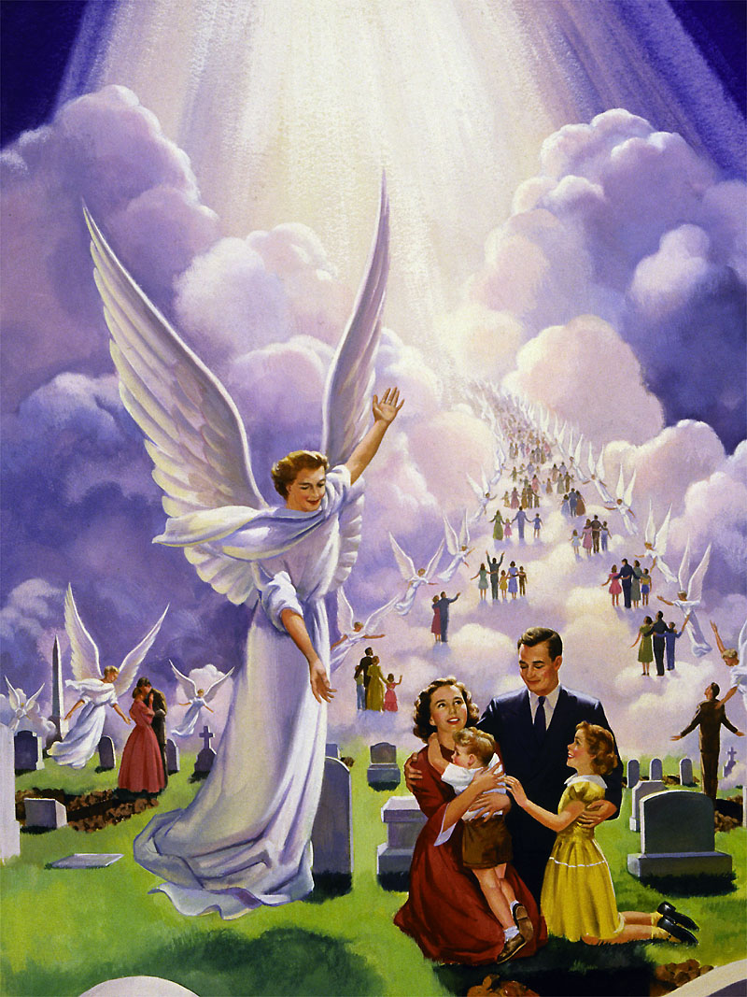
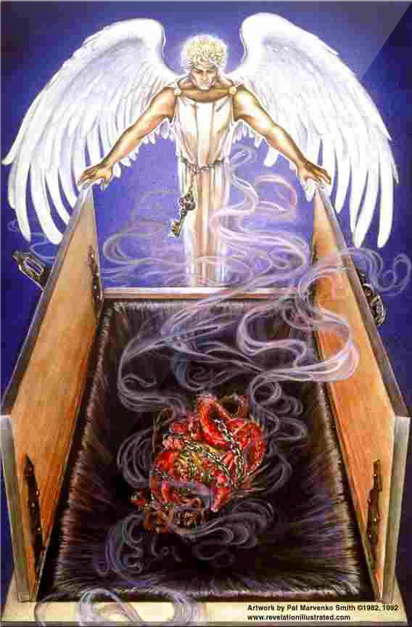
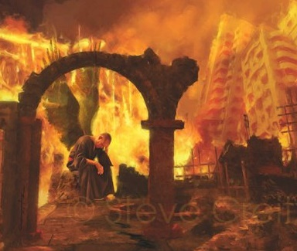
TIME OF DESOLATION
“The land shall be utterly emptied, and utterly spoiled: for the Lord hath spoken this word” (Isaiah 24:3)
When Jesus comes, the saints of all ages will be resurrected; and the living faithful, transformed, will ascend with them to go to Heaven with Jesus (1Thes. 4:16-17).
The wicked will die in the presence of Jesus. Their corpses will remain unburied and, finally, no trace of life will remain on Earth (Jer. 25:33; Rev. 19:17-21; Jer. 4:23-26; Is. 24:3).
At that time, Satan and his angels will be locked in the abyss for a thousand years, unable to deceive anyone (Rev. 20:1-3).
The abyss (abyssos, place of darkness), perfectly describes the situation on Earth at that time. Without human life in it, no demon will tempt. It will be a time of reflection for the rebellious angels, bound by the chain of circumstances, without the possibility of leaving the desolate Earth.

Slide 7
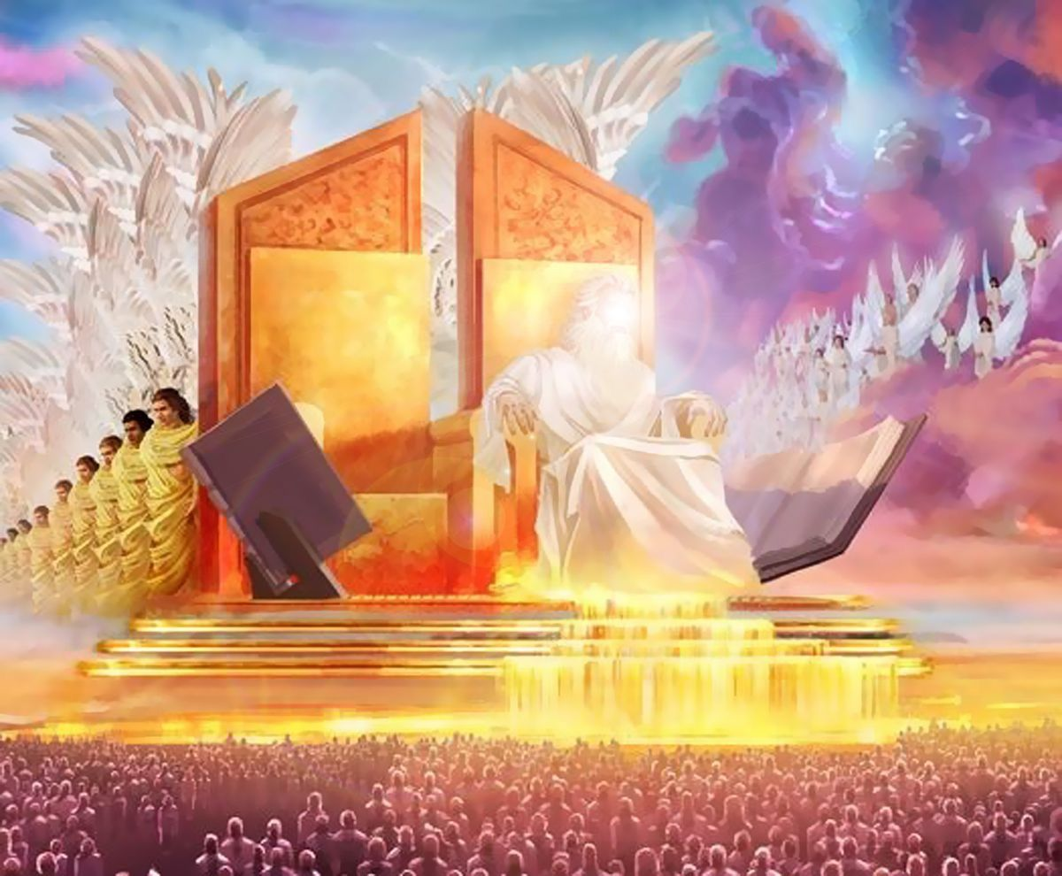
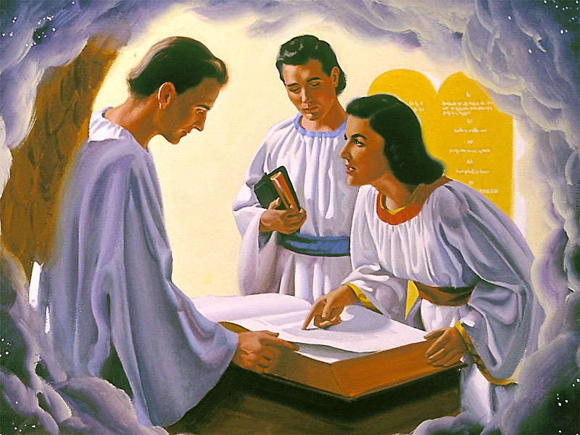
TRIAL TIME
“And I saw thrones, and they sat upon them, and judgment was given unto them; […] and they lived and reigned with Christ a thousand years” (Revelation 20:4)
If the Judgment was celebrated before the Second Coming, and Jesus already executed the sentence, giving eternal life to those who believed in Him... what sense does this new judgment have?
For centuries, God has shown his love and offered salvation to anyone who would receive it. It has also allowed evil to fully develop.
During the Judgment, all the worlds and faithful angels have been able to witness the justice and mercy of God in his dealings with sin and rebellion. Now, they have before them the real result of satanic rule: an empty and desolate land.
But those of us who have lived in the enemy's territory during the conflict, now redeemed, will also need to witness the justice and mercy of God. In the millennial judgment we will be so fully convinced of God's love that evil will never rise again (Nah. 1:9).

Slide 8
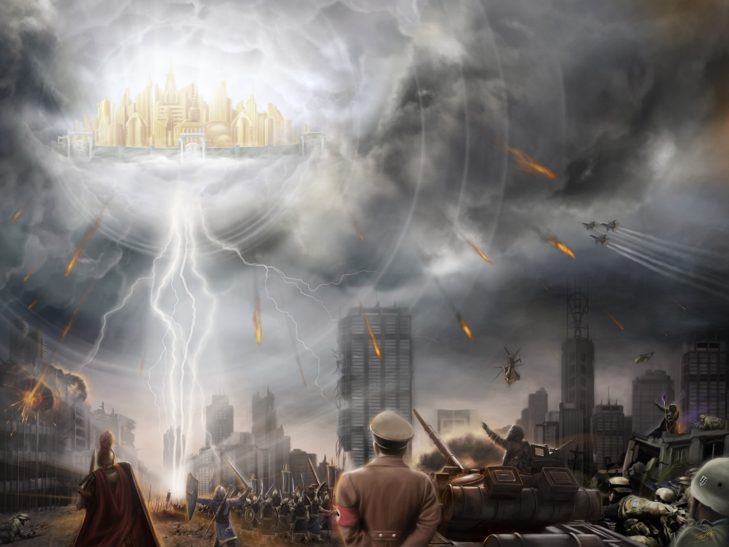
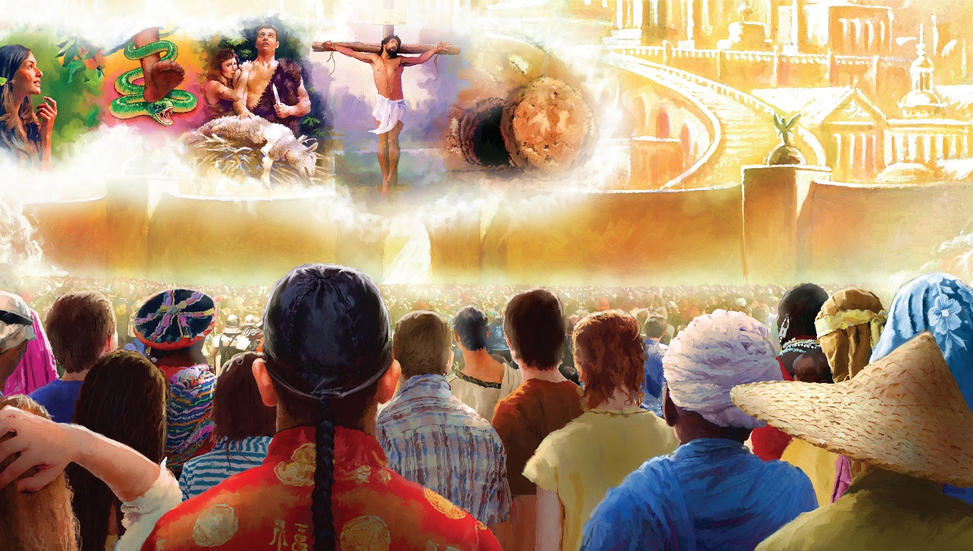
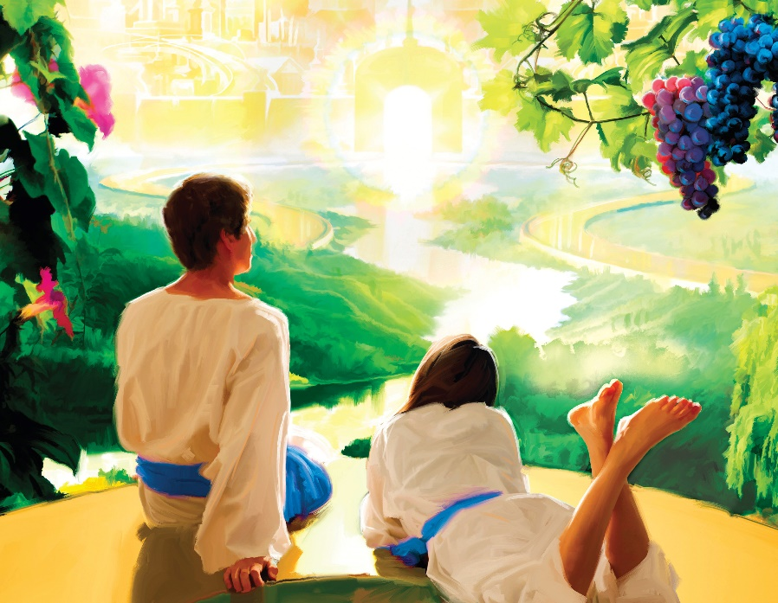
TIME OF LIFE AND DEATH
“For, behold, the day cometh, that shall burn as an oven; and all the proud, yea, and all that do wickedly, shall be stubble: and the day that cometh shall burn them up, saith the Lord of hosts, that it shall leave them neither root nor branch” (Malachi 4:1)
“But unto you that fear my name shall the Sun of righteousness arise with healing in his wings; and ye shall go forth, and grow up as calves of the stall” (Malachi 4:2)
At the end of the millennium, the wicked are resurrected. They accept Satan's direction again, and fight again against God and the saints. Nothing has changed, and all are destroyed by fire (Rev. 20:5-9).
But before they are destroyed, a final trial is held. The books are opened, and everyone recognizes in them their actions and their rejection of the loving callings of the Holy Spirit. All accept God's justice, and bow their knees before Him (Rev. 20:11-13; Is. 45:23; Phil. 2:10).
Far from living eternally (to be eternally punished), they suffer a “second death,” from which there is no resurrection (Rev. 20:14-15; Ps. 37:20; Mal. 4:1; Is. 26: 14).
Death and sin are over. It is time to wipe away every tear and enjoy eternal and happy life (Rev. 21:4).

Slide 9
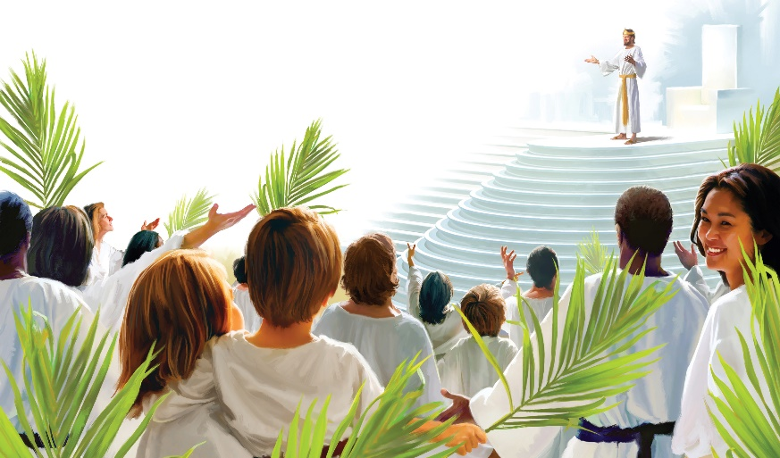
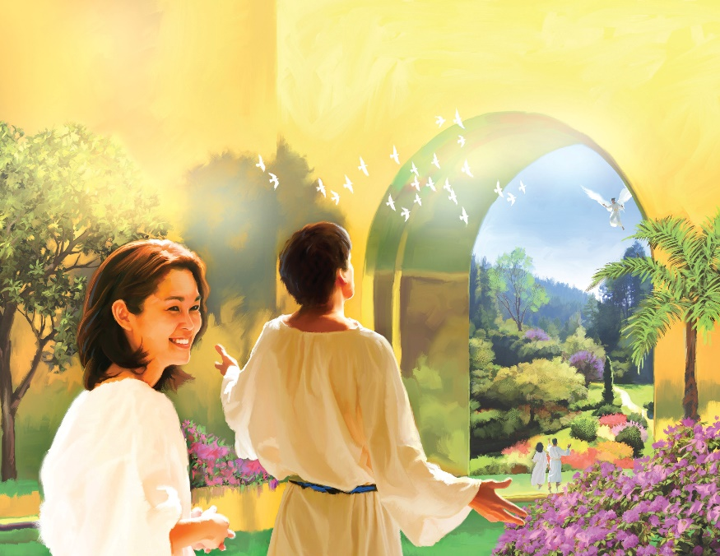
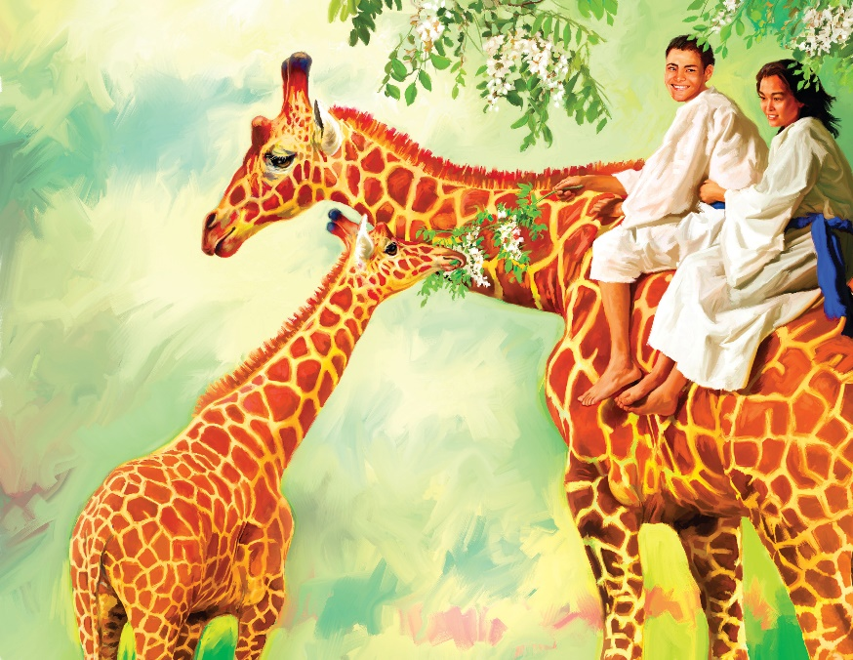
TIME TO LOVE AND BE LOVED
“The Lord hath appeared of old unto me, saying, Yea, I have loved thee with an everlasting love: therefore with lovingkindness have I drawn thee” (Jeremiah 31:3)
And what will we do on the New Earth for all eternity?
The cross of Christ will be the science and song of the redeemed throughout eternity.
On […] peaceful plains, on the edge of […] living streams, God's people […] will find a home
There immortal intellects will contemplate with eternal delight the wonders of creative power
Every faculty will be developed, every capacity increased
The acquisition of knowledge will not tire the intelligence or exhaust the energies
The greatest undertakings will be able to be carried out, the most sublime aspirations will be satisfied, the loftiest ambitions will be realized.
New heights will arise to overcome, new wonders to admire, new truths to understand, new objectives that sharpen the faculties of the spirit, soul and body.
They share [with unfallen beings] the treasures of knowledge and understanding acquired over centuries and centuries in the contemplation of the works of God
With clear vision, they consider the glory of Creation: suns and stars and systems that, in the order assigned to them, circle the Throne of Deity
Extracted from “The Great Controversy”, pp. 651, 666, 668, 675, 677, 678)

Slide 10
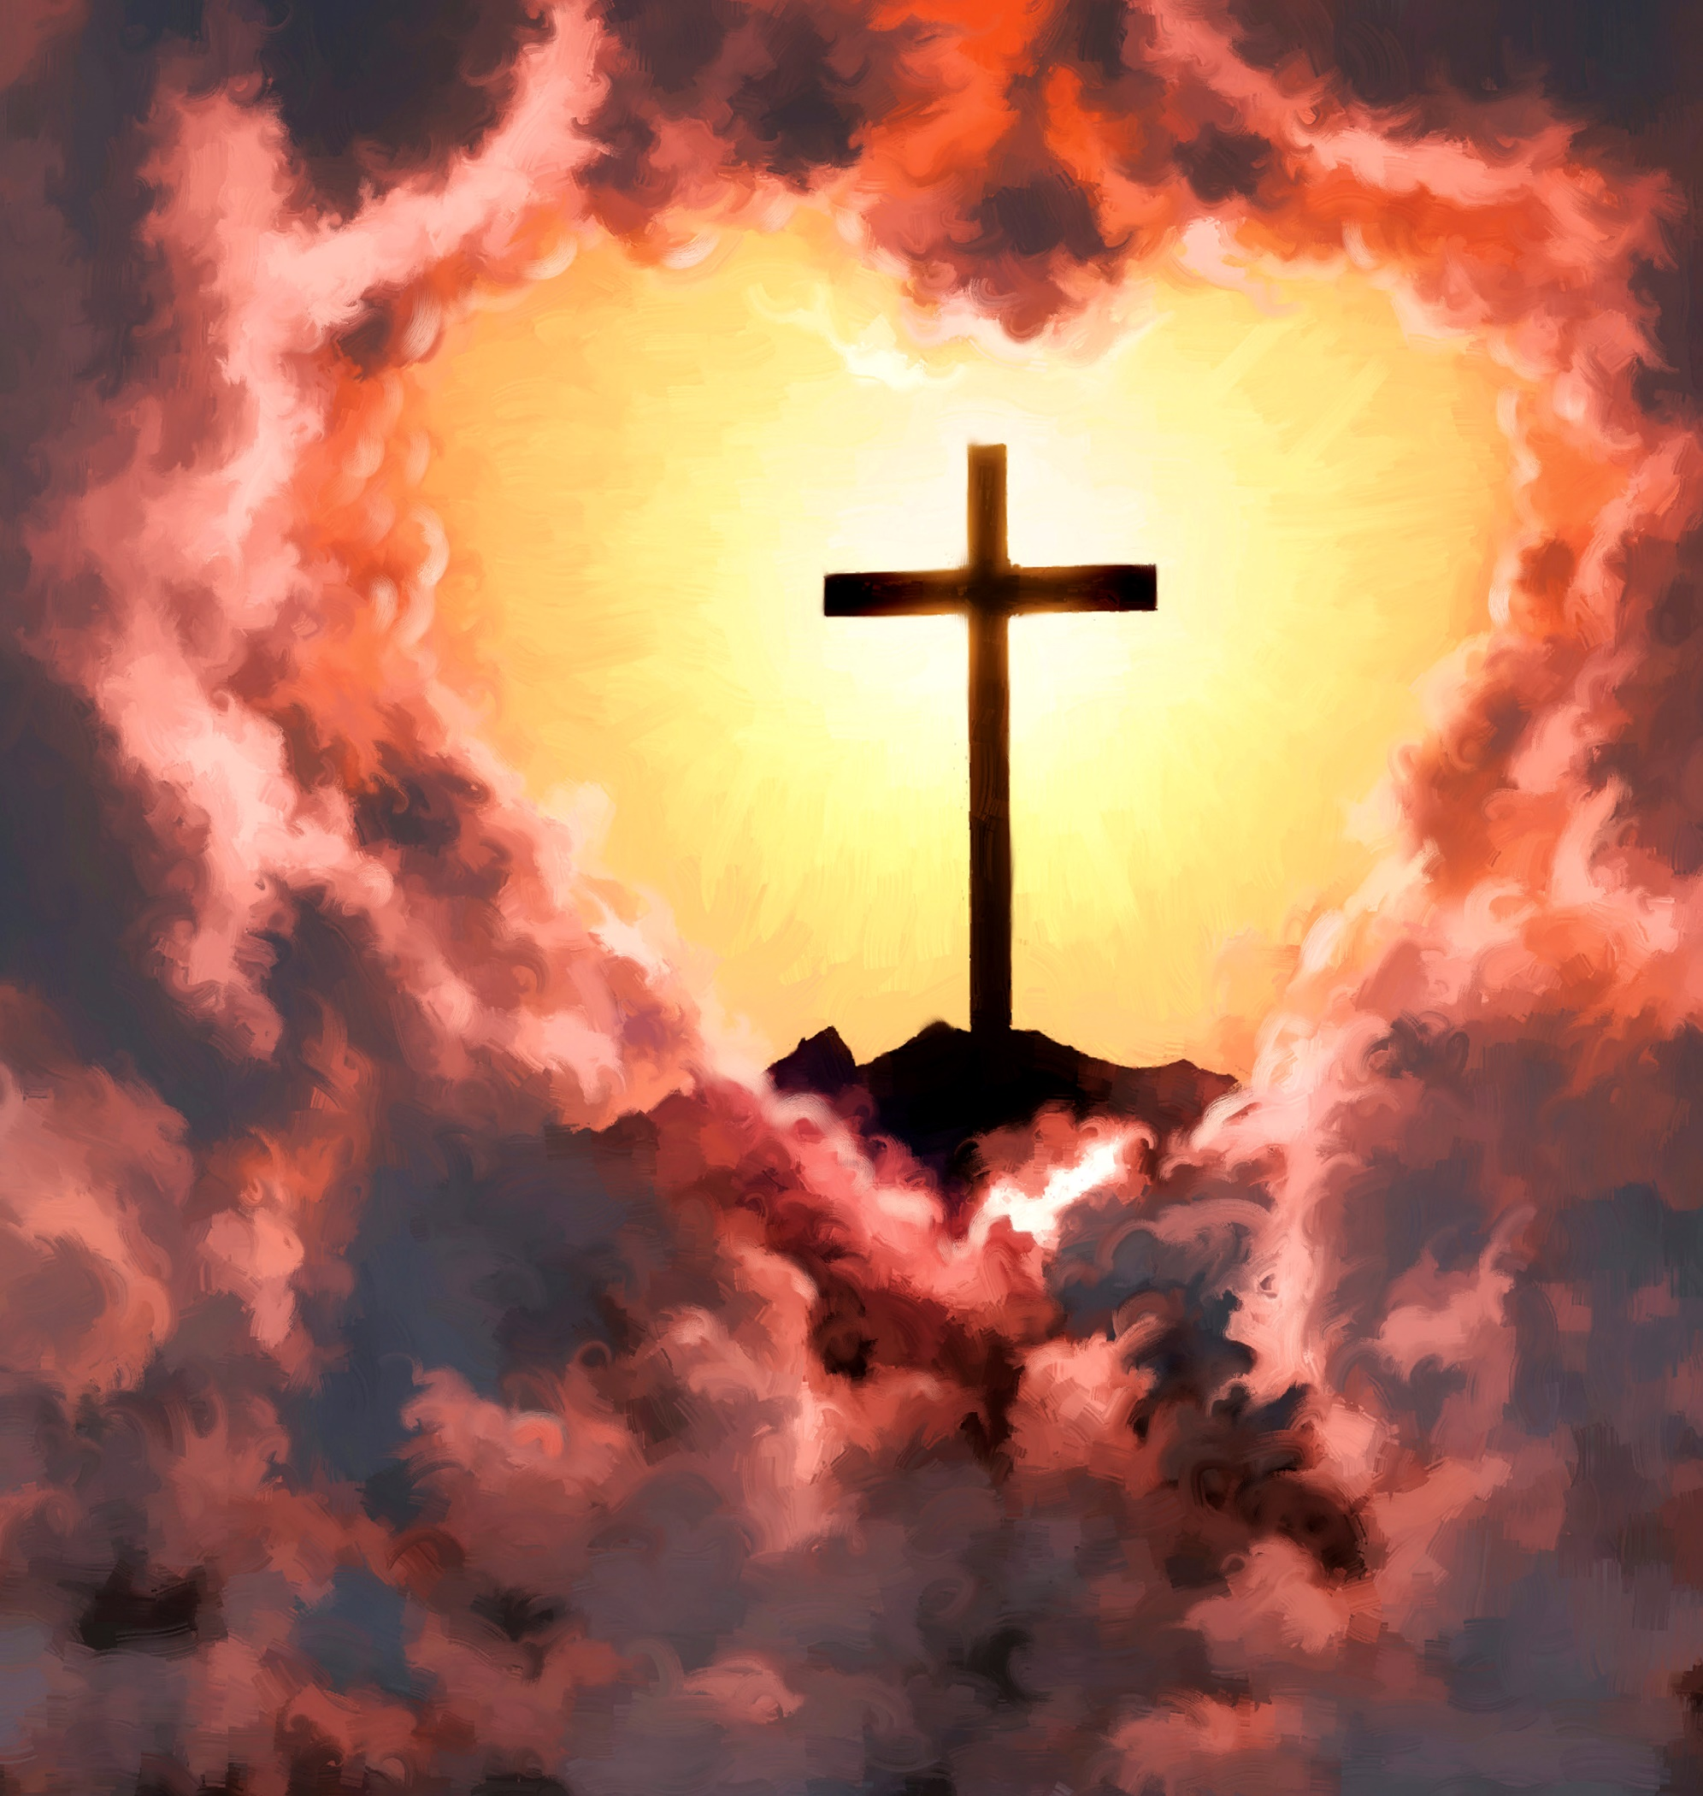
“The great controversy is ended. Sin and sinners are no more. The entire universe is clean. One pulse of harmony and gladness beats through the vast creation. From Him who created all, flow life and light and gladness, throughout the realms of illimitable space. From the minutest atom to the greatest world, all things, animate and inanimate, in their unshadowed beauty and perfect joy, declare that God is love.”
EGW (The Great Controversy, pg. 678)

