Slide 1
TEACHING DISCIPLES: PART 1
Lesson 7 for August 17, 2024

Slide 2
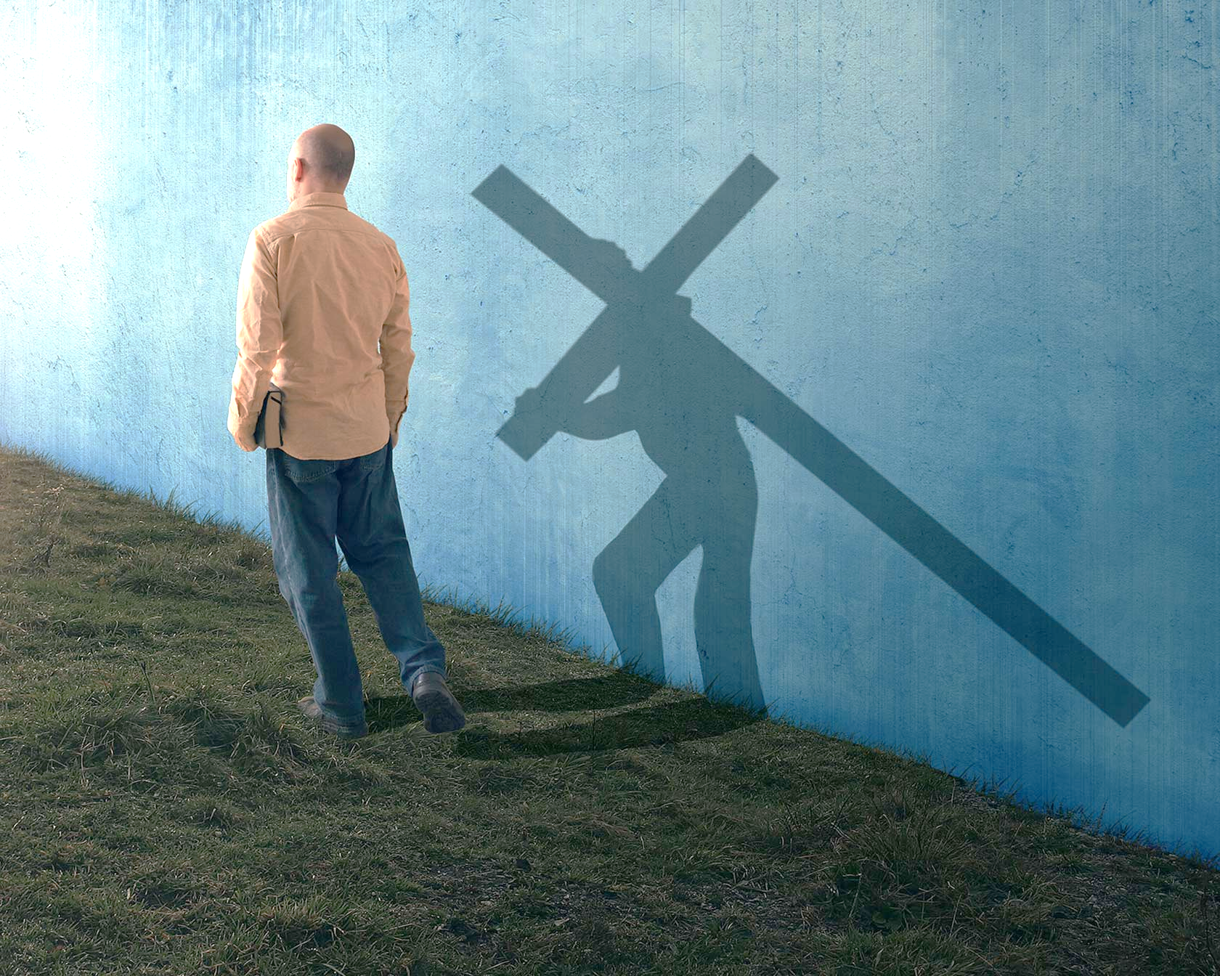
“When He had called the people to Himself, with His disciples also, He said to them, ‘Whoever desires to come after Me, let him deny himself, and take up his cross, and follow Me’ ”
(Mark 8:34, NKJV)

Slide 3
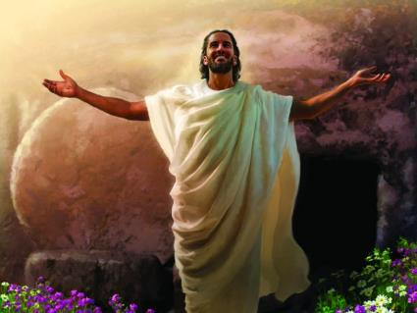
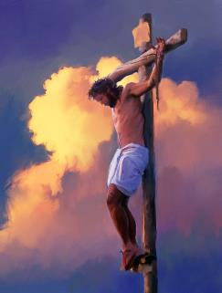
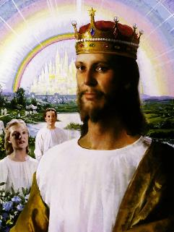
What will it be about “rising from the dead”? (Mark 9:10). The disciples could understand it from Jairus' daughter, who had died. But Jesus was the Messiah. He had not come to die, but to reign. These words of Jesus must have had a spiritual meaning, they thought, something like “being born again.”
The disciples had a clear concept of what the Christ should do. That made it difficult for Jesus to explain to them that this was not so; that His mission was different; that he had not come to establish an earthly kingdom; that the way to glory passed through the cross.
Teachings in two phases:
Basic instruction. Mark 8:22-30.
Full knowledge. Mark 8:31-38.
Teachings about the Kingdom:
The future and present Kingdom. Mark 9:1-13.
The largest in the Kingdom. Mark 9:30-41.
How to enter the Kingdom. Mark 9:42-50.

Slide 4
TEACHINGS IN TWO PHASES

Slide 5
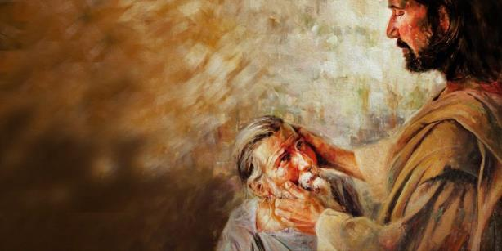
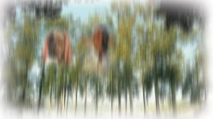
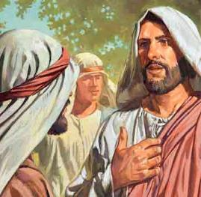
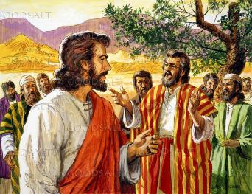
BASIC INSTRUCTION
“He looked up and said, “I see people; they look like trees walking around” (Mark 8:24 NIV)
The healing recorded in Mark 8:22-26 is the strangest of those performed by Jesus.
In the first phase, man is able to see blurred. In the second phase, finally see clearly.
This miracle serves as a parable of the way in which Jesus was going to instruct his disciples, preparing them to grasp as best as possible the reality of His saving mission.
In the first phase, the disciples had come to the conclusion that Jesus was the Christ. To secure that truth in their minds, Jesus led them to declare it by asking them an indirect question and a direct question (Mark 8:27-29).
But they were to remain silent regarding this statement, for they had not yet understood its full implications (Mark 8:30).

Slide 6
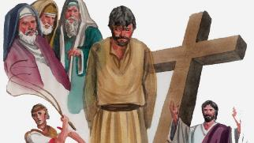
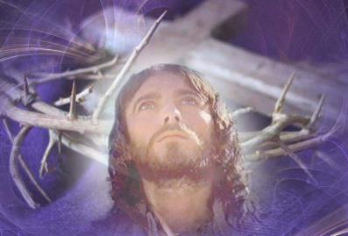
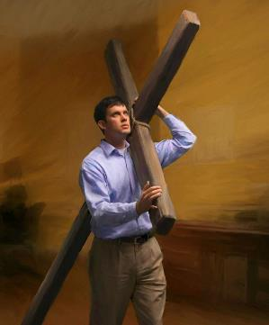
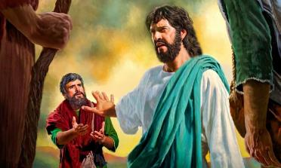
FULL KNOWLEDGE
“He then began to teach them that the Son of Man must suffer many things and be rejected by the elders, the chief priests and the teachers of the law, and that he must be killed and after three days rise again” (Mark 8:31)
In the second phase of his teaching, Jesus' words were very clear: rejection, death and resurrection (Mark 8:31-32a). But something exploded in Peter's head: “Lord, have mercy on you; in no way shall this happen to you” (Mk. 8:32b; Mt. 16:22).
Unknowingly, Peter was using the same tactic that Satan used in the wilderness (Mt. 4:8-9; Mark 8:33). The easy path led Jesus to an earthly kingdom; the difficult one, led him to achieve salvation on our behalf.
And that was not all. His followers had to be willing to tread the same path: take up the cross, and live or die for the precious gift of salvation, helping others achieve it (Mark 8:34-38).

Slide 7
TEACHINGS ABOUT THE KINGDOM

Slide 8
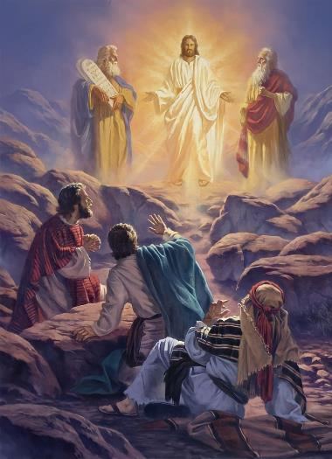
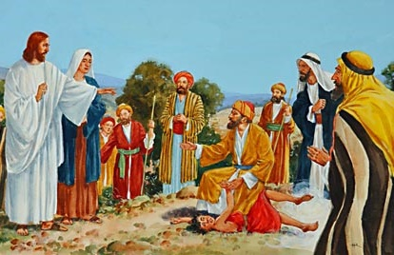
THE FUTURE AND PRESENT KINGDOM
“And there appeared before them Elijah and Moses, who were talking with Jesus” (Mark 9:4)
Peter, James, and John were not fully aware that they were glimpsing on the mountain the Kingdom of glory, a miniature representation of the Second Coming of Jesus (Mark 9:1-4).
What they were clear about was that they wanted to stay there (Mark 9:5-6). But at that moment they did not perceive the true meaning of the words that Moses and Elijah spoke to Jesus (Luke 9:30-31).
So that the dead in Christ – represented by Moses – and the living faithful of the last generation – represented by Elijah – could enter glory, Jesus had to die in Jerusalem.
Upon descending from the mountain, the present state of the Kingdom became evident. The lack of faith endangered its very structure. The apostles lacked faith, and a desperate father had lost confidence (Mark 9:14-22).
With faith everything is possible. But, if you lack faith, cry out like that father: “I do believe; help me overcome my unbelief!” (Mark 9:24).

Slide 9
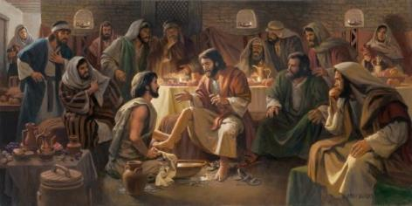
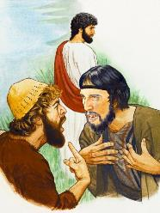
THE GREATEST IN THE KINGDOM
“Sitting down, Jesus called the Twelve and said, “Anyone who wants to be first must be the very last, and the servant of all” (Mark 9:35 NIV)
First teaching (Mark 9:35-37)
Second teaching (Mark 9:38-41)
Taking a child, he staged greatness in the Kingdom: the first are the last; the greatest is the servant; the smallest and humbler must be treated as if he were Jesus himself.
Everyone has their part to do, and no one should be left behind when doing God's work, no matter how small.
Jesus begins his way down to Jerusalem from Caesarea, stopping at Capernaum. He takes advantage of this period to instruct and prepare his disciples (Mark 9:30-33).
But they, far from understanding what Jesus wanted to teach them, disputed who would be the greatest when Jesus proclaimed himself king in Jerusalem (Mark 9:34).

Slide 10
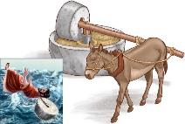
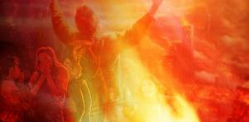
HOW TO ENTER THE KINGDOM
“For everyone will be seasoned with fire,
and every sacrifice will be seasoned with salt” (Mark 9:49)
Tie a huge stone around your neck and throw yourself into the sea; cutting off a hand, a foot, or gouging out an eye. Strange ways to save yourself, right? (Mark 9:42-48).
If we take these words literally – as many do with the phrase “the worms that eat them do not die, and the fire is not quenched” (Mark 9:44, 46, 48) –, we have to reach the following conclusions:
The redeemed will live eternally with a mutilated body.
The wicked will suffer eternally, but at least their body will be whole.
SIN
The lesson from this exaggeration is obvious: sin is so terrible that you must flee from it immediately.
Abandoning sin is hard and costs sacrifice, but the result is worth it and gives us peace (Mark 9:49-50).

Slide 11
“Every true, self-sacrificing worker for God is willing to spend and be spent for the sake of others. Christ says, “He that loveth his life shall lose it; and he that hateth his life in this world shall keep it unto life eternal” (John 12:25). By earnest, thoughtful efforts to help where help is needed, the true Christian shows his love for God and for his fellow beings. He may lose his life in service. But when Christ comes to gather His jewels to Himself, he will find it again."
EGW (Selected Messages, Book 1, page 78)

