Slide 1
TEACHING DISCIPLES: PART II
Lesson 8 for August 24, 2024

Slide 2
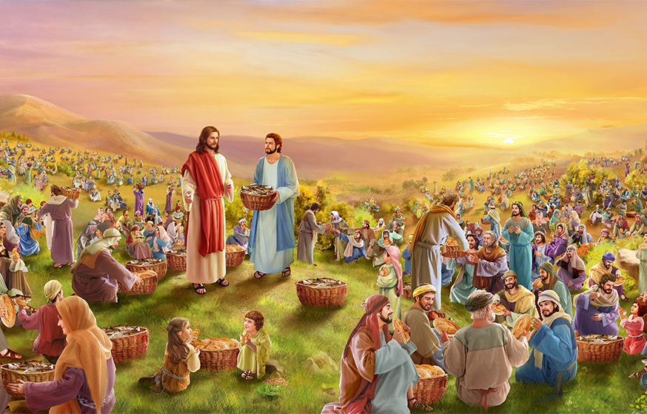
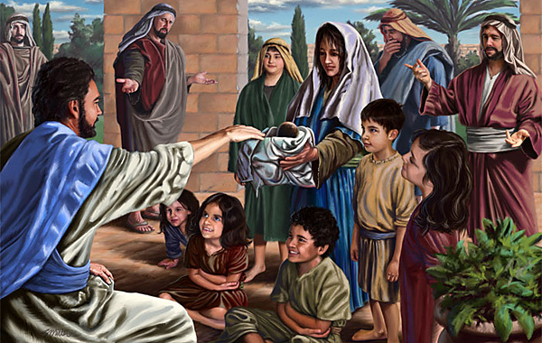
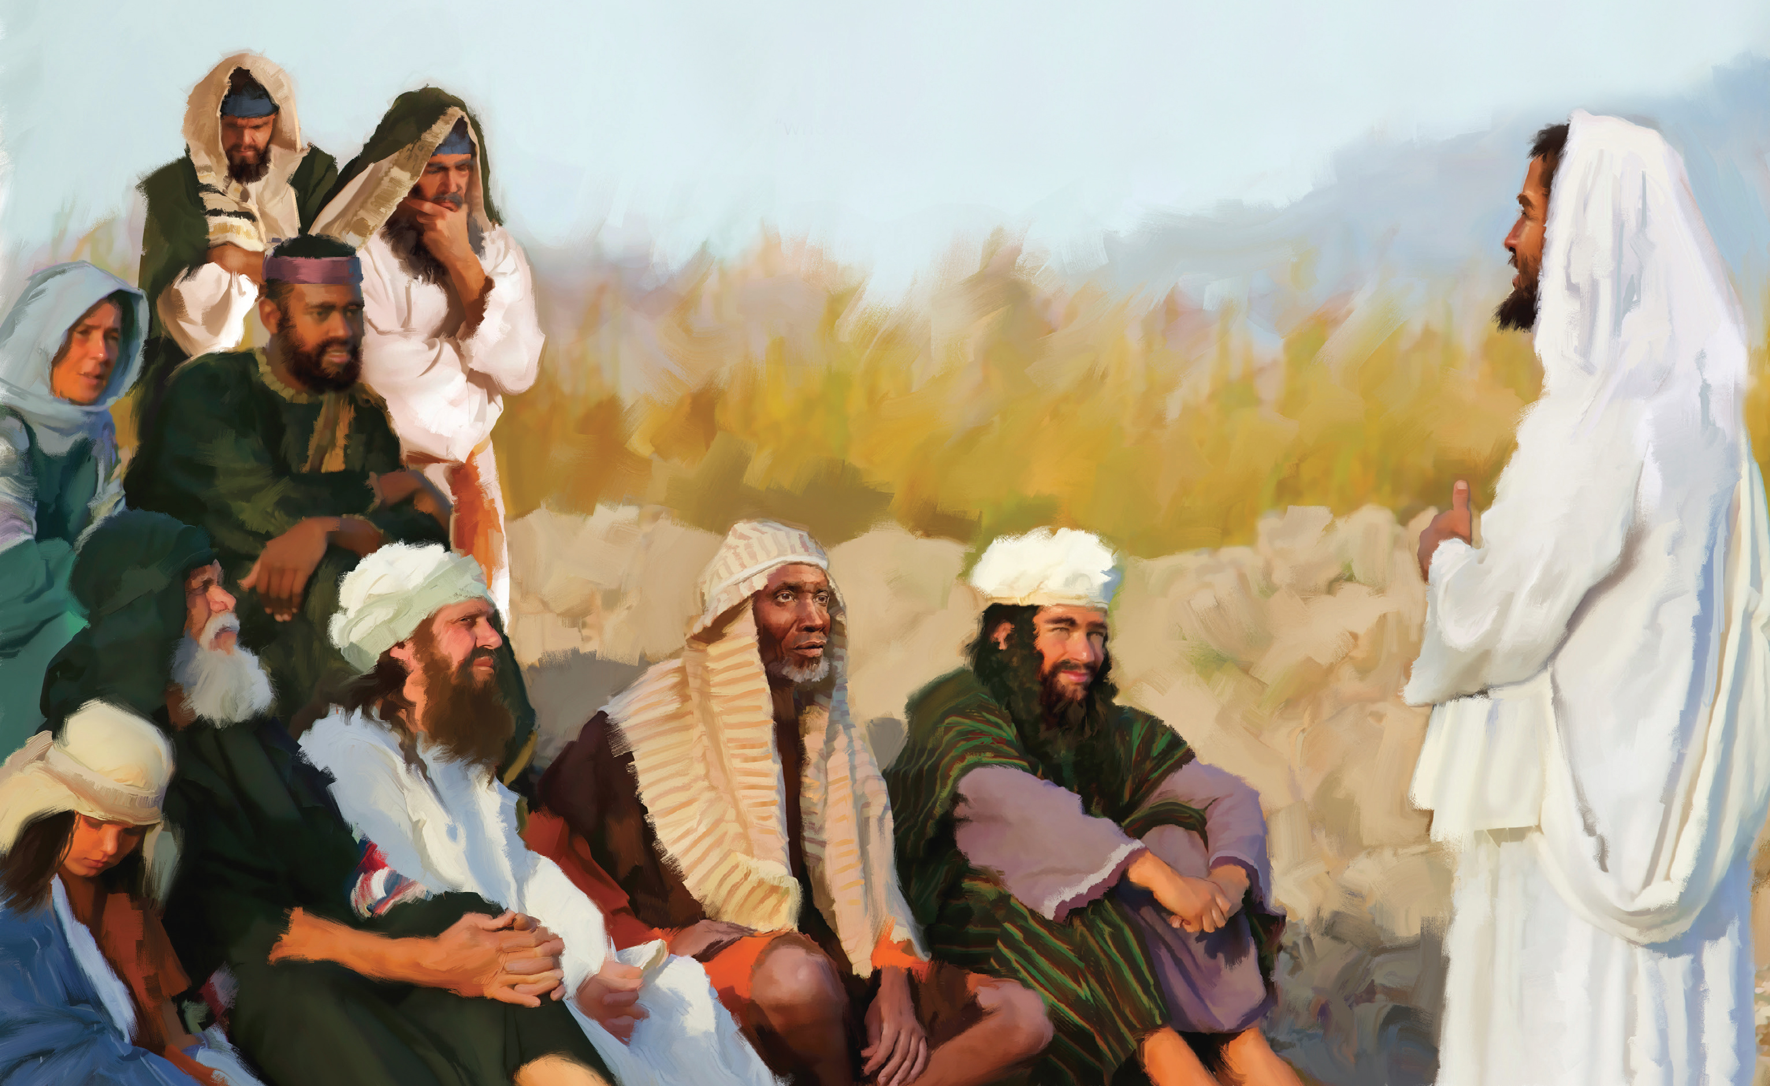
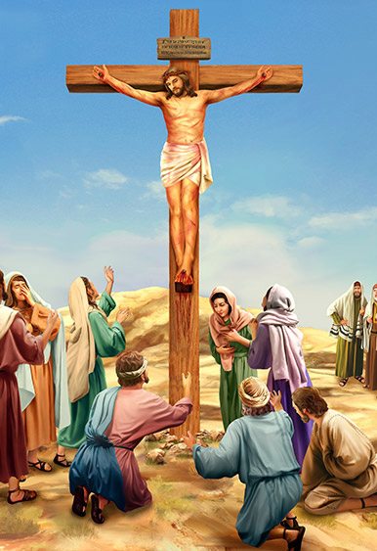
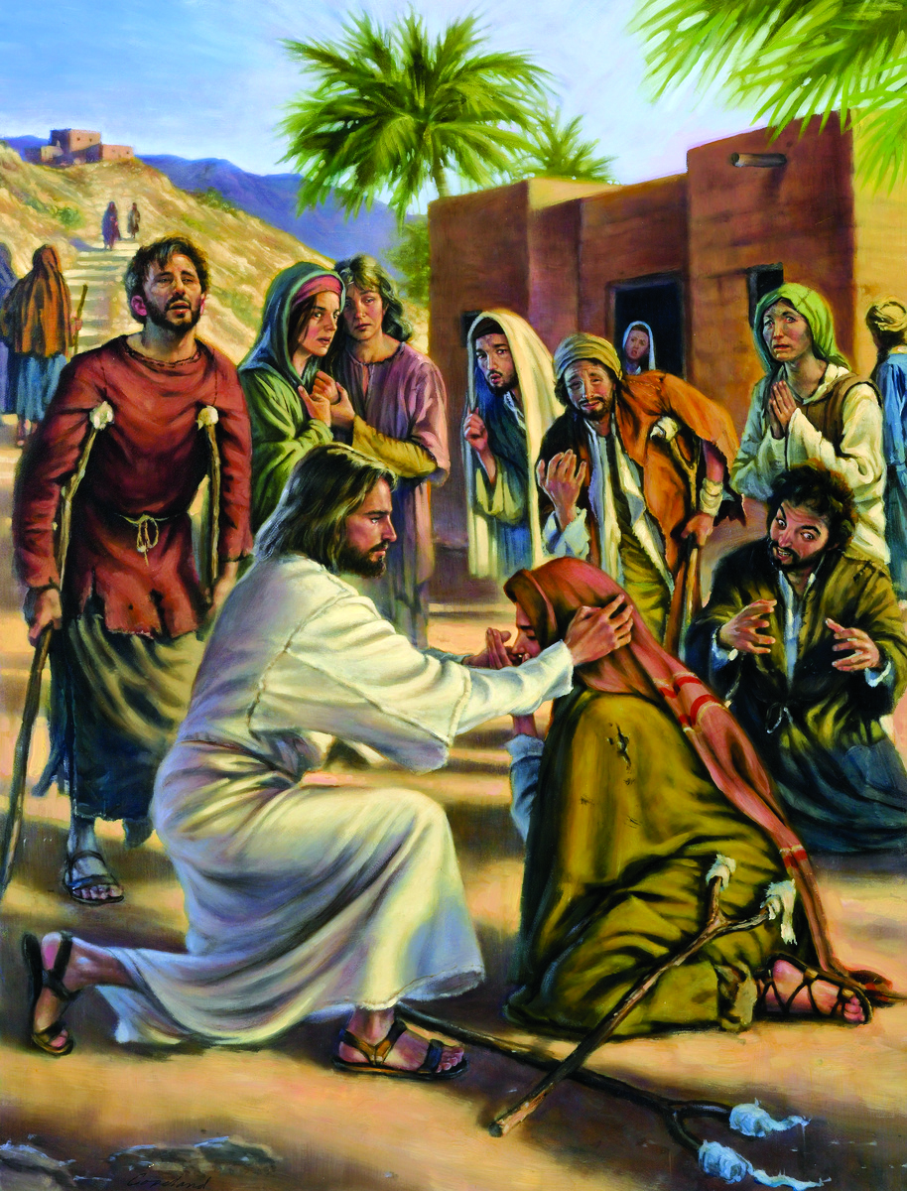
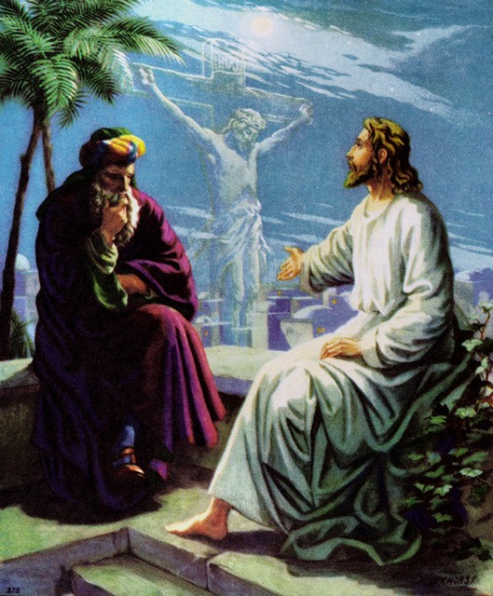
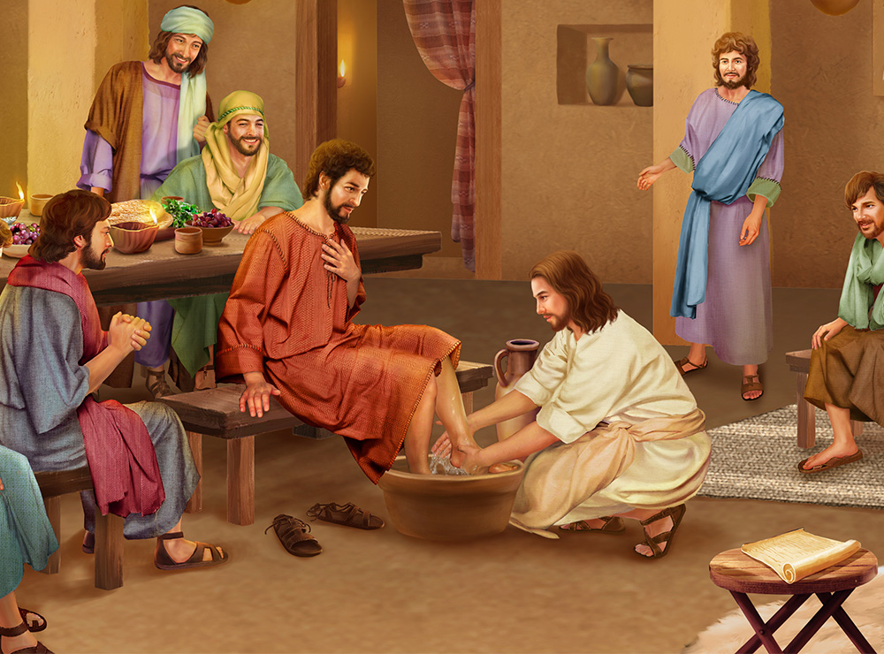
“For even the Son of Man did not come to be served, but to serve, and to give His life a ransom for many”
(Mark 10:45, NKJV)

Slide 3
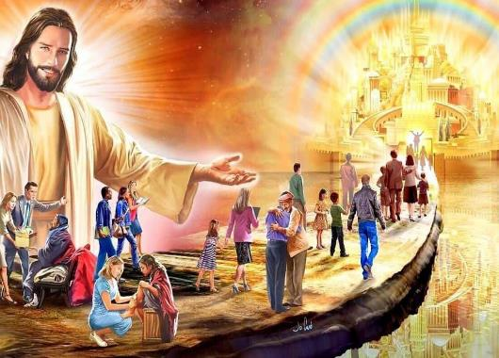
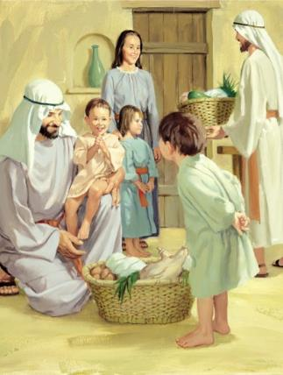
Everyone longed for the arrival of the Kingdom. But did they really understand what this meant? The Kingdom that Jesus had come to establish was totally different from the one they expected.
As he drew closer to Jerusalem, Jesus instructed his disciples about how citizens of the Kingdom should live and think.
He focused on teaching his disciples how to lead the church that would soon be founded: service, tolerance and love.
Instructions on marriage . Mark 10:1-12.
Instructions on childhood. Mark 10:13-16.
Instructions on priorities. Mark 10:17-31.
Instructions on leadership. Mark 10:32-45.
Instructions on His mission. Mark 10:46-52.

Slide 4
INSTRUCTIONS ON MARRIAGE
“Therefore what God has joined together, let no one separate” (Mark 10:9)
The Pharisees asked Jesus whether it was legal for a husband to divorce (put away) his wife (Mark 10:2). They did it “to tempt him.” What was the trap?
John had been beheaded for accusing Herod of divorcing his wife to marry his brother's wife (Mt. 14:3-4). They wanted, therefore, to bias Herod against Jesus.
The text that supported the Pharisees' demand allowed the husband to divorce his wife for “some indecent thing.” But it also protected the woman, saying that this “debased” her, and was an “abomination” to God ( Deut. 24:1-4; Mark 10:5).
Rabbi Hillel's followers went so far as to allow divorce for almost any reason. However, Jesus clarified that, from the beginning, God created man and woman to be united in an unbreakable bond that only adultery could break (Mark 10:6-12).
MARRIAGE

Slide 5
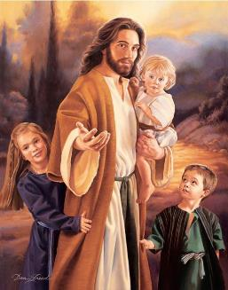
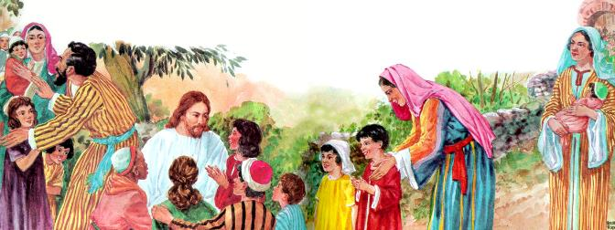
INSTRUCTIONS ON CHILDREN
“When Jesus saw this, he was indignant. He said to them, “Let the little children come to me, and do not hinder them, for the kingdom of God belongs to such as these” (Mark 10:14)
The disciples thought that Jesus' time was too valuable to waste caring for children. But Jesus was outraged by the attitude of his disciples (Mark 10:13-14).
Children are important to Jesus. «Jesus is attracting the children and commands us: “When Jesus told the disciples not to forbid the children to come to Him.” It is as if he were telling us: as if He would say, they will come if you do not hinder them» (EGW. DTG - Chapter 56, Pg. 476).
Furthermore, “anyone who will not receive the kingdom of God like a little child will never enter it” (Mark 10:15).
How does a child receive a gift when it is offered?
There is no question of whether the children deserve it, or if they have to pay for it. They simply extend their arms and take it with a big smile. Thus, we must accept the great gift of the kingdom of God.

Slide 6
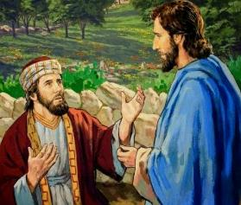
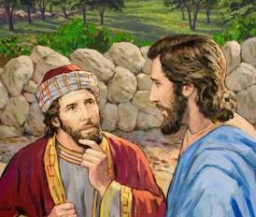
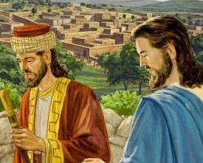
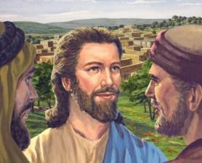
INSTRUCTIONS ON PRIORITIES
“Jesus looked at him and loved him. “One thing you lack,” he said. “Go, sell everything you have and give to the poor, and you will have treasure in heaven. Then come, follow me” (Mark 10:21)
Moved by the way Jesus dealt with children, and how he spoke about entering the Kingdom, a rich young man ran to Jesus to ask for more detailed instructions for achieving eternal life (Mark 10:17).
Jesus loved this young man who, sincerely, believed he was obeying all the commandments. However, he encouraged him to save the first one of all. He had made a god of his riches. He had to abandon that god, and completely follow Jesus (Mark 10:21).
The important thing here is that the Kingdom of God occupies the highest place in the human heart, above loyalty to any earthly kingdom. Therefore, Jesus emphasizes the lordship of God over our lives.
Let's be clear about our priorities. If our priority is God, He will give us eternal life. “With man this is impossible, but not with God; all things are possible with God” (Mark 10:27).

Slide 7
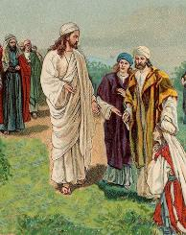
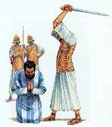
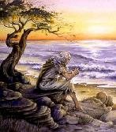
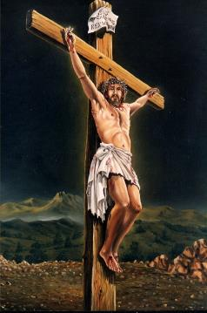
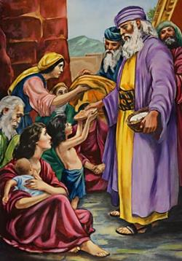
INSTRUCTIONS ON LEADERSHIP
“Not so with you. Instead, whoever wants to become great among you must be your servant” (Mark 10:43)
James and John wanted to make sure they would be close to their Lord when He reigned (Mark 10:35-37).
Is incredible! Jesus had just said that he would be betrayed, condemned, mocked, scourged, spit upon, and killed (Mark 10:32-34). Hadn't Zebedee's sons understood anything?
At their request, Jesus reminded them of the cost of discipleship: they would have to suffer like their Lord (Mark. 10:38-39).
Gathering the twelve together, Jesus clarified what true leadership consisted of (Mark 10:42-44).
In the Kingdom of God, power must always be used to uplift and bless others. Service is the standard of the leader.
He who wants to be great in the Kingdom must imitate his King: “For even the Son of Man did not come to be served, but to serve” (Mark 10:45).

Slide 8
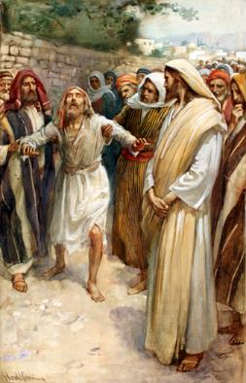
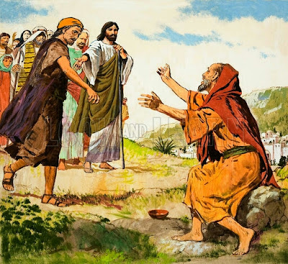
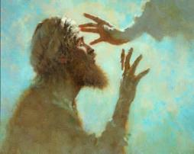
INSTRUCTIONS ON HIS MISSION
“When he heard that it was Jesus of Nazareth, he began to shout, “Jesus, Son of David, have mercy on me!” (Mark 10:47)
Bartimaeus cries and shouts to be heard above those who want to silence him (Mark 10:46-48).
When they told him “Cheer up! On your feet! He’s calling you” (Mark 10:49), he got up quickly. He left behind everything he had – his cloak – with the assurance that Jesus would heal him (Mark 10:50). And Jesus never rejects those who come to Him.
Once healed, he followed Jesus (Mark 10:52). However, he already believed in Jesus before he was healed. He saw in Him the Messiah, the King of Israel (Mark 10:47).
Until then, Jesus had called all those who wanted to confess him as the Messiah, or expressed their intention to make him King. But he did not act like that with Bartimaeus.
From now on, Jesus allows himself to be openly declared Messiah. His time has come. His mission is about to conclude.

Slide 9
“What a wonderful reverence for human life Jesus expressed in His life mission! He stood not among the people as a king, demanding attention, reverence, service, but as one who wished to serve, to uplift humanity. He said He had not come to be ministered unto but to minister.... Wherever Christ saw a human being, He saw one who needed human sympathy.”
EGW (Our High Calling, June 19)
“Those who believe in Christ and walk humbly with Him, ... who watch to see what they can do to help and bless and strengthen the souls of others, cooperate with the angels who minister to those who shall be heirs of salvation. Jesus gives them grace, and wisdom, and righteousness, making them a blessing to all with whom they are brought in contact. The more humble they are in their own estimation, the more blessings they receive from God, because receiving does not exalt them. They make a right use of their blessings, for they receive to impart.”
EGW (This Day With God, December 13)

