Slide 1
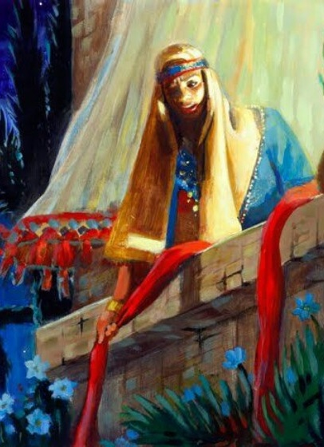
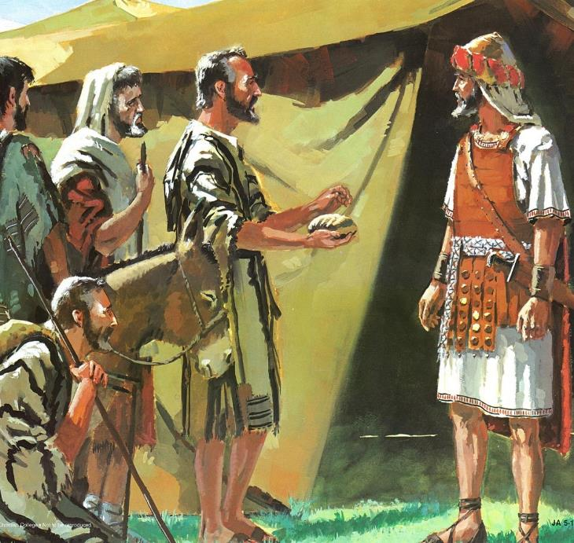
SURPRISED BY GRACE
Lesson 2 for October 11, 2025

Slide 2

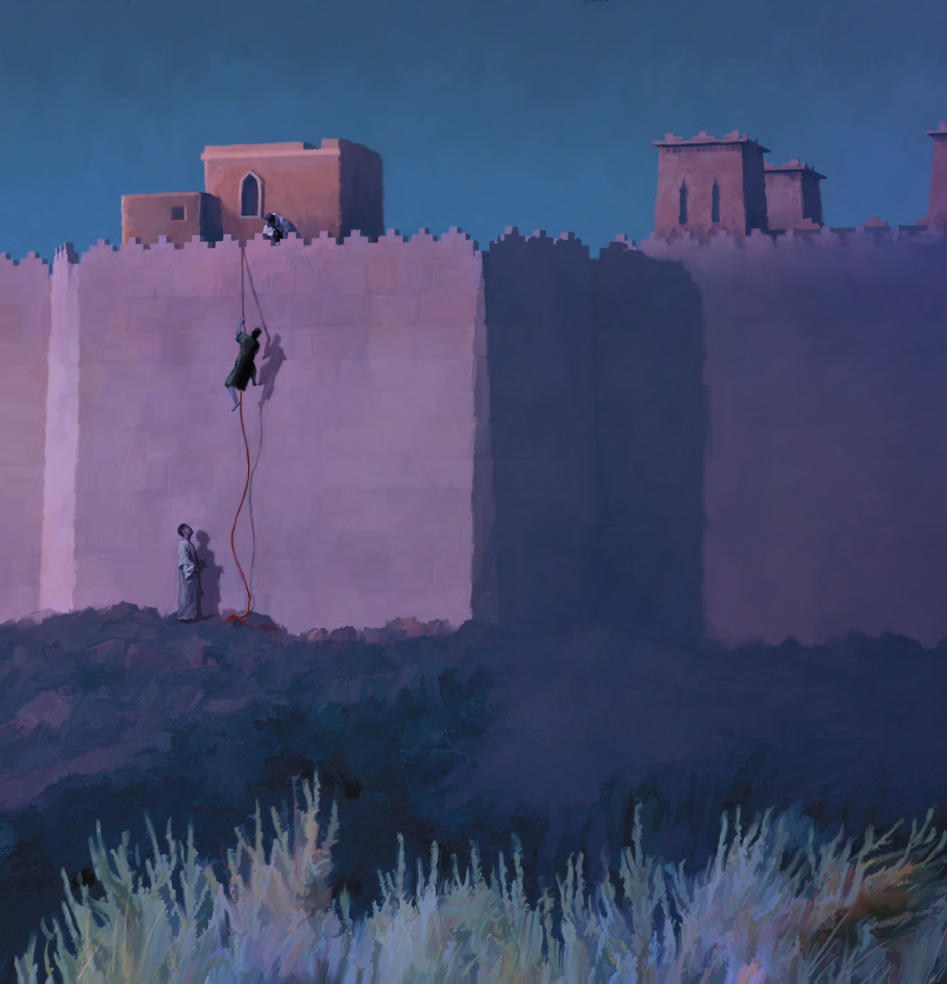
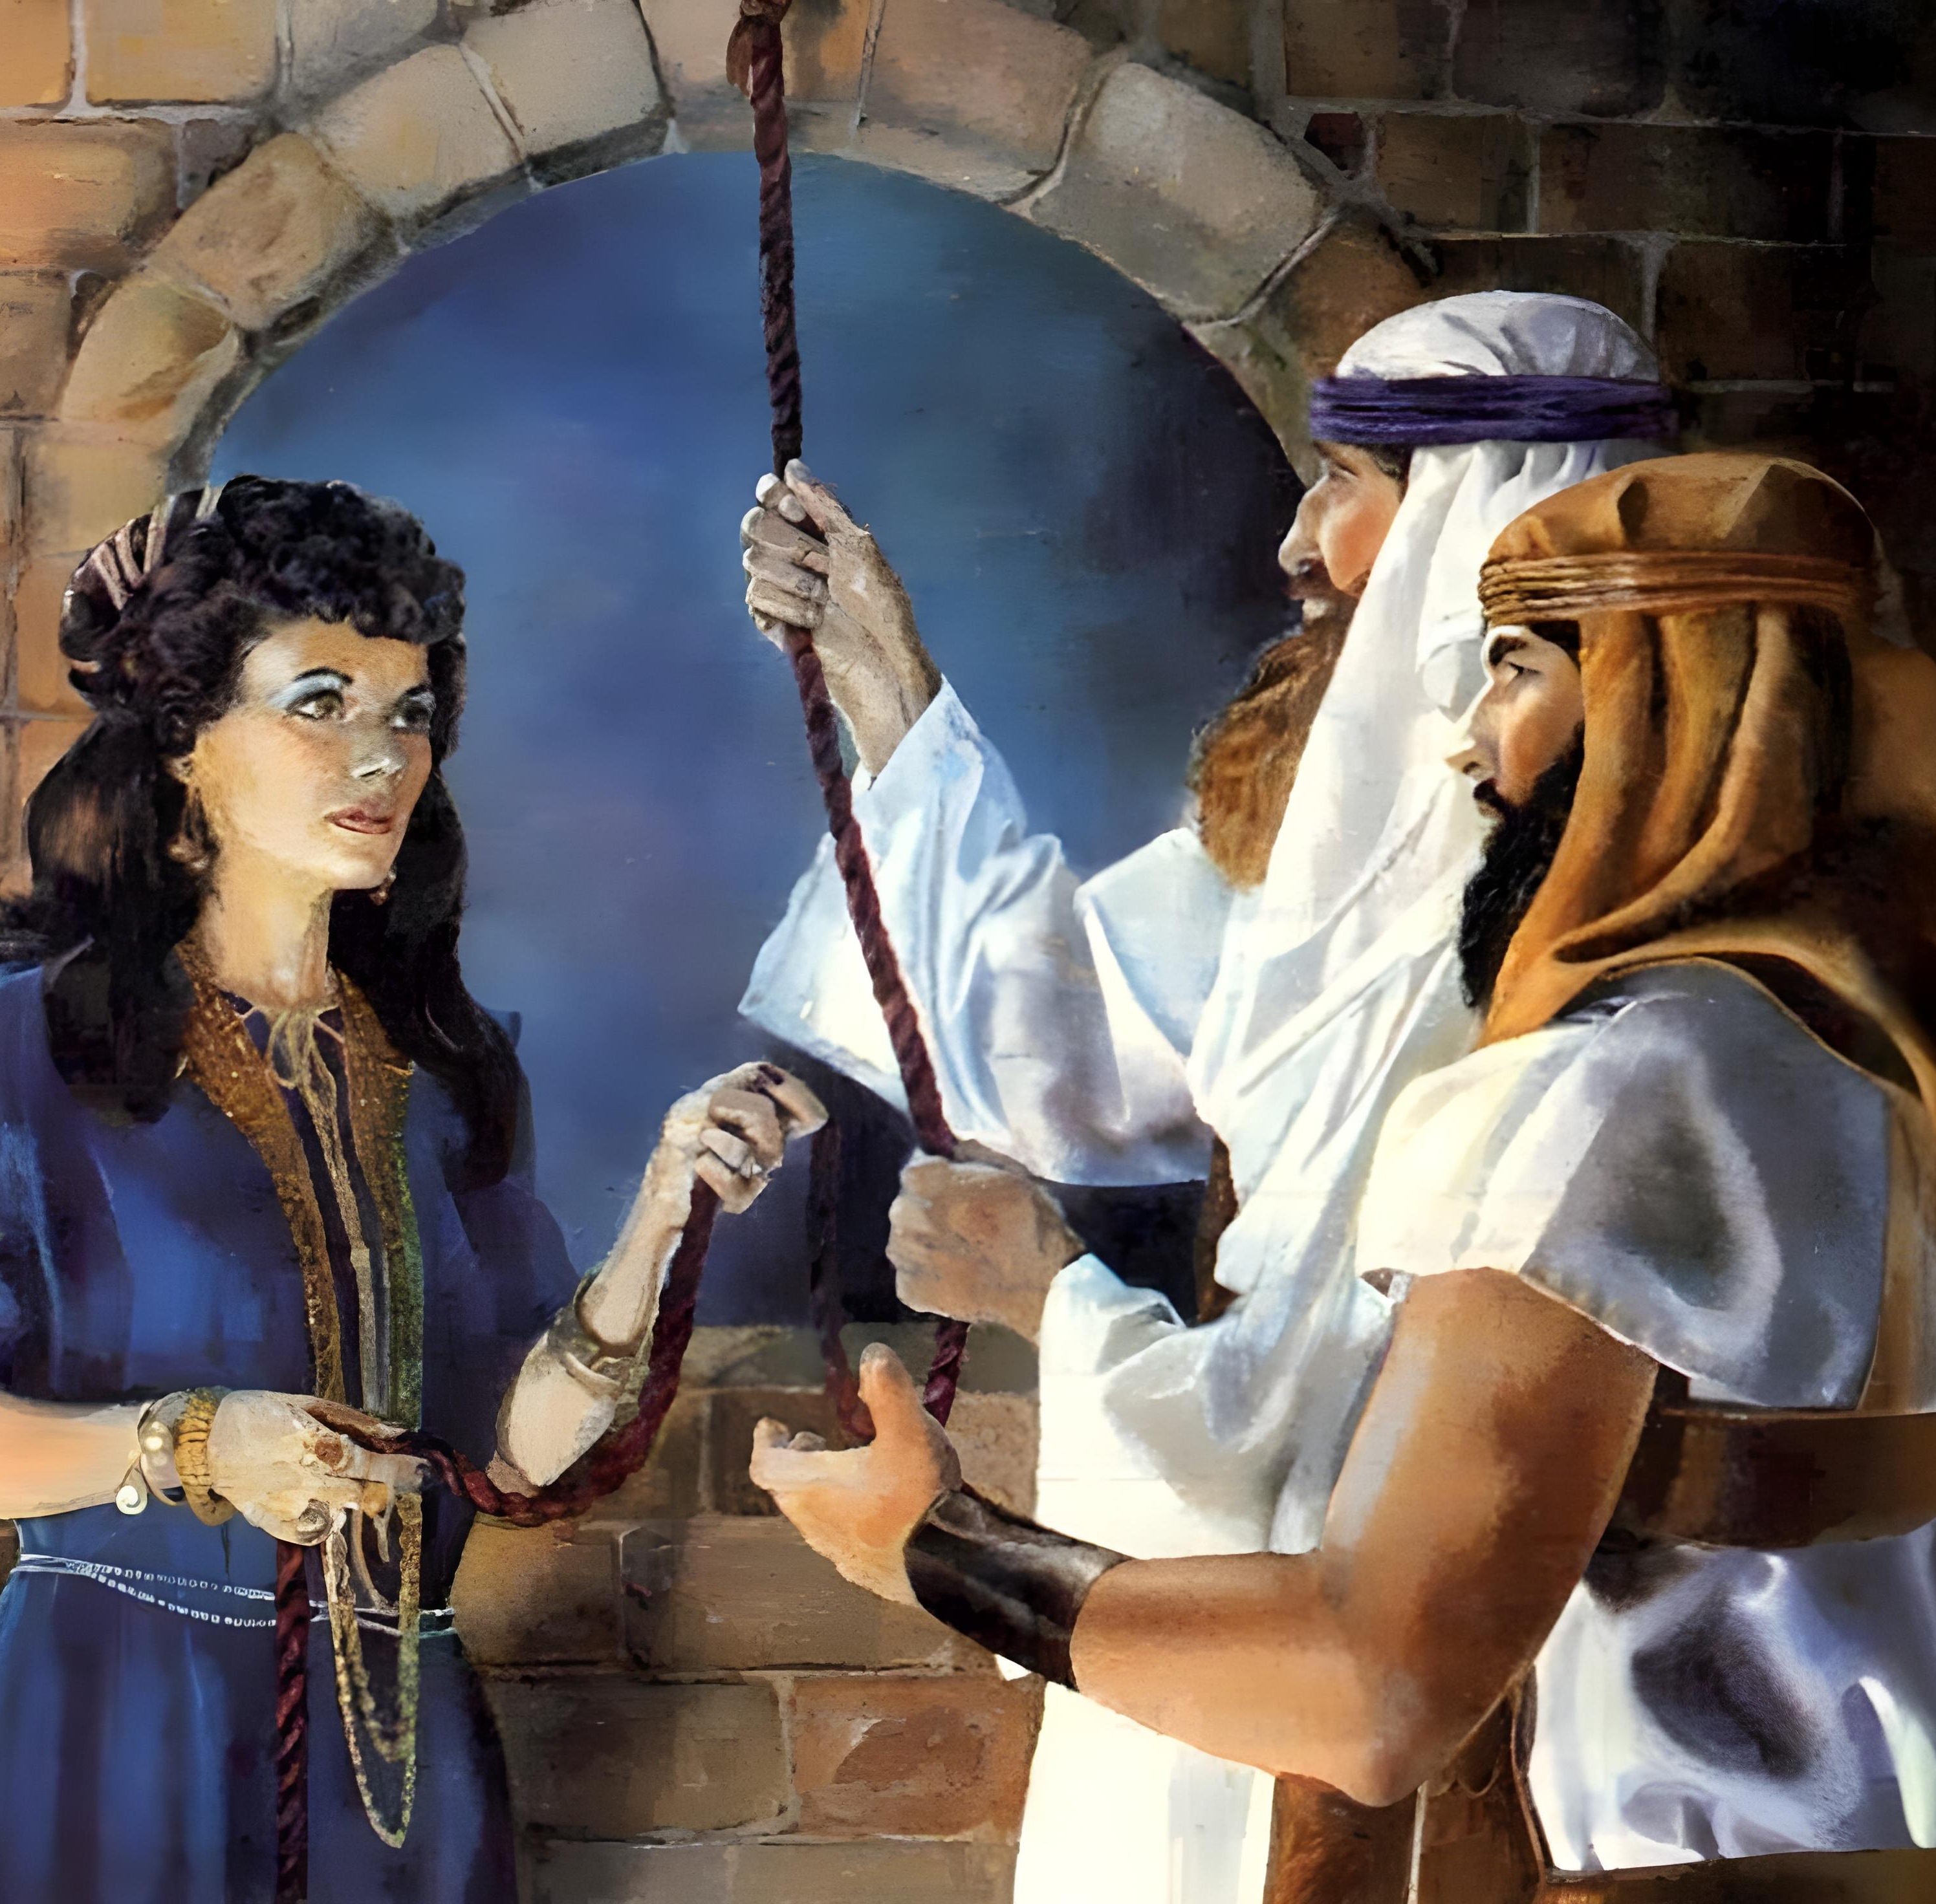
“By faith the harlot Rahab did not perish with those who did not believe, when she had received the spies with peace”
(Hebrews 11:31, NKJV)

Slide 3

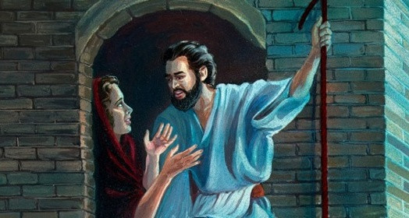
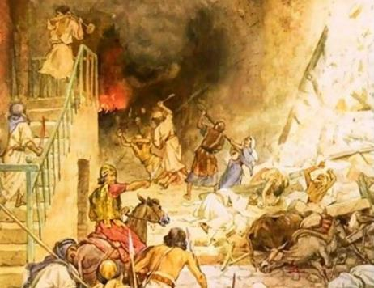



The Canaanites had overstepped the bounds of grace. For that reason, the command to Israel was: go in, kill them all, and seize their possessions.
However, there were still people in Canaan who had not crossed those boundaries. All who were willing to accept the grace God wanted to extend to them were saved from destruction.
Grace for the people of Israel (Joshua 2:1, 22-24):
Second chance
Grace for Rahab (Joshua 2:2-21):
The faith of a mustard seed
The covenant extended to Rahab
Grace for the Gibeonites (Joshua 9):
Deceptive ambassadors
Blessing and curse

Slide 4
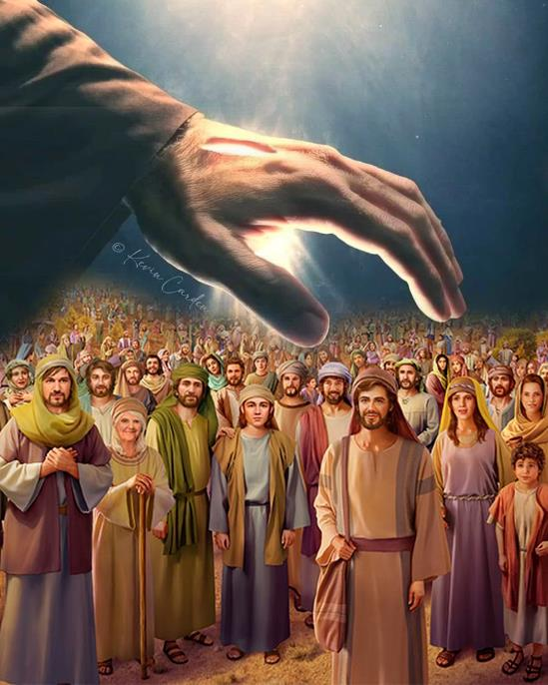
GRACE FOR THE PEOPLE OF ISRAEL
(JOSHUA 2:1, 23-24)

Slide 5


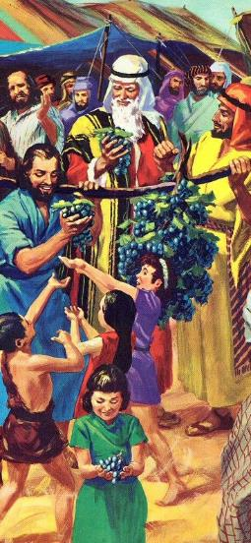
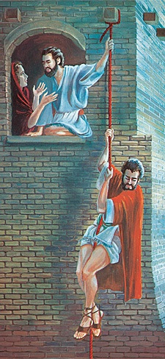
SECOND CHANCE
“Then Joshua son of Nun secretly sent two spies from Shittim. ‘Go, look over the land,’ he said, ‘especially Jericho’ ” (Joshua 2:1a NIV)
When Moses sent spies to inspect Canaan, the people refused to enter. Forty years later, new spies were sent, with different results.
Spies are sent
Publicly (12 spies)
Secretly (2 spies)
Performance of the spies
40 days inspecting
3 days in hiding
Report of the spies
They discourage the people
They encourage Joshua
Although the new generation had failed miserably in the face of Balaam's temptation, God gave them a second chance (Num. 25:1-3, 31:16; Josh. 2:1).
This time there were no bunches of grapes, no fruits of the land. Only a story of faith (that of Rahab), which encouraged Israel to possess the Promised Land.

Slide 6
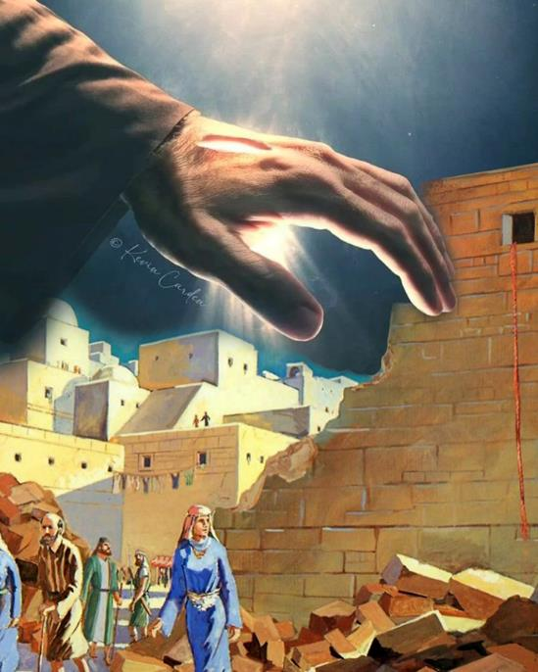
GRACE FOR RAHAB
(JOSHUA 2:2-21)

Slide 7

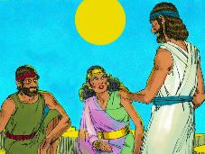
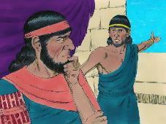
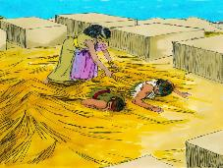
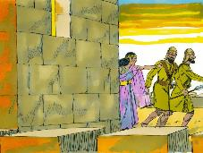
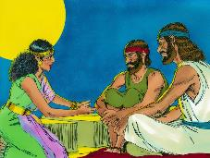
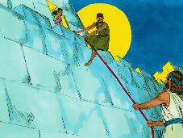
THE FAITH OF A MUSTARD SEED
“By faith Rahab the harlot did not perish with those who were disobedient, having received the spies with peace” (Hebrews 11:31)
What was Rahab's faith based on (Josh. 2:9-11)?
Notice that Rahab speaks of events that everyone knew about, such as the crossing of the Red Sea. But while the others feared the God of the Hebrews, she chose to take refuge under his wings (Josh. 2:12-13).
Why, if she believed in God, did she use a lie to help the spies?
Her fledgling faith didn't imply a complete understanding of God's will. She acted as best she could to help the spies and save her life and that of her family. Knowledge would come later.
The Bible commends her for the decision she made; for her understanding of God's way of acting; and for the way she backed up her words with concrete actions (James 2:25).
Rahab is an example of what would have happened to any Jericho resident who had surrendered to God.

Slide 8

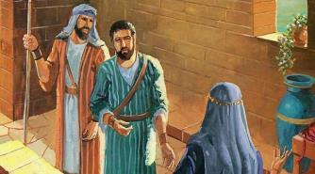
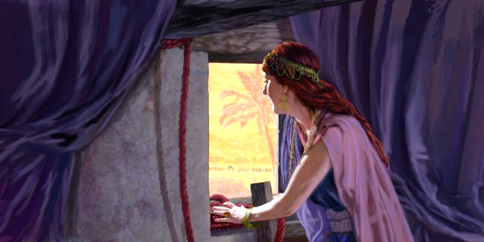
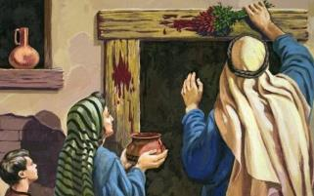
THE COVENANT EXTENDED TO RAHAB
“If any of them go outside your house into the street, their blood will be on their own heads; we will not be responsible. As for those who are in the house with you, their blood will be on our head if a hand is laid on them” (Joshua 2:19 NIV)
Israel at Passover
They had to anoint its lintel with blood (Ex. 12:7)
If they left home, they died (Ex. 12:13)
Rahab in Jericho
He had to put a red cord in his window (Josh. 2:18)
If she left the house, she died (Josh. 2:19)
Rahab's logic was indisputable: I have acted kindly [hesed] and saved you; now act kindly and save me and my relatives (Josh. 2:12-13).
Although she was not aware of it, Rahab was asking Israel to act toward her as God Himself had acted toward Israel, that is, with kindness [hesed] (Dt. 7:12).
The spies asked Rahab to fulfill the same conditions they had fulfilled to escape death in Egypt. In this way, she was included in God's covenant with Israel.

Slide 9
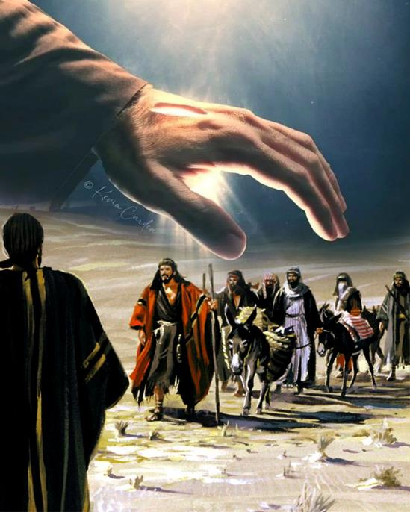
GRACE FOR THE GIBEBAITES
(JOSHUA 9)

Slide 10


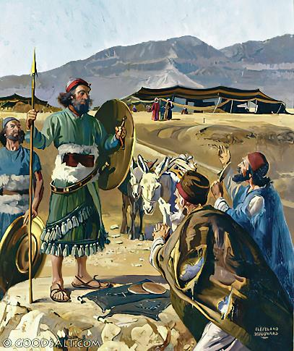
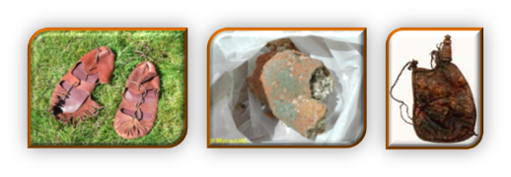
DECEPTIVE AMBASSADORS
“Then they went to Joshua in the camp at Gilgal and said to him and the Israelites, ‘We have come from a distant country; make a treaty with us’ ” (Joshua 9:6)
Notice the similarities and differences between Rahab and the Gibeonites:
Faith Elements | Rahab | Gibeonites
Basis | Hearing (2:10) | Hearing (9:3)
Means | Lie (2:4-5) | Lie (9:4)
Goal | To be spared (2:13) | To be spared (9:24)
Immediate Results | Deliverance (6:23) | Deliverance (9:26)
Long-term Results | Full citizenship (6:25) | Servitude (9:27)
Rahab lied spontaneously to free the spies. However, the Gibeonites lied deliberately, intent on deception, using cunning (see Genesis 3:1a). Furthermore, Israel's leaders failed by not consulting God (Josh. 9:14).
This placed them in a dilemma: destroy the Gibeonites, or respect the oath (Josh. 9:18).

Slide 11

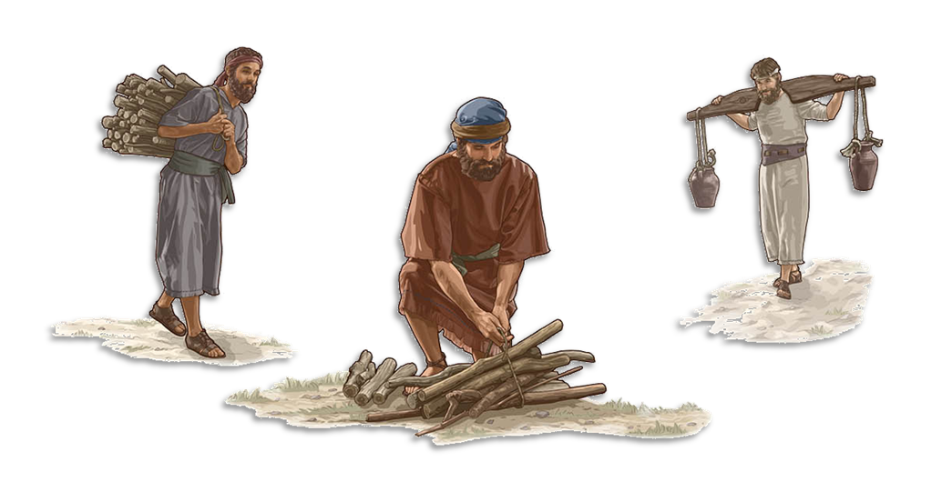
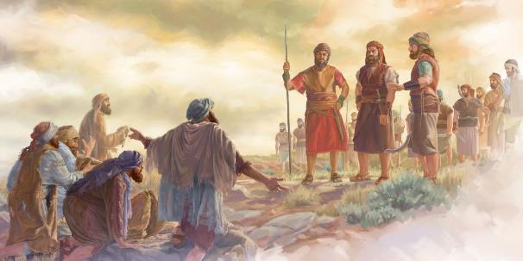
BLESSING AND CURSE
“You are now under a curse: You will never be relesed from service as woodcutters and water carriers for the house of my God” (Joshua 9:23)
Sparing the Gibeonites' lives would have disobeyed a direct command from God (Deut. 7:1-2). Breaking an oath like the one sworn to them was also considered a sin (Josh. 9:19; Ps. 15:4b). How was the dilemma resolved?
Their lives were spared, but they were placed under a curse (Josh. 9:20-23). The curse was to be servants from generation to generation. This placed them in close relationship with God's people, from whom they were never separated (Neh. 7:6, 25).
Furthermore, being water carriers and woodcutters for God's house put them in constant contact with God. By God's grace, the curse became a blessing. “I take no pleasure in the death of the wicked, but rather that they turn from their ways and live” (Ezek. 33:11 NKJV).

Slide 12

“The children of Israel were to occupy all the territory which God appointed them. Those nations that rejected the worship and service of the true God were to be dispossessed. But it was God’s purpose that by the revelation of His character through Israel men should be drawn unto Him. To all the world the gospel invitation was to be given. […] All who, like Rahab the Canaanite, and Ruth the Moabitess, turned from idolatry to the worship of the true God, were to unite themselves with His chosen people.”
EGW (Christ’s Object Lessons, p. 290)

