Slide 1
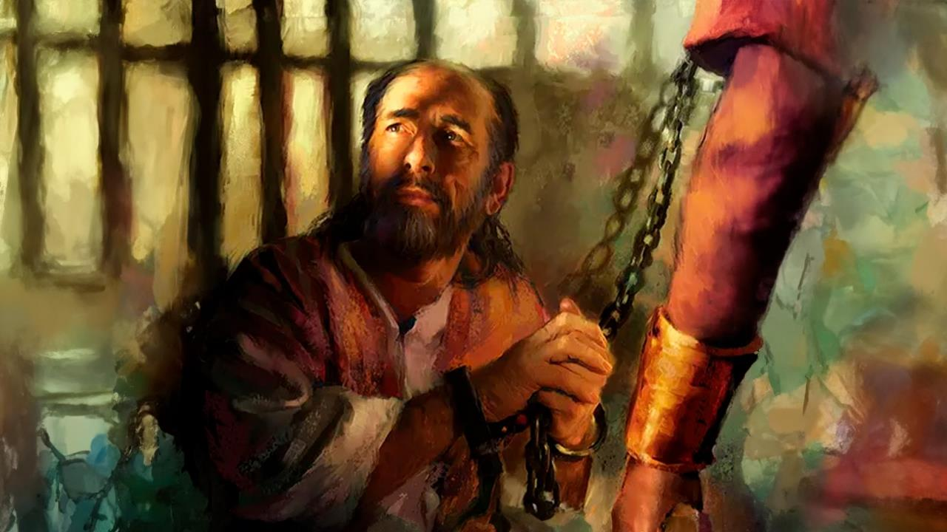
PERSECUTED BUT NOT FORSAKEN
Lesson 1 for January 3, 2026

Slide 2

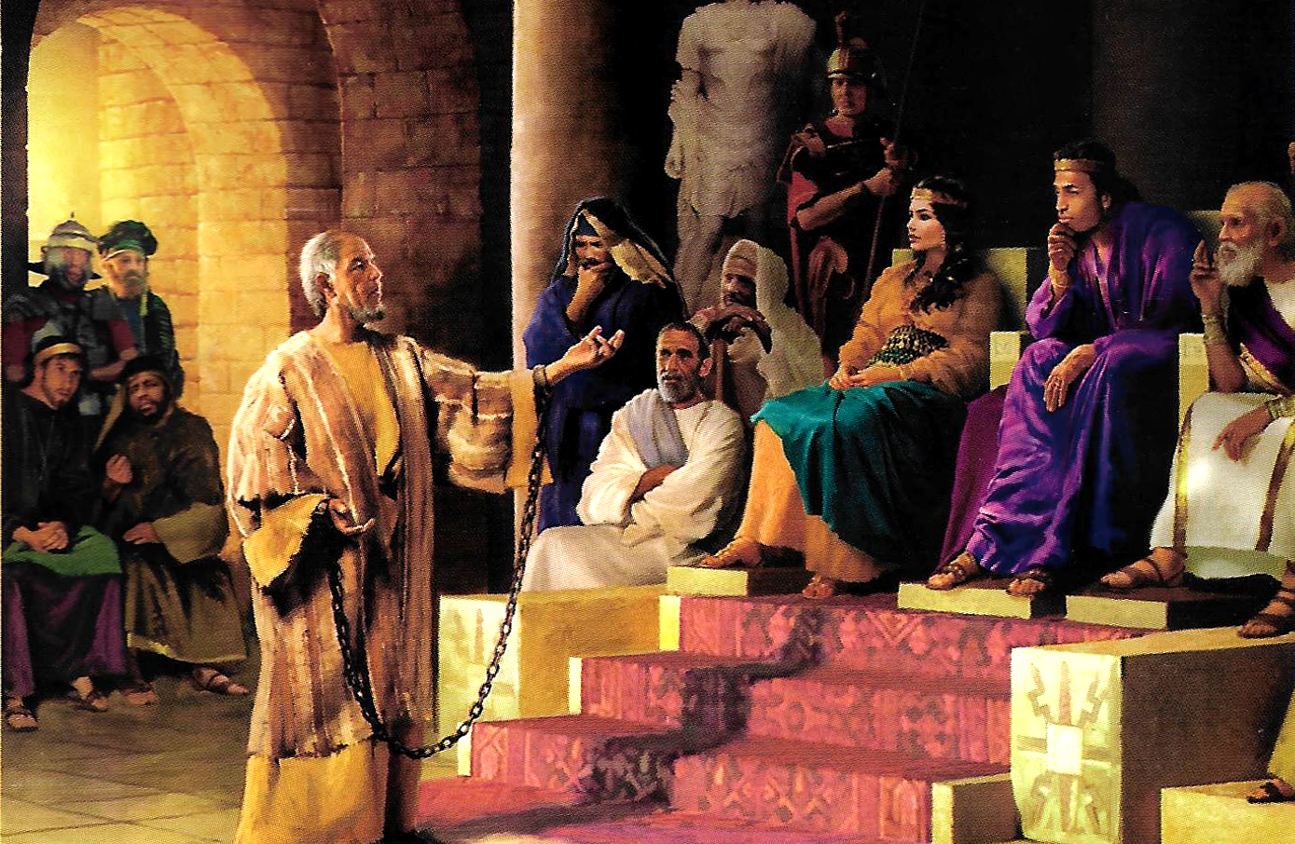
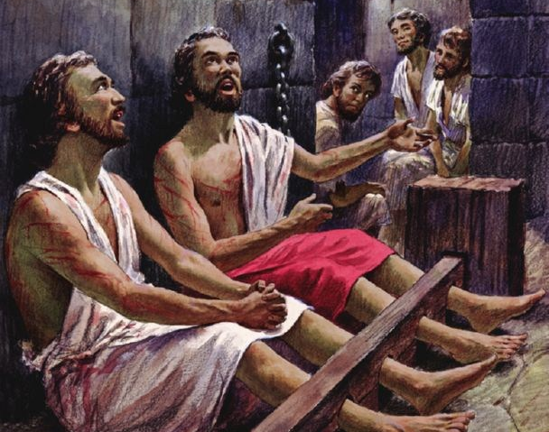
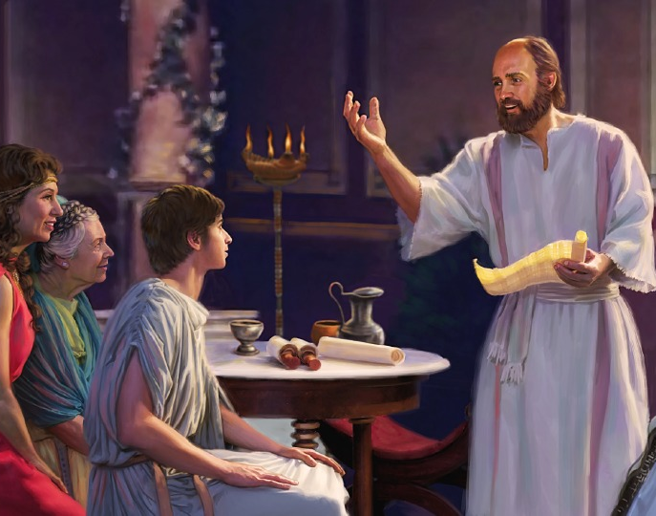
“Rejoice in the Lord always. Again I will say, rejoice!”
Philippians 4:4, NKJV

Slide 3

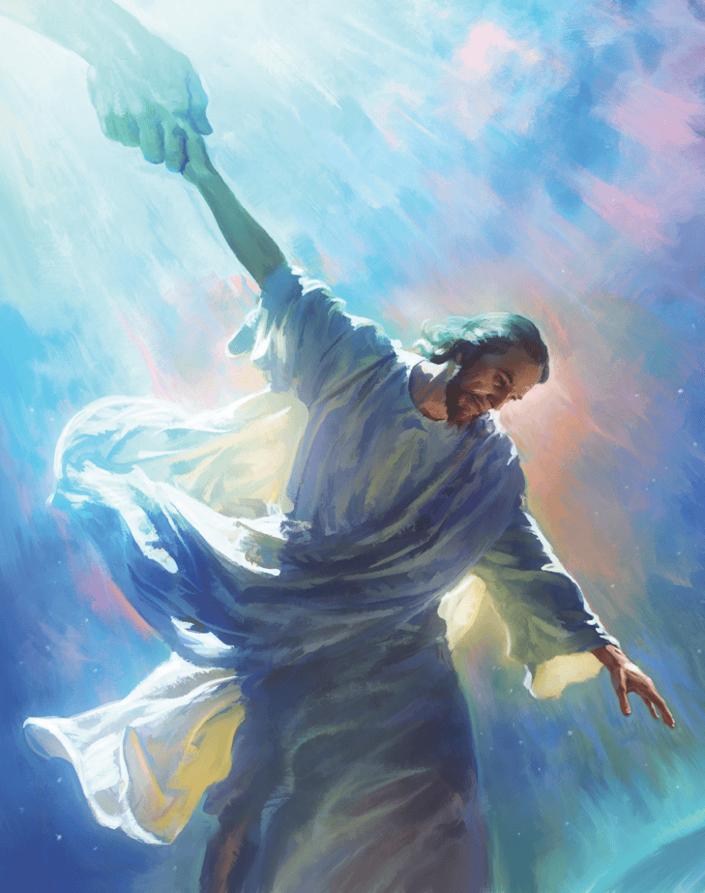


Throughout his ministry, Paul set out to present, to all those who would listen to him, the only one capable of uniting Heaven and Earth: Jesus Christ, the Savior.
In writing his letters to the Philippians and the Colossians, he did everything possible to bring the church closer to Heaven, and Christians closer to each other.
In doing so, he showed us how God's church today can unite with Heaven to fulfill on Earth the Commission that Jesus entrusted to us.
The author of the epistles:
  Paul imprisoned
  Ambassador in chains
The recipients:
  History of Philippi
  History of Colossae
  The churches of Philippi and Colossae

Slide 4
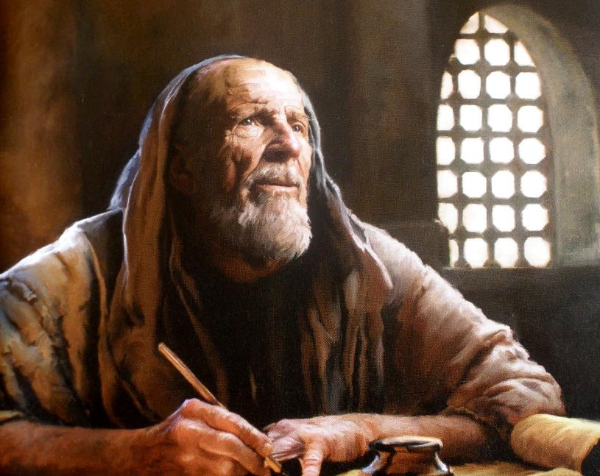

THE AUTHOR OF THE EPISTLES

Slide 5

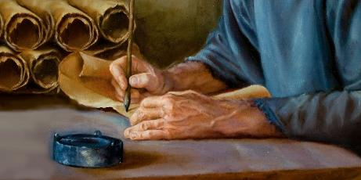
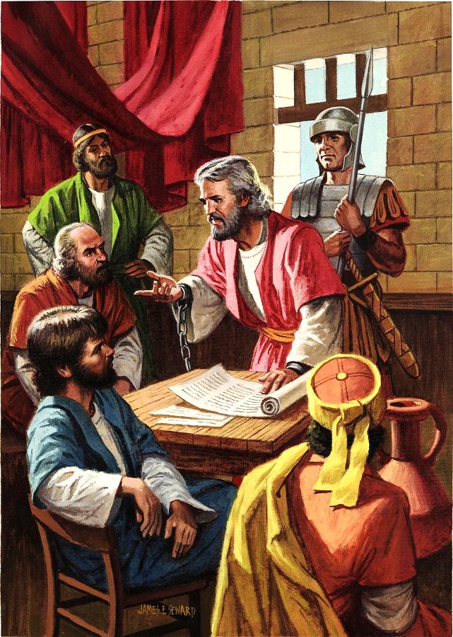
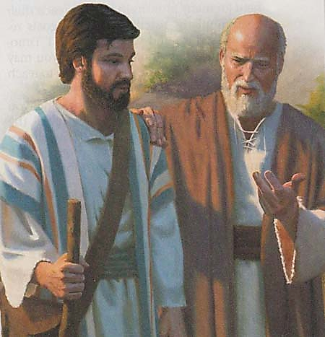
PAUL IMPRISONED
“Paul, a prisoner of Christ Jesus, and Timothy our brother, to Philemon our dear friend and fellow worker” (Philemon 1:1)
During his first imprisonment in Rome – between 60 and 62 AD – Paul wrote at least five epistles: to the Ephesians, to the Philippians, to the Colossians, to Philemon, and to the church of Laodicea (which has not reached us).
Since there were no serious charges against him, he was allowed to live in a rented house, always guarded by a Roman soldier (Acts 28:16). This allowed him to continue preaching the gospel, even to the Praetorian Guard itself (Philp. 1:13).
Examining the epistles, we can see that Paul had many collaborators (Col. 4:7-14; Philm. 23-24). He was also in contact with Caesar's household
(Philp. 4:22).
Paul had hoped to be released soon (Philm. 22), a hope he no longer had during his second imprisonment (2 Tim. 4:6).

Slide 6

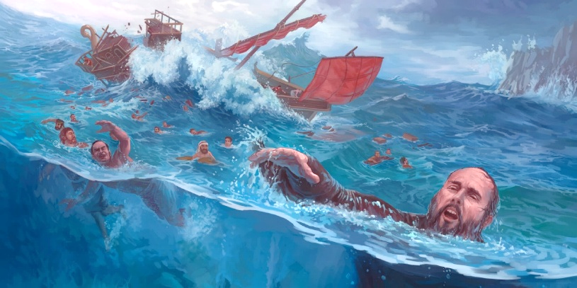
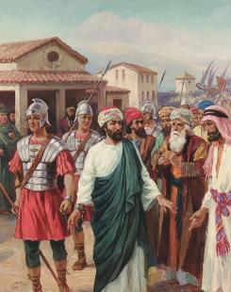
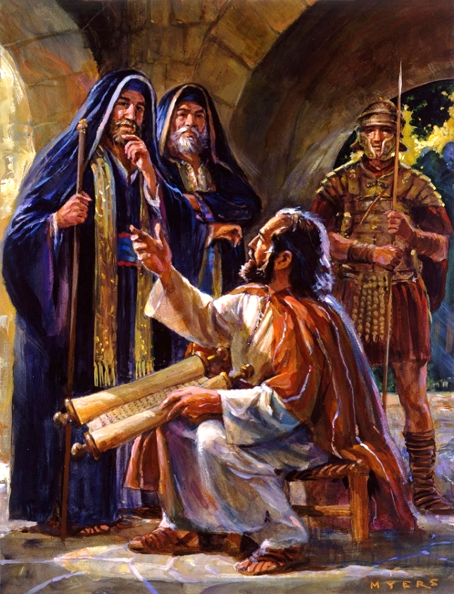
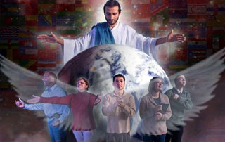
AMBASSADOR IN CHAINS
“for which I am an ambassador in chains. Pray that I may declare it fearlessly, as I should” (Ephesians 6:20)
From the moment he decided to be an ambassador for Christ, Paul's life was not easy (2 Cor. 6:4-5).
The Bible records only three imprisonments of Paul before he was taken to Rome: in Philippi (Acts 16:22-24); in Jerusalem (Acts 23:10); and in Caesarea (Acts 23:33-35). But surely there were several more (2 Corinthians 11:23).
In all these difficulties, Paul never considered himself helpless (2 Cor. 4:7-9). Unable to preach freely, he became an “ambassador in chains” (Eph. 6:20).
Paul's attitude teaches us that when we suffer hardships for preaching the gospel, we must put our full trust in God; always keep His Word in mind (2 Tim. 2:15); and cling to the Holy Spirit, the Comforter who gives us strength and courage (Zech. 4:6).

Slide 7
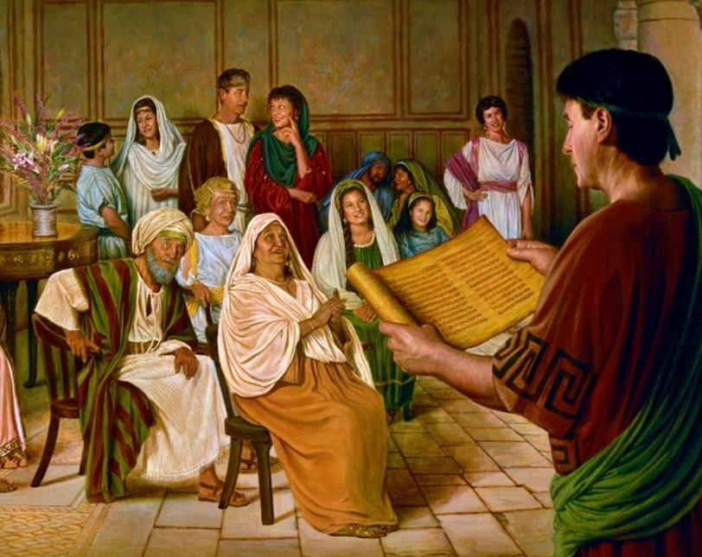

THE RECIPIENTS

Slide 8

“The apostle Paul felt a deep responsibility for those converted under his labors. Above all things, he longed that they should be faithful, "that I may rejoice in the day of Christ," he said, "that I have not run in vain, neither labored in vain." Philippians 2:16. He trembled for the result of his ministry. He felt that even his own salvation might be imperiled if he should fail of fulfilling his duty and the church should fail of co-operating with him in the work of saving souls.”
EGW (The Acts of the Apostles, p. 206)

Slide 9

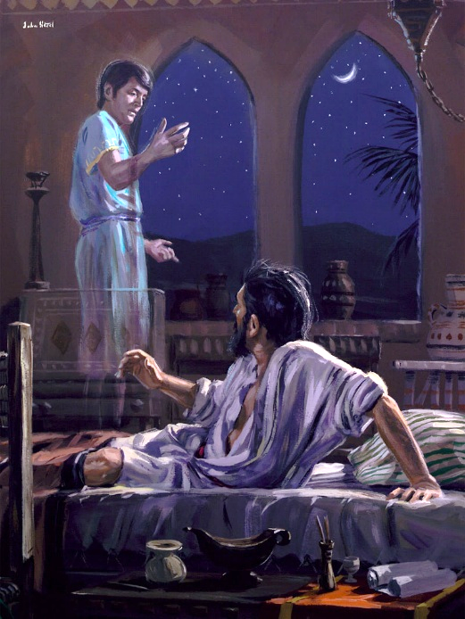
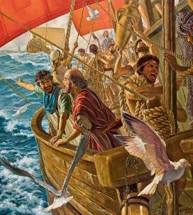
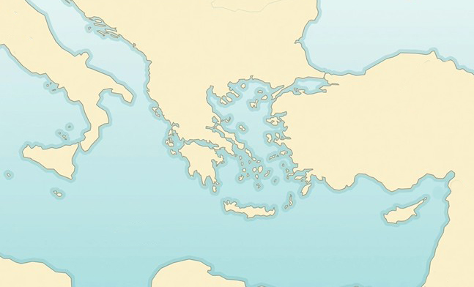

HISTORY OF PHILIPPI
“And a vision appeared to Paul in the night. A man of Macedonia stood and pleaded with him, saying, ‘Come over to Macedonia and help us’ ” (Acts 16:9)
Province of Macedonia
Philippi
Neapolis
Bithynia
Samothrace
X
During his second missionary journey, Paul's plans took a turn. The Holy Spirit was guiding his steps (Acts 16:6-12):
Troas
Mysia
Galatia
Phrygia
Paul went to Phrygia (6a)
He was unable to preach there or in Galatia (6b)
He arrived in Mysia (7a)
He tried to go to Bithynia, but he couldn't (7b)
He went to Troas, where he had a vision (8-10)
He sailed to Samothrace (11a)
From there to Neapolis (11b)
Finally, he arrived at Philippi (12)
Acts 16:6-12
Philippi was the place chosen by the Holy Spirit to begin the preaching of the Gospel in Europe. As a fully-fledged Roman city, the Philippians were exempt from paying taxes and held Roman citizenship by birth.

Slide 10

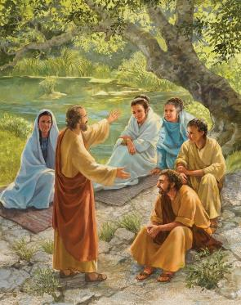
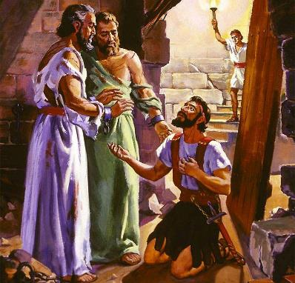
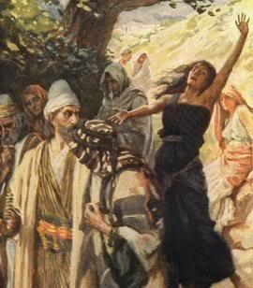
HISTORY OF PHILIPPI
“And a vision appeared to Paul in the night. A man of Macedonia stood and pleaded with him, saying, ‘Come over to Macedonia and help us’ ” (Acts 16:9)
Paul's custom upon arriving in a new city was to visit the synagogue. But in Philippi there was no synagogue! On the Sabbath they found a place of worship and there they preached to the women gathered (Acts 16:13).
From this meeting emerged the first European convert: Lydia. She was baptized, along with her entire family (Acts 16:14-15).
But the enemy did not remain idle. He urged a fortune teller to confuse people's minds by pretending to support Paul (Acts 16:16-17). When the girl was released, Paul and Silas' troubles began (Acts 16:18-24).
The result: the conversion of the jailer and his family (Acts 16:25-33). There is no doubt that the Gospel entered Europe with the power and guidance of the Holy Spirit.

Slide 11

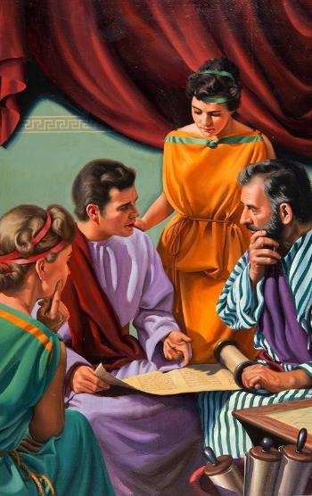
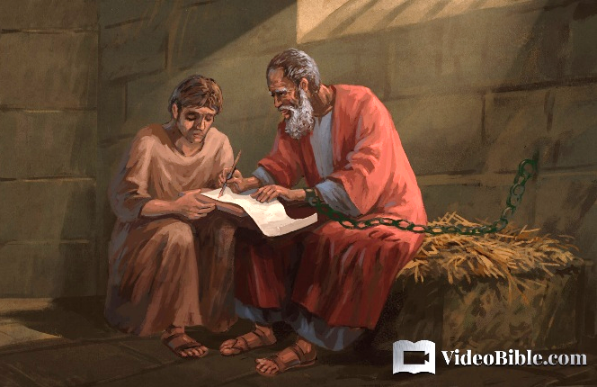
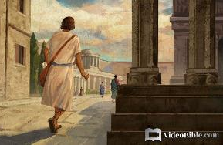
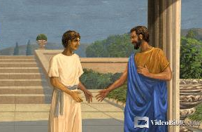
HISTORY OF COLOSSAE
“as you also learned from Epaphras, our dear fellow servant, who is a faithful minister of Christ on your behalf” (Colossians 1:7)
Epaphras was Paul's companion during his imprisonment in Rome (Philm. 23). A native of Colossae (Col. 4:12), he was the one who introduced the gospel to that city (Col. 1:7).
Colossae was a city in the province of Phrygia, near Laodicea and Heriapolis, where Epaphras also preached (Col. 4:13). It had a large Jewish population. One of the most prominent Jews living there was Philemon, a fellow worker of Paul, in whose house a church met (Philm. 1-2).
One of Philemon's slaves, Onesimus, ran away to Rome, where he accepted Jesus through Paul (Philm. 10-11). By returning Onesimus to his master, Paul showed how the relationship between masters and slaves, or superiors and subordinates, should be (Philm. 12-17).

Slide 12

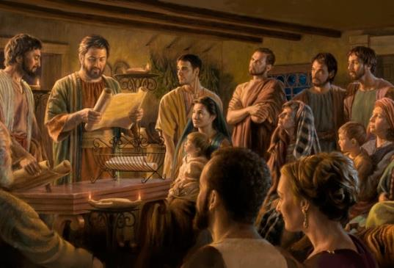
THE CHURCHES OF PHILIPPI AND COLOSSAE
“Paul and Timothy, bondservants of Jesus Christ, To all the saints in Christ Jesus who are in Philippi, with the bishops and deacons” (Philippians 1:1)
The introductions to the letters to the Philippians and to the Colossians, which are very similar, show us two important aspects (Phil. 1:1; Col. 1:1-2)
In God's eyes, church members are holy and faithful, despite their mistakes
In the church there is an order, where some of its members have more authority and responsibility than others:
Paul is an apostle, a top-level leader
Timothy is his collaborator (pastor)
Bishops are local leaders (elders)
Deacons administer the church
From prison, Paul thanks the Philippians for the help they sent him (Phil. 4:18).
To the Colossians, he sends his collaborators to comfort them (Col. 4:7-9).

Slide 13

“Let us consider the experience of Paul for a little. At the very time when it seemed that the apostle’s labors were most needed to strengthen the tried and persecuted church, his liberty was taken away, and he was bound in chains. But this was the time for the Lord to work, and precious were the victories won.
When to all appearance Paul was able to do the least, then it was that the truth found an entrance into the royal palace. Not Paul’s masterly sermons before these great men, but his bonds attracted their attention. Through his captivity he was a conqueror for Christ. The patience and meekness with which he submitted to his long and unjust confinement set these men to weighing character.”
EGW (Reflecting Christ, December 10)

