Slide 1

Lesson 12 for March 21, 2026
LIVING WITH EACH OTHER

Slide 2
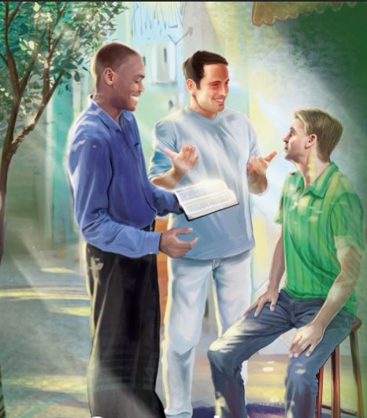
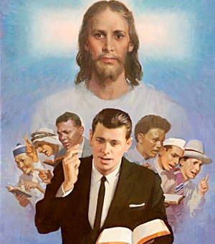


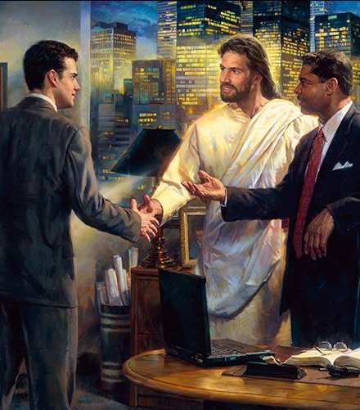

“Let your speech always be with grace, seasoned with salt, that you may know how you ought to answer each one” Colossians 4:6, NKJV

Slide 3




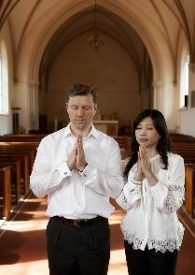

In the more practical part of the letter, Paul addresses the topic of interpersonal relationships in various circles of influence.
Relationships cause tension and arguments. Therefore, there needs to be harmony, a general agreement about values, goals, and objectives.
Paul provides us with useful principles for improving relationships between spouses, between parents and children, between masters and slaves, between church brothers and sisters, and between believers and unbelievers.
Relationships between spouses (Col. 3:18-19)
Relationships between parents and children (Col. 3:20-21)
Relationships between bosses and workers (Col. 3:22-25; 4:1)
Relationships in the Church (Col. 4:2-4)
Relationships with unbelievers (Col. 4:5-6)

Slide 4




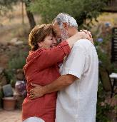


RELATIONSHIPS BETWEEN SPOUSES
“Wives, submit yourselves to your husbands, as is fitting in the Lord. Husbands, love your wives and do not be harsh with them.” (Colossians 3:18-19)
Written at the same time, the epistles of Colossians and Ephesians contain similar (and complementary) advice regarding spouses (Col. 3:18-19; Eph. 5:21-33).
Wives are subject to their husbands (Col. 3:18; Eph. 5:22-24)
This submission is within a mutual submission (Eph. 5:21), and must be “as is fitting in the Lord.”
Husbands should love their wives (Col. 3:19; Eph. 5:28)
Love them with the same love that Christ loved us (Eph. 5:25)
They are responsible for their own well-being (Eph. 5:29)
Do not be “harsh” (do not embitter them, do not behave harshly or violently, do not be tyrannical)
Both spouses should work as a team, consult with each other, and make decisions unanimously, with the husband being the ideal leader of the family. Each should always seek the well-being of the other.

Slide 5

“Let each give love rather than exact it. Cultivate that which is noblest in yourselves, and be quick to recognize the good qualities in each other. The consciousness of being appreciated is a wonderful stimulus and satisfaction. Sympathy and respect encourage the striving after excellence, and love itself increases as it stimulates to nobler aims. […]
The wife is to respect her husband. The husband is to love and cherish his wife; and as their marriage vow unites them as one, so their belief in Christ should make them one in Him. What can be more pleasing to God than to see those who enter into the marriage relation seek together to learn of Jesus and to become more and more imbued with His Spirit?
EGW (The Christian Home, pp. 107, 114)

Slide 6




RELATIONSHIPS BETWEEN PARENTS AND CHILDREN
“Children, obey your parents in everything, for this pleases the Lord. Fathers, do not embitter your children, or they will become discouraged. (Colossians 3:20-21)
In today's society, the word "parents" should be applied to both established marriages and single-parent families. According to Paul, a healthy relationship is not solely the responsibility of the parents, but also of the children themselves.
Responsibilities of sons and daughters (Col. 3:20; Eph. 6:1-3)
Children's obedience is not optional
This obedience is based on the fifth commandment
Furthermore, obedience comes with its own reward
Parental Responsibilities (Col. 3:21; Eph. 6:4)
Educate them without exasperating or irritating them, so as not to discourage them
Do not anger them by acting impatiently or capriciously
Educate them in the ways of God (Deut. 6:6-7; Prov. 22:6)
Morning and/or evening family worship is important for our children to learn about God and make decisions for eternal life. And let's not forget that our example is the greatest educator of our children.

Slide 7

“Parents, let your children see that you love them and will do all in your power to make them happy. If you do so, your necessary restrictions will have far greater weight in their young minds. Rule your children with tenderness and compassion, remembering that “their angels do always behold the face of My Father which is in heaven.” If you desire the angels to do for your children the work given them of God, co-operate with them by doing your part.”
EGW (The Christian Home, p. 193)

Slide 8



RELATIONSHIPS BETWEEN BOSSES AND WORKERS
“Slaves, obey your earthly masters in everything; and do it, not only when their eye is on you and to curry their favor, but with sincerity of heart and reverence for the Lord.” (Colossians 3:22)
The relationship of servitude that existed in Paul's time has little to do with the types of slavery that, unfortunately, still exist today. Therefore, we must understand this advice within the context of a boss/subordinate relationship.
Behavior of subordinates (Col. 3:22-25; Eph. 6:5-8)
Always do your best, even if no one is watching
Strive for excellence in your work, as if you were doing it for God
Accept reprimand when it is justified
Good work pays off
A bad boss does not exempt us from subordination (1P 2:18)
Behavior of bosses (Col. 4:1; Eph. 6:9)
To lead with justice and righteousness
Do not use threats or capricious demands
Every boss has a Boss over him, to whom he will be accountable
All of us, bosses or subordinates, are servants (slaves) of Christ, since we serve Him.

Slide 9

“It was not the apostle’s work to overturn arbitrarily or suddenly the established order of society. To attempt this would be to prevent the success of the gospel. But he taught principles which struck at the very foundation of slavery and which, if carried into effect, would surely undermine the whole system. […]
Christianity makes a strong bond of union between master and slave, king and subject, the gospel minister and the degraded sinner who has found in Christ cleansing from sin. They have been washed in the same blood, quickened by the same Spirit; and they are made one in Christ Jesus.
EGW (The Acts of the Apostles, p. 460)

Slide 10


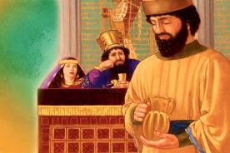

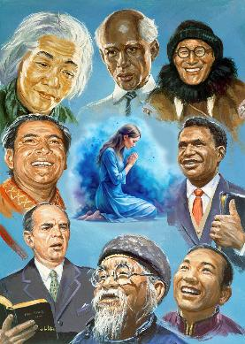
RELATIONSHIPS IN THE CHURCH
“Devote yourselves to prayer, being watchful and thankful” (Colossians 4:2)
We are urged to “pray for each other” because “The prayer of a righteous person is powerful and effective” (James 5:16 NIV).
Beyond morning and evening prayers, Paul proposes that we pray at any time (Col. 4:2; Eph. 6:18; 1 Thess. 5:17). Just as Nehemiah prayed silently before the king (Neh. 2:4), we have the privilege of praying in any place or situation.
Furthermore, we have the assurance that the Holy Spirit will transform our prayer to make it effective (Rom. 8:26).
Paul makes a special request to pray for those who proclaim the gospel (Col. 4:3-4; Eph. 6:19). It doesn't matter if the preacher has little or much experience in evangelism; no one is sufficient for this work. Paul himself not only prayed, but also asked the brothers to pray for him so that his words would be the right ones.

Slide 11

“In every effort in every place where the truth is introduced there is need of different minds, different gifts, different plans and methods of labor being united. All should make it a point to counsel together, to pray together. Christ says that, “If two of you shall agree on earth as touching any thing that they shall ask, it shall be done for them of my Father which is in heaven.” (Matthew 18:19)”
EGW (Selected Messages, vol. 3, p. 24)

Slide 12

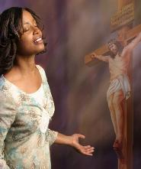
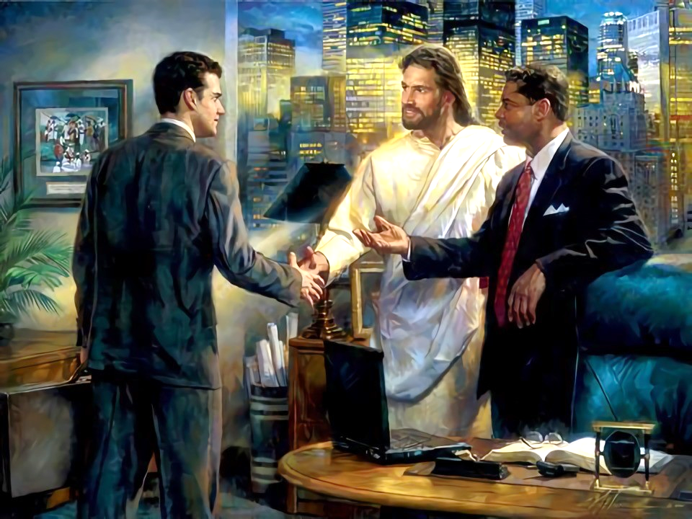
RELATIONSHIPS WITH UNBELIEVERS
“Be wise in the way you act toward outsiders; make the most of every opportunity.” (Colossians 4:5 NIV)
We have great benefits: we have learned what Jesus did for us; we have accepted it; and we have the assurance of salvation.
We know this because someone told us. Likewise, we must share it with others. How does Paul say we should relate to “outsiders,” those who do not yet know Jesus (Col. 4:5-6)?
With wisdom
We need “the wisdom that comes from heaven” (James 3:17) in our relationship with those who do not yet know Jesus
With kind words
Our words should always be courteous so that they will listen to us with pleasure.
With words “seasoned with salt”
The conversation should be appropriate and adapted to the person and the environment around them.
Answering each one as appropriate
Since each person is different, the Holy Spirit will guide us on what to respond in each moment

Slide 13

“True courtesy blended with truth and justice makes the life not only useful but beautiful and fragrant. Kind words, pleasant looks, a cheerful countenance, throw a charm about the Christian that makes his influence almost irresistible. In forgetfulness of self, in the light and peace and happiness that he is constantly bestowing on others, he finds true joy.
Let us be self-forgetful, ever on the watch to cheer others, to lighten their burdens by acts of tender kindness and deeds of unselfish love.”
EGW (In Heavenly Places, June 22)

