Slide 1
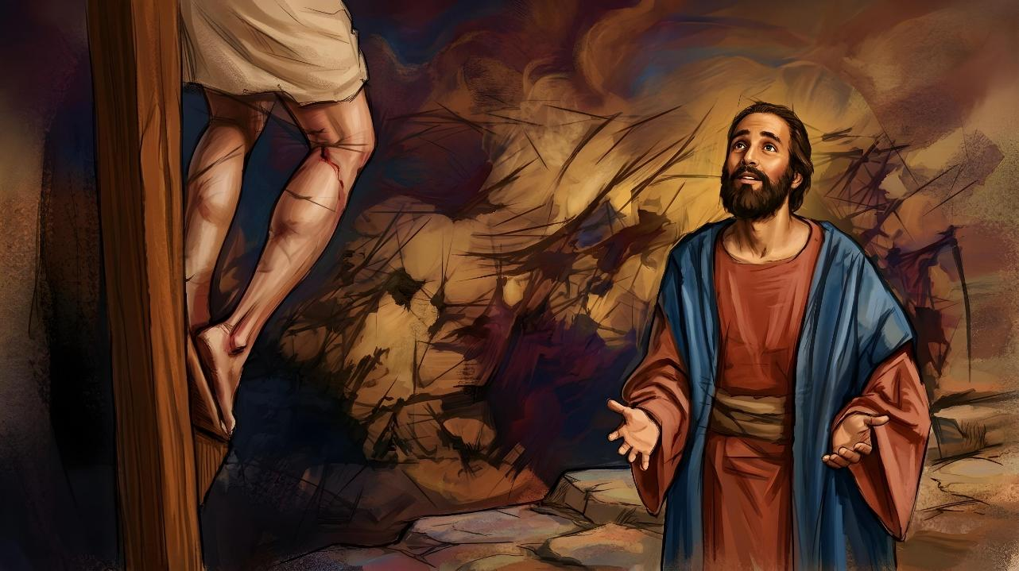
THE MESSAGE OF THE CROSS
Lesson 2 for July 11, 2026

Slide 2

“For the message of the cross is foolishness to those who are perishing, but to us who are being saved it is the power of God”
(1 Corinthians 1:18, NIV)

Slide 3

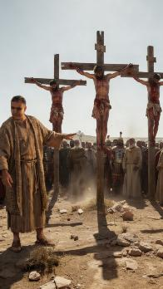
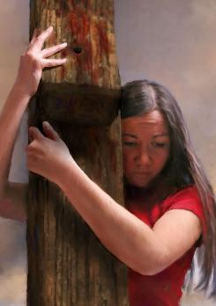

1 Corinthians 1:17-31 speaks of the way in which the cross impacts people's lives.
For believers, the cross is a symbol of salvation. But for people who lived in the first century, the cross represented only the shameful death of a criminal.
Saved by someone who died on a cross and then rose again? To men it is foolishness, senselessness, and weakness. But for those of us who have opened our hearts to the call of the Holy Spirit, the cross is “the power of God, […] wisdom, righteousness, sanctification, and redemption” (1 Cor. 1:18, 30).
The wisdom of God
The madness of the cross
The power of God
The message of the cross
The foolishness and weakness of God

Slide 4

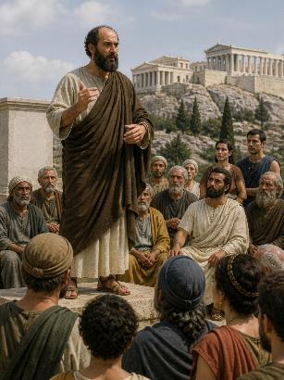
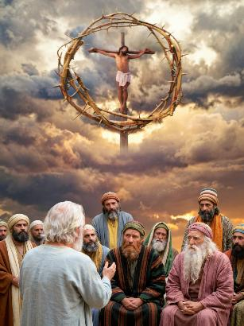
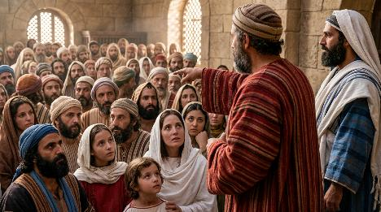
THE WISDOM OF GOD
“But to those whom God has called, both Jews and Greeks, Christ the power of God and the wisdom of God.” (1 Corinthians 1:24)
In Athens, Paul had used human wisdom to try to convince the wise men. From then on, he decided to use only divine wisdom.
God Himself had sent him to preach His message “without words of human wisdom, so that the cross of Christ might not be emptied of its power” (1 Cor. 1:17 NIV).
What is the divine wisdom preached by Paul?
The wisdom of God destroys “the wisdom of the wise”; it casts aside “the understanding of the wise” (1 Cor. 1:19); and “has made foolish … the wisdom of the world” (1 Cor. 1:20).
Contrary to all human logic, God's wisdom consists in “saving believers through the foolishness of preaching”
(1 Corinthians 1:21).

Slide 5

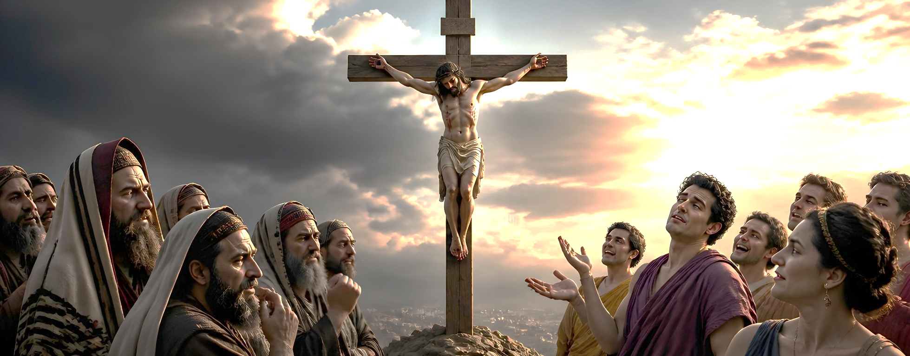

THE MADNESS OF THE CROSS
“but we preach Christ crucified: a stumbling block to Jews and foolishness to Gentiles” (1 Corinthians 1:23)
The Greek word mōria (madness, folly, foolishness) is used five times in 1 Corinthians:
“The message of the cross is foolishness to those who are perishing” (1 Corinthians 1:18)
“It pleased God through the foolishness of preaching to save those who believe” (1 Cor. 1:21)
“Christ crucified, […] foolishness to the Gentiles” (1 Cor. 1:23)
“To the natural man […] the things of the Spirit of God […] are foolishness” (1 Cor. 2:14)
“For the wisdom of this world is foolishness in God’s sight” (1 Corinthians 3:19)
The cross is foolishness to those who are lost; to those who do not know God (Gentiles); to those who only think about this world (natural man); to those who are governed only by their own wisdom.
But the cross is a blessing for those who are saved, that is, for those who are willing to see the cross from God's point of view.

Slide 6

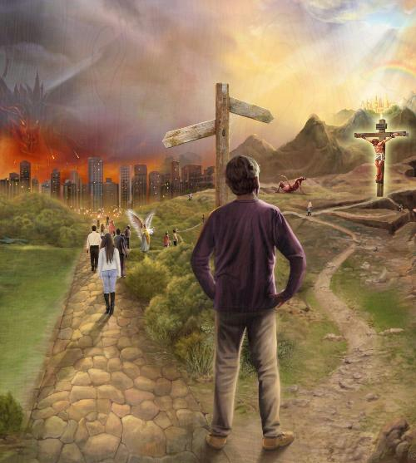
THE POWER OF GOD
“For the message of the cross is foolishness to those who are perishing, but to us who are being saved it is the power of God.” (1 Corinthians 1:18)
The cross has the power to show the worst of man and the best of God (1 Cor. 1:18).
The worst of man
Madness
Self-destruction
God's best
Power
Forgiveness
Perdition
Salvation
Rejection
Acceptance
Those who reject the cross reap the consequences of their wrong actions, and will ultimately be destroyed by the One they rejected.
The power of God, shown on the cross, is able to reconcile man with God by forgiving all his sins, and to grant him eternal life (Col. 1:20; 1P. 2:24).

Slide 7

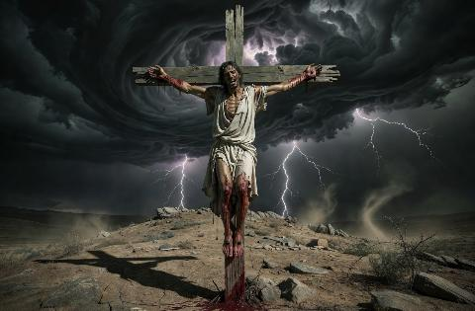
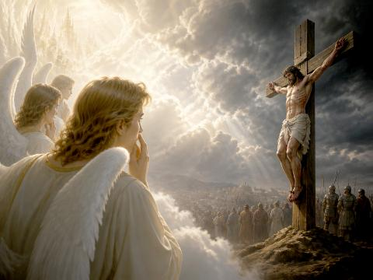
THE MESSAGE OF THE CROSS
“For since in the wisdom of God the world through its wisdom did not know him, God was pleased through the foolishness of what was preached to save those who believe.” (1 Corinthians 1:21)
Why is preaching the message of the cross foolishness (1 Corinthians 1:21-24)?
The Jews were expecting a Messiah who would deliver them from Roman oppression. When Jesus announced that he was going to be crucified, his own disciples were horrified. Moreover, for a Jew, a man hanging on a tree was a person cursed by God (Deuteronomy 21:23). For a Gentile, who wasn't even expecting a Redeemer, the conclusion was the same: the cross is madness.
However, for the angels, the message of the cross was something entirely different. Jesus, whom they had known in Heaven, allowed himself to be killed out of love for a race that had rejected him. This is the perspective Paul wanted to convey through his preaching.
The message of the cross shows how far God has been willing to go to grant us salvation.

Slide 8

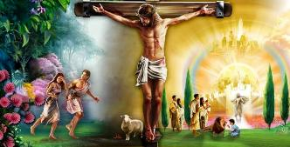

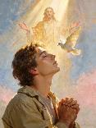
THE FOOLISHNESS AND WEAKNESS OF GOD
“For the foolishness of God is wiser than human wisdom, and the weakness of God is stronger than human strength.” (1 Corinthians 1:25)
Is God in any way foolish or weak (1 Cor. 1:25)?
Of course not, since God has no imperfections. Paul is simply making a figurative comparison: If God had any foolish thoughts, he would be wiser than the wisest thought of a person; or if there were any weak arguments in God, they would be much stronger than the strongest human arguments.
All the wisdom gathered from the wisest people is incapable of conceiving a plan of salvation for humanity.
Only God has been able to grant redemption, through the power of Jesus' sacrifice offered on the cross, “to those who are being saved” (1 Cor. 1:18); “to believers” (1 Cor. 1:21); and “to those who are called” (1 Cor. 1:24).
Note that only those who believe in Jesus in response to the call of the Holy Spirit will be saved .

Slide 9

“To the minds of multitudes living at the present time, the cross of Calvary is surrounded by sacred memories. Hallowed associations are connected with the scenes of the crucifixion. But in Paul's day the cross was regarded with feelings of repulsion and horror. To uphold as the Saviour of mankind one who had met death on the cross, would naturally call forth ridicule and opposition. […]
He would be looked upon as weak-minded for attempting to show how the cross could have any connection with the elevation of the race or the salvation of mankind.
But to Paul the cross was the one object of supreme interest. […] He knew by personal experience that when a sinner once beholds the love of the Father, as seen in the sacrifice of His Son, and yields to the divine influence, a change of heart takes place, and henceforth Christ is all and in all.”
EGW (The Acts of the Apostles, p. 245)

