Slide 1
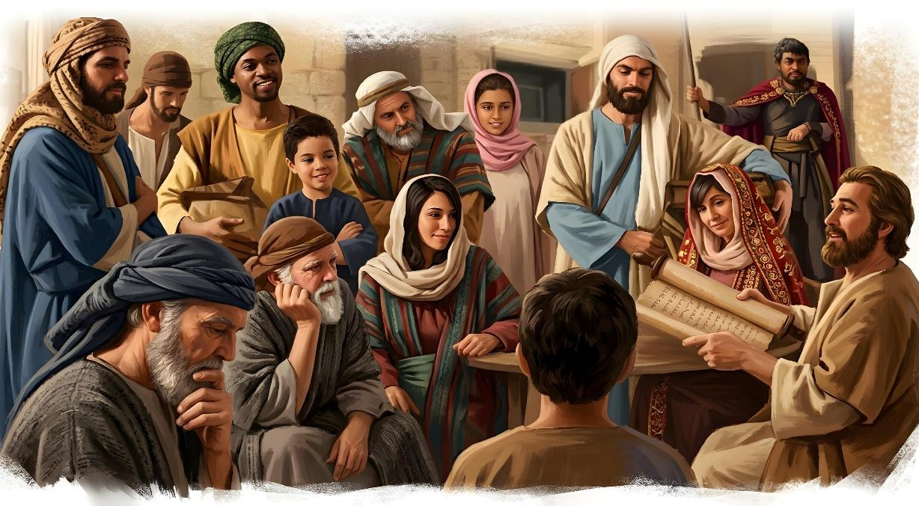
Lesson 3 for July 18, 2026
UNITY IN CHRIST

Slide 2
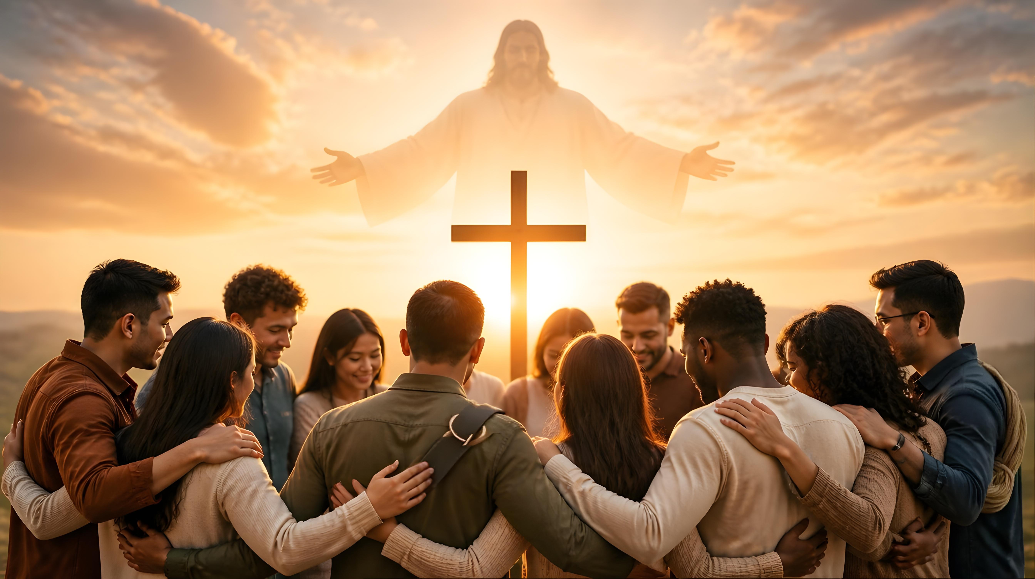
“I appeal to you, brothers, by the name of our Lord Jesus Christ, that all of you agree, and that there be no divisions among you, but that you be united in the same mind and the same judgment” (1 Corinthians 1:10, ESV)

Slide 3

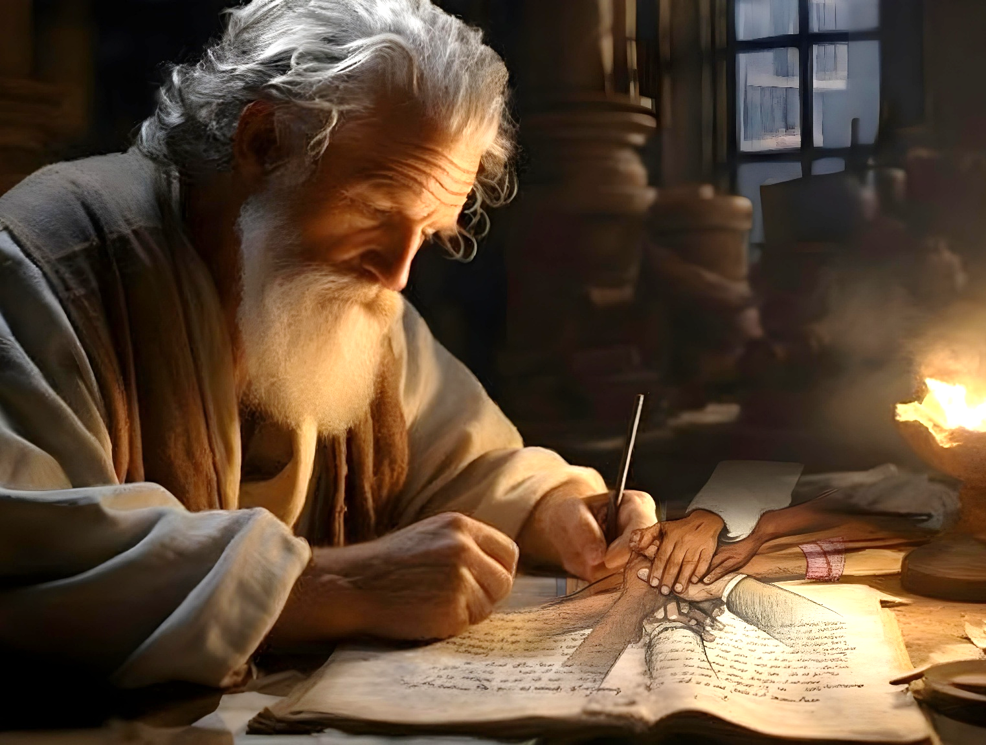
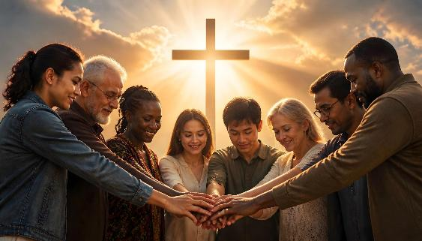


After greeting the Corinthians and praising them for their spiritual growth, Paul goes on to address the first of the problems affecting that church: the lack of unity.
Throughout the epistles to the Corinthians, and others that Paul wrote, we see how he gives us guidelines to solve this problem, which can also affect churches today.
One point is clear from the outset: unity in the church cannot be achieved through human effort. Only by focusing on Jesus can we attain unity.
Problems that cause disunity:
  Divisions and contentions
How to maintain unity:
  Unity in Jesus
  Wisdom and maturity
  Service and humility
  Respect for leaders

Slide 4

PROBLEMS THAT CAUSE DISUNITY

Slide 5

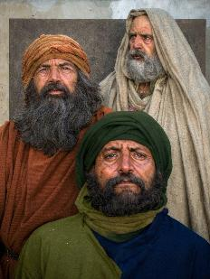
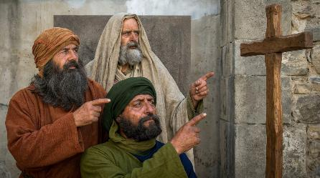
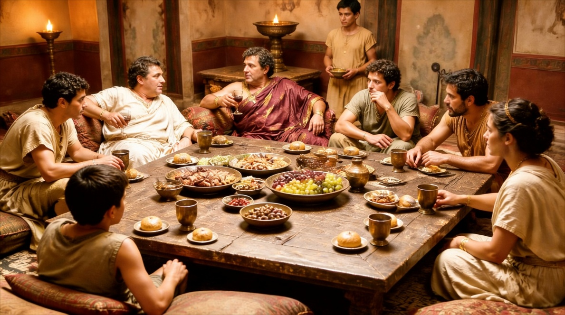
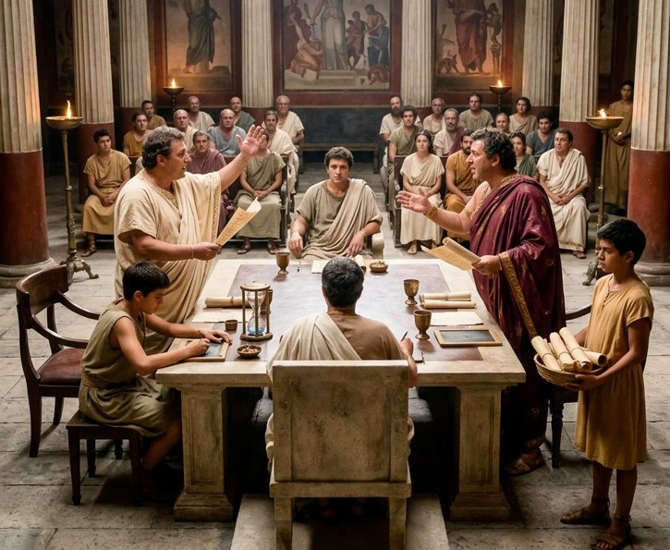
DIVISIONS AND CONTENTIONS
“I appeal to you, brothers, by the name of our Lord Jesus Christ, that all of you agree, and that there be no divisions among you, but that you be united in the same mind and the same judgment.”
(1 Corinthians 1:10)
What were the divisions that existed in the church of Corinth (1 Cor. 1:12)?
Various leaders had passed through Corinth, and each believer had his favorite preacher (Paul, Apollos, Peter…) This had reached the point of generating disputes among them (1 Cor. 1:11).
Without realizing that they were all preaching a common message, they focused on irrelevant aspects (1 Cor. 3:5-8).
Slowly, the life of the church was affected (1 Cor. 3:3). The lack of unity distorted the celebration of the Lord's Supper (1 Cor. 11:33), and they even went so far as to sue each other in court (1 Cor. 6:1).

Slide 6

HOW TO MAINTAIN UNITY

Slide 7

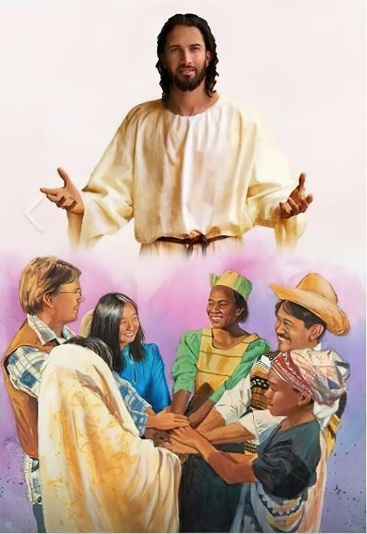
UNITY IN JESUS
“God is faithful, who has called you into fellowship with his Son, Jesus Christ our Lord.” (1 Corinthians 1:9)
“Is Christ divided? Was Paul crucified for you? Or were you baptized in the name of Paul?” (1 Corinthians 1:13). With these questions, Paul wants to make them reflect.
Unity can only be achieved by having Jesus as our Lord. Unity is not achieved by adhering to the thoughts or ideas of a brother or sister, or by forming closed groups.
But unity in Jesus is not uniformity. It does not imply that we all think the same about everything, or that we all act in the same way.
Small differences of opinion, the different gifts that each one has, when they are centered on Christ, instead of generating disunity, generate unity (1 Cor. 12:12-13, 25, 27).
Unity in the church is only achieved by dying to self and living for Jesus.

Slide 8

WISDOM AND MATURITY
“Brothers and sisters, I could not address you as people who live by the Spirit but as people who are still worldly—mere infants in Christ.” (1 Corinthians 3:1)
Paul calls immature Christians, “children in Christ,” “carnal” (1 Corinthians 3:1). These types of Christians focus more on people than on Jesus.
Immature
They are like children (1 Cor. 3:1)
They feed on milk (1 Cor. 3:2)
They are carnal (1 Cor. 3:3)
They are swayed by the opinions of others (1 Cor. 3:4)
Mature
They are adults
(1 Cor. 14:20)
They eat solid food (Heb. 5:14)
They are spiritual (1 Cor. 2:13)
They have spiritual discernment (1 Cor. 2:14)
When undue importance is given to some leaders at the expense of others, groups form that divide the church. This is a result of immaturity. Therefore, Paul invites us to reach maturity in Christ (1 Corinthians 2:6).

Slide 9

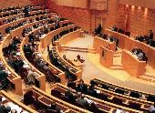
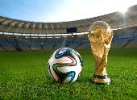


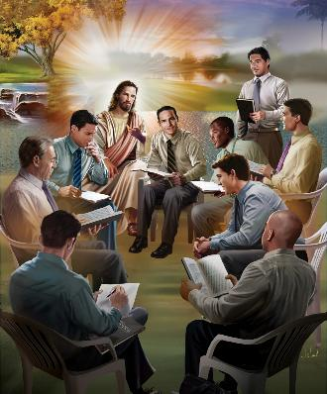

SERVICE AND HUMILITY
“This, then, is how you ought to regard us: as servants of Christ and as those entrusted with the mysteries God has revealed.” (1 Corinthians 4:1)
Just as today, in the first century people were divided by political, philosophical, religious, and other beliefs. How can we prevent this way of thinking from infiltrating the church and creating division?
The leader's attitude plays a significant role. Church leaders must be clear about their role as stewards. They are not the owners of the church; they simply manage it for Christ.
The leader of the church is Jesus, all others lead it as “servants of Christ” (1 Cor. 4:1).
The servant who administers must behave as his Lord behaves: always willing to humbly give himself to the service of others (Phil. 2:3-8).
What unity would there be in the church if everyone – not just the leaders, but every single member – acted this way?

Slide 10

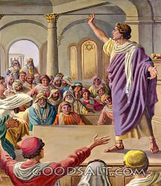
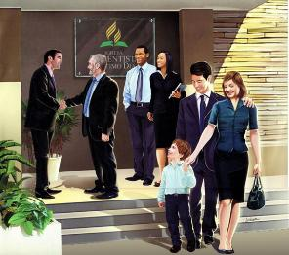
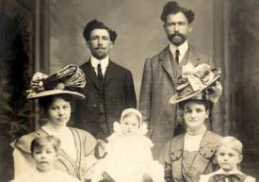
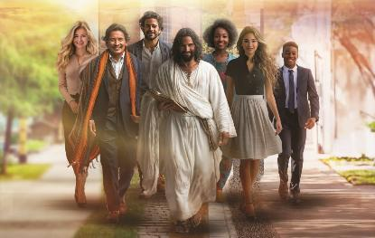
RESPECT FOR LEADERS
“Now it is required of stewards that they be found faithful.” (1 Corinthians 4:2)
The existence of rivalries and factions surrounding leaders does not mean we should reject them. On the contrary, Paul supported and defended Apollos' ministry and his work in Corinth (1 Cor. 3:5-6; 4:6; 16:12).
When leaders act faithfully, they are worthy of honor (1 Cor. 4:2; 1 Tim. 5:17). But even when they do not receive that honor, they remain faithful because they know that it is God himself, not men, who should judge them (1 Cor. 4:3-4).
Christian leaders follow in the footsteps of Jesus by being willing to suffer for their brothers and sisters, and even, if necessary, to die for their ministry
(1 Cor. 4:11-13; 2 Cor. 11:23-28).
Neither leaders nor members are called to fight or argue with each other, but to unite in praising Jesus and preaching the message of the cross.
Frank and Walter Bond were the first missionaries in Spain. Walter died for his faith in Jaen in 1914.

Slide 11

“Nothing can perfect a perfect unity in the church but the spirit of Christlike forbearance. Satan can sow discord; Christ alone can harmonize the disagreeing elements.... When you as individual workers of the church love God supremely and your neighbor as yourself, then there will be no labored efforts to be in unity, there will be oneness in Christ, the ears to report will be closed, and no one will take up a reproach against his neighbor. The members of the church will cherish love and unity and be as one great family. Then we shall bear the credentials to the world that will testify that God has sent His Son into the world.”
EGW (Reflecting Christ July 5)

