Slide 1



A PORTRAIT OF LOVE
Lesson 7 for August 15, 2026

Slide 2

“And now these three remain: faith, hope and love. But the greatest of these is love”
(1 Corinthians 13:13, NIV)

Slide 3



1 Corinthians 13 is known as “the love chapter.” It doesn’t define romantic love, but a much deeper kind of love: divine love.
Paul magnificently explains how to show in our lives the love of God that has been poured into our hearts (Rom. 5:5).
Love is the driving force behind all our actions, the reason why we do what benefits those with whom we interact.
A PORTRAIT OF LOVE
The supremacy of love
The most excellent way
The characteristics of love
What love does
What love does NOT do
A portrait of Jesus
The perseverance of love
The greatest of virtues

Slide 4


THE SUPREMACY OF LOVE

Slide 5



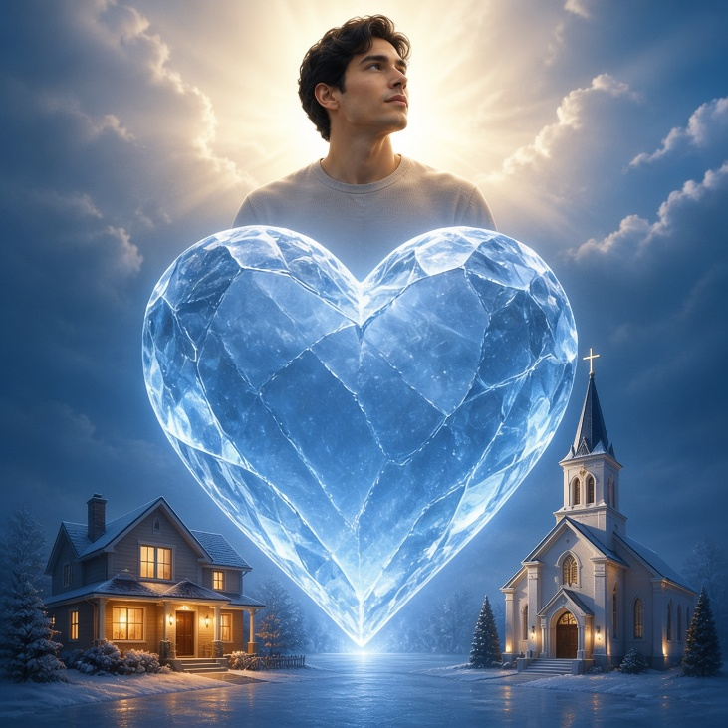
THE MOST EXCELLENT WAY
“But earnestly desire the best gifts. And yet I show you a more excellent way.” (1 Corinthians 12:31)
What kind of love is Paul presenting in 1 Corinthians 13, and why does it surpass any spiritual gift? (1 Cor. 12:31-13:3)
In Greek there are several words to define love. Paul chooses agape (selfless, unconditional, and reflective love, which seeks only the well-being of the beloved), which is the same one that John uses when saying that “God is love” (1 John 4:8).
No spiritual gift is useful if it is not exercised motivated by this kind of love. In fact, all our actions and thoughts should be infused with agape love.
Jesus warned us that, because of wickedness, this love will grow cold
(Matthew 24:12). But we must not allow this to happen to us, in our homes, or in our churches.

Slide 6

THE CHARACTERISTICS OF
LOVE

Slide 7


WHAT LOVE DOES
“Love suffers long and is kind; […] but rejoices in the truth; bears all things, believes all things, hopes all things, endures all things.” (1 Corinthians 13:4-7)
It suffers long
It is kind
It rejoices in the truth
makrothymeō: to have long spirit, to endure, to be patient
Show patience and tolerate the mistakes of others
jrēsteuomai : act benevolently
It is merciful and compassionate
synjairō: to express sympathy, to congratulate
It rejoices with those who support the truth
It bears all things
stegō: to cover with silence (to endure patiently)
Hide and keep silent about the faults of others, without revealing them
It believes all things
pisteuō: to have faith, to give credit, to trust
It does not condemn, but rather grants the benefit of the doubt
It hopes all things
Elpizō: to wait or to trust
Always expect something good to happen
It endures all things
hypomenō: to resist, to endure, to have fortitude, to persevere
Endure hardships, trials, and persecution

Slide 8


WHAT LOVE DOES NOT DO
It does not envy
zeloō: to have a
burning feeling
It does not envy those who have other gifts or virtues
It does not parade itself
perpereuomai : to boast, to brag
It does not want to be praised by others
It is not puffed up
fysioō: to swell up, to become proud
It does not have an exaggerated view of himself
It does not behave rudely
asjēmoneō: to act improperly
It does not act against social and moral norms
It does not seek his own
zēteō: to search
It gives up his rights for the good of others
It is not provoked
paroxynō : to sharpen something to irritate, incite or exasperate
It is neither irascible nor overly sensitive
It thinks no evil
logizomai : take inventory
It forgives and disregards offenses received
It does not rejoice in iniquity
jairō: to be cheerful, happy, or to feel well
It does not rejoice in mistakes, but seeks to correct them
“[…] love does not envy; love does not parade itself, is not puffed up; does not behave rudely, does not seek its own, is not provoked, thinks no evil; does not rejoice in iniquity […]” (1 Corinthians 13:4-7)

Slide 9

A PORTRAIT OF JESUS
“This is My commandment, that you love one another as I have loved you.” (John 15:12)
He endured beatings, insults, and contempt
(Matt. 27:27-31)
He is kind
He cared about anyone who was suffering
He suffers long
He rejoices in the truth
He taught the truth with clarity and conviction
He bears all things
He did not judge the sinful woman and granted her forgiveness (John 8:10-11)
He believes all things
He trusted in the sincerity of Zacchaeus
(Lk. 19:8-9)
He hopes all things
He prepared 12 men for an “impossible” mission
He endures all things
He endured hunger, rejection, pain, and persecution

Slide 10

A PORTRAIT OF JESUS
“This is My commandment, that you love one another as I have loved you.” (John 15:12)
He does not envy
He did not seek honors, and he associated with the humble
He does not parade itself
Although he was the King of the Universe, he did not boast about it
He is not puffed up
He was willing to do the humblest jobs
He does not behave rudely
He treated everyone with courtesy and propriety
He does not seek his own
He always did the will of his Father (Jn. 6:38)
He is not provoked
Even when they struck him, he responded with courtesy
(John 18:22-23)
He thinks no evil
He asked forgiveness for those who crucified him
(Lk. 23:34)
He does not rejoice in iniquity
He spoke harshly to the unjust Pharisees
(Mt. 23:27-28)

Slide 11


THE PERSEVERANCE OF
LOVE

Slide 12




THE GREATEST OF VIRTUES
“And now abide faith, hope, love, these three; but the greatest of these is love.”
(1 Corinthians 13:13)
The Corinthians were showing by their attitude what love does not do: they were envious; boastful; vain; they acted improperly; they were selfish; they were easily irritated; they were spiteful; and they tolerated sin.
Like them, we must abandon these faults and abound in the virtues of love, as Paul teaches us, in order to use spiritual gifts correctly. He also invites us to abide in two other virtues: faith and hope.
When Jesus comes, sin will cease to exist, and we will enjoy eternal life with Him. Then, prophecy, tongues, and other gifts, along with faith and hope, will no longer be necessary. But love will endure forever
(1 Corinthians 13:8).

Slide 13

“God is love. The love of the Father and the Son is an attribute of every believer. The Word of God is the channel through which divine love is communicated to man. God’s truth is the medium by which the intellect is reached. The Holy Spirit is given to the human agent who works in cooperation with divine agencies. It transforms mind and character, enabling man to endure as seeing Him who is invisible. Perfect love can be enjoyed only through the belief of the truth and the reception of the Holy Spirit.”
EGW (Our Father Cares, October 9)

