Slide 1
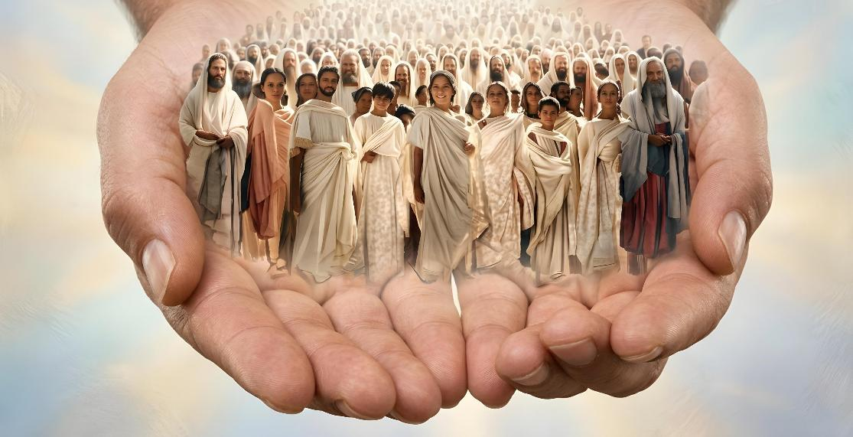
GRACE, LOVE AND FELLOWSHIP
Lesson 13 for September 26, 2026

Slide 2
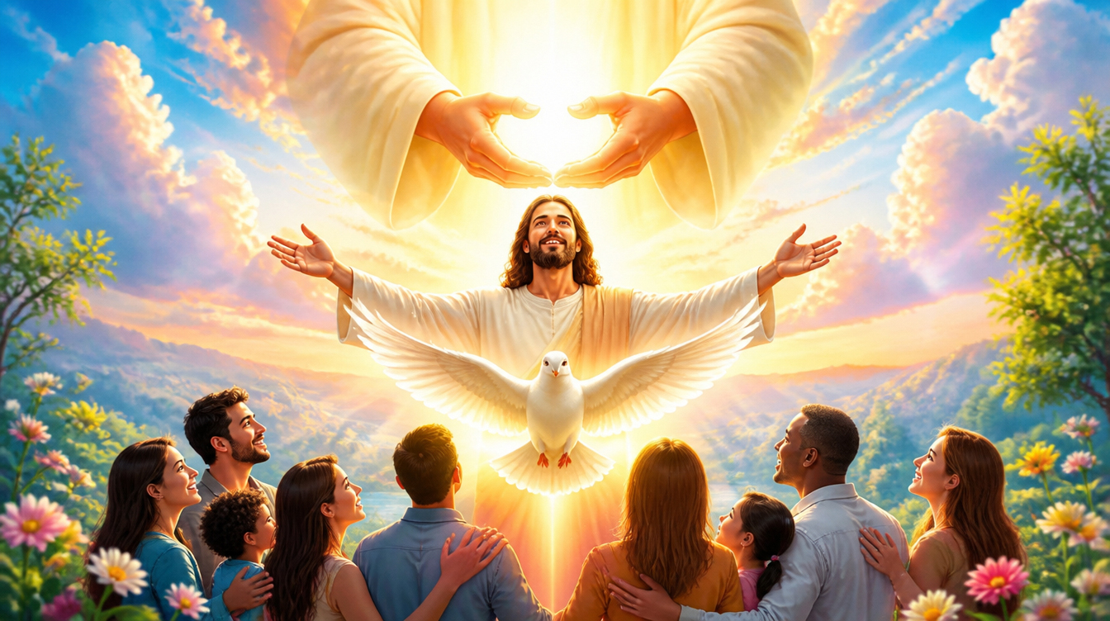
“The grace of the Lord Jesus Christ and the love of God and the fellowship of the Holy Spirit be with you all”
(2 Corinthians 13:14, ESV)

Slide 3

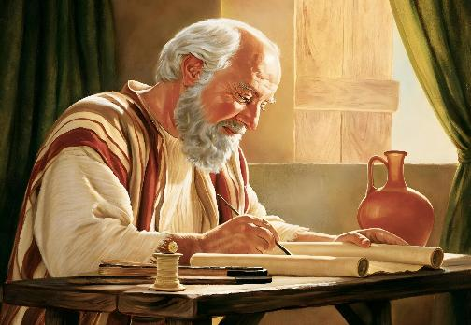
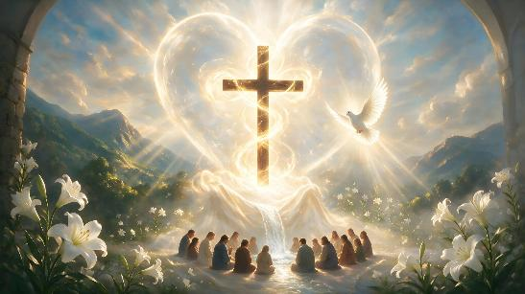
The most common formula in the closings of Paul's letters, used with slight variations in 13 of his 14 epistles, is: “The grace of our Lord Jesus Christ be with you” (Rom. 16:24; 1 Cor. 16:23; Gal. 6:18; Eph. 6:24; Phil. 4:23; Col. 4:18; 1 Thess. 5:28; 2 Thess. 3:18; 1 Tim. 6:21; 2 Tim. 4:22; Tit . 3:15 ; Philem. 1:25; Heb. 13:25).
However, in the second letter to the Corinthians, he makes an important exception. His farewell includes the grace, love, and fellowship of all the persons of the Godhead: the Son, the Father, and the Holy Spirit
(2 Cor. 13:14).
“The grace of the Lord Jesus Christ”
“The love of God”
“The fellowship of the Holy Spirit”
“Be with you all”

Slide 4

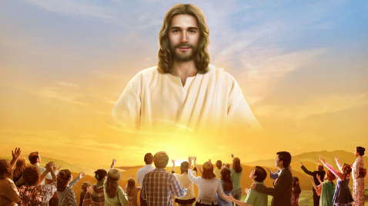
“THE GRACE OF THE LORD JESUS CHRIST”
“For you know the grace of our Lord Jesus Christ, that though he was rich, yet for your sake he became poor, so that you through his poverty might become rich.” (2 Corinthians 8:9)
Paul begins and ends his second letter to the Corinthians with a reference to the grace of Jesus. (2 Cor. 1:2; 13:14). What does this grace consist of?
He left the eternal riches of heaven and became poor so that we might inherit his riches (2 Cor. 8:9)
He walked through our world so that we might know Him,
love Him, and imitate Him (John 15:12)
He humbled himself and became obedient unto death to forgive our sins and give us eternal life (Phil. 2:8)
What happens to those of us who receive his grace?
We are justified (Rom. 3:24; Eph. 1:7)
We rejoice in hope (Rom. 5:2)
We receive power from Christ (2 Cor. 12:9)
Sin does not have dominion over us (Rom. 6:14)
We will reign in life with Jesus (Rom. 5:17, 21)

Slide 5


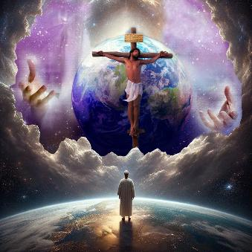

“THE LOVE OF GOD” (1)
“Whoever does not love does not know God, because God is love.” (1 John 4:8)
The Bible emphatically declares that God is love (1 John 4:8). He has poured out that love on all of His creation. We can see it in our own hearts; in the relationship between parents and children; in beautiful flowers; in melodious birds; …
Paul taught the Corinthians (and us, of course) that love builds up (1 Cor. 8:1); that nothing has value without love (1 Cor. 13:1-3); and that everything should be done with that love that comes from God. (1 Cor. 16:14).
But, without a doubt, the greatest expression of God's love can be seen in the offering of Jesus as a sacrifice for our sins (Jn. 3:16).
This example leads us to behave towards others with the same love that God has shown us
(1 John 3:16)

Slide 6


“THE LOVE OF GOD” (2)
“Finally, brothers and sisters, farewell. Put things in order, listen to my appeal, agree with one another, live in peace; and the God of love and peace will be with you.” (2 Corinthians 13:11)
Paul presents God in a multifaceted way:
That God the Father gives us his love
(1 John 3:1)
That God Christ fills us with all fullness with his love
(Eph. 3:19)
That God the Holy Spirit pours out his love on us (Rom. 5:5)
“God of patience” (Rom. 15:5)
“God of hope” (Rom. 15:13)
“God of peace” (Rom. 15:33)
“God […] of mercies” (2 Cor. 1:3a)
“God of all comfort” (2 Cor. 1:3b)
“God of love” (2 Cor. 13:11)
God not only possesses all these characteristics, but He is the source from which they all emanate to us.
As we saw, God is love, but He is also the God of love, that is to say:

Slide 7

“THE FELLOWSHIP OF THE HOLY SPIRIT”
“May the grace of the Lord Jesus Christ, and the love of God, and the fellowship of the Holy Spirit be with you all.” (2 Corinthians 13:14)
Paul desires that they be with us: the grace of a Person (the Lord Jesus Christ); the love of a Person (God); and the fellowship… of a power or of a Person? (2 Cor. 13:14). For the sake of consistency, Paul is speaking of a Person (the Holy Spirit), and not of a power.
Equip people for the mission
(1 Cor. 2:4)
He reveals to us the deep things of God
(1 Cor. 2:10)
He teaches us (1 Cor. 2:13)
He dwells in us (1 Cor. 3:16)
Cooperate with Christ for our justification (1 Cor. 6:11)
He bestows spiritual gifts (1 Cor. 12:7-11)
He seals us for salvation (2 Cor. 1:22)
Imprint the law on our hearts (2 Cor. 3:3)
He gives us new life in Christ (2 Cor. 3:6)
He gives us freedom from sin (2 Cor. 3:17)
In his more than 40 references to the Holy Spirit in the letters to the Corinthians, Paul presents him with personal qualities, and not as a mere force emanating
from God:

Slide 8

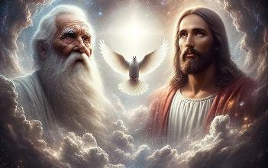
“BE WITH YOU ALL”
“who have been chosen according to the foreknowledge of God the Father, through the sanctifying work of the Spirit, to be obedient to Jesus Christ and sprinkled with his blood: Grace and peace be yours in abundance.” (1 Peter 1:2 NIV)
Although we are accustomed to referring to the Trinity (three divine Persons, one God) in the order “Father, Son, Spirit” (Mt. 28:19), Paul presents it as “Son, Father, Spirit” (2 Cor. 13:14), and Peter as “Father, Spirit, Son” (1 Pet. 1:2).
There is no hierarchy among them; each one simply assumes a different role in the plan of salvation, but all share the same characteristics and purposes.
GRACE
From the Father (1 Cor. 1:3)
From the Son (1 Cor. 1:3)
From the Spirit (Heb. 10:29 )
LOVE
From the Father (1 John 2:15)
From the Son (Rom. 8:35)
From the Spirit (Rom. 15:30)
FELLOWSHIP
From the Father (1 John 1:3)
From the Son (1 John 1:3)
From the Spirit (Phil. 2:1)
Paul concludes his letter, therefore, wishing that the grace, love, and fellowship of the whole Godhead may be with us all (2 Cor . 13:14)

Slide 9

EGW (Evangelism, p. 615)
“The Father cannot be described by the things of earth. The Father is all the fullness of the Godhead bodily, and is invisible to mortal sight.
The Son is all the fullness of the Godhead manifested. […]
The Comforter that Christ promised to send after He ascended to heaven, is the Spirit in all the fullness of the Godhead, making manifest the power of divine grace to all who receive and believe in Christ as a personal Saviour. There are three living persons of the heavenly trio; in the name of these three great powers --the Father, the Son, and the Holy Spirit--those who receive Christ by living faith are baptized, and these powers will co-operate with the obedient subjects of heaven in their efforts to live the new life in Christ.”

