Slide 1
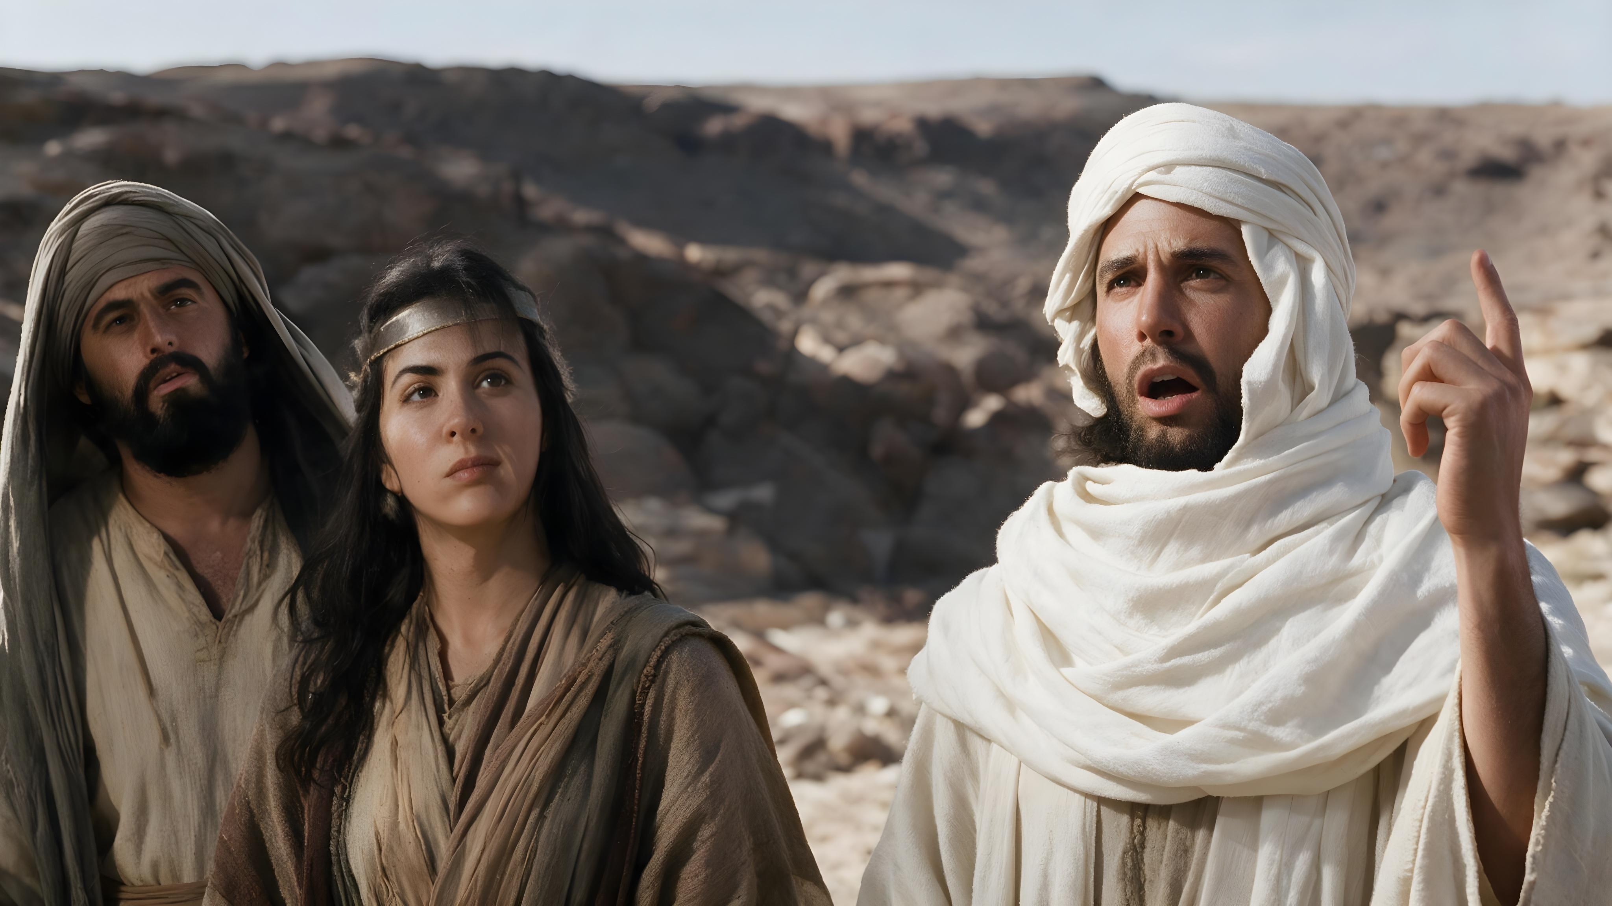
^{NOW HEAR THIS!}
Lesson 7 for November 14, 2026

Slide 2







“Now these things happened to them as an example, and they were written for our instruction, upon whom the ends of the ages have come” (1 Corinthians 10:11, NASB)

Slide 3

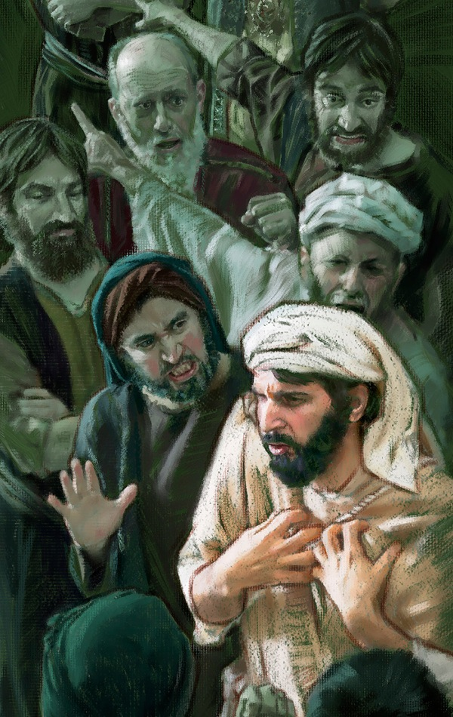
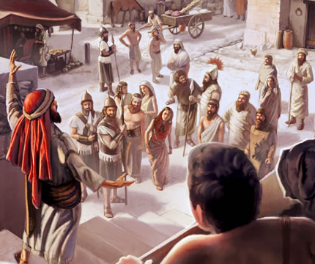
The biblical prophets upheld the highest moral standards, guided people to greater devotion to God, warned against sin, and provided comfort and strength.
Those who listened to them and accepted their message benefited greatly.
This happened, for example, with Asa (2Ch. 15:1-8); Jehoshaphat (2Ch. 20:14-23); or Amaziah (2Ch. 25:7-10).
The rejection of the messenger
The rejection of the message
Contempt
Obstinacy
Hypocrisy
Practical application
But unfortunately, that was not the general trend among the people of Israel. Very often the message of the prophets was rejected. Today, God continues to speak through his prophets.
How do I react to their message?

Slide 4


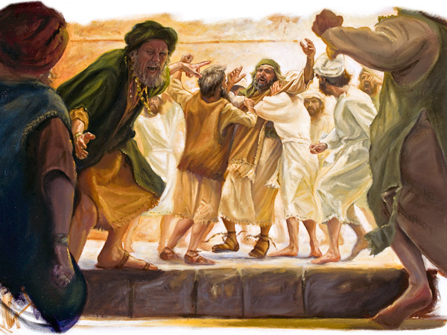
THE REJECTION OF THE MESSENGER

Slide 5

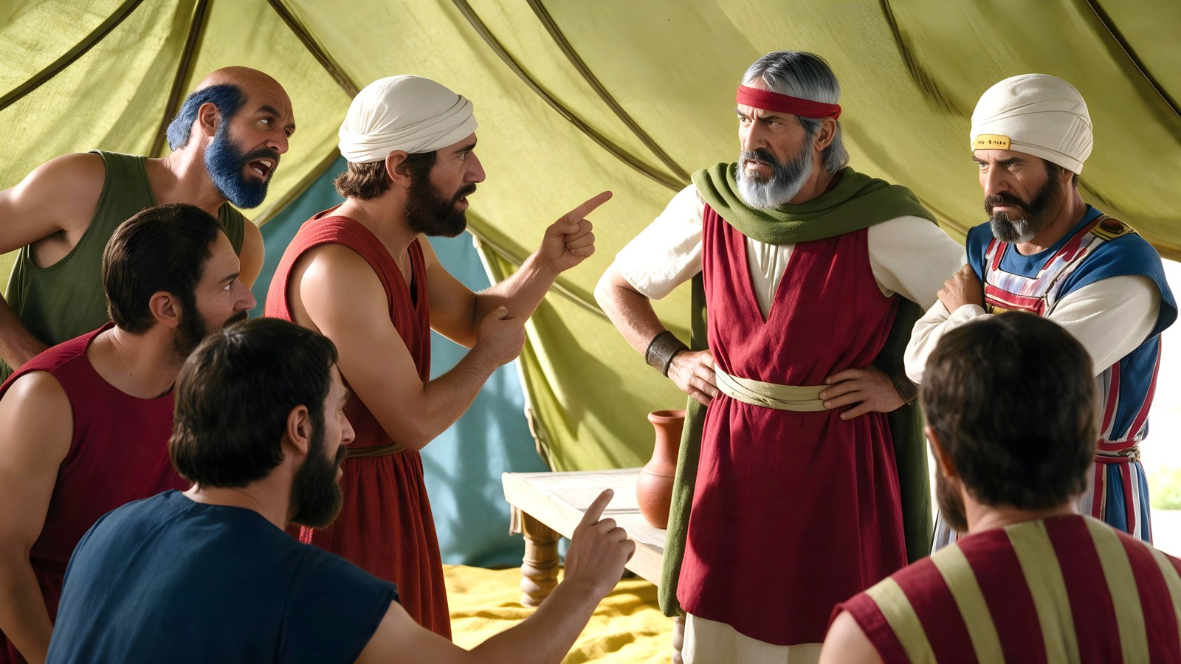

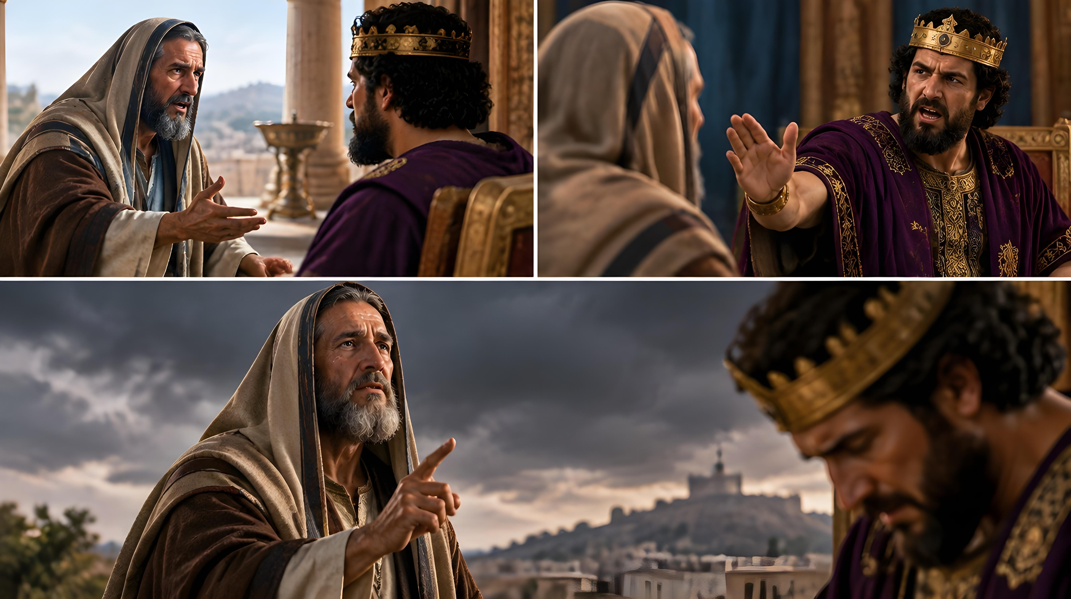
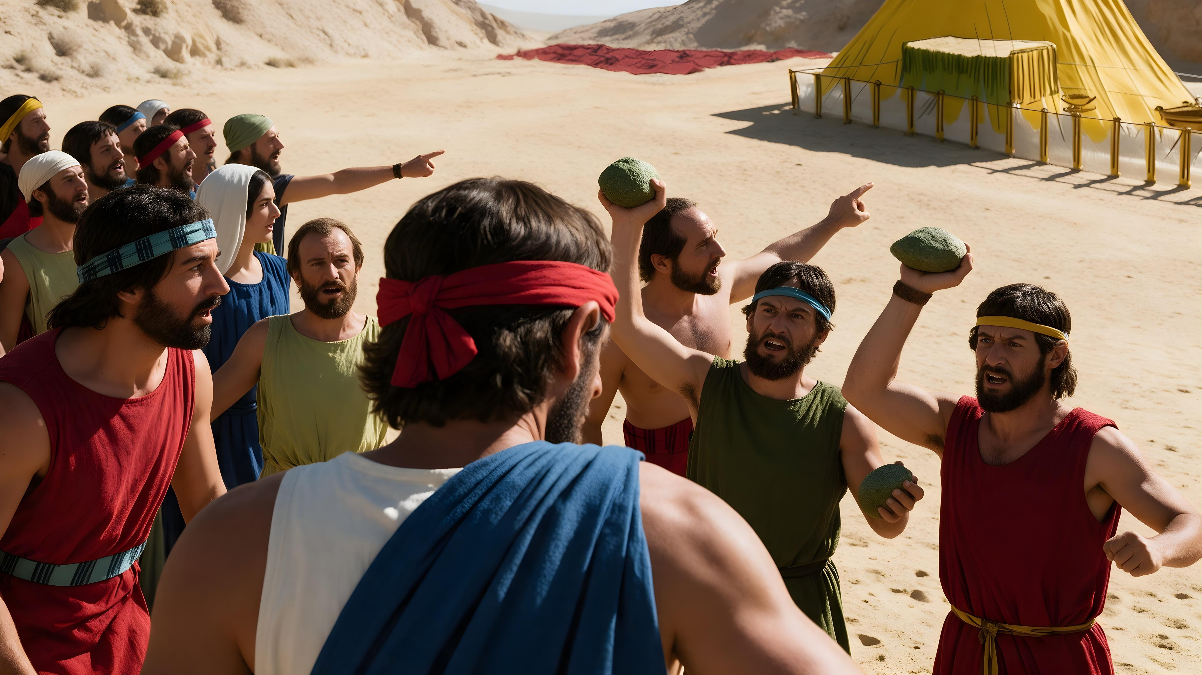
“And all the children of Israel murmured against Moses and against Aaron […] And Joshua the son of Nun, and Caleb the son of Jephunneh, which were of them that searched the land, rent their clothes: And they spake unto all the company of the children of Israel […] But all the congregation bade stone them with stones” (Numbers 14:2-10)
At the gates of the promised land, spies were sent to scout it out. Their report said that the land was as good as God had said (Numbers 13:27). But a discouraging message was added (Numbers 13:28, 31). Then God spoke through Caleb to encourage them to conquer it (Numbers 13:30).
After a night of meditation, the people made a decision: to reject the messengers of God who had been leading them (Num. 14:1-4). When Joshua and Caleb repeated words of encouragement to them, they decided to stone them (Num. 14:6-10).
Subsequently, many other messengers were also rejected (2Ch. 25:15-16; Amos 7:10-13).
What was the reason for the rejection? The message they brought from God did not match their expectations, nor did they want to abandon their sinful lifestyle.

Slide 6

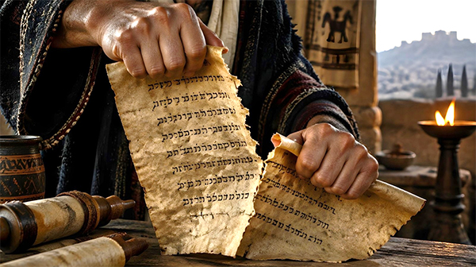
THE REJECTION OF THE MESSAGE

Slide 7

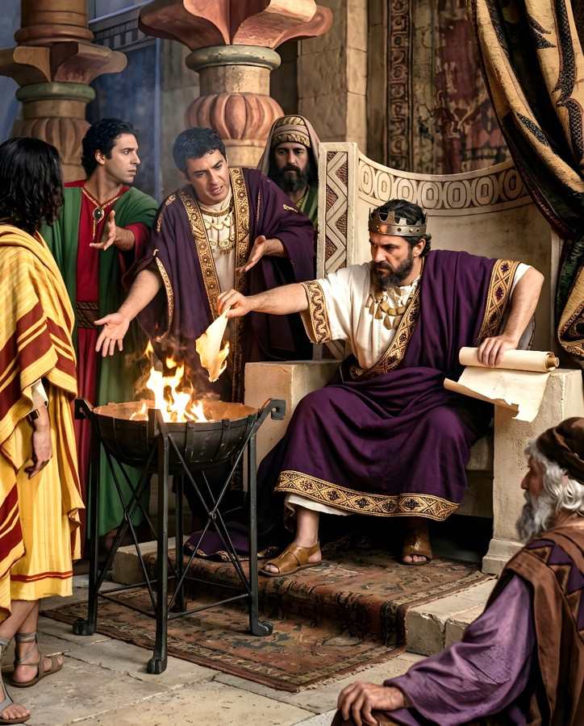
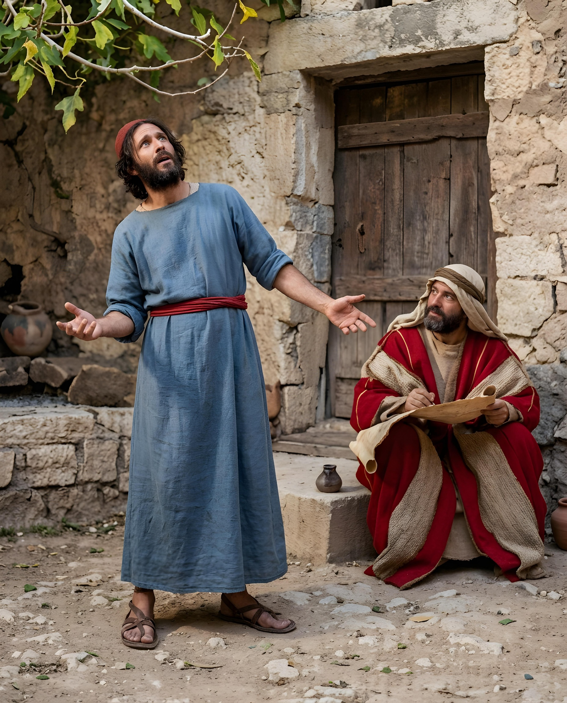
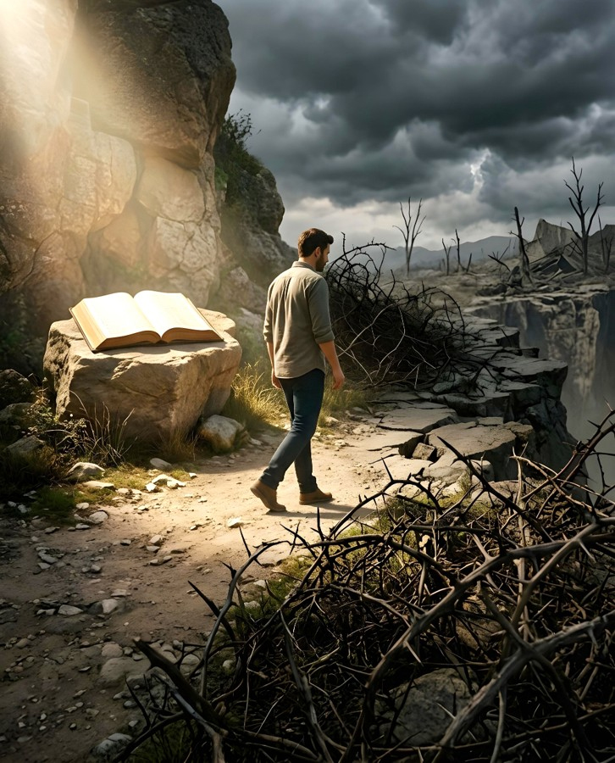
CONTEMPT
“And it came to pass, that when Jehudi had read three or four leaves, he cut it with the penknife, and cast it into the fire that was on the hearth, until all the roll was consumed in the fire that was on the hearth” (Jeremiah 36:23)
In the time of King Jehoiakim, the people were involved in serious sins. God commanded Jeremiah to write a scroll with the prophetic message so that the king and his advisors would be warned and repent of their evil ways (Jer. 36:1-3).
But Jehoiakim despised the message and destroyed it by throwing it into the fire, although a few begged him not to do so (Jer. 36:21-25).
In response, a harsh prophecy was pronounced against Jehoiakim, and the destroyed message was rewritten and expanded (Jer. 36:27-31).
We might think that if we don't read the Bible, we can do whatever we want and live peacefully. But if we ignore God's warnings, we will reap the consequences of our sin and wickedness.

Slide 8

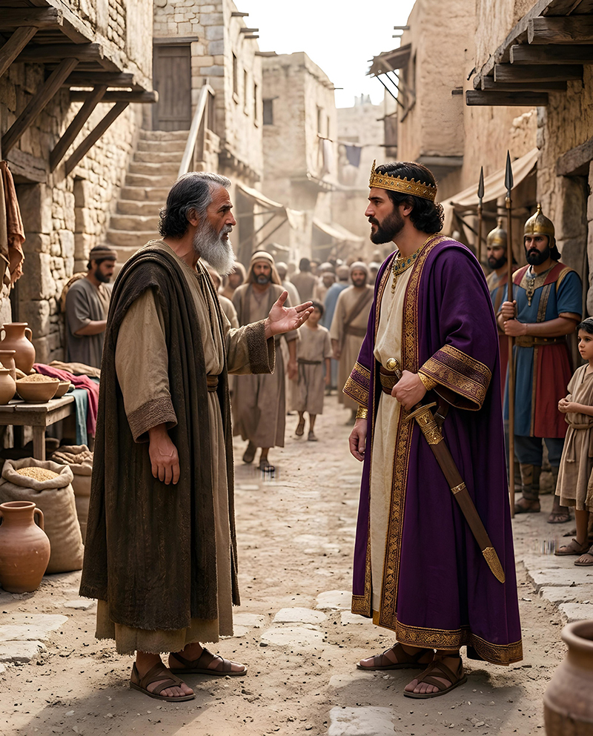
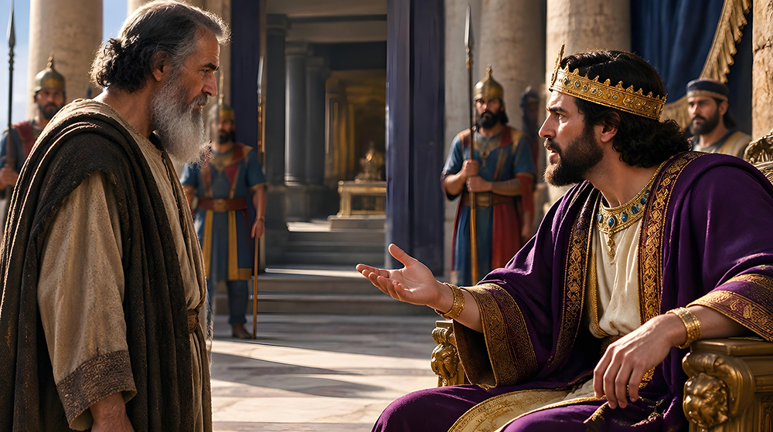
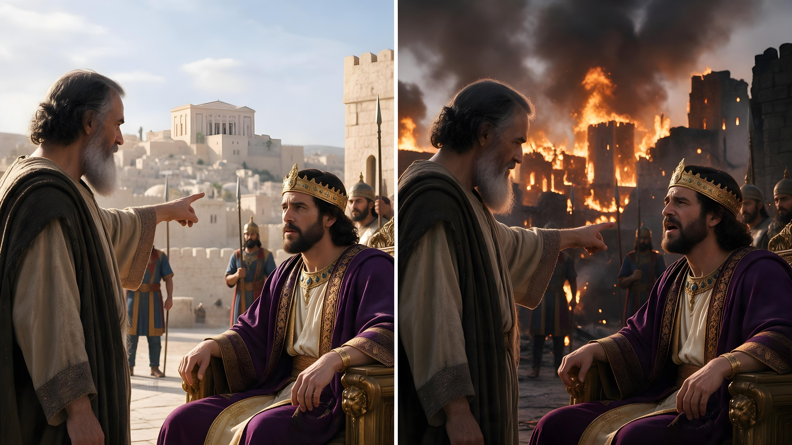
OBSTINACY
“And he also rebelled against king Nebuchadnezzar, who had made him swear by God: but he stiffened his neck, and hardened his heart from turning unto the Lord God of Israel.” (2 Chronicles 36:13)
The last king of Judah, Zedekiah, swore allegiance to Babylon, but broke his covenant. He repeatedly refused to accept the warning messages God gave him through Jeremiah
(2 Chronicles 36:12).
When Jerusalem was surrounded by the Babylonian army, Zedekiah called Jeremiah to give him a message from God (Jer. 38:14).
The message was clear: surrender to Babylon and you will save your own life, and Jerusalem (Jer. 38:17-23). But Zedekiah rejected the message. His obstinacy led to the final destruction of Jerusalem (2 Chron. 36:13).
For eleven years God communicated messages of hope to him if he would repent and change his conduct. At times, he even reacted positively, but he did not make permanent reforms (Jer. 34:8-11).

Slide 9

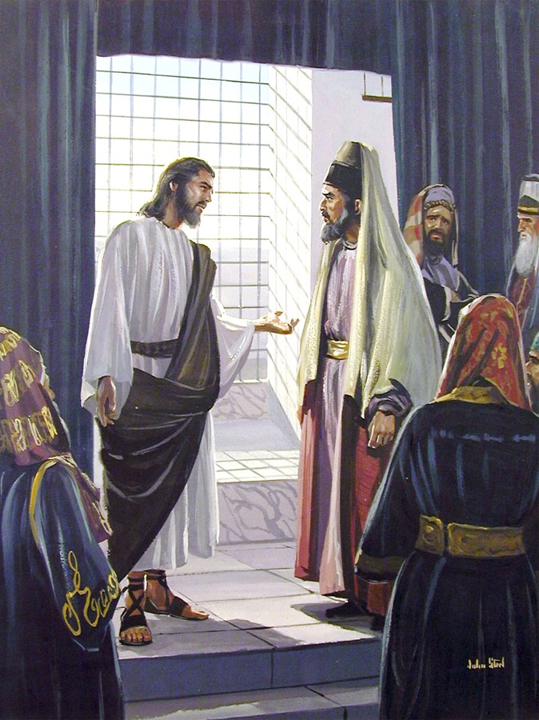
HYPOCRISY
“All therefore whatsoever they bid you observe, that observe and do; but do not ye after their works: for they say, and do not.” (Matthew 23:3)
Why did Jesus call the Pharisees hypocrites?
Because they preached one thing and did another (Mt. 23:3)
Because they imposed heavy burdens on others, but they themselves did not want to carry them (Mt. 23:4)
Because everything they did was a facade, only to be seen by others (Mt. 23:5)
Because they liked to receive honors, but they did not honor others
(Mt. 23:6-7, 11-12)
Because they praised the prophets, but did not want to obey their messages
(Mt. 23:29-31)
Because they claimed to serve God, but they wanted to kill those who spoke to them on His behalf (Mt. 23:34)
Jesus' words against the hypocritical Pharisees were written so that we would avoid following their example, and abandon any attitude or thought that leads us to reject the message that God gives us.

Slide 10


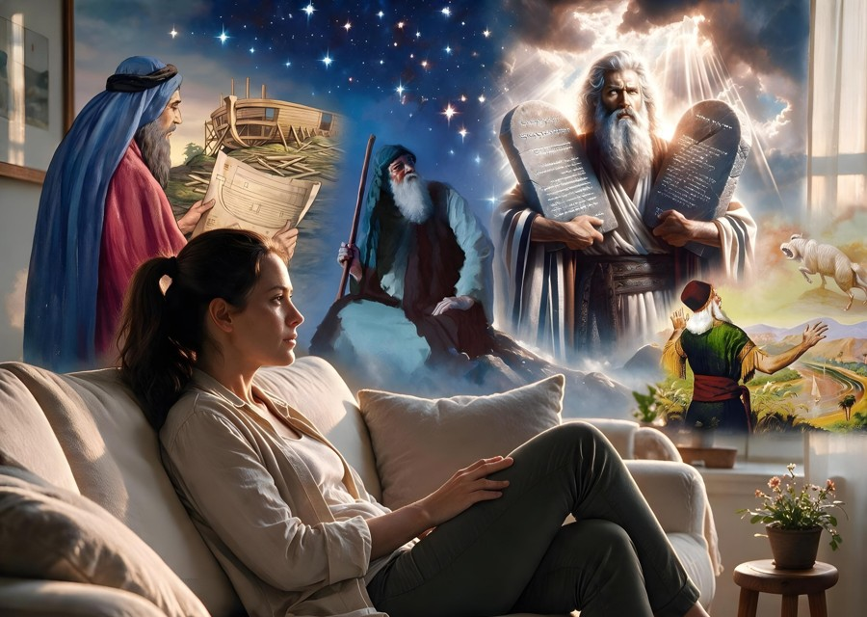
PRACTICAL APPLICATION

Slide 11

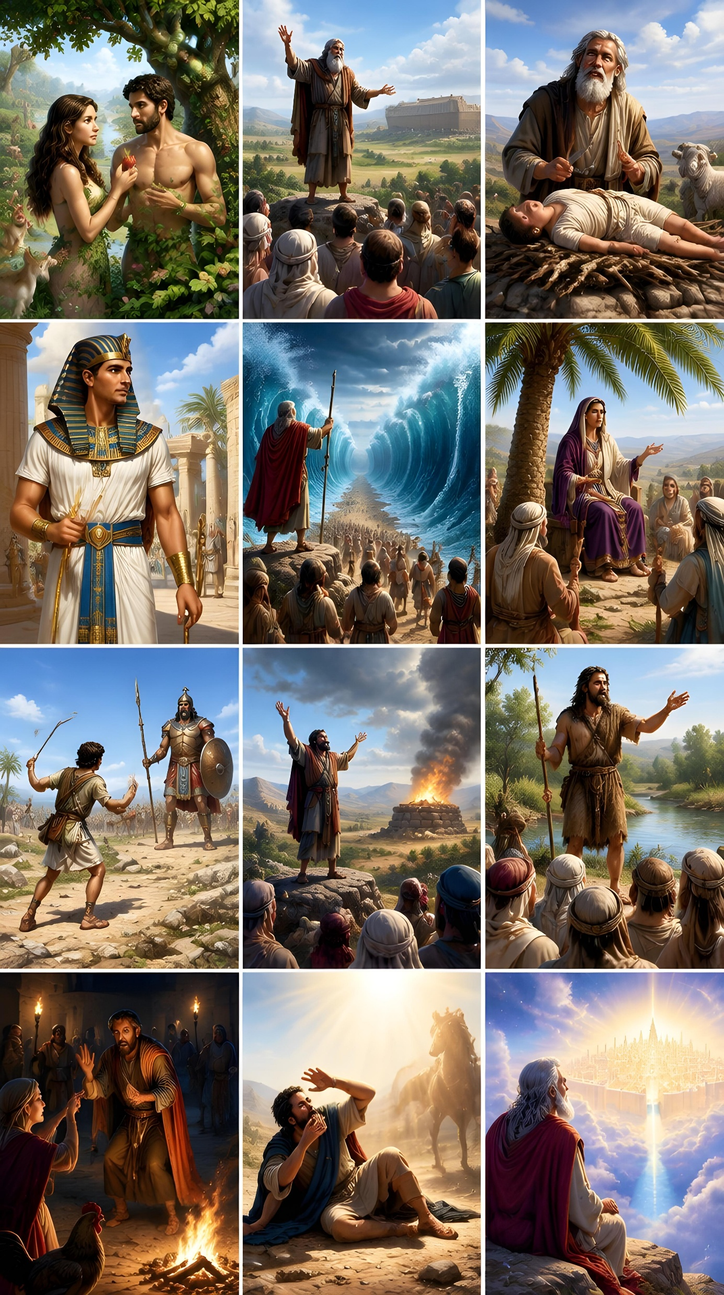
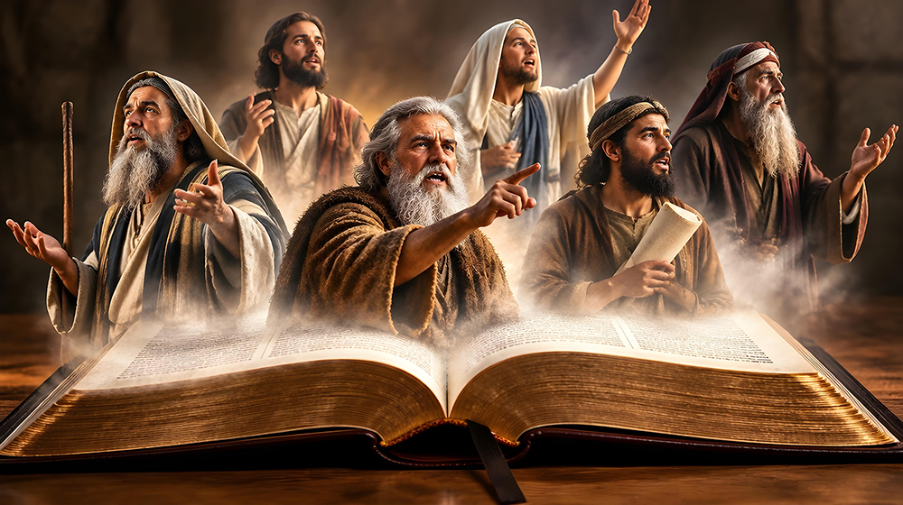
“Now all these things happened unto them for examples: and they are written for our admonition, upon whom the ends of the world are come” (1 Corinthians 10:11)
“Those who cannot remember the past are condemned to repeat it” (George Santayana).
Humanity's experiences with God—be they good or bad—are not to be overlooked or discounted.
The past is often prologue to the future. The past often sets the context for what is presently happening and what will happen in the future.
We are not condemned to repeat the mistakes of past generations if we pay attention to the warnings of Scripture and the messages that God sends us through his prophets (1 Cor. 10:11).
“Believe in the Lord your God, so shall ye be established; believe his prophets, so shall ye prosper.” (2 Chronicles 20:20)

Slide 12

“The spirit of opposition to reproof, that led to the persecution and imprisonment of Jeremiah, exists today. Many refuse to heed repeated warnings, preferring rather to listen to false teachers who flatter their vanity and overlook their evil-doing. In the day of trouble such will have no sure refuge, no help from heaven. God's chosen servants should meet with courage and patience the trials and sufferings that befall them through reproach, neglect, and misrepresentation. They should continue to discharge faithfully the work God has given them to do, ever remembering that the prophets of old and the Saviour of mankind and His apostles also endured abuse and persecution for the Word's sake.”
EGW (Prophets and Kings, p. 438)

Slide 13

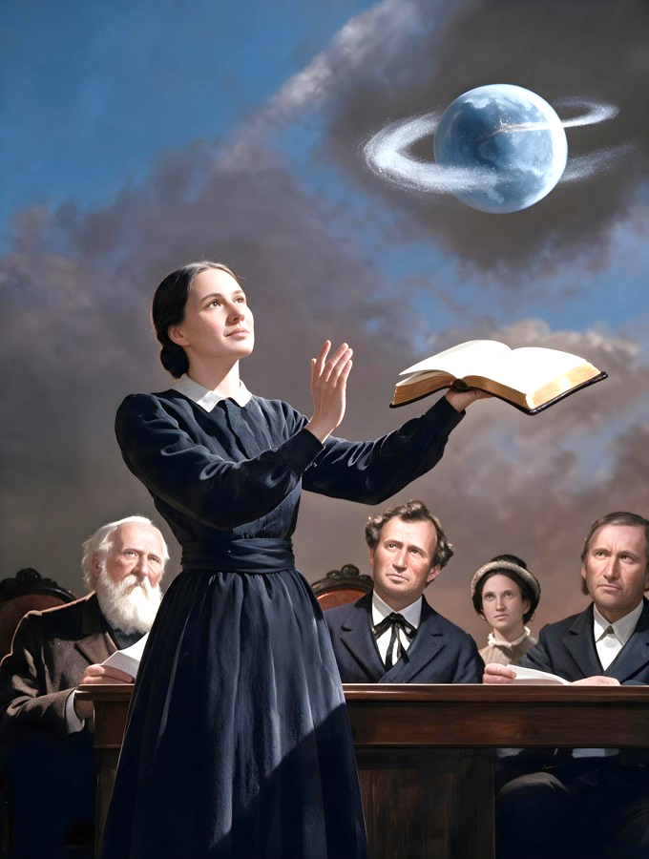
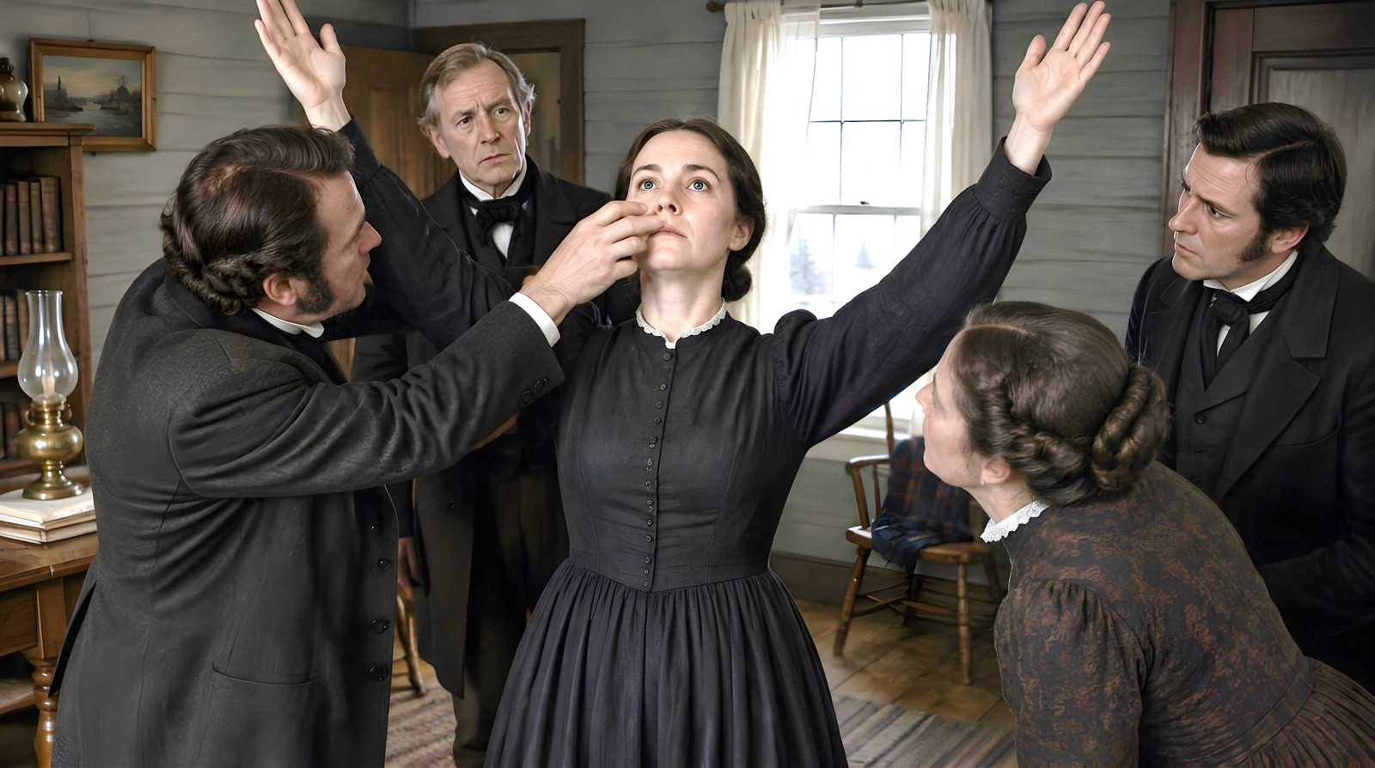

APPENDIX: THE VISIONS OF ELLEN G. WHITE
The visions that Ellen G. White received in public were accompanied by extraordinary phenomena: she did not breathe; her eyes remained open; she moved completely unaware of what was happening around her; …
Although some accused her of self-hypnotization (mesmerism), she did not control when she entered a vision, nor when she came out of it.
When Ellen went into vision, James White invited those presents to examine her to eliminate any doubt regarding her supernatural origin that her antagonists might have, and to strengthen those who believed in her.
Those who accused her of mesmerism were astonished to see that she was indeed not breathing and fled in terror from the place where the vision was occurring.

