Slide 1

INTERPRETING PROPHETIC WRITINGS
Lesson 8 for November 21, 2026

Slide 2

“Then beginning with Moses and with all the Prophets, He explained to them the things written about Himself in all the Scriptures”
(Luke 24:27, NASB)

Slide 3

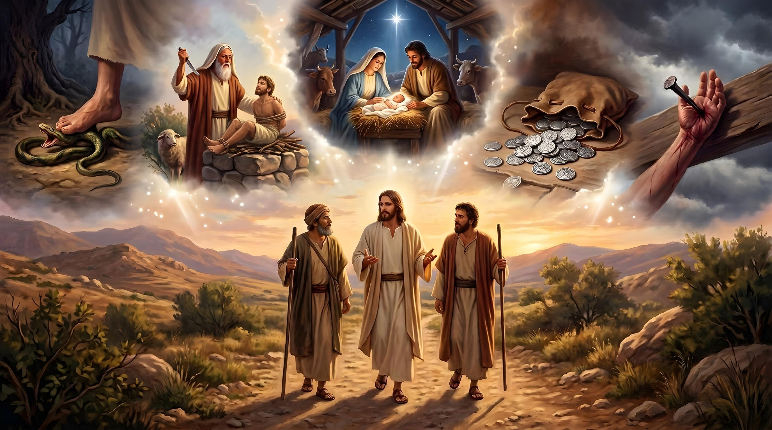
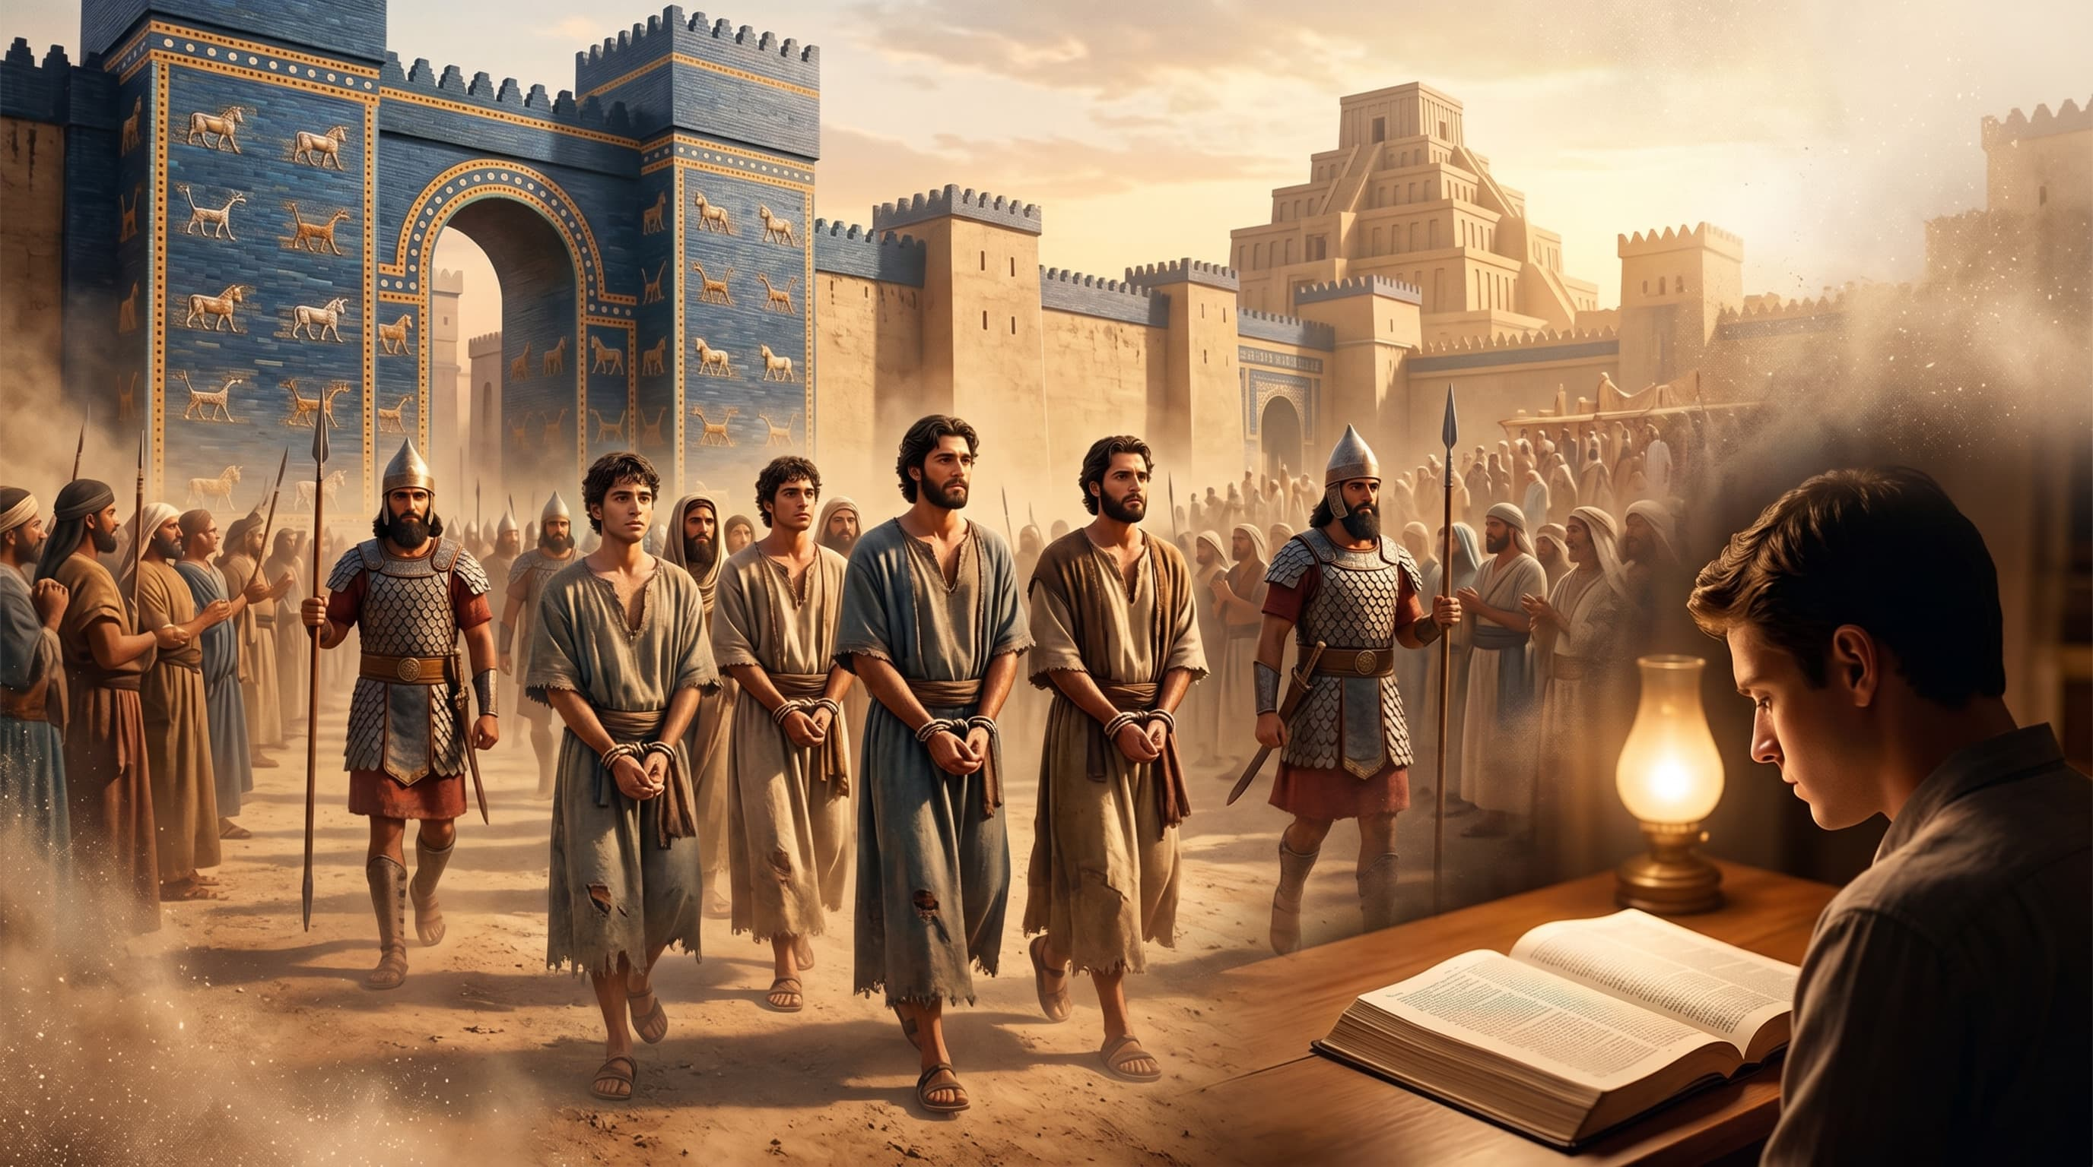
On the road to Emmaus, Jesus gave a Bible study to two of his disciples. We don't know the full content of it, but we do know the method he used to deliver that powerful Bible study that set his disciples' hearts ablaze.
What is the best method for studying the Scriptures and sharing their message?
In this lesson we will review several useful methods for studying the Bible that will enable us to share its message truthfully and effectively.
Interpreting the Bible with the Bible
The historical context
The cultural context
The literary context
Find out the meaning of the text
Thematic Bible Study

Slide 4


INTERPRETING THE BIBLE WITH THE BIBLE
“For precept must be upon precept, precept upon precept; line upon line, line upon line; here a little, and there a little” (Isaiah 28:10)
The Bible is its best interpreter.
Interpreted in its own text
For example, Daniel explains the meaning of his vision by saying that the beasts he saw are kingdoms
(Dan. 7:3, 17)
Interpreted by another prophet
Ezra interpreted the meaning of the 70 years of Jeremiah's prophecy (Jer. 25:11-12; 2Ch. 36:22-23)
The New Testament interprets the Old Testament
Matthew interpreted the birth of Jesus as the fulfillment of Isaiah's prophecy (Isaiah 7:14; Matthew 1:22-23)

Slide 5
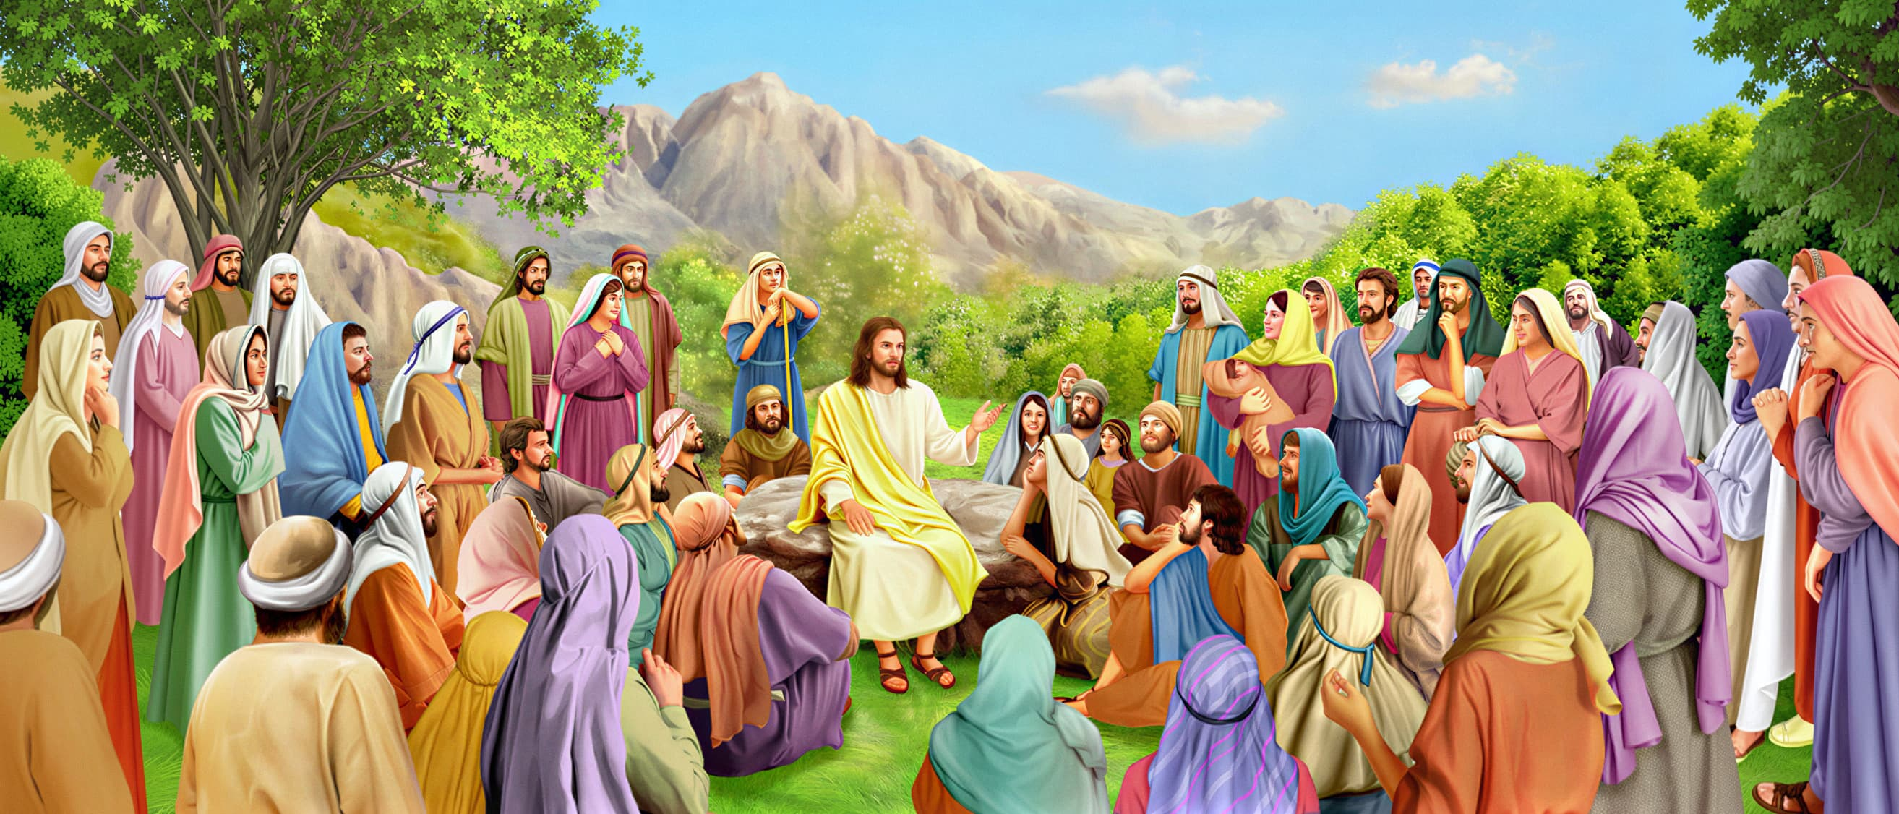
INTERPRETING THE BIBLE WITH THE BIBLE
Jesus not only interpreted the Old Testament, but gave it its true meaning, going beyond its literal sense.
OLD TESTAMENT
Exodus 20:13
Exodus 20:14
YOU HAVE HEARD…
Thou shalt not kill
You shall not commit adultery
Give the woman a divorce certificate
NEW TESTAMENT
Matthew 5:21-22
I SAY TO YOU…
Don't get angry or insult anyone
Deuteronomy 24:1
Leviticus 19:12
Leviticus 24:20
Leviticus 19:18
Thou shalt not perjure
An eye for an eye
Love your neighbor
Matthew 5:27-28
Matthew 5:31-32
Matthew 5:33-34
Matthew 5:38-39
Matthew 5:43-44
Don't look at a woman with lust
Divorce is only possible on the grounds of adultery
Do not swear under any circumstances
Do not resist the evil one
Love your enemies

Slide 6



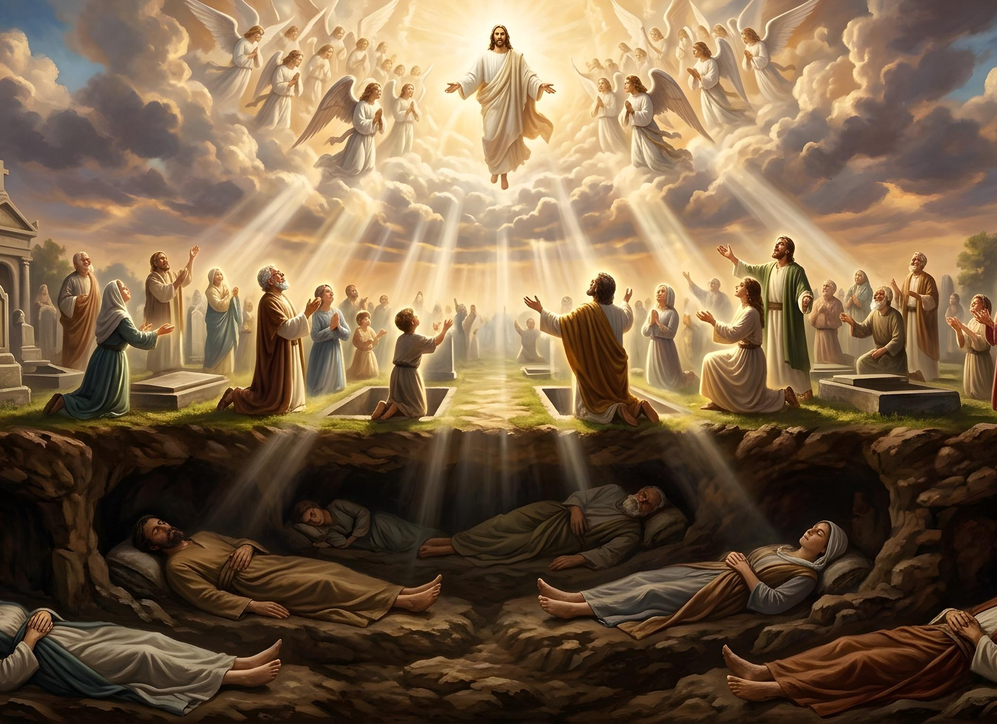
THE HISTORICAL CONTEXT
“There shall be no more thence an infant of days, nor an old man that hath not filled his days: for the child shall die an hundred years old; but the sinner being an hundred years old shall be accursed.” (Isaiah 65:20)
Will children die and will there be sinners in the new earth? (Isaiah 65:17-20)
Interpreted in the light of the apocalyptic prophecies of the New Testament, Isaiah's prophecy is not only shocking, but contradictory (Rev. 21:1-4).
We must understand that the historical context of Isaiah is one thing, and that of Revelation is another. Isaiah spoke of the future of Israel when it accepted the Messiah. In John's time, however, Israel had rejected the Messiah. The context had changed.
If Israel had accepted the Messiah, there would have been a significant change: the redemption and transformation of the Earth and humanity would have begun gradually. Holy men would have lived as long as trees. (Isaiah 65:22), and animals would be less aggressive in the holy land (Isaiah 65:25).
Then, in the end, the dead would be resurrected and death would cease to exist (Isa. 26:19; 25:8). Only this last part of Isaiah's prophecies will be fulfilled literally, since it does not depend on Israel's decision.

Slide 7

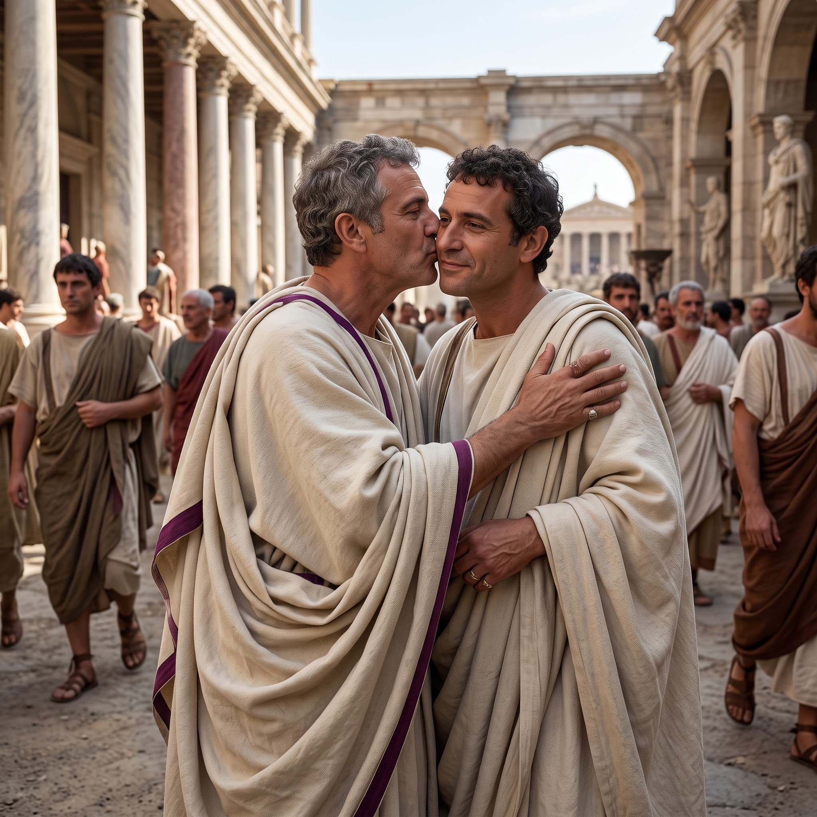






THE CULTURAL CONTEXT
“All the brothers and sisters here send you greetings. Greet one another with a holy kiss.” (1 Corinthians 16:20 NIV)
In the Roman Empire, as in many places today, greeting each other with a kiss on the cheek was commonplace. In that cultural context, Paul's advice was sound
(1 Cor. 16:20).
However, in Japanese culture – for example – physical contact in public is generally avoided, so it usually generates surprise, strangeness or discomfort in most people.
Given that, in that cultural context, following Paul's advice will generate rejection among people, we must extrapolate his advice by adapting it to their context.
Anglo-Saxon greeting
Thai greeting
Tibetan greeting
New Zealand greeting
Whether we are in Japan, or elsewhere in the world, let us greet each other with the culturally correct greeting, thus demonstrating our fraternal affection.

Slide 8

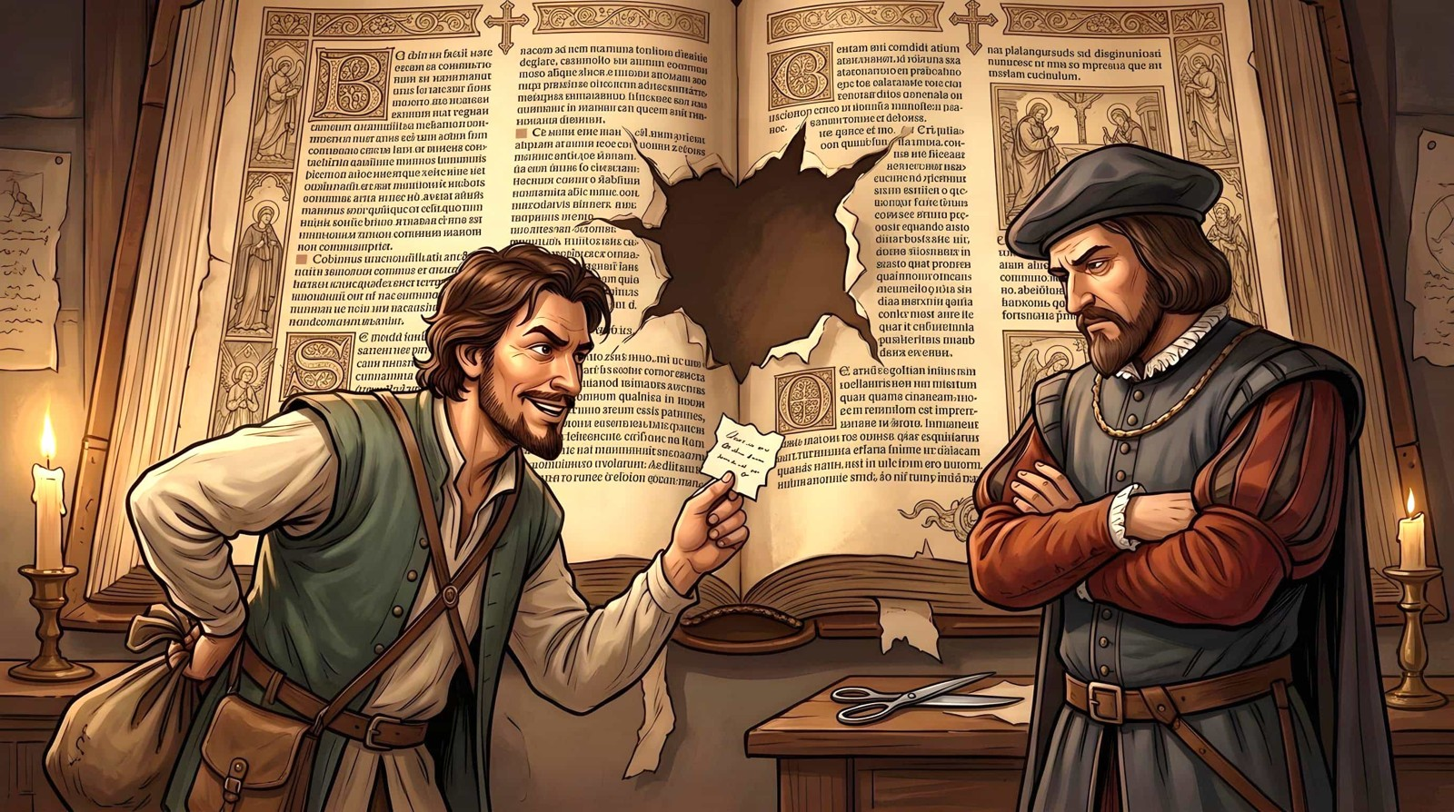
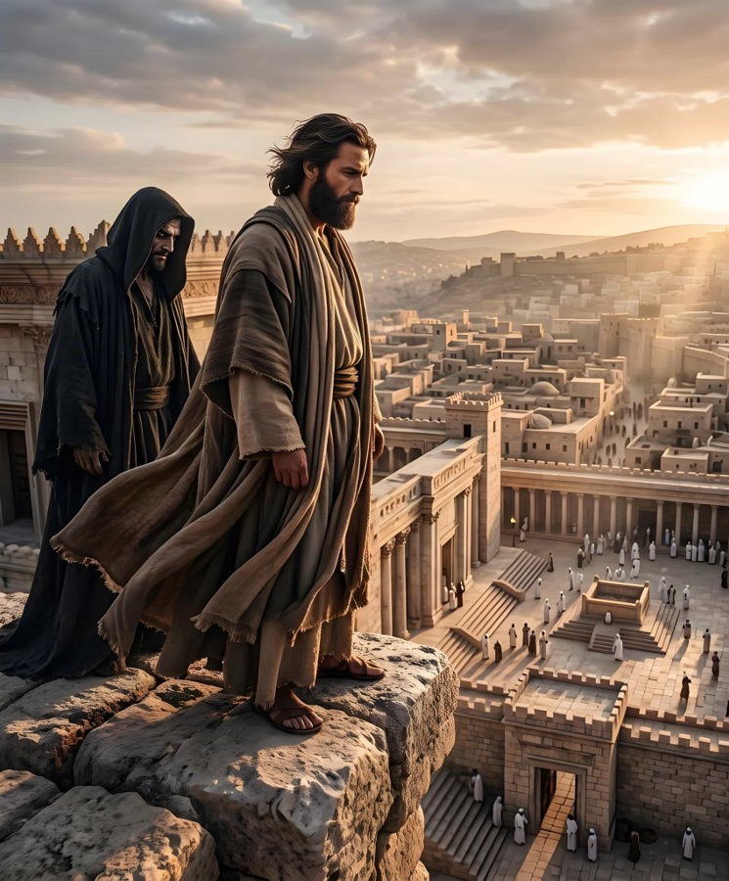

THE LITERARY CONTEXT
«And said to Him, “If You are the Son of God, throw Yourself down. For it is written: ‘He shall give His angels charge over you,’ and, ‘In their hands they shall bear you up, lest you dash your foot against a stone.’ ”» (Matthew 4:6)
A popular saying goes that “a text without context is a pretext.” In other words, using a text in isolation can lead to a personalized interpretation that suits our own tastes and is generally far removed from correct biblical teaching.
What is the context of a biblical text?
The immediate context consists of the verses before and after the text. A broader context is the chapter where the text is found. We can further expand the context by considering the entire book in which it appears.
Psalm 91:11-12 speaks of God's protection from external dangers. Taking it out of context and quoting it incompletely, Satan tried to get Jesus to deliberately put himself in danger by using this text as a pretext (Matthew 4:6).

Slide 9

“In order to sustain erroneous doctrines or unchristian practices, some will seize upon passages of Scripture separated from the context, perhaps quoting half of a single verse as proving their point, when the remaining portion would show the meaning to be quite the opposite. With the cunning of the serpent they entrench themselves behind disconnected utterances construed to suit their carnal desires. Thus do many willfully pervert the word of God. Others, who have an active imagination, seize upon the figures and symbols of Holy Writ, interpret them to suit their fancy, with little regard to the testimony of Scripture as its own interpreter, and then they present their vagaries as the teachings of the Bible.”
EGW (The Great Controversy, p. 521)

Slide 10


FIND OUT THE MEANING OF THE TEXT
“ ‘What is written in the Law?’ he replied. ‘How do you read it?’ ” (Luke 10:26 NIV)
All Christians should understand the Bible for themselves. The Bible is clear enough for all people to understand the way of salvation, yet complex enough to consistently challenge the brightest minds. Scripture is an endless treasure of saving knowledge that can never be fully exhausted.
But every correct interpretation of the biblical text must adhere to certain rules:
We must understand the words of the text (if possible, using the original languages or different translations)
Respect all contexts of the text (historical, cultural and literary)
Compare with parallel passages (such as the Gospels), or passages that deal with the same subject
The final interpretation must be in accordance with the teaching of the rest of the Bible.

Slide 11



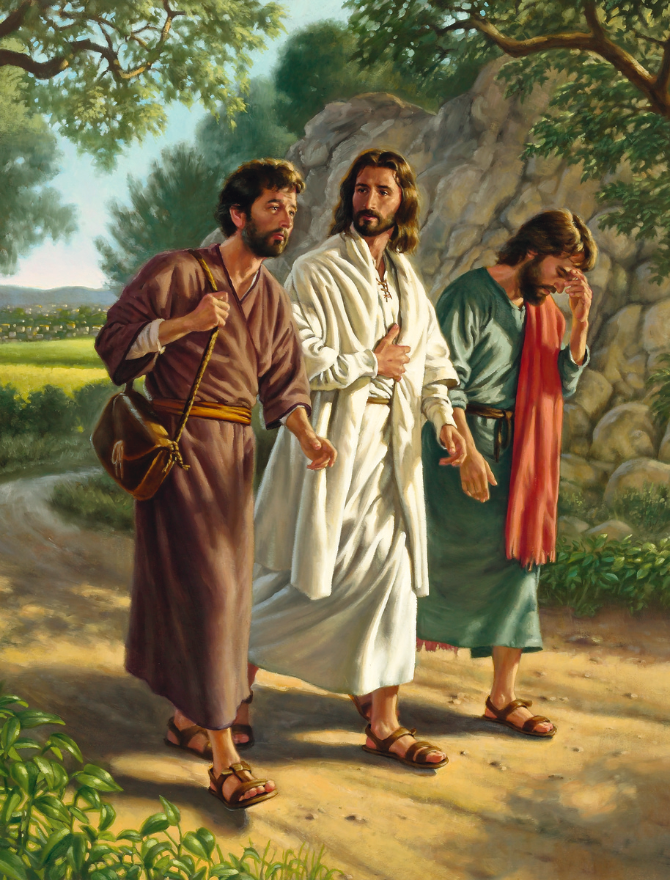
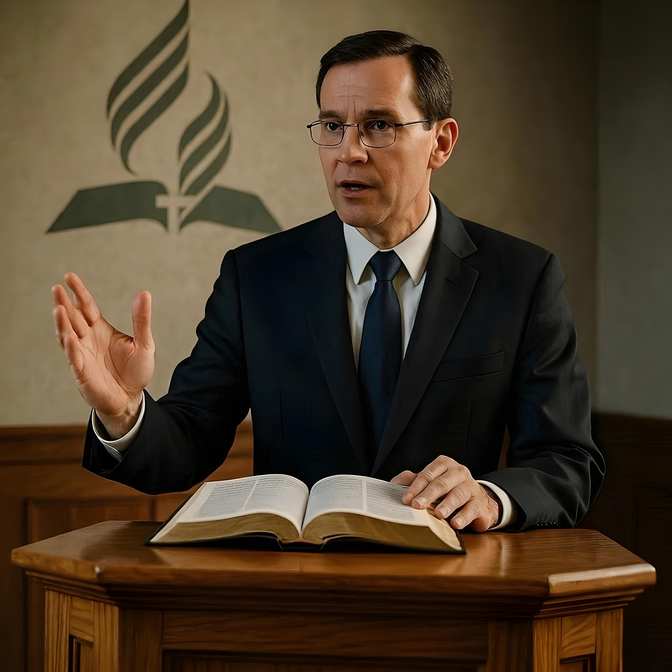
THEMATIC BIBLE STUDY
“And beginning with Moses and all the Prophets, he explained to them what was said in all the Scriptures concerning himself.” (Luke 24:27 NIV)
For a Christian, Bible study is not optional. We must always grow in the knowledge of God's will, allowing ourselves to be guided by the Holy Spirit in the study of His Word (John 16:13).
Furthermore, we must “always be ready to give a defense to everyone who asks you a reason for the hope that is in you” (1P 3:15).
Studying the Bible thematically will equip us to present the message to others, whether by giving Bible studies or preaching the Word.
It is also important to maintain a humble attitude in order to take advantage of the biblical knowledge of other people from whom we can learn.
Although we do not know the full content, we know that Jesus gave a Bible study to two people about His messianic work based on various biblical passages
(Lk. 24:25-27).

Slide 12

“Some portions of Scripture are, indeed, too plain to be misunderstood; but there are others whose meaning does not lie upon the surface, to be seen at a glance. Scripture must be compared with scripture; there must be careful research and patient reflection. And such study will be richly repaid. As the miner discovers veins of precious metal concealed beneath the surface of the earth, so will he who perseveringly searches the Word of God as for hid treasure, find truths of greatest value, which are concealed from the view of the careless seeker.”
EGW (Our High Calling, July 18)

Slide 13

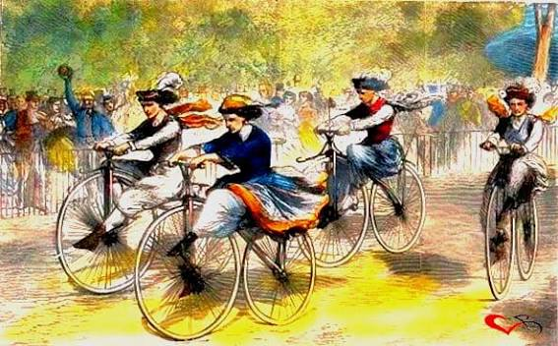



APPENDIX: INTERPRETING THE TEXTS OF ELLEN G. WHITE
When studying the writings of Ellen G. White, we must follow the same guidelines as when studying biblical texts.
Statements such as “The money expended in bicycles and dress and other needless things must be accounted for.” (TM 398), must be understood in the historical context (the price of a bicycle in 1890 was equivalent to several months' salary).
Using isolated paragraphs out of their literary context makes Ellen say what she never meant to say, or defend a doctrinal point contrary to what she believed and taught.
Before reaching a conclusion, we must study everything she taught on a specific topic, and not just rely on a few quotes.
On the other hand, we must ask ourselves: Did she really write what I'm being told? Always verify that the quote is real and accurate (use the official website https://egwwritings.org/).

