Slide 1
THE PARABLES OF JESUS

Slide 2
I will open my mouth in parables;
I will utter things which have been kept secret from the foundation of the world.
Matthew, 13:35

Slide 3
The 40 parables of Jesus recorded in the Gospels can be divided into the following sections:
Divine Mercy, Justice, and Love The Plan of Salvation Receiving the Truth The transformation of character Prayer Humility vs. Pride Taking advantage of the opportunities present The Christian and his neighbor Waiting for the Lord's Return The Last Judgment; Eternal Rewards
Below we will look at each of these parables and the lesson they want to teach us

Slide 4
Mercy, justice and Divine Love

Slide 5
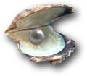
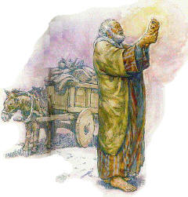
1. The pearl of great price
Redemptive love is of inestimable value; Man seeks salvation as the most precious thing
Matthew, 13:45-46

Slide 6
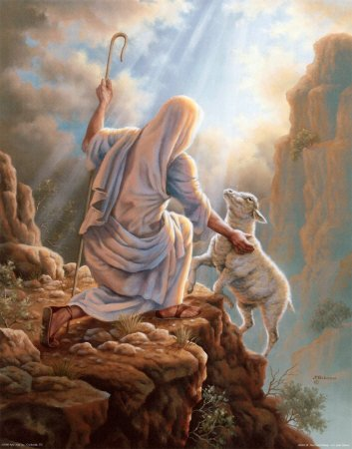
2. The Lost Sheep
The Lord's love for those who know they are lost but do not know how to return to God. God does not want anyone to perish.
Luke, 15: 3-7

Slide 7
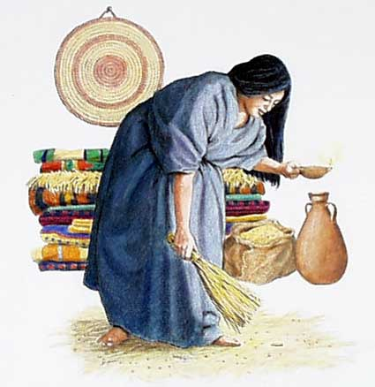
3. The Lost Coin
God's love for those who do not know they are lost. Diligence in searching for the lost.
Luke, 15:8-10

Slide 8
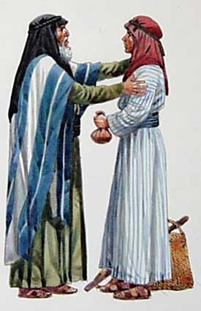
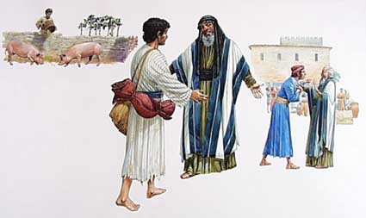
4. The Prodigal Son
God's love for those who have wandered away from His love. The hardness of the human heart in contrast to God's love.
Luke, 15:11-32

Slide 9
5. The barren fig tree
The relationship between divine justice and mercy. God's course with the Jewish nation.
Luke, 13:6-9

Slide 10
The Plan of Salvation

Slide 11
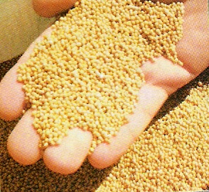
6. The Mustard Seed
The growth in quantity and quality of the Kingdom of divine Grace, the Church. God accomplishes great things by beginning small.
Matthew, 13:31-32

Slide 12
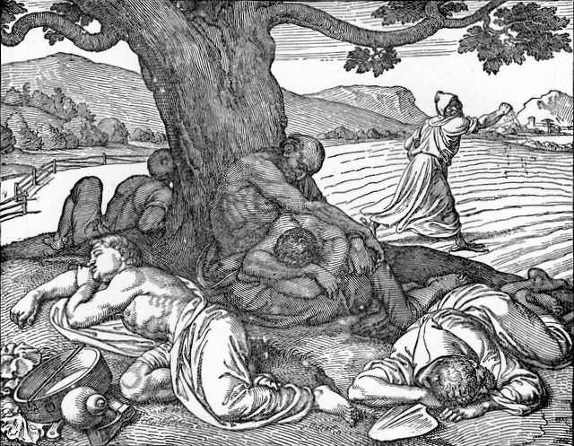
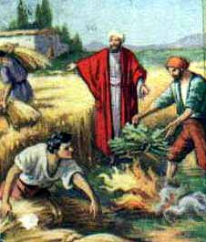
Character decides destiny. Purpose of probation. The tares do not finally turn into wheat.
7. The tares
Matthew, 13:24-30

Slide 13
8. The Wicked Husbandmen
God's eternal purpose will triumph in spite of man's unfaithfulness. Israel would lose its role as a chosen nation.
Matthew, 21:33-43

Slide 14
The Reception of Truth

Slide 15
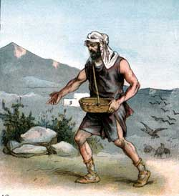
9. The Sower, the Seed, and the Soil
The Reception of the Truth in Different Kinds of Listeners
Matthew, 13:3-9, 18-23

Slide 16
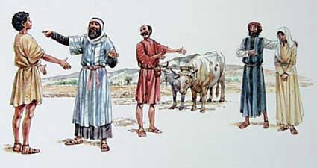
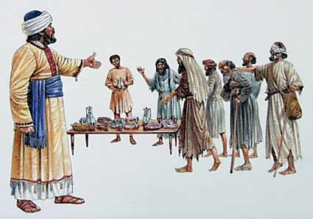
10. The Great Supper
The danger of neglecting or rejecting the truth. God cannot accept a divided heart.
Luke, 14:16-24

Slide 17
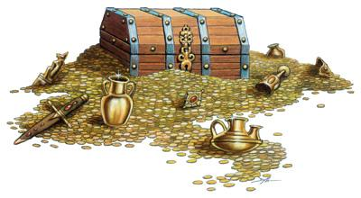
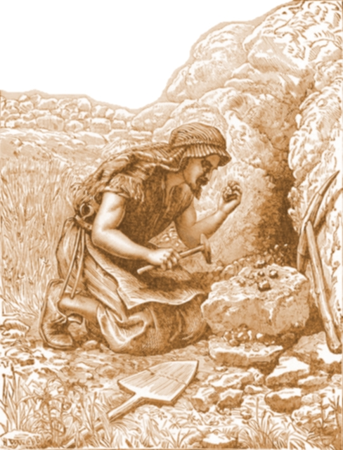
11. The Hidden Treasure
The supreme value of truth and the indispensable effort to acquire it.
Matthew, 13:44

Slide 18
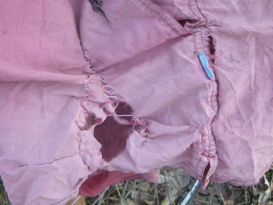
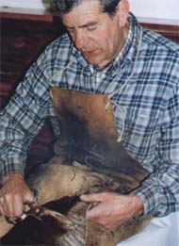
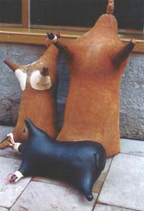
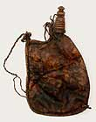
12. The New Cloth and the New Wine
Truth versus traditions. The danger of preconceived opinions.
Mark, 2:21-22

Slide 19
13. The Two Debtors
Appreciation and gratitude for God's love and mercy
Luke 7:41-43

Slide 20
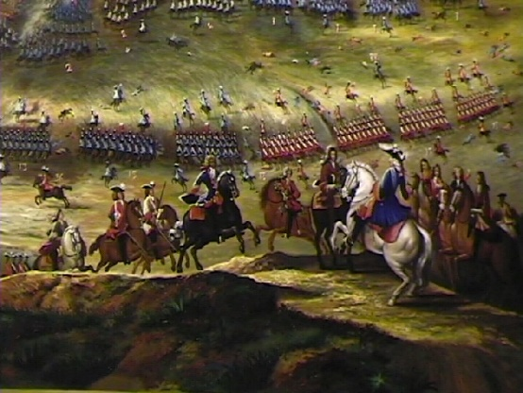
14. The Building of a Tower; A King goes to War
Calculating the Cost of Discipleship
Luke 14:28-33

Slide 21
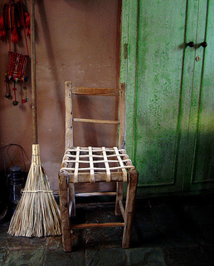
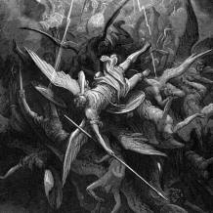
15. Seven Unclean Spirits
The need for a positive attitude toward truth; the unforgivable sin. The condition of the Jewish leaders. Justification is incomplete without sanctification.
Matthew, 12:43-45

Slide 22
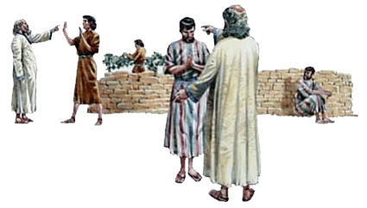
16. The Two Sons
Deeds count, not words; the profession of faith without practice is hypocrisy
Matthew, 21:28-32

Slide 23
17. Building on the Rock or on the Sand
The perception of truth is not an end in itself, but the means to achieve the transformation of life. The foolishness of knowledge without obedience.
Matthew, 7:24-27

Slide 24
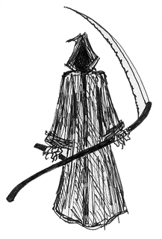
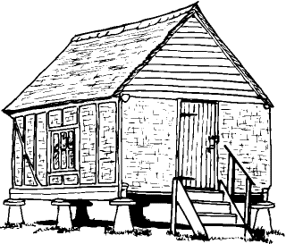
18. The Rich Fool
The danger of clinging to earthly things; foolishness to live for the material. To live for oneself is to perish.
Luke, 12:16-21

Slide 25
The transformation of character

Slide 26
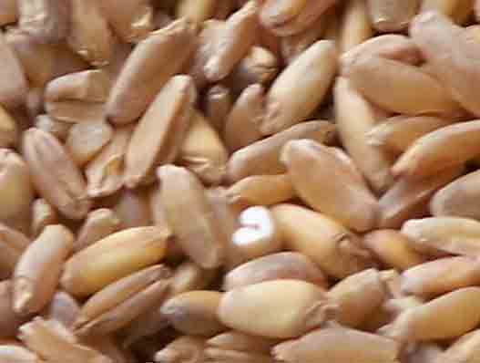
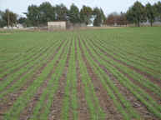
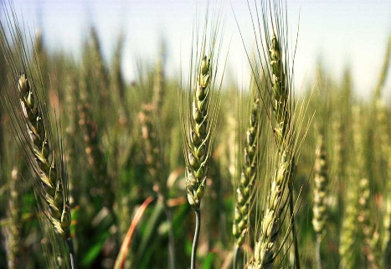
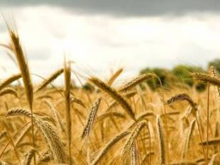
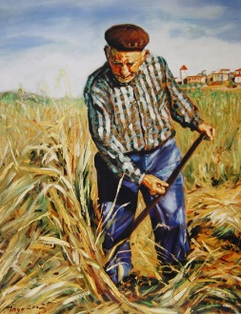
19. The Seed That Grows
Faith and Works: The Cooperation of Human Effort with Infinite Power in Christian Growth
Mark, 4:26-29

Slide 27
20. Yeast
The intense and qualitative growth of the kingdom of heaven. Heavenly power is implanted in the heart, and it transforms life.
Matthew, 13:33

Slide 28
21. The Man Without a Wedding Garment
The Importance of Christ's Righteousness
Matthew, 22:2-14

Slide 29
Prayer

Slide 30
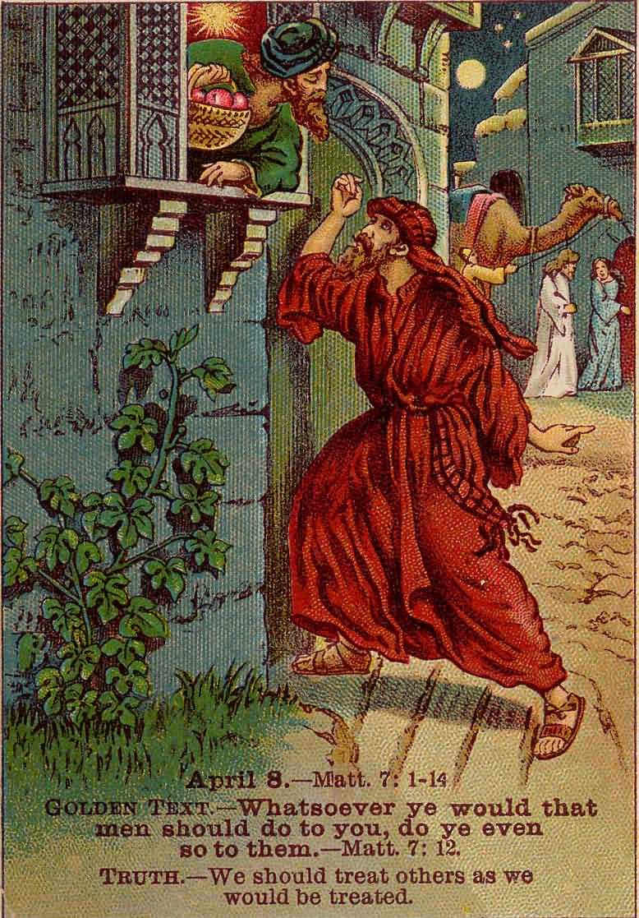
22. The Friend Who Calls at Midnight
Perseverance in prayer. Asking to give to others.
Luke, 11:5-13

Slide 31
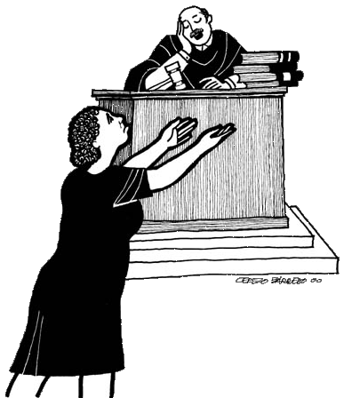
23. The Unjust Judge
Perseverance, fervor, and confidence in prayer
Luke, 18:1-8

Slide 32
Humility versus Pride

Slide 33
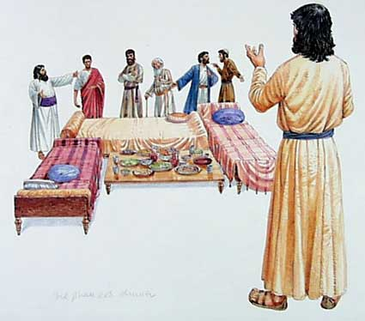
24. Choosing Honorary Positions
Humility in dealing with others; Honoring Others
Luke, 14:7-11

Slide 34
25. The Pharisee and the Publican
Humility before God; The Danger of Pride and Self-Righteousness
Luke, 18:9-14

Slide 35
Taking advantage of Present
Opportunities

Slide 36
26. The Nobleman and the Pounds
The cultivation of talents and the use of opportunities. Work while waiting for the kingdom. Faithful service will be the basis of the award.
Luke, 19: 11-27

Slide 37
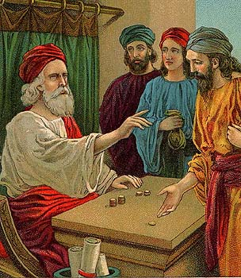
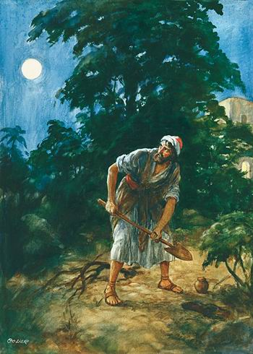
27. The Talents
The same teaching as the parable of the noble man and the pounds. In addition, it teaches us to help others in preparation for our Lord's return.
Matthew, 25:14-30

Slide 38
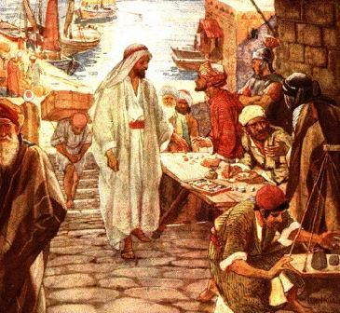
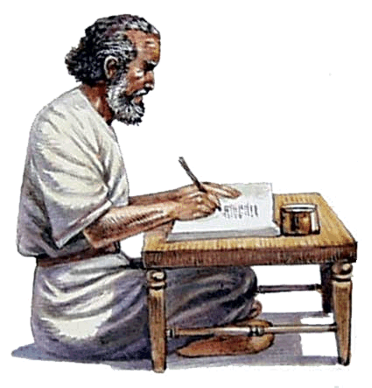
28. The Unfaithful Steward
Diligent use of present opportunities in preparation for future life
Luke, 16:1-9

Slide 39
29. The Rich Man and Lazarus
Eternal destiny is decided in the present life. There is no second time of grace. Danger due to concern for material things.
Luke, 16:19-31

Slide 40
The Christian and His Neighbor

Slide 41
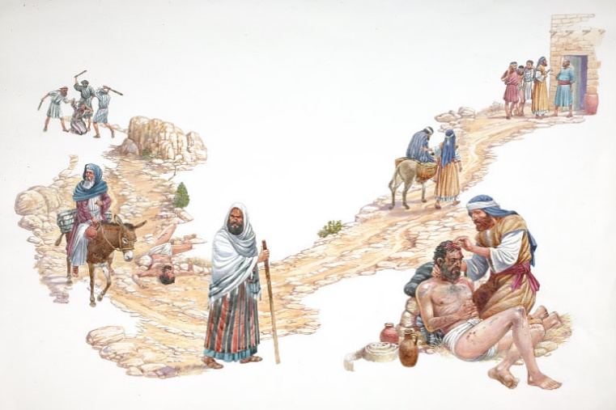
True religion consists in active service on behalf of others; eternal destiny depends on this. Contact with the one who suffers frees the soul from selfishness.
30. The Good Samaritan
Luke, 10:30-37

Slide 42
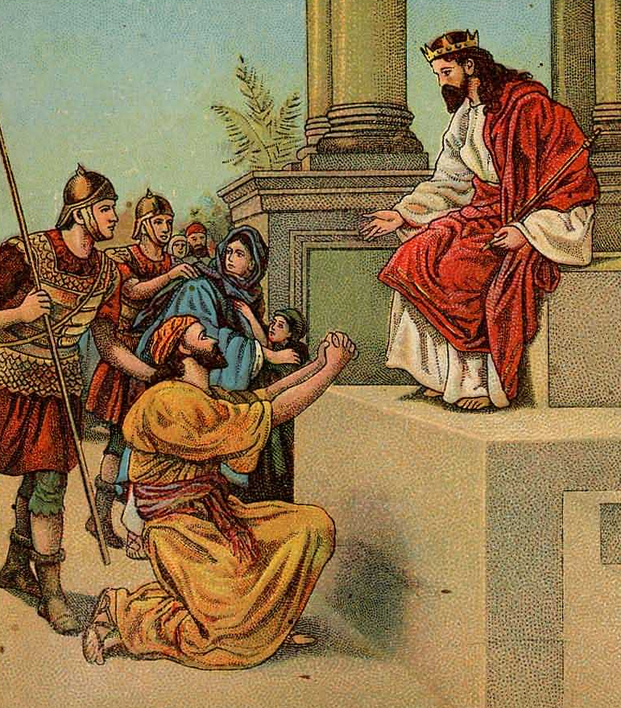
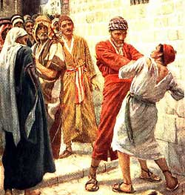
31. The Servant Who Didn't Forgive
Mercy and forgiveness for others. God's forgiveness depends on how we forgive our neighbor.
Matthew, 18:23-35

Slide 43
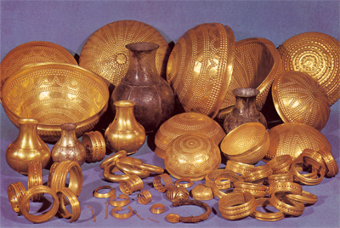
32. Old and New Treasures
Familiarity with ancient truths; Beware of the new ones. Adapt the truth to the needs of the listeners.
Matthew, 13:52

Slide 44
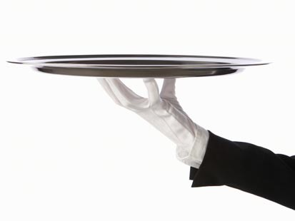
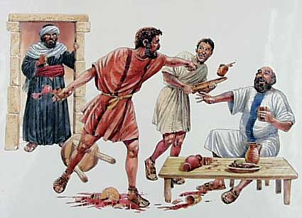
33. The Faithful Steward
The Accurate Conscientious Supervision of the Affairs of God's House, the Church
Luke, 12: 42-48

Slide 45
Waiting
For The Lord’s
Return

Slide 46
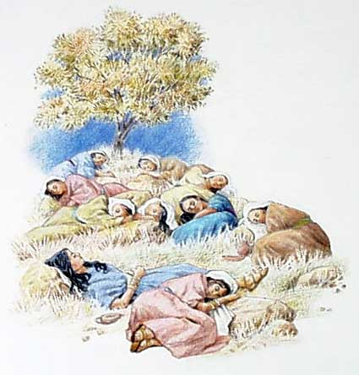
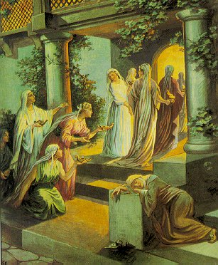
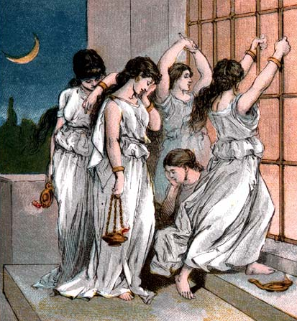
34. The Ten Virgins
Personal preparation for the return of our Lord; His coming seems to be delayed. Our need for the Holy Spirit.
Matthew, 25:1-13

Slide 47
35. The Watchful Servant
Dusk
Midnight
Watching and Awaiting the Master's Return
Rooster crow
Dawn
Mark, 13:34-37

Slide 48
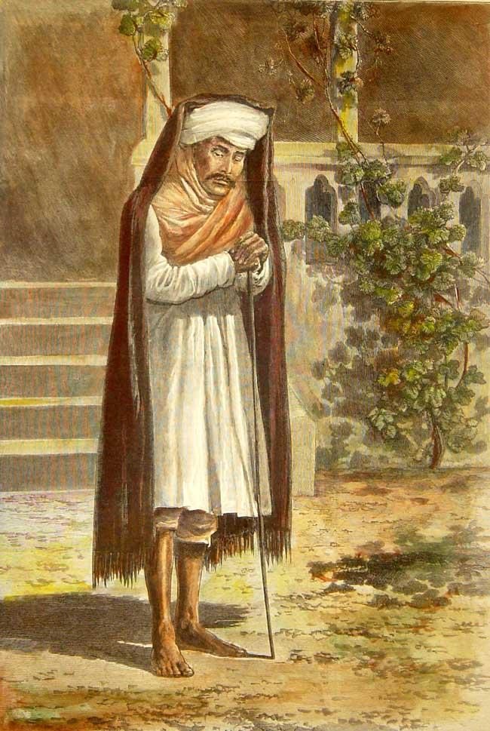
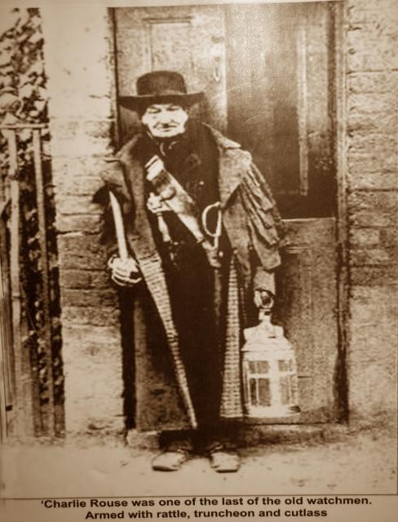
36. The vigilant servants; The goodman who watches
Preparation for the surprise return of our Lord. Living according to the light we possess; our personal responsibility to the truth.
Luke, 12:35-40

Slide 49
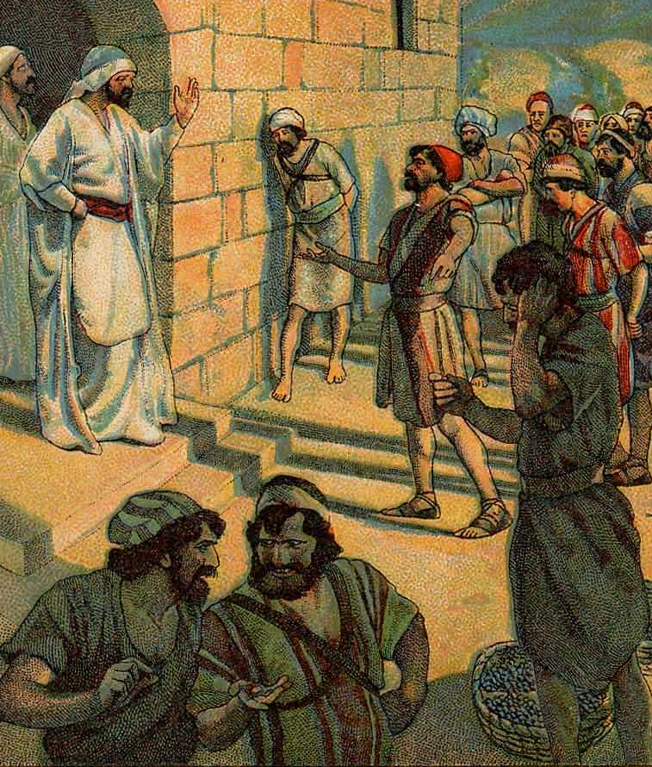
37. The Laborers in the Vineyard
God measures service by the goodwill and faithfulness with which it is done. The reward depends on the grace and generosity of our Lord and the spirit that motivates our service to Him.
Matthew, 20:1-16

Slide 50
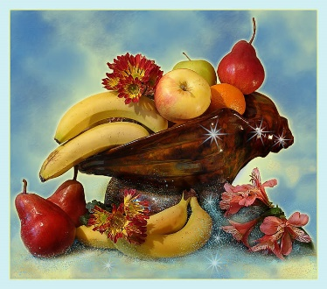
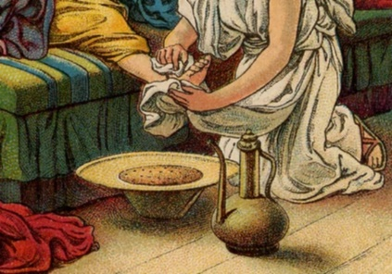
38. Unprofitable Servants
Fidelity to duty. God is entitled to all our services
Luke, 17:7-10

Slide 51
39. The sheep and the goats
The meaning of practical religion. The supreme test of the reality of our religion is what it induces us to do on behalf of others.
Matthew, 25:31-46

Slide 52
The Last
Judgment; Eternal
Rewards

Slide 53
40. The Net
The final separation of the good and the bad. Not all sinners will eventually become righteous.
Matthew, 13:47-50

Slide 54
All these things spake Jesus unto the multitude in parables; and without a parable spake he not unto them:
Matthew, 13:34

