Slide 1
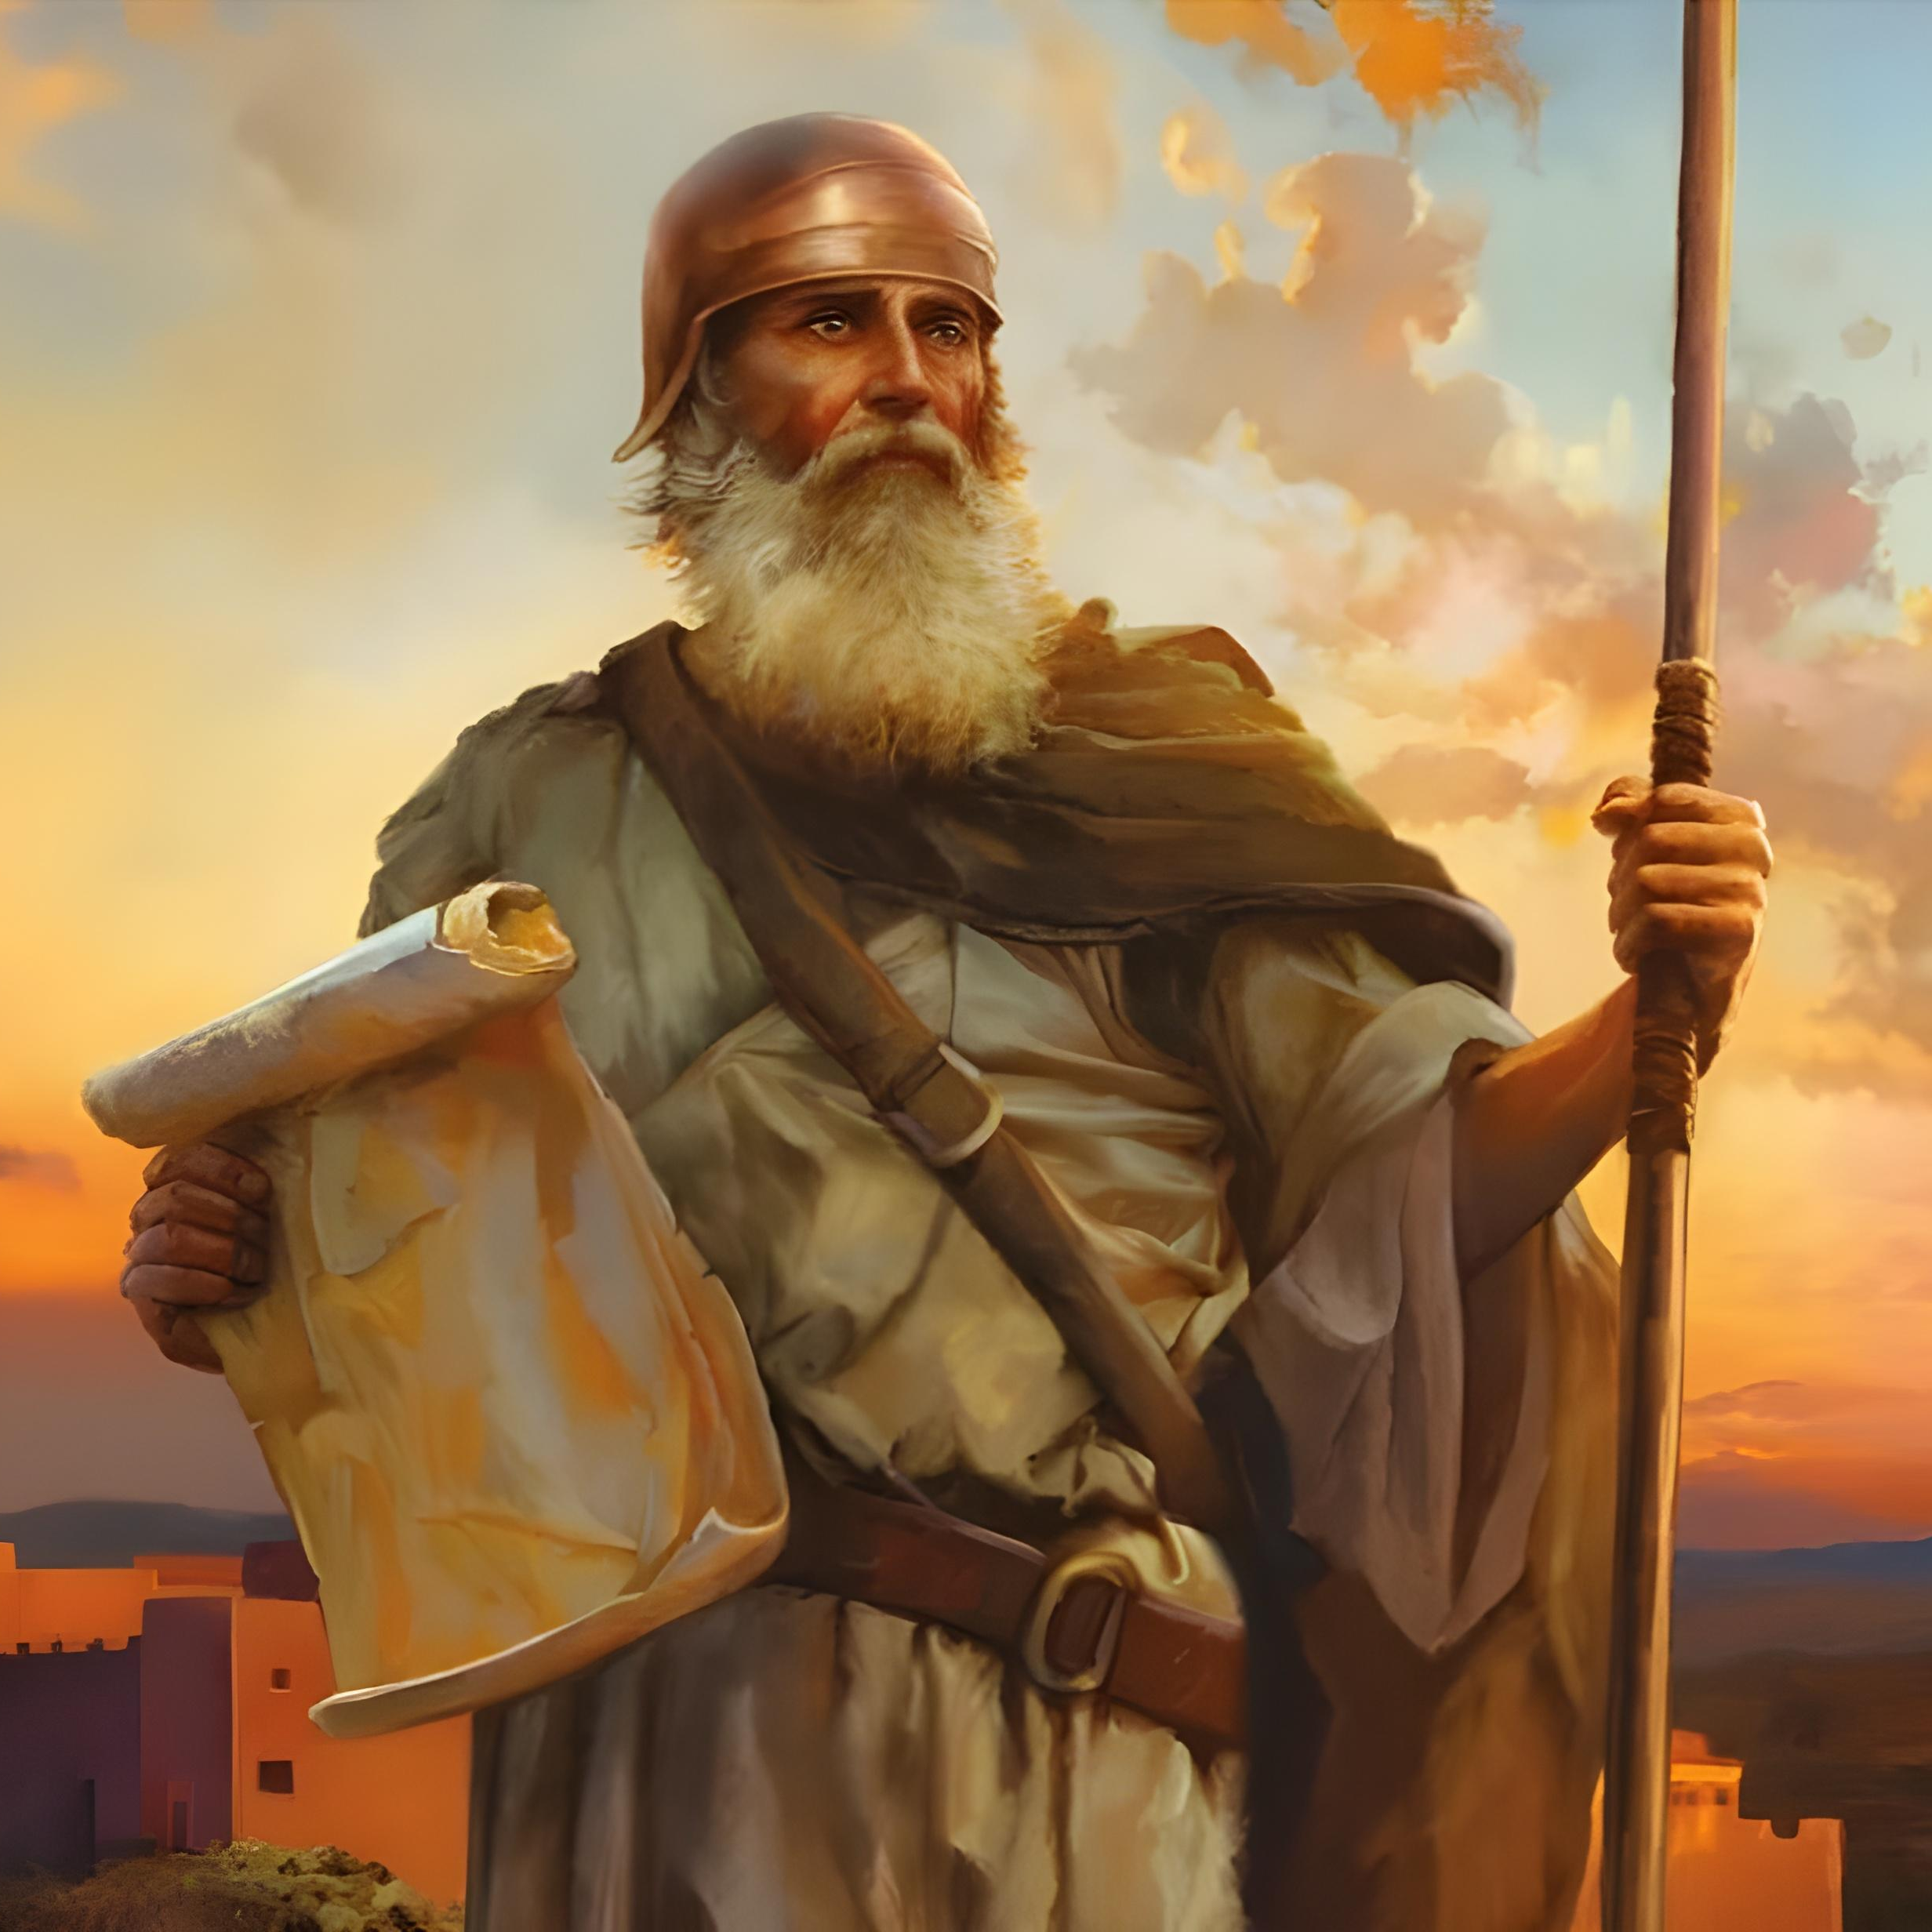
“Only be strong and very courageous, that you may observe to do according to all the law which Moses My servant commanded you; do not turn from it to the right hand or to the left, that you may prosper wherever you go” Joshua 1:7, NKJV

Slide 2


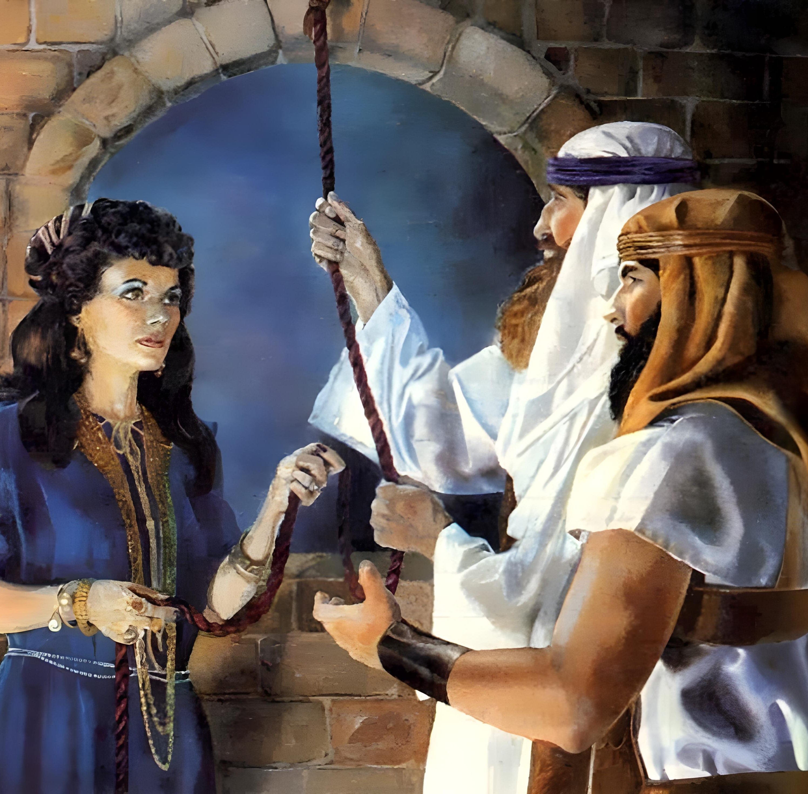
“By faith the harlot Rahab did not perish with those who did not believe, when she had received the spies with peace”
(Hebrews 11:31, NKJV)

Slide 3

“For the Lord your God dried up the waters of the Jordan for you until you passed over, as the Lord your God did to the Red Sea, which he dried up for us until we passed over, so that all the peoples of the earth may know that the hand of the Lord is mighty, that you may fear the Lord your God forever”
Joshua 4:23, 24, ESV

Slide 4
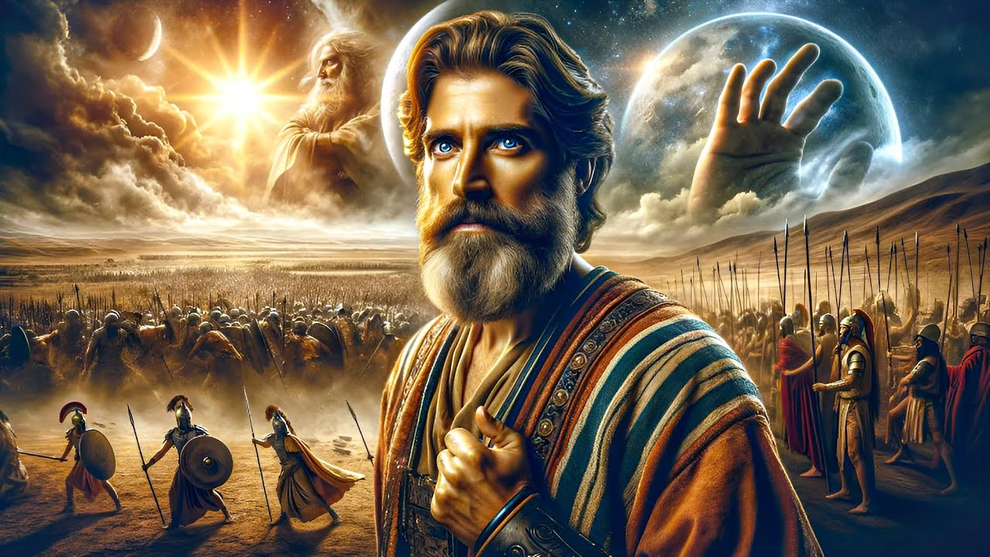
“There has been no day like it before or since, when the Lord heeded the voice of a man, for the Lord fought for Israel”
Joshua 10:14, ESV

Slide 5

“And Joshua captured all these kings and their land at one time, because the Lord God of Israel fought for Israel”
Joshua 10:42, ESV

Slide 6


“I the Lord search the heart and test the mind, to give every man according to his ways, according to the fruit of his deeds”
Jeremiah 17:10, ESV

Slide 7



“But seek first the kingdom of God and his righteousness, and all these things will be added to you”
Matthew 6:33, ESV

Slide 8
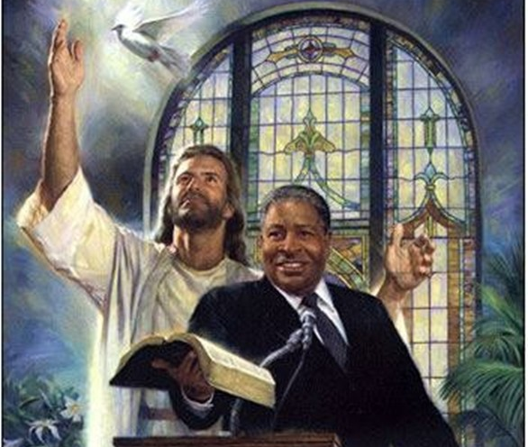
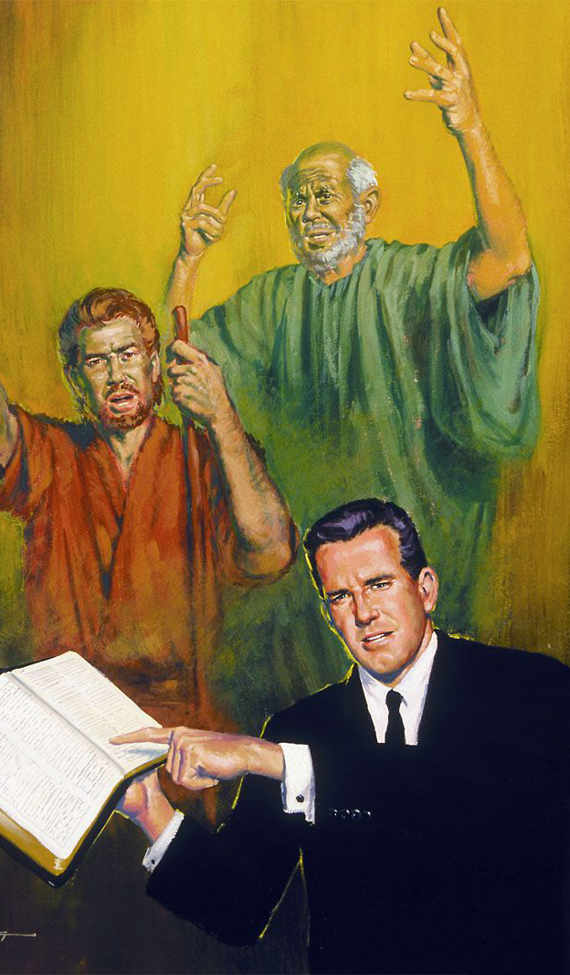

“Remember your leaders, those who spoke to you the word of God. Consider the outcome of their way of life, and imitate their faith”
(Hebrews 13:7, ESV)

Slide 9
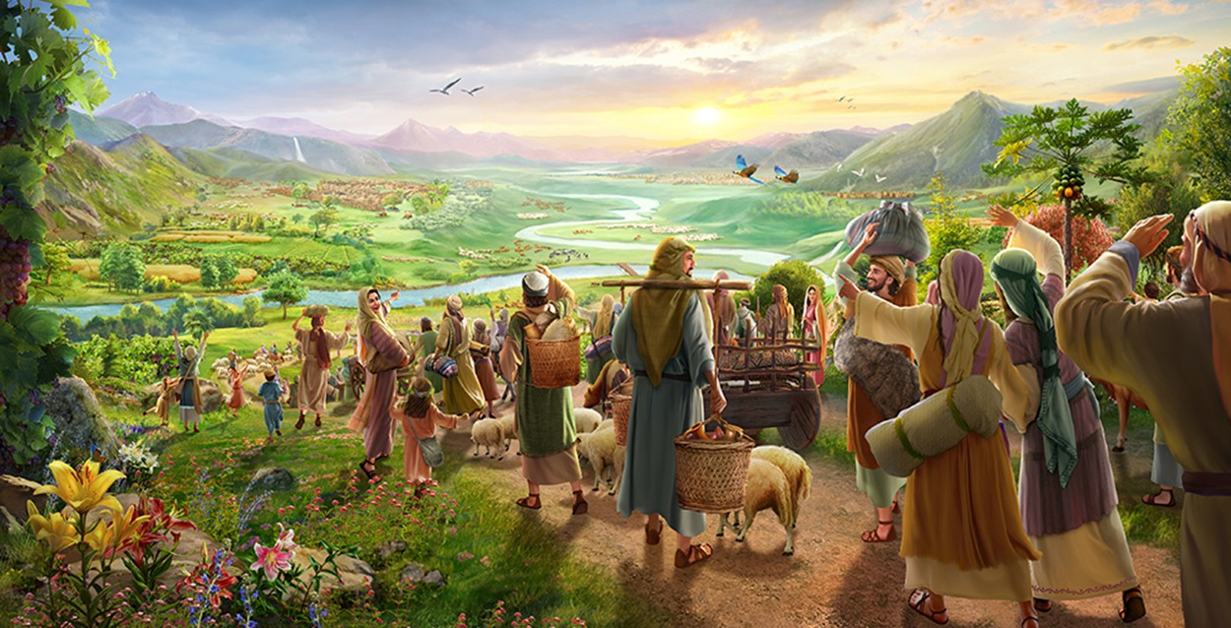
“Return to your stronghold, O prisoners of hope; today I declare that I will restore to you double” (Zechariah 9:12, ESV)

Slide 10
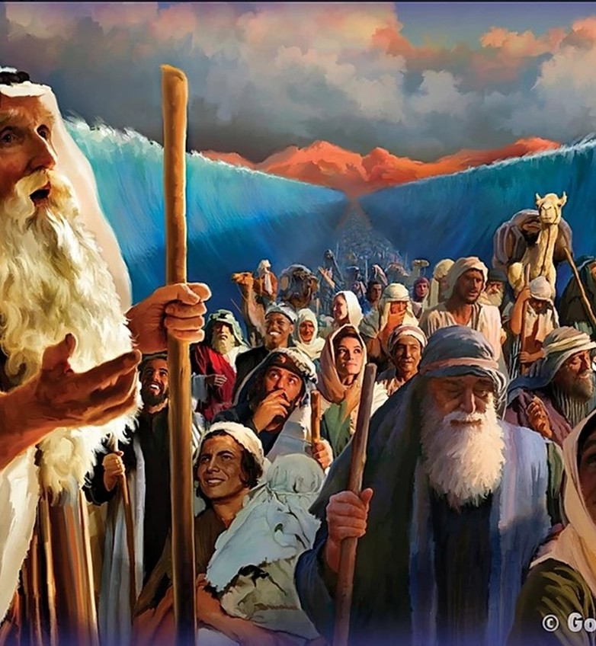
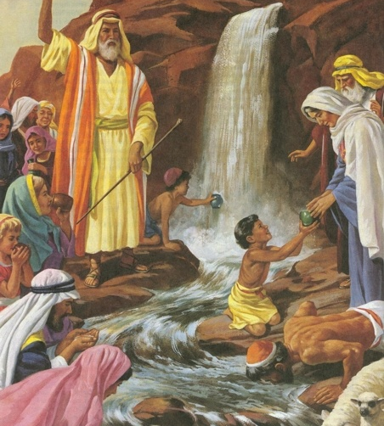
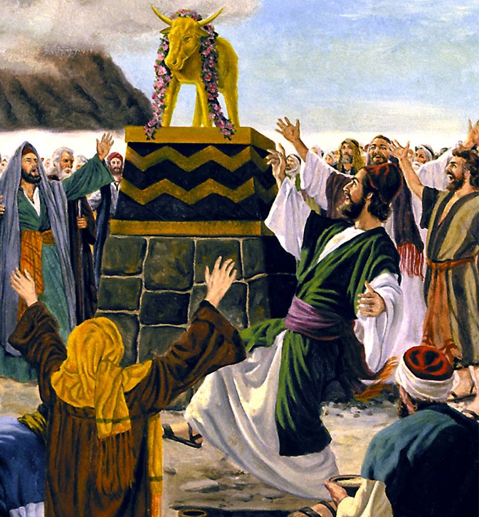
“Now these things happened to them as an example, but they were written down for our instruction, on whom the end of the ages has come” (1 Corinthians 10:11, ESV)

Slide 11
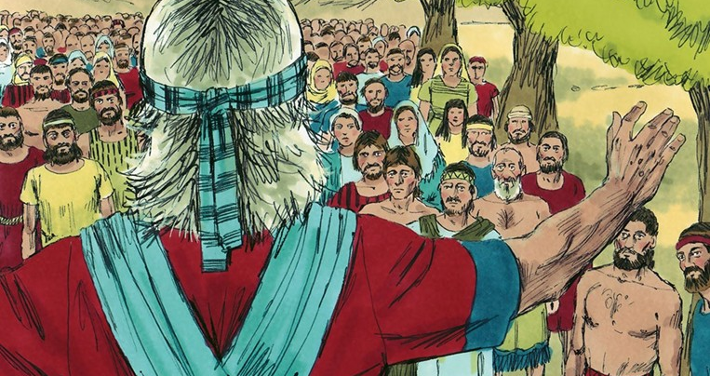

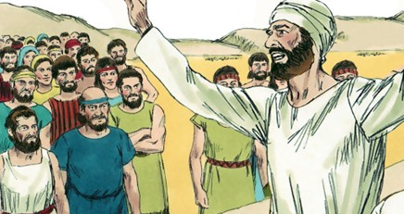
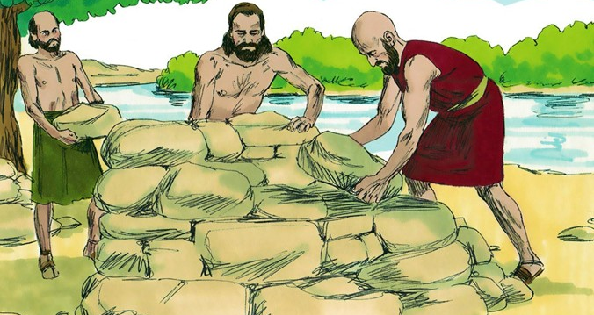
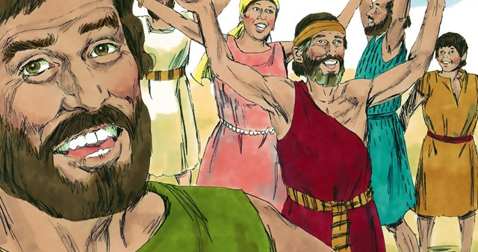
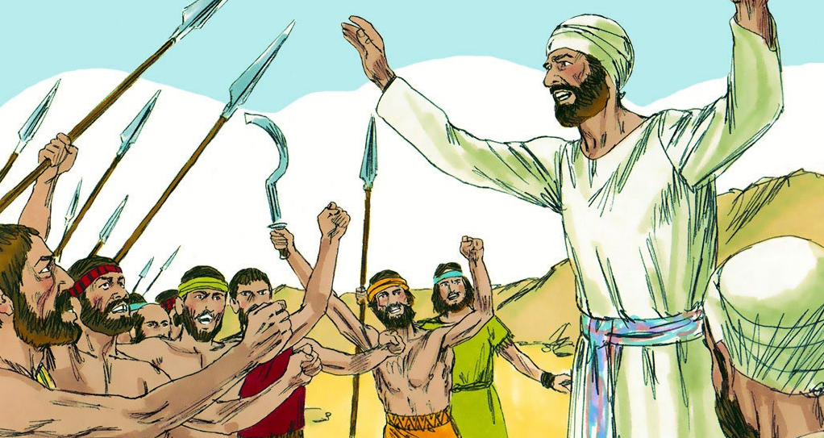
“A gentle answer turns away wrath, but a harsh word stirs up anger” (Proverbs 15:1, NIV)

Slide 12

“Not one word of all the good promises that the Lord had made to the house of Israel had failed; all came to pass” (Joshua 21:45, ESV)

Slide 13
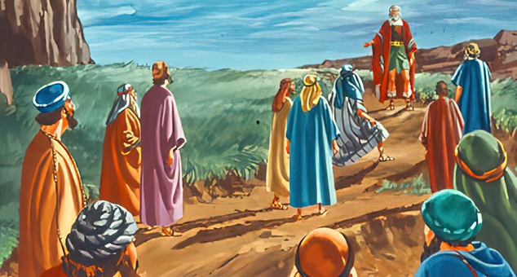
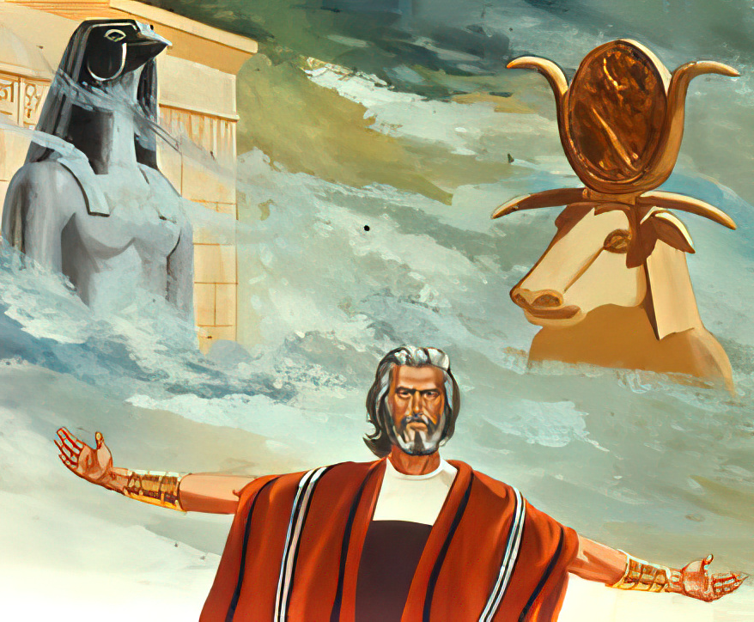
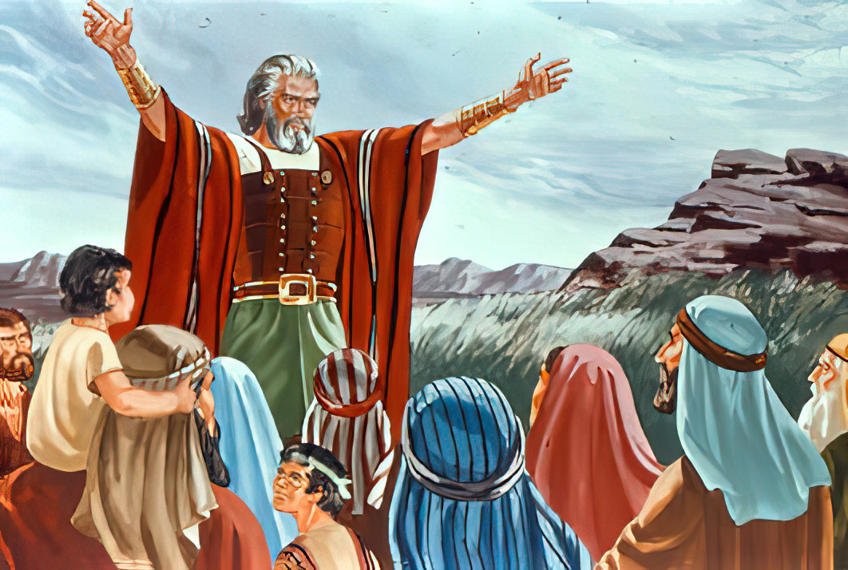
“And if it seems evil to you to serve the Lord, choose for yourselves this day whom you will serve. . . . But as for me and my house, we will serve the Lord”
(Joshua 24:15, NKJV)

