Slide 1
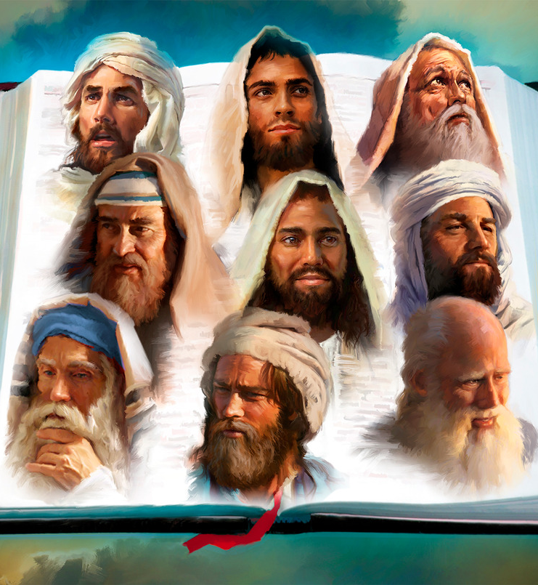
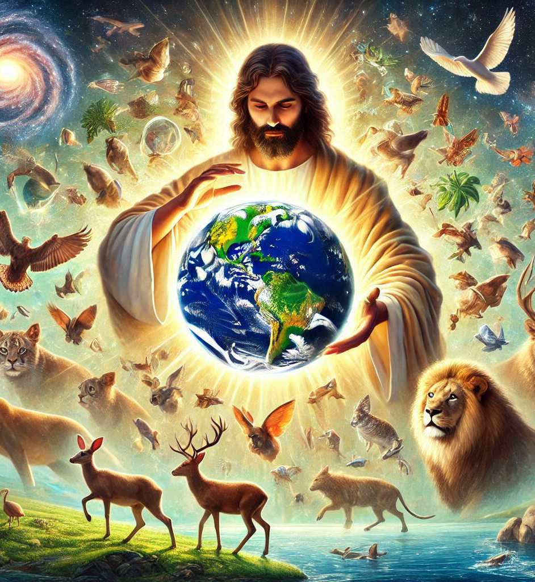
“God, who at various times and in various ways spoke in time past to the fathers by the prophets, 2 has in these last days spoken to us by His Son, whom He has appointed heir of all things, through whom also He made the worlds”
(Hebrews 1:1-2, NKJV)

Slide 2

«Also I heard the voice of the Lord, saying: “Whom shall I send, and who will go for Us?” Then I said, “Here am I! Send me.”»
(Isaiah 6:8, NKJV)

Slide 3

«Jehoshaphat stood and said, “Hear me, O Judah and you inhabitants of Jerusalem: Believe in the Lord your God, and you shall be established; believe His prophets, and you shall prosper.”»
(2 Chronicles 20:20, NKJV)

Slide 4

“There are diversities of gifts, but the same Spirit. There are differences of ministries, but the same Lord. And there are diversities of activities, but it is the same God who works all in all” (1 Corinthians 12:4-6, NKJV)

Slide 5

“The Revelation of Jesus Christ, which God gave Him to show His servants—things which must shortly take place. And He sent and signified it by His angel to His servant John, who bore witness to the word of God, and to the testimony of Jesus Christ, to all things that he saw” (Revelation 1:1-2)

Slide 6


“For whatever things were written before were written for our learning, that we through the patience and comfort of the Scriptures might have hope” (Romans 15:4)

Slide 7







“Now these things happened to them as an example, and they were written for our instruction, upon whom the ends of the ages have come” (1 Corinthians 10:11, NASB)

Slide 8

“Then beginning with Moses and with all the Prophets, He explained to them the things written about Himself in all the Scriptures”
(Luke 24:27, NASB)

Slide 9
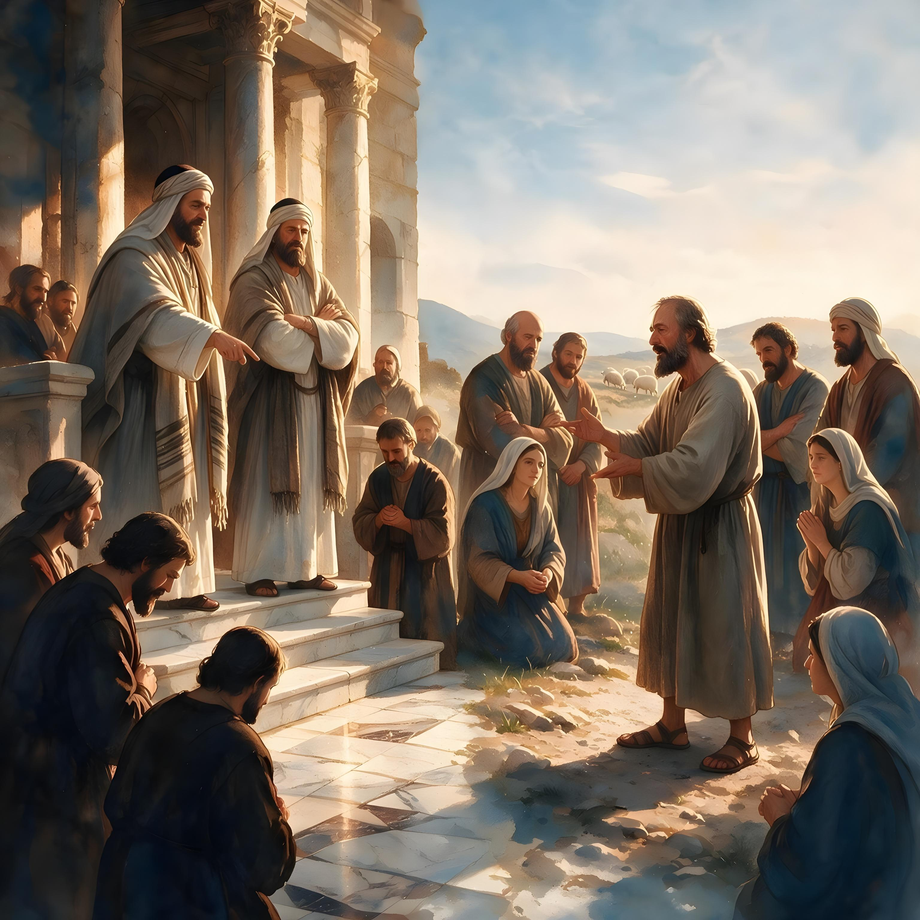

“Beloved, do not believe every spirit, but test the spirits, whether they are of God; because many false prophets have gone out into the world”
(1 John 4:1, NKJV)

Slide 10

“For the word of God is living and powerful, and sharper than any two-edged sword, piercing even to the division of soul and spirit, and of joints and marrow, and is a discerner of the thoughts and intents of the heart” (Hebrews 4:12, NKJV)

Slide 11

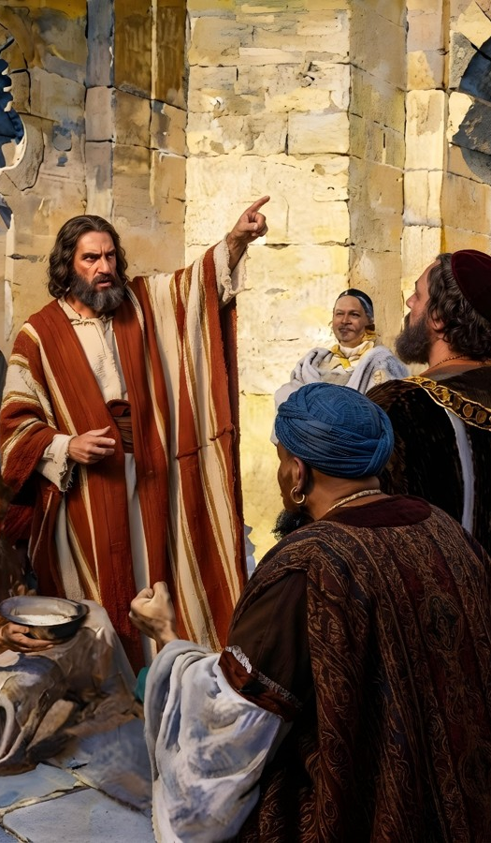
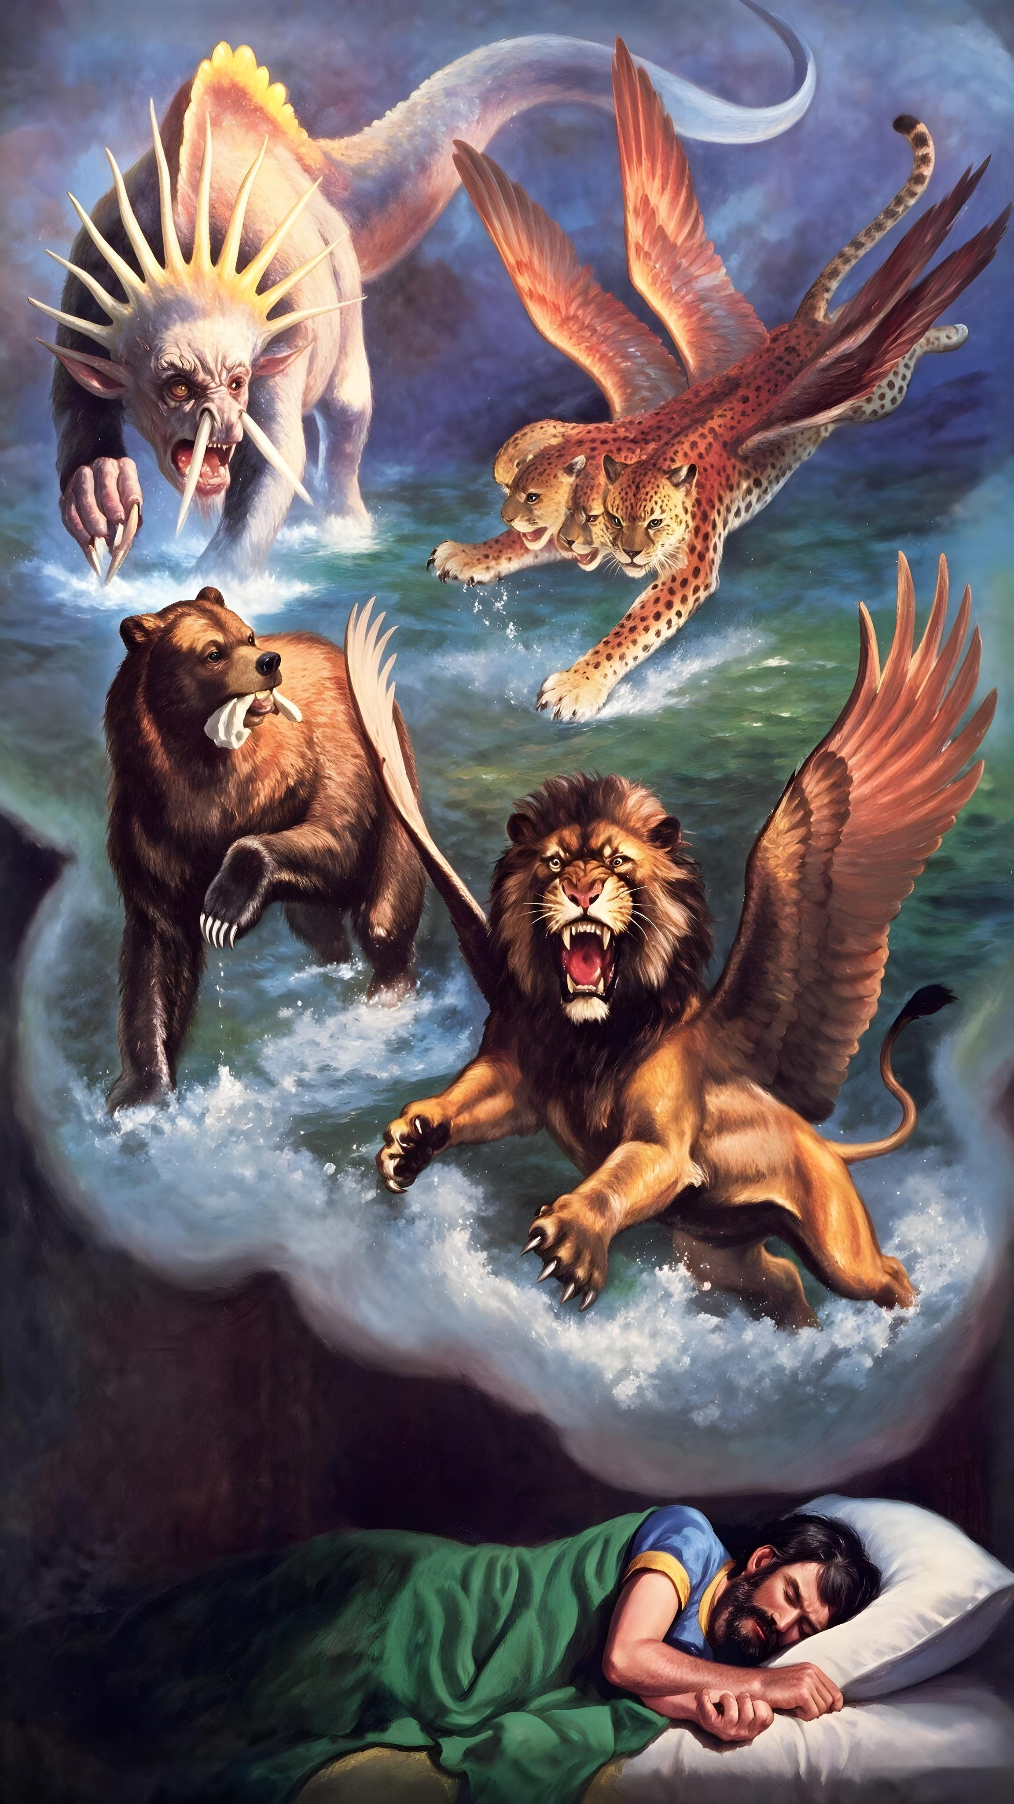
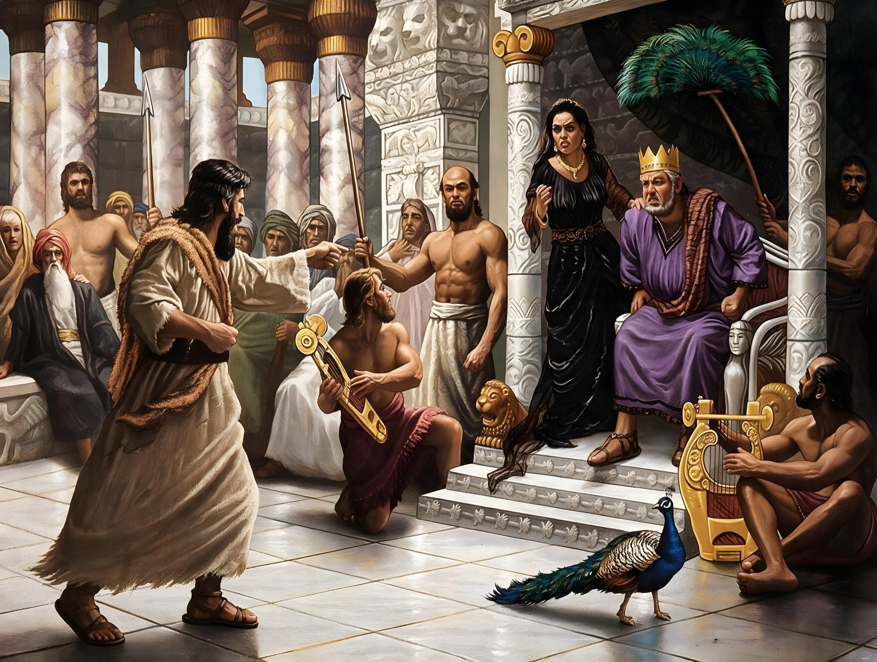
“Surely the Lord God does nothing,
Unless He reveals His secret to His servants the prophets”
(Amos 3:7, NKJV)

Slide 12

“And it shall come to pass afterward that I will pour out My Spirit on all flesh; your sons and your daughters shall prophesy, your old men shall dream dreams, your young men shall see visions. And also on My menservants and on My maidservants I will pour out My Spirit in those days”
(Joel 2:28-29, NKJV)

Slide 13

“All Scripture is given by inspiration of God, and is profitable for doctrine, for reproof, for correction, for instruction in righteousness, that the man of God may be complete, thoroughly equipped for every good work”
(2 Timothy 3:16-17, NKJV)

