Slide 1
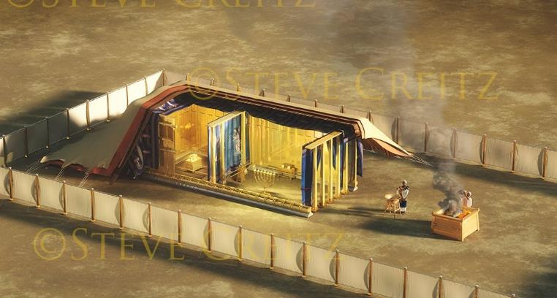
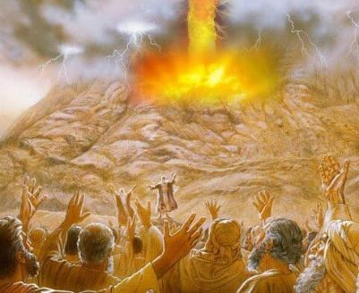
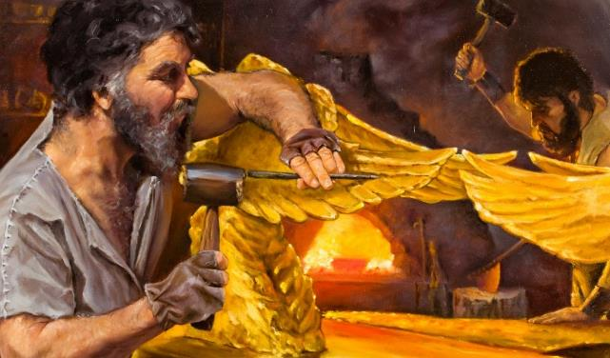
Lesoni 10 Sepiteba 6, 2025
NA VEIYALAYALATI
KEI NA KENA IVAKATAKARAKARA
Notes:
THE COVENANT AND THE BLUEPRINT

Slide 2
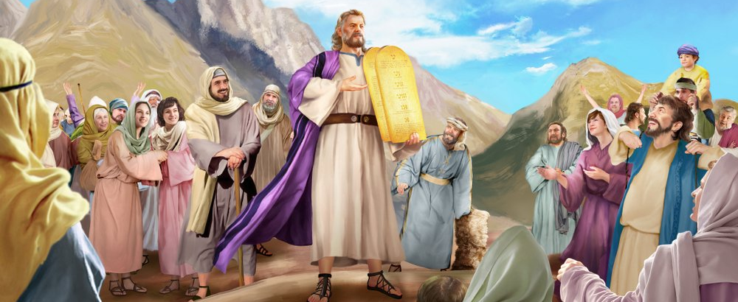
“A sa lako ko Mosese, ka tukuna vei ira na tamata na vosa kecega i Jiova, kei na lewa kecega: a ra sa vosa na tamata kecega, ka kaya, A vosa kecega sa kaya ko Jiova keimami na cakava’ ”Lako Yani 24:3
Notes:
³ A sa lako ko Mosese, ka tukuna vei ira na tamata na vosa kecega i Jiova, kei na lewa kecega: a ra sa vosa vata na tamata kecega, ka ra kaya, A vosa kecega sa kaya ko Jiova keimami na cakava.

Slide 3

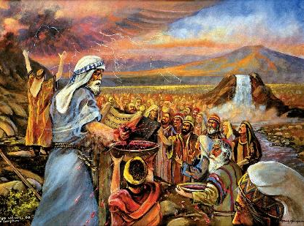
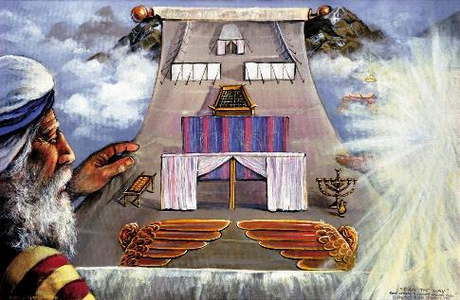


Ni a sa cavuti oti vakadomoilevu na iVunau e Tini, ka soli talega ki vei Mosese na yavu levu ni vei vunau tale eso,sa qai vinakata ka Kalou me cakava e dua na veiyalayalati kei Isireli.
E rawarawa sara na veiyalayalati oqo: A na nomu Kalou, au na totaki iko ka vakalougatataki iko; ko na cakava na noqu I vunau
Ni sa volai oti na I vunau ena vatu, sa dodonu me rau na vakadonuya na yasana ruarua. Era sa vakadonuya na tamata ena nodra kaya, “a vosa kecega sa kaya ko Jiova keimami na cakava. E vakadonuya vakacava ko jiova? Ena dra: ena kanavata; ena dua na I vakatakarakara me rawarawa kina ni ra kila na vosa ni veiyalayalati.
Na veiyalayalati:
Na dra ni veiyalayalati (Lako Yani 24:1-6, 8)
Vakayacori na veiyalayalati (Lako Yani 24:7)
Na Kanavata ni Veiyalayalati (Lko Yani 24:9-18)
Na ivakatakarakara:
Na inaki ni vakatakarakara (Lako Yani 25:1-9)
Caka ni ivakatakarakara (Lako Yani 31:1-18)
Notes:
After loudly proclaiming the Ten Commandments and giving Moses a basic set of laws, God wanted to make a covenant with Israel.

Slide 4
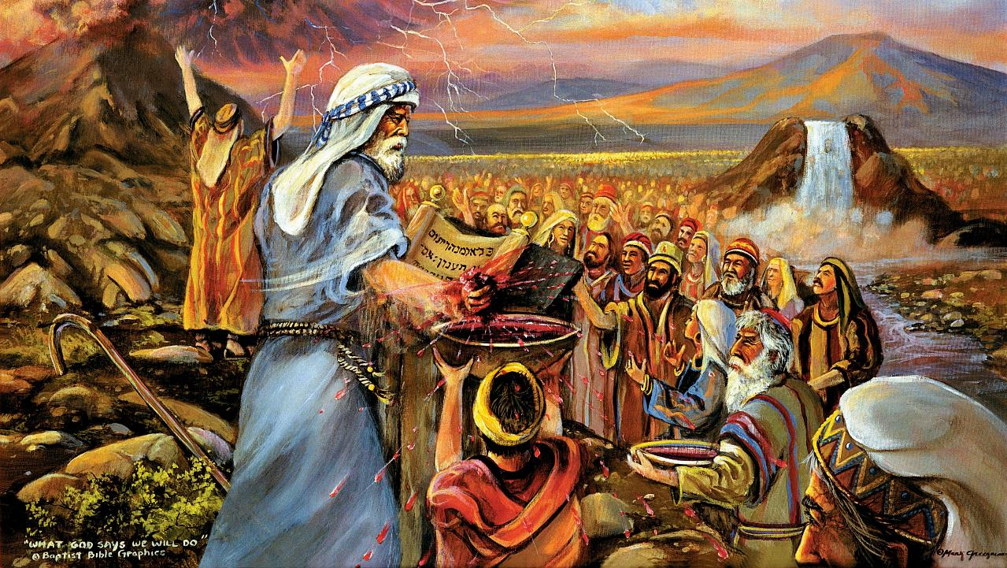
NA VEIYALAYALATI
Notes:
THE COVENANT

Slide 5

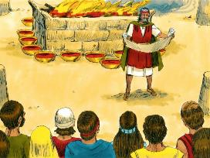
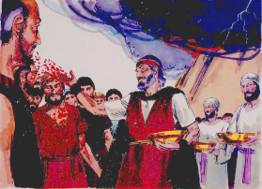
NA DRA NI VEIYALAYALATI
A sa taura na dra ko Mosese, ka kureitaka vei ira na tamata, ka kaya, Raica na dra ni veiyalayalti, sa ia vei kemudou ena vosa kecega oqo ko Jiova.’ ” (Lako Yani 24:8)
Na valavala ni kena caka na veiyalayalati
E wiliki vei ira na tamata na veiyalayalati (LY. 24:3a)
Era vosa na tamata ka vaka io kina (LY. 24:3b)
Sa volai vakaivola na veiyalayalati (LY. 24:4a)
Sa tara e dua na icabocabo ni soro (LY. 24:4b)
Sa vakaduri e 12 na duru (LY. 24:4c)
Cabori na isorokama (LY. 24:5)
Kureitaki e dua na wase ni dra e dela ni cabocabo ni soro (LY. 24:6)
Wiliki tale vakadua na veiyalayalati (LY. 24:7a)
Era vosa na tamata ka vaka io tale ki na I vunau (LY. 24:7b)
Kureitaki e dua tale na I wase ni dra vei ira na tamata (LY. 24:8a)
E kaya ko Mosese ni oya “na dra ni veiyalayalati” (LY. 24:8b; Maciu 26:28)
Kana ka gunu me dregati kina na veiyalayalati (LY. 24:9-11)
Na Kalou sa okati Isireli me dua na matanitu (12 na duru); E vakabibitaka na nodra bula na gone; ka vauci koya ki na bula ni tamata yadua (kureitaka vei ira na Nona dra).
Na Kalou e gadreva na veiwekani kei keda, tamata vakabauta vakayadua, vaka I kumukumu.
Notes:
THE BLOOD OF THE COVENANT
6. Half of the blood. Because blood symbolized the life of the victim (Lev. 17:14) it was an essential part of every sacrifice, and the sprinkling of it upon the altar was a focal point of the usual sacrificial ritual (Lev. 1:5; 3:8). Now, half of the blood was apportioned to the people and half to God, the blood sprinkled on the altar binding God, in symbol, and that sprinkled on the people binding them to the terms of the covenant (Heb. 9:18 22; see also on Gen. 15:9-13, 17).
Behold the blood. Among the nations of antiquity it was a common custom to seal a covenant with blood (see on Gen. 15:9-13, 17). Sometimes the blood was that of a victim, the two parties solemnly affirming that if they broke the covenant, the victim’s fate would be theirs. Sometimes, among the heathen, it was the blood of the two parties themselves, each of whom drank of the other’s blood and thereby contracted a blood relationship. This was presumed to make the breaking of the covenant of life-and-death matter. Moses chose simply to sprinkle the blood upon the altar and the people (see on v. 6), thus bringing the contracting parties together in solemn covenant union. Applied to the people, the blood also symbolized cleansing from sin and consecration to divine service. Thereafter, God claimed them as His special property; they were His (Isa. 43:1). Made free from sin, we too become servants of God (Rom. 6:22; 1 Peter 2:9, 10).

Slide 6

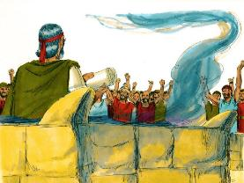
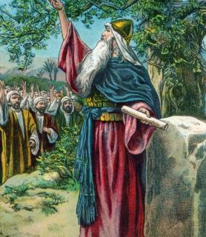


VAKAYACORI NA VEIYALAYALATI
“A sa taura na I vola ni veiyalayalati, ka wilika ni ra sa rogoca tiko na tamata: a ra sa kaya, A ka kecega sa kaya ko Jiova keimami na cakava, ka talairawarawa.’ ” (Exodus 24:7)
Era dina vakaoti na tamata ni soli ira ki na maroroi ni veiyalayalati. Na dina oqo e sega soti ni balavu sara. (Lako Yani 32:8).
Na I tabatamata ka tarava era soli ira talega ki na maroroi ni veiyalayalati (Josua 24:18b). Sa vakaroti ira vakamatata ko Josua “Kemuni na sega ni qaravi Jiova rawa” (Josh. 24:19).
Na cava na ka e tarovi keda mai na noda talairawarawa vua na Kalou dina ga ni da sa vinakata?
Ai tovo ni tamata na talaidredre (Rom 7:18), ka sega ni da cakava e dua na ka me veisautaka rawa na lomada (Roma 7:24).
Ia kevaka eda laiva vua, ena veisautaka na keda I tuvaki na Kalou (Isi 36:26-27). E vakasavasavataka, kauta tani, solia, ka vakarautaki keda me rawa ni da talairaarawa. O koya ga e solia vei keda na kaukauwa (2 Cor. 12:10).
Notes:
THE FULFILLMENT OF THE COVENANT
⁷ A sa taura nai vola ni veiyalayalati, ka wilika ni ra sa rogoca tiko na tamata: a ra sa kaya, A ka kecega sa kaya ko Jiova keimami na cakava, ka talairawarawa.

Slide 7

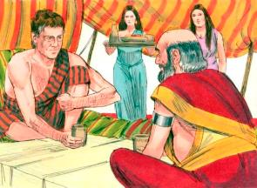
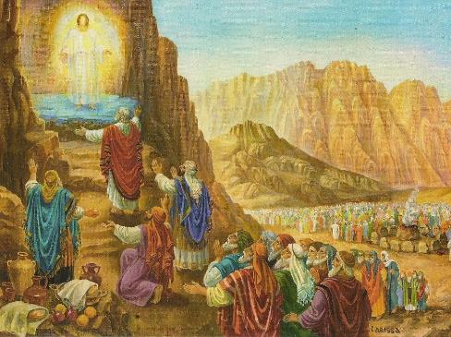
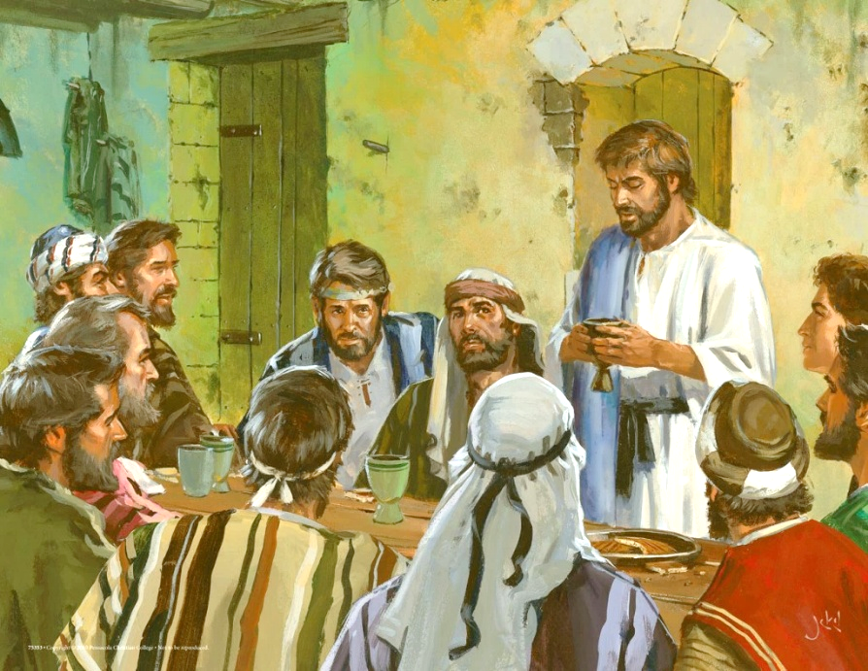
NA KANA NI VEIYALAYALATI
“Sa qai cabe ko Mosese, Eroni, Netapi kei Epaiu, ka le 70 na qase ni Isireli […] ara sa raica na Kalou, ka ra kana ka gunu” (Lako Yani 24:9, 11b)
Eda raica ena ivakaraitaki mai vei Jekope kei Lepani, ena gauna makawa mai na tokalau, na dregati ni veiyalayalati e okati kina na nodrau kana vata na yasana e rua (Vakatekivu 31:44-54).
E Saineai, sa ia na Kalou na “kanavata ni veiyalayalati”kei ira e 74 na tamata: Mosese, Eroni, Netapi, Epaiu kei na 70 na qase, ka ratou matataki ira kece na tamata (LakoYani 24:9-11).
E tauyavutaka na veiyalayalati vou o Jisu, ena e dua na kanavata kei ratou na 12 na tisaipeli (Mt. 26:26-28).
Eda vakavoutaka na noda veiyalayalati kei na Kalou ena Vakayakavi ni Turaga. Ena kana madrai kei na gunu waini, eda soevutaka na noda vosoti ka vakabulai ena vukui Jisu (1 Koro. 11:26).
Dina ga ni ra cata na vakabulai, ia ko Netapi, Epaiu se o Jutasa eratou sega ni vakuai ena “kanavata ni veiyalayalati” oqo.
Notes:
THE COVENANT MEAL
Every time we partake of the Lord's Supper, we renew our covenant with God.

Slide 8
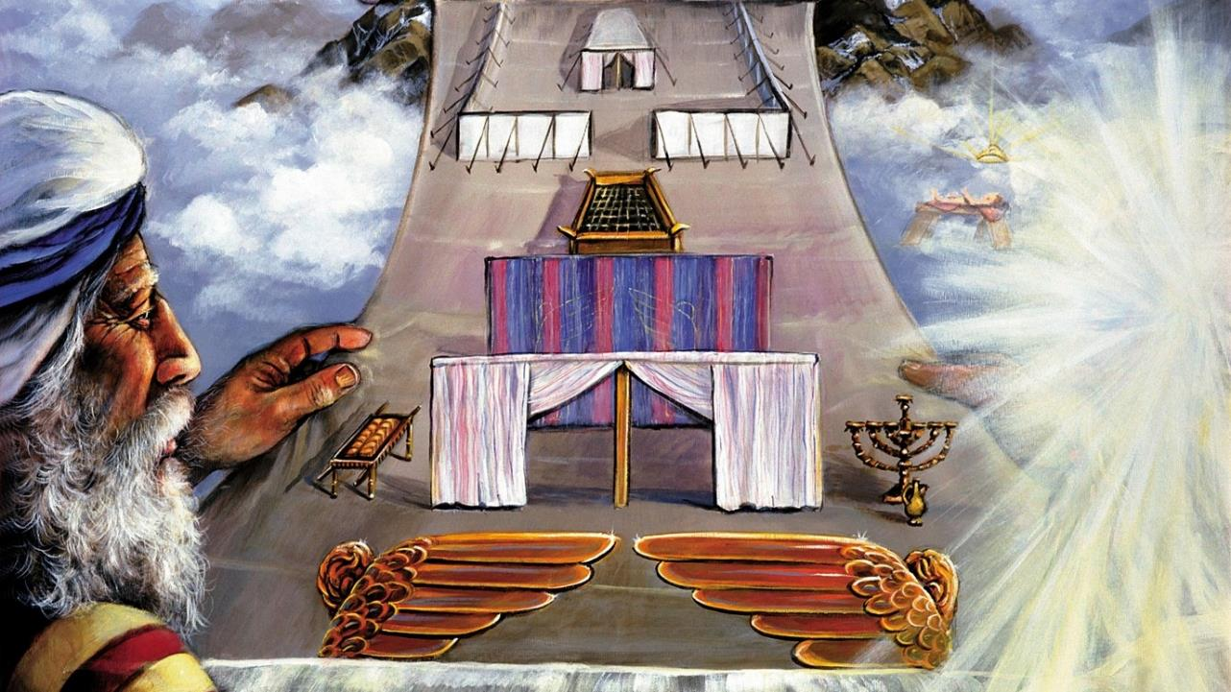
NA I VAKATAKARAKARA
Notes:
THE MODEL

Slide 9

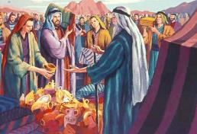
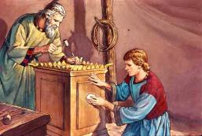
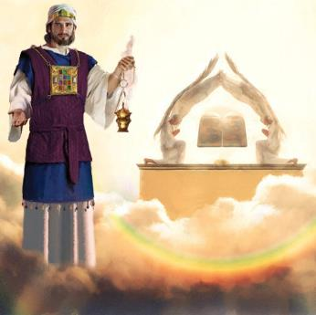
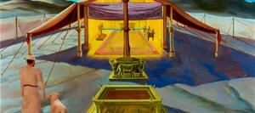
NA INAKI NI IVAKATAKARAKARA
“ia me ra cakava e dua navaletabu me noqu, meu tiko kina ena kedra maliwa” (LY. 25:8)
Mei vakadei ni nona na vakayacora nona yasa ni veiyalayalati, sa nakita na Kalou me aki tiko ena kedra maliwa na tamata.
Ia na nona na tiko vakatamata na Kalou era na mate kece kina na tamata (Ex. 33:20). Oya na vuna, sa vakaroti ira kina me ra tara e dua na valetabu me vakatakilai kina na nona tiko. Na nona tiko oqo e laurai ena I vakatakilakila eso, me vaka ni Kalou e sega ni tiko ena vale sa caka ena liga (Cakacaka 17:24.
E vakaraitaki ki vei Mosese e dua na I vakatakarakara ka soli ki vua na I vakasala kece ni kena tara. Era kerei na tamata me ra vakaitavi ena veika e yaga me na tara kina (Lako Yani 25:2-7).
Na Valetabu kei na vale ni soro ka tara o Solomonierau I vakatakarakara ruarua ni valetabu ka tara mai lomalagi (Iperiu 8:1-2; 1Tui 8:27, 30).
Ni curuma na valetabu e dua na Isireli-e ivakataka -rakara- ni nona curu-ki na iserau- ni Kalou… yacova ni dresuki nai latilati ni sa mate ko Jisu.
Notes:
THE PURPOSE OF THE MODEL
⁸ Ia me ra cakava e dua na vale tabu me noqu, me’u tiko kina e na kedra maliwa.

Slide 10

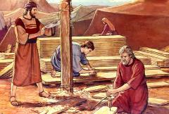
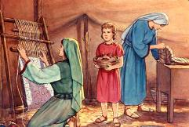
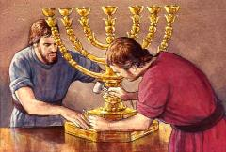
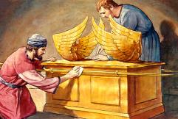
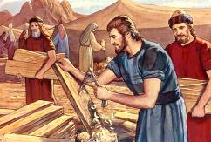
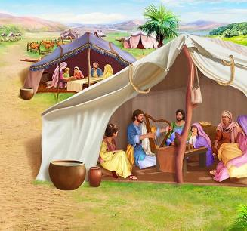
NA KENA TARA NA IVAKATAKARAKARA
“Raica kaú sa cavuta na yacai Pisalieli na luvei Urei, na luvei Uri, ena mataqali I Juta kau sa vakasinaiti koya talega ena Yalo ni Kalou, ena vuku, kei na yalomatua, kei na daukila ka, kei na cakacaka vakamatai kecega” (Lako Yani 31:2-3)
Dina ga ni solia vakamatata sara vei Mosese na I vakasala ni kena tara, e sega ni tukuni kece vei koya na veika matailalai. Na beseni ni vuluvulu parasa, na jerupi, na nona I sala na bete etc, ena vakaevei na kedra I rairai? E solia na galala vua naYalo Tabu mecakacaka vata kei na nodra i solisoli na dautara vale.
Ena veika matailalai oqo, sa solia kina na Yalo Tabu na I solisoli talei kivei:
Pisalieli, ka liutaka na cakacakataucoko(LY 31:2)
Aoliapi, na nona I vukevuke (LY. 31:6a)
Ira tale eso era veivuke ena cakacaka (LY. 31:6b)
Ena lomaloma ni ivakasala ni kena tara na valetabu, e cavuti kina na Siga ni Vakacecegu (Lako Yani 31:12-17). Na cava na nona I tavi na Siga ni Vakacecegu ena veika kece oqo?
Na bula Vakatabui na ki. Me torovi na Kalou Savasava, sa dodonu me da Savasava me vakataki koya. Na Siga ni Vakacecegu ei vakatakilakila ni Savasava oya (LY. 31:13; Isikeli 20:12, 20).
Notes:
THE PREPARATION OF THE MODEL

Slide 11

“Ena kena tara na valetabu me itikotiko ni Kalou, sa vakasalataki ko Mosese me cakava na ka kece me vaka na kena ivakatakarakara ka tu mai lomalagi. Na Kalou sa kacivi koya ki na ulunivanua, ka vakaraitaka vua na veika vaka lomalagi, kei na I vakatakarakara ni valetabu, kei na kena I yaya kecega.
Kivei Isireli, o koya ka vinakata ko Koya me nona itikotiko, sa vakatakila kina na I rairai ni nona itovo lagilagi. […] Ia na ka oqo, sa sega ni tiko vei ira na kaukauwa me rawata. Na veika ka yaco e Saineai, sa dodonu ga me vakavuilica vei ira na nodra malumalumu kei na tawayaga.”
EGW (Education, p. 35-36)
Notes:
In the building of the sanctuary as a dwelling place for God, Moses was directed to make all things according to the pattern of things in the heavens. God called him into the mount, and revealed to him the heavenly things, and in their similitude the tabernacle, with all that pertained to it, was fashioned.
So to Israel, whom He desired to make His dwelling place, He revealed His glorious ideal of character. […] But this ideal they were, in themselves, powerless to attain. The revelation at Sinai could only impress them with their need and helplessness

