Slide 1
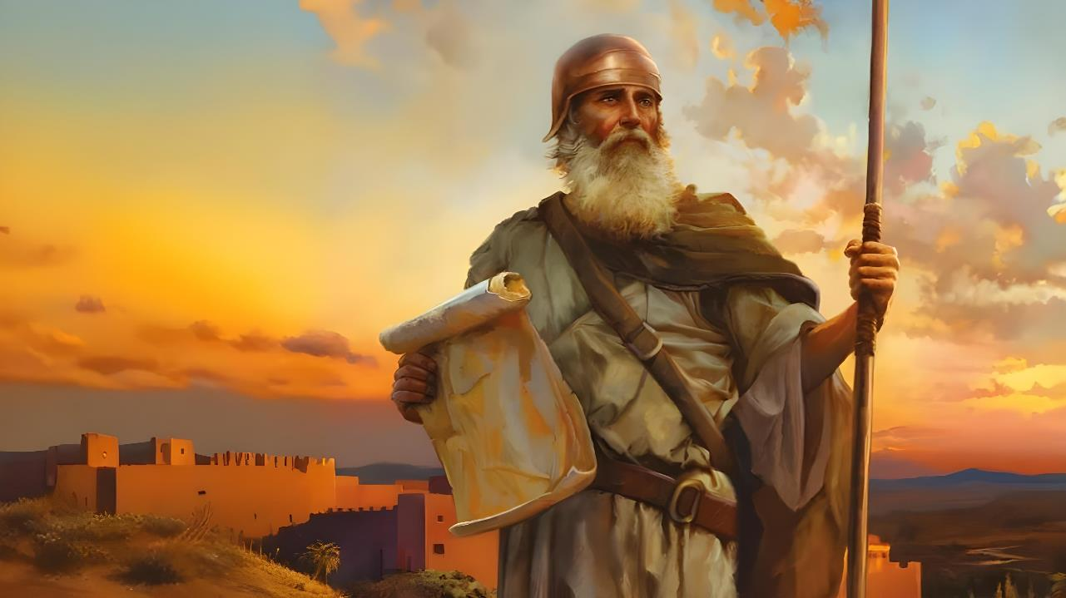

GIK MAKELO DHI MABER
Lesson 1 mar Oktoba 4, 2025

Slide 2
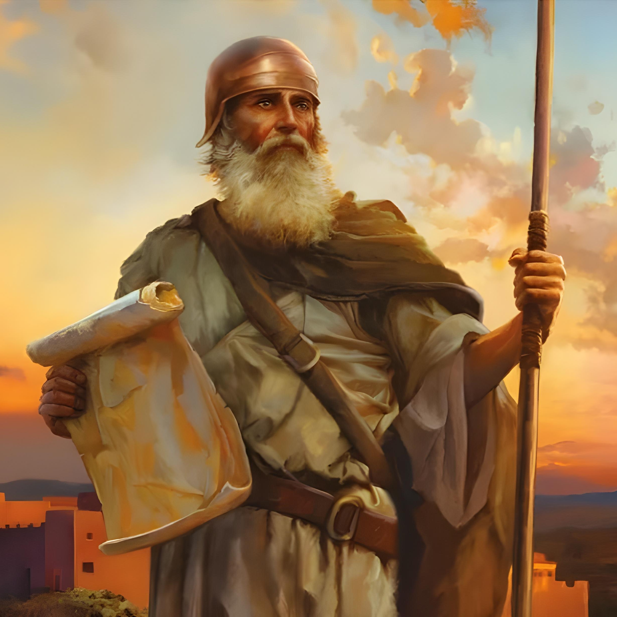
“To bed mana gi chir, kendo gi jing’o, kiluwo chik duto mane Musa jatichna omiyi. Kik iwe chikno, kibaro koracham kata korachwich, mi inibed gi hawi kuonde duto midhiye” Joshua 1:7

Slide 3

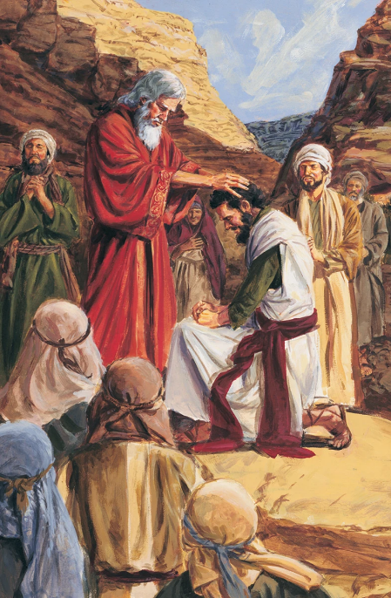

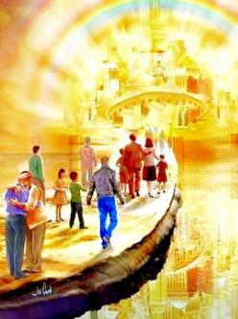

Bang’ higni 40 mag wuotho, anyuola manyien osewuok, kendo kinde osechopo mar kawo Piny Singruok. Musa osetho, kendo Nyasaye oseyiero jatelo manyien mondo otim tijni: Joshua.
Kapok gichako locho, jatelo manyien kod tieng’ manyien duto oluongi mondo oket geno chuth kuom Nyasaye.
Kaka tieng’ ma sani (wan) ochung’ e tong’ Kanaan mar polo, luong mar Nyasaye pod winjore gi teko: “Bed mana gi chir, kendo gi jing’o” (Josh. 1:7).
Weche motelo (Joshua 1:1-3):
Musa gi Joshua
Migepe mag kitabuni
Tij Joshua (Joshua 1:4-9):
Cham gikeni mosingi
Chir kod jing’o
Ber mar tichne

Slide 4
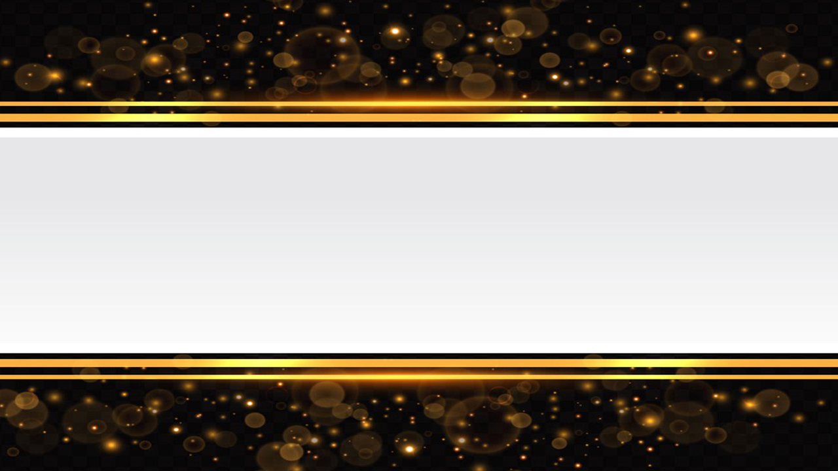
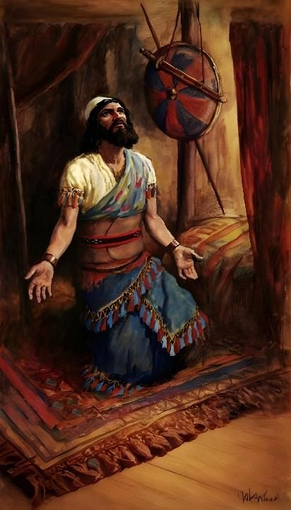
WECHE MOTELO
(JOSHUA 1:1-3)

Slide 5







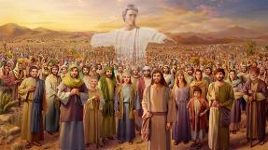
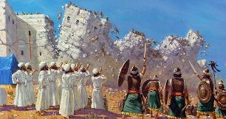








MUSA KOD JOSHUA
Nyasaye nofwenyorenegi (Wuok 3:2-4; Josh. 5:13-14)
Nonyisgi ni gilony wuochegi (Wuok 3:5 ; Josh. 5:15)
Nyasaye nosingo ni nobed kodgi (Wuok 3:12; Josh. 1:5)
Ne gitimo nyasi mar Pasaka (Wuok 12:21-23; Josh. 5:10)
Ne gikalo e pi e piny motwo (Wuok 14:21-22; Josh. 3:14-17)
Mana nobiro gi achiel, to norumo gi machielo (Wuok 16:4-5, 31; Josh. 5:11-12)
Ne gioro jombetre odhi ocheng piny (Kwan 13:1-3; Josh. 2:1)
“Kane Musa jatich Ruoth Nyasaye osetho, Ruoth Nyasaye nowacho ni Joshua wuod Nun, mane jalup Musa niya,” (Joshua 1:1)
E sura mokwongo mar Joshua, uluong nyinng Musa nyadipar gachiel, kendo nyinge yudore dimang’eny e bugno duto.
Nitie gik mang’eny ma chalre e kind jotelo ariyogo:
Kata obedo ni sura mokuongo mar Joshua wuoyo kuom lokruok mar telo e kind jotelo ariyo madongogi, kata achiel kuomgi ok en ng’at ma lich e kitabuni. Jal malich kae ahinya en Ruoth Nyasaye owuon, ma wechene ema kwongo e kitabuni kendo wechenego ema tayo okenge duto. Kuom mano, nenore maler ni jatend Israel hie ne en ng’a.

Slide 6
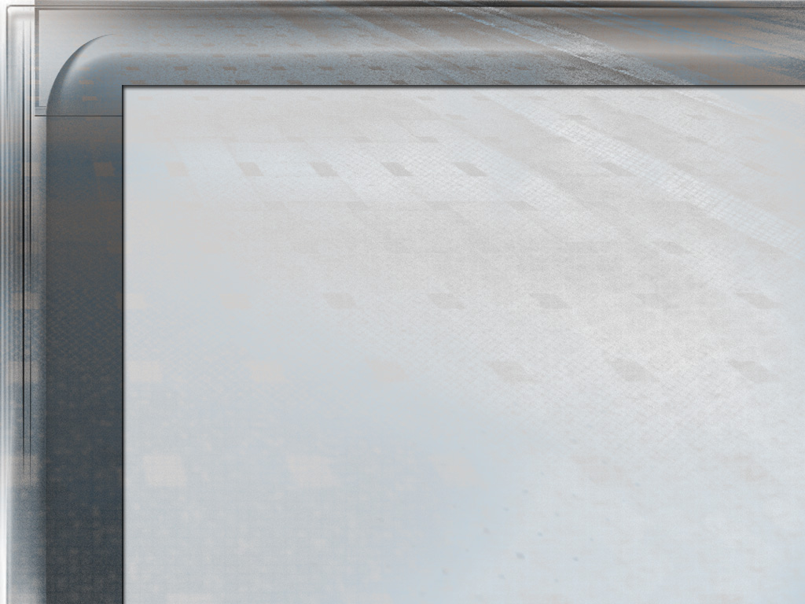
“Koro Joshua ne ong’ere kaka jatelo mar Israel. Ne ong’ere ahinya kaka jalweny, kendo michne kod timbene mabeyo ne nigi nengo ahinya e kindeni e sigana mar ogandane. Ne en ng’at ma jachir, mane ochung’ motegno, kendo jakinda, mane timo gik moko mapiyo, mane ok kaw asoya, mane ok par mana gik mobiro yudo kuom joma omiye mondo oriti, kendo moloyo gik moko duto, ne omiye roho mar yie mangima kuom Nyasaye—mano e kido mar ng’at mane oyier gi Nyasaye mondo otelne jolwenj Israel e donjogi e Piny Mosingi. E kinde ma ne gidak e thim, ne en kaka jalup Musa, kendo kuom muolo mare kendo bedo motegno, bedo motegno e kinde ma jomoko ne bagni, bedo motegno mar rito adier e kind gik ma ne nyalo kelo luoro, ne omiyo nenore ni owinjore mondo okaw kar Musa, kata kapok oluonge gi dwol mar Nyasaye mondo okaw telono.”
EGW (Patriarchs and Prophets, p. 481)

Slide 7

MIGEPE MAG KITABUNI
“Musa jatichna osetho. Omiyo ikri gi jo-Israel duto mondo ung’ad aora Jordan, udhi e piny mamiyou” (Joshua 1:2)
Kitap Joshua nyiso chopo singo ma Nyasaye nosingo ne jo-Israel kane ogologi piny Misri, tiende ni, ne obiro miyogi piny Kanaan. Giduto, weche motelo (sura mar 1) kod kitabuno owuon opogi e migepe ang’wen madongo:
NG’AD idhi Kanaan
Joshua 1:1-9
Joshua 1:1-5:12
KAW Kanaan
Joshua 1:10-11
Joshua 5:13-12:24
POG piny
Joshua 1:12-15
Joshua 13:1-21:45
TICH kokalo kuom winjo Chik
Joshua 1:16-18
Joshua 22:1-24:33

Slide 8
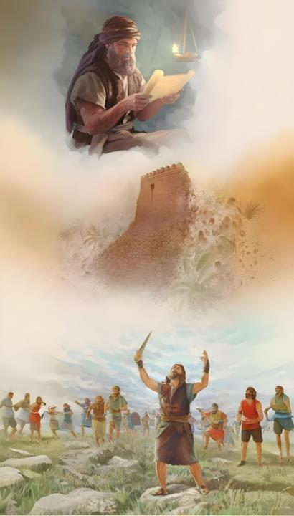
TIJ JOSHUA
(JOSHUA 1:4-9)

Slide 9

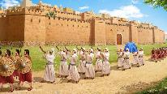
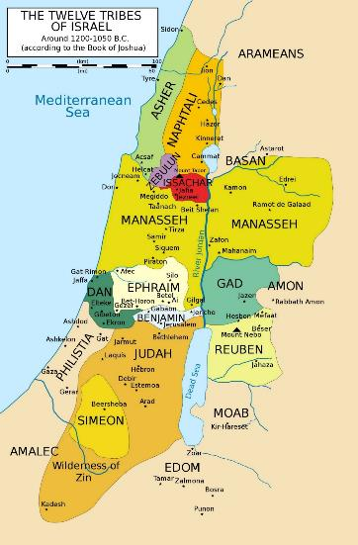
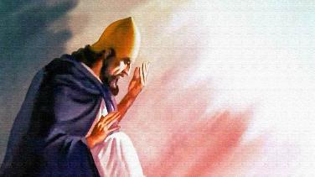
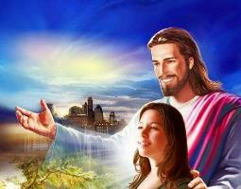
CHAM GIKENI MOSINGI
“Kamoro amora ma tiendu onyono, nobed maru, kaka nasingora ni Musa” (Joshua 1:3)
E Joshua 1:3, Nyasaye wuoyo e yor ranyisi mar kinde ma kawuono. Owuoyo kuom piny Kanaan mana ka gimane osemiye Israel chon. Mano nyiso ni Nyasaye ne omiyogi adier chuth nine gidhi loyo lwenyno.
EUPHRATES
Bang’e, oparonegi kuonde ma lochno biro chope (Josh. 1:4): koa aora Jordan (e wuokchieng’) kod Nam Mediteranea (e podho chieng’), kowuok e thim (e piny ma milambo) nyaka e aora Efrate (e nyandwat).
MEDITERRANEAN
Bang’e, olokore ir Joshua kendo onyise ni ka en gi chir kod jing’o, onge ng’at ma biro nyalo chung’ e nyime (Joshua 1:5-6).
JORDAN
To loch ne ok ni kuom tich matek mar Joshua, ne en kuom Nyasaye. Ne omiye geno, kaka omiyowa geno ng’ato ka ng’ato kuomwa: “Anabed kodi” (Josh. 1:5; Mt. 28:20).
DESERT

Slide 10

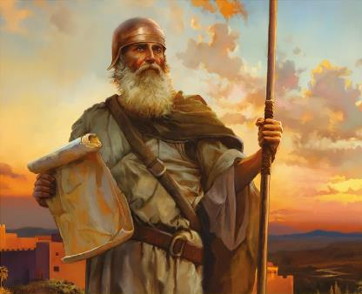
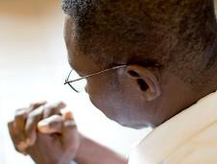
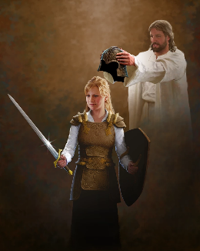
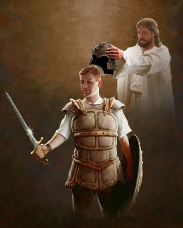
CHIR KOD JING’O
“Par kaka asechiki ni mondo ibed gi chir kendo gi jing’o. Kik iluor kendo kik chunyi nyosre, nikech an Ruoth Nysaye ma Nyasachi, an kodi kuonde duto midhiye.” (Joshua 1:9)
Kapok okwayo Joshua mondo obed gi chir kod jing’o e lweny (Josh. 1:9), Nyasaye nokwaye mondo obed gi chir kod jing’o e luwo Chik (Josh. 1:7).
Mano bende en gima timore e kindegi. Nyasaye kwayowa mondo watem matek mondo warit chikne (Fweny 14:12). Mano dwaro ni wabed gi chir motegno.
Kor ka kore, osingo ni “an kodi kuonde duto midhiye” (Josh. 1:9), okonyowa mondo waked lweny ma wantie. Ok en lweny mar ringruok, to “wakedo gi joloch gi joma nigi teko, kod ruodhi mag piny motimo mudhoni, kaachiel gi lang chuny maricho ma ok mag pinyni” (Efes 6:12). Mondo watim kamano, osemiwa gik ma dwarore (Efes. 6:13-17).
Gima nyalo konyowa mondo wabed gi loch en geno Nyasaye chuth. Kendo mondo watim kamano, dwarore ni wabed gi winjruok kode ndalo ka ndalo (Efes. 6:18).

Slide 11


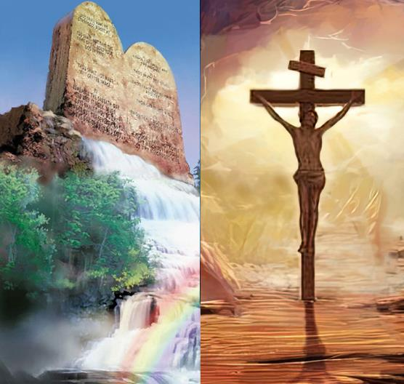
BER MAR TICHNE
“Kik wiyi wil gi Kitap Chikno, to nyaka isome odiechieng’ gotieno, kendo ine ni iluwo chik duto mondikie. Eka inidongi,kendo noguedh gik moko duto mitimo.” (Joshua 1:8)
Dhi maber kaluwore gi kaka Nyasaye neno ok chalre gi dhi maber kaka dhano neno.
Dhi maber mar pinyni inyalo yudo kuom ketho chike mag Nyasaye kod mag dhano, to loch mar adier kendo ma nyaka chieng’ ok nyal (Josh. 1:8).
Wabiro bedo gi ngima maber ka waluwo chike kod timbe ma yudore e Chik Nyasaye. To mano donge en warruok kuom tich?
Ok kamano. Yie kod Chik ok gin gik ma ok nyal winjore, to gin gik ma konyore (Rumi 3:31). Ka wawuoyo kuom Chik, wawuoyo kuom yo ma owinjore wadakgo, to ok yo ma wayudogo warruok. Winjruok marwa gi Nyasaye nenore kuom winjo dwaro mare.

Slide 12

“Kinde duto Jakristo nigi jakony motegno ma en Ruoth. Yo ma Ruoth konyogo nyalo bedo ni ok wang’eyo; to gima wang’eyo en niya: Ok nowe jogo moketo genogi kuome. Kapo ni Jokristo ne nyalo ng’eyo kar kwan ma Ruoth osechike yoregi, ni mondo dwaro mar jasigu kuomgi kik ochop kare, ok di gidhach adhacha gi wuoth ka ging’ur. Yiegi disiki kuom Nyasaye, kendo onge tem moro amora ma nigi teko manyalo gologi kuome. Giyie ni en e rieko kod nyalo margi, kendo odhi miyo gima odwaro timo kokalo kuomgi timore.”
EGW (Prophets and Kings, p. 576)

