Slide 1
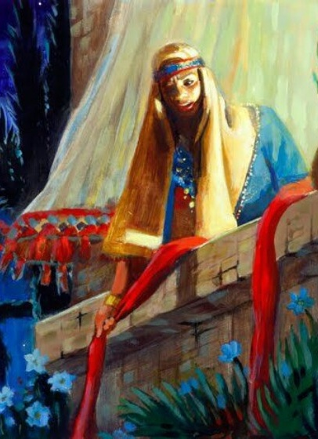
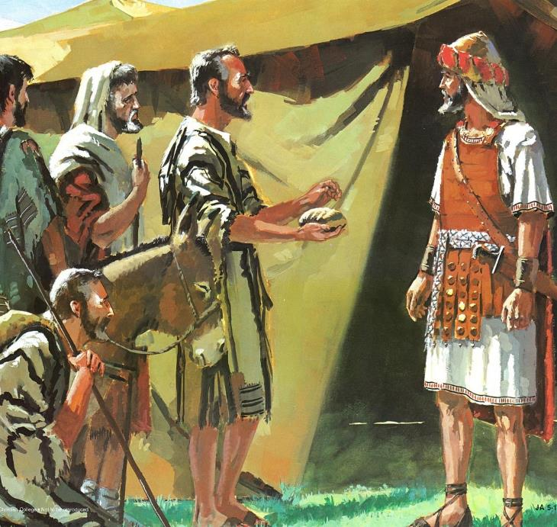
OPO GI NG’WONO
Lesson 2 mar Oktoba 11, 2025

Slide 2
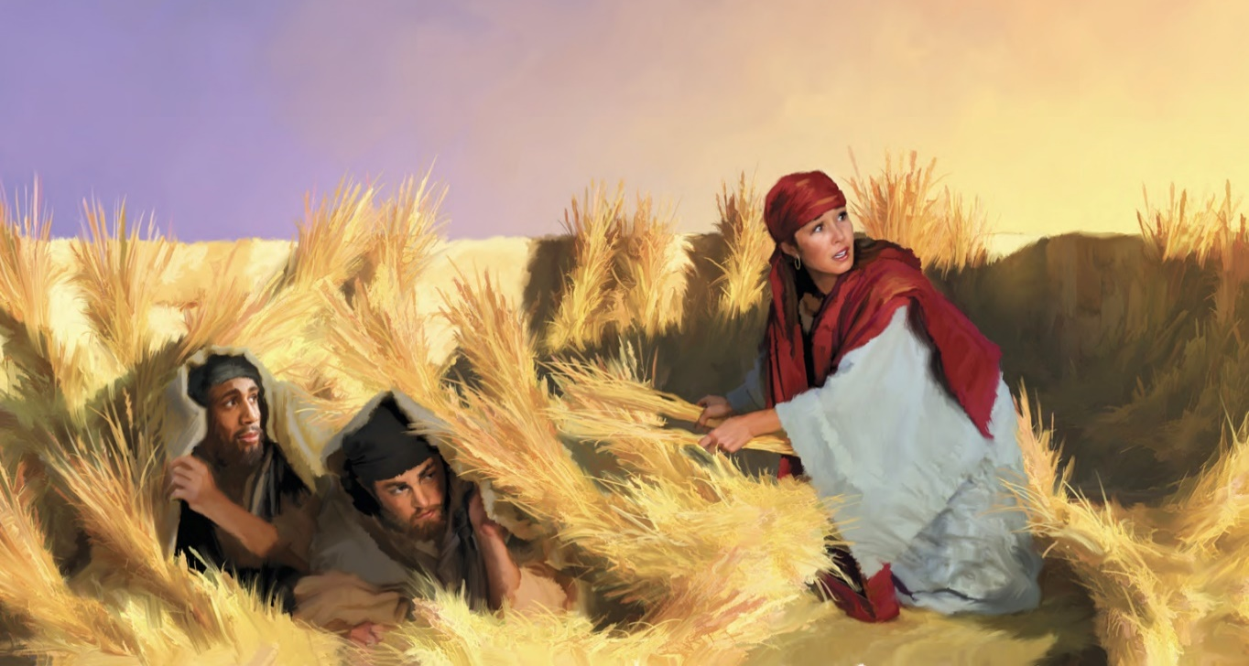
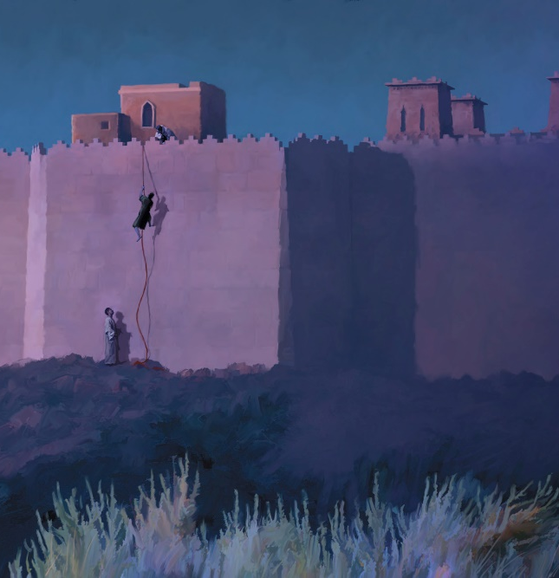
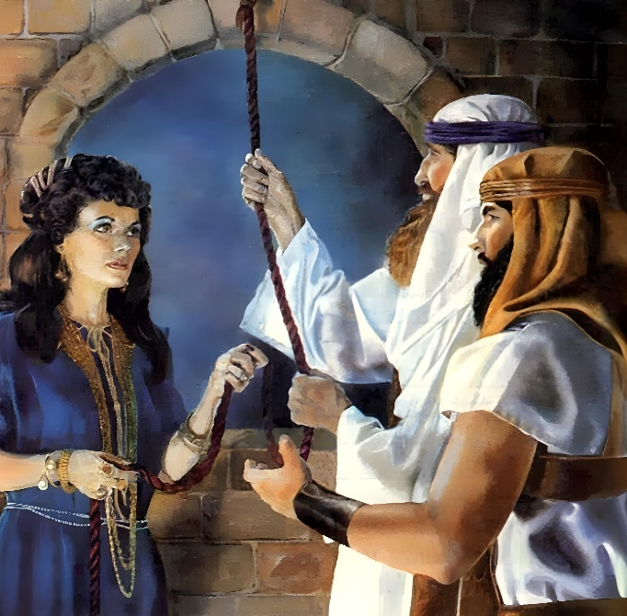
“Yie ema ne omiyo Rahab, dhako ma jachode, ok onegi kane inego joma notamore winjo wach Nyasaye. Ne ok onege nikech ne oserwako jombetre gi ng’wono”
(Jo-Hibrania 11:31)

Slide 3

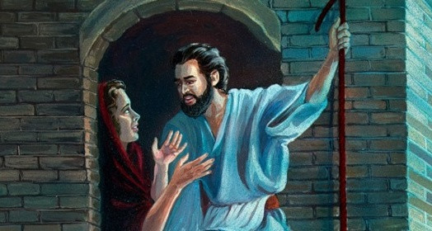
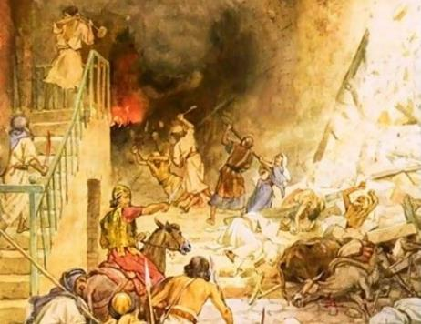



Jo-Kanaan ne osekalo kiewo mar ng’wono. Kuom mano, chik ma ne omi jo-Israel ne en ni: donj, neg-gi duto, kendo uyak mwandugi.
Kata kamano, pod ne nitie ji mane ni e piny Kanaan mane pok okalo tong’go. Jogo duto mane oyie rwako ng’uono ma Nyasaye ne dwaro nyisogi, ne oresi kuom tho.
Ng’wono ne jo-Israel (Joshua 2:1, 22-24):
  Thuolo moro kendo
Ng’wono ne Rahab (Joshua 2:2-21):
  Yie mar koth karadali
  Singruok ochopo ne Rahab
Ng’wono ne jo-Gibeon (Joshua 9):
  Jombetre mariambo
  Gweth gi kuong’

Slide 4
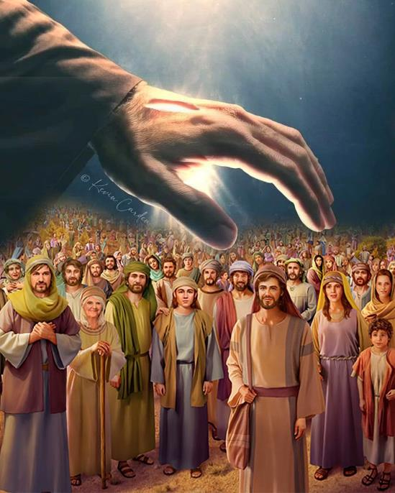
NG’WONO NE JO-ISRAEL
(JOSHUA 2:1, 22-24)

Slide 5


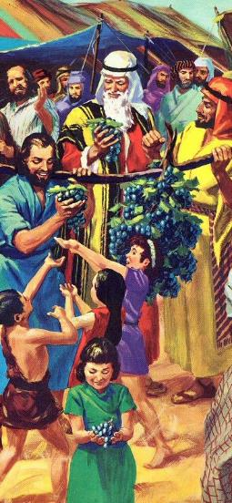
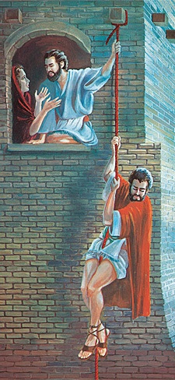
THUOLO MORO KENDO
“Kane pod gin Shitim., Joshua wuod Nun nooro jombetre ariyo ling’ling’ mondo odhi ocheng piny, ‘ahinya to Jeriko’ ” (Joshua 2:1a)
Ka Musa nooro jombetre mondo odhi oleng piny Kanaan, oganda ne ok oyie donjo. Bang’ higni 40, ne oor jombetre manyien, dwoko mopogore.
Oor jombetre
Ayanga (jombetre 12)
Ling’lingg’ (jombetre 2)
Tij jombetre
Ndalo 40 ka ginono
Ndalo 3 ka gipondo
Repod jombetre
Gimiyo ji bedo gi paro ma ok kare
Gijiwo Joshua
Kata obedo ni tieng’ manyien ne oserem ahinya e tem mar Balaam, Nyasaye ne omiyogi thuolo mar ariyo (Kwano 25:1-3, 31:16; Josh. 2:1).
E kindeni ne onge saglo mag mzabibu, ne onge olembe mag piny. Mana sigand yie (mar Rahab), ma ne ojiwo Israel mondo okaw Piny Singruok.

Slide 6
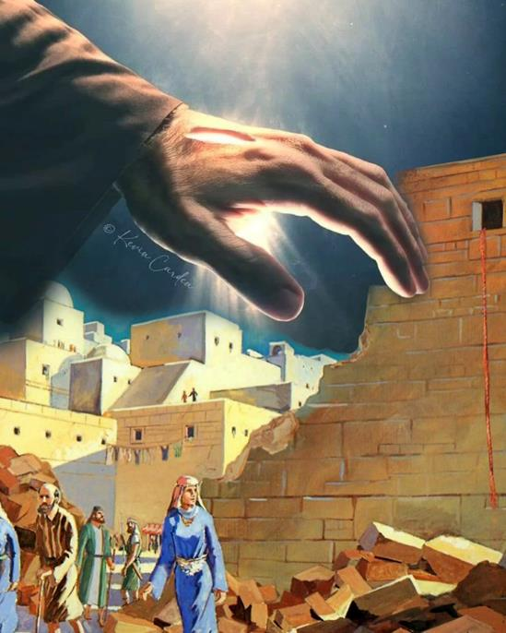
NG’WONO NE RAHAB
(JOSHUA 2:2-21)

Slide 7

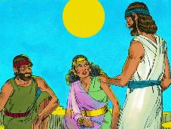
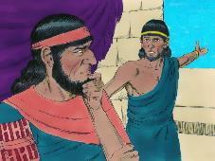
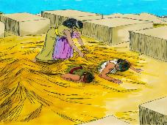
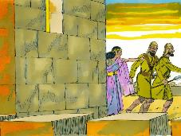
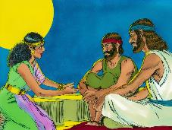
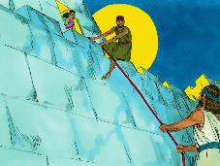
YIE MAR KOTH KARADALI
“Yie ema ne omiyo Rahab, dhako ma jachode, ok onegi kane inego joma notamore winjo wach Nyasaye. Ne ok onege nikech noserwako jombetre gi ng’wono” (Jo-Hibrania 11:31)
Yie mar Rahab ne oyiengore kuom ang’o (Josh. 2:9-11)?
Ne ni Rahab wuoyo kuom gik mane otimore ma ji duto nong’eyo, kaka ng’ado Nam Makwar. To ka jomoko ne oluoro Nyasach jo-Hibrania, en to ne oyiero yudo resruok e bwo bwombe (Josh. 2:12-13).
Ang’o momiyo, ka ne oyie kuom Nyasaye, notiyo kod miriambo mondo okony jombetrego?
Yie ma ne en-go ma ne pok odongo ne ok nyis ni ong’eyo chuth dwaro mar Nyasaye. Ne otimo duto mane nyalore mondo okony jombetrego kendo ores ngimane kod mar joode. Ng’eyo ne dhi biro bang’e.
Biblos miye pak nikech yiero mane otimo; nikech ne ong’eyo yo ma Nyasaye timogo gik moko; kendo kaka ne ochung’ ne weche mane owacho kuom tim (Jakobo 2:25).
Rahab en ranyisi mar gima ne dhi timore ne ng’ato ang’ata mane odak e Jeriko mane oweyo Nyasaye.

Slide 8

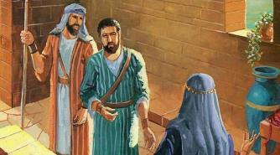
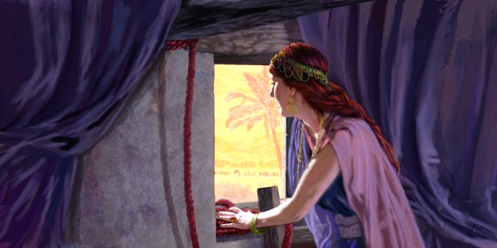
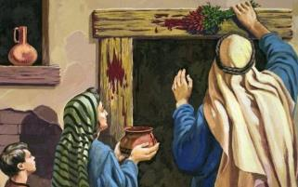
SINGRUOK OCHOPO NE RAHAB
“Ka ng’ato nowuog oko, mi negi, to rembe nobed e wiye owuon, kendo ok wanabed joketho. To ka noneg ng’ato man kodi e ot, to rembe nobed e wiwa.” (Joshua 2:19 NIV)
Israel e Pasaka
Nyaka ne giwir sis dhoudi gi remo
(Wuok 12:7)
Kane giwuok oko, ne githo (Wuok 12:13)
Rahab ei Jeriko
Nyaka ne otue tol makwar e dirisa (Josh. 2:18)
Kane owuok e ot, to notho
(Josh. 2:19)
Gima Rahab ne owacho ne nikare: asetimonu ng’wono [hesed] kendo aseresou; koro timnauru ng’wono kendo uresa an kaachiel gi wedena (Josh. 2:12-13).
Kata obedo ni ne ok ong’eyo wachno, Rahab ne kwayo Israel mondo otimne kaka Nyasaye owuon ne otimone Israel, tiende en ni, gi ng’wono [hesed] (R.Chik 7:12).
Jombetrego nokwayo Rahab mondo otim gik mane gitimo mondo kik githo e piny Misri. E yo ma kamano, ne okete e singruok ma Nyasaye notimo gi Israel.

Slide 9
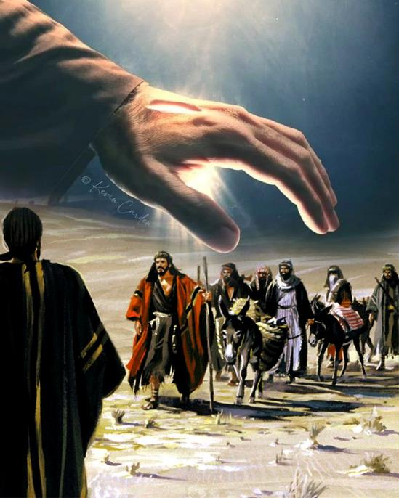
NG’WONO NE JO-GIBEON
(JOSHUA 9)

Slide 10


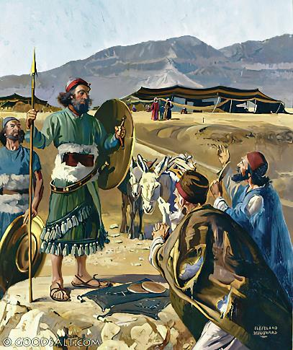
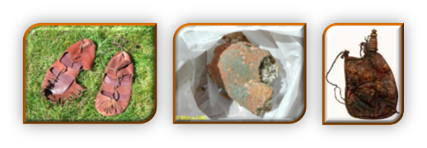
JOMBETRE MARIAMBO
“Eka ne gibiro ir Joshua e kambi Gilgal, mi giwachone kod jo-Israel niya, ‘Waa e piny mabor ahinya, omiyo yie watim kodu winjruok mar kue’ ” (Joshua 9:6)
Ne gik ma chalre gi mopogore e kind Rahab kod jo-Gibeon:
Gik ma nyiso Yie | Rahab | Jo-Gibeon
Gimomiyo | Winjo (2:10) | Winjo (9:3)
Yor yudo dwoko | Miriambo (2:4-5) | Miriambo (9:4)
Dwaro | Mondo orese (2:13) | Mondo oresgi(9:24)
Dwoko Mapiyo | Resruok (6:23) | Resruok (9:26)
Dwoko ma kinde Malach | Bedo japiny chuth (6:25) | Wasumbini (9:27)
Rahab noriambo nyadichiel mondo okony jombetrego. Kata kamano, jo-Gibeon noriambo gi ng’eyo, ka gin gi gombo mar wuondo ji, ka gitiyo gi rieko (ne Chakruok 3:1a). Bende, jotelo mag Israel ne oketho kuom rem penjo Nyasaye wach (Josh. 9:14).
Mano ne oketogi e chandruok: nego jo-Gibeon, kata miyo singruok luor (Josh. 9:18).

Slide 11

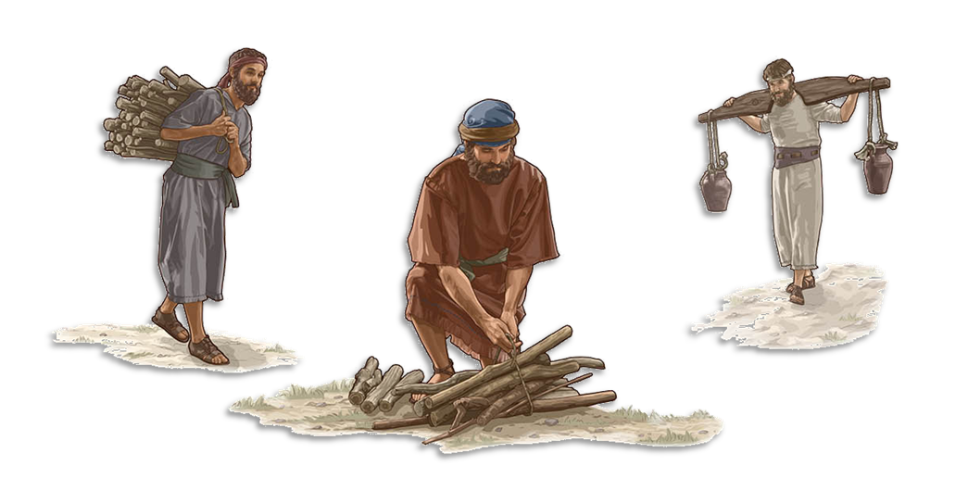
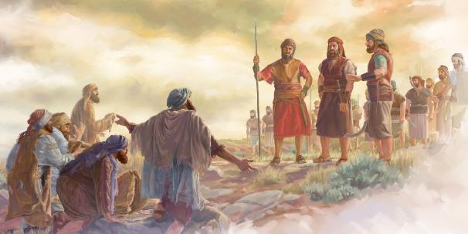
GWETH GI KUONG’
“Koro unubed joma okwedi nikech wachni, kendo e kinde duto unubed wasumbwa ma baro yien kendo umbo pi e Od Nyasachwa” (Joshua 9:23)
Reso ngima jo-Gibeon ne dhi ketho chik mane oa kuom Nyasaye (R.Chik. 7:1-2). Ketho singruok machalo gi mane gisetimo, mano bende ne okaw kaka richo (Josh. 9:19; Zab. 15:4b). Ere kaka ne itieko pekno?
Ngimagi ne oresi, to ne giyudo kuong’ (Josh. 9:20-23). Kuong’ ne en bedo wasumbini tieng’ ka tieng’. Mano ne omiyo gibedo e winjruok machiegni gi oganda Nyasaye, mane ok gipogorego nyaka chieng’ (Neh. 7:6, 25).
Bende, bedo jogo mane ting’o pi kendo baro yien mag od Nyasaye nomiyo gibedo gi tudruok gi Nyasaye kinde duto. Kuom ng’wono mar Nyasaye, kuong’ nobedo gueth. “Ok berna ka ng’at ma timbene richo tho, to abedo mamor mana ka oweyo timbene maricho, mobedo mangima”
(Ez. 33:11).

Slide 12

“Nyithind Israel ne onego okaw piny duto ma Nyasaye ne oketo negi. Joma ne ok oyie lamo kod tiyo ne Nyasaye ma adieri ne onego okaw gigegi. To ne en dwaro mar Nyasaye ni kuom fwenyruok mar kite kokalo kuom Israel, ji ne onego oywa ire. Piny duto ne onego omi lwong mar injili. [...] Jogo duto, kaka Rahab ma ja-Kanaan, kod Ruth ma ja-Moab, ma ne oweyo lamo nyiseche ma nono kendo ochako lamo Nyasaye ma adieri, ne nyaka riwre gi ogandane moyier .”
EGW (Christ’s Object Lessons, p. 290)

