Slide 1
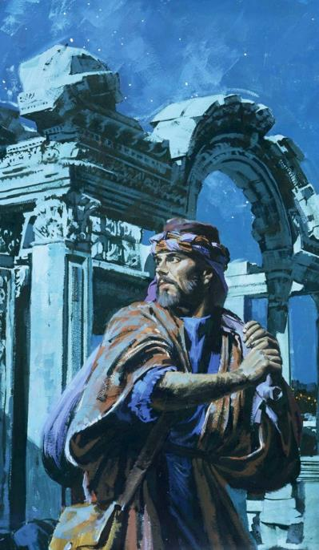
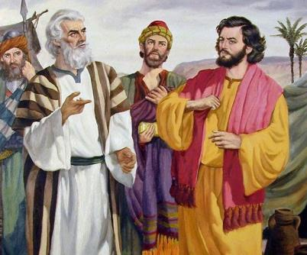
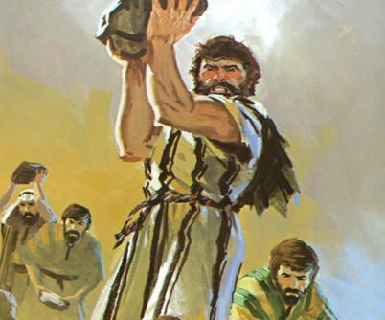
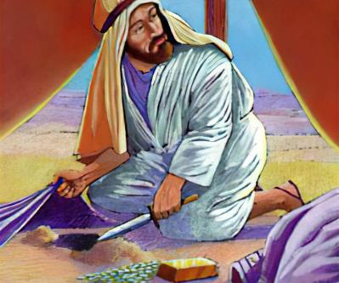
Lesson 6 mar Novemba 8, 2025
JASIGU MANTIE E DIER JI

Slide 2


“An Jehova Nyasaye ema anono chuny kendo apimo paro, mondo achiwne ng’ato kaluwore gi timne, kendo kaluwore gi kaka kite chalo”
Jeremia 17:10, Loko Manyien

Slide 3


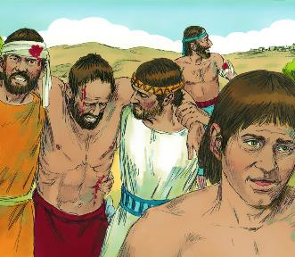
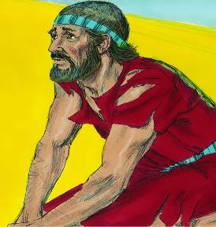





Bang’ yo mar lweny maonge kore, ohinga mar Jeriko ne opodho. Israel ne odonjo e dalano kendo ne okethe chuth. Loch! Mar ng'a? Nyasaye, nikech Israel ne onge gima ne gitime.
Bang’ tiyo kod yore mag lweny ma ne opar maber, Ai oloyo. Loch! Kokalo kuom ng’a? Kuom oganda Israel, nikech ne pok gigeno kuom Nyasaye.
Ka e giko ne gipenjo Nyasaye, dwoko ne ler: Israel osetimo richo kendo koro ok onyal loyo wasike. Ere kaka onyalo yudo ng’wono mar Nyasaye kendo?
Gima omiyo ologi (Joshua 7:1-5, 10-13)
Gibedo gi luoro kod chandruok (Joshua 7:6-9)
Hulo jaketho (Joshua 7:14-19)
Richo mar Akan (Joshua 7:20-26)
Giloyo kendo (Joshua 8:1-29)

Slide 4

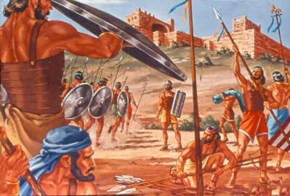
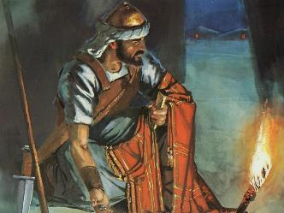
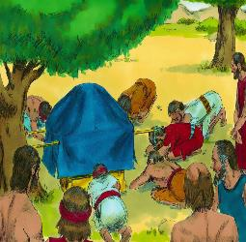
GIMA OMIYO OLOGI
“Jo-Israel oseketho! Ok giserito chik ma namiyogi,to gisekwalo gik mokwer, kendo giriwogi gi mekgi” (Joshua 7:11)
Bang’ yudo wach maber ma ne oa kuom jombetre mane oor Jeriko, Joshua nopenjo Nyasaye kendo noyudo kuome yo mar kawo dalano.
Ka dine Joshua bende tim kamano bang’ yudo ripot kuom jombetre mane oor Ai, ji 36 dine ok otho. (Joshua 7:1-5).
To ang’o maduong’ mane omiyo ologi, kata ang’o mane omiyo Nyasaye onyiso Joshua ni kik odhi omak Ai (Josh. 7:11)?
Nyasaye ne oseneno ni “Israel osetimo richo.” Onge kamoro e Biblos ma olere richo gi weche ma kamagi: “giseketho chik... gisekawo... gisekwalo... giwuondore... giseriwogi gi mekgi.”
Ne kwan mar ji mang’eny. Richono ne otim gi ng’at achiel, to Nyasaye nokwano oganda duto e richono. Ne giseketho singruokno; richo ne nyaka gol oko eka inyal duog singruok.

Slide 5
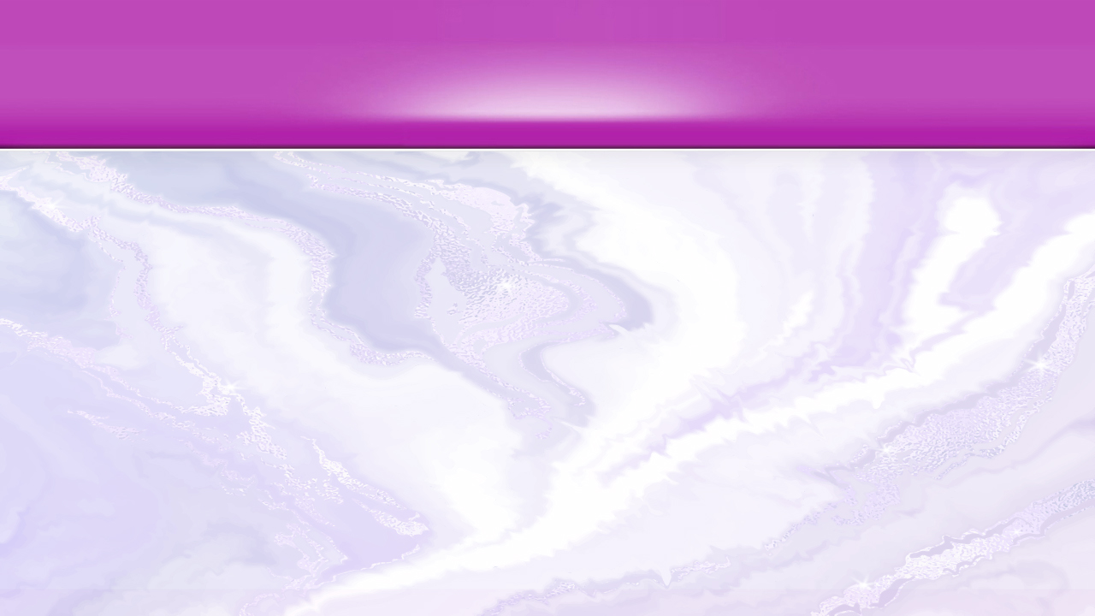
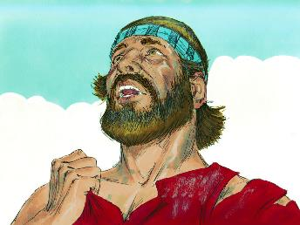
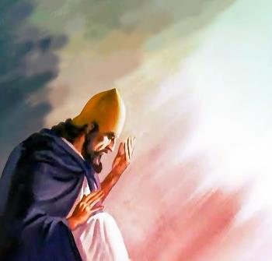
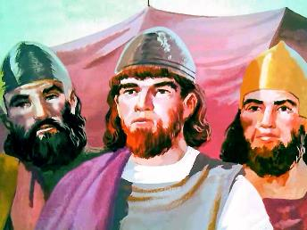
GIBEDO GI LUORO KOD CHANDRUOK
“Joshua nowacho niya, ‘A Ruoth Nyasaye, ere gimomiyo isekelo jogi loka Jordan mana ni mondo ichiwgi e lwet jo-Amor, kendo itiekgi? Mad ne wasik loka cha!’ ” (Joshua 7:7)
Joshua kod jodongo ne owinjo marach ahinya kuom loch mane ologi e Ai, kendo ne ginyiso ranyisi maler mag kuyo (Josh. 7:6).
Bang’e, Joshua ochako gi ng’ur ma chal gi kaka Israel ne timore kinde ka kinde e higni 40 mane giwuothoe: “Ere gimomiyo isekelowa loka...? Mad ne wasik loka cha...!” (Josh. 7:7).
Kata kamano, chuny Joshua ne ok chal gi mar jo-Israel e kinde mane gin e thim. Gima ne omiye ng’ur ne ok en nikech lweny ne ok odhinegi maber, to ne en nikech ne oluor ni nying Nyasaye ne dhi kethore e kind ogendini.
Ne oneno maler ni kit Nyasaye ne dhi ng’ere gi joma ok oyie kaluwore gi kaka ogandane timore. E kindeni pod wadhi nyime bedo joneno mag Nyasaye e piny. Mano doko ting’ maduong’manade!

Slide 6
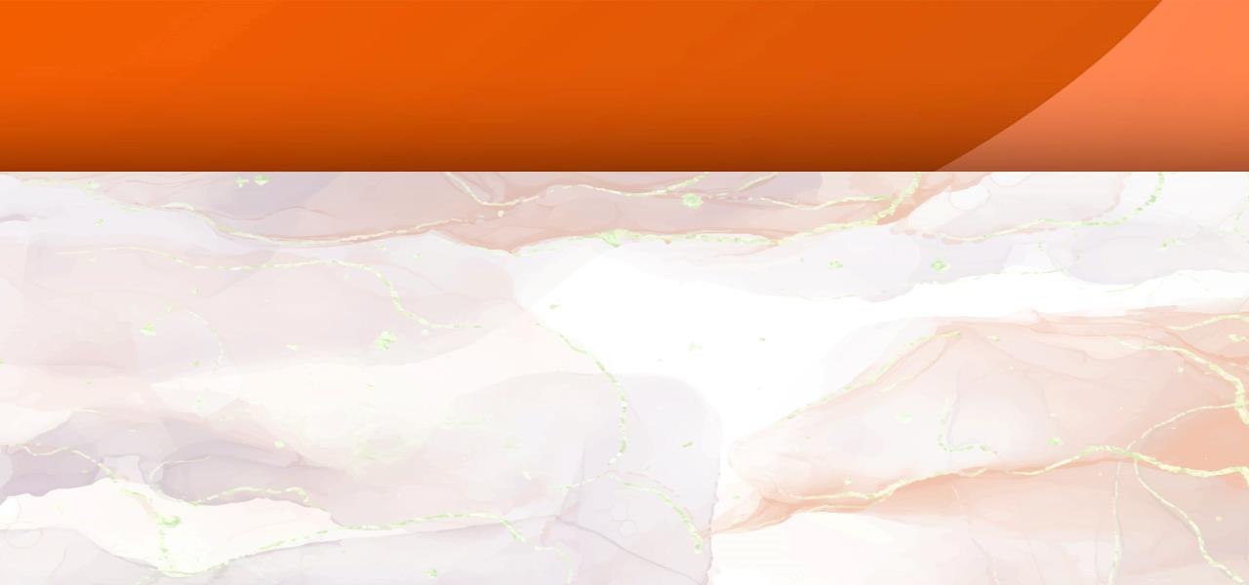
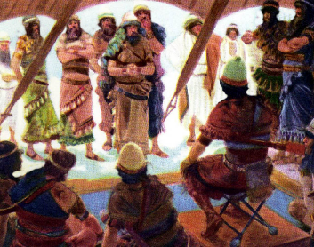
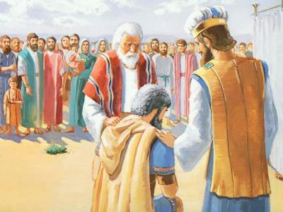
HULO JAKETHO
“Kiny gokinyi giniwuog oko libamba ka libamba, kendo libamba ma Ruoth Nyasaye okwanyo nowuog oko dhoot ka dhoot. To dhoot ma Ruoth Nyasaye okwanyo nowuog oko, anywola ka anywola.” (Joshua 7:14)
Mondo ogol richo mar riwruok (richo mar oganda duto), jaricho ne nyaka tiek chuth (Josh. 7:15). Tiek chuth? Ne ok nyal ng’wonne ka oloko chunye? En adier ni ne inyal ng’wonne! To Akan ne ok onyiso kido mar loko chuny adier (kendo ne en gi thuolo malach mar timo kamano).
Cheno mar nonro ne olandi kendo oriyo nyaka kinyne (Josh. 7:14-15)
Okwany libamba mar Juda (Josh. 7:16)
Okwany joka Zera (Josh. 7:17a)
Okwany anywola Zabdi (Josh. 7:17b)
Okwany Akan (Josh. 7:18)
Akan oling’ thi
Akan oling’ thi
Akan oling’ thi
Akan oling’ thi
Akan oling’ thi
Ka onyiso ng’wono kod hera mar Nyasaye, Joshua nokwayo Akan mondo ohul richone (Joshua 7:19).
Bura ne oloyo Akan. Ne ohulo richone, to ne ok okwayo ng’wono (Josh. 7:20). Kata kamano Nyasaye ne oywak nikech chuny Akan matek, ma ne onyisore e luong moro amora mondo olok chunye.

Slide 7
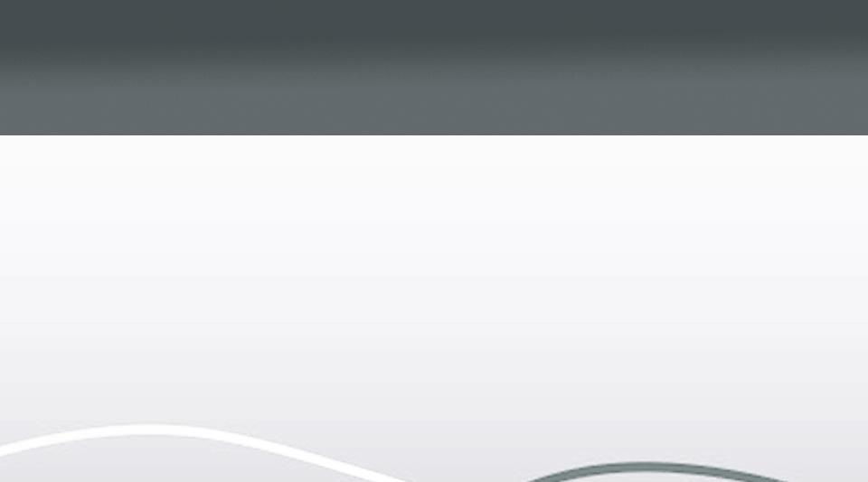
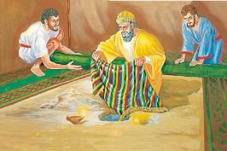
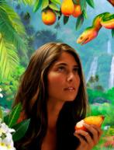
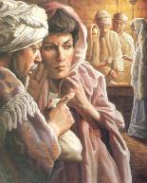
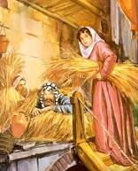
RICHO MAR AKAN
“nikech kane aneno law maber molos Shihar, gifedha ma pekne oromo kilo ariyo, kod dhahabu ma pekne oromo nus kilo kuom mwandu Jeriko, gombo nomaka, makawogi. Nakunyogi e hemba ka fedha ema akwongo keto e bur” (Joshua 7:21)
Joshua nokwayo Akan mondo omi Nyasaye duong’ kendo ohul richone (Joshua 7:19). Ne en thuolo mare mogik. Kadine okwa ng’wono bang’ hulo richo... To ne ok otimo kamano, kendo ne ok oyudo ng’wono (Kwano 15:30-31).
Rahab
Nopano jocheng piny e wi osuch ot
Notimo tim ng’wono ni Israel
Akan
Nokawo gik makwero kendo opando e lowo
Nokelo ni jo- Israel masira
Nokelo loch kuom yie mare
Nomiyo ologi nikech timne
Notimo singruok gi jo-Israel
Noketho singruok jo-Israel
Noreso ngimane gi mar joodgi
Notho gi joode
Mana kaka Hawa, Akan “ne oneno,” “gombo ne omake,” kendo “okawo,” kendo richone omulo ji mang’eny (Chakruok 3:6). Mana kaka Anania gi Safira, Akan nokawo moko kuom gik mane okuong’ kendo ne ochulo gi ngimane (Tich Joote 5:1-2).
Weche ma Akan ne ong’ado e Jeriko ne opogore ahinya gi mago mag Rahab:

Slide 8

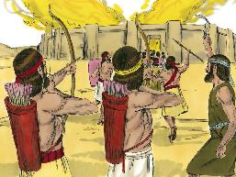
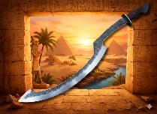
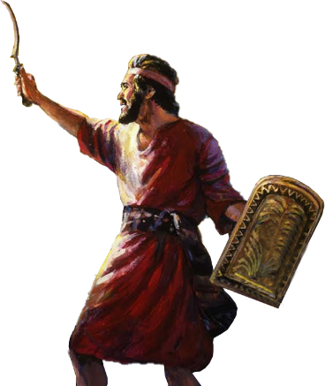
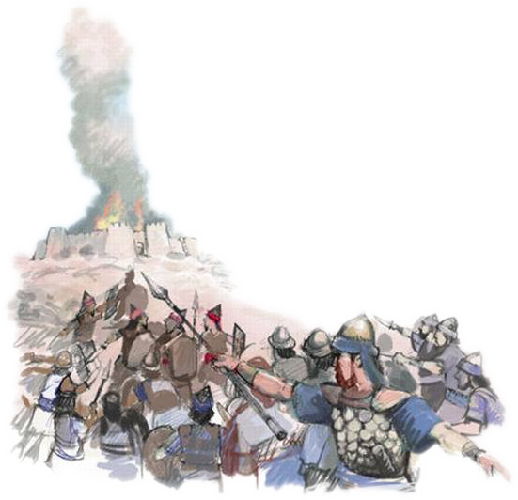
GILOYO KENDO
“Ruoth Nyasye nowacho ni Joshua niya, ‘Kik iluor, kendo kik chunyi nyosre. Kaw jolweny duto kendo dhi, imonj Ai. Anachiw ruodh Ai gi dalane gi joge kod pinye e lweti.’ ” (Joshua 8:1)
Mana kaka e Jeriko, Nyasaye nomiyo Joshua yo mar yudo loch kuom Ai (Joshua 8:1-2).
Gotieno, jolweny ne opondo tok dalano. Kogwen, jolwenygo ne ochopo machiegni gi Ai kendo ne giwuondore ka gima giringo e nyimgi kendo.
Kaka Musa noting’o ludhe malo nyaka noyudo loch kuom jo-Amalek, kaluwore gi chik mar Nyasaye, Joshua noting’o “gige lweny” malo (nyalo bedo nine en ligangla mane jo-Misri tiyogo), kendo nosiko koting’e malo nyaka noyudo loch chuth (Josh. 8:18-22, 26).
Nyasaye nochiwo loch kendo ne ogandane. Hoho mar Akor, kama ne onege Akan kod joode, ne oyawo dhoot mar loch, “dhood geno” (Hosea 2:15).
Ka waruako kuom yie ni Nyasaye weyonwa richowa, oiko richowa e Akor, kendo oyawo dhood geno.

Slide 9

“Gima kanisa onego oluor ahinya ok en joma kwedo ayanga, joma ok oyie, kod joma yanyo nying Nyasaye, to jogo ma seche moko wacho ni gin kuom Kristo to seche moko giweye. Magi e jogo ma geng’o gueth mag Nyasach Israel kendo kelo nyawo kuom kanisa, seyo ma ok nyal gol mayot...
Bedo ja Kristo ok en mana gima iriedo chieng’ Sabato kendo inyiso ei kanisa; en mar odiechieng’ ka odiechieng’ e juma kendo mar kuonde duto. Gik ma odwaro nyaka ong’ere kendo oluw e kar tich, e ot, kendo e yore mag ohala gi jogo moyie kachiel kod piny...”
EGW (Conflict and Courage, April 23)

