Slide 1
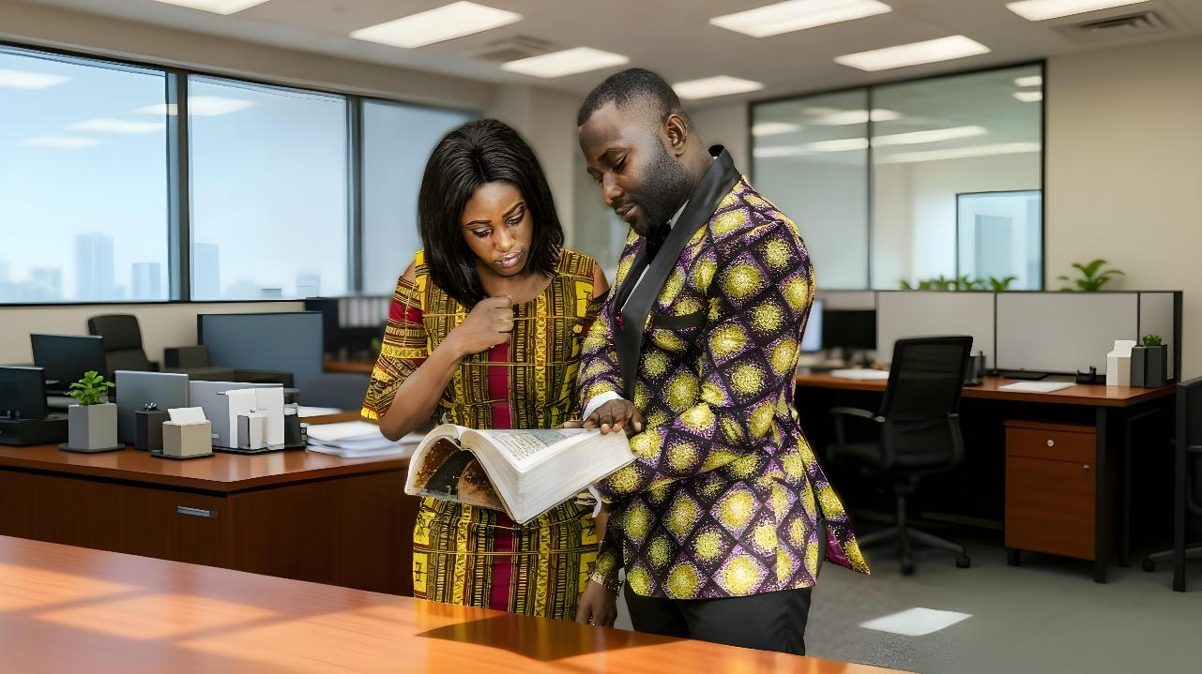
NYIS JI WACH KUOME
Lesson 12 mar Jun 20, 2026

Slide 2
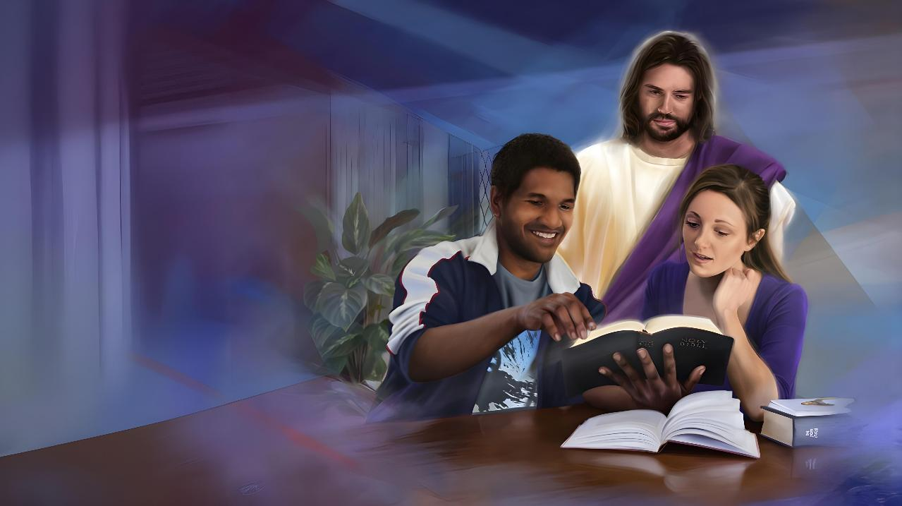
“Jehova Nyasaye Manyalo Gik Moko Duto osemiyo apong’ kod puonj, mondo omi ang’e wach manyalo hoyogo ng’ama ni e chandruok. Ochiewa pile okinyi kokonyi, kendo oyawo ita mondo abed gi winjo ka ng’at mipuonjo.”
(Isaya 50:4)

Slide 3
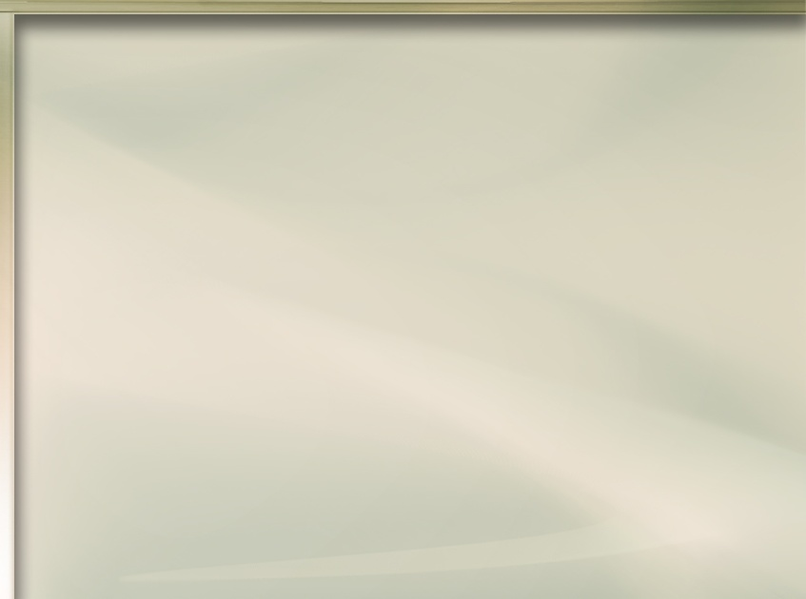
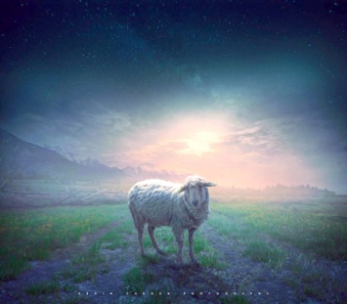
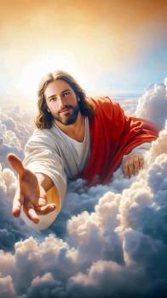
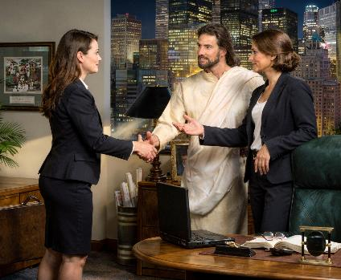



Ji gana gi gana ok ong’eyo Yesu gadier. Waluongogi ni “rombe molal,” to ok ging’eyo kata ni gilal. Ere kaka gibiro ng’eyo ni gidwaro Yesu ka onge ng’ama oleronegi wachno?
Nyasaye dewo ng’ato ka ng’ato e pinyni kendo “odwaro mondo ji duto okwo, kendo ong’e adiera” (1 Timo. 2:4). Mano oting’o jogo ma ok ong’eye kod jogo ma, bang’ ng’eye, oselokore oweyo yore mage.
Ere kaka Nyasaye oseyiero chopo kuom jogo duto? Kokalo kuomwa. Mano e “tich maduong’ momiwa.”
Ang’o ma owinjore wanyis ji?
  Tich Maduong’
Ere kaka wanyalo nyiso ji?
  Luwo ranyisi mar Yesu
  Loso osiep
Kaka iduogo jogo mane oweyo?
  Nyasaye manyo nyithinde
  Wamanyo jogo mane oweyo
Ang’o ma owinjore wanyis ji?
  Tich Maduong’
Ere kaka wanyalo nyiso ji?
  Luwo ranyisi mar Yesu
  Loso osiep
Kaka iduogo jogo mane oweyo?
  Nyasaye manyo nyithinde

Slide 4

ANG’O MA OWINJORE WANYIS JI?

Slide 5


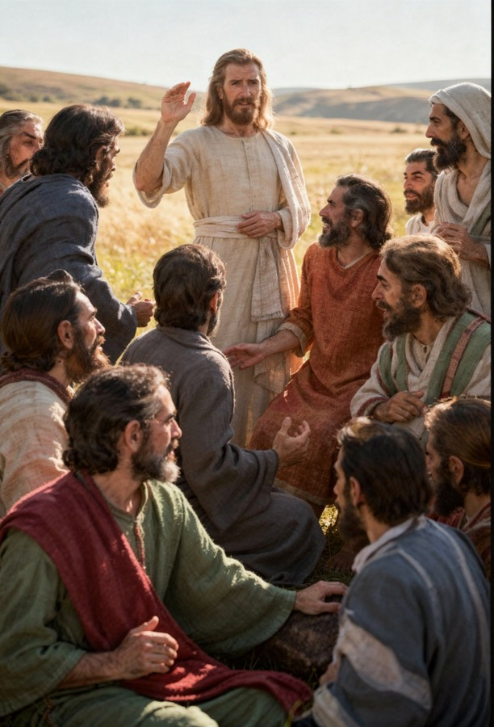
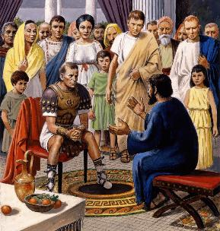
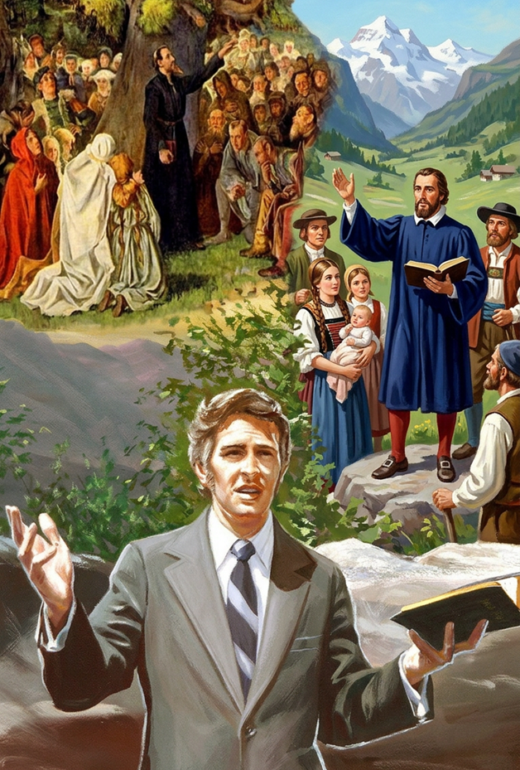
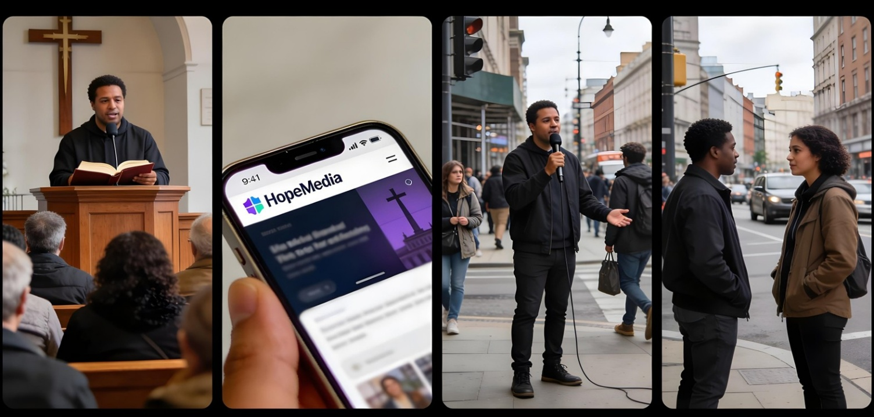

TICH MADUONG’
“Omiyo dhiuru ulok ogendini duto jopuonjrena, kubatisogi e nying Wuoro gi Wuowi gi Roho Maler” (Mathayo 28:19)
“Dhi... [e] ogendini duto” e tich mane Yesu omiyo ji mane ochokore mondo onene bang’ chierne (Math. 28:18-19a).
Ang’o mane onego gitim? Ne onego gidhi kendo gilos jopuonjre. Mano en, tudruok gi ji, batisogi, kendo puonjogi mondo gibed jopuonjre Yesu (Math. 28:19-20).
Jopuonjrego, bende, nopuonjo jopuonjre mamoko... kendo kamano kuom higni gana ariyo... nyaka e kindewa. Koro, wan e ma wayudo chik mar Yesu.
Mana kaka Petro kod Johana, “ok wanyal weyo mak wawuoyo kuom gik ma wan wawegi waseneno, kendo wawinjo” (Joote 4:20). Wanyalo wuoyo kowuok e kar yalo e kanisa, wuoyo matek e yore, lando neno marwa e mbui, kata nyiso ng’ato wach kuome. Wan duto wan e tijni.

Slide 6

ERE KAKA WANYALO NYISO JI?

Slide 7


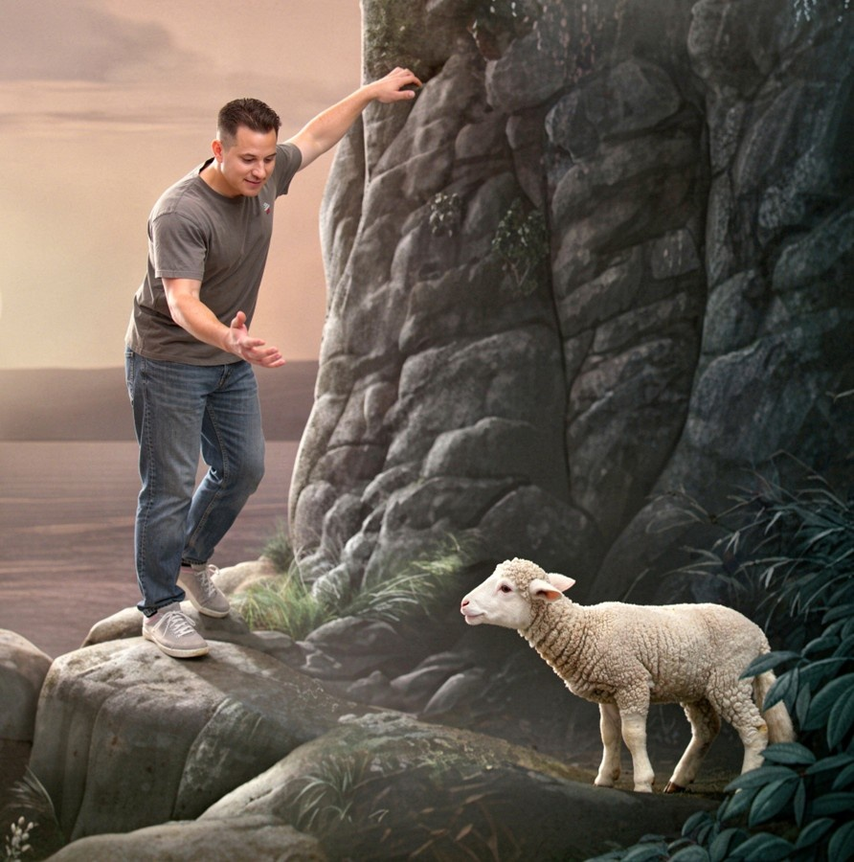
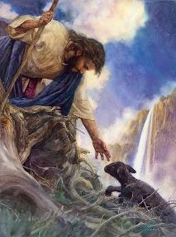
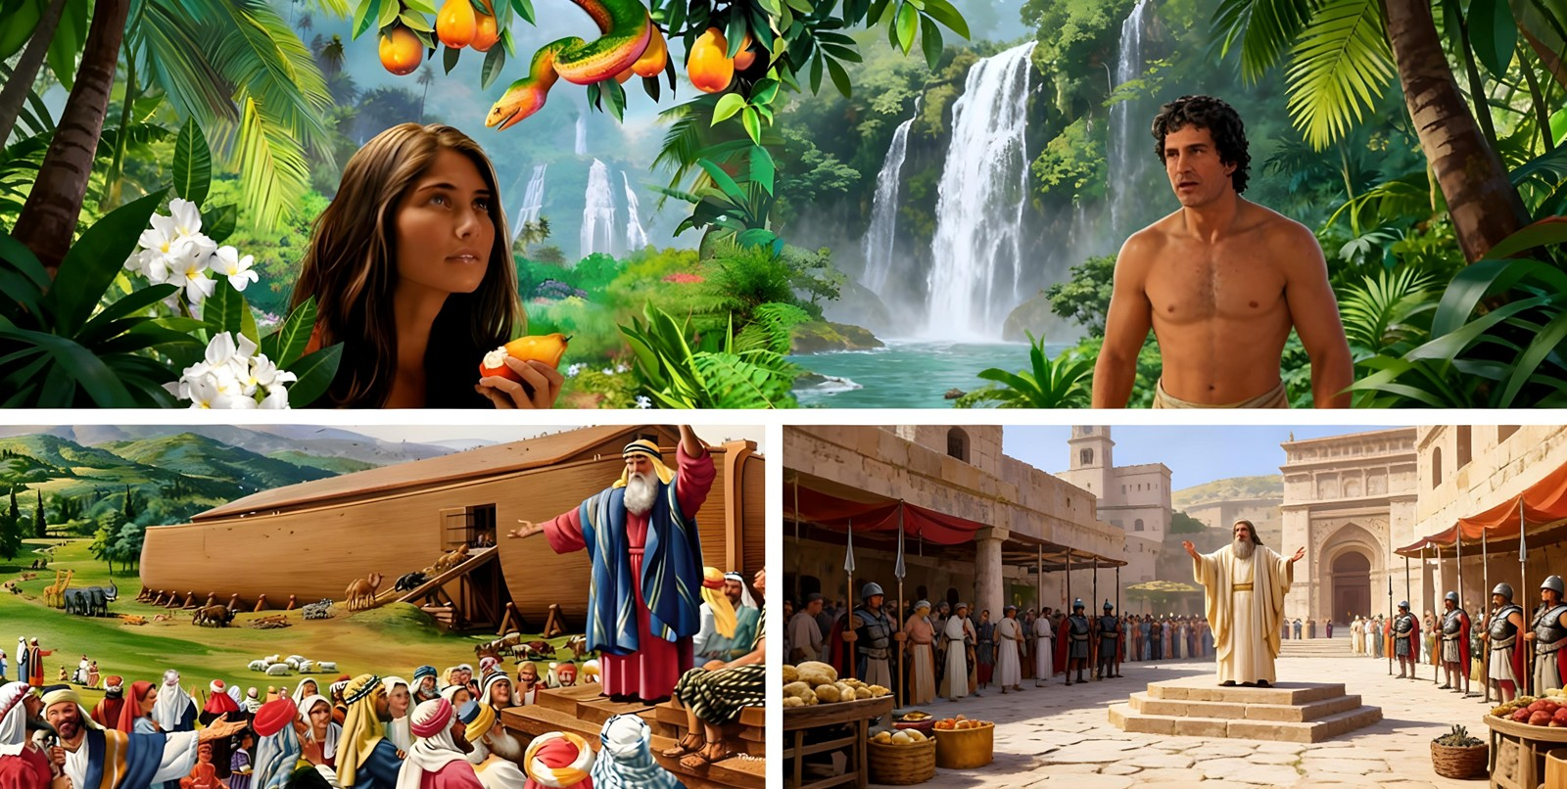
LUWO RANYISI MAR YESU
“Nimar hera mar Kristo oloyowa chuth. Waseng’eyo malong’o ni ng’at achiel notho ni ji duto” (2 Jo-Korintho 5:14a)
Ang’o mane omiyo Yesu obedo gi chuny mar manyo “rombe molal” (Math. 15:24)?
Maonge kiawa, ne en hera mare kuomwa (Math. 9:36; Efes. 5:2). Bende oseketo herane e chunywa, mondo wanyis herano ni jogo ma pok ong’eyo Yesu. Seche moko, ji temo chuno jomoko mondo oyie kuom Yesu mondo giyud ber gin giwegi. To mano ok e yo ma Nyasaye noyiero.
Nyasaye ne ok ochuno Adam gi Hawa mondo kik gitim richo. Ne ok ochuno ji mondo odonj e yie mondo mi kik ataro ywogi. Ne ok ochuno Jo-Nineve mondo orwake. Ne owuoyo kodgi gi hera kendo ne onyisogi gik ma ne dhi timore ka giluwo yore maggi giwegi.
Ka waluwo ranyisi mar Yesu, wanyiso hera mare ne jomoko, kendo waluongogi mondo giluw bang’e.

Slide 8

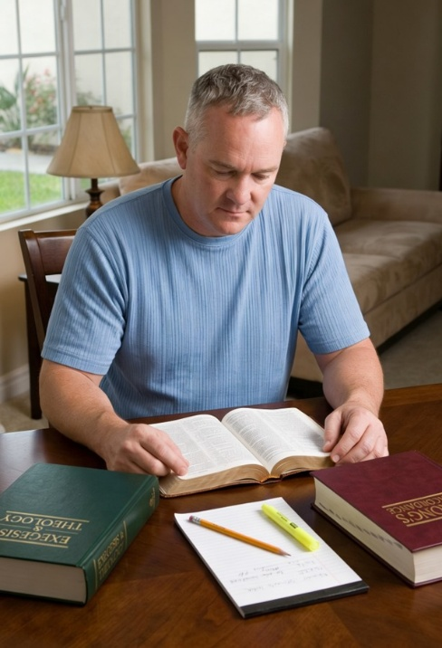

LOSO OSIEP
Ng’e ng’ato kendo los kode osiep bang’ kinde moko
Lem mondo Roho Maler odonj e chuny ng’atno. Lem mondo iyud thuolo makare mar tudruok kode
Many yo maber mar wuoyo kuom yieni kata lemnigi
Many yo mar tudo osiepni manyienni gi jo kanyaklani moko
Lem ni dwaro moro makende kata penj moro ma osiepni manyienni nyalo bedogo
Many thuolo mar nyisogi kaka Biblos kelo hoch, rieko, kendo chiko ngimawa
Thuolo biro chopo ma ibiro dwaro penjo osiepni ka bende ogombo mondo uso kode Biblos. Bang’e, osiepni nyalo dwaro ni obatise
Miuru Ruoth Kristo duong’ e chunyu, kendo pile beduru kuikoru dwoko ng’ato ang’ata mapenjou tiend geno ma un-go.” (1 Petro 3:15)
Wan duto wan joyalo mag Yesu kendo ochikwa ni waikre ni wachno (1 Petro 3:15). To, ok wan duto wang’eyo kaka onego wayal. Kata kamano, wan gi singruok ni Nyasaye owuon biro miwa weche ma dwarore
(Isaya 50:4).
Magi moko kuom gik monego itim e kinde ma iikori mar donjo e tich mar puonjo ji wach Yesu:

Slide 9

KAKA IDUOGO JOGO MANE OWEYO?

Slide 10
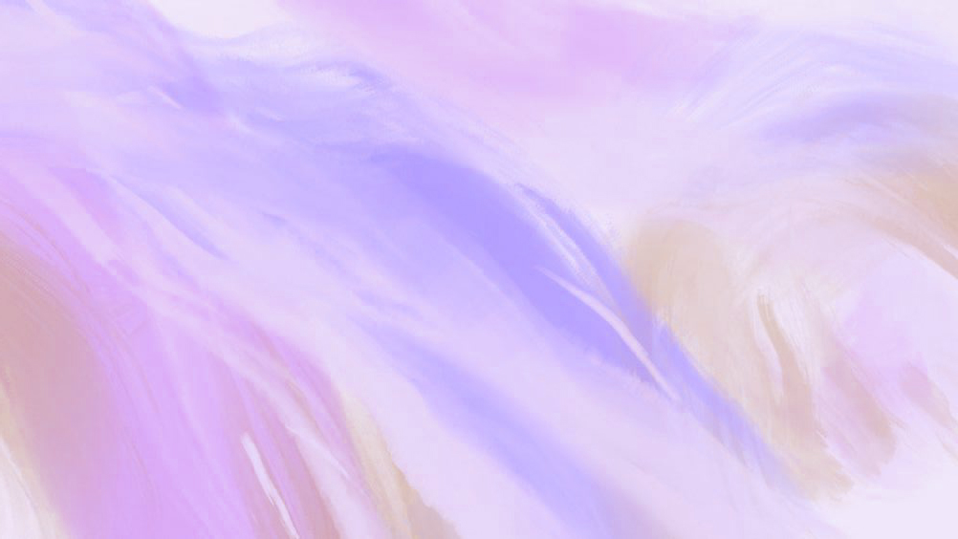

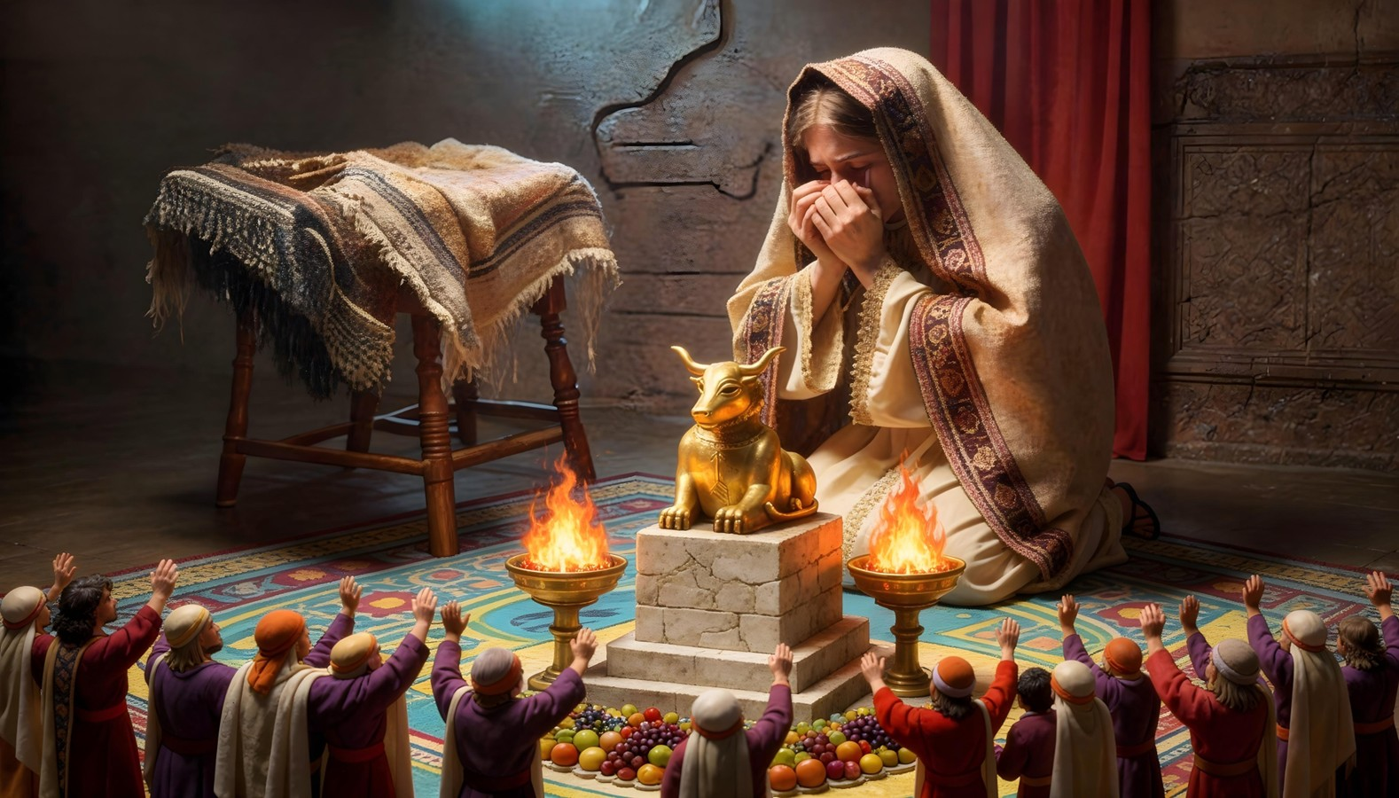
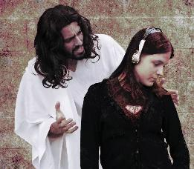
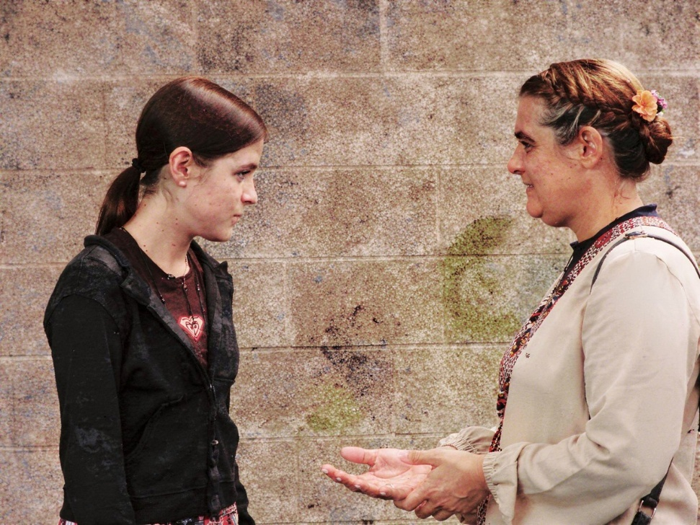
NYASAYE MANYO NYITHINDE
“To an Ruoth Nyasaye awacho kama: In Israel, in e wuoda mahero moloyo. E sa asaya ma aluongoe nyingi, to apari gi hera. Chunya oheri, omiyo abiro kechi.”
(Jeremia 31:20)
E kinde moro, oganda Nyasaye ne opogore: Efraim (pinyruoth ma yo nyandwat) noweyo Nyasaye; Juda (pinyruoth ma milambo) nodong’ motegno.
Kata obedo ni ne oweye, Nyasaye ne pod dhi nyime neno Efraim kaka wuode ma ohero (Jer 31:20). Ne onyiso kata damare, Rahel, kaka ywak yawuote mane osetho e richogi (Jer 31:15).
Joma ne otiyo ni Nyasaye kendo bang’e oweyo Nyasaye, Nyasaye dhi nyime ka luongogi gi hera. Gin nyithinde, kendo oherogi kendo ojiwogi kinde duto mondo gidwog ire.
Dipo ni moko kuom nyithindwa wawegi, mane ong’eyo yie chon, oseweyo yie. Kar weyogi, nyaka wadhi nyime herogi kendo wuoyo kodgi e yo mamuol. Nyasaye paronwa ni gin gik ma onyiso ng’wono maduong’ie moloyo, kendo odwaro ahinya ni gidwog ire.

Slide 11


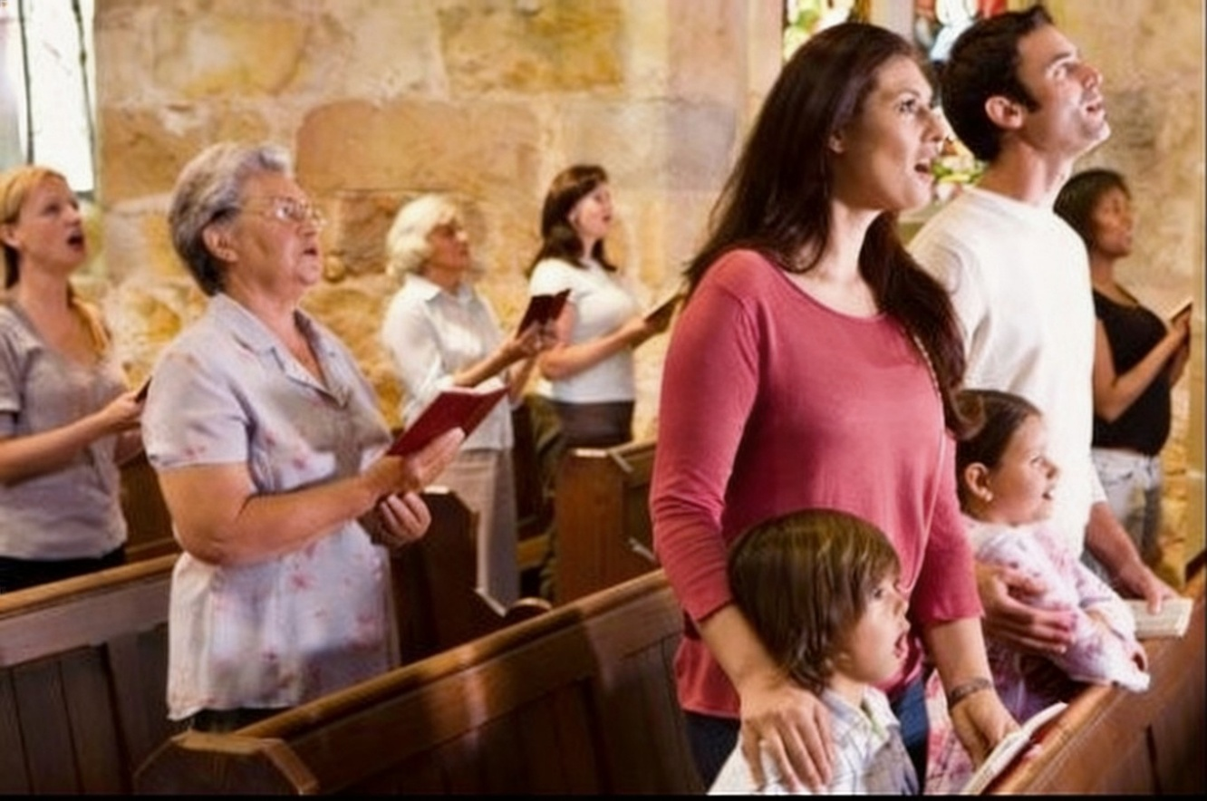

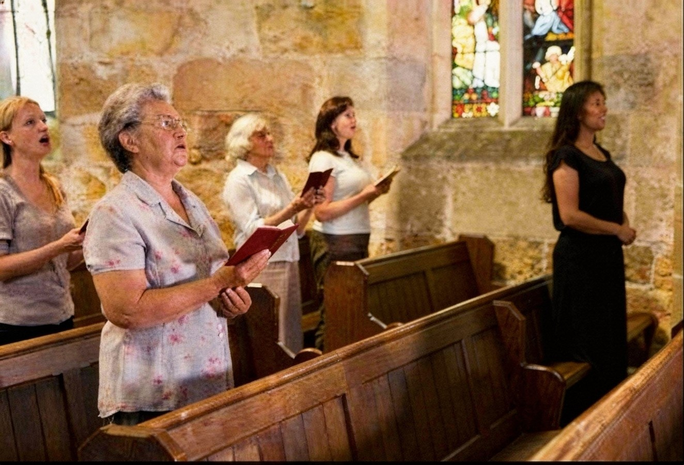
WAMANYO JOGO MANE OWEYO
“Kata obedo ni nakeyogi e kind ogendini man maboyo kamano, to ginipara, mi gipidh nyithindgi kuondego. Bang’e giniduogi” (Zekaria 10:9)
Jo-utwa; wuodwa; nyarwa; osiepwa; jadirwa; owadwa kata nyaminwa mane jabet e mberono... Ndalo moko ne gilemo kodwa, to sani, gin kanye?
Nitie gik mathoth ma miyo ji weyo kanisa. Ok oluongwa mondo wang’ad bura kuom gik ma gitimo, wakwed pachgi, kata mana ni mondo wiwa owil kodgi.
Tijwa en dhi manyogi kendo dwokogi dala. Ere kaka watimo mano? Mokwongo, kuom lamo. Mar ariyo, kuom bedo negi ranyisi mar hera kod muolo.
Kokalo kuom ranyisi mar ngimani, timbegi, wecheni, kod alam mari ne ng’at mosewuok kuom Nyasaye nyalo loko ngimane ahinya kod kaka obiro bet e kinde mabiro.

Slide 12

“Nyasaye ne nyalo chiwo tich mar injili, kod tich duto mar hera, ne malaike mag polo. Ne onyalo tiyo kod yore mamoko mag chopo dwarone. To kuom hera mare maonge giko, noyiero mondo oketwa jotich kanyakla kode, gi Kristo kod malaike, mondo wan bende wayud gweth, mor, dongo mar chuny, ma wuok kuom tijni ma ok dwar mare kende. [...]
Ka ibiro dhi tiyo kaka Kristo ochano ni jopuonjre mage otim, kendo yudone chunje, ibiro bedo gi dwaro mar ng’eyo matut kod rieko mathoth e weche mag Nyasaye, kendo ibiro bedo gi kech kod riyo mar dwaro tim makare. Ibiro ywak ni Nyasaye, kendo yie mari biro bedo motegno, kendo chunyi biro modho pi ma iye e soko mar warruok. Romo gi akweda kod tem biro teri kuom Biblos kod alam. Ibiro dongo e ng’wono kod ng’eyo mar Kristo, kendo ibiro bedo gi ng’eyo mathoth .”
.
EGW (The Way to Christ, pp. 79-80)

