Slide 1
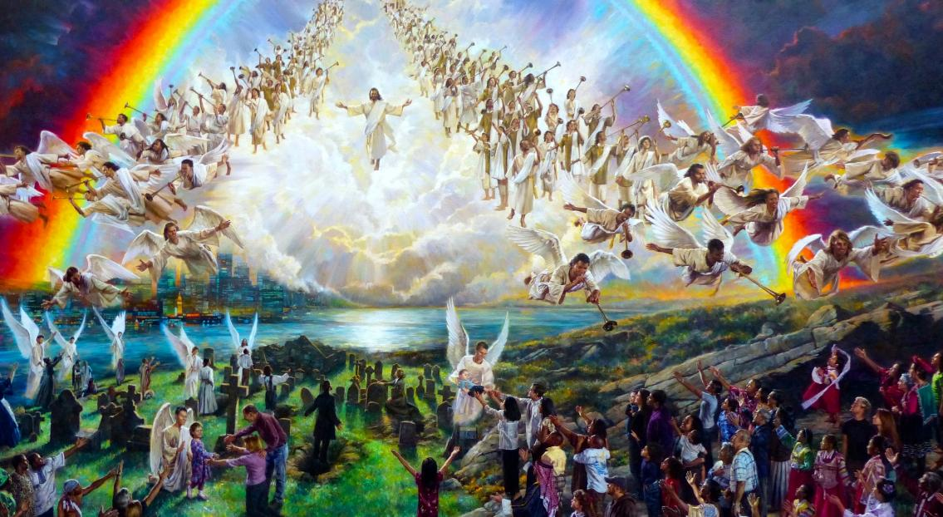
NGIMA MOCHWERE
Lesson 13 mar Jun 27, 2026

Slide 2
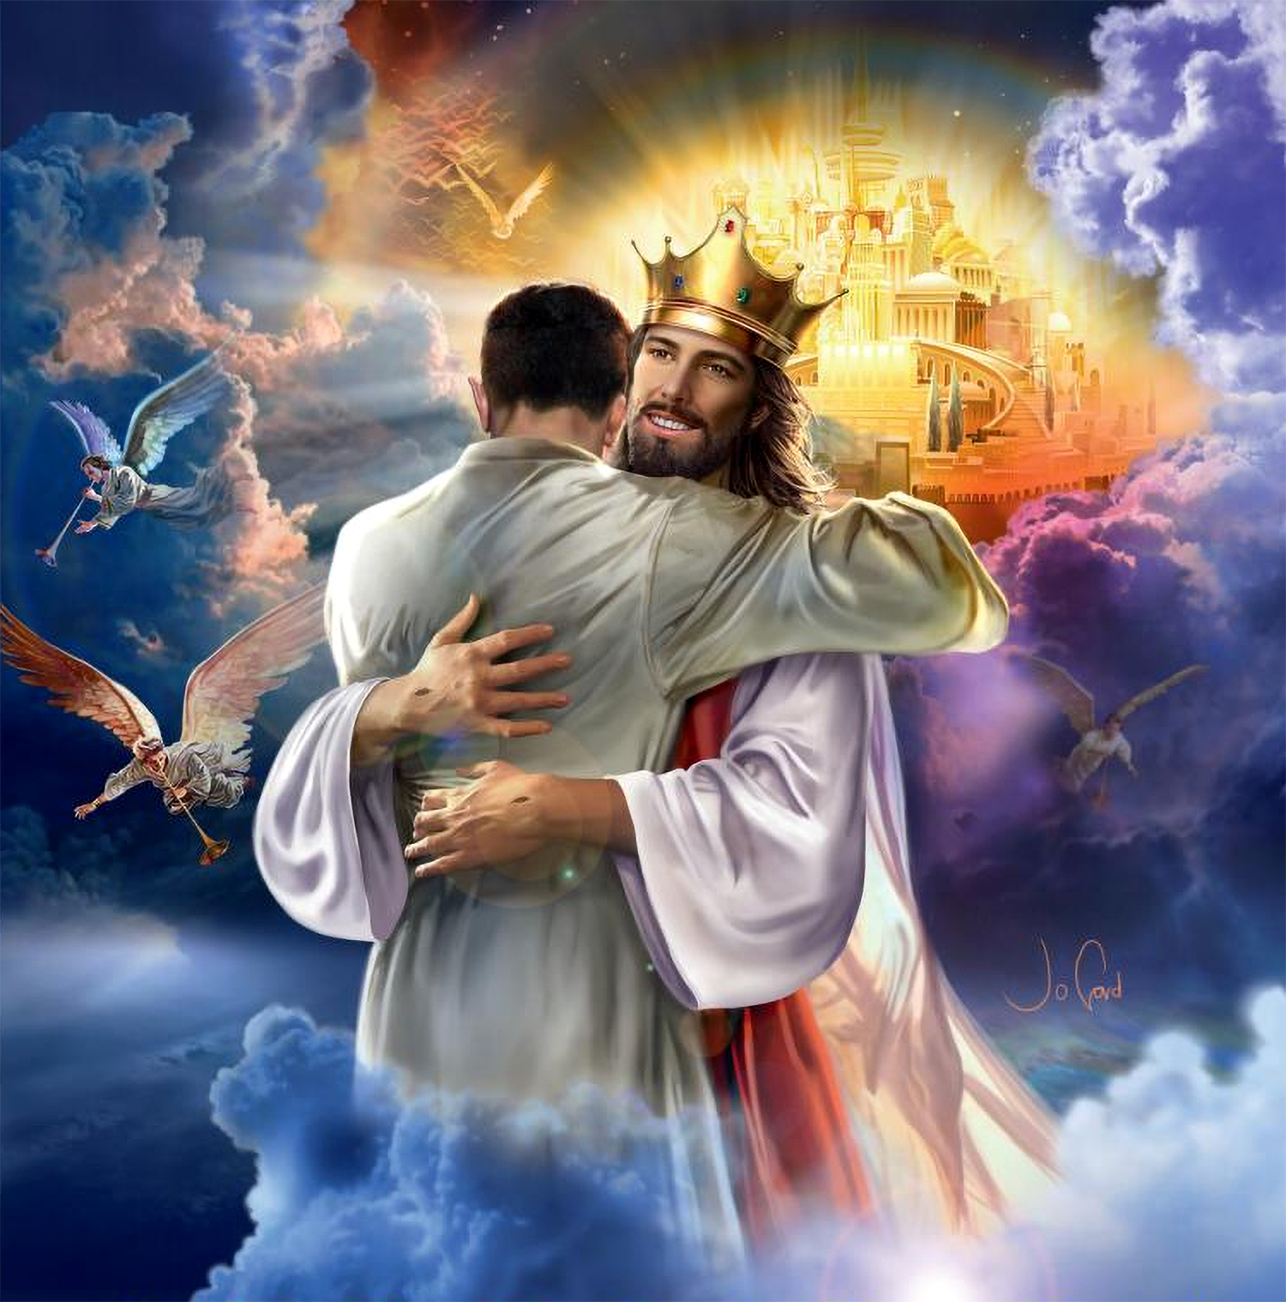

“Osiepena mageno, koro wan nyithind Nyasaye, to kaka wabiro bedo achien pok ong’ere. To wang’eyo ni ka Kristo nofwenyre to wanabed machal kode, nikech wananene kaka ochal”
(1 Johana 3:2, Loko Manyien)

Slide 3
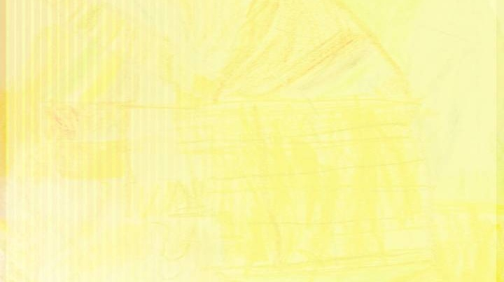
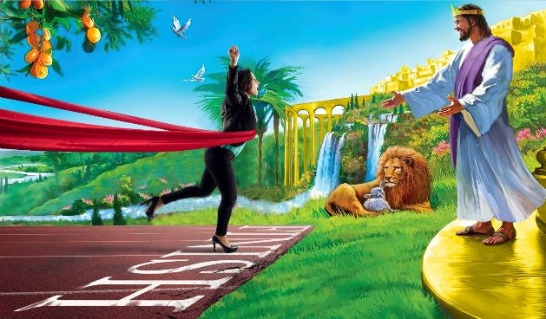
Kata obedo ni bedo gi winjruok kod Nyasaye kendo ng’eye e ngimawa kinde duto en gima duong’, mano ok en e gima Jakristo dwaro.
Seche mag rito
Biro mar Ariyo
Chopo dala
Ang’o ma wadhi timo e piny ma nyaka chieng’?
Tichwa
Wagombo yudo gimoro maber moloyo mano. Wadwaro romo wang’ gi wang’ gi Ng’at ma waseromogo kendo ma wasebedo ka walosogo kae.
Nyaka karang’o ka kindeno pok ochopo? Ang’o ma biro timore bang’e? Ere kaka ng’eyo ma kamano mulo ngimana ma pile ka pile?

Slide 4

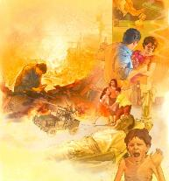
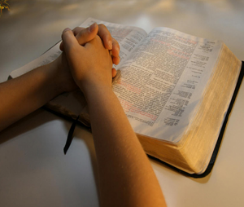
SECHE MAG RITO
“To ng’e malong’o ni kinde mag chandruok nobedie ndalo giko.” (2 Timotheo 3:1)
Yesu nomiyowa ranyisi mane dhi timore ka Birone mar Ariyo pok ochopo. Gin gik ma biro medore ameda ka ndalo sudo (Math. 24:6-11):
Lwenje gi mahu mag lwenje
Pinje monjore
Tuoche, kech, kod yiengni mar piny
Jo-Kristo ibiro sandi
Ji mathoth nowe Nyasaye
Jonabi mag miriambo nowuogi
Map mar lwenje ma dhi nyime:
  Lwenje madongo (tho 10,000 kata mokalo)
  Lwenje matindo (tho 1,000-9,999)
  Dhawo (tho 100-999)
  Gwandruok gi ywaruok (tho 1-99)
Mondo wasik gi geno e “kinde mag chandruok” (2 Timo. 3:1) nyaka wabed gi winjruok makare gi Nyasaye, kendo wabed gi adiera ni oseweyo richowa kendo osewarowa.
Chiewo chuny dwarore. Owinjore walem kaka Asaf: “A Nyasaye, duogwa iri, kendo rienynwa mondo wayud resruok” (Zaburi 80:3).

Slide 5


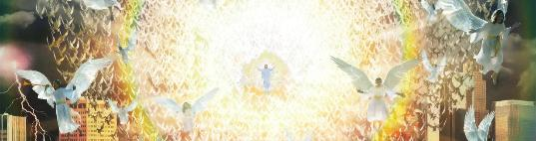
BIRO MAR ARIYO
Masiche madongo yiengo Piny
(Fweny 6:12-14)
Ranyisi mar Wuod Dhano biro nenore (bor polo matin)
Yesu othichore kowuok e boche polo
(Fweny 1:7)
Duonde chiero joma otho kendo loko joma ngima (Johana 5:28; 1 ​​Jo-Thesalonika 4:16; 1 Jo-Korintho 15:51-52)
Malaike choko jogo mowar kendo kelogi ir Yesu (1 Jo-Thesalonika 4:17)
“Enoor malaikane e tung’ piny gi tung’ piny, ka tung’ ywak matek, mondo ochok joge ma oseyiero, chakre e tung’ piny kochiel nyaka komachielo.” (Mathayo 24:31)
Mathayo 24:29-31 nyiso e yo machuok gik madongo ma timore e kinde maduong’ni, gik ma timore ma bende opong’ gi weche mamoko:
E kindeno, ka tung’ ywak kendo ji duto neno Yesu, wabiro yie ni kara rito nigi ohala. Alam duto mane otim gi kinda, thuolo duto mane wamiye e ngimawa, kinde duto mane wawuoyo kuome gi chir, tembe duto—biro chopo e ng’iendgi ka wanane wang’e

Slide 6

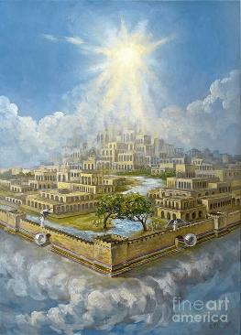
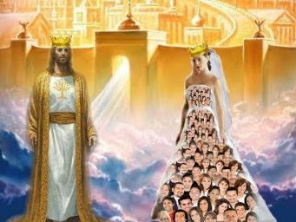
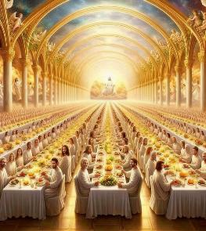
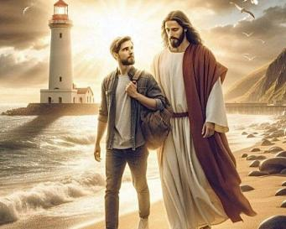
CHOPO DALA
“E dala Wuora nitie udi mang’eny, to ka da ni ok kamano, to dikoro asenyisou, to adhi mondo alosnu kar dak.” (John 14:2)
E polo nitie kama Yesu oselosonwa, dala ma wabiro dak e iye: Jerusalem Manyien (Johana 14:2; Hib. 11:10; Fweny 21:10).
Dala ni, kaachiel gi jodak manie iye – wan – iluongo ni “Miaha chi Nyarombo” (Fweny 21:2, 9; Fweny 19:7-8).
Gima okwongo ma wabiro timo e dalawa manyien en gima wich ok wilgo: kisera mar Nyarombo (Fweny 19:9).
To mondo wabed miaha mar Kristo, mokwongo nyaka wabed miaha mare e pinyni. Nyaka wabed gi winjruok machiegni gi Yesu sani. Mondo wang’eye. Mondo wawuo kode pile ka pile. Mondo wagene. Mondo wabed gi gombo mar neno ndalo ma wabiro dak kode nyaka chieng’.

Slide 7
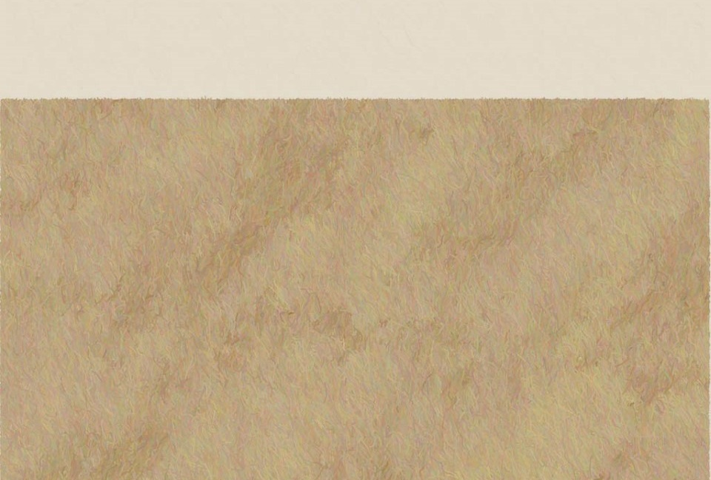
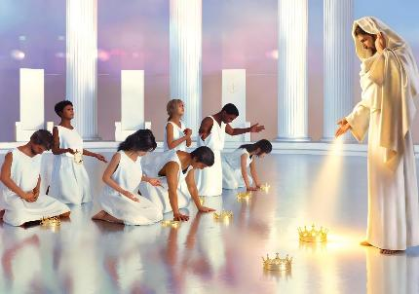
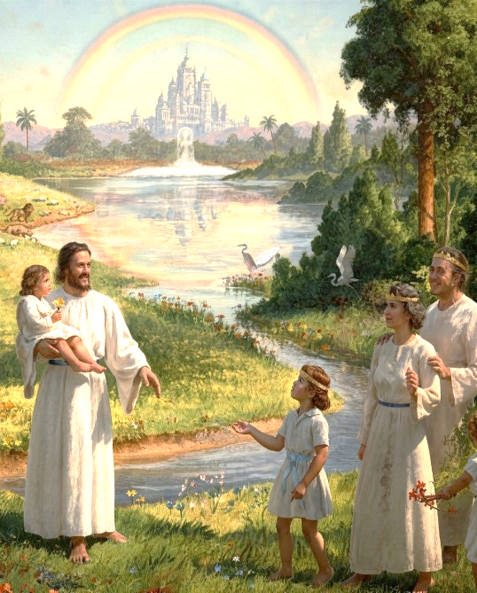
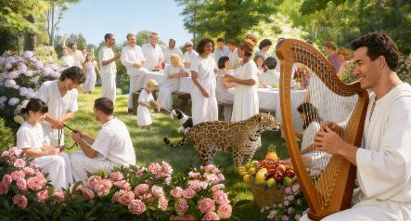
ANG’O MA WADHI TIMO E PINY MA NYAKA CHIENG’?
“nikech Nyarombo manie dier kom duong’ tir nobed jakwadhgi. Notelnigi e sokni mag pi ngima, kendo Nyasaye noywe pi wang’gi duto.” (Fweny 7:17)
Gweth maduong’ ma wabiro bedogo e polo biro bedo neno Yesu kendo goyone erokamano, kuom gima osetimonwa.
To ok wanadag e Polo kinde duto. Kinde biro chopo ma wanalor e Piny, ma en dalawa mogik (Fweny 21:1-3; Zab. 37:9). Kata obedo ni gik maricho ok bi bedo kuno kendo, Yesu pod biro bedo Jakwadhwa, koritowa gi ng’uono (Isa. 25:8; Fweny 7:17).
En adier ni ok obi bedo ngima ma onge gimoro ma itimo. Mana kaka Nyasaye nomiyo dhano tich ka nochweye, ng’ato ka ng’ato kuomwa biro bedo gi gino ma onego otim kuno. Wabiro bedo gi nyalo mar medo ng’eyo marwa kendo dhi nyime gi fwenyo gik miwuoro manyien.
Mopogore gi gima timore sani, kuno paro magwa biro bedo 100% kochikore kuom Nyasaye, ma herane biro pong’o chunywa gi ngimawa te (Fweny 14:1).

Slide 8
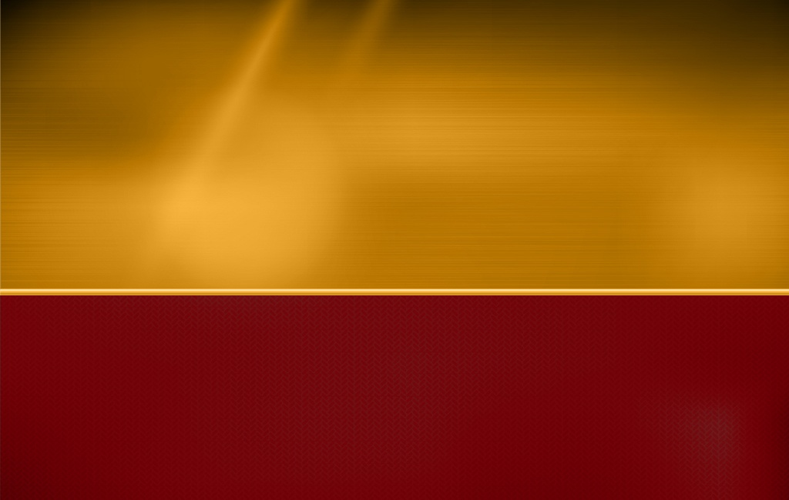
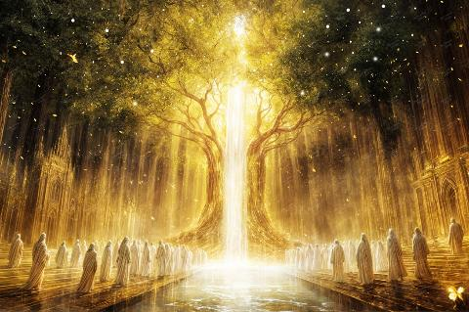
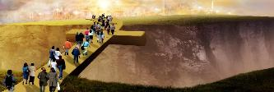
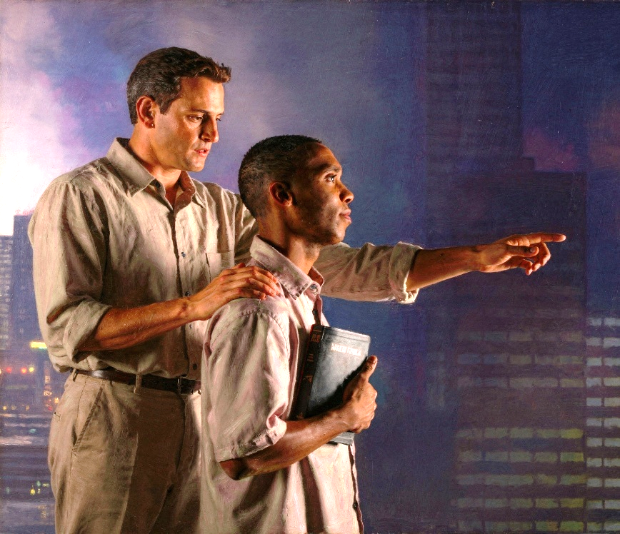
TICHWA
“Roho gi Miaha wacho ni, ‘Bi!’ Ng’ama owinjo, bende mondo owach ni, ‘Bi!’ To ng’ama riyo oloyo, mondo obi oyud pi mar ngima nono, mak ochulo gimoro.” (Fweny 22:17)
E Jerusalem Manyien—dalawa ma nyaka chieng’—aora mar pi ngima mol kaa e kom duong’ mar Nyasaye, komiyo yath mar ngima chiemo (Fweny 22:1-2). Ngima mar mor, ngima mosiko.
Chopo ire onge chudo. Yesu nochulo nengo. Chieng’ moro ne warwako luong mar Roho Maler kendo wang’eyo kaka wanyalo chopo kuno, to jomoko pod ok ong’eyo yo.
Wan gi ting’ ni jogo ma gombo yudo ngima mosiko to ok ong’eyo kaka ginyalo yude. Nyaka waland gi dwol maduong’ niya: “Ng’ama riyo oloyo, mondo obi oyud pi mar ngima nono, mak ochulo gimoro” (Fweny 22:17).
Nyaka chop kinde ma wanyalo modhe pino, kik waol gi rito. Wasik gi gombono. Bi, Ruoth Yesu.

Slide 9

“Lweny maduong’ otieki. Richo kod joricho orumo chuth. Piny ngima ler. Gwecho wang’ achiel mar chuny mar winjruok kod mor wuok e chuech duto. Ngima kod ler kod mor mol, e piny duto ma onge giko, kaa kuom En ma nochueyo gik moko duto. Chakre kuom “atom” (gima tinie moloyo) nyaka piny maduong’ie moloyo, gik moko duto, ma nigi ngima kod ma onge ngima, e bergi ma onge tipo moro mogeng’o kod morgi malong’o chuth, wacho ni Nyasaye en hera.”
EGW (The Great Controversy, p. 678)

