Slide 1
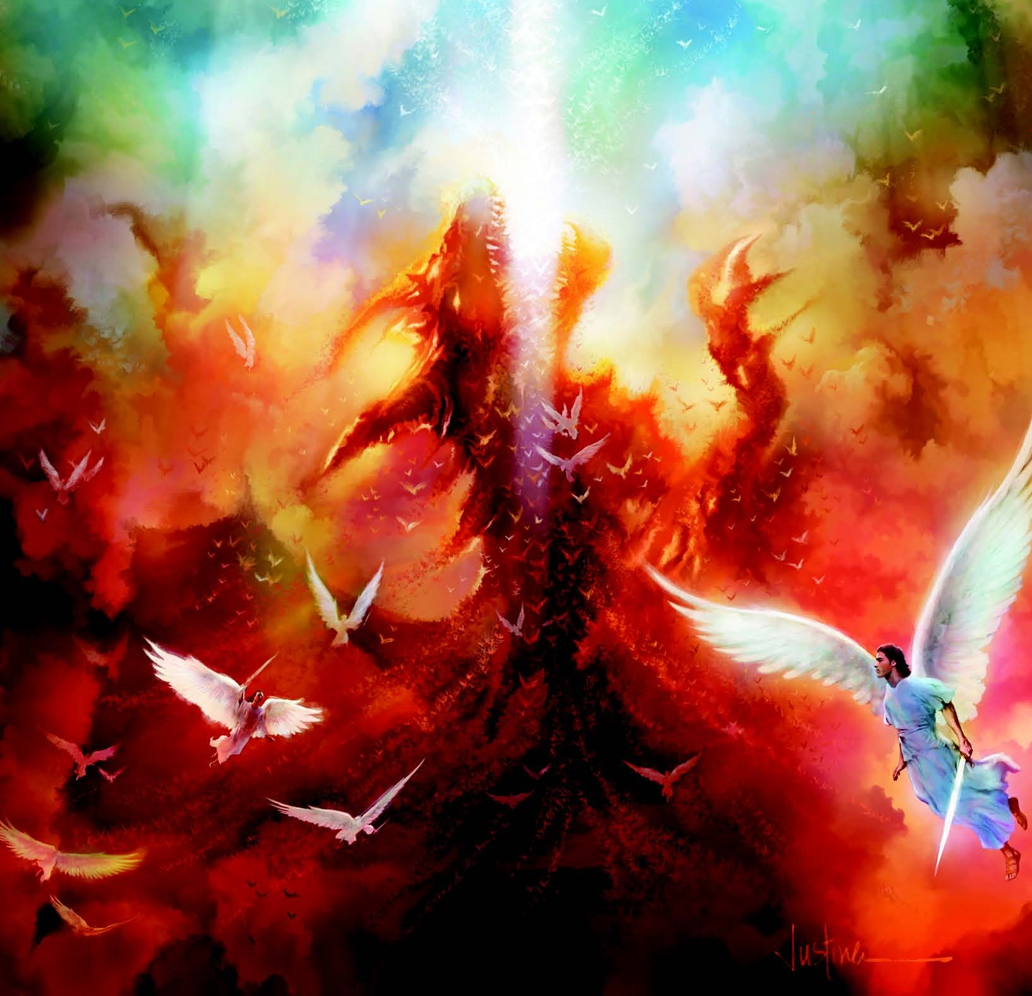
IMPI ESINGETHWE YIZIMPI
Isifundo sokuqala kuMabasa ilanga lesithuphaku2024

Slide 2
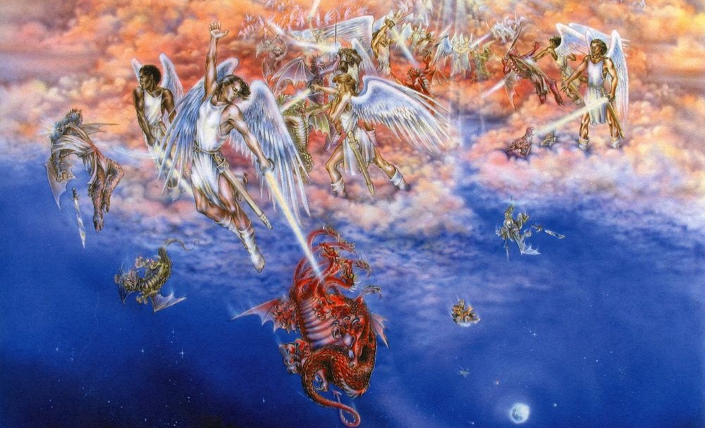
“Kwase kuqhamuka impi ezulwini: uMikayeli lezingelosi zakhe balwa lomgobho; umgobho lezingelosi zakhe balwa, kepha abanqobanga, lendawo yabo ayibange isatholakala ezulwini.”
( IsAmbulo 12:7, 8 )

Slide 3

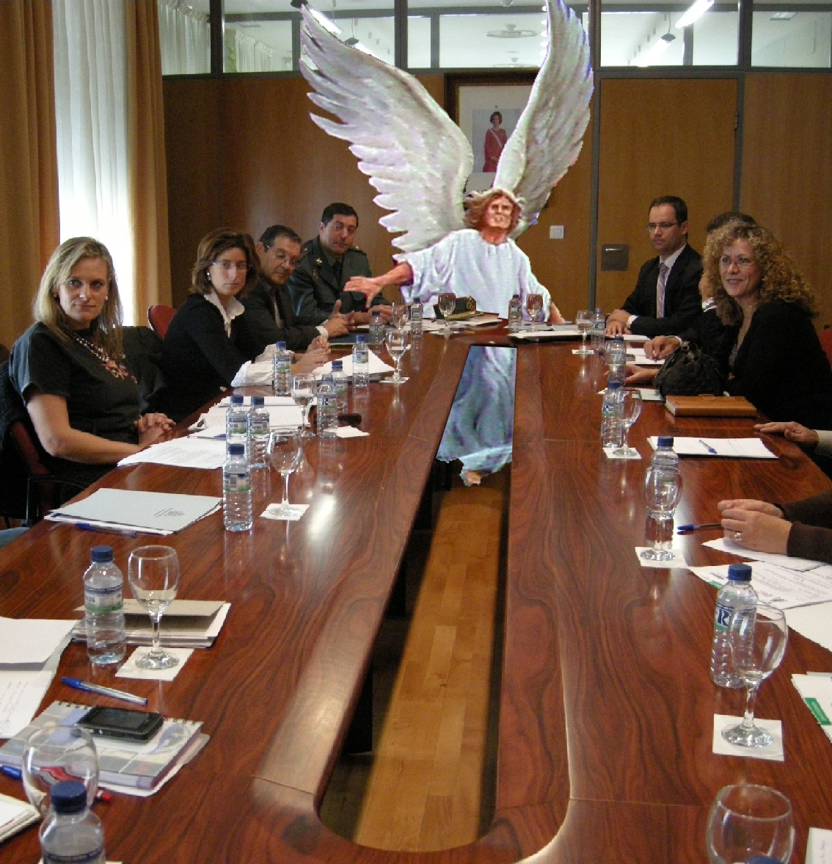
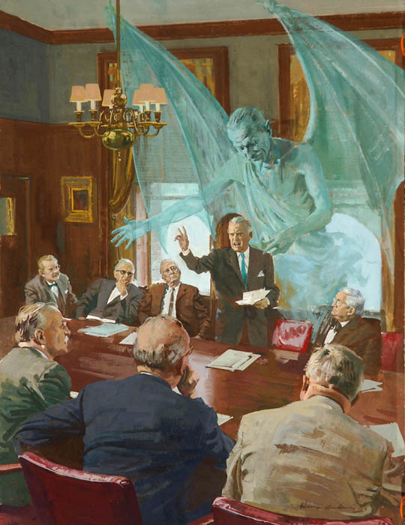
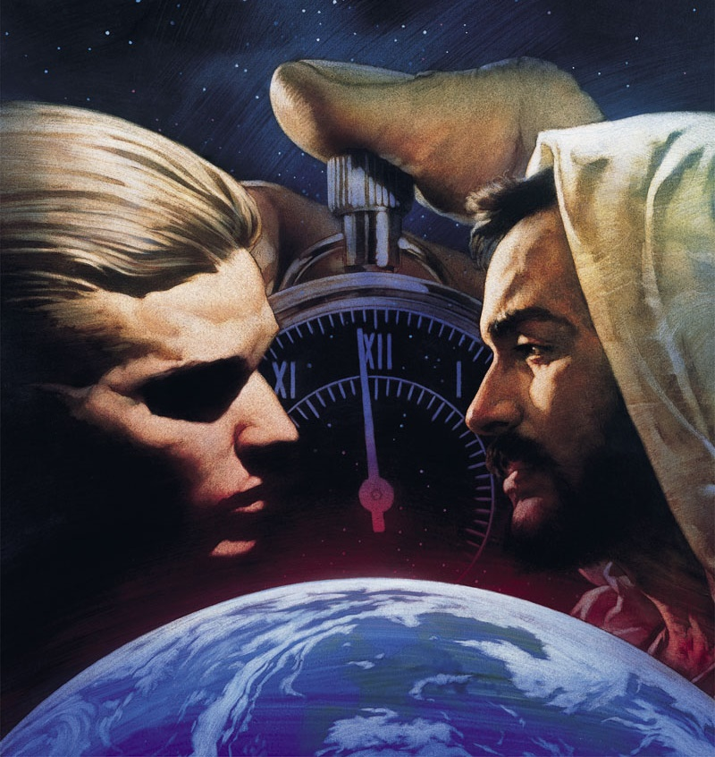
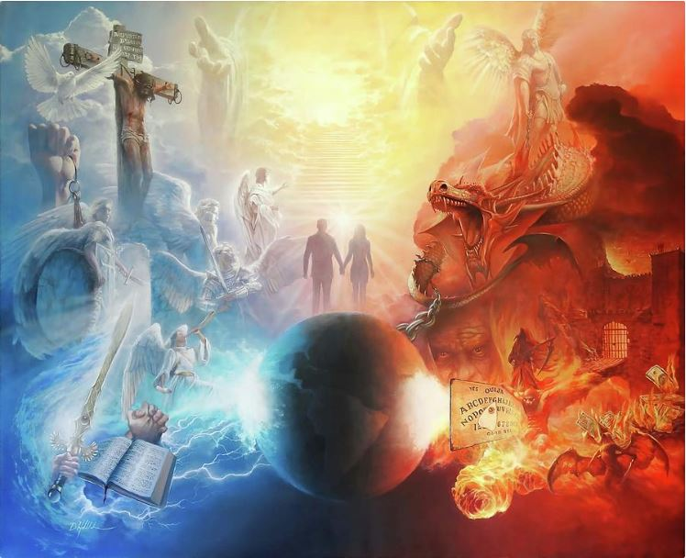





Siphila siphakathi kwenxabano yakomoya emazulwini.. Ngitsho loba singazi, loba singakholwa ukuthi lokhu kungenzeka, inxabano ingoyoqobo.
Amandla alwayo angakamoya, awabonakali kithi (Efe. 6:12). Lokho, singayizwa imiphumela yempi. Izenzakalo ezimbi, ukuziphatha okubi, ukufa...
Kwakusengozini uhulumeni kaNkulunkulu, ukwethembeka kwezingelosi kanye lezwe elingelasono. Lamuhla ukwethembeka kwakho lokwami kusengozini.
Ukuqala kwenxabano
Imvukela eZulwini
Imvukela Emhlabeni
Uthando luphindisela ngothando
Inxabano lamuhla

Slide 4


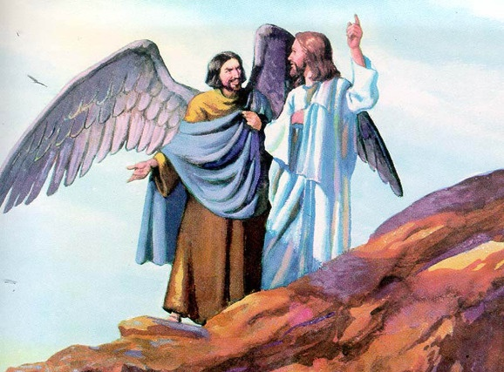
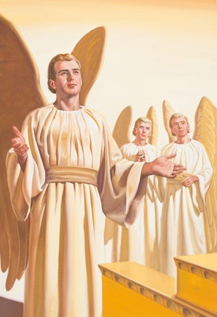
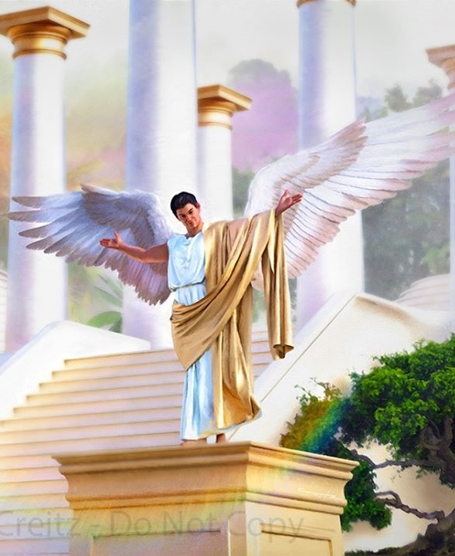
UKUQALA KWENXABANO
“Wawungelasici ezindleleni zakho kusukela osukwini lokudalwa kwakho;
kuze kutholakale ububi kuwe” (Hezekeli 28:15).
Iqiniso lokuthi, e-Edene, kwakukhona isidalwa esabangela u-Eva ukuba angamethembi uNkulunkulu, lisikisela ukuhlubuka kuNkulunkulu ngaphambi kokuba abantu babe khona (Gen. 3:1).
UJesu wabiza lesi sidalwa esihlanyela ukungathembani phakathi kukaNkulunkulu lezidalwa zakhe ngokuthi “isitha,” asichaza ngokuthi udeveli ( Mt. 13:39 ).
Umbuzo wokuqala okufanele sizibuze wona uthi: ingabe uNkulunkulu wadala udeveli, okungukuthi, ingabe uNkulunkulu wadala isidalwa esibi?
IBhayibheli lisitshela ukuthi udeveli uyingelosi ebizwa ngokuthi uLusifa (Isaya 14:12). Le ngelosi yadalwa iphelele futhi iyinhle (Ez. 28:12). Waphakanyiselwa esikhundleni esiphezulu ingelosi eyayingasifisa: ikherubi elivikelayo ( Ez. 28:13-14 ).
Uluba uLusifa wayephelele, waba kanjani usathane? Kwaqala kanjani inxabano phakathi kukaNkulunkulu laye? UNkulunkulu wamnika, njengazo zonke izidalwa zakhe ezidaliwe, inkululeko yokuzikhethela futhi, ngendlela engachazeki, uLusifa wanquma ukuhlubuka, walangazelela ukuhlala esihlalweni sobukhosi sikaNkulunkulu (Ez. 28:15; Isaya 14:13-14).

Slide 5

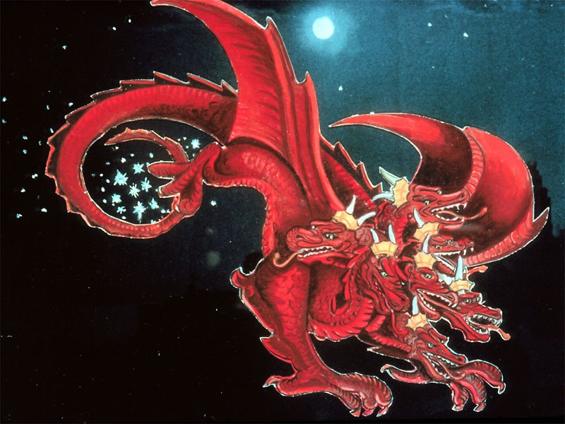
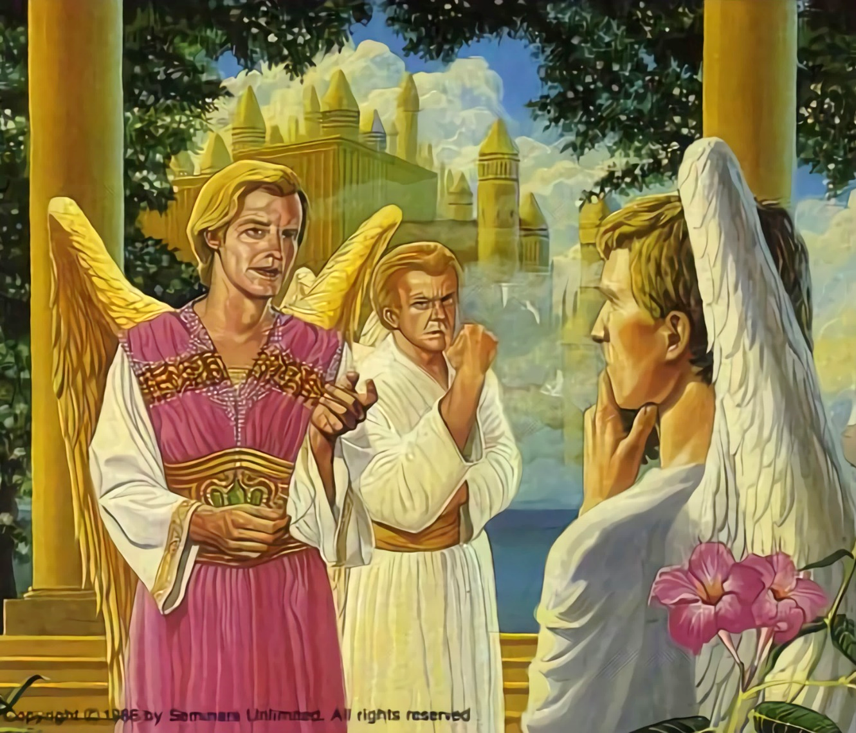
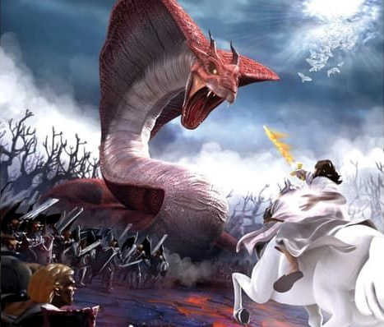
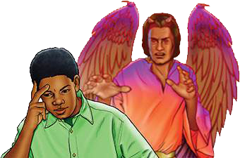
UMVUKELA EZULWINI
“Umsila wawo wakhukhula ingxenye yesithathu yezinkanyezi esibhakabhakeni waziphonsa emhlabeni…” (IsAmbulo 12:4a)
Esifisweni sakhe sokuthatha isihlalo sobukhosi saseZulwini, uLusifa waphakamisa ukuthandabuza ezingelosini ngokwahlula bukahulumeni waphezulu. Babengakhululekile yini bonke? Kungani uthobela imithetho ewomileyo futhi, mhlawumbe, engelabulabubelo loba engelangqondo?
ULusifa waba nguSathane, ummangaleli ( IsAm. 12:10; Jobe 1:6, 9-10 ). Wenqaba zonke izingcingo zikaNkulunkulu zothando zokushintsha isimo sakhe sengqondo.
Umvukela kwaba yingxabano esobala, impi lapho ingelosi ngayinye kwakufanele yenze isinqumo sayo. Ingxenye eyodwa/3 yezingelosi yalandela uSathane, kuyilapho zonke ezinye zahlala zithembekile kuNkulunkulu ( IsAm. 12:4a ).
Lamuhla impi isaqhubeka. Usathane usasebenza. Uzama ukudonsa wonke umuntu ukuba ahlubuke kuNkulunkulu. Kulezinhlangothi ezimbili kuphela. Labo abafuna ukulalela uMthetho kaNkulunkulu, loba labo abawenqabayo. Isinqumo singesethu ( Dut. 30:11, 16, 19; Josh. 24:15 ).

Slide 6

“UNkulunkulu omkhulu wayengamjikijela ngaso leso sikhathi lo mkhohlisi omkhulu evela ezulwini; kodwa lokhu kwakungayisiyo inhloso Yakhe. Wayezanika abahlubuki ithuba elilinganayo lokulinganisa amandla lamandla ngeNdodana yaKhe kanye lezingelosi zaKhe ezithembekileyo. Kulempi ingelosi ngayinye yayizokhetha uhlangothi lwayo futhi ibonakale kubo bonke. […] Aluba uNkulunkulu wayesebenzise amandla Akhe ukuze ajezise lesi sihlubuki esikhulu, izingelosi ezihlakazekileyo ngabe azizange zibonakale; ngakho, uNkulunkulu wathatha enye inkambo, ngoba wayezabonakalisa ngokusobala kulo lonke ibutho lasezulwini ukulungiza lokwahlulela Kwakhe.”.”
EGW (The Story of Redemption, pg. 17)

Slide 7
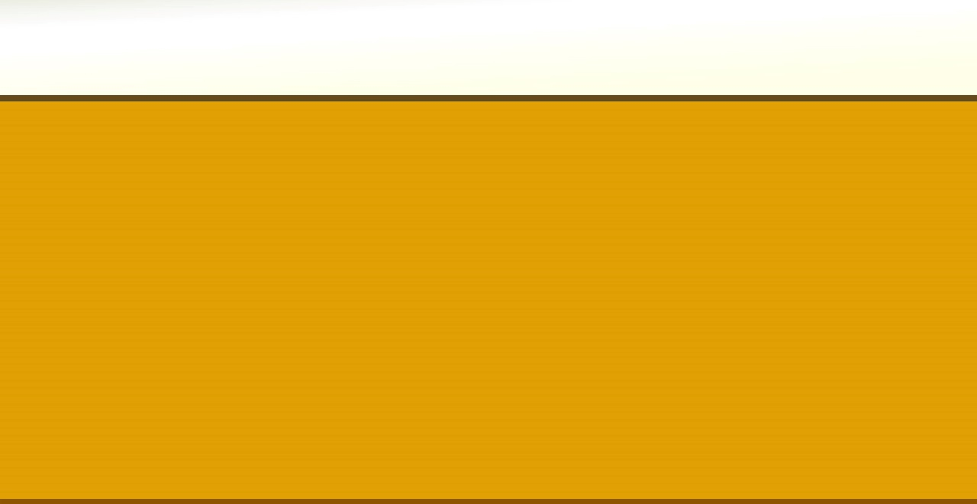
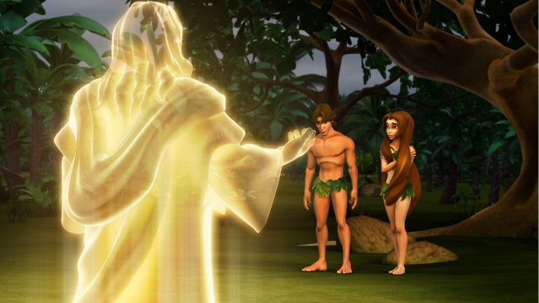
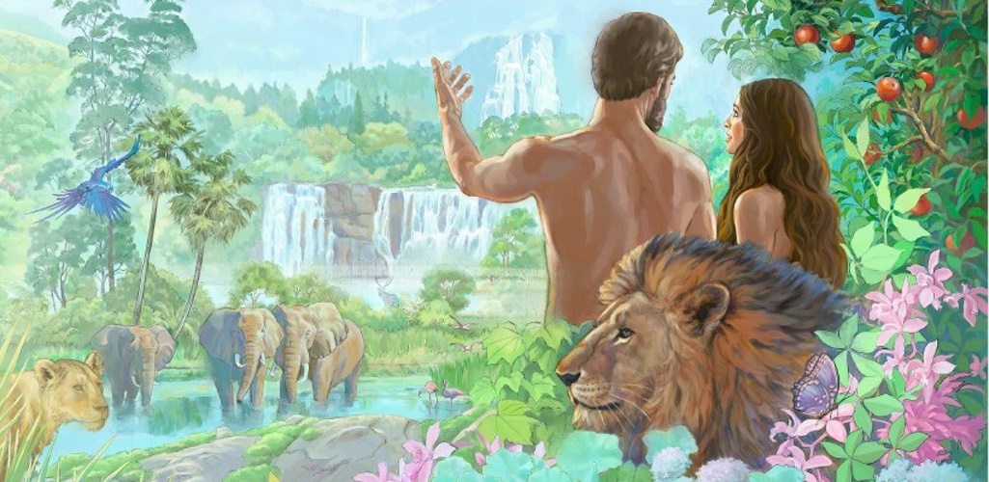
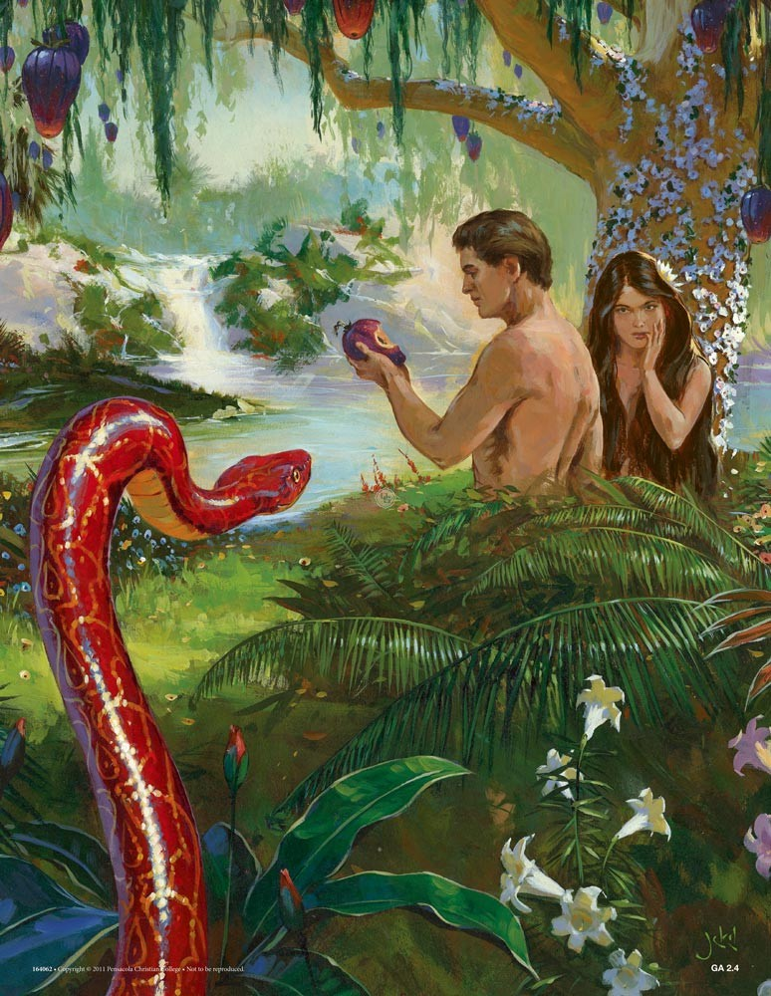
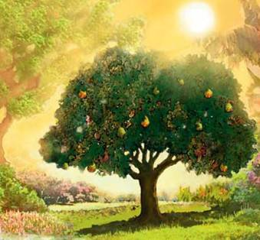
UMVUKELA EMHLABENI
Wathi, ‘Ngubani okutshele ukuthi uhamba ze? Udlile yini emthini engakuyala ngawo ukuba ungadli kuwo?’ ” ( Genesise 3:11 ) Ngakho
UNkulunkulu wadala izingelosi endaweni engelasono lepheleleyo. Ngokufanayo, uNkulunkulu wadala uluntu endaweni epheleleyo, engelasono (Gen. 1:31).
Njengoba nje kwenzeka ezingelosini, uNkulunkulu laye wasidala silamandla okuzikhethela. Ngakho, u-Adamu lo-Eva babekwazi ukusebenzisa leyo nkululeko, wabapha umyalo olula: “kodwa ungadli kuso isihlahla sokwazi okuhle lokubi” ( Gen. 2:17 ).
Yilokho kuphela lapho uSathane ayengabenza bathandabuze. Ngobuqili, wawufinyelela umgomo wakhe. U-Adamu lo-Eva bathandabuza uNkulunkulu, abamlalelanga, futhi bafulathela umthombo wokuphila ( Gen. 3:6, 9-13, 19 ). U-Adamu wavula umnyango wokuba isono singene, futhi kanjalo ukufa kwadlulela kubo bonke abantu ( Roma 5:12 ).
Kusukela ngaleso sikhathi, siphila ezweni eligcwele ubuhlungu, ukugula lokufa. Ingabe sonke siyabhadala isono sika-Adamu?
Sonke sibhadala izono zethu: “ngokuba bonke bonile basilele kunkazimulo kaNkulunkulu” (Roma 3:23).

Slide 8

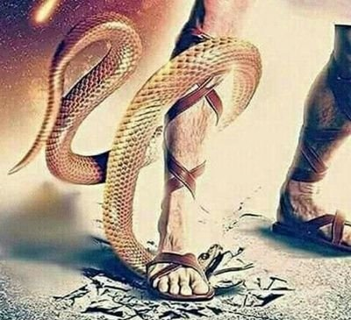

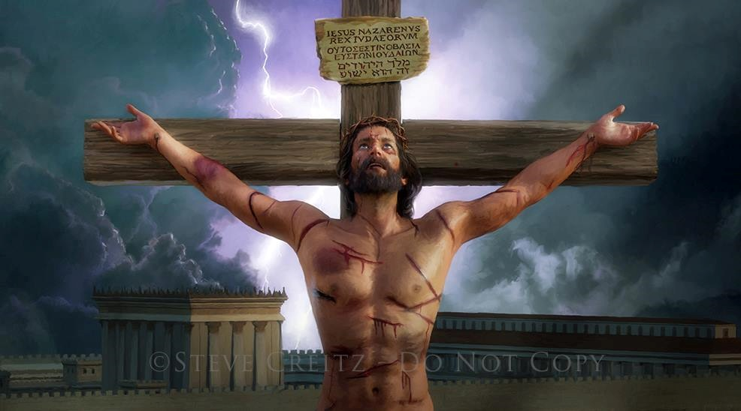
UTHANDO LUPHINDISELA NGOTHANDO
“Lolu luthando: akusikho ukuthi thina samthanda uNkulunkulu, kodwa yikuthi yena wasithanda futhi wathumela iNdodana yakhe ibe-yinhlawulo yezono zethu” ( 1Joh. 4:10 )
Ngitsho langaphambi kokuba amemezele imiphumela yokungalaleli, uNkulunkulu wakhuluma lo-Adamu lo-Eva ukuthi kulecebo lokuhlengwa kwabo ( Gen. 3:15 ).
Uluntu lwaluzihlukanise ngowentando loMdali. Kodwa ngaphandle kokulahla abantwana bakhe abangabongiyo, uNkulunkulu wembula isimilo sakhe sangempela ngokubathanda ngaphezu kokukholwa (Johane 3:16).
Ukufa kwakungadingeki kube isiphetho saphakade sesoni. UJesu wabonisa uthando lwakhe ngokukhokha imbadalo yesono ngokuphila kwakhe (Roma 5:8).
Akukho kithi ukusenza sifanelwe luthando lukaNkulunkulu. Ngakho, ngawo wonke amathonsi egazi uJesu alichitha eKalvari, uNkulunkulu uyasitshela: “Ngiyakuthanda

Slide 9
UTHANDO OLUNGAKHETHIYO
“Lolu luthando: akusikho ukuthi thina samthanda uNkulunkulu, kodwa yikuthi yena wasithanda futhi wathumela iNdodana yakhe ibe-yinhlawulo yezono zethu” ( 1Joh. 4:10 )
UJesu wasibonisa njani uthando lwakhe?
?
UJesu wadala konke okukhona (Johane 1:3)
Waba yisidalwa (Johane 1:14)
Wadlula ebunzimeni, ekuhluphekeni, endlaleni lasezinhlungwini, njengathi (Isaya 53:3; Marku 11:12).
Walingwa njengathi ( Heb. 4:15 )
Njengoba elungile, ngokuzithandela wahlupheka ngenxa yezono zethu ( 1 Pet. 3:18; Joh. 10:17-18 ) Ngakho
Ngokufa langokusivusa, wasiqinisekisa ngokuphila okuphakade kanye laye ( Roma 6:3-4 )
Futhi konke lokhu kwakungenxa yothando ( 1Joh. 4:10 )

Slide 10

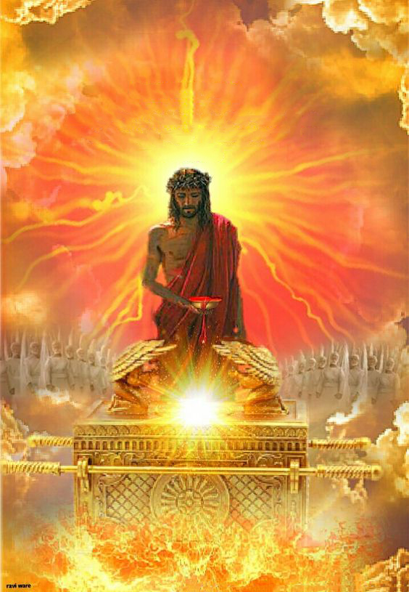
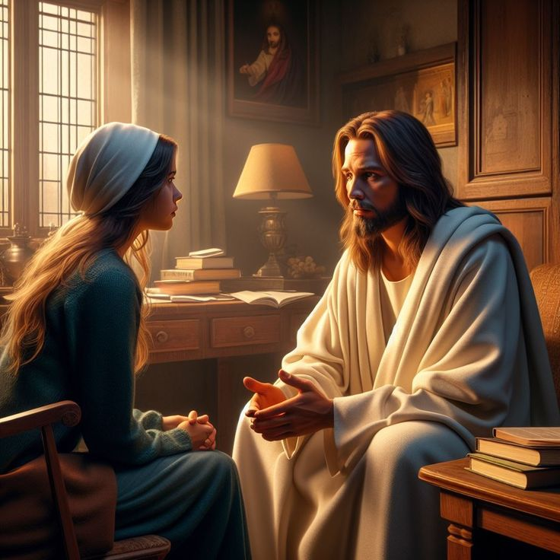
INXABANO LAMUHLA
“Ngakho-ke ulamandla okusindisa ngokupheleleyo abeza kuNkulunkulu ngaye, ngokuba uphilela njalo ukubamela” (KumaHeberu 7:25)
Lamuhla, uJesu uyasinxusela endaweni engcwele yaseZulwini (Heb. 9:24; 7:25).
Ngegazi lakhe elachithwa esiphambanweni, uJesu usethula phambi kukaBaba - laphambi kwabo bonke abakhileyo eMkhathini - njengabantu abalungileyo, abapheleleyo, abafaneleyo indawo yeZulwini.
Ngakho-ke, siyamenywa ukuba sisondele kuNkulunkulu ngokuqiniseka ngoJesu ( Heb. 4:15-16 ).
UJesu ufuna sithembele kuye ngazo zonke izidingo ezimpilweni zethu (Johane 14:13-14). Lapho okulokwesaba khona, uletha ukuthula; lapho kukhona icala, uletha intethelelo; lapho kukhona ubuthakathaka, uletha amandla.
'Isifiso sikaJesu esikhulu siyikuphila lathi phakade (NgokukaJohane 17:14). Ingabe lesi futhi yisifiso sakho esikhulu?

Slide 11

“Lapho izilingo zikuhlasela, lapho ukunakekela, ukudideka, kanye lobumnyama kubonakala kuzungeza umphefumulo wakho, bheka lapho ugcine khona ukubona ukukhanya. Phumula othandweni lukaKristu langaphansi kokunakekelwa Kwakhe okuyisivikelo. Lapho isono sitshukulezela ukubusa enhliziyweni, lapho icala licindezela umphefumulo futhi lingumthwalo unembeza, lapho ukungakholwa kugubuzele ingqondo, khumbula ukuthi umusa kaKristu wanele ukunqoba isono futhi uxotshe ubumnyama. Ngokungena ekuhlanganyeleni loMsindisi, singena endaweni yokuthula.”
EGW (The Ministry of Healing, pg. 193)

