Slide 1

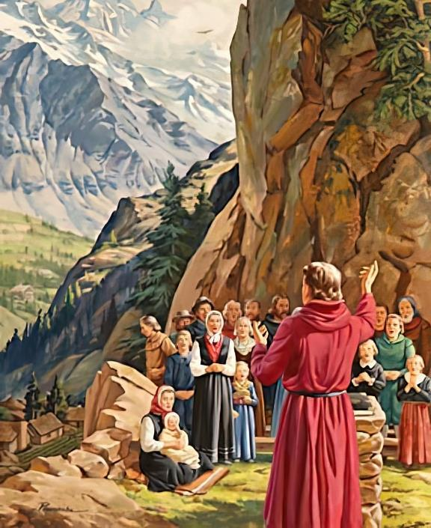
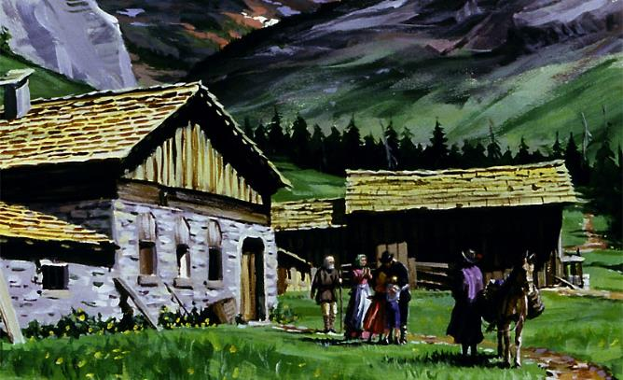
UKUMELA IQINISO
Isifundo sesine kuMabasa ilanga lamatshumi amabili lesikhombisa, 2024

Slide 2
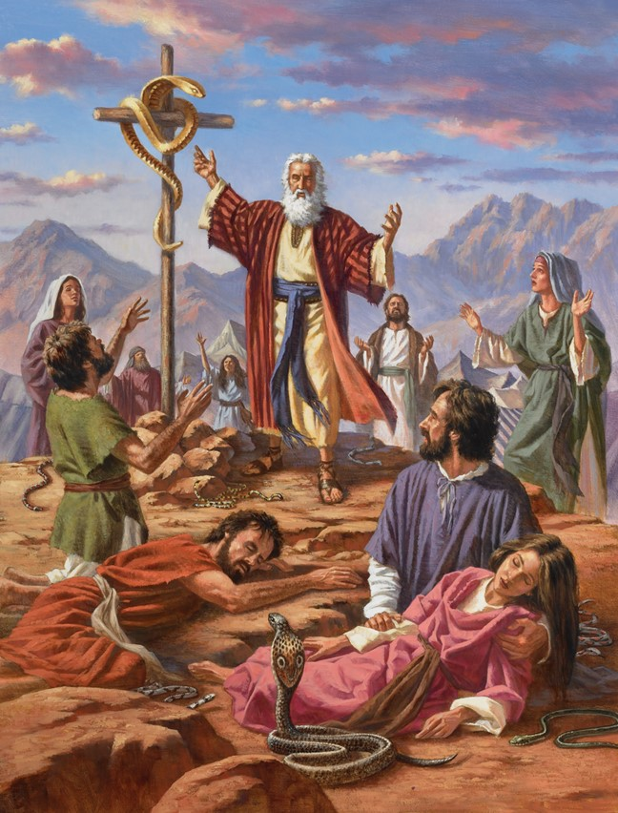
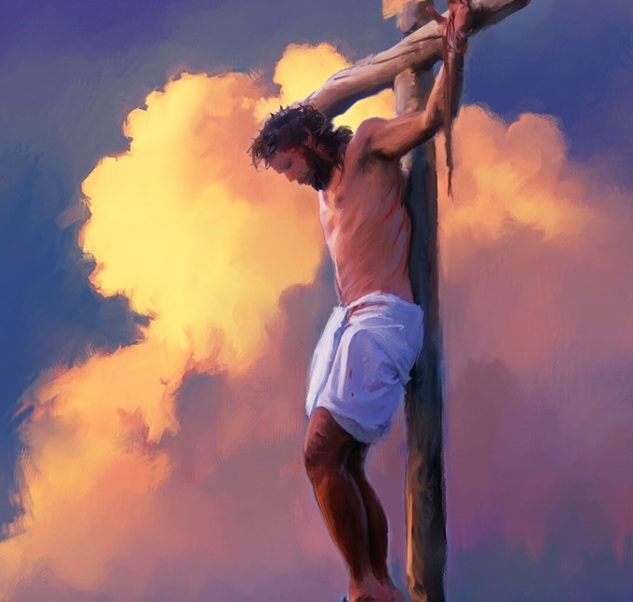
“Futhi njengoba uMose waphakamisa inyoka ehlane, kanjalo iNdodana yomuntu imelwe ukuphakanyiswa, ukuze yilowo lalowo okholwa kuyo angabhubhi, kodwa abe lokuphila okuphakade’ ” (NgokukaJohane 3:14,15).

Slide 3

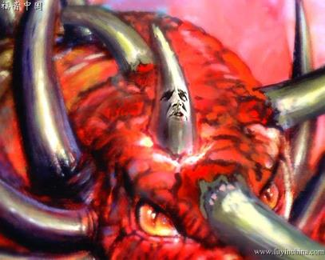
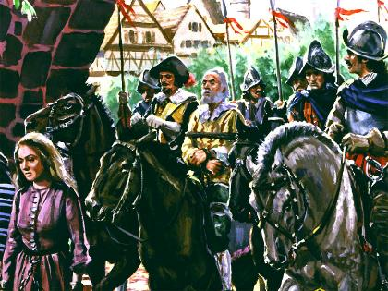
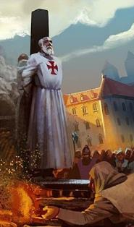


UDaniyeli lesAmbulo bamemezela isikhathi lapho uSathane ayeyosebenzisa amandla ezombusazwe lezenkolo ukuze atshutshise futhi abhubhise labo ababemi baqinile eqinisweni.
La mandla “aphosa phansi iqiniso” ( Dan. 8:12 ). Ngaleso sikhathi “Abanye kwabahlakaniphileyo bayakukhubeka, ukuze bacolisiswe, bahlanzwe, bangabi labala kuze kube sesikhathini sokugcina, ngokuba kusezakufika ngesikhathi esimisiweyo.” ( Dan. 11:35 ).
Ngalesi sikhathi - iSikhathi Yobumnyama - iqiniso lalibuzwa. Kodwa kwakukhona abantu ababevela bevikela iqiniso, futhi babezimisele ukunikela ukuphila kwabo ngenxa yalo.
Iqiniso okukhulunywa ngalo:
  Izikhathi zokuhlupheka.
  Ukwethembeka ekuphitshekeni
Ukuvikelwa liqiniso:
  Ukwabelana izwi(Ibhayibhili): The Waldenses.
  Iqhawe lenguquko: John Wycliffe.
  Baqiniswa lukholo: John Huss labanye.

Slide 4
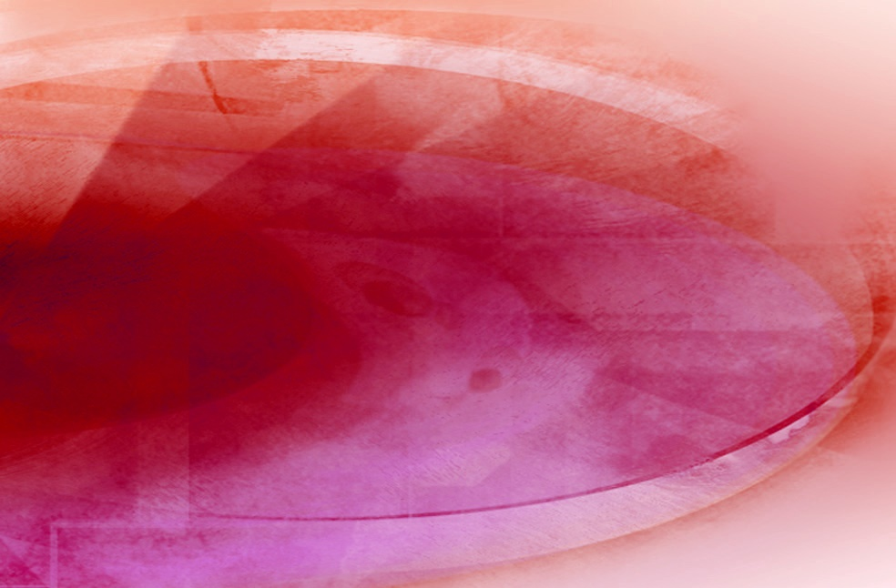
IQINISO OKUKHULUNYWA NGALO

Slide 5

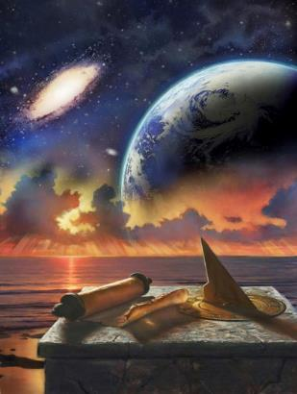
IZIKHATHI ZOKUHLUTSHWA
“Uyokhuluma ngokumelene loPhezukonke futhi acindezele abantu bakhe abangcwele futhi azame ukuguqula izikhathi ezimisiweyo lemithetho. Abantu abangcwele bayakunikelwa esandleni sayo isikhathi, lezikhathi, lenxenye yesikhathi” (Daniyeli 7:25).
Isikhathi sokuhlutshwa simenyezelwa ngezidlelai ezintathu ezahlukeneyo
“isikhathi, izikhathi, lengxenye yesikhathi” ( Dan. 7:25; 12:7; IsAm. 12:14 )
Izinsuku1,260 (Rev. 11:3; 12:6)
42 Izinyanga (Rev. 11:2; 13:5)
Igama elithi “isikhathi” lihlobene lelithi “unyaka,” kuyilapho igama elithi “izikhathi” elisetshenziswe nguDaniyeli ngokwezwi lezwi lisho “izikhathi ezimbili.”
Kokubili ezikhathini zasendulo nanamuhla, ubude benyanga obujwayelekile izinsuku ezingama-30:
42 months
30 days
1.260 days
1 umnyaka
2 iminyaka
½
umnyaka
3 ½ iminyaka
Zonke izinkulumo zibonisa isikhathi esisodwa: izinsuku eziyi-1,260.
12 izinyanga
24 izinyanga
6 izinyanga
42 izinyanga
Ngaphansi kwesimiso esithi “usuku ngomnyaka” ( Ez. 4:6; Num. 14:34 ), lenkathi yokuhlupheka ihlanganisa iminyaka engu-1 260 yembali.
42 izinyanga
30 amalanga
1.260 amalanga

Slide 6
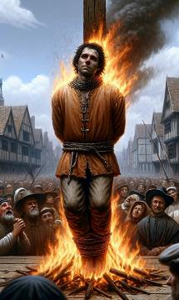
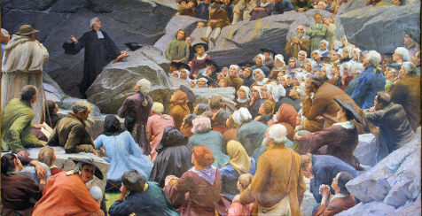
IZIKHATHI ZOKUHLUTSHWA
“Uzakhuluma ngokumelene loPhezukonke futhi acindezele abantu bakhe abangcwele futhi azame ukuguqula izikhathi ezimisiwe lemithetho. Abantu abangcwele bayakunikelwa esandleni sayo isikhathi, lezikhathi, lenxenye yesikhathi” (Daniyeli 7:25).
Yisiphi isikhathi sembali esimelwe yikuhlutshwa kweminyaka engu-1 260 okwamenyezelwa uDaniyeli lesAmbulo?
Umnyaka 538
Umnyaka 1798
IBandla lamaRoma lathola amandla ezombuso ngesikhathi izizwe ezintathu ezamukela ubu-Arian zinqotshwa: ngamaHeruli, amaVandals lamaOstrogoths.
Omkhulu webutho laseFrance uBerthier, ngaphansi kwemiyalo kaNapoleon, lathumba uPapa, aqeda ukuphakama kweBandla lamaRoma.
Lapho imibuso yezombangazwe elitshumi ivela eRoma (izizwe ezazihlasela umbuso), kwakuyovela omunye umbuso futhi ubhidlise imibuso emithathu kwelitshumi (Dn. 7:23-25).
Njengoba kwakuprofethiwe, uNkulunkulu walungiselela indawo yokusiza ibandla elithembekileyo: ihlane, okungukuthi, izindawo ezingelabantu abayingcosana (IsAm. 12:6, 14).
Ngezikhathi zobunzima lotshutshiso, amakholwa athembekileyo ama aqinile ekuvikeleni iqiniso, ephephela othandweni lasekunakekeleni kukaNkulunkulu ( IHu. 46:1-3 ).
Ngokuswelakala kwenhlanhla, abanengi kwadingeka bakhokhele ukwethembeka kwabo ngegazi labo

Slide 7



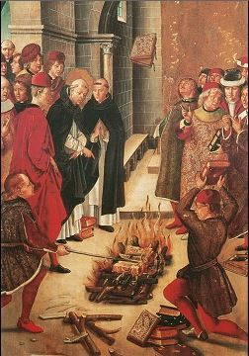
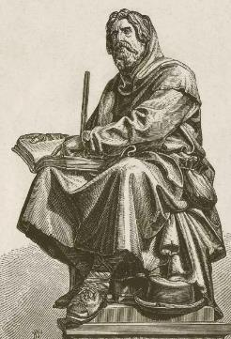
UKWETHEMBEKA EKUHLUTSHWENI
“Bathandekayo, ngenxa yesifiso esikhulu ebengilaso ukulilobela ngensindiso esisonke ngayo, bekuswelekile ukuba ngililobele, ngiliyala ukuba lilulwele ngenkuthalo ukholo olwanikelwa kwabangcwele kanye” ( Jude 1:3 )
Lapho selithole amandla ezombangazwe, ibandla LamaRoma laqala ukusebenzisa amandla alo ukuze lifune ukuba wonke umuntu enze ngokuvumelana lemithetho yalo engokwenkolo, eminengi yayo eyayiphendulelwe.
Ngaphezu kwalokhu kwakusanda inkohlakalo phakathi kwabaholi bezenkolo. Ukuze avimbele inengi ukuba luvukele igunya lakhe, wathatha kubo into eyigugu kakhulu: IZwi likaNkulunkulu
Kodwa akazangea alibhubhise ngokupheleleyo. Kwavuka abathembekileyo okwathi, beholwa yizimfundiso zeBhayibheli futhi belandela iseluleko sikaJuda, balwa ngamandla ukuze bavikele ukholo lwabo ( Jude 1:3 ).
Bekhuthazwe amandla eZwi, basakaza izimfundiso zalo ngesibindi. Beqiniswe izithembiso ezifana nesAmbulo 2:10 , bathembeka kwaze kwaba sekufeni, bazi ukuthi babeyothola umqhele wokuphila.

Slide 8

UKUVIKELWA LIQINISO

Slide 9

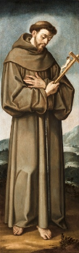
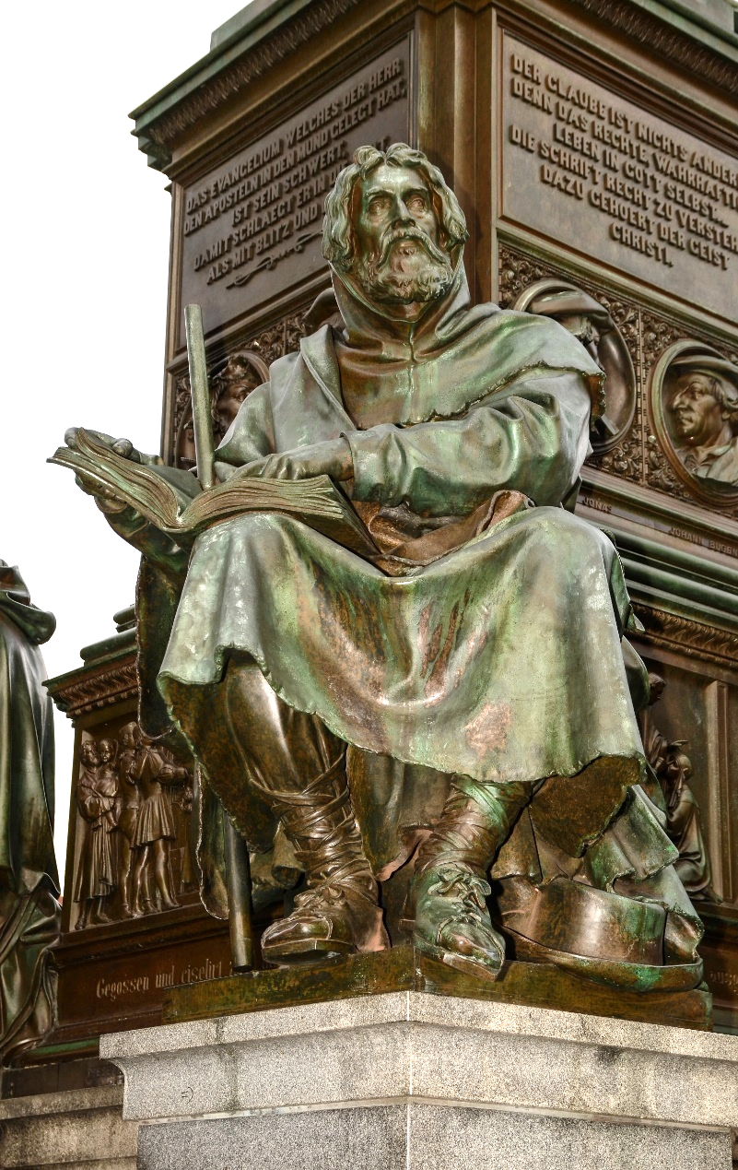
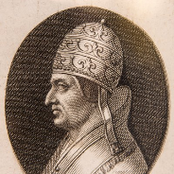
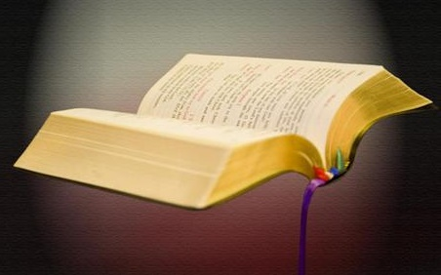
UKWABELANA IBHAYIBHILI: AMAWALDENS
“UPetru labanye abafundi baphendula: “Kumele silalele uNkulunkulu kulabantu.”— IzEnzo 5:29 .
UPeter Waldo (1140-1218), usomabhizinisi ongumFulentshi ocebile owadela ingcebo yakhe ukuze atshumayele uKristu, wasungula inhlangano “Yabampofu YaseLyon,” eyaziwa ngokuthi “amaWaldens.” UPapa Alexander III wasamukela isifungo sakhe sobumpofu.
Ngesikhatshana ngemva kwalokho, uFrancis wase-Assisi (1181-1226), laye owenza isifungo sobumpofu, esavunywa uPapa Innocent III, wasungula inhlanganiso yamaFrancisca.
Ngaleso sikhathi, uPapa Lucius III wayeselahle abalandeli bakaPeter Waldo njengabahlubuki. Lokho, amaFranciscas aba insika yeSonto LamaRoma kuyilapho amaWaldens eshushiswa kwaze kwacishe kwaqedwa. Kungani?
Ngokwethembeka kwakhe. Abokuqala babethembekile kuPapa, kanti abemuva babethembekile ezimfundisweni zeBhayibheli.

Slide 10
UKWABELANA IBHAYIBHILI: AMAWALDENS
Ayebonakala ngani amaWaldens?
Babengabokuqala ukuba leBhayibheli elitholakala ngolimi lwabo (kuze kube yileso sikhathi, lalitholakala kuphela ngesiLatini, isiGreki loba isiHebheru).
Njengoba kwakuyincwadi enqatshelweyo, bayikopitsha embalwini, becatsha kubalandeli babupapa ababebavimbezele
Ngaso sonke isikhathi babephethe ingxenye zeBhayibheli, okwakuthi ngezikhathi ezinhle babehlanganyela labanye, zibanike ithemba lesikhuthazo eNkosini.
Balondoloza amaqiniso eBhayibheli ababewazi amakhulu eminyaka. Babesaziwa ngokwethembeka lokuzinikela kwabo..
Wonke amadolobhana aguqulwa kokubili eningizimu yeFrance nasenyakatho ye-Italy, ePiedmont.
Inengi lala madolobhana lacekelwa phansi ubuPhapha, futhi izakhamuzi zakhona zabulawa.

Slide 11

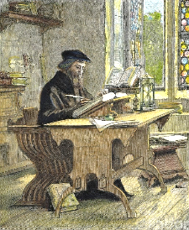
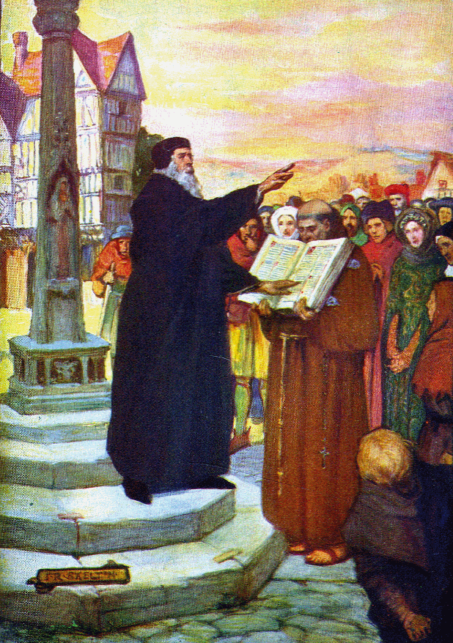
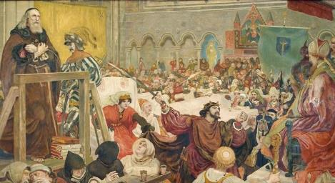
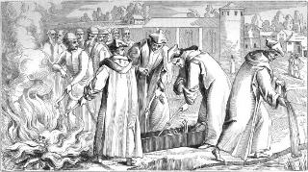
ISIBANE SENGUQUKO: JOHN WICLEF
“Indlela yabalungileyo unjengelanga lekuseni, elikhanya njalo kuze kube semini enkulu.” ( IzAga 4:18 )
UJohn Wycliffe (1324-1384) wanikela ingxenye enkulu yokuphila kwakhe ekuhumutsheni iBhayibheli ngesiNgisi. Yini eyamtshukumisela ukuba enze lokhu? Izizathu ezimbili: UKristu wayemguqule ngeZwi; futhi wayefuna ukwabelana labanye ngothando lukaKristu.
Lowo ofunda iBhayibheli ngobuqotho, futhi avule inhliziyo yakhe endoselweni kaMoya oNgcwele, uyaguqulwa (Heb. 4:12).
Yebo, lokhu kwamenza waxabana leBandla elisemthethweni. Ngenxa yokuthintana kwakhe lezikhulu eziphakemeyo eNgilandi, uJohn wakubalekela ukufa ezandleni zeBandla.
Ngo-1428 izinsalela zomtshisekeli wenguquko zatshiswa, futhi umlotha wakhe waphonswa emfuleni. Umlotha wakhe ohlakazekileyo waba luphawu lwefa lakhe.
Ukukhanya okuncane kweqiniso uJohn Wycliffe akukhanyisa kwafinyelela eBohemia, lapho uJohn Hus athatha khona ifa lakhe. Ngale ndlela, iqiniso lahamba kwaze kwaba yilapho kuqala inguquko. Usuku lwase luqala ukuhwalala.

Slide 12

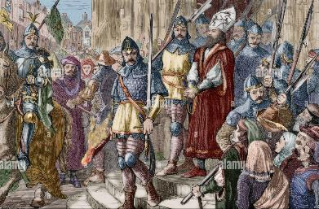
UKUQINISWA LUKHOLO:UJOHN HASS LABANYE
“OleNdodana ulokuphila; ongelayo iNdodana kaNkulunkulu akalakho ukuphila” (1 Johane 5:12).
Ngemva kukaJohn Wycliffe, kwavela abanye abatshisekeli bezinguquko
John Huss (1370-1415)
Jerome (1360-1416)
Tyndale
(1494-1536)
Hugh Latimer (1490-1555)
Kuyini okwabanika isibindi sokwenza inguquko futhi babhekana lenhlupho lokufa?
Babekholwa ezithembisweni zikaKristu
Amandla kaKristu ayenele ukuba banqobe izilingo
Bathola injabulo ngokuba lengxenye ekuhluphekeni kukaKristu
Ukwethembeka kwakhe kwakuyibufakazi obulamandla emhlabeni
Bakangela ngaphabilini, bekhangele ikusasa elikhazimulayo
Babazi ukuthi ukufa kuyisitha esinqotshiweyo
Babambelela ngokuqinileyo ezithembisweni zeZwi likaNkulunkulu
UJohn Hus wabotshwa futhi ekugcineni watshiswa esithandweni somlilo. Esejele wabhala: “Yeka indlela uNkulunkulu abe lesihe ngayo kimi, futhi yeka indlela aye wangisekela ngokumangalisa ngayo.” Njengoba nje izithembiso zikaNkulunkulu zabasekela abantu bakhe esikhathini esidlule, ziyasisekela lamuhla.

Slide 13

“Bonke labo ngalolo suku olubi ababezakhonza uNkulunkulu ngokungesabi ngokuvumelana leziyalezo zikanembeza, kumele babe lesibindi, ukuqina, lolwazi ngoNkulunkulu lezwi Lakhe; ngoba labo abaleqiniso kuNkulunkulu bazahlutshwa, izisusa zabo ziyophikwa, imizamo yabo emihle kakhulu ihunyutshwe ngokungayisikho, futhi amabizo abo akhitshwe ngokuthi mabi. USathane uzosebenza ngawo wonke amandla akhe okukhohlisa ukuze adonse inhliziyo futhi afiphaze ukuqonda. […] Lapho ukholo lwabantu bakaNkulunkulu luqina futhi lumsulwa, futhi lapho kuqina ukuzimisela kwabo ukumlalela, kulapho uSathane ezama ngamandla ukuvusela ulaka lwalabo abathi, lakuba bethi balungile, banyathele umthetho wokuphila. UNkulunkulu. Kuzodinga ukwethenjwa okuqinile, inhloso yobuqhawe kakhulu, ukubamba ngokuqinile ukholo kanye olunikezwe abangcwele."”
EGW (The Acts of the Apostles, pg. 431.1)

