Slide 1
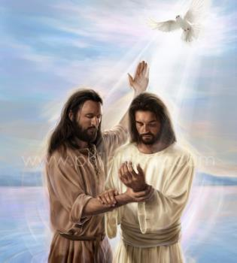
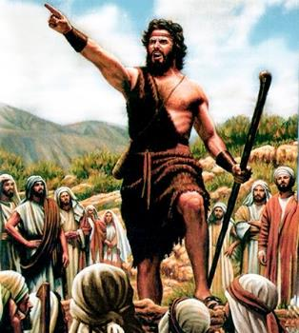
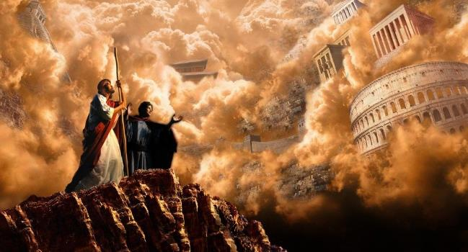
UKUQALA KWEVANGELI
Isifundo sakuqala kuNtulikazi ilangalesithupha , ku2024

Slide 2
“Ngemva kokuba uJohane esebotshiwe, uJesu waya eGalile, etshumayela indaba ezinhle zikaNkulunkulu. “Isikhathi sesifikile,” esithi. “Umbuso kaNkulunkulu ususondele. Phenduka ukholwe yizindaba ezinhle!' ” ( Marku 1:14, 15 )

Slide 3
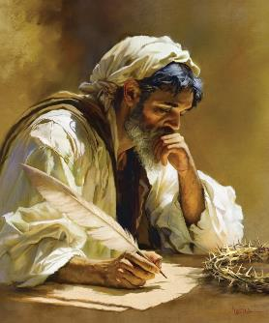
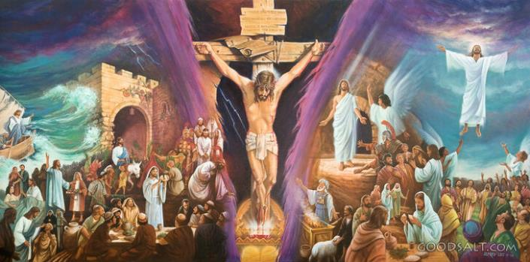
Ivangeli likaMarku lifitshane kulawo wonke amavangeli amane alandisa ngempilo kaJesu.
Yindaba ephangisayo, eguquguqukayo, ecindezelwe. Izigcawu zikhanya phambi kwamehlo ethu. Ungeke uphuthelwe loba yiziphi izicephu, njengoba kufakwe eziqakathekileyo nje kuphela.
Ngamafitshane, uMarku ulivangeli lekhulu lama-21, lapho konke kwenzeka ngokuphangisa njaloi ngokuphangisa, lapho ngoba isikhathi siyimali. Kasisebenzise leso sikhathi ukuze sifunde into eqakathekileyo kakhulu: “Ivangeli likaJesu Kristu, indodana kaNkulunkulu” (Marku 1:1).
Umlobi wevangeli:
Isithunywa sevangeli esehlulekileyo.
Ubuvangeli obulusizo.
Ukuqala kwevangeli:
Ukulungiselela. Marku 1:1-8.
Umbhapathizo. Marku 1:9-13 .
Umbiko. Marku 1:14-15 .

Slide 4
UMLOBI WEVANGELI

Slide 5
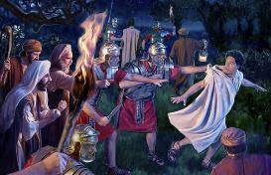
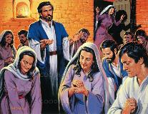
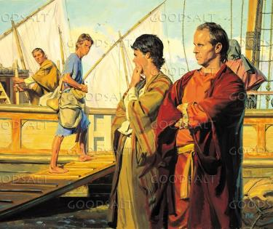
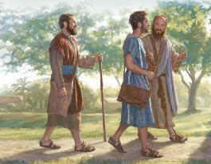
UMVANGELI OWEHLULEKILEYO
“Kwathi uBarnaba loSawulu sebeqedile uthumo lwabo, babuya eJerusalema, behamba loJohane othiwa laye uMarku” (IzEnzo 12:25)
Njengabo bonke abavangeli, uMarku akazitsho yena ngegama. Wayesengumfana lapho izenzakalo azilandisayo zenzeka, okungenzeka wafunda ngazo ngobuhlobo bakhe obuseduze lomfundi uPetru ( 1 Pet. 5:13 ).
Umama kaJohane Marku wayengumnikazi wendawo eJerusalema lapho ibandla lalihlangene khona ukuze lithandaze ngesikhathi sokubotshwa kukaPetru ( IzEnzo 12:12 ).
Masinyazana ngemva kwalokho, uBarnaba loSawulu (owayeye eJerusalema ukuyoletha umnikelo) bathatha uJohane Marku baya e-Antiyokiya ( IzEnzo 12:25 ).
E-Antiyokiya, lapho uMoya oNgcwele ubiza uBarnaba noSawulu ukuba babe izithunywa zevangeli phakathi kwabeZizwe, bathatha uJohane Marku kanye nabo njengomhlanganyeli ( IzEnzo 13:2-5 ).
Kodwa impilo yobufundisi yaba nzima kakhulu kuMarku osemutsha, owanquma ukubuyela eJerusalema ( IzEnzo 13:13 ).

Slide 6
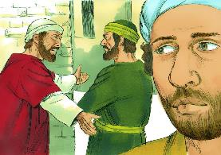
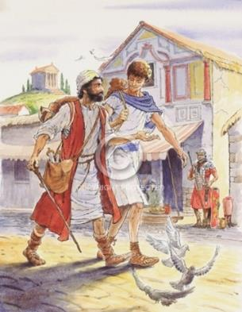
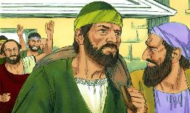
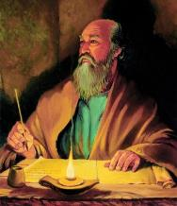
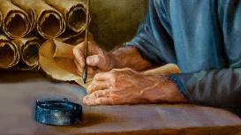
ULUSIZO EBUFUNDISINI
“NguLuka kuphela olami. Thatha uMarku uze laye, ngoba ulusizo kimi emsebenzini wobuvangeli bami.” ( 2 Thimothewu 4:11 )
Lapho uPawulu ekhomba kwabanye uhambo lwesibili lobufundisi, wala ukwamukela uMarku njengomhlanganyeli (IZenzo 15:36-38). UPawulu wayedinga abasizi abaqinileyo, ababezoba abasizi, hatshii umthwalo. UMark akazange alingane afanele okwakudingakala.
Ngakho, uBarnaba wayeleqiniso lokuthi umzukulu wakhe uMarku wayelethuba elaneleyo lokuba yisithunywa sevangeli esihle. Ngakho wathatha uMarku waya laye eKhupro, kuyilapho uPawulu loSila balibangisa e-Asiya ( IzEnzo 15:39-41 ).
Asazi ukuthi kwenzekani ngemva kwalokho, kodwa siyazi ukuthi uBarnaba wayeqinisile. Ngokubhekisela kwakhe kuye kathathu ezincwadini zakhe, uPawulu wabheka uMarku ‘njengosizo enkonzweni,’ umhlanganyeli ophumelelayo ( Kol. 4:10; Flm. 24; 2Thim. 4:11 ) Ngokulandelayo
Ngenxa yaleli thuba lesibili, lamuhla singajabulela indaba ethokozisayo yevangeli likaMarku

Slide 7
UKUQALA KWEVANGELI

Slide 8
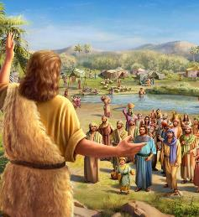
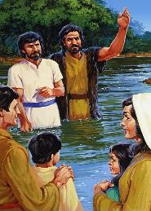
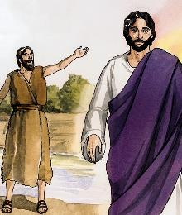
AMALUNGISELELO
Futhi lesi kwakuyisigijimi sakhe: “Emva kwami kuza lowo olamandla kulami, ontambo zamanyathela akhe angifanele ukukhothama ngithukulule” ( Marku 1:7 )“
UMarku uqala ngokusethulela kuNkulunkulu elungiselela uhambo lweNdodana yakhe ( Mk. 1:1-2; Mal. 3:1 ). Uhambo oluqala emagumeni asezulwini, futhi oluzothatha uJesu Kristu lumuse esiphambanweni, ukuze amukelwe futhi eZulwini (Marku 16:19).
Ukuze alungiselele le indlela, uNkulunkulu ukhetha uJohane uMbhapathizi, “izwi elimemeza ehlane” ( Marku 1:3; Isaya 40:3 ).
Ngaphambi kokuba uJesu aqale uhambo lwakhe lokunikela ngokuphila kwakhe ngenxa yethu, uJohane walungisa izinhliziyo zabantu ngokubaqondisa ekuphendukeni futhi ebamema ukuba babhapathizwe ( Marku 1:4-6 ).
Wabalungiselela ukwamukela indodana kaNkulunkulu: elamandla kuloJohane ngokwakhe; ofaneleyo kakhulu; lokuthi uyobhapathiza ngobhapathizo oluqinisekileyo ( Marku 1:7-8 ).

Slide 9
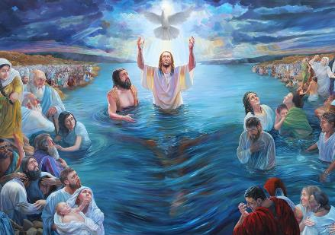
UMBHABHATHIZO
“Ngaleso sikhathi kwafika uJesu evela eNazaretha laseGalile, wabhapathizwa nguJohane eJordani” (Marku 1:9)
UJesu uqala uhambo lwakhe ngendlela emangalisayo: UNkulunkulu uBaba umethula njengeNdodana yakhe, futhi uMoya oNgcwele ubonakalisa ubukhona bakhe ngesimo somzimba (Marku 1:10-11). Kusukela ekuqaleni, uJesu uvezwa njengomuntu waphezulu, iNdodana kaNkulunkulu. Kodwa futhi uvezwa njengomuntu:
Ubhapathizwa nguJohane, hatshi ngenye indlela (Marku 1:9)
Iqondiswa nguMoya (Marku 1:12)
Kudingeka abe yedwa loNkulunkulu (Marku 1:13a))
Ulingwa ngusathane (Marku 1:13b)
UBhekana lobunzima obubonakalayo ( Marku 1:13c )
Izingilosi ziyamkhonza (Marku 1:13d)
)
Le yindlela uJesu wethulwa ngayo kithi: unguNkulunkulu ngokugcwele futhi ungumuntu ngokugcwele. UnguMsindisi loMfowethu, iNkosi leSibonelo. Kuyisambulo esigcwele sothando lukaNkulunkulu esintwini.

Slide 10
“Inkazimulo eyahlala kuKristu iyisifungo sothando lukaNkulunkulu ngathi. Lisitshela ngamandla omthandazo: ukuthi izwi lomuntu lingafinyelela kanjani endlebeni kaNkulunkulu futhi izicelo zethu zingathola ukwamukelwa emagumeni asezulwini... Ukukhanya okuthululwa eminyango evuliwe ngaphezu kwekhanda loMsindisi wethu wathululelwa kithi lapho sithandazela usizo lokumelana lesilingo. Izwi elakhuluma loJesu lithi kuyo yonke imiphefumulo ekholwayo: “Lo uyiNdodana yami ethandekayo, engithoza ngayo.”
EGW (In the Heavenly Places - God Has Chosen Me, January 20)

Slide 11
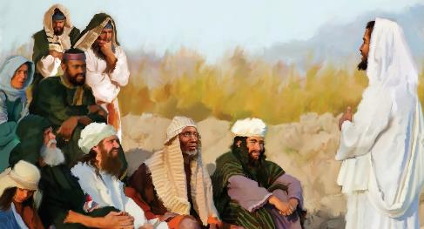
70 amaviki = 490 iminyaka
UMBIKO
7amaviki
62 amaviki
½ yeviki
½ yeviki
49 iminyaka
434 years
7 iminyaka
“Ngemva kokubotshwa kukaJohane, uJesu weza eGalile etshumayela ivangeli lombuso kaNkulunkulu” (Marku 1:14)
'Isigijimi sikaJesu sokuqala sasihlanganisa izici ezintathu ( Marku 1:15 )
“Umbuso kaNkulunkulu ususondele”
“Phendukani likholwe evangelini””
"Isikhathi sesifikile""
Ukubhekiseni esiprofethweni samaviki angu-70 (Dan. 9:24).
Kusukela esimisweni sika-Aritahishashita, ngonyaka wama-457 ngaphambi kokuzalwa kukaKristu, kuze kufike ekugcotshweni kukaMesiya, kwakuzadlula amaviki angu-69 (v. 25).
Lokhu kwagcwaliseka ekubhapathizweni kukaJesu, AD 27. Ingxenye yeviki kamuva, AD 31, uJesu wafa (v. 27).
Isithembiso sokuthi isivumelwano sensindiso sase siqala ukugcwaliseka.
Ubizo lokuhlanganyela obonakalayo esivumelwaneni, ngokwamukela intethelelo ngokukholwa kuJesu.
Isigijimi sethu salamhlanje sihlanganisa lalezi zici ezintathu: Isikhathi sesigcwalisekile; UJesu uyeza; futhi kufanele siphenduke futhi sikholwe ukuze sikwazi ukuhamba Laye.

Slide 12
“Umthwalo wokutshumayela kukaKristu wawusithi, “Isikhathi sigcwalisekile, umbuso kaNkulunkulu ususondele; phendukani, likholwe ivangeli.” Ngakho-ke umbiko wevangeli, njengoba unikezwe uMsindisi ngokwakhe, wawusekelwe eziprofethweni. “Isikhathi” asimemezela ukuthi sigcwalisekile kwakuyisikhathi eyamazisa uDaniyeli ingelosi uGabriyeli...
Njengoba umbiko wokufika kukaKristu kokuqala wamemezela umbuso womusa Wakhe, kunjalo lesigijimi sokuza Kwakhe kwesibili simemezela umbuso wenkazimulo yaKhe. Futhi umbiko wesibili, njengowokuqala, umiswe eziprofethweni."
EGW (The Desire of Ages, pg. 233, 234)

