Slide 1
USUKU EBUFUNDISINI BUKAJESU
Isifundo sesibili ilanga letshumi lantathu kuNtulikazi 2024

Slide 2
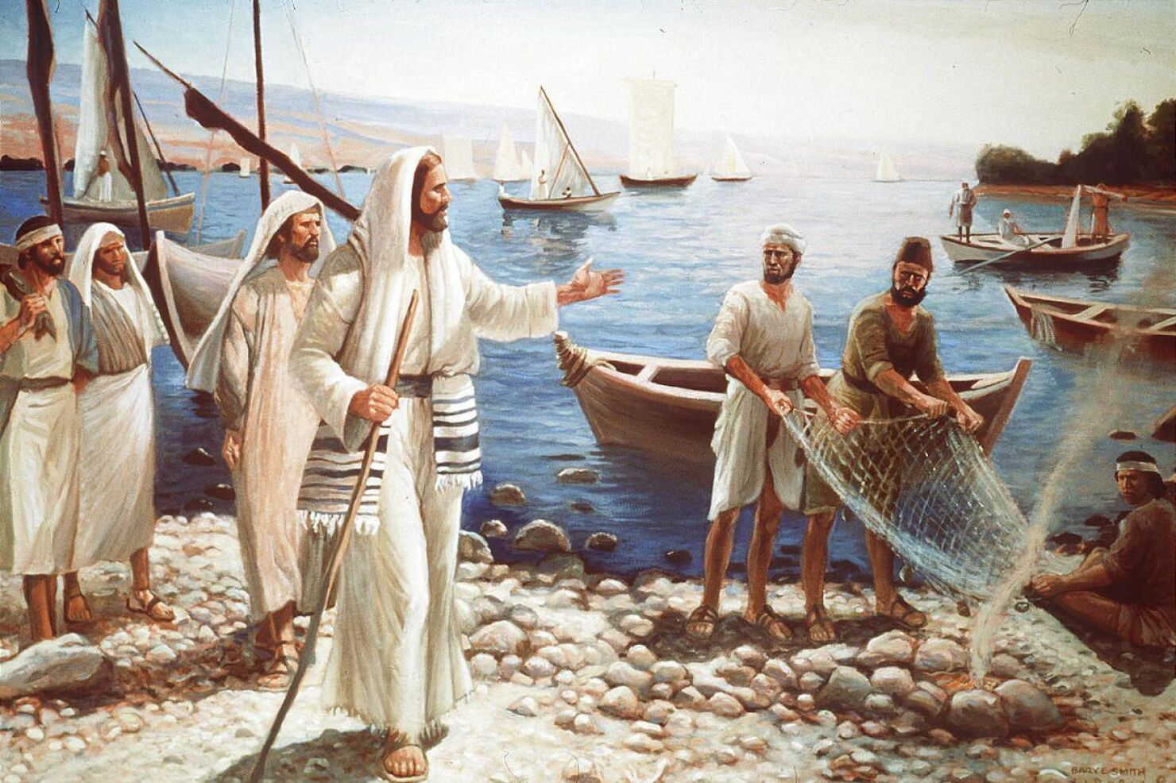
“Wozani, ngilandeleni,” kutsho uJesu, “ngizakulenza ukuba libe ngabagoli babantu’” ( Marku 1:17 )

Slide 3
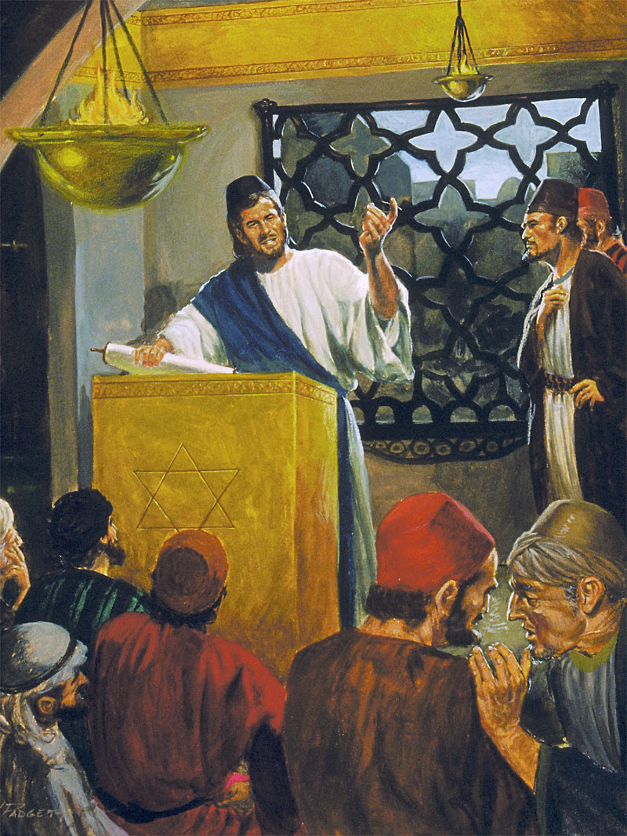
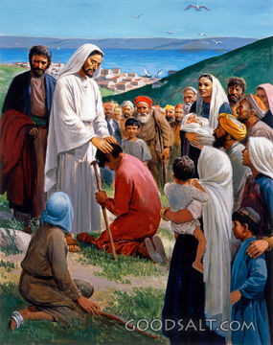
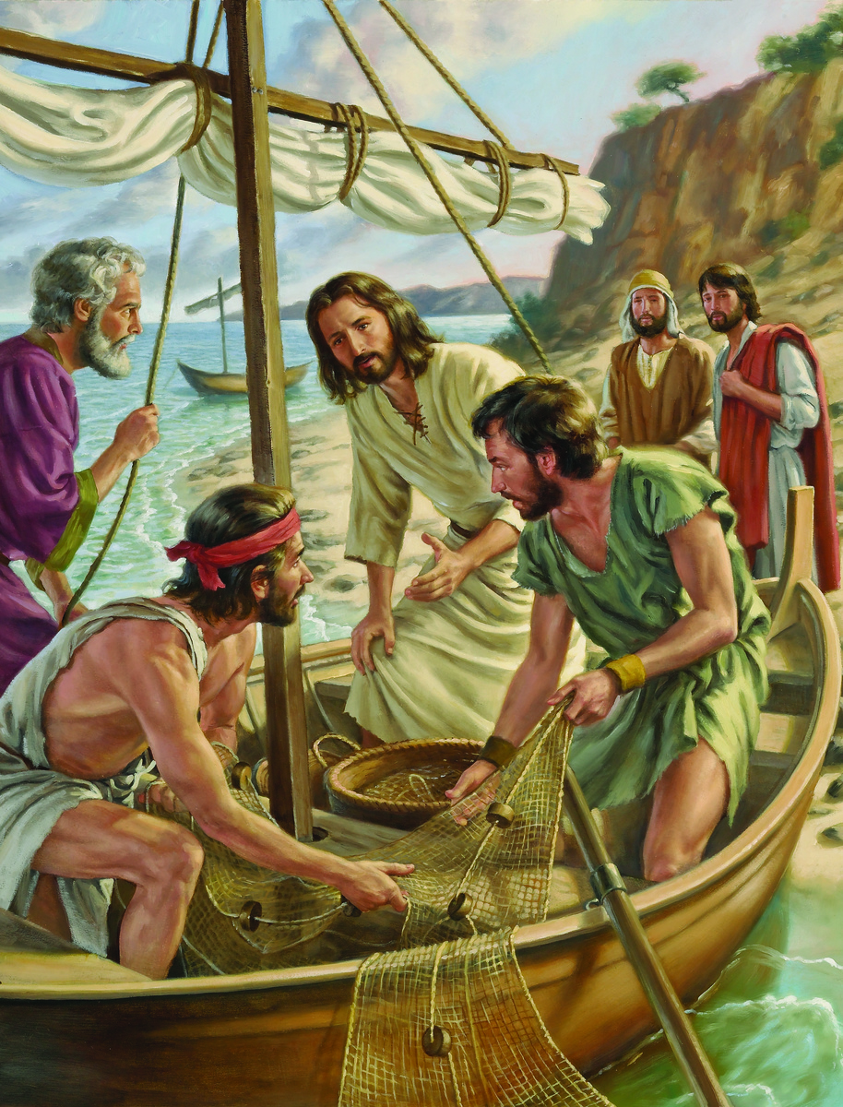
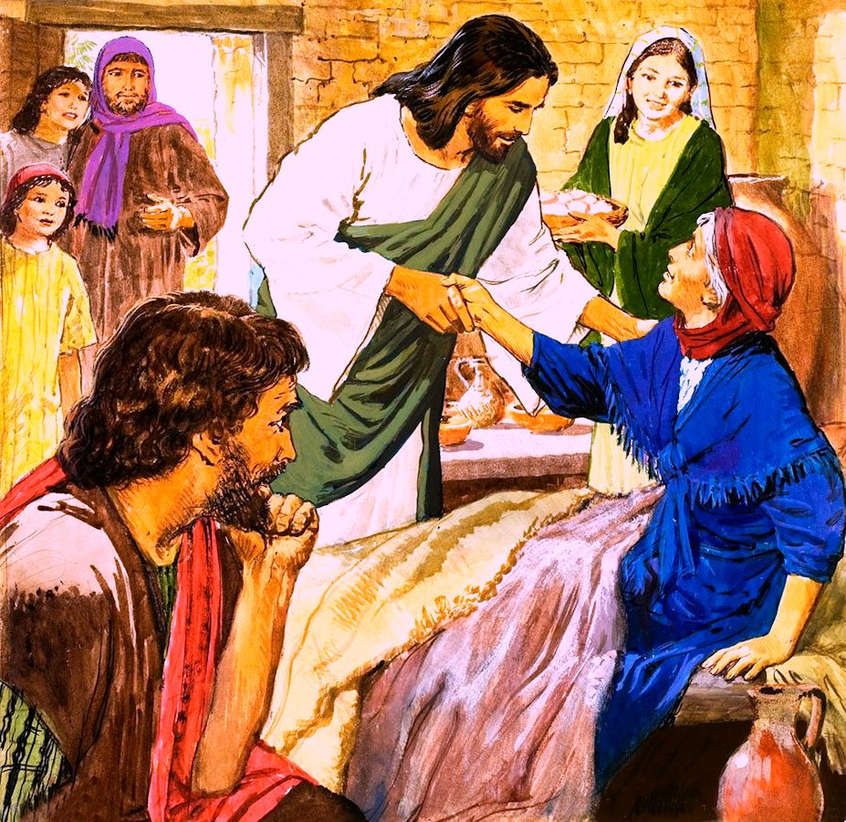
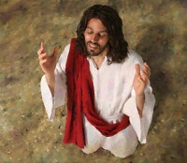
Lungaba njani usuku sisempilweni kaJesu? Kanjani aluba singahamba laye iviki lonke?
UMarku usisiza ukuba siphile leyi nkambo engxenyeni yokugcina yesahluko sakhe sokuqala (Marku 1:16-45).
Sizahamba loJesu ngokubiza iqembu labagoli ukuba limlandele isikhathi esigcweleyo; ukujabulela usuku lweSabatha oluphathekileyo; futhi, ekucineni, sizabona ukuthi yayiyini imikhuba yabo yansuku zonke.
Imisebenzi ekhethekileyo:
Biza abafundi. Marku 1:16-20.
Imisebenzi ngeSabatha:
Tshumayela ethempelini. Marku 1:21-28 .
Silisa. Marku 1:29-34 .
Imisebenzi yansuku zonke:
Khuleka utshumayele. Marku 1:35-39 .
Silisa futhi uhloniphe uMthetho. Marku 1:40-45 .

Slide 4
IMISEBENZI EKHETHEKILEYO

Slide 5
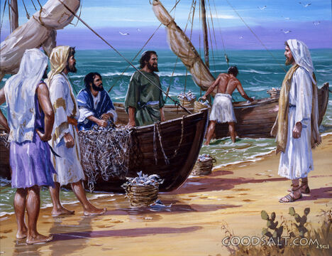
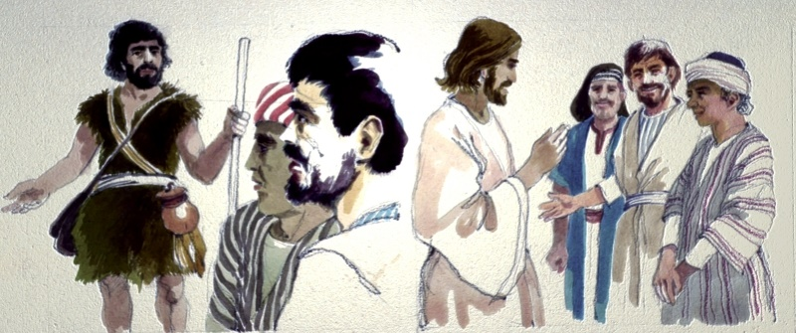
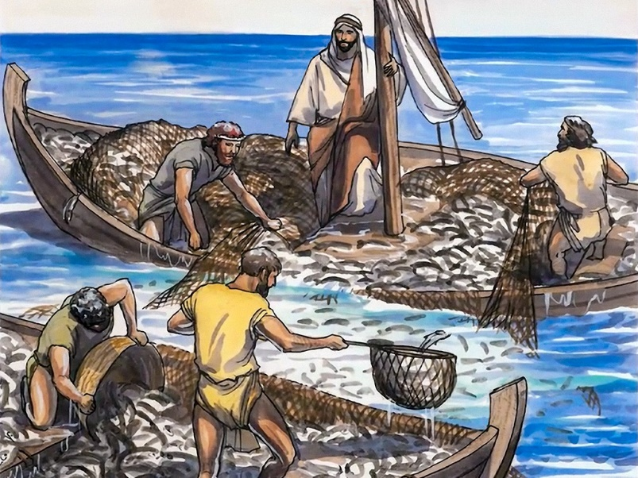
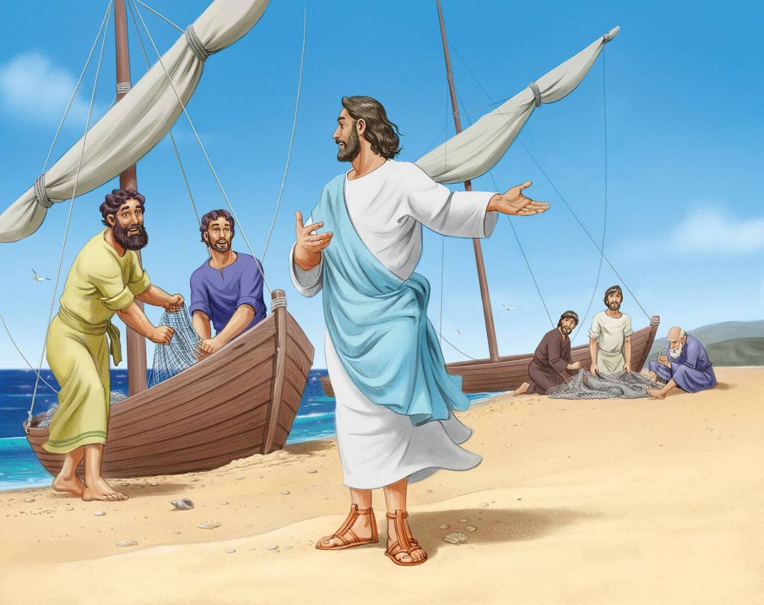
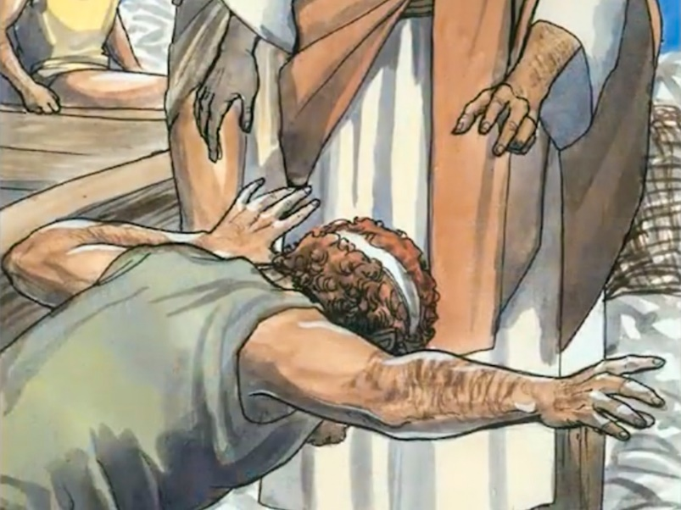
BIZA ABAFUNDI
“UJesu wathi kubo: “Wozani, ngilandeleni, ngizakulenza libe ngabagoli babantu.” ( Marku 1:17 )
UMarku ubonakala ngobufitshane bakhe. Uma singabhekanga amanye amavangeli, singafinyelela iziphetho eziyiphutha mayelana lalolu bizo.
Babengaqali la madoda ukubona uJesu. Njengabalandeli bakaJohane uMbhapathizi, babezwile amazwi akhe ngoJesu, bamlandela. Abokuqala ukwenza kanjalo kwakungu-Andreya loJohane, balandelwa abafowabo abahlukene ( Johane 1:35-42 ).
UJesu utshumayela esikepeni sikaPetru, ngemva kwalokho kwabanjwa izinhlanzi ngokuyisimangaliso. amanethi abazalwane abane acitshe adabuka ngenxa yobunengi bezinhlanzi ( Luka 5:1-7 ). Lapho uJakobe loJohane belungisa amanethi, uPetru uwela ezinyaweni zikaJesu ( Luka 5:8-11 ).
UJacob loJuan batshiya uyise ephethe ibhizimisi lomndeni, futhi uPeter no-Andrew batshiya indlela yabo yokuziphilisa ukuze bazuze imiphefumulo. Ngokulalela ubizo lukaJesu, baguqula izimpilo zabo, kanye lezimpilo zomhlaba wonke.

Slide 6
IMISEBENZI NGESABATHA

Slide 7
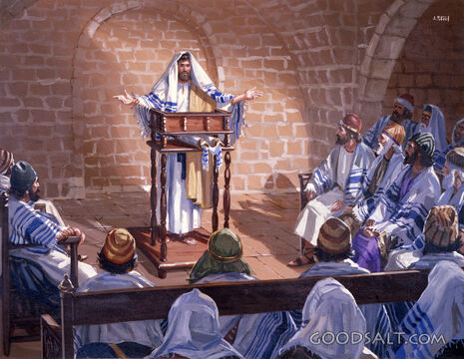
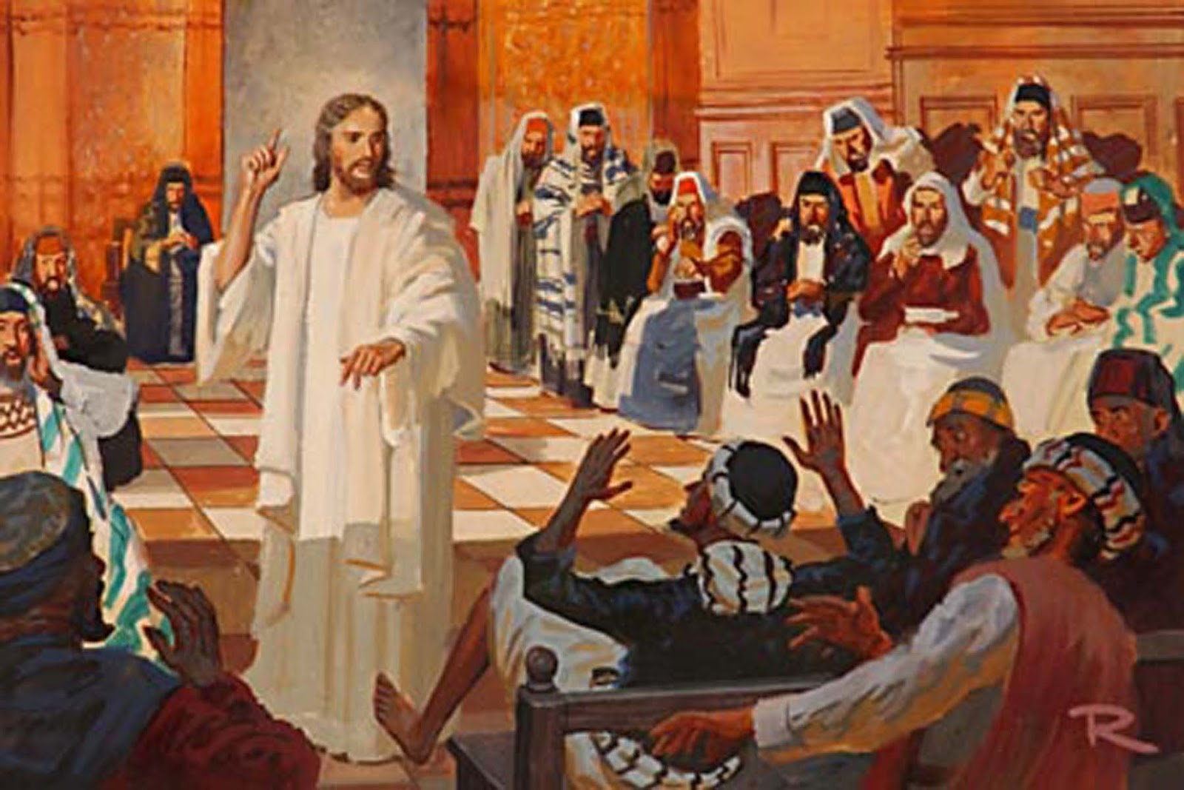
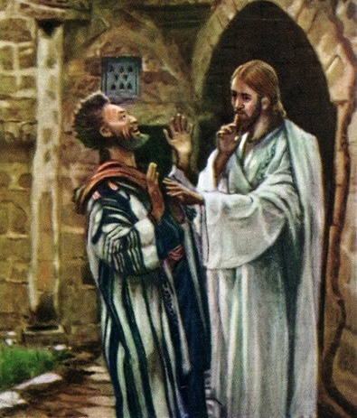
TSHUMAYELA ETHEMPELINI
“Baya eKapernawume, kwathi sekufikile isabatha, uJesu wangena etemelini, waqala ukufundisa” (Marku 1:21).
Ivangeli likwenza kucace ukuthi ukuya thempelini ngeSabatha kwakungumkhuba kaJesu, hatshi isenzakalo esingavamile (Luka 4:16).
Abantu basabela kanjani ekutshumayela kukaJesu? ( Marku 1:22 )
Kodwa akusibo bonke ababejabulile. Isitha sanquma ukuphazamisa inkonzo, silethemba lokuqeda amandla kaJesu (Marku 1:23-26). Ukungenela ngokuphangisa kwenza abantu bandonselwe kakhulu Kuye (Marku 1:27-28).
Amaqiniso amathathu apumileyo kule indaba.
Kwakukhona idimoni enkonzweni. Kukhona “ukhula” ebandleni, futhi asikwazi ukuluhlukanisa (Mt. 13:24-30).
Idemoni lalisazi ukuthi uJesu ungubani, futhi lafuna indlela yokuqeda amandla aKhe.
UJesu wamtshela ukuba athule. Kwakungakabi isikhathi sokuziveza obala ukuthi unguMesiya

Slide 8
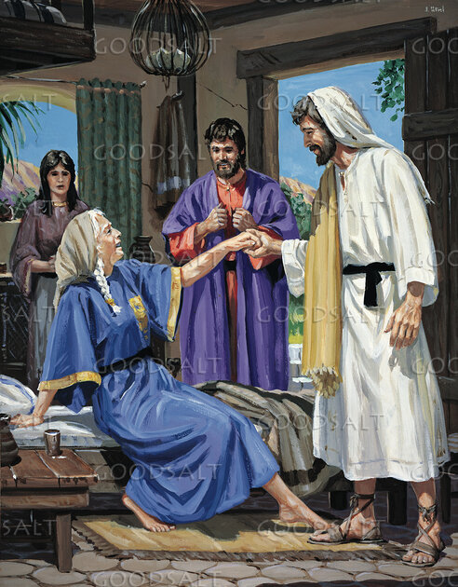
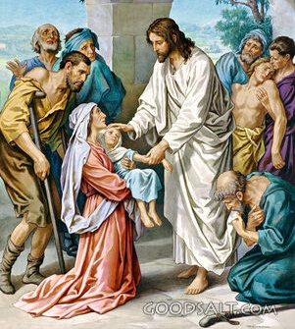
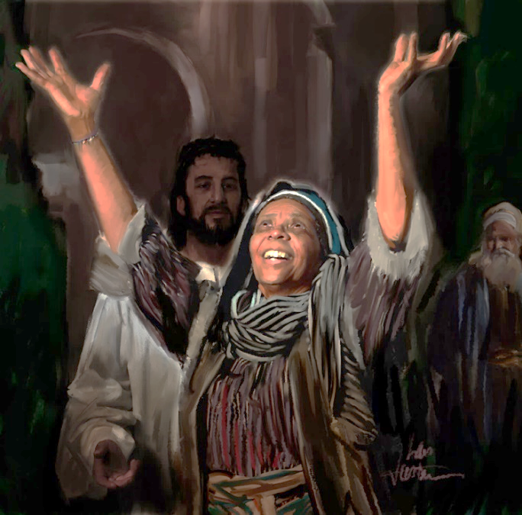
SILISA
“Kwathi sekuhlwile, selitshonile ilanga, baletha kuye bonke ababelezifo labahlaselwe ngamademoni” ( Marku 1:32 )
Ekupheleni kwenkonzo etempelini, uJesu wathatha isikhathi sokuphumula labafundi bakhe abane baya endlini kaPetru ukuze bathokoze besidla (Marku 1:29).
Bathi belungisa itafula, batshela uJesu ngoninazala kaPetru owayephethwe ngumkhuhlane (Marku 1:30). Kuthe esesilile, lo wesifazane wazinikela ekukhonzeni izivakatshi (Marku 1:31). Izinzuzo uJesu asinika zona zivusa kithi isifiso sokuzihlanganyela labanye.
Isimangaliso sokukhwelwa yidemoni sasiyingxoxo emizini eminengi eKapernawume. Ngakho, ekupheleni kwamahora angcwele eSabatha, lapho ilanga selitshonile, baletha abagulayo abanengi kuJesu ukuze basiliswe ( Marku 1: 32-34 ).
Yeka injabulo! Yeka ukukhala kokudumisa okwakuzwakala endlini kaSimoni! Futhi akukhona nje ukudunyiswa okusilisweni, uJesu ngokwakhe wakujabulela ukubalethela ukusila.
Ngemva kosuku olukhathalisayo, sekuse busuku kakhulu, ekugcineni uJesu waphumula.

Slide 9
IMISEBENZI YANSUKUZONKE

Slide 10
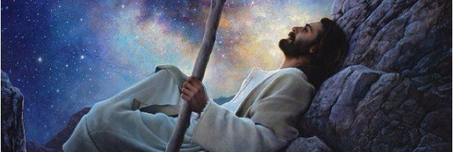
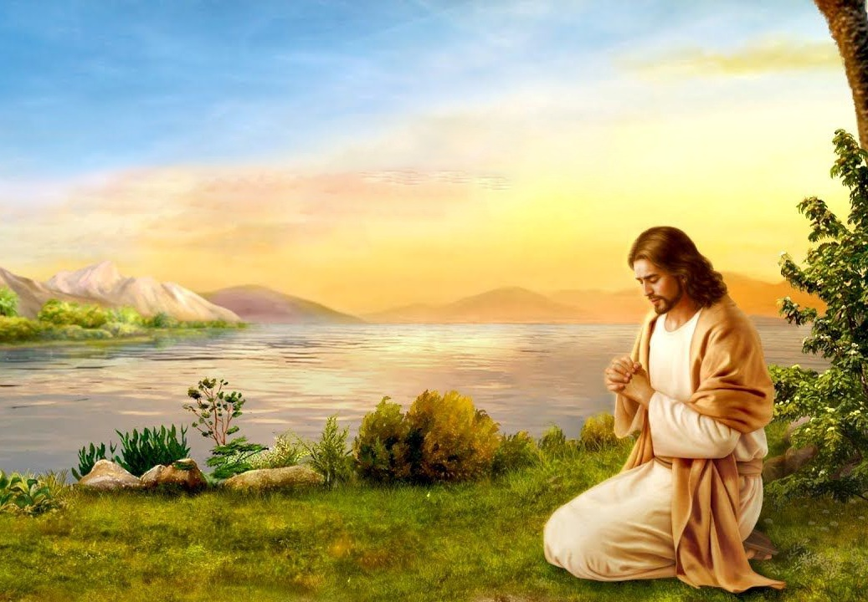
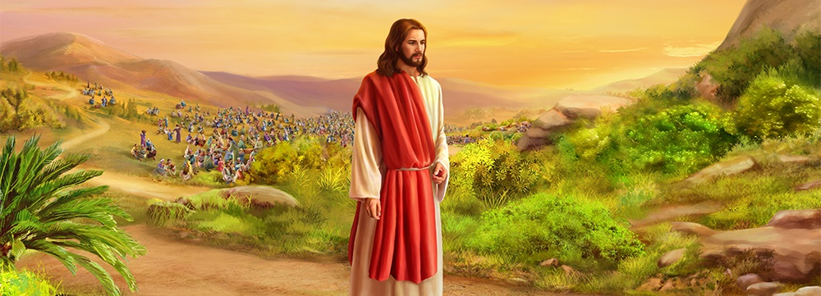
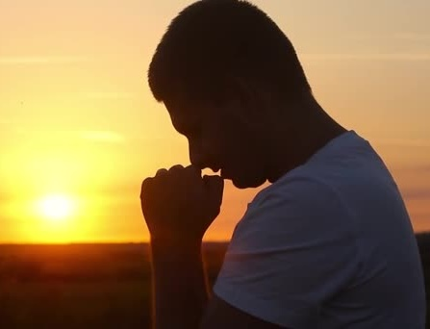
KHULEKA UTSHUMAYELE
“Ekuseni kakhulu, kusesemnyama, uJesu wavuka, waphuma endlini, waya ehlane, wakhuleka khona.”— Marku 1:35;
NgeSonto, abafundi babelindele uJesu ukuba atshumayele edolobheni. Kodwa izinhlelo zikaJesu zazihlukile. Kwakufanele azuze abaningi ngamazwi langezenzo zakhe ( Marku 1:36-39 ).
Kodwa uJesu wayengenzi ngokuthanda kwakhe. Njengenjwayelo, wayeqala akhulume loYise ukuze amtshele lokho okwakumele akwenze ngalolo suku ( Marku 1:35; Joh. 8:28 ).
Nsuku zonke uJesu wayevame ukukhuluma loNkulunkulu ngomthandazo, futhi usimema ukuba simlingise ( Marku 6:46; Luka 3:21; 5:16; 9:18; 11:1; 18:1 ). Ezimweni ezikhethekileyo, waze wanikela ubusuku bonke emthandazweni ( Luka 6:12-13; Mt. 14:21-23 ).
Akufanelanga yini, njengoJesu, sifune uNkulunkulu nsuku zonke ngomthandazo ukuze sazi intando yakhe? Ezimweni ezikhethekileyo, ngeke yini simfune ngokukhethekileyo ngomthandazo?

Slide 11
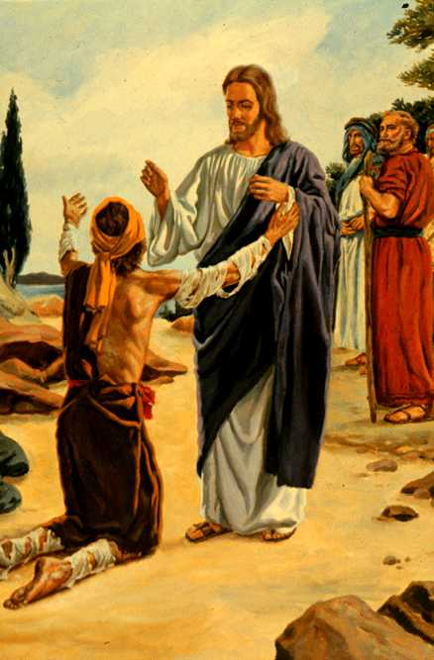
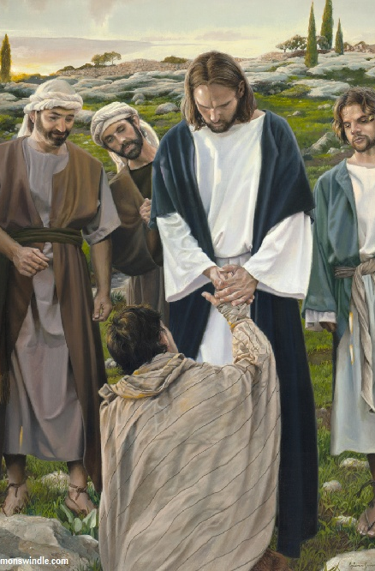
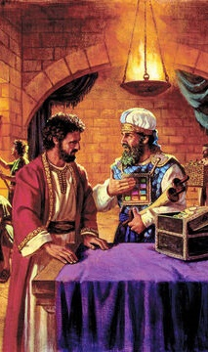
SILISA FUTHI UHLONIPHE UMTHETHO
“Bona ukuthi lento awuyitsheli muntu. Kodwa hamba uziveze kumphristi, unikele imihlatshelo uMozisi alaya ngayo yokuhlanjululwa kwakho, kube yibufakazi kubo. ( Marku 1:44 )
Umuntu olamalepelo, wehlukanisiwe labantu ngenxa yokugula kwakhe, waguqa phambi kukaJesu ecela ukusiliswa (Lev. 13:45; Marku 1:40).
Phambi kwesixuku, uJesu wenza okwakungasikho okusemthethweni: uthinta olamalepelo futhi ngenxa yalokho uba ngongcolileyo. Kodwa, esikhundleni sokuthola ukungcola lamalepelo, olamalepelo wathola ukusiliswa nguJesu.
Njengoba siza kuJesu lezono zethu lokungcola, ngeke asuke kithi. Uzasinika intethelelo lokusiliswa, asenze sihlanzeke njengaye.
Ngemva kokusiliswa, wanikeza imiyalo emibili ngezinjongo ezimbili ( Marku 1:44 ):
Zibonakalise kubapristi
Wabonisa inhlonipho ngomthetho
Wapha abapristi ithuba lokumamukela njengoMesiya.
Ukuze athule
Wavimbela abapristi ekubeni bathintane lomuntu olamalepelo
Wavikela ukuvusa ithemba lobuMesiya exukwini

Slide 12
“Impilo yoMsindisi emhlabeni yayingelula. Kodwa akazange adinwe ukusebenzela ukusindisa abantu abalahlekile. Waphila impilo engelabugovu kusukela ekuzalweni Kwakhe kwaze kwaba sekufeni Kwakhe. Akazange azame ukukhululeka emsebenzini onzima lohambo olukhathazayo. Wathi iNdodana yomuntu “ayizanga ukuzokhonzwa, kodwa ukukhonza lokunikela ngokuphila kwayo ukuba ihlenge abaningi.” Mathewu 20:28 . Lena kwakuyinhloso enkulu yempilo Yakhe. Konke okunye kwakungabalulekile kangako. Ukwenza intando kaNkulunkulu lokuqeda umsebenzi Wakhe kwakunjengokudla lesiphuzo Kuye. Kwakungekho ukuzicabangela mina emsebenzini Wakhe."
EGW (Steps to Christ, pg. 77)

