Slide 1
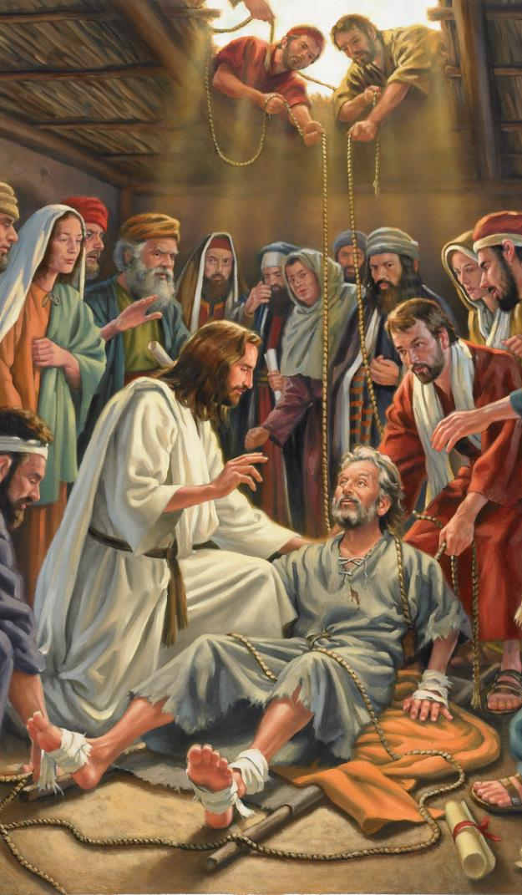
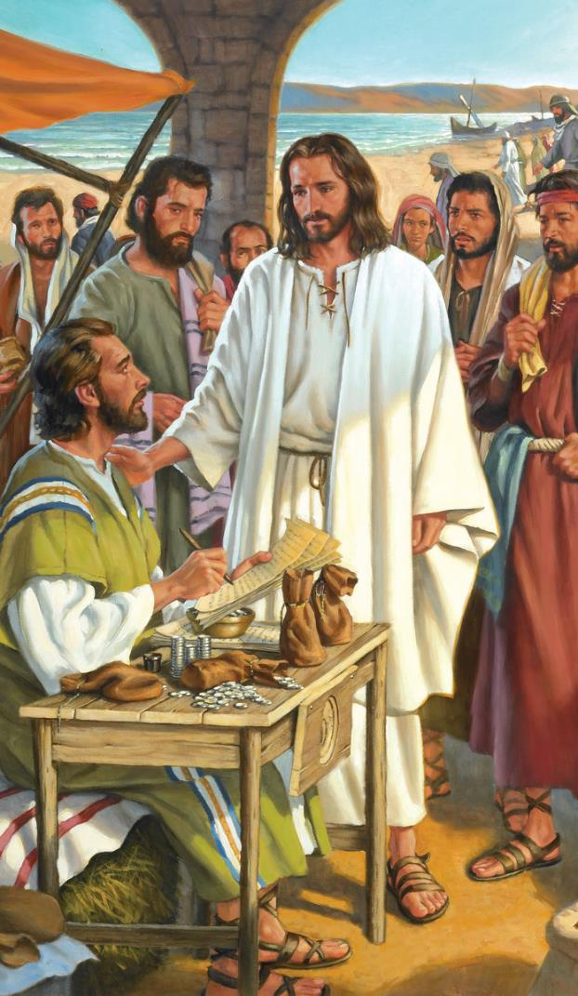
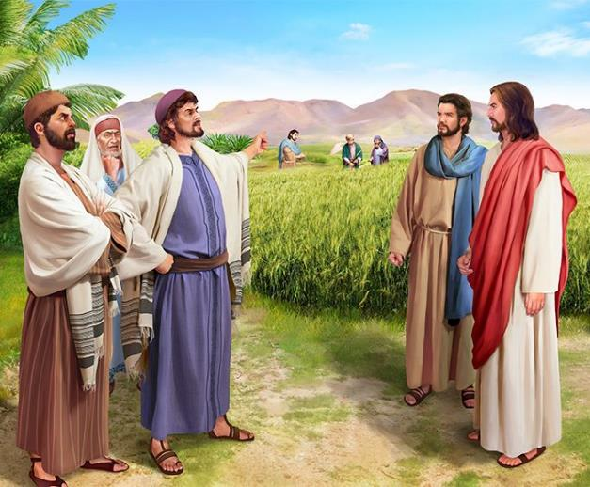
IMPIKISANO
Isifundo sesithathu kuNtulikazi ilanga lamatshumi amabili, 2024

Slide 2
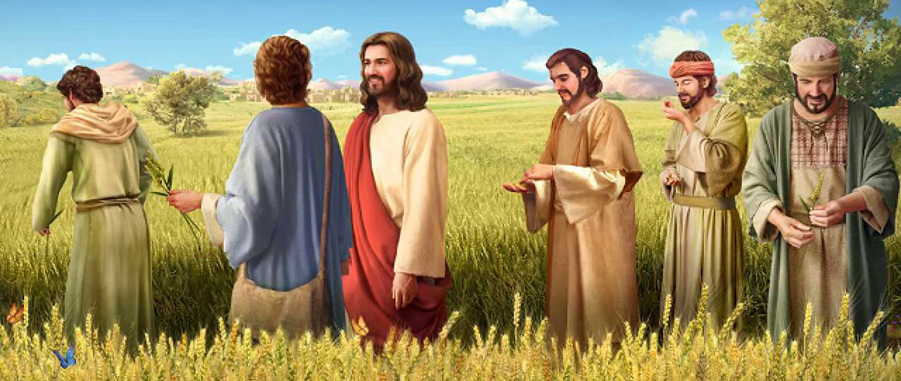
“Wathi kibo: “Isabatha lenzelwa umuntu, umuntu kenzelwanga isabatha. Ngakho-ke iNdodana yomuntu iyiNkosi yesabatha” (Marku 2:27, 28)

Slide 3
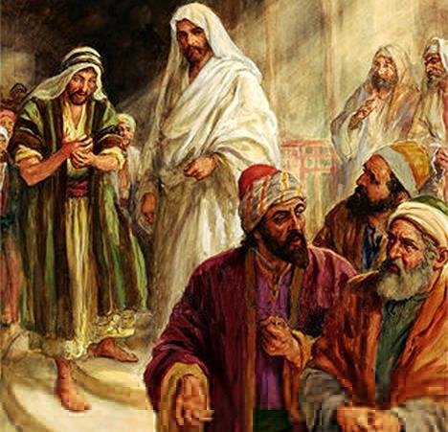
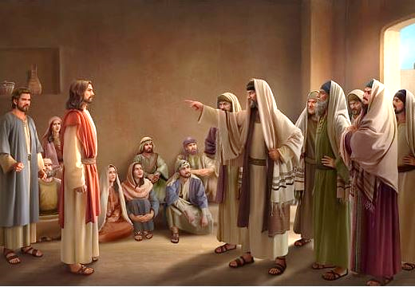
Ukuziphatha kukaJesu, yindlela yakhe yokutshumayela, ngitsho lokusilisa kwakhe, kwaphikisana lamasiko eziphathamandla zenkolo.
Basebemthatha njengohlambazayo; isihwaba lomngane wezoni; Oweqa umthetho weSabatha... Baze bamsola ngokuthi usebenzela uBelzebule!
Izihlobo zakhe zakholwa ukuthi uJesu wayelahlekelwe ingqondo ngenxa yokusebenza kakhulu.
Kungelakuthandabuza, ukuphila kukaJesu kwakuyikuphila okunempikiswano.
Ingxabano ngokuxolelana. Marku 2:1-12 .
Ingxabano yokudla. Marku 2:13-22 .
Ingxabano ngeSabatha. Marku 2:23-3:6 .
Imibuzo eyimpikiswano ngoJesu:
Ngamandla kabani ayenza ngawo izimangaliso? Marku 3:22-30
Ingabe uJesu uyahlanya? Marku 3:20-21, 31-35 .

Slide 4
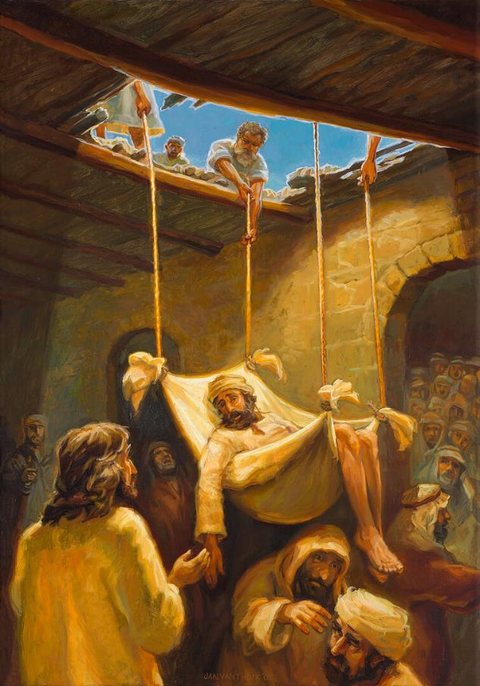
IMPIKISANO NGOKUXOLELANA
“UJesu ebona ukukholwa kwabo wathi kofe uhlangothi: “Ndodana, uthethelelwe izono zakho.” (Marku 2:5)
Kuthe uJesu esebuyela endlini kaPetru eKapernawume, abantu abanengi beza bazomlalela ( Marku 2:1-2 ). Abangane abane beza ukuze uJesu asilise umngane wabo owayefe uhlangothi, kodwa abakwazanga ukusondela kuye. Bezimisele ukumletha kuJesu, bakhwela ephahleni bavula imbobo ukuze bamehlise. Inkulumo kaJesu yaphazamiseka, wonke umuntu wathula, elindele ukubona ukuthi uJesu uzokwenzani (Marku 2:3-4).
“Izono zakho zithethelelwe” (Marku 2:5). Ofe uhlangothi wayengase athi: “Engikudingayo ukuhamba.” Kodwa akazange akwenze. UJesu welapha umsuka wokugula kwakhe. Wayengelandaba yingabe ezahamba futhi, kodwa wayelendaba lentethelelo eyayinikeza ukuthula emphefumulweni wakhe.
Kubabhali, lokhu kwakuyikuhlambalaza (kuliqiniso, ukube uJesu wayengeyena uNkulunkulu). Ukuze abonise ukuthi wayelamandla okuthethelela, uJesu welapha owayefe uhlangothi (Marku 2:8-11).
Abantu badumisa uNkulunkulu ngokunika uJesu amandla okuthethelela izono ( Marku 2:12; Mt. 9:8 ). Ofe uhlangothi wahamba; kodwa ababhali basala beyizimpumputhe, bengakwazi ukubona ukuthi uJesu wayekwazi ukufunda izingqondo zabo, athethelele isoni, futhi asinike ukusiliswa.

Slide 5
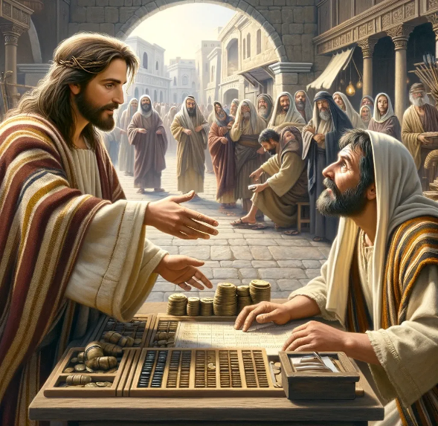
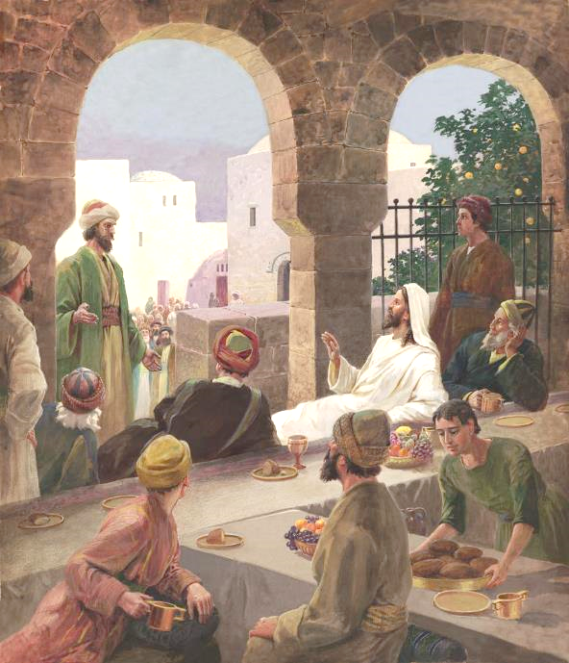
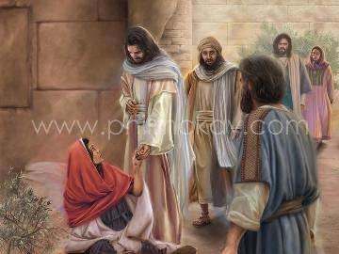
INXABANO NGOKUDLA
“Esahamba wabona uLevi indodana ka-Alfewu ihlezi endaweni yokuthela. “Ngilandele,” uJesu wamtshela, loLevi wasukuma wamlandela” (Marku 2:14).
Akunzima ukucabanga ngempikiswano ubizo lukaLevi olwayivusayo ( Marku 2:13-14 ). KumJuda wokholo, umthelisi wayemubi kuloweZizwe. WayengumJuda ongumhlamuki, othengiswe ezitheni zakhe. Babengelakudla laye loba bamthinte.
Kodwa izinto zaba zimbi kakhulu. UJesu akadlanga endlini yomthelisi kuphela, wazungeza abaningi abafana laye. ( Marku 2:15 ) Abasoli abazange bachithe leli thuba: “Kuyini lokhu, ukuthi udla futhi uphuze labathelisi lezoni?” ( Marku 2:16 )
UJesu wabaphikisa ngokulengqondo: kuphi okungcono kulalapha lapho engingathola khona izoni ukuze ngisindise? ( Marku 2:17 ). Ngaphezu kwalokho, wababekela inselele ukuba bahlole eyabo imizwa. Kwakumele bafunde ukuthanda ( Mat. 9:12-13 ).

Slide 6
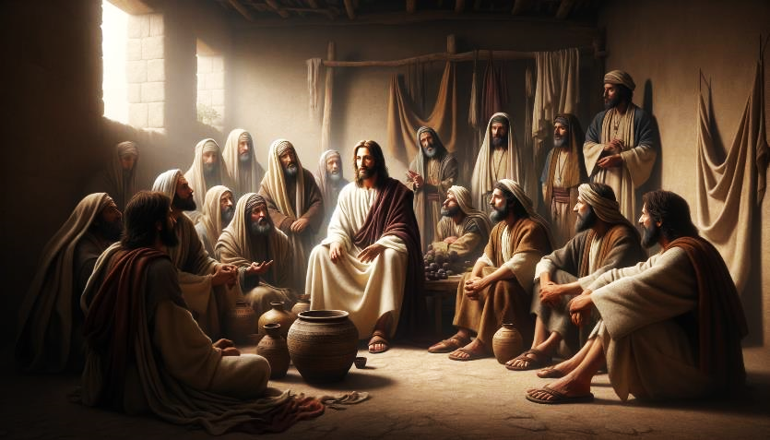
INXABANO NGOKUDLA (2)
“UJesu waphendula wathi: “Abayeni bomyeni bangazila kanjani ukudla, yena eseselabo? Bangeke, inqobo nje uma belaye” (Marku 2:19).
Kulokuba bafunde ukuthanda, abaFarisi batshitshisa abafundi bakaJohane ukuba bahlanganyele ekusoleni kwabo: “Kwenzeka kanjani ukuthi abafundi bakaJohane labafundi babaFarisi bazilile, kodwa abenu abazili na?” ( Marku 2:18 )
Umfanekiso womtshado (Marku 2:19-20).
Umuntu angazila kanjani lapho esemtshadweni? Umkhwenyana nguJesu; abamenyiweyo abafundi. Lapho uJesu esifa futhi evuswa, abafundi bakhe kwakuyodingeka bazile ukudla.
Umfanekiso omutsha lomdala (Marku 2:21-22).
Izimfundiso zikaJesu eziphilayo zazingelandawo ezimfundisweni ezifileyo zesiko; futhi ngokuphambene.
Impendulo kaJesu yeza ngemifanekiso:

Slide 7
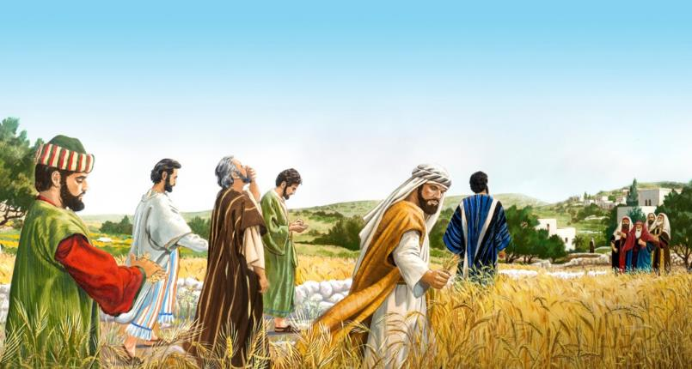
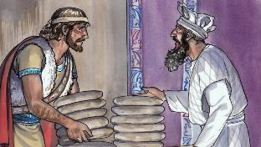
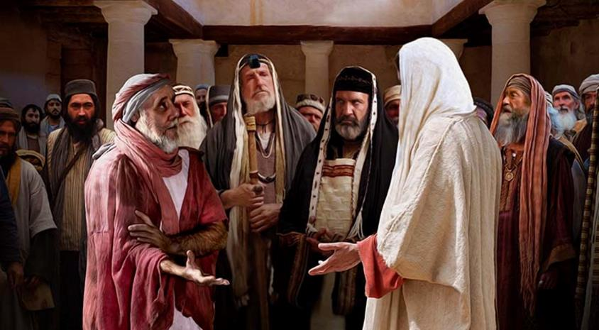
INXABANO NGESABATHA
“AbaFarisi bathi kuye: “Bheka, benzani okungavunyelwa ngesabatha na?” ( Marku 2:24 )
AbaFarisi bafundisa izinhlobo ezingama-39 zomsebenzi oweqa ukuphumula kweSabatha okumiswe nguNkulunkulu
Ngokuthatha okusanhlamvu lokukhipha izikhwebu ukuze badle, abafundi benza imisebenzi emithathu eyenqatshelwe ngeSabatha: ukuvuna; ukubhula; futhi lokwela. ( Mk. 2:23-24; Mat. 12:1-2 ).
Impendulo kaJesu: Awukhumbuli yini ukuthi uDavide, wathi eselambile, wadla isinkwa esingcwele, esasidliwa ngabapristi wodwa? ( Marku 2:25-26 )
Ngemva kwalokho, uJesu wenza “umsebenzi” ongahlanganiswanga kwabangama-39, kodwa owawubhekwa njengokweqa iSabatha: ukusilisa ( Marku 3:1-3 ).
UJesu waphendula: “Yikuphi okungokomthetho ngesabatha: ukwenza okuhle loba ukwenza okubi, ukusindisa ukuphila loba ukubulala na?” ( Marku 3:4 )
Ekugcineni, uJesu uyiNkosi yeSabatha, futhi wasinika lona ngokuhle(Marku 2:27-28).
Kuyamangalisa ukuthi abagcini beSabatha abatshisekayo bakha icebo lokubulala (Marku 3:6).

Slide 8
IMIBUZO EYIMPIKISWANO NGOJESU

Slide 9
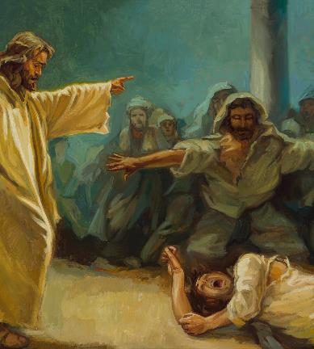
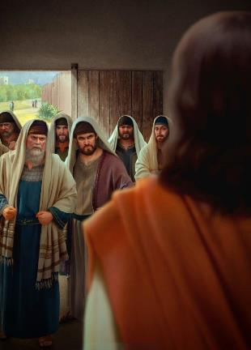
NGAMANDLA KABANI EYENZA NGAWO IZIMANGALISO
“Labafundisi bomthetho abeza bevela eJerusalema bathi: “UloBelzebule! ngenkosi yamademoni, ukhipha amademoni” (Marku 3:22)
UMarku uqala indaba ephathelene lomndeni kaJesu, kodwa uyayiphazamisa ukuze axoxele impikiswano ephakathi kwabaFarisi. Kamuva, uzobuyela endabeni yakuqala. Leli indlela isetshenziswa uMakho ezikhathini ezinengana ukuze ahlanganise izindaba ezimbili ezifananayo, egxilise emaphakathi njengebaluleke kakhulu.
Umndeni kaJesu uyamfuna
Makhu 3:20-21
Ukumangalelwa ngabaFarisi
Marku 3:22-30
Kulokhu, indaba ebalulekile ukusola kwababhali ukuthi kwakungamandla angakanani avumela uJesu ukukhipha amademoni (Marku 3:22).
Umndeni kaJesu uyamdinga'
Marku 3:31-35
Futhi, uJesu usebenzisa umfanekiso ukuze abonise ubuwula bezinsolo abekwa zona (Marku 3:23-27). UJesu ungena endlini yendoda elamandla (uSathane), ayibophe, futhi kanjalo angaphanga impahla yayo (akhulule idemoni).
Kuthatha ithuba lokuxwayisa ngengozi yokuthi umsebenzi kaMoya oNgcwele usuka kudeveli ( Marku 3:28-30 ).

Slide 10
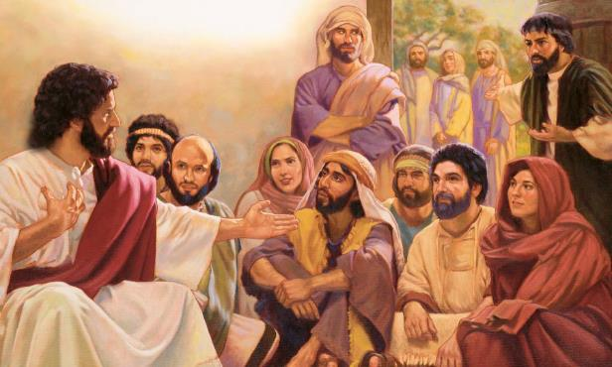
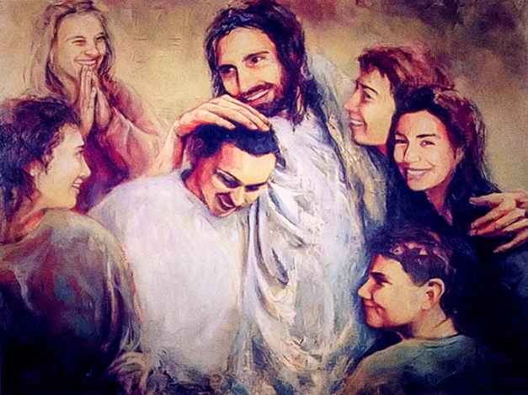
UJESU NGA UPHAMBENE NA?
“Kwathi abakubo bekuzwa lokho, baya ukuyombamba, ngokuba bathi, “Uphambene” (Marku 3:21, NKJV).
Yini eyenza umndeni kaJesu ucabange ukuthi uphambene ( Marku 3:20-21 )?
Ukusebenza kakhulu, ukudla okungakhimzimba, ukudangala ngenxa yezingxoxo zakhe ezaziqhubeka labafundi labaFarisi...
Ngemva komutsho omfishane, uMarku uqhubeka nga lendaba, ethula izihlobo ezazifuna uJesu: unina labafowabo (Marku 3:31).
Yeka ukuswelakala kokunakekela ngokucabangelwa ngumdeni wakibo ngohlangothi lukaJesu! ( Marku 3:32-33 )
Kodwa ukubonakala kuyakhohlisa. Unina labafowabo babelephutha. Ukutshiya umsebenzi wabo ukuze babanakekele ngaleso sikhathi kwakulimaza umsebenzi wakhe kanye lakubo ngokwabo.
Okubaluleke kakhulu kulobudlelwano benyama izibopho ezihlanganisa uJesu lomndeni wakhe ongokomoya: “Lowo owenza intando kaNkulunkulu ungumfowethu lodadewethu lomame” (Marku 3:35).

Slide 11
“Umoya wokutshutshisa ngeke uvuke labo abangahlanganyelanga loNkulunkulu, futhi abangelawo amandla okuziphatha. Liyovuselwa abathembekileyo, abangavumelani lezwe futhi abangeke badukiswe yimibono yalo, umusa walo, loba ukuphikiswa kwalo. Inkolo isipha ubufakazi obuphilayo obuvumelana lobungcwele, futhi esola ukuzidla, ubugovu, ubuhwaba, kanye lezono zodumo kulezinsuku, iyozondwa yizwe kanye lamaKristu angabonakaliyo.... Kuthe ubhekana lokuhlanjalazwa lokutshutshiswa uphakathi kwabantu abahle kakhulu. ; ngoba uJesu wakubekezelela konke, lokunye okunengi. Aluba lingabalindi abathembekileyo bakaNkulunkulu, lezi zinto ziyikuncoma kini. Yimiphefumulo yobuqhawe, ezoba liqiniso nxa izimela yodwa, izothola umqhele engabhubhiyo."
EGW (The Medical Ministry, pg. 282)

