Slide 1
IMIFANEKISO
Isifundo sesine kuNtulikazi ilangalamatshumi amabili lesikhombisa , 2024

Slide 2
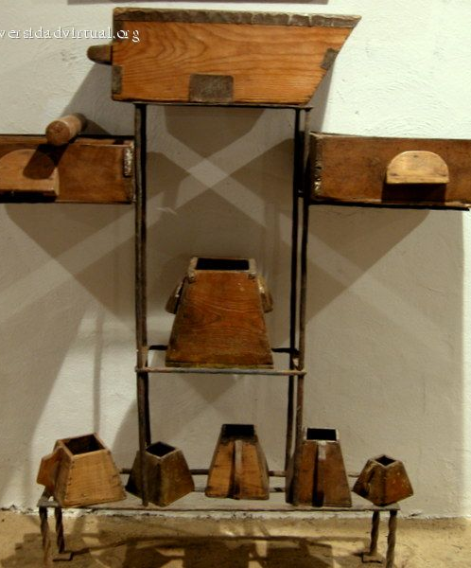
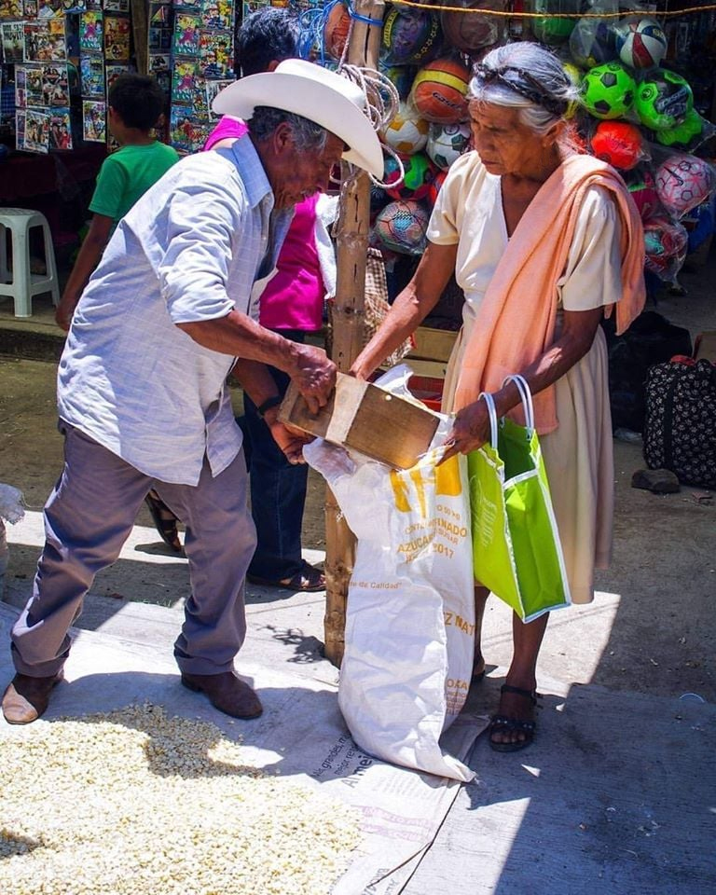
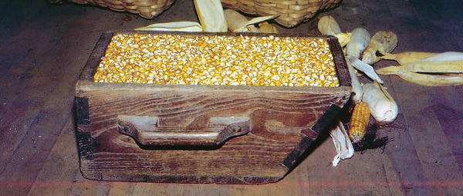
“Khona wathi kubo: ‘Kuqapheleni elikuzwayo. Ngesilinganiso elilinganisa ngaso lani liyakulinganiselwa ngaso; lani elizwayo lizaphiwa. Ngoba lowo olakho, uyophiwa okwengeziwe; kodwa lowo ongelakho, ngitsho lalokho alakho kuyathathwa.” ( Marku 4:24, 25

Slide 3
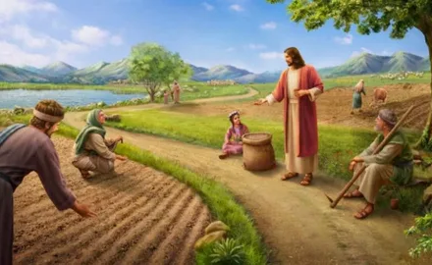
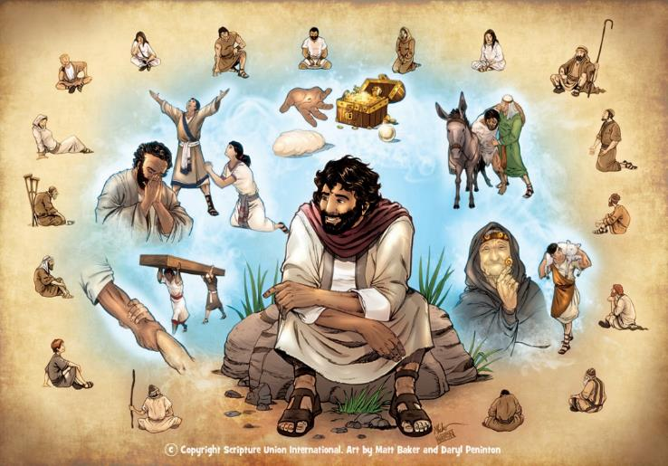
Umfanekiso yikulandisa kwesenzakalo esibunjiweyo (okusekelwe yisenzakalo loba kungekhona ezehlakalweni zangempela) lapho iqiniso elibalulekileyo loba imfundiso yokuziphatha itholakala ngokuqhathanisa loba ukufanana.
Lolu luhlelo uJesu ayelusebenzisa ngokuyinhloko ezimfundisweni zakhe (Marku 4:34). Imifanekiso yakhe ikakhulu yayithethwe ekuphileni kwansuku zonke, ngakho-ke, kulula ukuyikhumbula lokuyisebenzisa.
Kwakusithi izilaleli zakhe zibuyela ekhaya, zazixoxela imhuli zazo labangane ngalokho ebezikufunda.
The Isizathu sokuba khona kwemifanekiso. Marku 4:10-12
Umfanekiso womhlanyeli:
Umhlanyeli waphuma ukuyahlanyela… Marku 4:1-9.
Incazelo yomfanekiso daba. Marku 4:13-20.
Eminye imifanekiso:
Isibani lesilinganiso. Marku 4:21-25.
Ukukhula lemastadi. Marku 4:26-32.

Slide 4
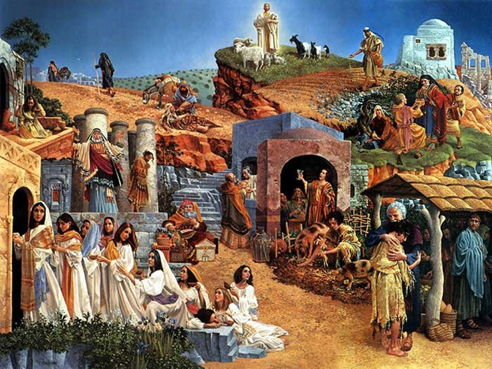
ISIZATHU SOBUKHONA BEMIFANEKISO
“banga hlala bebona kodwa bengabonisisi, futhi bezwe kodwa bangazwisisi; kungenjalo bangaphenduka bathethelelwe!” ( Marku 4:12 )
Ukutshumayela kukaJesu kwakugxile eMbusweni weZulu (Marku 1:14-15 ). Imizekeliso yakhe eminengi yakhulunywa ukuba ichaze uhlobo loMbuso lowo (Marku 4:30).
Kuyathakazelisa ukuthi isizathu esabekwa nguJesu ngokwakhe sokusebenzisa imifanekiso siyamangalisa ngempela: kenzeke baqonde, loba baguqulwe, loba bathethelelwe! (Marku 4:12 )
Lokhu kwakungasiyo into entsha. Uthe emtshela ukuba atshumayele, uNkulunkulu watshela u-Isaya: “Yizwani kahle, lingaqondi; bhekani impela, kepha lingaqondi. […] funa abone ngamehlo akhe, ezwe ngezindlebe zakhe, loba aqonde ngenhliziyo yakhe, loba aphenduke, futhi kube khona ukusiliiswa kuye” (Isaya 6:9-10).
Olambele iZwi likaNkulunkulu uzakuzwa iqiniso futhi ajabule. Kodwa labo abangafuni ukuzwa, kungakhathalekile ukuthi leli qiniso livezwa kalula kangakanani, bayokwala ukuqonda, ukuguquka, lokuzuza insindiso.

Slide 5
UMFANEKISO WOMHLANYELI

Slide 6
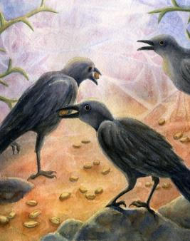
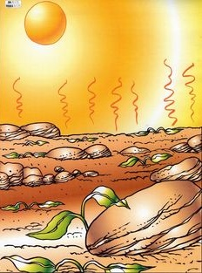
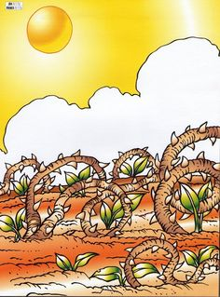
UMHLANYELI WAPHUMA WAYAHLANYELA...
“Wabafundisa izinto ezinengi ngemifanekiso, lasekufundiseni kwakhe wathi: “Lalelani! Umlimi waphuma ukuyahlanyela ihlanyelo yakhe.”—Marku 4:2-3.
Endleleni
Ezinsukwini ezimbalwa, inhlanyelo iyafa ( Marku 4:4 )
Phakathi kwamatshe
Emavikini ambalwa, inhlanyelo iyafa ( Marku 4:5-6 )
Phakathi kwameva
Ezinyangeni ezimbalwa, inhlanyelo iyafa ( Marku 4:7 )
Emhlabeni omuhle
Ekupheleni kwesikhathi, inhlanyelo ithela izithelo (Marku 4:8)
TheUmhlanyeli lenhlanyelo akuhlukani. Ngakhoke, umphumela wehlukile ngokupheleleyo endaweni ngayinye kwezine. Konke kweyame endleleni inhlanyelo eyamukelwa ngayo.

Slide 7
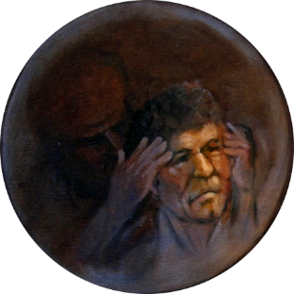
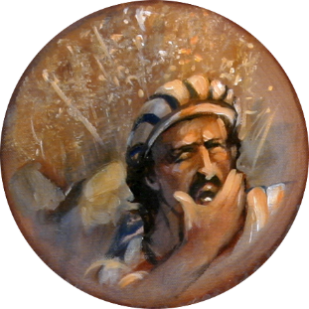
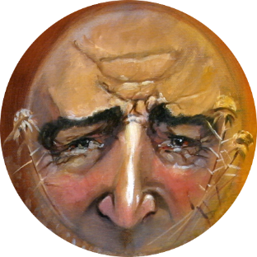
INCAZELO YOMFANEKISO
“Umlimi uhlanyela izwi” (Marku 4:14)
Inhlanyelo iyiliZwi likaNkulunkulu, futhi umhlanyeli yiloba ngubani oyidluliselayo.
Endleleni
Abalasithakazelelo, futhi uSathane uyabadukisa (Marku 4:15)
Phakathi kwamatshe
Bayalamukela izwi, kodwa abazibekezeleli izilingo ( Marku 4:16-17 )
Phakathi kwameva
Bayalamukela izwi, kodwa bakhululeka ( Marku 4:18-19 )
Emhlabeni omuhle
Bamelana lezilingo futhi abaxazululi. Bathela izithelo (Marku 4:20)
Ngiluhlobo luphi lomhlabathi? Yini okufanele ngiyenze ukuze ngithele?

Slide 8
EMINYE IMIFANEKISO

Slide 9
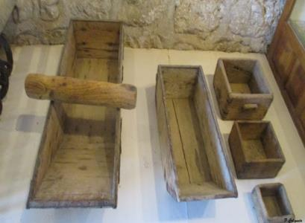
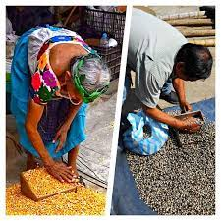
ISIBANI LESILINGANISO
“Wathi kibo: “Liyasiletha isibani ukuba lisibeke ngaphansi kwesitsha loba ngaphansi kombheda na? Kunalokho, awulibeki endaweni yalo? ( Marku 4:21 )
“Cabangani ngokunanzelela lokho elikuzwayo,” eqhubeka. “Ngesilinganiso elilinganisa ngaso, lani liyakulinganiselwa ngaso, ngitsho langokwengeziwe” (Marku 4:24).
Bona ngeso lengqondo ingxoxo: "Ingabe uyangenisa ...?" "hatshi!"; "awuyibeki...?" "Awu kunjalo!"
Emigwaqweni yasemadolobheni, abathengisi bathengisa imigomo yabo besebenzisa izilinganiso ezivamileyo loba ezingaphansi ukuze balinganise inani lomgomo umthengi awufunayo.
UJesu wayeyazi indlela yokudonsa ukunaka kwezilaleli zakhe. Manje base bekulungele ukuthola isifundo esingokwakomoya.
Kancane kancane, uJesu wembula iqiniso levangeli ukuze laziwe yibo bonke (Marku 4:22).
Aluba umthengisi elomusa, wayesengeza umgomo okunengi esikalini ukuze anelise umthengi wakhe.
Ngalobo busuku, njengoba babekhanyisa izibani zabo ekhaya, “labo abalezindlebe zokuzwa” ( Marku 4:23 ) ngokungathandabuzi basikhumbula isifundo..
Aluba othile elamukela iqiniso, uzathola okwengeziwe. Kodwa uma usala, ngitsho leqiniso olalo liyolahleka (ngokukaMarku 4:25).

Slide 10
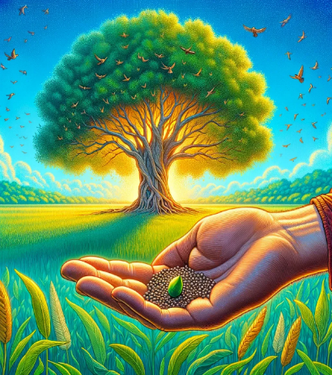
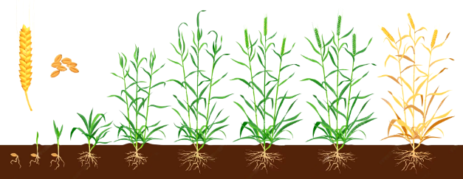
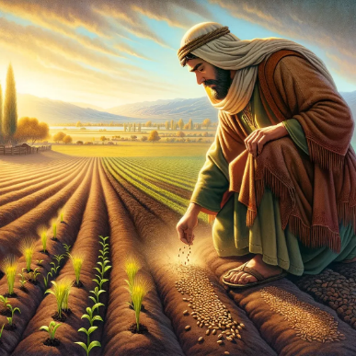
UKUKHULA KANYE LEMASTADI
“Wabuye wathi: “Umbuso kaNkulunkulu ufana lalokhu. Umuntu uhlanyela emhlabathini emhlabathini” (Marku 4:26)
“Unjentanga yemastadi oluncane kulazo zonke inhlanyelo emhlabeni” ( Marku 4:31 )
Umbuso weZulu ufaniswa lenhlanyelo yemastadi encane
( Marku 4:30-31 ).
Ngemuva kwezinsuku ezingama-50 zokuhlanyela, imastadi ifinyelela ku-30-40 cm ubude, futhi isivele ikwazi ukukhipha izithelo ezivunwayo. Ingakhula ibe ngamamitha angu-7 ukuphakama (23 Ft).
UJesu ukhumbula uhambo lokukhula kwentanga eyinhlanyelo Marku 4:28
Untshani
Ukusungula
Inhlamvu.
Kuyinqubo eyeme kuNkulunkulu, hatshi kumuntu (Marku 4:27).
Le yinhlanyelo yevangeli ehlanyelwe emhlabathini ovundileyo wekholwa.
Kuncane, vele, kwakuyisiqalo: abantu abayi-120 “abangafundanga” bacasthe ekamelweni eJerusalema
Ngokusebenza kukaMoya oNgcwele sikhula kakhulu eqinisweni... kuze kufike uJesu (Marku 4:28; Mt. 13:39).
Kodwa ukwanda kwayo sekufinyelele emhlabeni wonke, iba inkolo elamakholwa amanengi kulawo wonke.

Slide 11
“Emifanekisweni laseziqhathanisweni Wathola indlela engcono kakhulu yokukhuluma iqiniso laphezulu. Ngolimi olulula, esebenzisa imifanekiso lemifanekiso ethethwe emhlabeni wemvelo, Wavulela abamlalelayo iqiniso likamoya, futhi waveza izimiso eziligugu ezazizobe zingasekho ezingqondweni zabo, futhi watshiya lomncane umkhondo, ukube Akazange axhumanise amazwi Akhe lokunyakazisa umzimba. izigcawu zokuphila, isipiliyoni, noma imvelo. Ngale ndlela Wabiza isithakazelo sabo, wavusa ukubuza, futhi lapho esekuqinise ngokugcwele ukunaka kwabo, wanquma ngokugcizelela kubo ubufakazi beqiniso. Ngalendlela Wakwazi ukwenza umqondo owaneleyo enhliziyweni ukuze kusasa izilaleli Zakhe zikwazi ukukhangela into ayehlanganisa laso isifundo Sakhe, futhi zikhumbule amazwi oMfundisi waphezulu..
EGW ( Fundamentals of Christian Education, 236)

