Slide 1
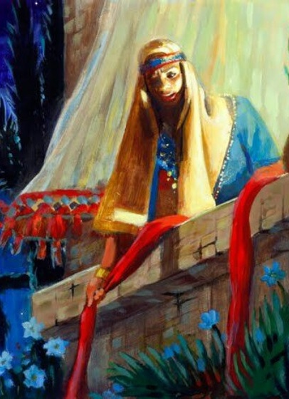
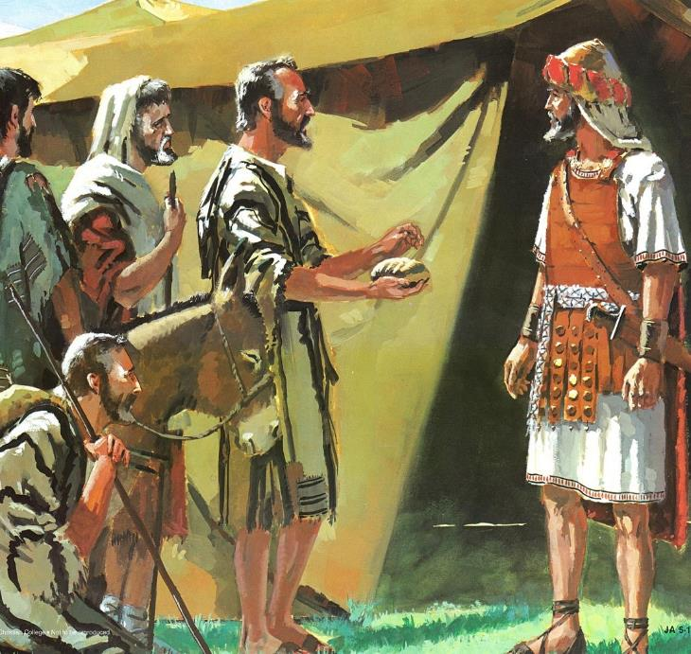
UKUMANGALISWA NGUMUSA
Isifundo sesibili kuMfumfu ilanga letshumi lanye ku2025

Slide 2

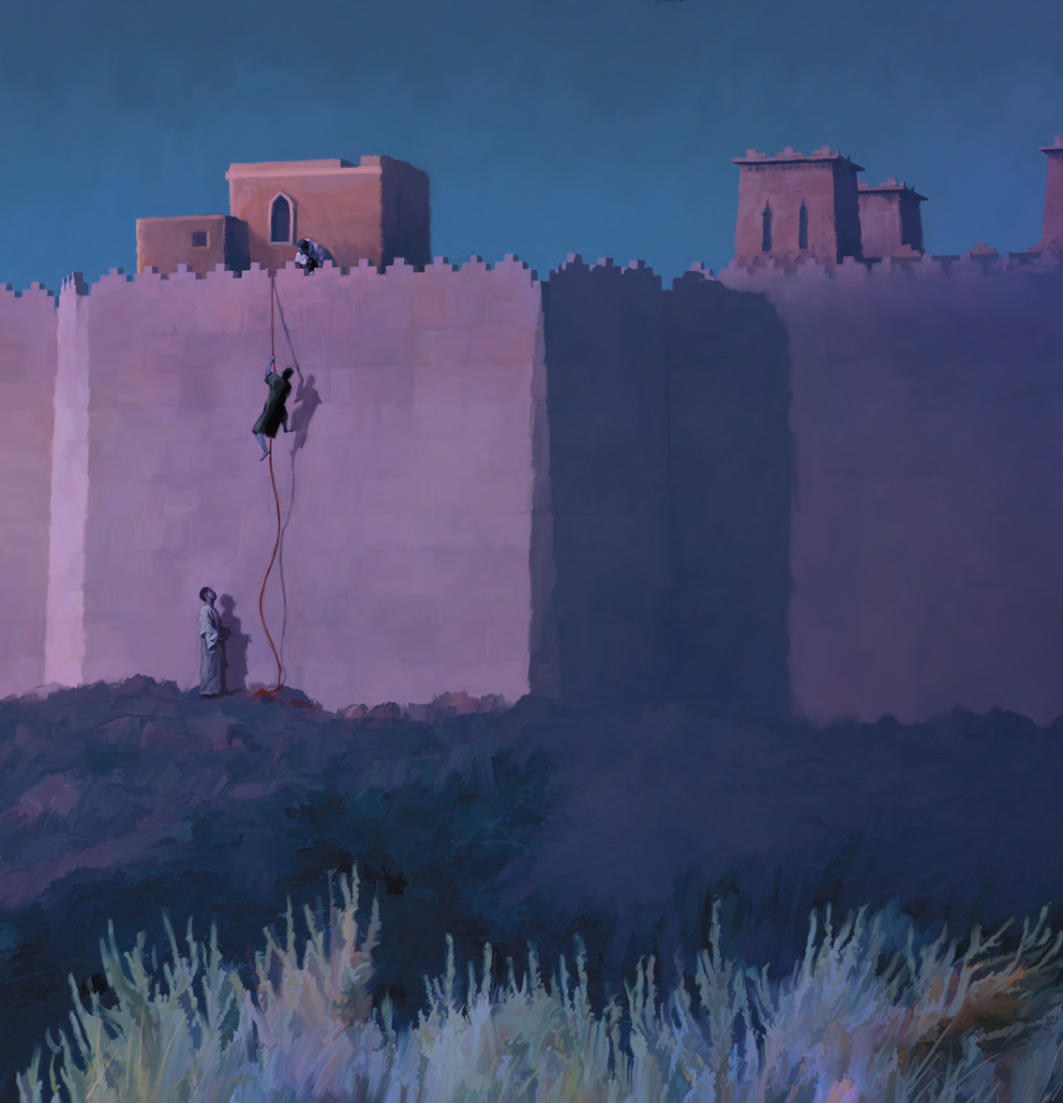
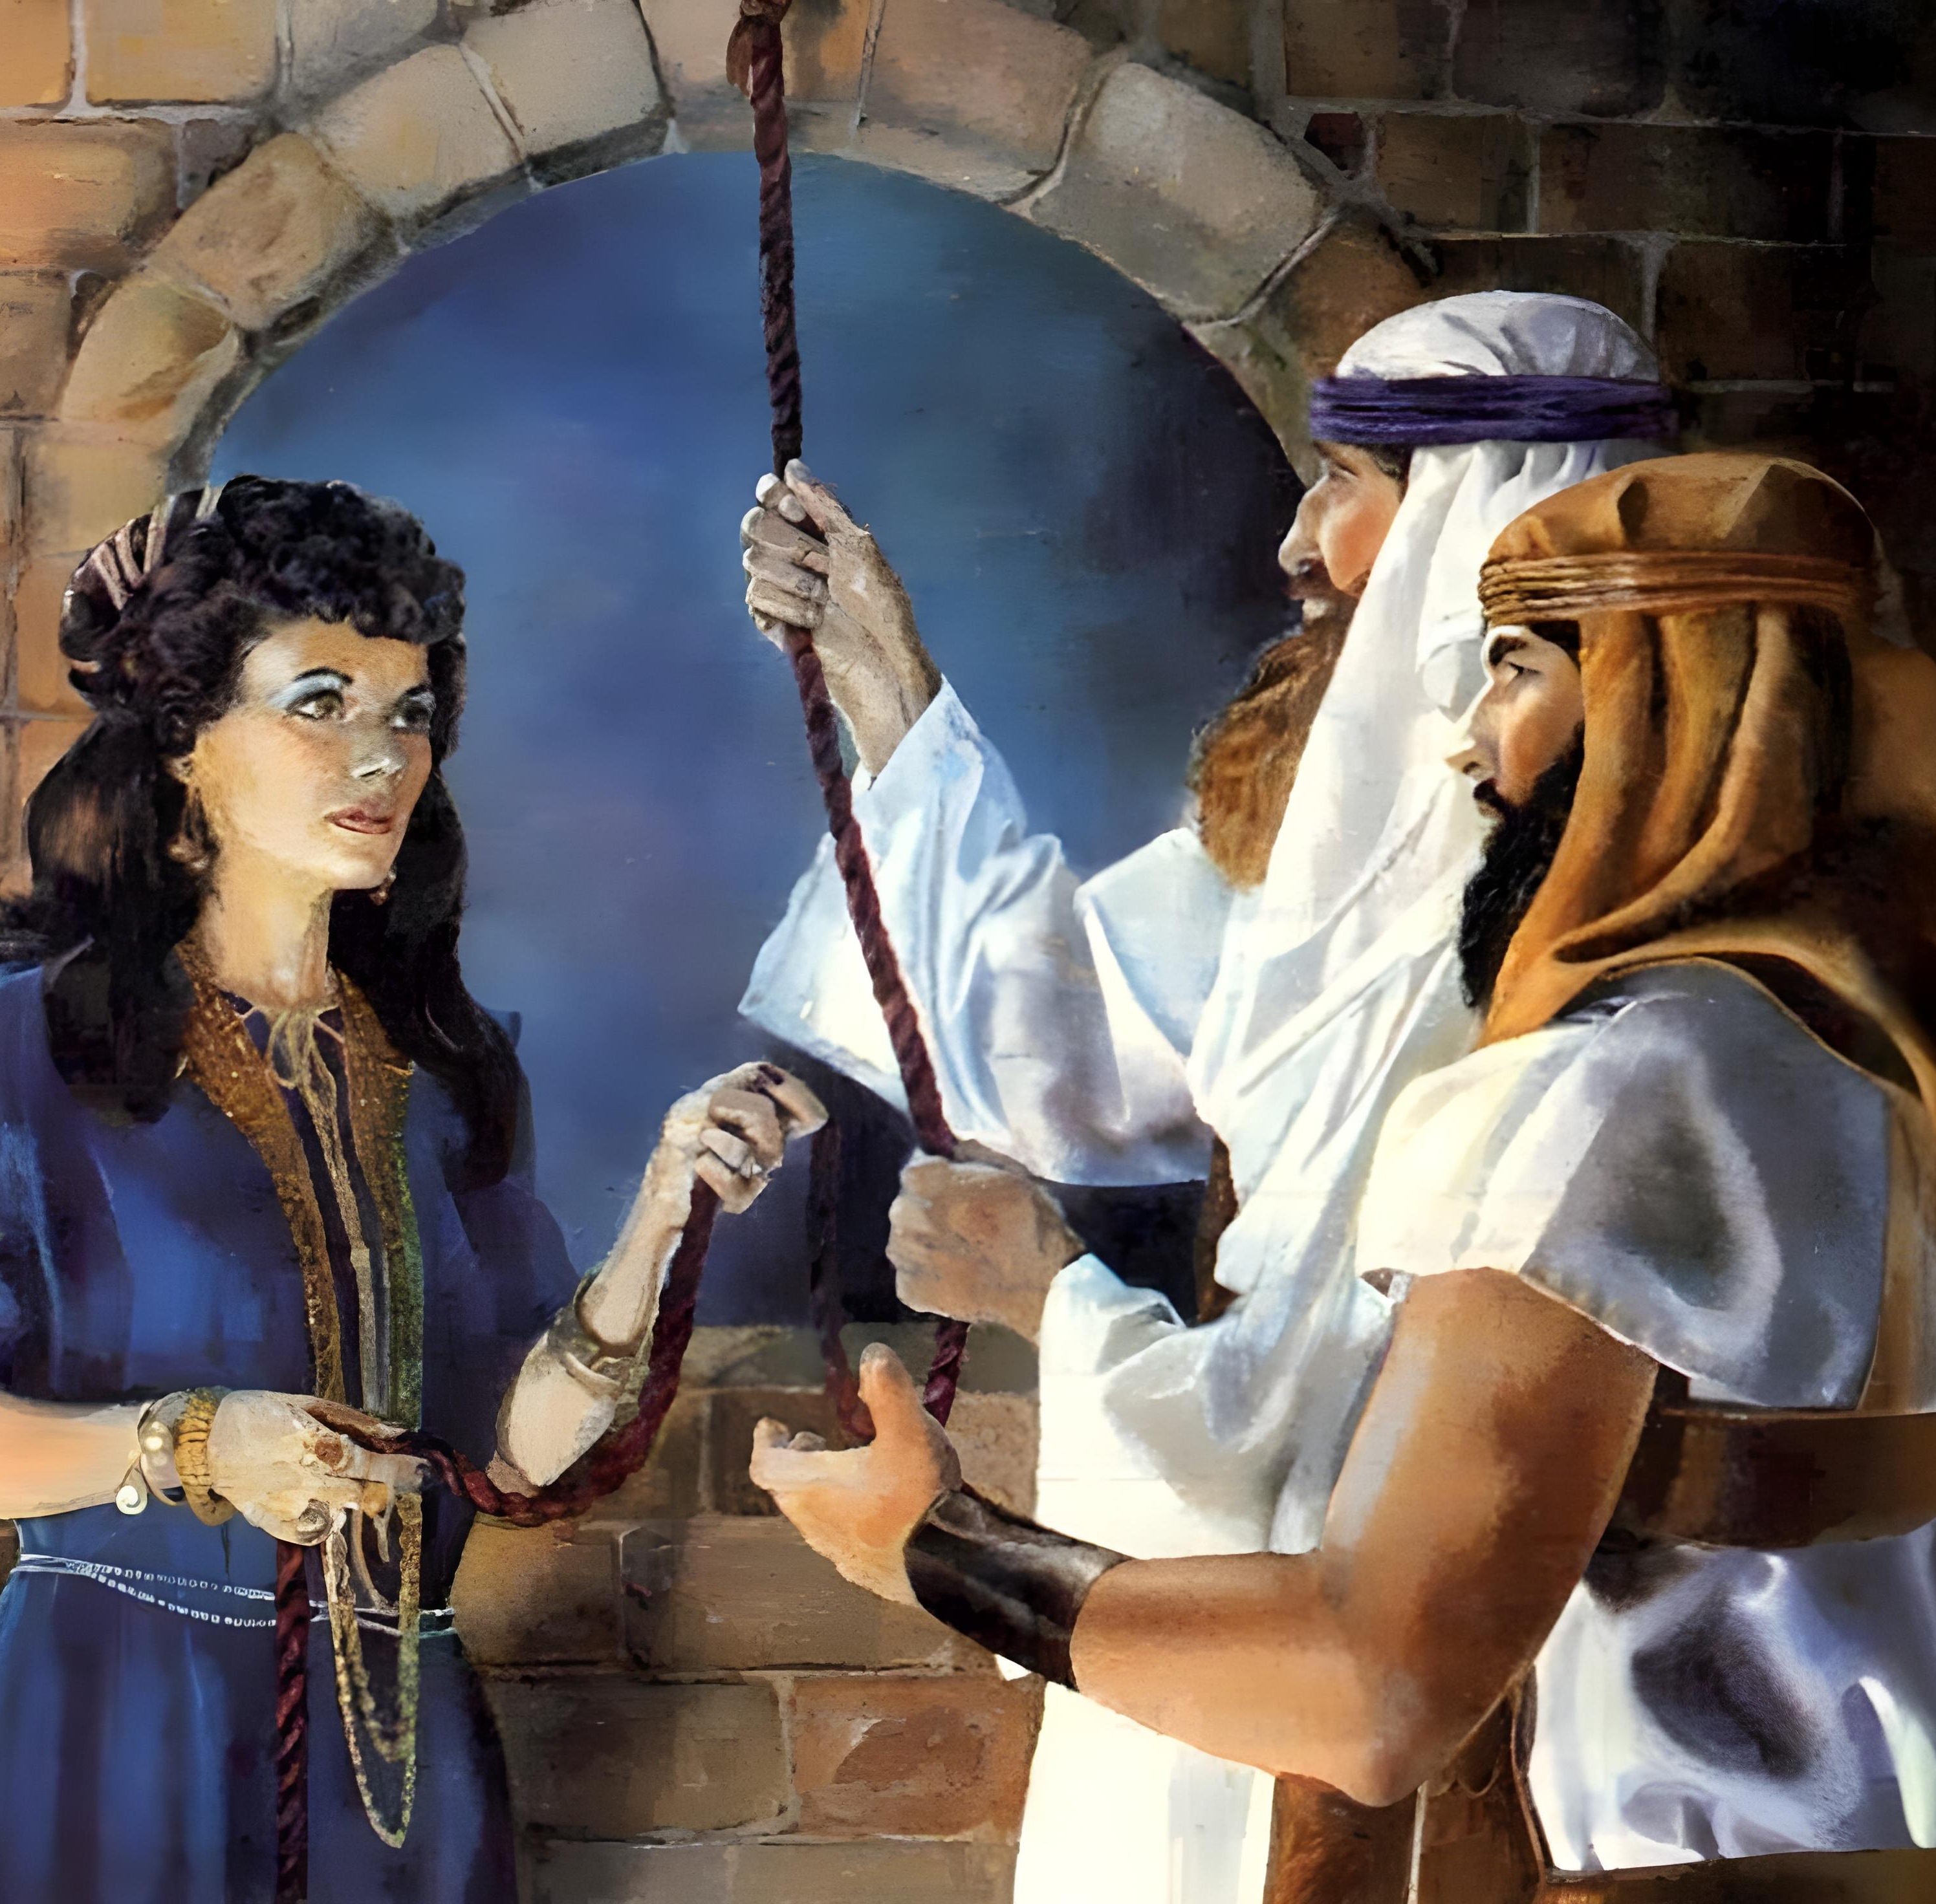
“Ngokukholwa uRahabi isifebe akabhubhanga kanye labangakholwanga, esezamukele izinhloli ngokuthula.” (Hebheru 11:31, NKJV)

Slide 3

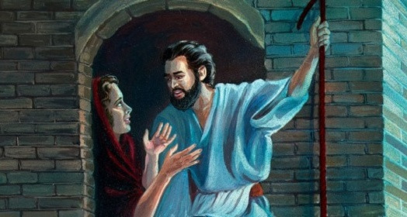
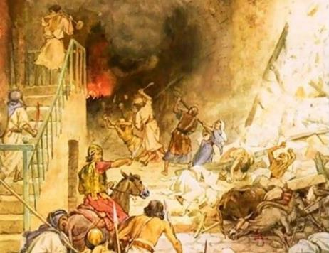



AmaKhanani ayeqe imingcele yomusa. Ngaleso sizathu umlayo ku-Israyeli wawutsihi: Ngenani, libabulale bonke, lithathe impahla yabo
Ngakho, kwakusekhona abantu eKhanani ababengayeqi leyo mingcele. Bonke ababezimisele ukwamukela umusa uNkulunkulu ayefuna ukuwedlulisela kubo basindiswa ekubhujisweni.
Umusa kubanto bakoIsraeli (Joshuwa 2:1, 22-24):
Ithuba lesibili
Umusa kuRahabe (Joshuwa 2:2-21):
Ukukholwa kwentanga yemastadi
Isivumelwano sadlulela lakuRahabi
Umusa kuma Gibeonites (Joshuwa 9):
Abathungameli abakhohlisayo
Isibusiso lesiqalekiso

Slide 4
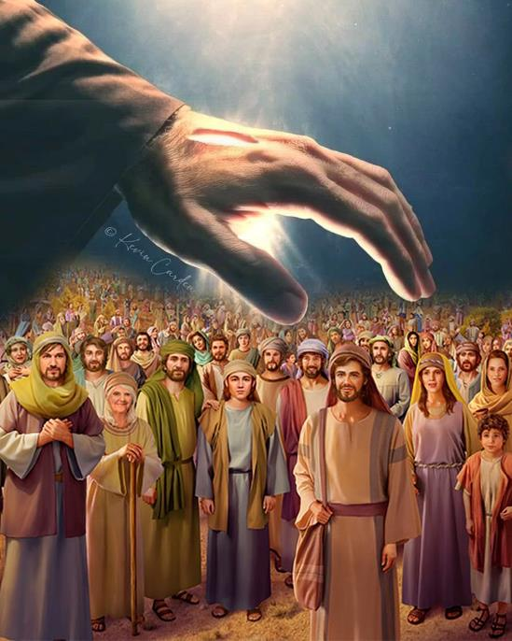
UMUSA KUBANTU BAKO ISRAYELI
(JOSHUWA 2:1, 23-24)

Slide 5


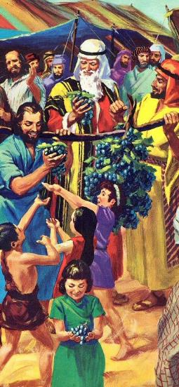
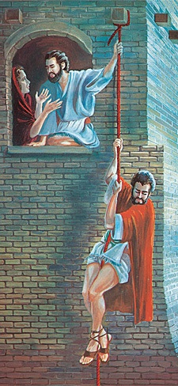
ITHUBA LESIBILI
UJoshuwa indodana kaNuni wayesethuma izinhloli ezimbili ngasese zivela eShithimi. “Hambani likhangele izwe,” etsho, “ikakhulukazi iJeriko” (Joshuwa 2:1a NIV)“
Lapho uMose ethuma izinhloli ukuba ziyohlola iKhanani, abantu bala ukungena. Ngemva kweminyaka engu-40, kwathunyelwa izinhloli ezintsha, lemiphumela ehlukeneyo..
Kuthunyelwa izinhloli
Ngokusobala (12 izinhloli)
Ngokuyimfihlo(2 izinhloli)
Ukusebenza kwezinhloli
40 izinsuku zokuhlola
3 izinsuku efihliwe
Umbiko wezinhloli
Bakhuthaza uJoshuwa
Bengakhuthazi abantu
Langoba isizukulwane esitsha sasihlulekile ngokudabukisayo lapho sibhekene lokulingwa kukaBhalami, uNkulunkulu wasinika ithuba lesibili ( Num. 25:1-3, 31:16; Josh. 2:1 ).
Ngalesi sikhathi zazingekho izingatsha zamagilebhisi, kungekho zithelo zezwe. Indaba yokukholwa kuphela (ekaRahabi), eyakhuthaza uIsrayeli ukuba athathe iZwe Lesithembiso.

Slide 6
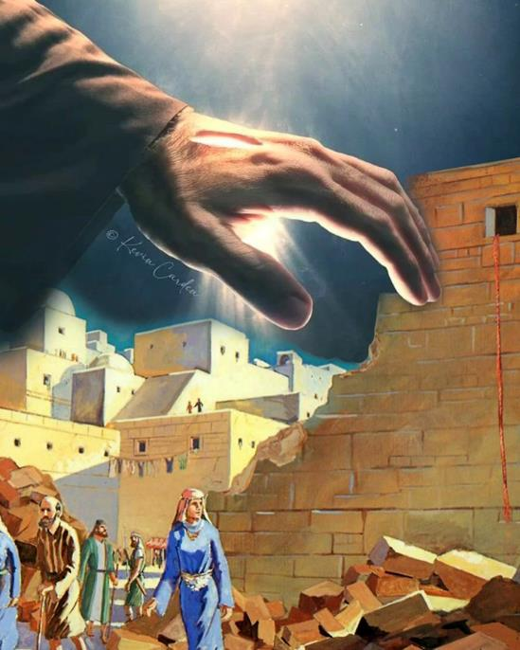
UMUSA KU RAHABI
(JOSHUWA 2:2-21)

Slide 7

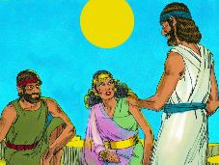
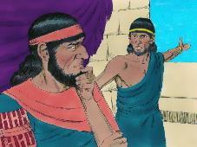
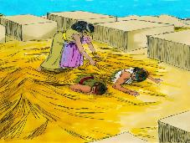
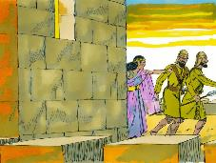
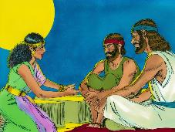
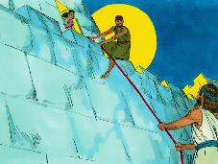
UKUKHOLWA OKUFANA LENTANGA YEMASTADI
“Ngokukholwa uRahabi isifebe, ngokuba wazemukela izinhloli, akabulawanga kanye labangalalelanga.”— Heberu 11:31;
Ukholo lukaRahabi lwalusekelwe kuyini ( Josh. 2:9-11
Phawula ukuthi uRahabi ukhuluma ngezenzakalo wonke umuntu owayezazi, njengokuwela uLwandle Olubomvu. Kodwa ngokuba abanye babemesaba uNkulunkulu wamaHebheru, yena wakhetha ukuphephela ngaphansi kwamaphiko akhe ( Josh. 2:12-13 ).
Kungani, uma wayekholwa kuNkulunkulu, wasebenzisa amanga ukuze asize izinhloli?
Ukholo lwakhe olutsha lwalungabonisi ukuqonda okupheleleyo kwentando kaNkulunkulu. Wenza okusemandleni akhe ukuze asize izinhloli futhi asindise ukuphila kwakhe lemhuli yakhe. Ulwazi lwaluzofika ngemva.
IBhayibheli liyamkhuthaza ngesinqumo asenzileyo; ukuze aqonde indlela kaNkulunkulu yokwenza; langendlela asekela ngayo amazwi akhe ngezenzo ezibambekayo ( Jakobe 2:25 ).
URahabi uyisibonelo salokho okwakungenzeka kuloba yisiphi isakhamuzi saseJeriko esasizinikele kuNkulunkulu.

Slide 8

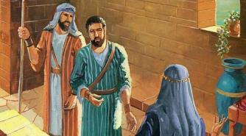
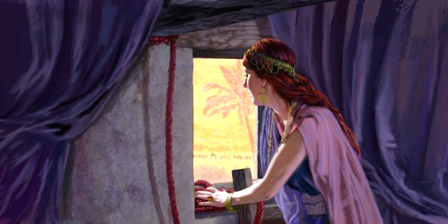
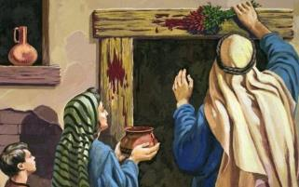
ISIVUMELWANO SELULELA KURAHABI
“Uma omunye wabo ephumela ngaphandle kwendlu yakho, igazi lakhe liyakuba phezu kwamakhanda akhe; thina asilacala. Kepha kwabasendlini kanye lawe, igazi labo liyakuba phezu kwekhanda lethu, uma kubekwa isandla phezu kwabo. (Bala uJoshuwa 2:19
UIsrayeli ngePhasika
Nxa besuka ekhaya, babezakufa ( Eks. 12:13 )
URahabi eJeriko
Kwadingeka afake intambo ebomvu efasiteleni lakhe ( Josh. 2:18 ).
Aluba ephuma endlini, wayezakufa ( Josh. 2:19 )
Kwakumele bagcobe umphetho walo ngegazi ( Eks. 12:7
Umbono kaRahabi wawungelakuphikiswa: Ngenzé ngomusa [ngalalela] ngalisindisa; manje yenza umusa futhi ungisindise lezihlobo zami ( Josh. 2:12-13 ).
Langoba wayengakuqapheli lokho, uRahabi wayecela u-Israyeli ukuba enze kuye njengoba uNkulunkulu ngokwakhe ayenzé ku-Israyeli, okungukuthi, ngomusa [walalela] (Dut. 7:12).
Izinhloli zacela uRahabi ukuba agcwalise izimiso ezazizigcwalisile ukuze zibaleke ekufeni eGibhithe. Ngale ndlela, wafakwa esivumelwaneni sikaNkulunkulu lo-Israyeli.

Slide 9
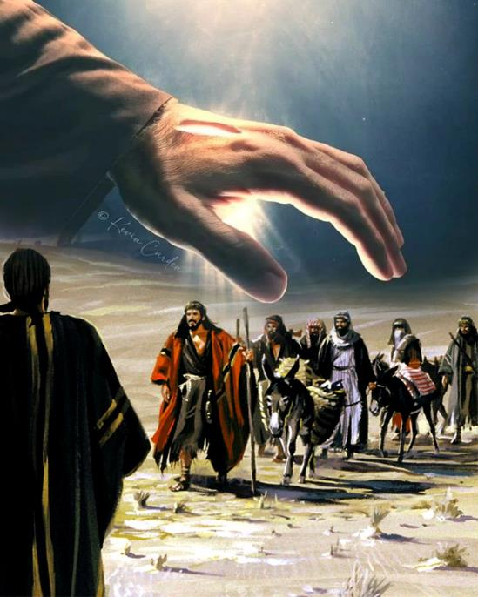
UMUSA KWABASEGIBEBA (JOSHUWA 9)

Slide 10


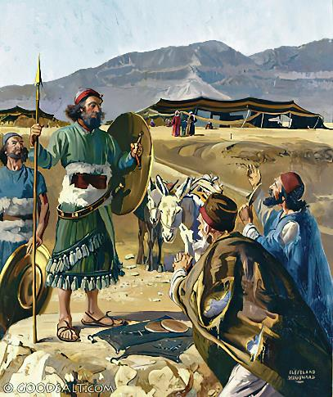
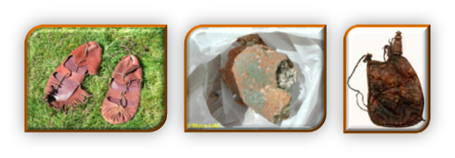
ABATHUNGAMELI AKHOHLISAYO
“Baya kuJoshuwa ekampini laseGiligali, bathi kuye lakubantwana bakwa-Israyeli: “Sivela ezweni elikude; yenza isivumelwano lathi.” ( Joshuwa 9:6 )
Phawula ukufana lokuhluka phakathi kukaRahabi nabaseGibeyoni:
I-zici zokholo | Rahabi | Gibeonites
Isisekelo | Ukuzwa (2:10) | Ukuzwa (9:3)
Indlela zokutsho | Amanga (2:4-5) | Amanga (9:4)
Umgomo | Ekusindeni (2:13) | Ukusinda (9:24)
Impumela Ephangisayo | Ukukhululwa (6:23) | Ukukhululwa (9:26)
Impumela Yesikhathi Eside | Ukubangumhlali opheleleyo (6:25) | Ubugqili (9:27)
Rahab lied spontaneously to free the spies. However, the Gibeonites URahabi waqamba amanga ngokuzenzakalelayo ukuze akhulule izinhloli. Ngakho, abaseGibeyoni baqamba amanga ngamabomu, behlose ukukhohlisa, besebenzisa ubuqili (bona uGenesise 3:1a). Ngaphezu kwalokho, abaholi bakwa-Israyeli behluleka ngokungabuzi uNkulunkulu ( Josh. 9:14 ).
Lokhu kwababeka enkingeni: babhubhise abaseGibeyoni, loba bahloniphe isifungo ( Josh. 9:18 ).

Slide 11

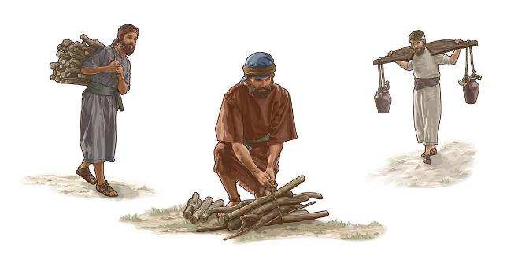
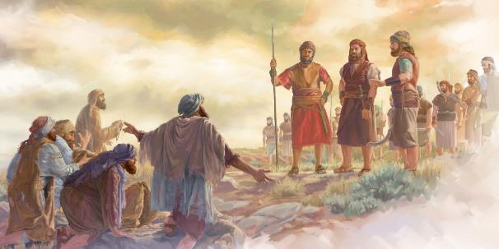
ISIBUSISO LESIQALEKISO
“Manje lingaphansi kwesiqalekiso: alisoze lakhululwa emsebenzini wokuba ngabagawuli bezinkuni labakhi bamanzi bendlu kaNkulunkulu wami” ( Joshuwa 9:23)
Ukusindisa ukuphila kwabaseGibeyoni kwasikutsho ukungawulaleli umlayo oqondileyo kaNkulunkulu ( Dut. 7:1-2 ). Ukwephula isifungo njengalowo owayefungiswe kubo kwakukhangelwa njengesono ( Josh. 9:19; IHu. 15:4b ). Yaxazululwa kanjani le nkinga?
Izimpilo zabo zasinda, kodwa zabekwa ngaphansi kwesiqalekiso ( Josh. 9:20-23 ). Isiqalekiso sasihlanganisa ukuba yizinceku ezizukulwaneni ngezizukulwane. Lokhu kwababeka ebuhlotsheni obuseduze labantu bakaNkulunkulu, abangazange bahlukane labo ( Neh. 7:6, 25 ).
Ngaphezu kwalokho, ukuba ngabatheli bamanzi labagawuli bezinkuni bendlu kaNkulunkulu kwabenza basondelana njalo loNkulunkulu. Ngomusa kaNkulunkulu, isiqalekiso saba yisibusiso. “Angithokozi ngokufa komubi, kodwa ukuba aphenduke ezindleleni zakhe aphile” (Hez. 33:11).

Slide 12

“Abantwana bakwa-Israyeli kwakufanele bathathe yonke indawo uNkulunkulu ayebabekele yona. Lezo zizwe ezala ukukhulekelwa lenkonzo kaNkulunkulu weqiniso zazizophucwa izwe. Kodwa kwakuyinjongo kaNkulunkulu ukuthi ngokwembulwa kwesimo Sakhe ngoIsrayeli amadoda adonseleke kuYe. Kuwo wonke umhlaba isimemo sevangeli kwakumele sinikezwe. […] uNkulunkulu weqiniso, kwakufanele bazihlanganise labantu Bakhe abakhethiweyo”
EGW (Christ’s Object Lessons, p. 290)

