Slide 1

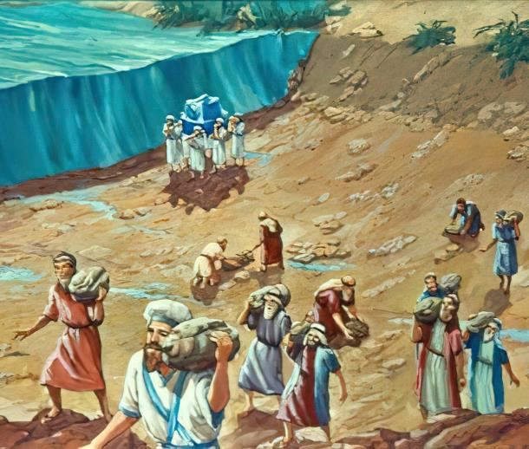
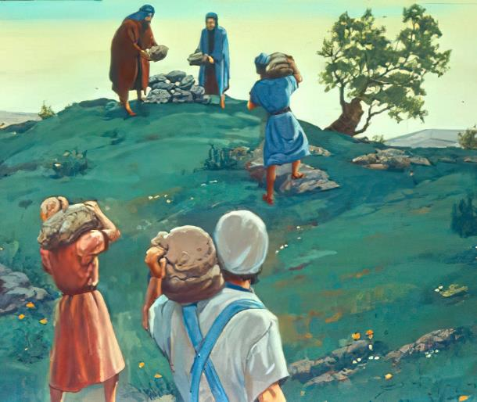

Isifundo sesithathu kuMfumfu ilanga letshumi latshiyangalombili ku2025
IZIKHUMBUZO ZOMUSA

Slide 2

“ ‘Ngokuba uJehova uNkulunkulu wenu womisa amanzi aseJordani kini, laze lawela, njengalokho uJehova uNkulunkulu wenu wenza oLwandle Olubomvu, walomisela thina, saze sawela, ukuze zonke izizwe zomhlaba zazi ukuthi isandla sikaJehova silamandla, ukuze limesabe uJehova uNkulunkulu wenu kuze kube phakade.”
Joshuwa 4:23, 24, ESV

Slide 3

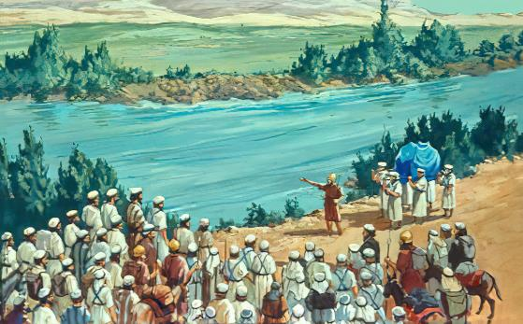
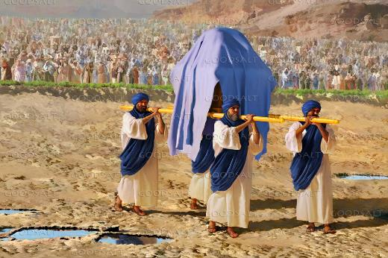







Intwasa. Imvula leqhwa elincibilikayo kugcwalise uMfula iJordani kwaze kwaba seqophelweni lokuchichima. Amanzi alo ageleza ngokuphangisa kuLwandle Olufileyo. Ngitsho lasezindaweni ezingatshoni kakhulu—izibuko zaseJordani—ukuwela umfula kungumsebenzi oyingozi.
Ungawela kanjani umuzi wonke, uthwele izalukazi, abakhulelweyo, izingane lemfuyo?
Kumuntu, akulakwenzeka. KuNkulunkulu, kulula: “Zingcweliseni liwele iJordani.”
Ukuchapha iJordani (Joshuwa 3): (Joshuwa 3):
Isidingo sobungcwele
Izimanga zikaNkulunkulu
Khumbula futhi ukhohlwe (Joshuwa 4):
Izimpawu zokukhumbula
Izingozi zokukhohlwa
Inkambo Emfuleni uJodani

Slide 4

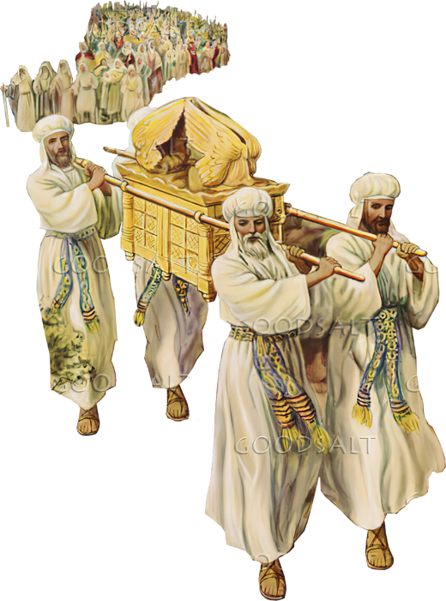
UKUCHAPHA IJORDANI
(JOSHUWA 3)

Slide 5
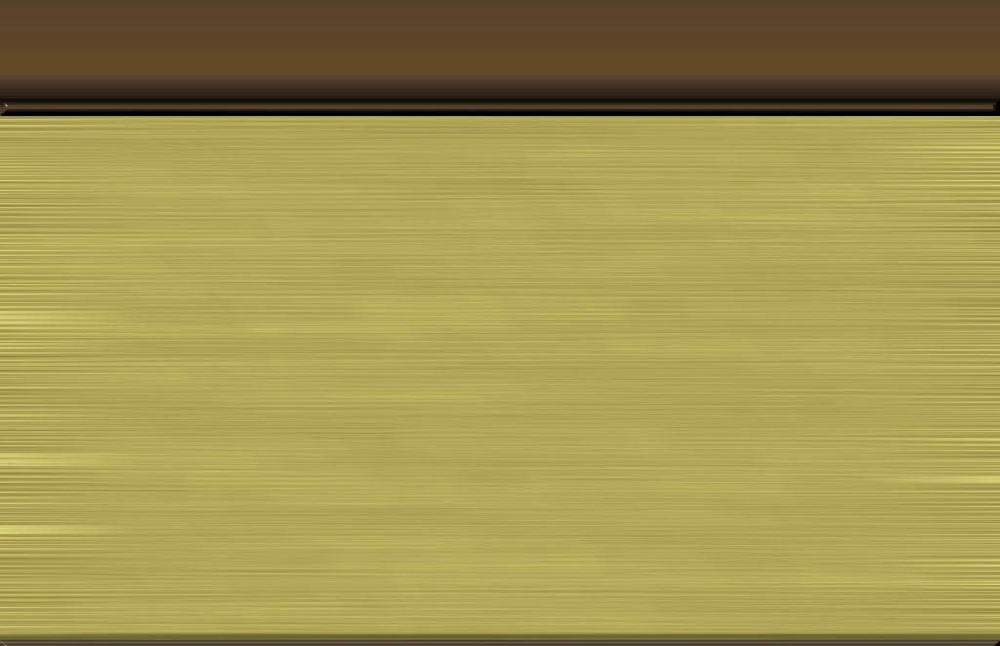
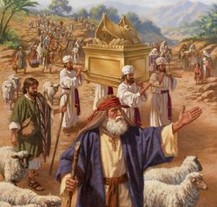
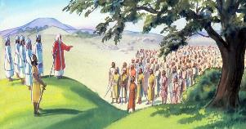
ISIDINGO SOBUNGCWELE
“UJoshuwa wathi kubantu: “Zingcweliseni, ngokuba kusasa uJehova uzokwenza izimangaliso phakathi kwenu.” ( Joshuwa 3:5 )”
Iminyaka engu-40, iyezi lalibonise isikhathi sokuphumula lokusuka, futhi umphongolo waqondisa u-Israyeli endaweni yawo entsha ( Num. 9:17; 10:33 ).
Ukulandela umkhumbi ohlanganyelayo
Lalela UNkulunkulu (Imithetho elitshumi)
Ukuthembela ekunakekeleni kukaNkulunkulu (isitsha esilemana)
Hlonipha abaholi abakhethwe nguNkulunkulu (induku ka-Aroni)
Sase sifikile isikhathi sokuhamba. Basuka eShithimi, bamisa izinsuku ezintathu ngaphetsheya kweJordani. Base bethola umyalo wokulandela umkhumbi baye eZweni Lesithembiso ( Josh. 3:1-3 ).
Kodwa kwakukhona imfuneko: kwakufanele bangcweliswe (Josh. 3:5). Lokhu kungcweliswa kwakuhlanganyela lokuhlanzwa okungokomthetho (ukugeza izingubo lomzimba), ukutshiya isono, lokuba lesimo sengqondo sokwamukela ukulalela imiyalo kaNkulunkulu.

Slide 6

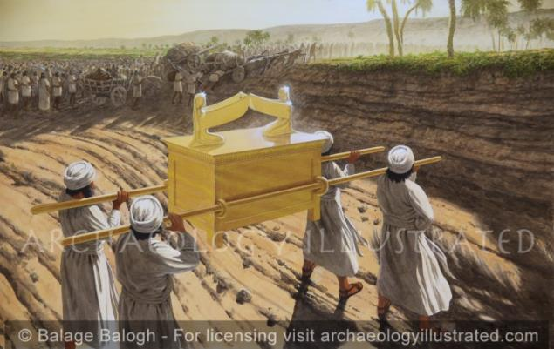
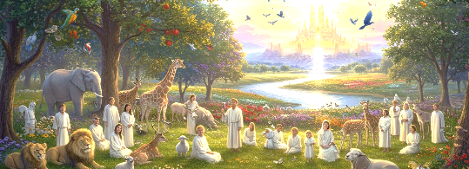
IZIMANGALISO ZIKANKULUNKULU
e“Amanzi avela enhla komfula ama ukugeleza, aba yinqwaba kude buncwadlana, emzini othiwa i-Adamu eduze kwaseZarethani, amanzi ehlela oLwandle lwase-Araba, okuyikuthi uLwandle Olufileyo, aqhamuka, abantu bawela maqondana leJeriko.” ( Joshuwa 3:16 ) Y
UNkulunkulu “Nguye kuphela owenza izimangaliso” (IHu. 72:18). Ngakho-ke, simqaphela njengoNkulunkulu oyedwa ( IHu. 86:10 ); sikhumbula izimangaliso zakhe ( IHu. 77:11 ); futhi silandisa ngemisebenzi yakhe emangalisayo (IHu. 96:3).
Ayikho into enzima kakhulu loba emangalisayo kakhulu kuYe, owadala zonke izinto (Jer. 32:17; Luka 1:37). Ngakho singamethemba ukuthi angenza izimangaliso ezimpilweni zethu (IHu. 107:8).
Ukuchapha iJordani kungesinye sezimangaliso zikaNkulunkulu, okungokwesiprofetho esikhomba kwesinye sezimangaliso ezinkulu uNkulunkulu athembise ukuzenza kithi: ukungena eKhanani lasezulwini (Zak. 8:6-8).

Slide 7


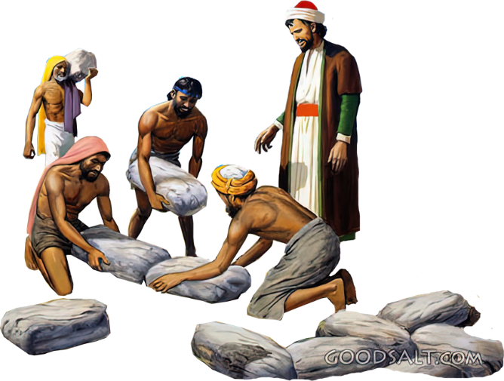
KHUMBULA PHINDE UKHOHLWE
(JOSHUWA 4)

Slide 8

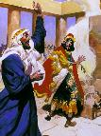
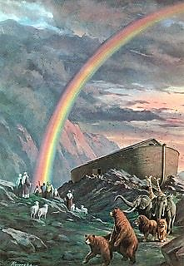
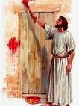

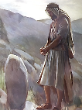
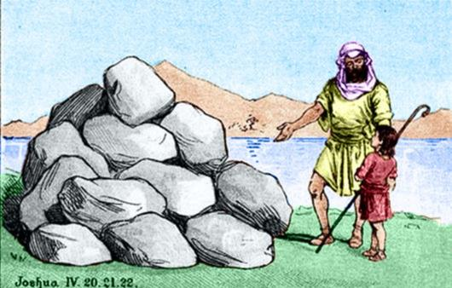
IZIBONISO ZESIKHUMBUZO
“ukuba kube yisibonakaliso phakathi kwenu, lapho abantwana benu benibuza ngesikhathi esizayo, bethi: ‘Ayini lawa matshe na?Joshuwa 4:6-7niv
EBhayibhelini, uphawu lungaba lezincazelo ezinengana:
Isenzo esimangalisayo (1 AmaKhosi 13:3))
Uphawu lokuthile (Gen. 9:13)
Isixwayiso sophawo( Eks12:13)
Uphawu olulomahluko ( Hez. 20:20 )
Isikhumbuzo ( Gen. 28:18 )
Amatshe alitshumi lambili athathwa eJordani amiswa nguJoshuwa njengesibonakaliso awohlobo lwakamuva: isikhumbuzo.
Ngaphandle kwenkumbulo ngokwayo, yayiyini injongo kaNkulunkulu lapho ecela ukuba kumiswe la matshe ( Josh. 4:6-7 )?
Izizukulwane ezintsha kwakufanele zazi ukuthi uNkulunkulu wenzeni. Ukholo lwabo kwakumelwe lusekelwe ezimangalisweni zikaNkulunkulu. Kwakungumsebenzi wabazali ukudlulisela lolu lwazi ezinganeni zabo (Dut. 4:9). Ngalolu lwazi, ngamunye wethu kufanele aphile ngokholo lwakhe.

Slide 9
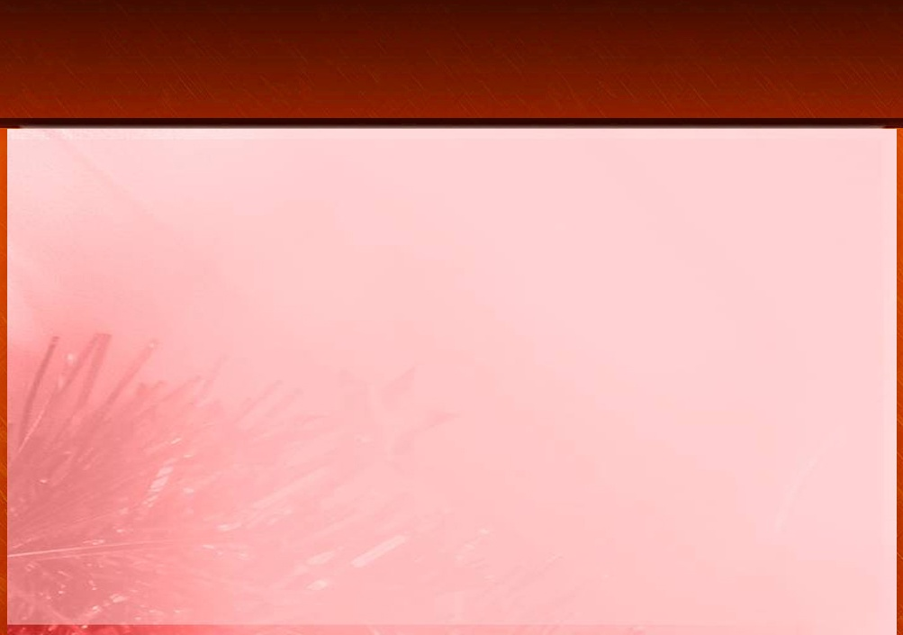
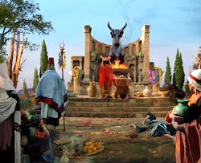
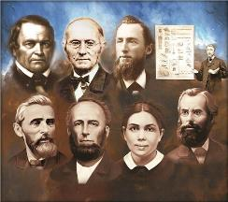
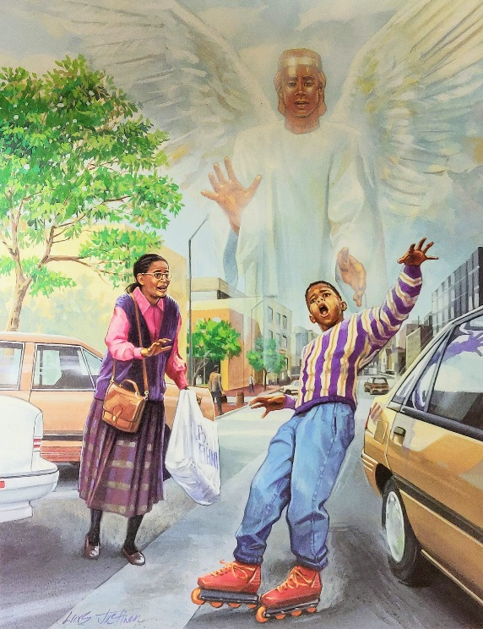
INGOZI YOKUKHOHLWA
“Abantwana bakwa-Israyeli benza okubi emehlweni kaJehova, bamkhohlwa uJehova uNkulunkulu wabo, bakhonza oBali no-Ashera.” (AbaHluleli 3:7)
Lapho emisa amatshe esikhumbuzo alitshumi lambili eGiligali, uJoshuwa wagcizelela amimicijo eqakathekileyo emibili ( Josh. 4:23 ):
UNkulunkulu womisa uLwandle Olubomvu phambi kwethu (uJoshuwa, uKalebi, labambalwa ababesaphila kusukela esizukulwaneni esaphuma eGibhithe)
UNkulunkulu womisa umfula uJordani phambi kwenu (isizukulwane esitsha esazalelwa ehlane, esasimiselwe ukunqoba iKhanani)
Isizukulwane esitsha sasisengozini yokwenza iphutha elifanayo lelabazali baso: ukukhohlwa izenzo zikaNkulunkulu zamandla. Ngetshwa, bakhohlwa, futhi bakhokha imiphumela (AbaHl. 3:7-8).
Yeka ukuthi kubaluleke kangakanani-ke ukuba sihlale sikutsha ezingqondweni zethu indlela uNkulunkulu ayebanakekela ngayo okhokho bethu, lezikhathi lapho siye sazibonela ngawethu isandla sikaNkulunkulu esilamandla!

Slide 10

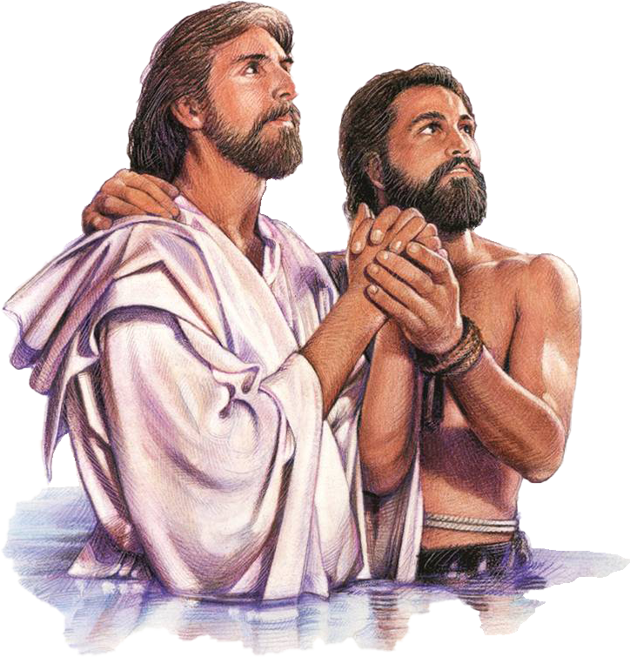
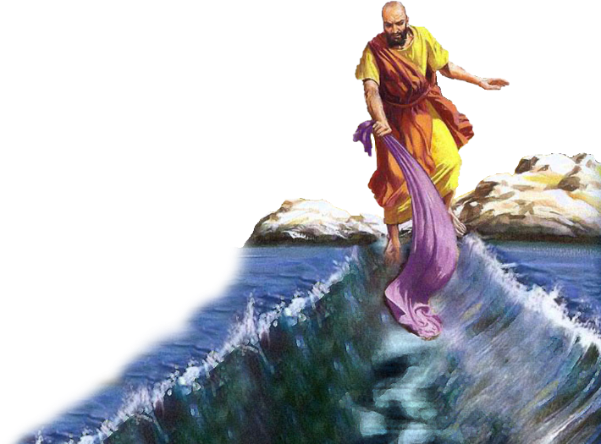
INKAMBO EMFULENI IJODANI

Slide 11

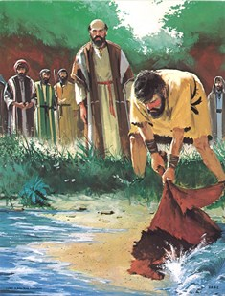
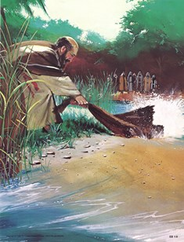
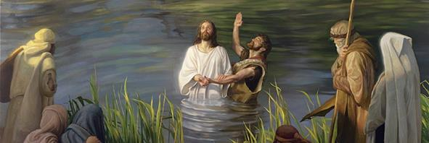
“Waphendula ulwandle lwaba umhlabathi owomileyo, bawela umfula ngezinyawo, lapho siyakuthokoza ngaye.( IHubo 66:6 )
“Ulwandle lwakubona lwabaleka; iJordani labuyela.” (IHubo 114:3)
Ukuchapha uLwandle Olubomvu kanye leJordani kuyizehlakalo ezimbili zembali eziye zahlangana njengeziqophambali embalini yokuhlengwa (IHu. 66:6; IHu. 114). Ndawonye, aphawula ukukhululwa kwethu esonweni lasekufinyeleleni kwethu ekuphileni okuphakade
Ukuwela umfula iJordani ngokuyisimangaliso lokulethwa ebukhoneni bukaNkulunkulu kwakuyiqiniso ku-Eliya (2 AmaKhosi 2:1, 7, 8, 11).
Ku-Elisha nokho, lesi senzakalo sasiwuphawu lokwamukela koMoya oNgcwele, okwamenza wakwazi ukwenza umsebenzi wakhe (2 AmaKhosi 2:14-15).
Ukungena emanzini eJordani kwaba lomthelela ofananayo kuJesu, owanikwa amandla nguMoya oNgcwele okwenza umsebenzi wakhe: wokusikhulula esonweni futhi asinike ukuphila okuphakade (Marku 1:9-11; Johane 1:29; 3:16).

Slide 12

“Masikhumbule-ke umusa kaJehova, lobunengi bobubele bakhe. Njengabantu bakwa-Israyeli, masimise amatshe ethu obufakazi, sibhale kuwo imbali eligugu yalokho uNkulunkulu asenzele khona. Futhi njengoba sibukeza ukusebenzelana kwakhe lathi ohambweni lwethu, masincibilike ngokusuka enhliziyweni ngenxa yokubonga kwami kuJehova, “Ngizofakaza ngani kuJehova? ngiyakuthatha indebe yensindiso, ngibize igama leNkosi. Ngiyakuzigcwalisa izithembiso zami kuJehova manje phambi kwabo bonke abantu bakhe.”— IHubo 116:12-14 .
EGW (The Desire of Ages, p. 348)

