Slide 1
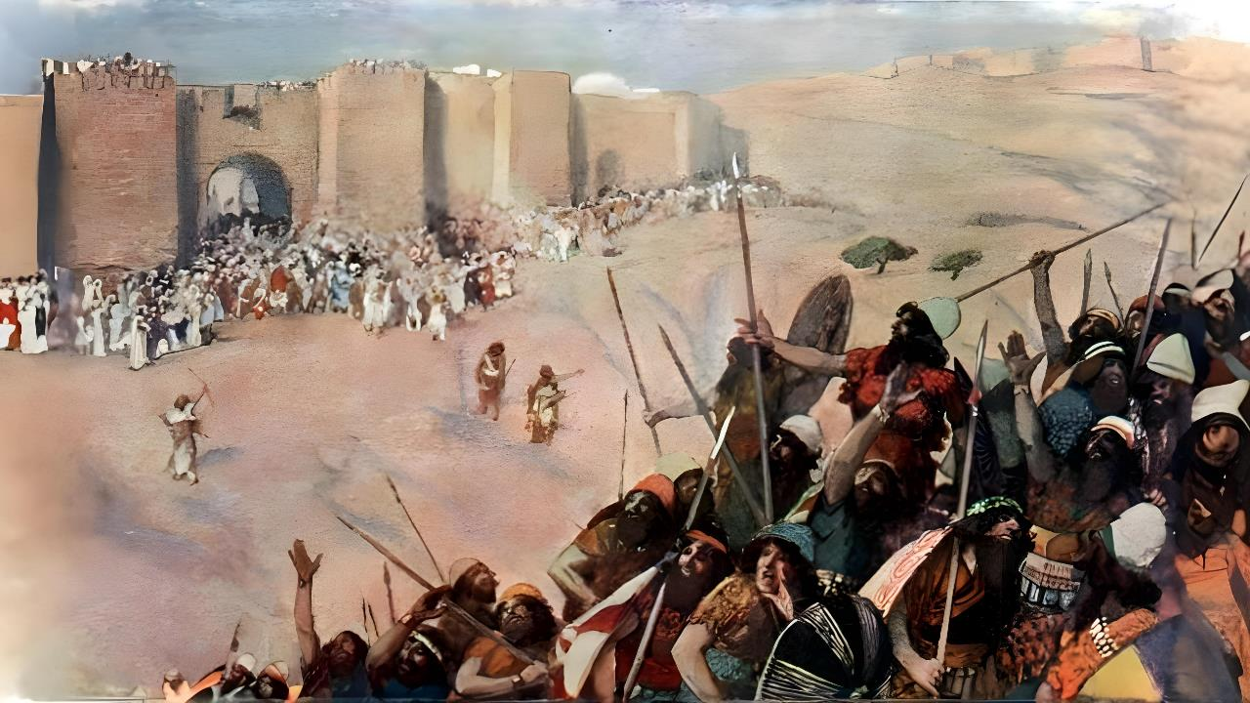
UNKULUNKULU UYAKULWELA
Isifundo sesihlanu kuLwezi ilanga lakuqala ku2025

Slide 2

“Futhi uJoshuwa wathumba wonke la makhosi lezwe lawo ngasikhathi sinye, ngoba uJehova uNkulunkulu ka-Israyeli wayemlwela u-Israyeli.”
Joshuwa 10:42, ESV

Slide 3

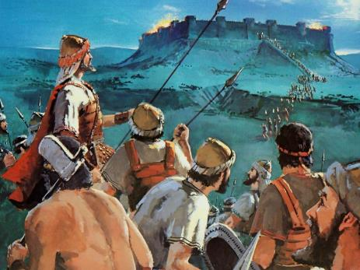
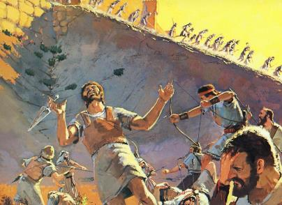
Ukuzwisisa impi eyadonsela u-Israyeli ukuba adle izwe laseKhanani akusiyo into elula.
Njengoba nje uNkulunkulu ayengahlosile ukuba isono sibe khona, wayengahlosanga lokuba kube khona impi.
Pho kungani kwafa abantu abanengi kangaka? Ingabe leyo mpi ingabhekwa “njengengcwele”?
Ukuze siqonde loluhlupho, kufanele singene sijule emqondweni weBhayibheli wempi kanye lezindinganiso zokuziphatha ezisengozini ngaleso sikhathi esibucayi emlandweni.
Indaba yobubi
Indaba yokulungisa
Umqondo weBhayibheli wempi
Babhujiswe ngokuzikhethela kwabo
Funa ukuthula

Slide 4

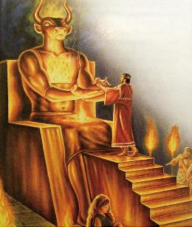
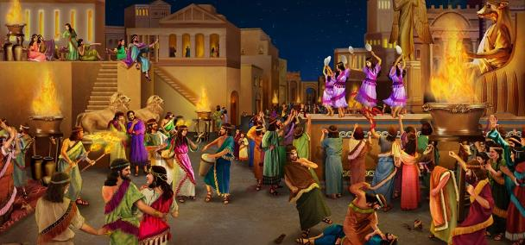
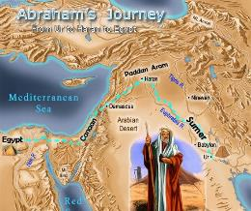
INDABA YOBUBI
“Esizukulwaneni sesine inzalo yakho iyakubuyela lapha, ngokuba isono sama-Amori asikafiki esilinganisweni saso” (Genesise 15:16).
Abolwazi lokucubungula ngoluntu lembali bembula ukuthi inkolo yaseKhanani yayiyilokho kanye iBhayibheli elikutshoyo: ubuthakathi, ubusanuse, ukuxhumana labafileyo, ukusebenzelana lemimoya... lokunikela ngabantwana! ( Dut. 18:9-12 ).
Kulokhu kumele kwengezelelwe umkhuba “wobufebe obungcwele” - owawungahlangene kangako lobungcwele - owawuqhutshwa yibo bobabili abapristi labapristikazi
Langokuba le mikhuba yayisivamile kakade ngesikhathi sika-Abrahama, uNkulunkulu wabanika iminyaka engaphezu kuka-400 ukuba balungise ukuziphatha kwabo
Ekugcineni, le mikhuba ephambeneyo, eyehlisa isimilo sabantu futhi ikhuthaza yonke inhlobo yobubi, kwadingeka iqedwe. Ukubhujiswa kwamaKhanani kwakuyovimbela—okungenani isikhathi esithile—ukuwohloka kokuziphatha koluntu

Slide 5

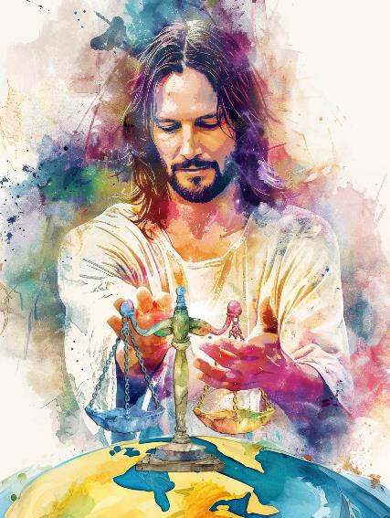
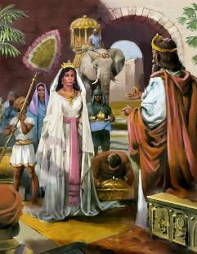
INDABA YOKULUNGISISA UKULOKULUNGA
“UNkulunkulu ungumahluleli olungileyo, uNkulunkulu obonakalisa ulaka lwakhe usuku ngosuku. Uma engaphenduki, uyolola inkemba yakhe; uyakugoba, abophe umntsoko wakhe.” (Funda iHubo 7:11-12.)
Uthando lokulunga kuyisisekelo sesimo sikaNkulunkulu. Lokhu kumenza abe ngumahluleli olungileyo longakhethiyo, ohlehlisa isijeziso ukuze isoni siguquke, kodwa ongeke abekezelele ububi kuze kube phakade.
Impi yokunqoba iKhanani ayizange ilwe ngenxa yezizathu zombuso, kodwa ngomyalo waphezulu wokufeza isijeziso esasifanele izakhamuzi zakhona ezimbi.
Isifiso sikaNkulunkulu kwakuyikumisa uhulumeni olungileyo kuleyo ndawo, owayezoba yisibonelo kuzo zonke izizwe, uzidonsele ukuba ziphakamise imiqondo yazo yokuziphatha, ngaleyo ndlela zifinyelele isimo sokuthula lokulungisa ukuqondileyo emhlabeni wonke ( Duteronomi 4:5-6 ).
Njengeqhawe nlomahluleli, uNkulunkulu uzibophezele ekusebenziseni, ekuqiniseni lasekugcineni umthetho, okuyinkomba yesimilo sakhe.

Slide 6

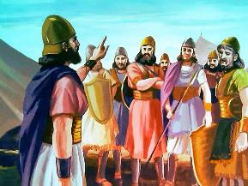
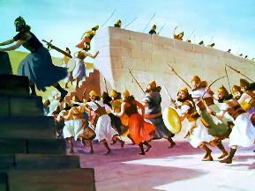
UMBONO WEBHAYIBHELI NGEMPI
“Kepha yazi lamuhla ukuthi uJehova uNkulunkulu wakho nguye odabula phambi kwakho njengomlilo oqothulayo, uyakubabhidliza, bazithobe phambi kwakho, abaxotshe, libabhuqe masinyane, njengalokho uJehova ekuthembisile. ( Duteronomi 9:3 )
NgokweBhayibheli, izimpi kwakufanele zilinganiselwe ezimweni ezithile futhi zazichazwa nguNkulunkulu Uqobo Lwakhe. Le imithetho eyayibusa izimpi ezazimiswe nguNkulunkulu:
Ibutho elifundisiweyo lalingavunyelwa
Amasotsha ayengakhokhelwa futhi ngezinye izikhathi ayengakwazi ngitsho lokweba
Impi yayivunyelwe kuphela ukunqoba loba ukuvikela iZwe Lesithembiso ngaleso sikhathi somlando
Babeholwa ngabaprofethi ababephefumulelwe uNkulunkulu (njengoMose loba uJoshuwa)
Ukulungiselela okungokomoya kwakudingeka ngaphambi kwempi
loba nguphi umIsrayeli owayengayilandeli imithetho yempi wayekhangelwa njengesitha
Ezikhathini eziningi, uNkulunkulu wangenela ngokuqondile kule mpi

Slide 7

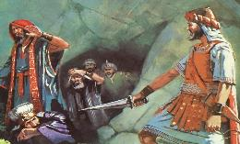
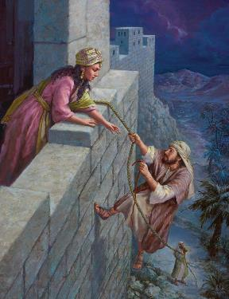
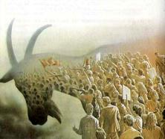
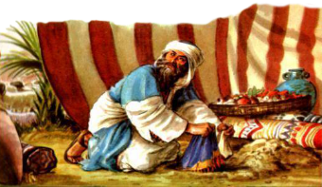
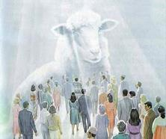
BABHIDLIZWE NGOKUZIKHETHELA KWABO
“Ngakho uJoshuwa wasinqoba sonke isigaba sezintaba, leningizimu, lezintaba zasentshonalanga, lemithambeka yezintaba, kanye lawo wonke amakhosi azo. Akashiyanga loyedwa owasindayo. Waqeda konke okuphefumulayo, njengokulaya kukaJehova uNkulunkulu ka-Israyeli.” ( Joshuwa 10:40 )
Yonke indawo yaseKhanani yabizwa ngokuthi isiqalekiso, okunguyikuthi, inikezelwe ekubhujisweni. Konke okuphilayo kwakuzakufa ( Dut. 20:16-18; Josh. 10:40 ).
Labo ababemiselwe ukubhujiswa abalalela uNkulunkulu babengaphila (isb., uRahabi)
Ama-Israyeli angazange amlalele uNkulunkulu ayezobulawa (isb., u-Akani).
Ngalokho, kwakukhona okuhlukileyo:
Phambi kukaNkulunkulu, amaKhanani lama-Israyeli ayebhekwa ngokulinganayo: ngokungakhethi. Umehluko wawuyikuthi abanye bakhetha ukuphikelela ekuhlubukeni kwabo kuNkulunkulu, kuyilapho abanye bekhetha ukumlalela.
Manje, isinqumo ngesethu. Lapho uJesu efika, sizosindiswa loba sibhujiswe ngokukhetha kwethu.

Slide 8

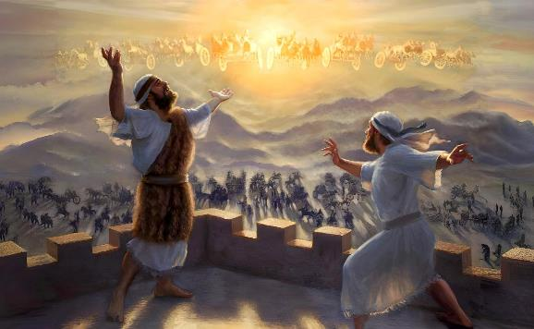
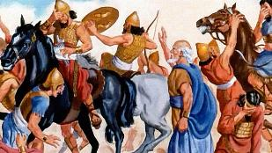
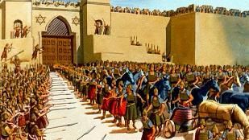
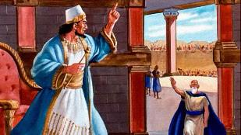
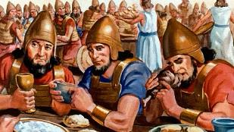
DINGA UKUTHULA
“Ngiyakwenza ukuthula kube ngumbusi wakho, lokuphila kahle umbusi wakho.”—Isaya 60:17b.
UJesu ubizwa ngokuthi “iNkosi yokuthula” ( Isaya 9:6 ). Uzele ukuletha ukuthula, futhi uzabusa ngokuthula. ( Johane 14:27; Isaya 60:17 ).
Kodwa kuze kube yilapho umbuso wakhe wokuthula uba ngokoqobo, sihlala endaweni elempi, sicwile engxabanweni yamazulu phakathi kokuhle lokubi
Lapho ibutho laseSiriya livimbezela iDothani ukuze libambe umprofethi u-Elisha, akazange acele uNkulunkulu ukuba avumele ibutho lasezulwini elimzungezileyo libhubhise abaseSiriya. Kunalokho, wacela ukuhola ibutho laseSiriya elaliphuphuthekile alise eSamariya ukuze, lapho selikhona, alethe ukuthula phakathi kwezizwe ezimbili ezilwayo (2 AmaKhosi 6:12-23).
Lesi isibonelo uJesu asifundisa sona: ukufuna ukuthula njalo lapho kungqubuzana. Ukunqoba okubi ngokuhle. ( Roma 12:20-21 ).

Slide 9

“Ukubhujiswa okupheleleyo kwabantu baseJeriko kuwukuyigcwaliseka kwemiyalo eyanikezwa ngaphambili ngoMose ngokuphathelene lezakhamuzi zaseKhanani [...] Kwabaningi le miyalo ibonakala iphikisana lomoya wothando lesihe olawulwe kwezinye izingxenye zeBhayibheli, kodwa eqinisweni yayiyizimemezelo zokuhlakanipha lobuhle obungapheliyo. UNkulunkulu wayesezamisa u-Israyeli eKhanani futhi abe ngumbusi phezu kwabo ukuze abe lombuso waKhe phakathi kwabo futhi babe lmbuso Wakhe emhlabeni. hatshi nje ukuba yizindlalifa zenkolo yeqiniso, kodwa lokufakaza izimiso zayo emhlabeni wonke amaKhanani ayesezitshiyile ubuqaba obunyanyekayo lobubi kakhulu, futhi kwakudingekile ukuba izwe lisuswe lokho okwakuyovimbela ngokuqinisekiley ukugcwaliseka kwenjongo kaNkulunkulu y`omusa.”
EGW (Patriarchs and Prophets, p. 492)

