Slide 1
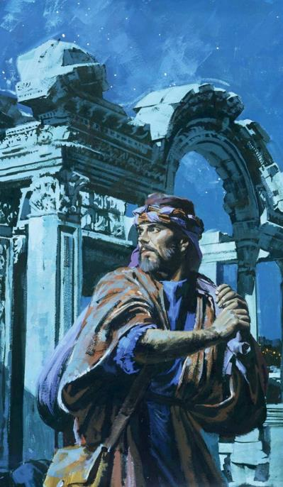
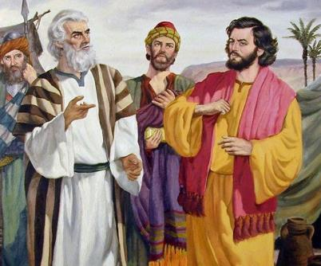
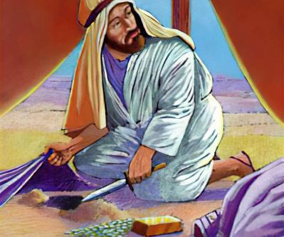
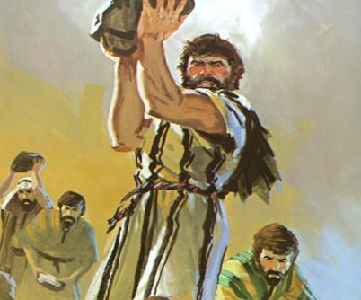
Isifundo sesithupha kuLwezi ilangaletshiyangalombili ku2025
ISITHA NGA
PHAKATHI

Slide 2


“Mina Jehova ngihlola inhliziyo, ngihlolisise umnqondo, ukuze nginike yilowo lalowo njengezindlela zakhe, njengezithelo zezenzo zakhe.”
Jeremiya 17:10

Slide 3


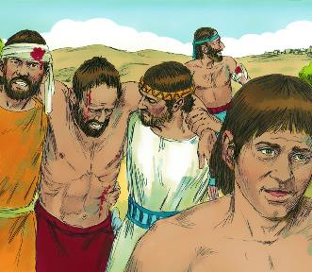
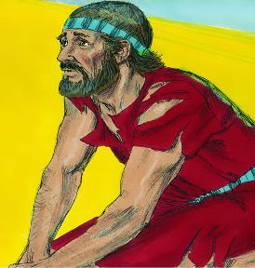





Ngemva kweqhinga lezempi elingelangqondo, izindonga zaseJeriko zawa. U-Israyeli wangena emzini, wawudilizela phansi. Ukunqoba! Okabani? NgokukaNkulunkulu, njengoba uIsrayeli wayelokuncane ukwenza ngakho.
Ngemva kweqhinga lezempi elicatshangelwe kahle, i-Ai iyawina. Hlula! Ngobani? Ngabantu bakwa-Israyeli, njengoba babengethembanga kuNkulunkulu.
Lapho ekugcineni bebuza uNkulunkulu, impendulo yayilamandla: U-Israyeli wonile futhi akasakwazi ukunqoba izitha zakhe. Ingaphinde iwuthole kanjani umusa waphezulu?
Imbangela yokwehlulwa (Joshuwa 7:1-5, 10-13)
Bakhathazeka futhi bahlutshwa (Joshuwa 7:6-9)
Uthola umeqamthetho (Joshuwa 7:14-19)
Isono sika-Akani (Joshuwa 7:20-26)
Unqobile Futhi (Joshuwa 8:1-29)

Slide 4

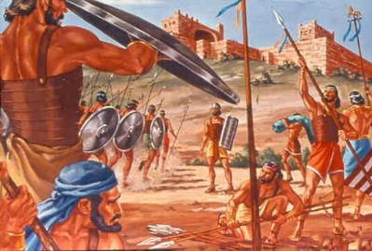
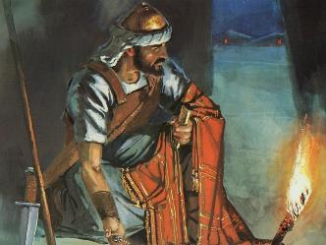
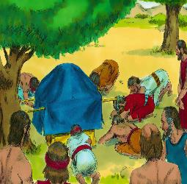
OKWABANGELA UKWEHLULWA
“U-Israyeli wonile, basephulile isivumelwano sami engabalaya ukuba basigcine, bathathile kokuqalekisiweyo, bebile, beqambe amanga, bakubeke empahleni yabo.”— Joshuwa 7:11 .
Ngemva kombiko omuhle wezinhloli ezathunyelwa eJeriko, uJoshuwa wabuza uNkulunkulu futhi wathola kuye isu lokuwuthatha lo muzi.
Uma, ngemva kokuthola umbiko ezinhlolini ezazithunyelwe e-Ayi, uJoshuwa wenza okufananayo, ukufa kwabantu abangu-36 kwakungavikeleka ( Joshuwa 7:1-5 ).
Kodwa sasiyini isizathu sangempela sokunqotshwa, loba yini eyayingaba yisizathu sokuba uNkulunkulu atshele uJoshuwa ukuba angalihlaseli i-Ayi ( Josh. 7:11 )?
UNkulunkulu wayebonile ukuthi “u-Israyeli wonile.” Akukho ndawo eBhayibhelini lapho isono sichazwa ngamagama ahlukeneyo anjengalawa: “badlwanguzile . . . bathathé… bebile . . . baqambe amanga . . .
Qaphela ubuningi. Isono senziwa ngumuntu oyedwa, kodwa uNkulunkulu wabeka icala kubo bonke abantu. Basephulile isivumelwano; isono kwadingeka sisitshulwe ukuze sibuyiselwe.

Slide 5

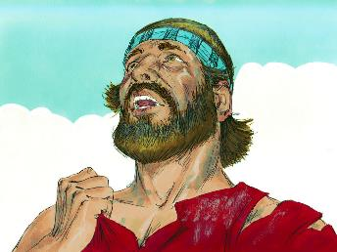
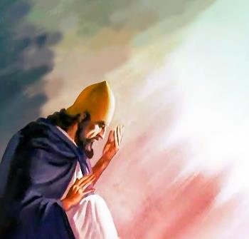
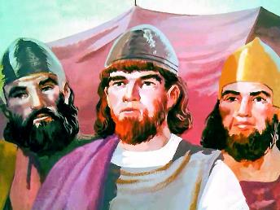
UDIDEKILE FUTHI UYAHLUPHEKA
“UJoshuwa wathi: “Maye, Nkosi EnguMbusi, ubachaphiseleni laba bantu iJordani ukuba usinikele esandleni sama-Amori ukuba asibhubhise na? Ukube sanelisiwe yikuhlala ngaphetsheya kweJordani!” ( Joshuwa 7:7
UJoshuwa labadala bebandla bakhathazeka ngokunqotshwa e-Ayi, futhi babonisa izimpawu ezicacileyo zokukhala( Josh. 7:6 ).
UJoshuwa wasabela ngokuthukuthela okufana lokusabela kukaIsrayeli ngokuphindaphindiweyo phakathi leminyaka engu-40 ezulazula: “Usiletheleni lapha…? Ukube sanelisiwe yikuhlala …!” ( Josh. 7:7 ).
UJoshuwa wasabela ngokuthukuthela okufana lokusabela kukaIsrayeli ngokuphindaphindiweyo phakathi leminyaka engu-40 ezulazula: “Usiletheleni lapha…? Ukube sanelisiwe yikuhlala …!” ( Josh. 7:7 ).
Ngakho, umoya kaJoshuwa wawungafani lowama-Israyeli ehlane. Ukukhononda kwakhe kwakungashukunyiswa ukudumazeka, kodwa kwakubangelwa yikwesaba ukuthi igama likaNkulunkulu laliyohlanjalazwa phakathi kwabeZizwe ( Josh. 7:8-9 ).

Slide 6
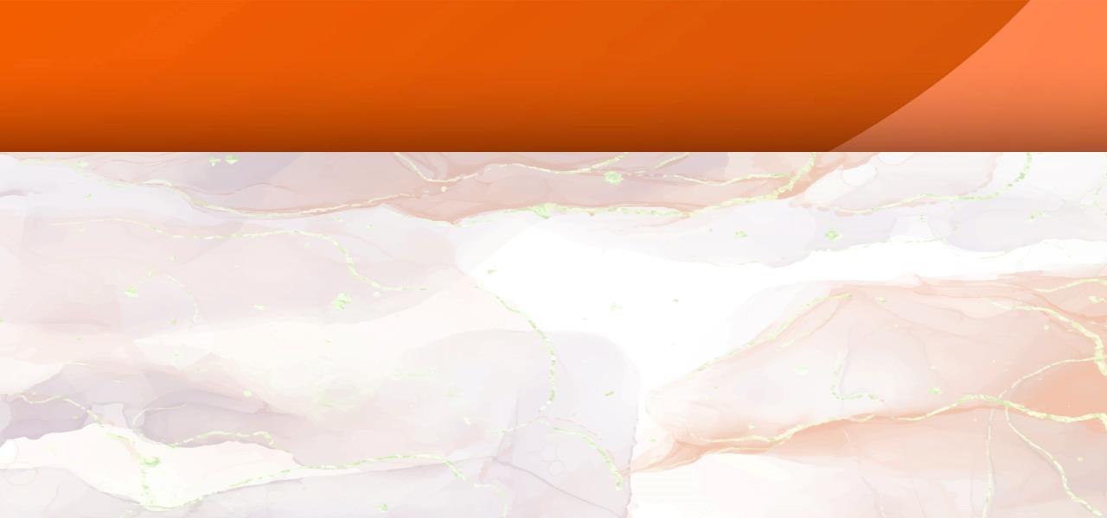
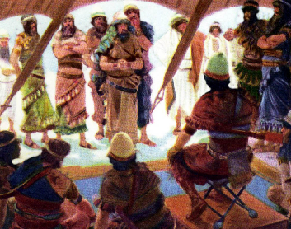
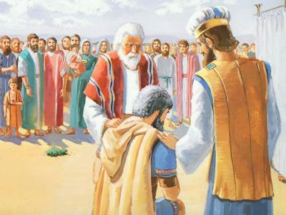
UKUTHOLA UWEQUMTHETHO
“Kusasa, zimiseni ngokwezizwe ngezizwe. Isizwe uJehova asikhethayo siyakusondela ngomindeni; lomndeni uJehova awukhethayo uyakusondela imhuli ngemhuli; lemhuli uJehova azayikhetha izakusondela indoda ngendoda” (Joshuwa 7:14).
Ukuze kususwe isono senhlangano (icala labantu bonke), isoni kwakufanele siqedwe ( Josh. 7:15 ). Siqediwe? Ubengeke yini athethelelwe uma ephenduka? Yebo wayezokwenza! Kodwa u-Akani akazange abonise sibonakaliso sokuphenduka okuqotho (futhi wayelamathuba amanengi okwenza kanjalo).
Inqubo yokupheywa kwamenyezelwa futhi yahlehliswa kwaze kwaba ngakusasa (Josh. 7:14-15)
Isizwe sakwaJuda sathathwa (Josh. 7:16)
Umndeni kaZera wathathwa (Josh. 7:17a)
Umholi uZabdi wathathwa (Josh. 7:17b)
U-Akani wathathwa (Josh. 7:18)
Achani wathula
Achani wathula
Achani wathula
Achani wathula
Achani wathula
Ebonisa umusa lothando lwaphezulu, uJoshuwa wacela u-Akani ukuba avume isono sakhe ( Josh. 7:19 ).
Icala lika-Akhani lehluleka. Wavuma, kodwa akazange acele intethelelo (Josh. 7:20). Ngakho uNkulunkulu walilela ubulukhuni benhliziyo yakhe, ebonakaliswa kukho konke ukubiza ukuthi aphenduke.

Slide 7
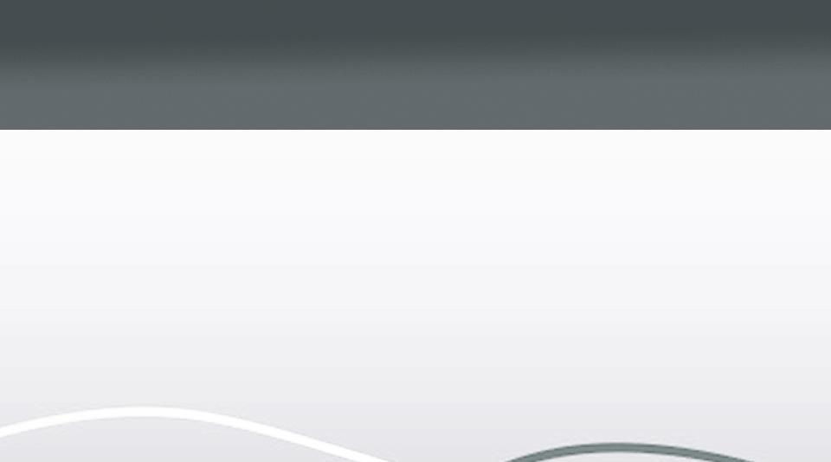
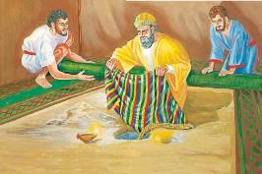

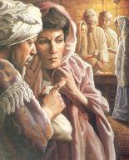
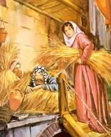
ISONO SIKA-AKAN
““Lapho ngibona ingubo enhle yaseBabele, lamashekeli angamakhulu amabili esiliva, lesigaxa segolide, isisindo saso singamashekeli angamatshumi ayisihlanu, ngakufisa, ngakuthatha, kuthukuzwe emhlabathini phakathi kwetende lami, isiliva liphansi kwalo.”
Rahab
Wafihla izinhloli ophahleni
He acted kindly toward Israel
Achan
Akuntshontshayo wakufihla emhlabathini
Kwaletha inkathazo ku-Israyeli
Wenza umusa ku-Israyeli
Wenza ukunqotshwa ngemisebenzi yakhe
Wenza isivumelwano lo-Israyeli
Wephula isivumelwano sika-Israyeli
Wakhulula ukuphila kwakhe lemhuli yakhe
Watshona lomndeni wakhe
UJoshuwa wacela u-Akani ukuba anike uNkulunkulu inkazimulo futhi avume isono sakhe ( Josh. 7:19 ). Bekulithuba lakhe lokugcina. Uma, lapho evuma, wayecele intethelelo… Kodwa akazange, futhi kwakungekho ukuthethelelwa kuye. ( Num. 15:30-31 ).
Njengo-Eva, u-Akhani “wabona,” “wafisa,” futhi “wathatha,” futhi isono sakhe sathinta abanengi ( Gen. 3:6 ). Njengo-Ananiya loSafira, u-Akani wathatha ezinye zezinto eziqalekisiweyo ezinikelwe kuNkulunkulu wazikhokhela ( IzEnzo 5:1-2 ).
Izinqumo u-Akhani azenza eJeriko zaziphikisana ngokupheleleyo lezikaRahabi:

Slide 8

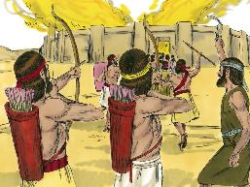
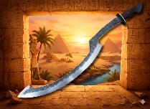
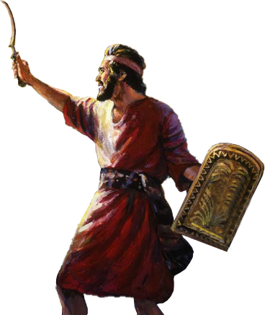
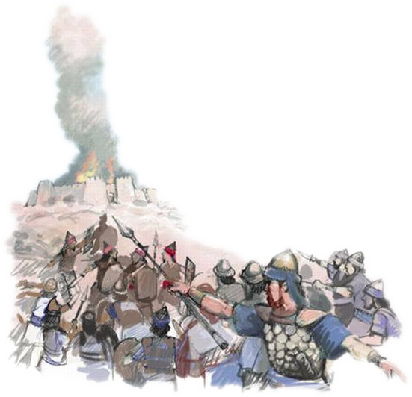
UYANQOBA FUTHI
“UJehova wasesithi kuJoshuwa: “Ungesabi; ungadangali. Thatha lonke ibutho, futhi ukhuphuke futhi uhlasele i-Ayi. Ngokuba nginikele esandleni sakho inkosi yase-Ayi, labantu bayo, lomuzi wayo, lezwe layo.” ( Joshuwa 8:1 )
NjengaseJeriko, uNkulunkulu wanikeza uJoshuwa isu lokunqoba i-Ayi ( Josh. 8:1-2 ).
Ebusuku, kwacathamelwa abantu ngemva komuzi. Kwathi kusempondo zankomo, ibutho lafika e-Ayi latshaya sengathi liyabaleka futhi phambi kwalo.
Njengoba uMose ephakamisa udondolo lwakhe kwaze kwaba yilapho enqoba ama-Amaleki, ngomlayo kaNkulunkulu, uJoshuwa waphakamisa “isikhali” sakhe (cishe inkemba yesikela eyayisetshenziswa ngaseGibithe) wasigcina siphakeme kwaze kwaba yilapho enqoba ngokupheleleyo ( Josh. 8:18-22, 26 ) .
UNkulunkulu waphinde wabapha ukunqoba abantu bakhe. Isigodi sase-Akori, lapho u-Akhani lomndeni wakhe babulawa khona, savula umnyango wokunqoba, “umnyango wethemba” ( Hoseya 2:15 ).
Lapho samukela intethelelo yaphezulu ngokholo, uNkulunkulu ungcwaba isono sethu e-Akori, futhi uvula umnyango wethemba.

Slide 9

“Indonsela okufanele yesatshwe kakhulu libandla akusiyo elalabo abaphikisa obala, abangakholwayo labahlambalazayo, kodwa lingabaprofessor bakaKristu abangaguqukiyo.” Laba yilabo abasigodlayo isibusiso sikaNkulunkulu ka-Israyeli futhi balethe ubuthakathaka phezu kwebandla, inhlamba engesulwa kalula.
UbuKristu akumele bubukiswe nje ngeSabatha futhi bubukiswe endaweni engcwele; kungokwazo zonke izinsuku evikini lasezindaweni zonke. Izimangalo zayo kufanele ziqatshelwe futhi zilalelwe emhlanganweni wokufundisaa ngolwazi, ekhaya, lasekuhwebeni kwebhizimisi labazalwane kanye lomhlaba…”
EGW (Conflict and Courage, April 23)

