Slide 1
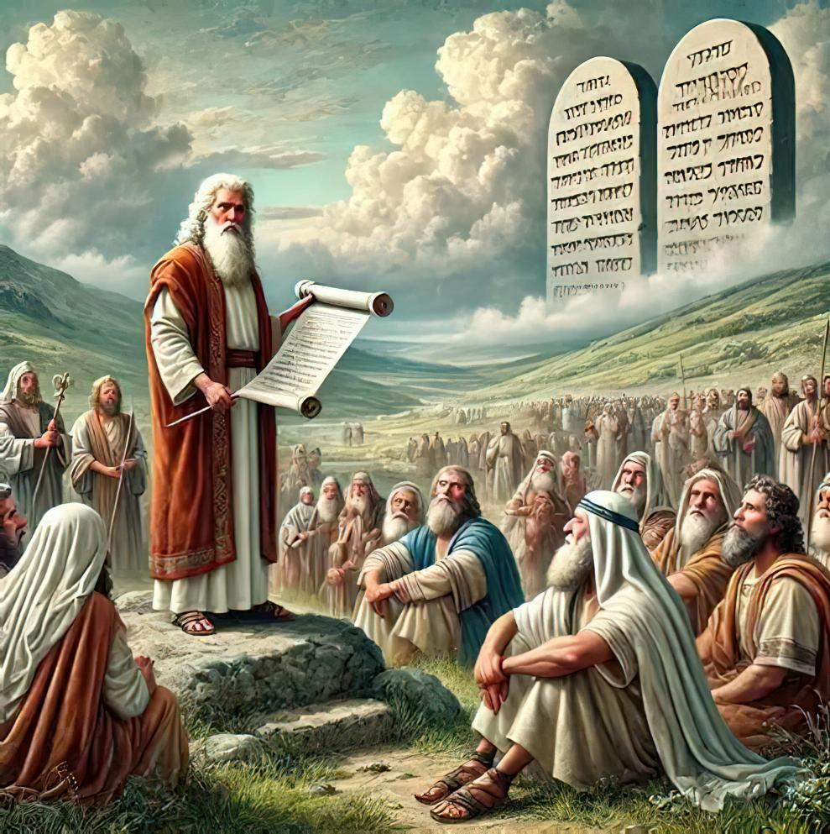
UKWETHEMBEKA OKUPHELELEYO: UKUKHONZA ENDAWENI YEMPI
Isifundo sesikhombisa kuLwezi ilanga letshumi lanhlanu 2025

Slide 2
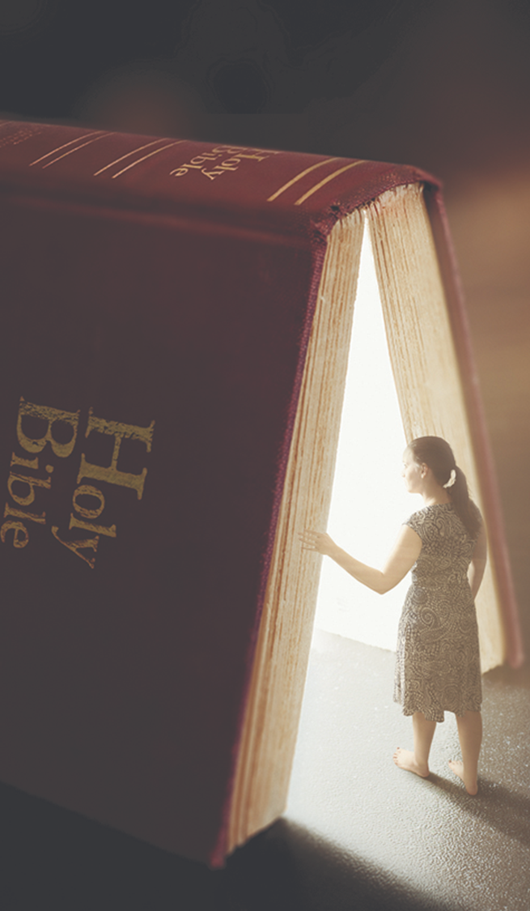
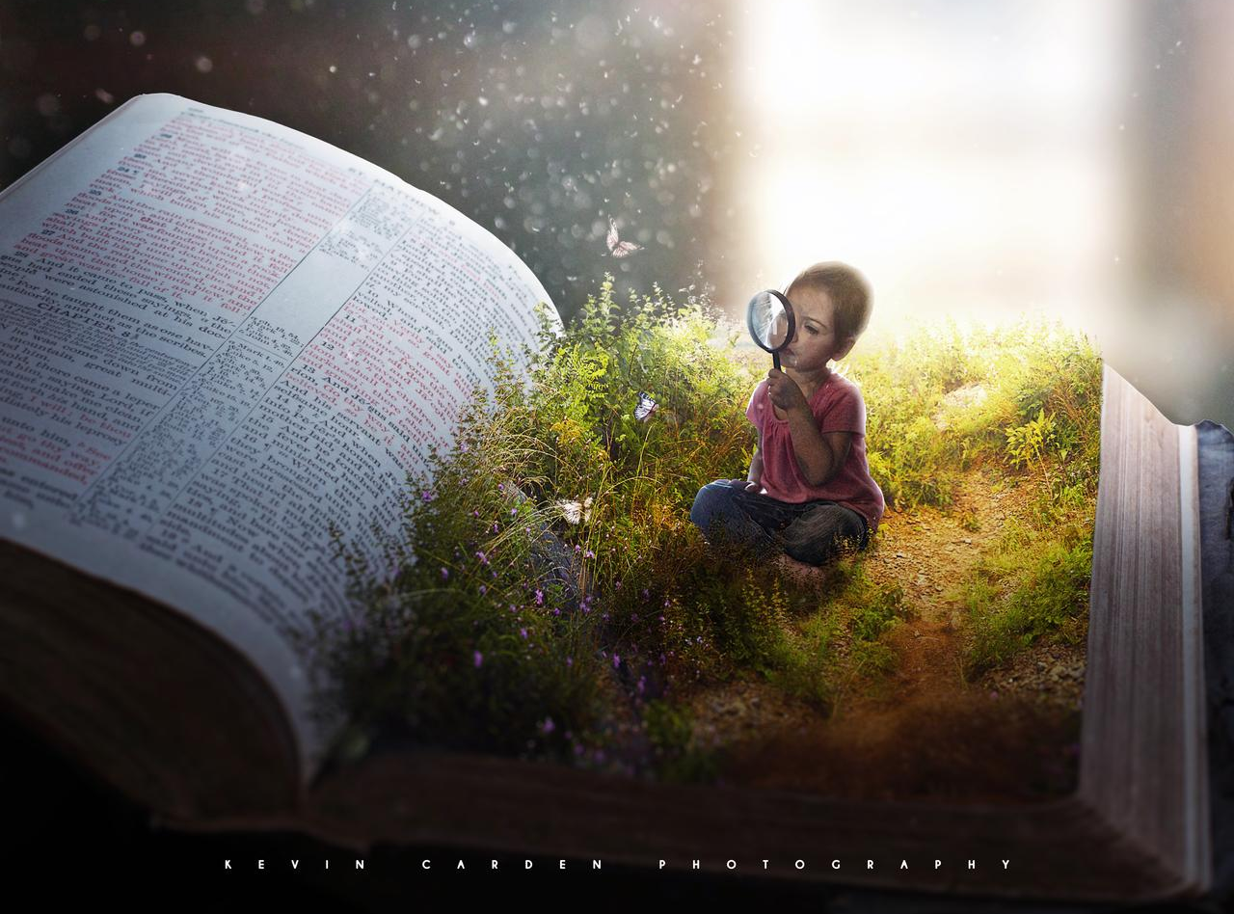

“ ‘Kepha funa kuqala umbuso kaNkulunkulu lokulunga kwakhe, khona konke lokhu kuyakwengezelelwa kuwe’ ” Mathewu 6:33

Slide 3

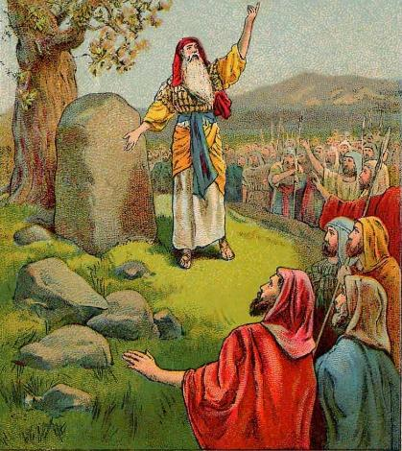
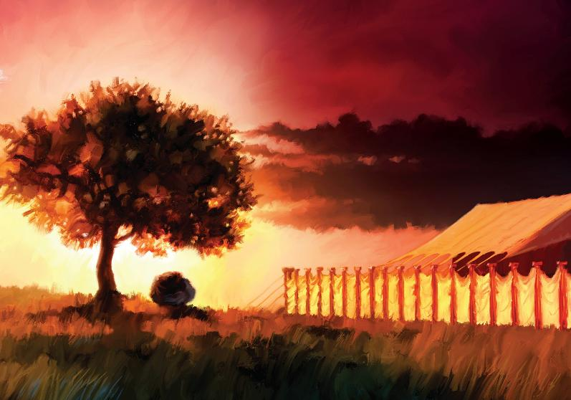








Ekuweleni iJordani okuyisimangaliso, wonke amakhosi aseKhanani ayesaba (Joshuwa 5:1). Inkundla yalungiselelwa ukunqoba ngokuphangisa.
Ngalokho, lokhu kwakungasiyo into eyabuya kuqala kuma-Israyeli. Kwakufanele baqale bafune ukuhlanganyela loNkulunkulu.
Phakathi kokunqoba, banquma futhi ukuthatha ikhefu ukuze bazinikele kakubutsha kuJehova emhlanganweni omkhulu phakathi kwezintaba zase-Ebali laseGerizimu.
Lapho sebezaqeda ukunqoba, bafinyelela ibanga elitsha lokukhonza: bakha iNdawo Engcwele eShilo
Khonza phambi kokunqoba:
  Ukwenziwa kakutsha kwesivumelwano (Joshuwa 5:1-9)
  IPhasika lokuqala eKhanani (Joshuwa 5:10-12)
Ukukhonza phakathi kwezintaba:
  Ilathi lokukhuleka(Joshuwa 8:30-31)
  Khumbula umthetho(Joshuwa 8:32-35)
Indawo ekhethekileyo yokukhonza:
  Ukuphakamisa indawoendcwele (Joshuwa 18:1)

Slide 4

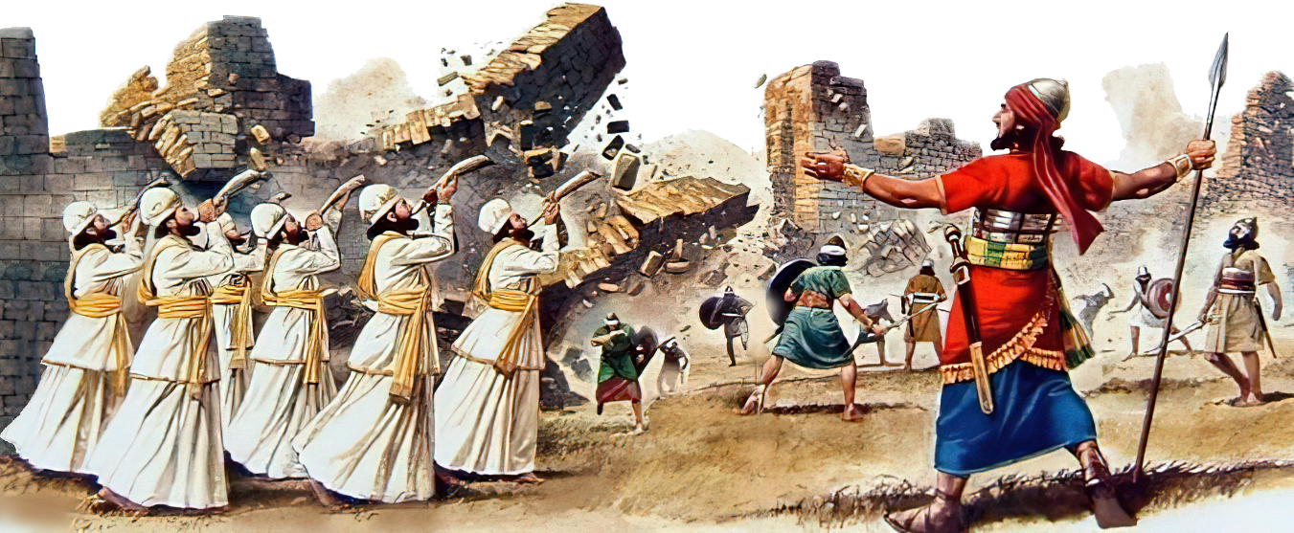
UKUDUMISA NGAPHAMBI KOKUNQOBA

Slide 5

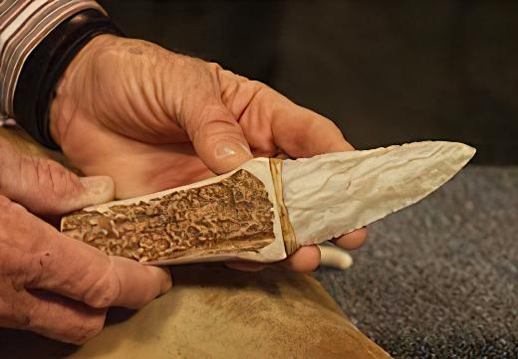
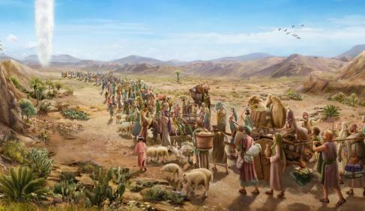

UKUVUSELELWA KWESIVUMELWANO
“Ngaleso sikhathi uJehova wathi kuJoshuwa: “Zenzele inqamu , uphinde usoke abantwana bakwa-Israyeli.” (Bala uJoshuwa 5:2.)
IGiligali ligama elaphiwa inkama yama-Israyeli, isikhungo sokuqondisa phakathi lengxenye yokuqala yokunqoba. yikuphi ukubaluleka okwaphiwa leli gama ( Josh. 5:9 )?
Langoba kwase kudlule iminyaka engaphezu kwengu-40 ephuma eGibhithe, ama-Israyeli ayengakangeni eZweni Lesithembiso. Manje, izinyawo zabo zaziwunyathela. Kwase kuyisikhathi sokususa “iukuhlambalazwa kwaseGibhithe” futhi kuvuselela isivumelwano loNkulunkulu.
Ngaphambi kokuba badle iPhasika lokuqala, abesilisa bama-Israyeli babesokwa, ngoba akekho umuntu ongasokile owayengadla kulo ( Eks. 12:48 ). Kodwa ngenxa yokuthi bala ukungena eKhanani okokuqala, isivumelwano sephulwa, futhi akekho umIsrayeli owasokwa ehlane ( Josh. 5:5 ).
Ukuvuselela isivumelwano, kwakudingeka ukuphinda leso sibonakaliso senyama (Gen. 17:10). Lesi senzo sabeka okwakubalulekile kuqala. Kithina, kuyisibonelo sokusilandela: “Kodwa funani kuqala umbuso wakhe lokulunga kwakhe, khona konke lokho kuyakwengezelwa kini.” ( Mt. 6:33 ).

Slide 6

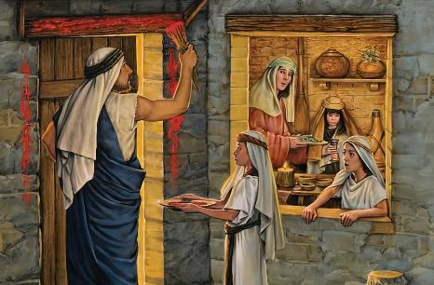
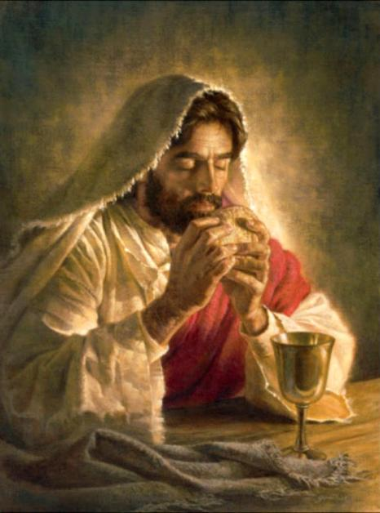
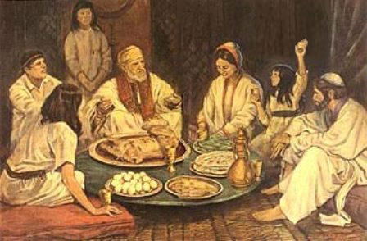
IPHASIKA LOKUQALA EKHANANI
“Kusihlwa ngosuku lwetshumi lane lwenyanga, bekhempe eGiligali emathafeni aseJeriko, abantwana bakwa-Israyeli bahanganyela kuPhasika.”—Joshuwa 5:10
Ukusuka eGibhithe kuya eKhanani, u-Israyeli walandela inqubo “yechiastic,” ephinda izenzakalo ngokulandelana kwazo:
EGibhithe
Ukusoka kanye lePhasika
Ukuwela uLwandle Olubomvu
Inkangala
Ukuwela iJordani
Ukusoka kanye lePhasika
Ikhenani
IPhasika lokuqala laliluphawu lokukhululwa eGibhithe. IPhasika lesibili, eligujwa isizukulwane esitsha, laliluphawu lokuthatha kwaso iZwe Lesithembiso.
Ngaphambi nje kokubethelwa kwakhe, uJesu wanika lesi siko incazelo entsha, elezimpawu ezintsha: iwundlu laba isinkwa, futhi igazi laba iwayini.
Manje seziluphawu lomzimba legazi loMhlengi wethu, osikhipha eGibhithe (okuyikuthi, esonweni sethu), futhi osiletha eZweni Lesithembiso ( 1 Kor. 11:23-26 ).

Slide 7

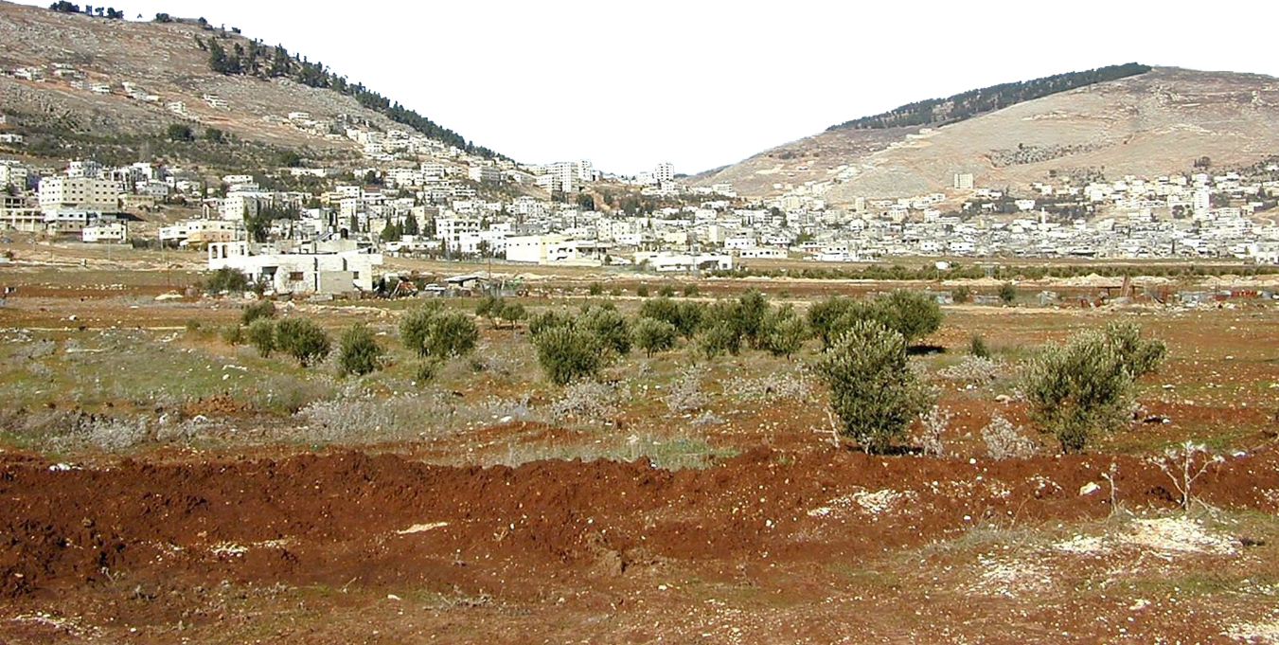
UKUKHONZA PHAKATHI KWEZINTABA

Slide 8

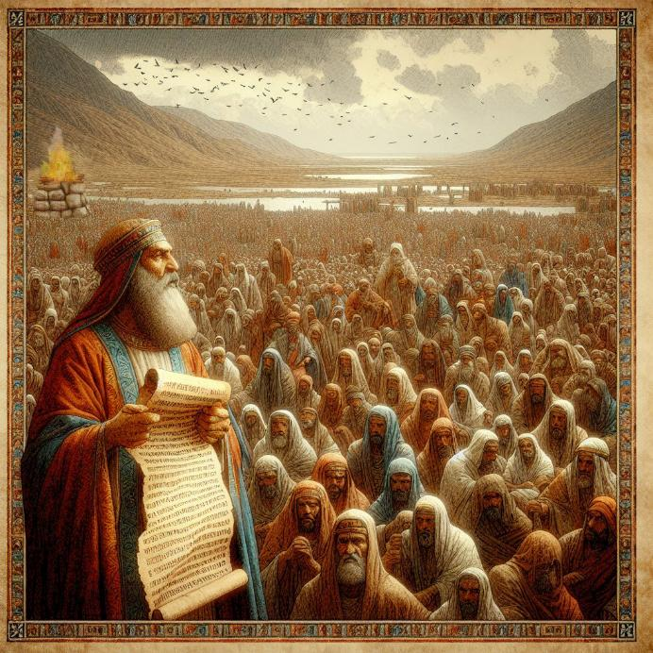
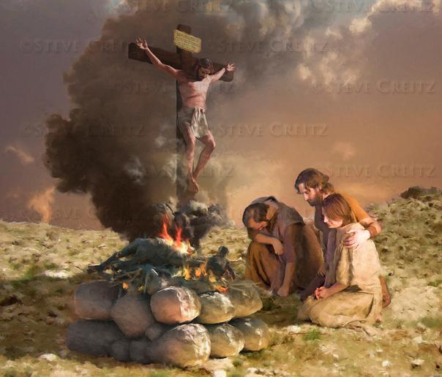
I-LATHI LOKUDUMISA
“UJoshuwa wamakhela uJehova uNkulunkulu ka-Israyeli i-lathi entabeni yase-Ebali.”— (Joshuwa 8:30)
UMose wayelaye ukuthi nxa bengena eKhanani, kwakhiwe i-lathi eNtabeni i-Ebali, futhi udumo kufanele luphiwe uNkulunkulu ( Dut. 27:5-7 ). Kungani eNtabeni i-Ebali hhayi eGerizimu?
Kokubili i-lathi lemithetho okwakumele ilotshwe etsheni lesikhumbuzo futhi ifundelwe abantu kwakuhambelana lezibusiso leziqalekiso ( Dut. 27:12-13 ). Isibusiso samenyezelwa eGerizimu, lesiqalekiso phezu kuka-Ebali.
UJesu waba yisiqalekiso ngenxa yethu, ukuze sithole isibusiso (Gal. 3:13-14). Leli ilathi, kithi, lingumfanekiso ocacileyo womhlatshelo kaJesu ngenxa yethu
Phakathi lokunqoba, u-Israyeli wafuna isikhatshana sokuzinikezela kakutsha kuNkulunkulu. Lesi isimemo sokuba silingise isibonelo sabo, sizinikele kakutsha kuNkulunkulu, hhayi nje ngabanye, kodwa lanjengabakhethiweyo bakaNkulunkulu.

Slide 9

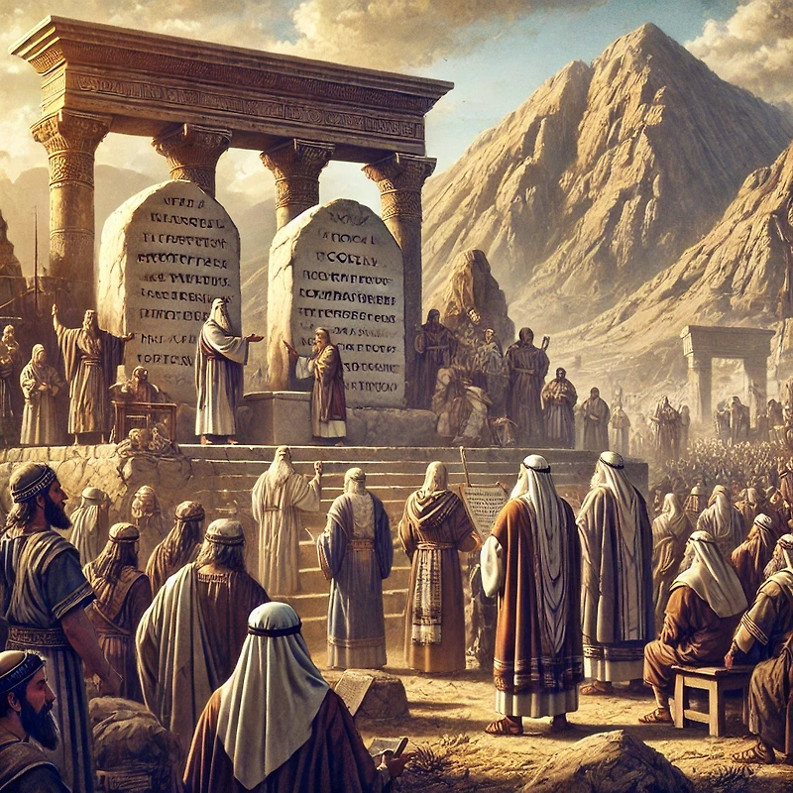
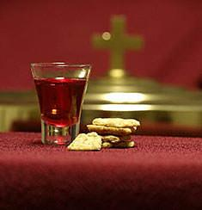
KHUMBULA UMTHETHO
“Lapho, phambi kwabantwana bakwa-Israyeli, uJoshuwa waloba ematsheni ikhophi yomthetho kaMose”
(Joshuwa 8:32)
Ngemva kokwakha i-lathi eNtabeni i-Ebali, uJoshuwa wamisa amatshe wawanameka ngodaka. Wase bhala kuwo umthetho [Duteronomi, eyayihlanganisa iMithetho Elitshumi lemithetho ehlukahlukeneyo, kanye lezibusiso leziqalekiso] ( Josh. 8:32; Dut. 27:2-3 ).
Ekugcineni, umthetho wafundelwa abantu, wahlukaniswa waba zingxenye ezimbili—enye ohlangothini ngalunye lwentaba ( Josh. 8:33-35 ). Ngale ndlela, isivumelwano phakathi kukaNkulunkulu labantu bakhe savuselelwa.
Lolu bizo lakithi. Njengabantu bakaNkulunkulu abaseleyo, kumele ngezikhathi ezithile sivuselele isivumelwano sethu Laye, sikhumbule ukuthi usihole kanjani kuze kube manje kanye lezibusiso asiphe zona
Ngaphezu kokuvuselelwa kwethu siqu, iSidlo esiNgcwele siphinde sisinikeze leso sikhathi esikhethekileyo sokwenziwa kakutsha njengabantu bakaNkulunkulu.

Slide 10
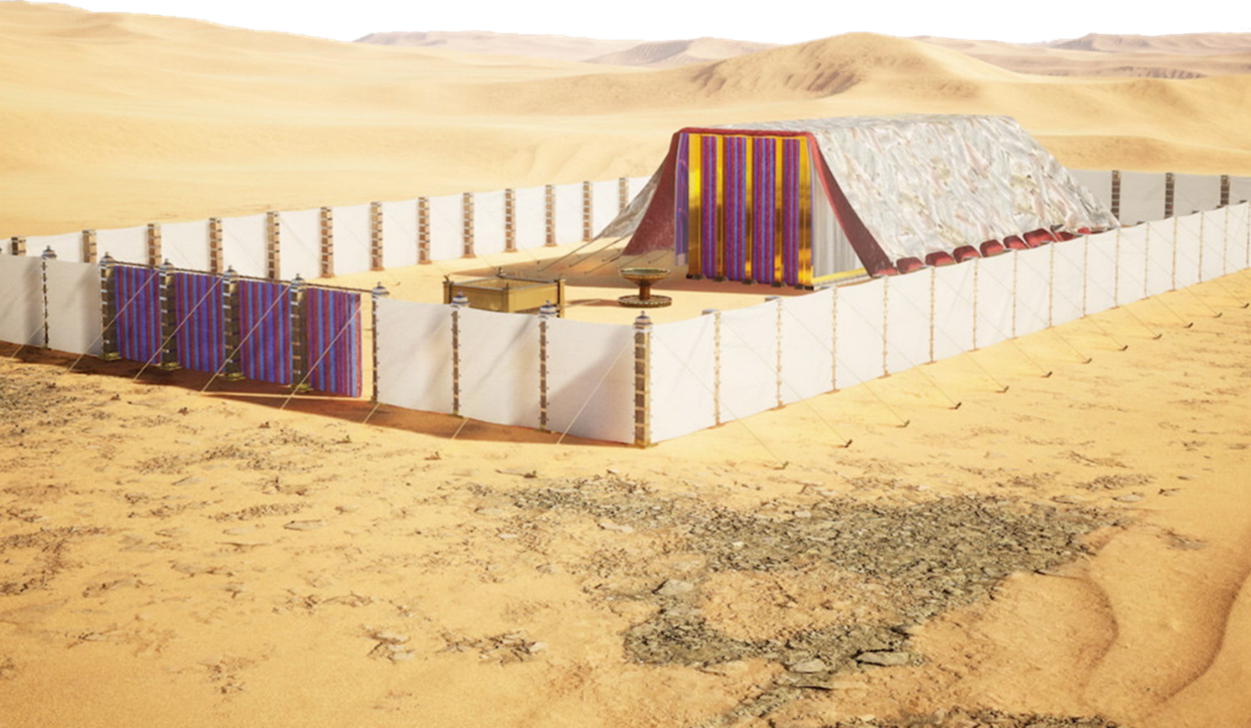
INDAWO EKHETHEKILEYO YOKUKHONZA

Slide 11
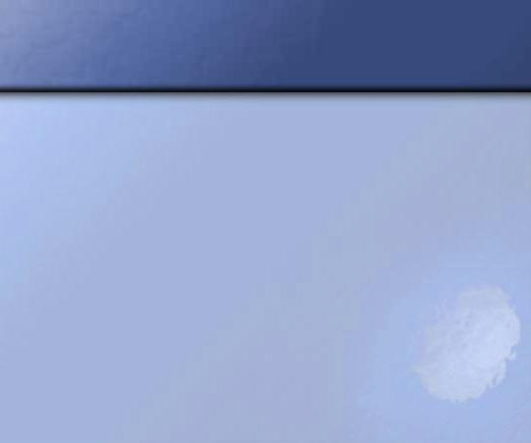
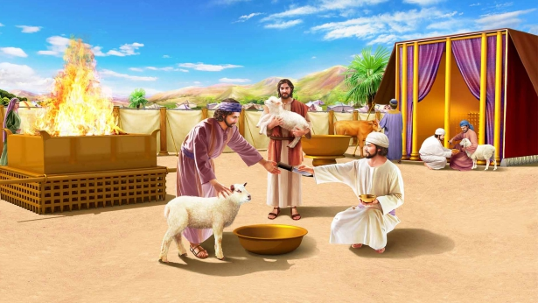
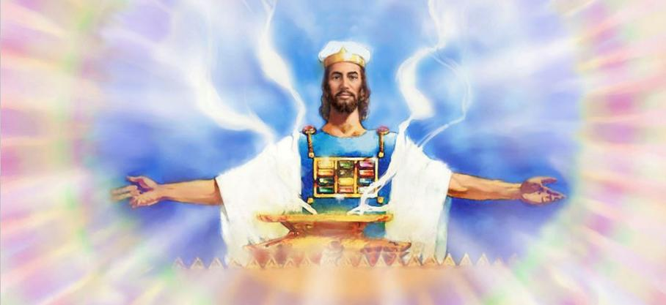
UKUVUSA INDAWO ENGCWELE
“Yonke inhlangano yabantwana bakwa-Israyeli yabuthana eShilo, yamisa khona itende lokuhlangana, izwe lalawulwa yibo.”— Joshuwa 18:1
Le ndawo yayihlukaniselwe izizwe ezaziwayo, langoba izizwe eziyisikhombisa zazingakasitholi isabelo sazo. Amaqhawe akwaRubeni, loGadi, lenxenye yesizwe sakwaManase athunyelwa kokwakuzathujwa ngaphesheya kweJordani
Ngaphambi kokuba izizwe zihlukane, kwenziwa isenzo esikhethekileyo lesibalulekileyo: ukumiswa kweTabernakele, isikhungo sokukhonza kukaIsrayeli ( Josh. 18:1 ).
INdawo Engcwele, njengendawo kaNkulunkulu yokuhlala ebonakalayo, yayiyindawo yobunye lapho bonke babehlangana khona ekukhulekeleni. Ngaphandle kobukhona bukaNkulunkulu, ukuba lezwe kwakungatsho lutho
Lamuhla, lapho kuselezinsinde zamanje kanye lezamuva okufanele siyinqobe, kubaluleke kakhulu ukuthi sigxile eNdaweni Engcwele yaseZulwini, lapho uJesu esinxusela khona.

Slide 12

“Kwakungakadluli amaviki amangaki uMose ayinike abantu yonke incwadi kaDuteronomi, lokhu uJoshuwa waphinda wawufunda umthetho.
Akusiwo amadoda akwaIsrayeli odwa, kodwa “bonke abesifazane labancane” balalela ukufundwa komthetho; ngoba kwakubalulekile ukuthi labo bazi futhi benze umsebenzi wabo. […]
Zonke izahluko lawo wonke amavesi eBhayibheli ayikukhuluma okuvela kuNkulunkulu kubantu. Kufanele sibophe imiyalo yalo njengezibonakaliso ezandleni zethu lanjengemiphetho phakathi kwamehlo ethu. Uma itadishwa futhi ilalelwa, yayizahola abantu bakaNkulunkulu, njengoba amaIsrayeli ayeholwa, ngensika yefu emini lensika yomlilo ebusuku.”
EGW (Patriarchs and Prophets, pp. 500-504)

