Slide 1

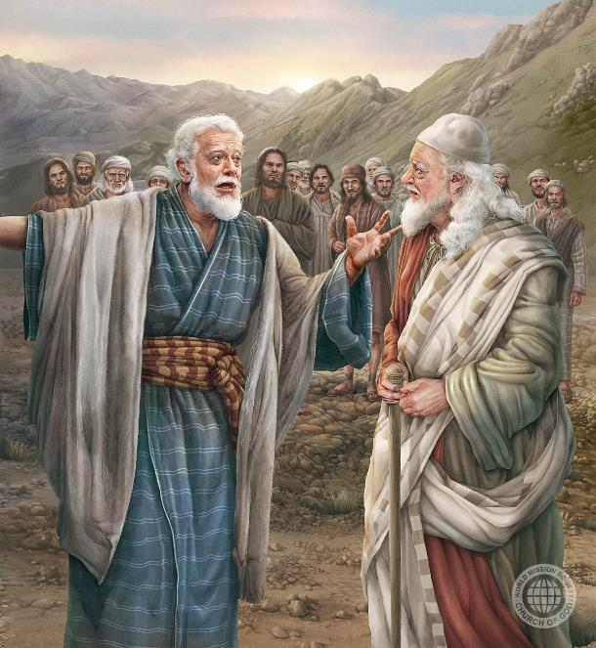
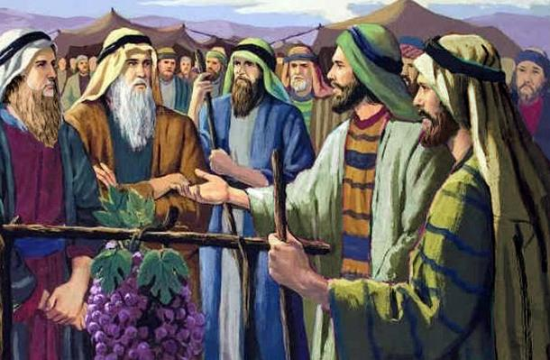
IZIQHWAGA ZOKUKHOLWA: UJOSHUWA LOKALEBI
Isifundo setshiyangalombili kuLwezi ilanga lamatshumi amabili lambili ku2025

Slide 2
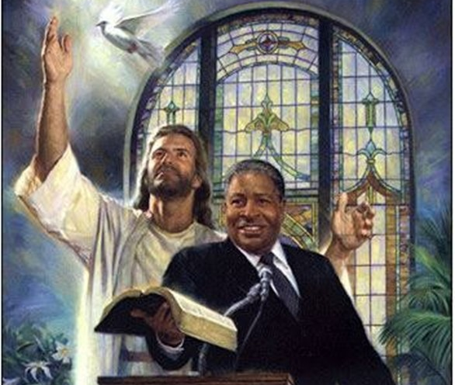
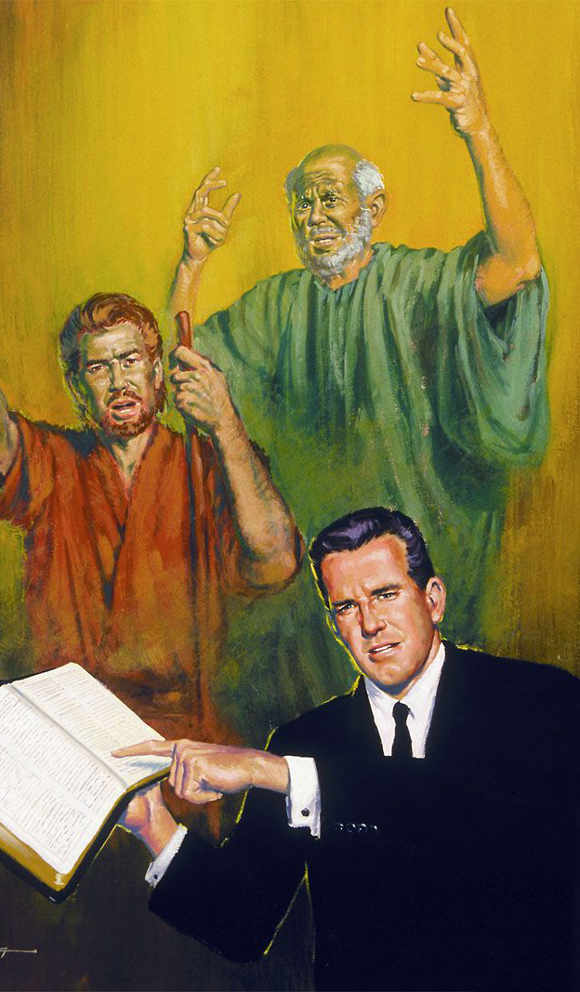
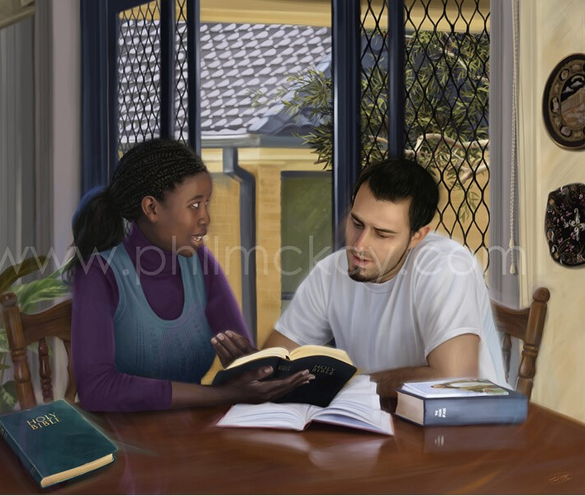
“Khumbulani abakhokheli benu abakhulume izwi likaNkulunkulu kini, libheke ukuphela kwendlela yabo, lilingise ukukholwa kwabo”
( KumaHeberu 13:7 )

Slide 3


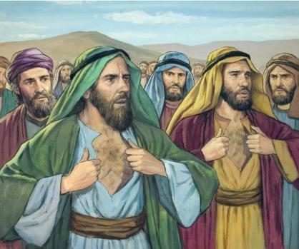




Uyabazi yini laba bantu abalitshumi: uShamuwa, uShafati, u-Igali, uPhaliti, uGadiyeli, uGadi, u-Amiyeli, uSethuri, uNabi loGewuweli?
“Udumo” lwakhe lwaluhlanganisa ukungawethembi amandla kaNkulunkulu, futhi ngalokho eletha ukufa kwakhe kanye lokwaso sonke isizukulwane (Num. 14:36-37).
Kodwa cishe uke wezwa ngalaba bantu ababili: uJoshuwa loKalebi. Bama baqina, bakholwa ezithembisweni zikaNkulunkulu, futhi baphila ukuze bazibone zigcwaliseka ( Num. 14:38 ).
Singakulingisa njani ukholo lwabo futhi sithembe ngokugcweleyo ukuthi uNkulunkulu angenza okungenzakaliyo, njengoba nje esenza?
Ukukholwa kukaKalebi:
  Ukwenza okungenzeki kwenzakale.
  Ukukholwa ngezenzo.
  Eqhubelana (ithotshi) isibane.
Ukukholwa kukaJoshuwa..
Indlela yokuthola ukholo..

Slide 4

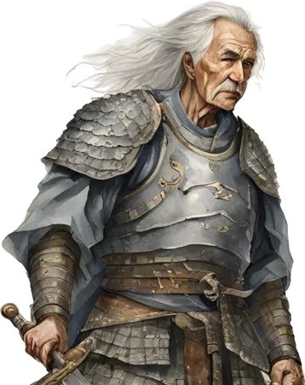
UKHOLO LUKA KALEBI

Slide 5

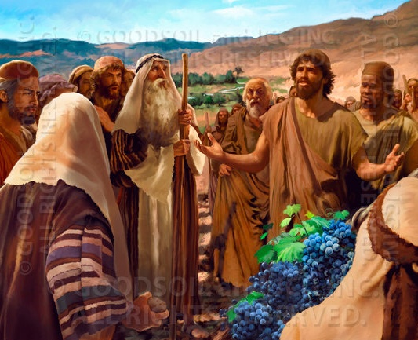
UKWENZA OKUNGENZEKALIYO KWENZAKALE
“Ngalokho, abafowethu abakhuphuka lami bancibilikisa izinhliziyo zabantu, kepha mina ngamlandela uJehova uNkulunkulu wami ngokupheleleyo” (Joshuwa 14:8, NKJV).
Ibizo elithi "Kalebi" litsho "inja." Njengoba ukuphila kwakhe kwakubonisa, lelo gama akalitholanga njengegama eliyindelelo, kodwa ngenxa yobuqotho bakhe obungantengantengi. Wayethembekile lapho abanye bengathembekile khona. Wahlala ethembekile kuNkulunkulu lapho abanye behlubuka.
Lapho izinhloli ezilitshumi zazibona amadolobha engelakunqotshwa, leziqhwaga eezingelakunqotshwa, uKalebi wabona amadolobha enqotshiweyo leziqhwaga “zidliwa njengesinkwa” ( Num. 13:28-33; 14:6-9 ).
Ekanye loJoshuwa (owayemncane ngandlela-thile kulaye), wema eqinile embonweni wakhe, ngitsho lalapho isixuku sasifuna ukubakhanda ngamatshe (Num. 14:10).
Isibonelo sakhe sisikhuthaza ukuba silondoloze ukholo lwethu luqine kuNkulunkulu, ongenza lokho esingelakukwazi ukukwenza kwenzeke

Slide 6

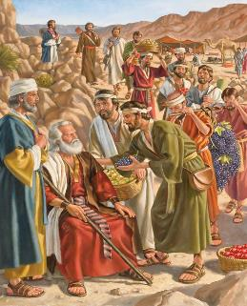
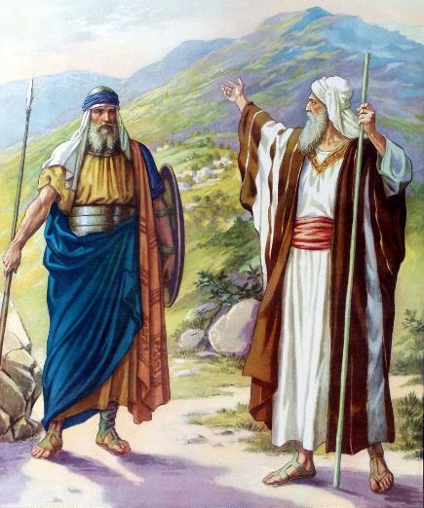

UKHOLO NGEZENZO
“Manje nginike leli zwe lezintaba uJehova alithembisa kimi ngalolo suku, wena ngokwakho wezwa ukuthi ama-Anaki ayelapho lemizi yawo yayimikhulu ilezivikelo eziqinileyo, kodwa, uJehova, engisizile, ngizowaxotsha njengokutsho kwakhe.”— Joshuwa 14:12
NgokukaKalebi ngokwakhe, lapho uMose ecela ukuba alandise, “ngabuya lawo umbiko ngokwezinkolelo zami.” ( Josh. 14:7 NIV ), futhi “ngalandela uJehova uNkulunkulu wami ngenhliziyo yonke” ( Josh. 14:8 ).
Ngenxa yokwethembeka kwakhe, wathenjiswa ukuthi wayezazuza indawo lapho unyawo lwakhe lwalunyathele khona ngesikhathi sokuhlolwa ( Josh. 14:9 ).
UKalebi wayeleminyaka engu-40 lapho ethunywa ukuba abe yinhloli. Ngemva kweminyaka emihlanu yokunqoba, manje wayeseyindoda endala eleminyaka engama-85 ( Josh. 14:10 ). Umzimba lengqondo yakhe kwakuselamandla, futhi imicabango yakhe yayisafana (Josh. 14:11).
Sase sifikile isikhathi sokubanga isithembiso futhi afakazele ukuthi amazwi akhe ayengelona ize. Ngosizo lukaNkulunkulu, wayezoshwabadela lezi ziqhwaga futhi anqobe imizi yazo ( Josh. 14:12-14 ).

Slide 7

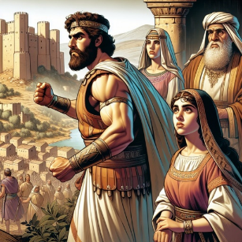
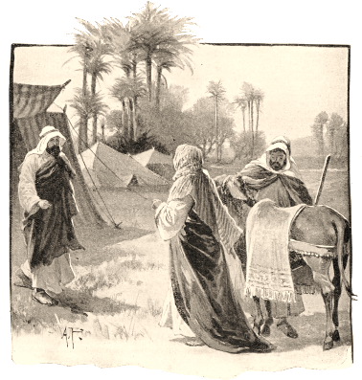
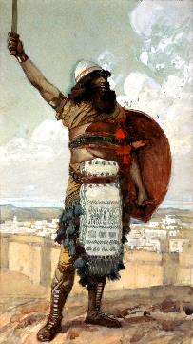
UKUQHUBELANA ( ITHOTSHI) ISIBANE
UKalebi wathi: “Ngizonila indodakazi yami u-Akisa ukuba ibe ngumkakhe kumuntu ozohlasela futhi athathe iKiriyati Seferi.” ( Joshuwa 15:16 )“
Lapho eseyinqobile ingxenye yensimu okwakungeyakhe ngokufaneleyo, uKalebi wacabanga ilifa ayezalishiya. Ingabe inzalo yakhe yayizaqhubeka ithembele kuNkulunkulu njengaye?
Wayesefakazile ukuthi uNkulunkulu wayethembekile, manje wayesefuna ukuthola umuntu olokholo olufanayo, ukuze adlulisele ithoshi kubo.
Ngenxa yalesi sizathu, wathembisa isandla sendodakazi yakhe kulowo owanqoba iKiriyati-seferi, ebizwa langokuthi iDebiri ( Josh. 15:15-16 ).
Umzukulu wakhe u-Otheniyeli wayeyindoda elamandla eyanqoba umuzi, futhi waba ngumahluleli wokuqala wakwa-Israyeli ( Josh. 15:17; AbaHluleli 3:9-11 ).
Ngemva kokutshada lo-Akisa, indodakazi kaKalebi, yancenga uyise ukuba amvumele andise indawo enqotshiwe ( Josh. 15:18-19 ), kanjalo ezibonisa eyindlalifa efanelekayo kaKalebi.

Slide 8

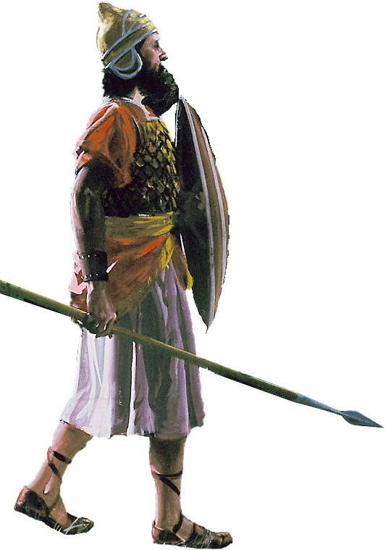
UKHOLO LUKAJOSHUWA

Slide 9

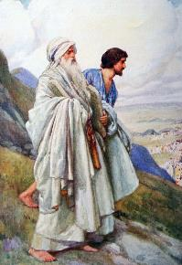
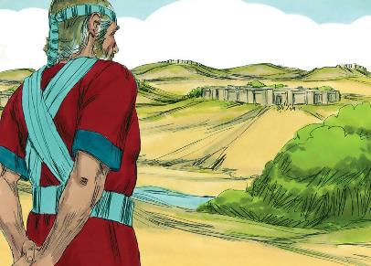
“Kwathi sebeqedile ukwaba izwe libe yizabelo zalo, abantwana bakwa-Israyeli bamnika uJoshuwa indodana kaNuni ilifa phakathi kwabo.”— Joshuwa 19:49 .
Esemutsha, uJoshuwa wakhethwa nguMose ukuba abe ngumsizi wakhe. Wazibonakalisa elalela, elesibindi, ethembekile, elusizo futhi ethanda izinto zikaNkulunkulu ( Eks. 33:11 ).
Lapho kufika isikhathi sokuthatha indawo yakhe, walinda kwaze kwaba yilapho zonke izizwe zithole iilfa lazo, futhi wakhetha “isabelo esiseleyo” [iThimnati-sera] ( Josh. 19:50 ), umuzi owawuseduze neShilo, lapho kwakwakhiwe khona iNdawo Engcwele.
Endabeni yakhe, sifunda ukuthi:
Ukholo alweyisi amaqiniso; lumane luveze icele ehlukileyo lokuzwisisa
Esikhundleni sokukhonona, sibizelwe ukuba sithembele futhi sizithobe ezinhlelweni zikaNkulunkulu
Izibusiso ziza kulabo abahlala ngokugcwele eNkosini
Impilo kuzo zonke izilinganiso zayo kumele iphile ngokwezinhlelo ezimiswe nguNkulunkulu
Kungcono ukuphila eduze loNkulunkulu ( IHu. 84:10 )

Slide 10

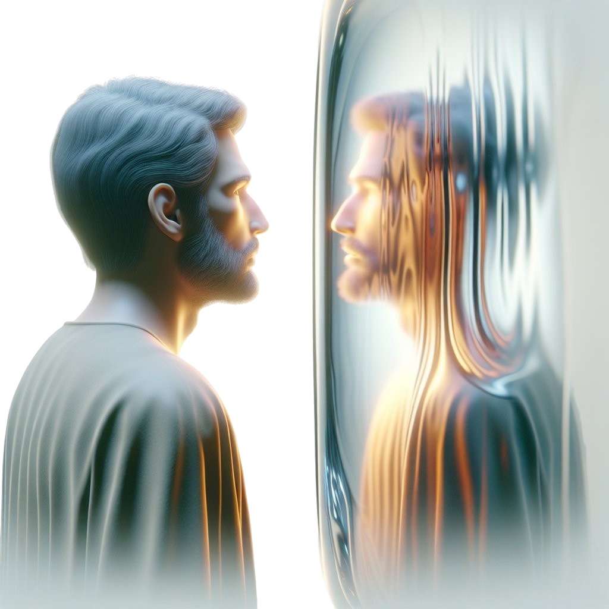
INDLELA YOKUTHOLA UKHOLO

Slide 11

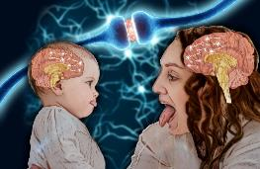
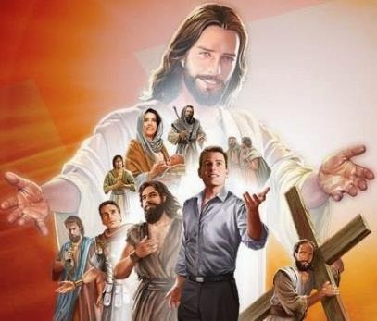

“Ngakho-ke, njengoba sizungezwe lifu elingaka labofakazi, masilahle konke okusivimbelayo kanye lesono esithandela kalula kangaka. Masiwugijime ngokubekezela umjaho esiwubekelweyo, sigxilise amehlo ethu kuJesu umqalisi lomphelelisi wokukholwa. Ngenxa yentokozo eyayibekwe phambi kwakhe wakhuthazelela isiphambano, edelela ihlazo laso, futhi wahlala ngakwesokunene sesihlalo sobukhosi sikaNkulunkulu. ( Hebheru 12:1-2 )
Ukuziphatha kwethu kuvame ukuveza esikubonayo. Kukhona okuthiwa "ama-mirror neurons" afiphaza umehluko phakathi kokubuka okuthile lokukwenza..
IBhayibheli liyasimema ukuba sibheke isibonelo samaqhawe amakhulu okholo, sinake ngokukhethekile uJesu, isibonelo esiphakeme kunazo zonke ( Heb. 12:1-2 ).
Ngokufunda ukuphila kwabantu bokholo njengoKalebi loJoshuwa, sifunda ukuthembela kuNkulunkulu njengoba benza; ukuthobeka njengoba babenjalo; ukuze bafakazele iqiniso ngesibindi, njengoba benza.
Kodwa singaguqulwa kanjani? IBhayibheli licacile: ngokuvumela uMoya oNgcwele ukuthi asebenze kithi (2 Kor. 3:18). Lona umsebenzi osebenzayo. Kufanele sikhethe ukuguqulwa futhi, njengoKalebi, siqale ukusebenza. Sibizelwe ukuba sibe yimihlatshelo ephilayo kaNkulunkulu ( Roma 12:1-2 ).

Slide 12

“Lamuhla sidinga amadoda athembeke ngokupheleleyo, amadoda alandela iNkosi ngokugcweleyo, amadoda angathambekele ekuthuleni lapho kufanele akhulume, aleqiniso njengensimbi esimisweni, angafuni ukwenza umboniso wokuzenzisa, kodwa ahamba loNkulunkulu ngokuthobeka, amadoda abekezelayo, alomusa, alesibopho, alesizotha, aqondayo ukuthi isayensi yomthandazo iyikusebenzisa ukholo futhi ibonise inkazimulo yenhliziyo kaNkulunkulu yonke futhi idinga uJesu abonise inkazimulo kaNkulunkulu. ukuguqulwa ekuqaleni, kanye lokuphinda lokhu kuguqulwa nsuku zonke.
Kwakulukholo lukaKalebi kuNkulunkulu olwamnika isibindi, olwamgcina ekwesabeni abantu, futhi lwamenza ukuba ame ngesibindi langokunganyikinyeki ekuvikeleni okulungile. Ngokuthembela emandleni afananayo, uJenene olamandla wamabutho asezulwini, wonke amasotsha eqiniso esiphambanweni angathola amandla lesibindi sokunqoba izithiyo ezibonakala zingelakunqotshwa.
EGW ( Sons and Daughters of God , July 19)

