Slide 1
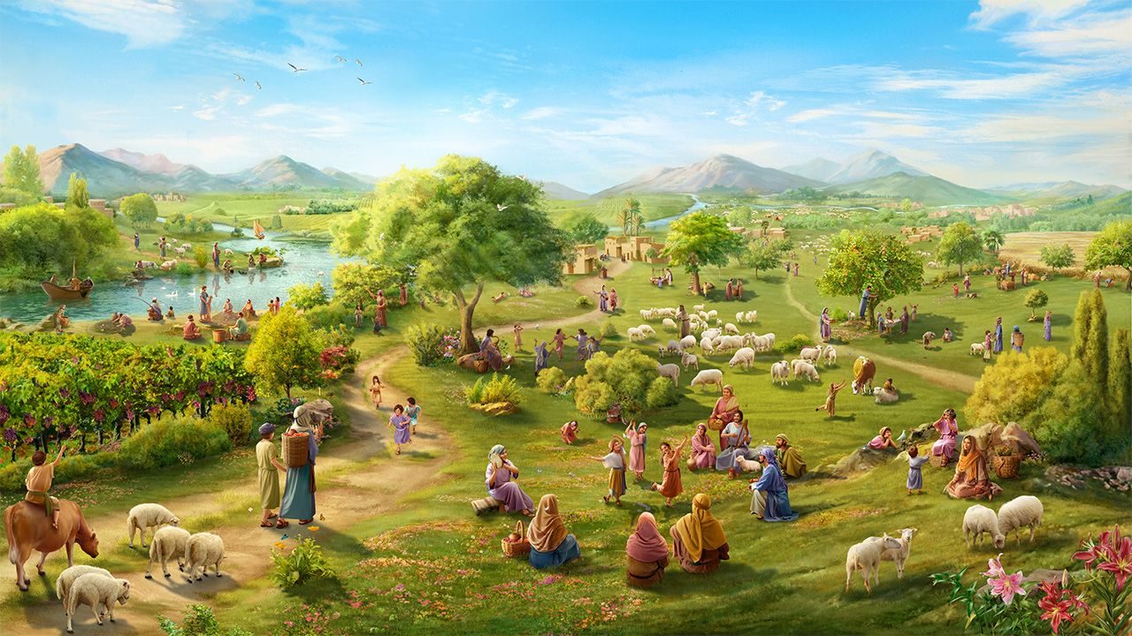
INDLALIFA ZESITHEMBISO, IZIBOTSHWA ZETHEMBA
Isifundo setshiyangalonye kuLwezi ilanga lamatshumi amabili lanye ku2025

Slide 2
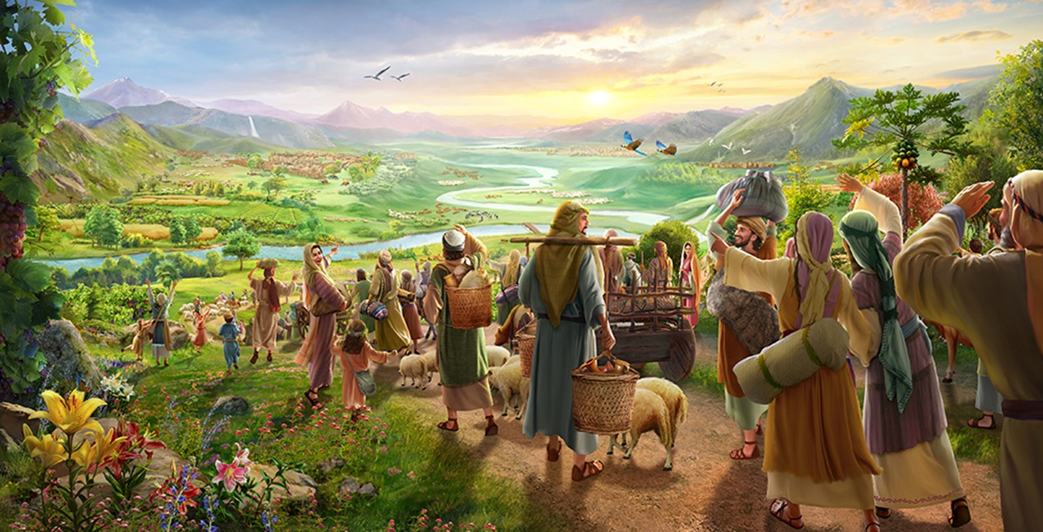
““Buyelani enqabeni yenu, zibotshwa zethemba; lamuhla ngiyamemezela ukuthi ngiyakubuyisela kini ngokuphindwe kabili.” (Funda uZakariya 9:12.)

Slide 3

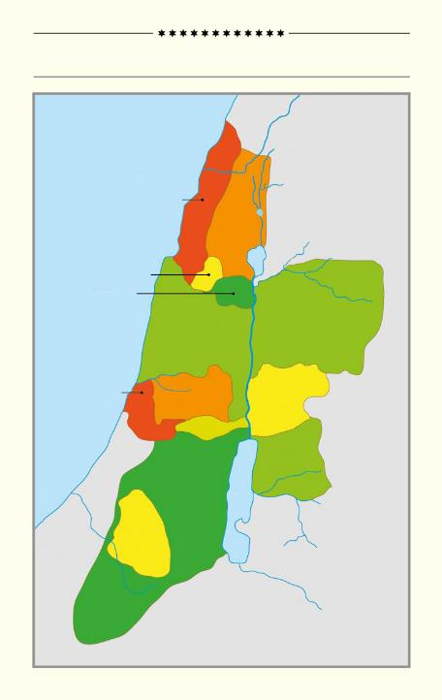
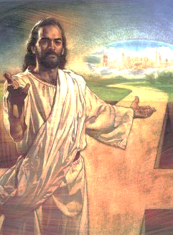
Ingxenye enkulu yencwadi kaJoshuwa, izahluko 13 kuya ku-21, ikhuluma ngokwabiwa kwezwe laseKhanani phakathi kwezizwe ezihlukahlukeneyo zakwaIsrayeli.
IZIZWE EZILITSHUMI LAMBILI ZAKWA-ISRAYELI
Mediterranean Sea
Phakathi kokubhekisela kwezindawo, abantu, lezizwe, singabona izwe elalivele liyilifa lika-Israyeli, kodwa, ngesikhathi esifananayo, ababengakabi lalo ngokupheleleyo.
ASER
NEPHTHALI
Ukufa kukaJesu kusiqinisekisa ngokuthi manje silizuze njengelifa izwe u-Adamu lo-Eva abake balahlwa ngalo. Ngalokho, sisengaba “yizithunjwa zethemba” lokulithola.
ZEBULON
ISSACHAR
MANASSEH
MANASSEH
Izwe elalilahlekile
Izwe uNkulunkulu aliphayo
Nqoba izwe
Gcina isipho
Umhlaba otholiweyo
DAN
A
EPHRAIM
GAD
BENJAMIN
RUBEN
B
JUDAH
C
SIMEON
B'
A'

Slide 4



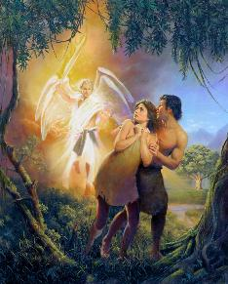
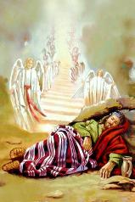
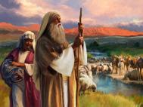
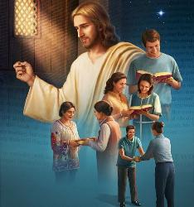
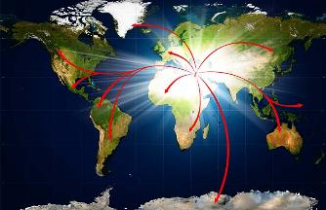
UMHLABA OLAHLEKILEYO
“UJehova uNkulunkulu wamxosha ensimini yase-Edene ukuba alime umhlabathi athathwe kuwo” (Genesise 3:23, NIV)
UNkulunkulu wabeka u-Adamu lo-Eva ababusi balomhlaba (Gen. 1:27-28), futhi wababeka ensimini yase-Edene (Gen. 2:8).
Lapho bengamlaleli uNkulunkulu, baxoshwa lapho (Gen. 3:23). Babelahlekelwe ukubusa phezu koMhlaba
Kodwa uNkulunkulu wayelesu lokuthi isintu sibuyise umhlaba olahlekileyo. Esigabeni sokuqala, wanika u-Abrahama, u-Isaka, kanye loJakobe isiqetshana sezwe: iKhanani (Gen. 13:14-15).
Kancane kancane, ilifa lalizanabela emhlabeni wonke, njengoba ulwazi ngoNkulunkulu lwalufinyelela kubo bonke abantu lezizwe (Isaya 11:9).
Ukungalaleli kuka-Israyeli kwaholela ekushintsheni kwezinhlelo zakuqala. UNkulunkulu wavusa abantwana baka-Abrahama ematsheni ukuze bazuze izithembiso zakhe: thina ( Luka 3:8; Hebheru 6:11-12 ).

Slide 5



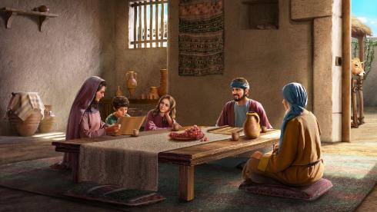
UMHLABA UNKULUNKULU AWUPHAWO
““Umhlaba ungokaJehova, lakho konke okukuwo, umhlaba, labo bonke abakhileyo kuwo.” ( IHubo 24:1 )
Njengoba u-Adamu lo-Eva bengenzanga lutho ukuze bafanele insimu yase-Edene, u-Abrahama lenzalo yakhe abenzanga lutho ukuze bafanele iZwe Lesithembiso. Kwakuyisipho esivela kuNkulunkulu.
Lesi sipho singasiqhathanisa lendlu yokurenta. Ngokuba u-Israyeli wayekwazi ukuhlala eKhanani, izwe lahlala lingelikaNkulunkulu (IHu. 24:1).
Umnikazi wendlu nguye onakekela uphahla, amapayipi amanzi, lokunye.Ngokufanayo, uNkulunkulu nguye owapha izuluelinayo, wavikela izilimo lokunye, ukuze u-Israyeli ahlale ngokuqiniseka ezweni uNkulunkulu amnika lona.
Njengase-Edene, kwakukhona imali yokurenta ukuze “ibhadalwe”: ukulalela ( Lev. 20:22 ). Kwakuyindaba yobudlelwane ngempela: ukuthanda uNkulunkulu lokujabulela izibusiso Zakhe.
Izolo, njengalamuhla, kuseyindaba yokholo ( Heb. 11:9-13 ).

Slide 6


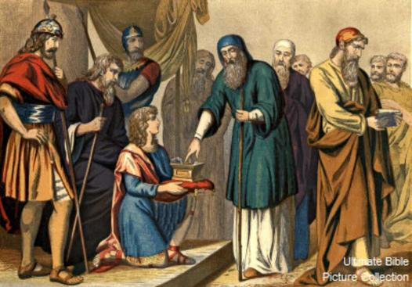
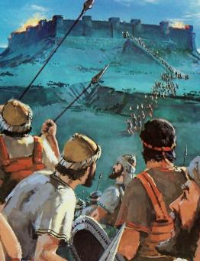
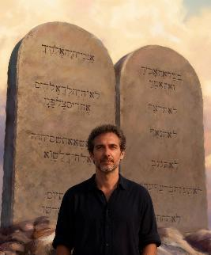

NQOBA UMHLABA
“and divide it as an inheritance among the nine tribes and half of the tribe of Manasseh” (Joshua 13:7)
Futhi uhlukanise libe yilifa phakathi kwezizwe eziyisitshiyangalonye lengxenye yesizwe sakwaManase” (Joshuwa 13:7)
Kuthe uJoshuwa esemdala, uNkulunkulu wamlaya ukuba ahlukanise izwe phakathi kwezizwe zakwa-Israyeli, kuhlanganise lezindawo ezazingakanqotshwa (Josh. 13:1-7).
Langokuba babelwela ukunqoba, ukuphumelela kwabo kwakungekona ukufaneleka kwabo, kodwa kwakungokukaNkulunkulu (Dut. 9:5). Njengo-Israyeli, asinakwenza lutho ukuze sithole insindiso futhi sizuze izithembiso njengefa ( Efe. 2:8-9; Gal. 3:29 ). Kodwa uma belwa… yini okufanele siyenze namuhla?
Lapho esesindisiwe, uNkulunkulu udinga izinto ezimbili indlalifa zakhe: ukulalela ( Flp. 2:12 ) kanye nokubonga ( Heb. 12:28 ).

Slide 7

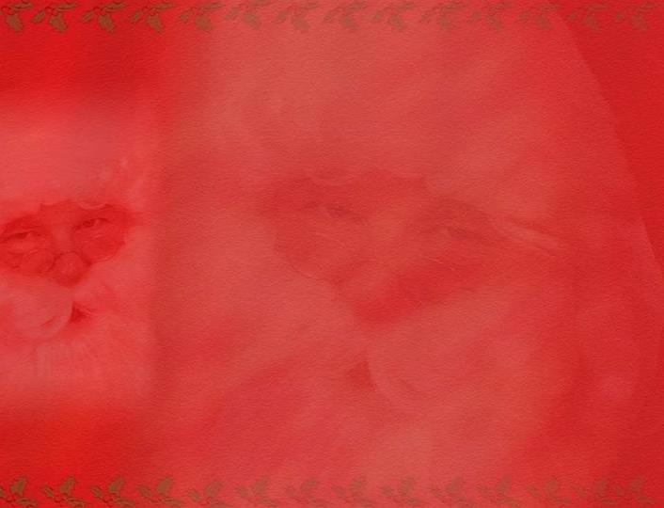
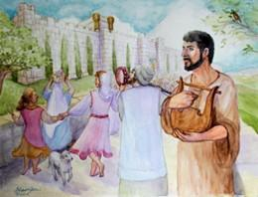
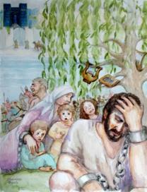
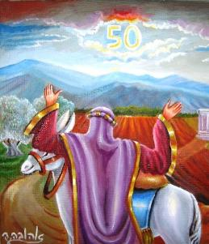
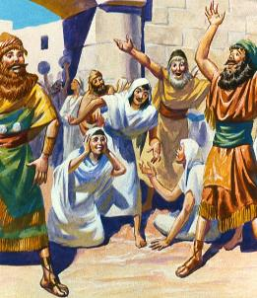
GCINA ISIPHO
“Izwe aliyikuthengiswa kuze kube phakade, ngokuba izwe lingelami, ngokuba lingabafokazi lezihambi kanye nami” (Levitikusi 25:23).“
Lapho ilifa selitholiwe, kwakulemithetho ekhethekileyo elawula ukusetshenziswa komhlaba: unyaka wesabatha lejubili
Umnyaka weSabatha, ukwandiswa okukhulu kweSabatha, wawuvumela izwe ukuba liphumule ( Lev. 25:2-5 ). Ukwehluleka ukugcina lomthetho kwakungesinye sezizathu zokudingiswa ( 2 IziKr. 36:20-21 ).
Ijubili lalihlanganyela ukubuyiselwa komhlaba kubanikazi bawo bokuqala, ukugwema ukungalingani kwezenhlalo ( Lev. 25:10, 23, 40-41 ).
Empeleni, le inhloso enkulu yeVangeli: ukwesula umehluko phakathi kwabanothileyo labampofu, abaqhatshi labasebenzi, abalenhlanhla labancitshwe amathuba, kusibeka sonke endaweni elinganayo ngokubona isidingo sethu esipheleleyo somusa kaNkulunkulu.

Slide 8

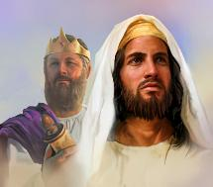
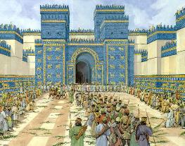
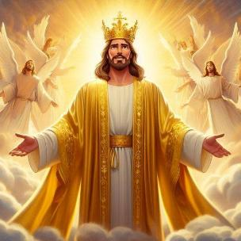
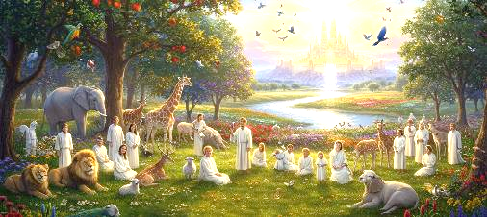
UMHLABA OFUNYANIWEYO
“Bayakuhlala ezweni engalinika inceku yami uJakobe, izwe lapho oyihlo ababehlala khona, bona labantwana babo labantwana babantwana babo bayakuhlala khona kuze kube phakade, loDavide inceku yami uyakuba yisikhulu sabo kuze kube phakade.”— Hezekeli 37:25;“
Ngenxa yokungalaleli kwakhe, u-Israyeli wasuswa ezweni lawo waphonswa eBabiloni. Kodwa uNkulunkulu akazange abalahle.
Wathembisa ukubabuyisela emuva, abaphe izwe kuze kube phakade, futhi wabeka uDavide njengenkosi phezu kwabo (Hez. 37:25). Kodwa u-Israyeli akazange abe lalelo zwe kuze kube phakade, futhi uDavide wayesefile isikhathi eside. Sitsho ukuthini-ke lesi siprofetho?
Lapha kumenyezelwa uJesu, iNkosi yeqiniso ebusa phakade. Lowo, ngegazi lakhe, usiqinisekisa ngelifa eliphakade.
Ungukugcwaliseka kwazo zonke izithembiso ( Rom. 15:8; 2 Kor. 1:20 ). Kuyena sithola izibusiso manje, nasesikhathini esizayo, nefa elithenjisiwe (1 Pet. 1:3-4). Ngokushesha, izinyawo zethu zizofika eZweni Lesithembiso..

Slide 9

“Ngokungalaleli uNkulunkulu, u-Adamu lo-Eva balahlekelwa yi-Edene, futhi ngenxa yesono umhlaba wonke waqalekiswa. Kodwa uma abantu bakaNkulunkulu belandela imilayo Yakhe, izwe labo laliyobuyiselwa ekuvundeni lasebuhleni. UNkulunkulu Uqobo Lwakhe wabanika iziqondiso maqondana lamasiko omhlaba, futhi kwakufanele babambisane Laye ekubuyiselweni kwawo. Ngaleyondlela izwe lonke, ngaphansi kwemithetho engokomoya, lalizaba yisifundo sikaNkulunkulu esingokomoya njengesifundo saKhe esingokomoya. umhlaba kufanele ukhiqize ingcebo yawo, ngakho ngokulalela umthetho waKhe wokuziphatha izinhliziyo zabantu kwakufanele zibonise izimfanelo zesimo Sakhe.”
EGW (Christ's Object Lessons, p. 289)

