Slide 1
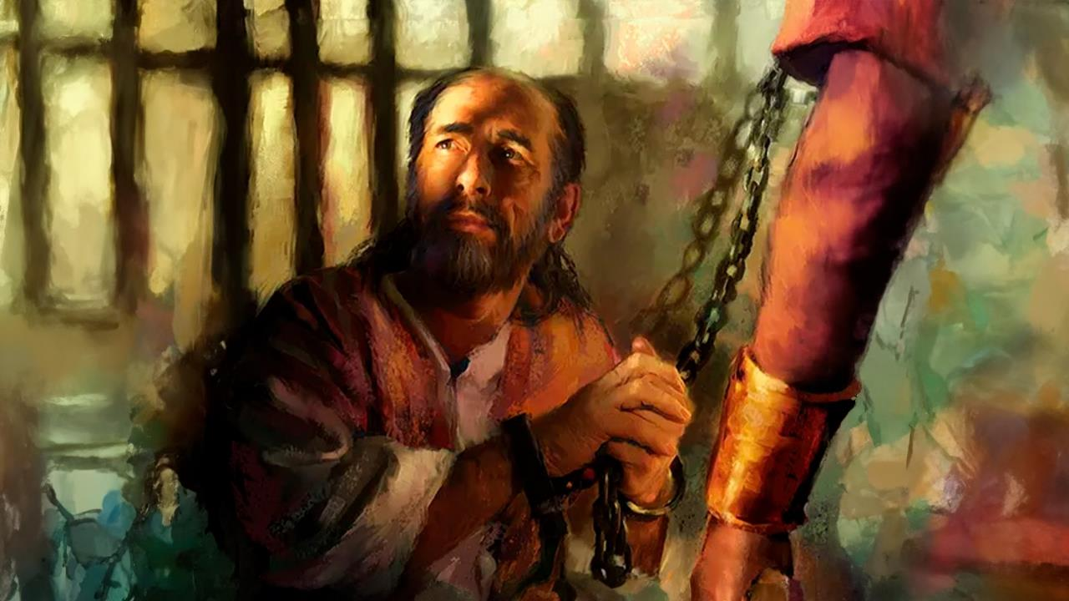
SIYAHLUKULUZWA KODWA KASILAHLWANGA
Isifundo sakuqala ilanga lesithathu kuZibandlela ku2026

Slide 2

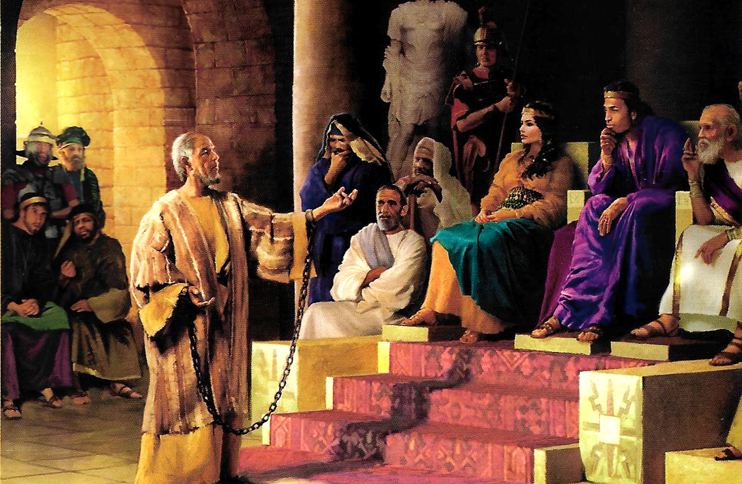
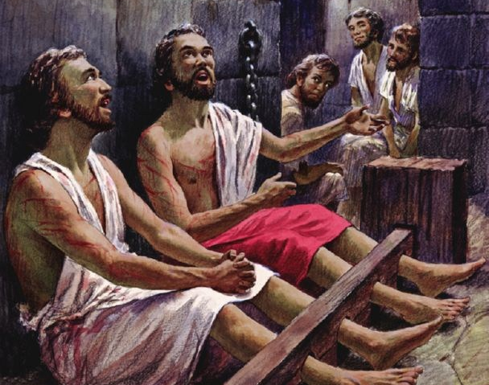
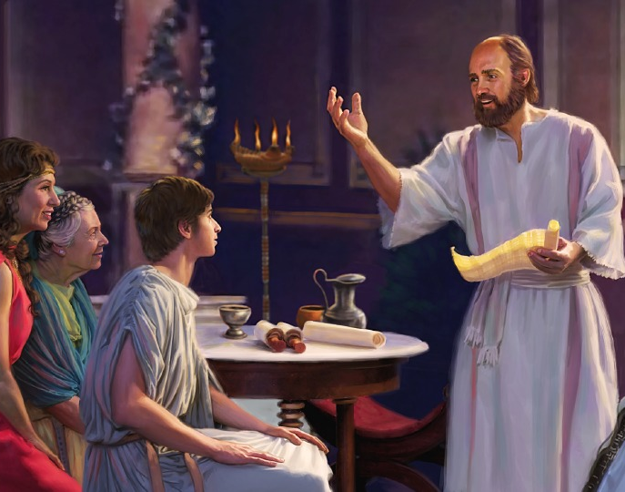
“Jabula kuJehova njalo. Ngiphinde ngithi, jabula njalo” IHubo 4:4NKJV

Slide 3

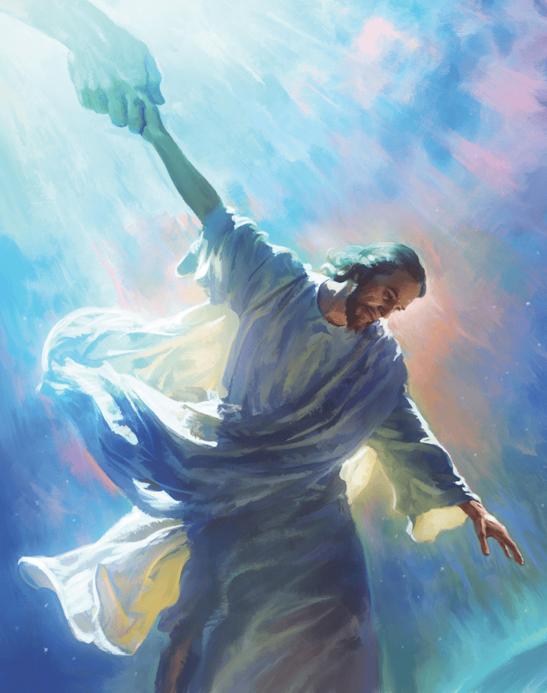


Kubo bonke ubufundisi bakhe, uPawulu waqala ukwethula, kubo bonke ababemlalela, okunguyena kuphela umuntu okwazi ukuhlanganisa iZulu loMhlaba: nguJesu Kristu, uMsindisi.
Ekubhaleni izincwadi zakhe kwabaseFilipi labaseKolose, wenza konke okusemandleni akhe ukusondeza ibandla eZulwini, kanye lamaKristu eduze komunye lomunye.
Ngokwenza kanjalo, wasibonisa ukuthi ibandla likaNkulunkulu lamuhla lingahlangana kanjani leZulu ukuze lifeze uthumo uJesu asinike wona eMhlabeni.
Umbhali wezincwadi:
UPablo ubotshiwe
Abameli ababotshwe ngamaketane
Abamukeli:
Imbali yaseFilipi
Imbali yaseKolose
Amabandla aseFilipi laseKolose

Slide 4
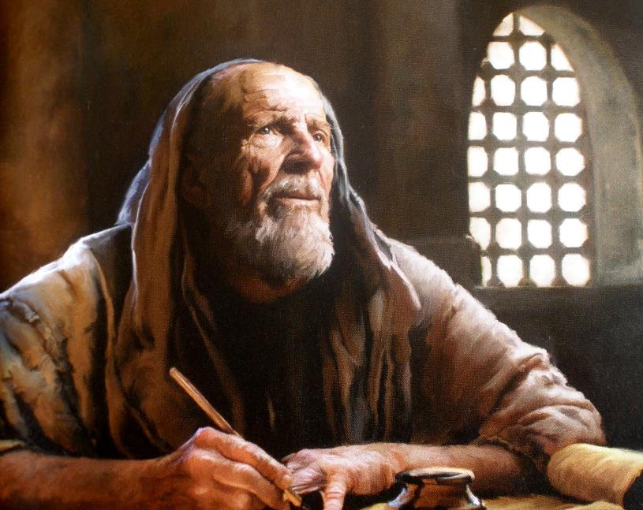

UMLOBI WEZINCWADI

Slide 5

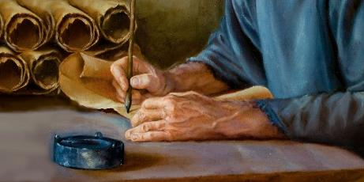
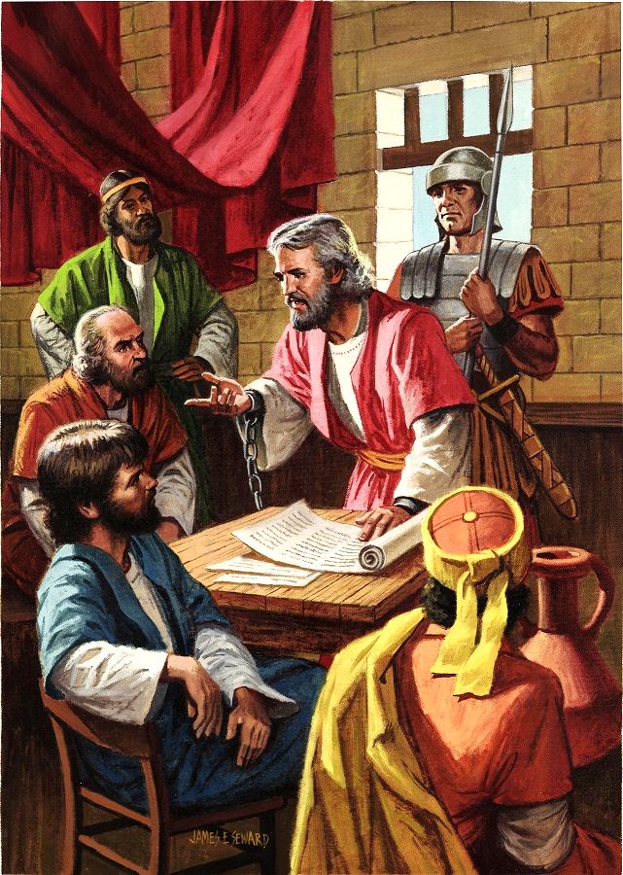
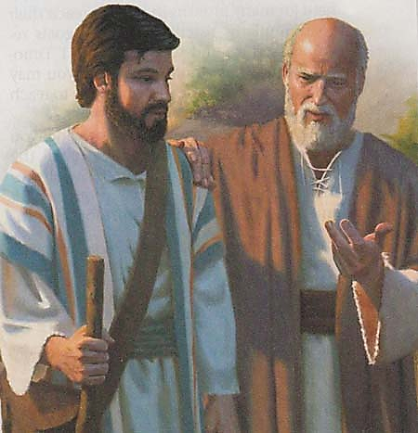
UPABLO UVALELWE EJELE
UPawulu, isibotshwa sikaKristu Jesu, loThimothewu umfowethu, kuFilemoni umngane wethu othandekayo lesisebenzi esikanye lathi” (Filemoni 1:1)“
Ngesikhathi ebotshwe okokuqala eRoma – phakathi kuka-60 no-62 AD – uPawulu wabhala okungenani izincwadi ezinhlanu: kwabase-Efesu, kwabaseFilipi, kwabaseKolose, kwaFilemoni, lasebandleni laseLawodikeya (elingakafiki kithi).
Njengoba kwakungekho macala anzima ayebekwe wona, wavunyelwa ukuhlala endlini ebhadalelwayo, ekhangelwe njalo yisotsha lamaRoma (IzEnzo 28:16). Lokhu kwamvumela ukuba aqhubeke ngokutshumayela ivangeli, ngitsho lakubaQapheli Bombusi uqobo (Fil. 1:13).
Uma sihlola izincwadi, singabona ukuthi uPawulu wayelabamnedisayo abanengi (Kol. 4:7-14; Fil. 23-24). khulumisana lendlu kaKesari (Fil. 4:22).
UPawulu wayelethemba lokuthi uzokhululwa masinyazana (Film. 22), ithemba ayengasenalo ngesikhathi ebotshwa okwesibili (2 Thim. 4:6).

Slide 6

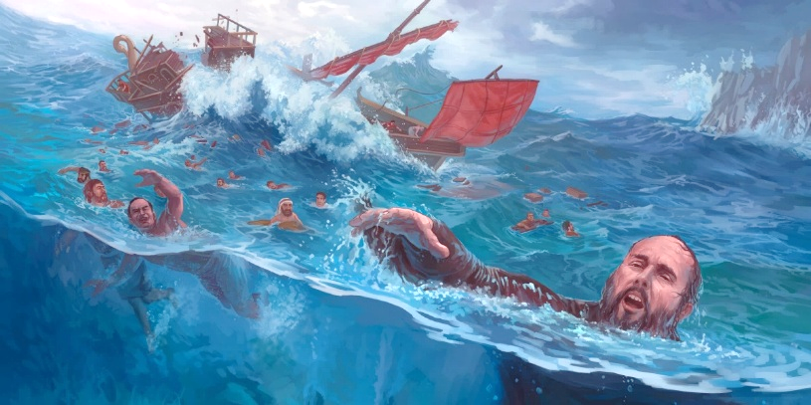
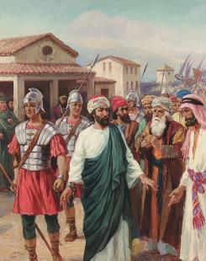
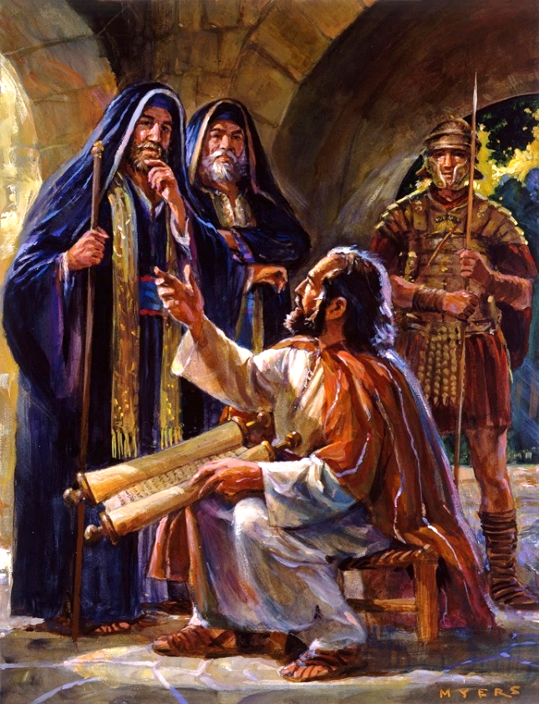
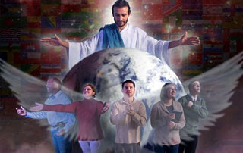
ABAMELI ABABOTSHWE NGAMAKETANE
engingumeli obotshwe ngamaketani. Ngikhulekele ukuba ngikumemezele ngesibindi, njengoba kufanele” (Efesu 6:20)
Kusukela ngesikhathi enquma ukuba ngumumeli likaKristu, impilo kaPawulu yayingelula (2 Kor. 6:4-5).
IBhayibheli lilandisa ngokubotshwa kukaPawulu kathathu kuphela ngaphambi kokuba asiwe eRoma: eFilipi (IzEnzo 16:22-24); eJerusalema (IzEnzo 23:10); laseKesariya (IzEnzo 23:33-35). Kodwa ngokuqinisekileyo kwakulezinye ezinengana (2 Korinte 11:23).
Kuzo zonke lezi zinkinga, uPawulu akazange azibheke njengongelalusizo (2 Kor. 4:7-9). Engakwazi ukutshumayela ngokukhululeka, waba “ngumeli obotshwe ngamaketane” (Efe. 6:20).
Isimo sengqondo kaPawulu sisifundisa ukuthi lapho sibhekene lobunzima ngenxa yokutshumayela ivangeli, kumelwe sithembele kuNkulunkulu ngokugcweleyo; sihlale sikhumbula iZwi laKhe (2 Thim. 2:15); futhi sibambelele kuMoya oNgcwele, uMduduzi osinika amandla lesibindi (Zak. 4:6).

Slide 7
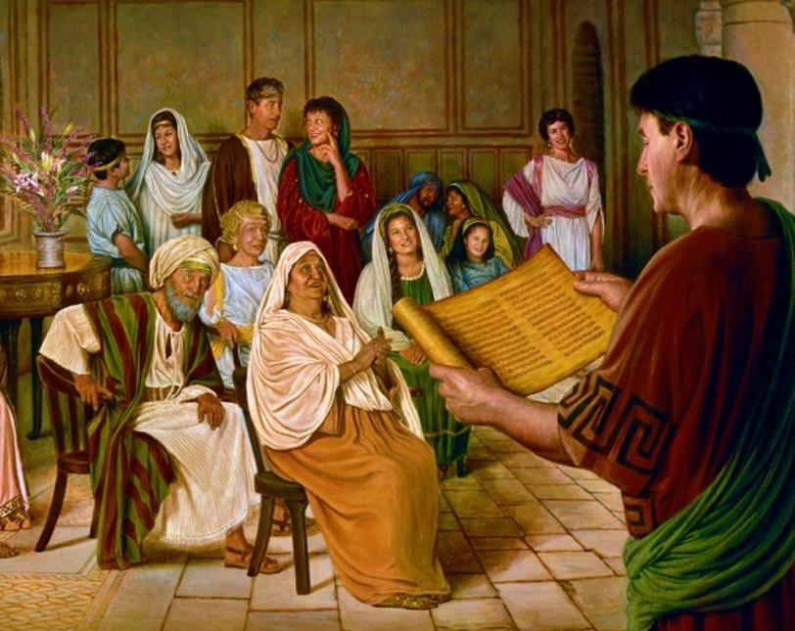

ABAMUKELI

Slide 8

“Umphostoli uPawulu wayezizwa elomthwalo wemfanelo ojulileyo ngalabo abaguqukileyo ngaphansi kwemisebenzi yakhe. Ngaphezu kwakho konke, wayefisa ukuba bathembeke, “ukuze ngijabule ngosuku lukaKristu,” etsho, “ngokuthi angigijimelanga ize, futhi angisebenzelanga ize.” KwabaseFilipi 2:16. Wayethuthumela ngenxa yenkonzo yakhe. Wayelomuzwa wokuthi ngitsho lensindiso yakhe ingase ibe sengozini uma ehluleka ukufeza umsebenzi wakhe futhi ibandla lingase lihluleke ukubambisana laye emsebenzini wokusindisa imiphefumulo.”
EGW (The Acts of the Apostles, p. 206)

Slide 9

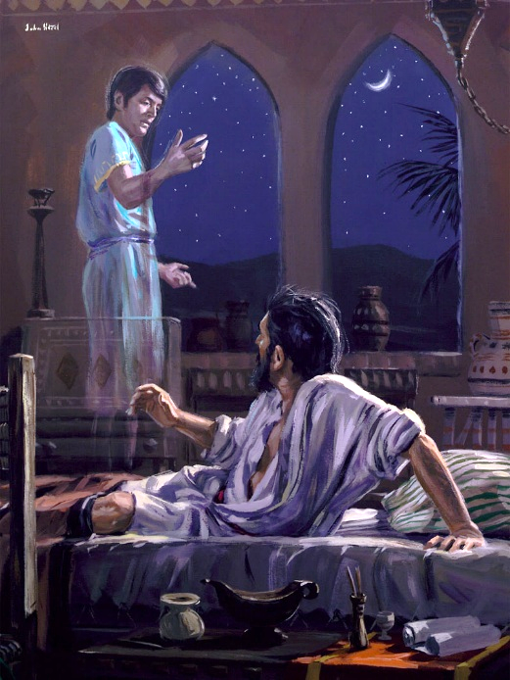
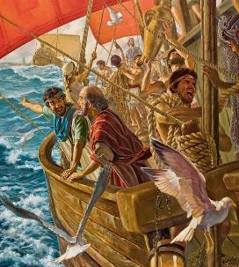
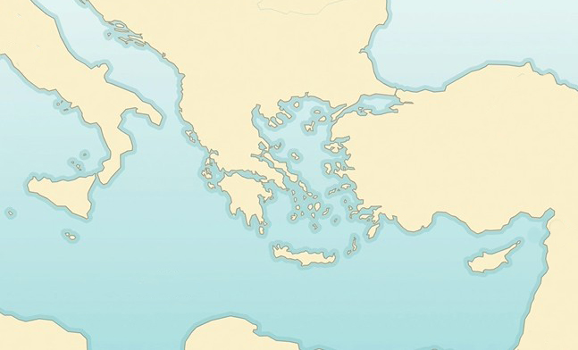

IMBALI YASEPHILIPPI
“Kwabonakala umbono kuPawulu ebusuku. Indoda yaseMakedoniya yayimi imncenga, ithi: “Welela eMakedoniya, usisize” (IzEnzo 16:9)
Province of Macedonia
Philippi
Neapolis
Bithynia
Samothrace
X
Ngesikhathi sohambo lwakhe lwesibili lobuthunywa bevangeli, izinhlelo zikaPawulu zantshintsha. UMoya oNgcwele wawuqondisa izinyathelo zakhe. (IzEnzo 16:6-12):
Troas
Mysia
Galatia
Phrygia
UPawulu waya eFrigiya (6a)
Wayengelakukwazi ukutshumayela lapho loba eGalathiya (6b)
Wafika eMisiya (7a)
Wazama ukuya eBithiniya, kodwa akakwazanga (7b)
Waya eTrowa, lapho abona khona umbono (8-10)
Wahamba ngomkhumbi waya eSamotrake (11a)
Ukusuka lapho waya eNeyapholi (11b)
Ekugcineni, wafika eFilipi (12)
Acts 16:6-12
IFilipi kwakuyindawo eyakhethwa nguMoya oNgcwele ukuqala ukutshunyayelwa kweVangeli eYurophu. Njengoba babelidolobha laseRoma eligcwele, abaseFilipi babekhululekile ekukhokheni intela futhi babelezakhamuzi zaseRoma ngokuzalwa.

Slide 10

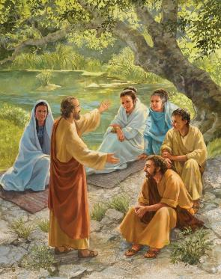
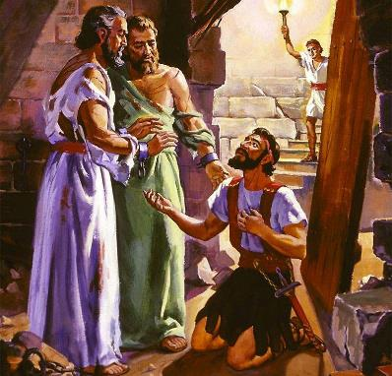
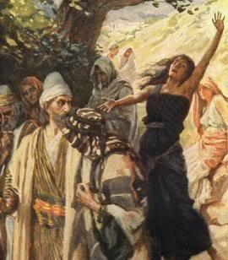
IMBALI YE PHILIPPI
“Kwabonakala umbono kuPawulu ebusuku. Indoda yaseMakedoniya yema yamncenga, yathi: “Woza eMakedoniya usisize” (IzEnzo 16:9)
Umkhuba kaPawulu lapho efika edolobheni elitsha kwakuyikuvakatshela isinagogeni. Kodwa eFilipi kwakungekho sinagoge! NgeSabatha bathola indawo yokukhulekela futhi lapho batshumayeza abesifazane ababebuthene (IzEnzo 16:13).
Kulo mhlangano kwavela umYurophu wokuqalaophendukileyo: uLidiya. Wabhapathizwa, kanye lomndeni wakhe wonke (IzEnzo 16:14-15).
Kodwa isitha asizange sihlale singenzi lutho. Sanxusa umbhuli ukuba adide izingqondo zabantu ngokwenza sengathi usekela uPawulu (IzEnzo 16:16-17). Lapho intombazane ikhululwa, kwaqala izinkinga zikaPawulu loSila (IzEnzo 16:18-24).
Umphumela: ukuguquka komgcini wejele lomndeni wakhe (IzEnzo 16:25-33). Akungabazeki ukuthi iVangeli langena eYurophu ngamandla lesiqondiso sikaMoya oNgcwele..

Slide 11

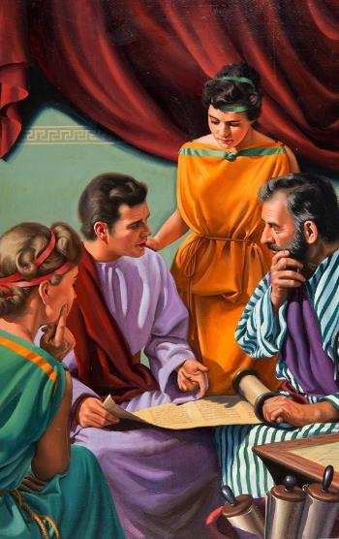
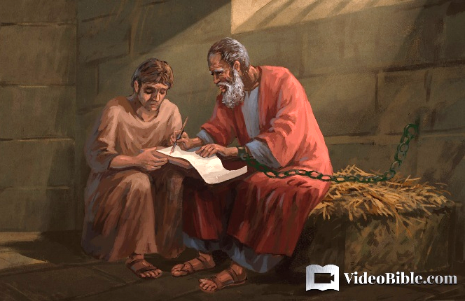
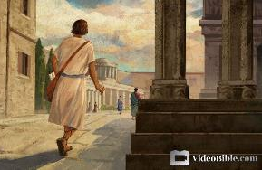
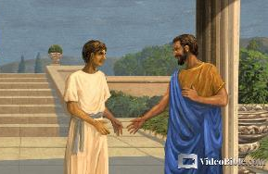
IMBALI YABASEKOLOSE
“njengoba lani lifundile ku-Ephafra, inceku ethandekayo esikanye layo, oyisikhonzi sikaKristu esithembekileyo ngenxa yenu” (Kolose 1:7)
U-Ephafra wayeyinceku kaPawulu ngesikhathi ebotshiwe eRoma (Film. 23). Owazalelwa eKolose (Kol. 4:12), nguye1 owaletha ivangeli kulowo muzi (Kol. 1:7).
IKolose kwakuyidolobha endaweni yaseFrigiya, eduze leLawodikeya leHeriapolis, lapho no-Ephafra ayetshumayela khona (Kol. 4:13). Lalilabantu abanengi abangamaJuda. Omunye wamaJuda avelele kakhulu ahlala lapho kwakunguFilemoni, isisebenzi esikanye loPawulu, lapho isonto lalihlangana khona endlini yakhe (Film. 1-2).
Esinye sezigqili zikaFilemoni, u-Onesimu, wabaleka waya eRoma, lapho amukela khona uJesu ngoPawulu (Film. 10-11). Ngokubuyisela u-Onesimu enkosini yakhe, uPawulu wabonisa ukuthi ubuhlobo phakathi kwamakhosi lezigqili, loba abaphezulu labangaphansi, kufanele bube njani (Film. 12-17).

Slide 12

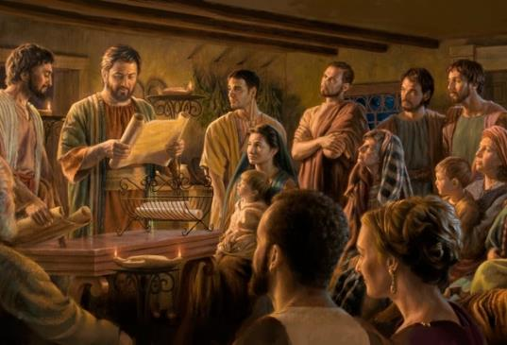
AMABANDLA ASEFILIPI LASEKOLOSAE
“UPawulu loThimothewu, izinceku zikaJesu Kristu, kubo bonke abangcwele kuKristu Jesu abaseFilipi, kanye labafundisi lamadikoni” (Filipi 1:1)
Izingeniso zezincwadi eziya kwabaseFilipi lakwabaseKolose, ezifana kakhulu, zisibonisa izici ezimbili ezibalulekileyo (Filipi 1:1; Kol. 1:1-2)
Emehlweni kaNkulunkulu, amalunga ebandla angcwele futhi athembekile, laphezu kwamaphutha awo
Ebandleni kukhona uhlelo, lapho amanye amalunga alo enegunya elikhulu lomthwalo wemfanelo kulabanye:
UThimothewu ungumhlanganyeli wakhe (umfundisi)
Abafundisi bangabaholi bendawo (abadala)
Amadikoni aphatha ibandla
UPawulu ungumphostoli, umholi osezingeni eliphezulu
Esejele, uPawulu ubonga abaseFilipi ngosizo abamthumelele lona (Filipi 4:18).
KwabaseKolose, uthumela abahlanganyeli bakhe ukuba babaduduze (Kol. 4:7-9).

Slide 13

“Ake sicabange ngokuhlangenwe loPawulu kancane. Ngesikhathi esifanayo lapho kwakubonakala sengathi imisebenzi yomphostoli yayidingeka kakhulu ukuqinisa isonto elalivivinywa futhi litshutshiswa, inkululeko yakhe yasuswa, waboshwa ngamaketanga. Kodwa lesi kwakuyisikhathi sokuba iNkosi isebenze, futhi ukunqoba kwakuzuza kwakuligugu.
Kunini lapho uPawulu ayekwazi ukwenza okuncane khona, yilapho iqiniso lathola khona indlela yokungena esigodlweni sobukhosi. Akuzona izintshumayelo zikaPawulu zobuciko phambi kwalaba bantu abakhulu, kodwa izibopho zakhe zadonsela ukunaka kwabo. Ngokuthunjwa kwakhe wayengumnqobi kaKristu. Ukubekezela lobumnene azithoba ngakho ekuboshweni kwakhe isikhathi eside lokungafanele kwenza laba bantu balinganise ubuntu babo.”
EGW (Reflecting Christ, December 10)

