Slide 1
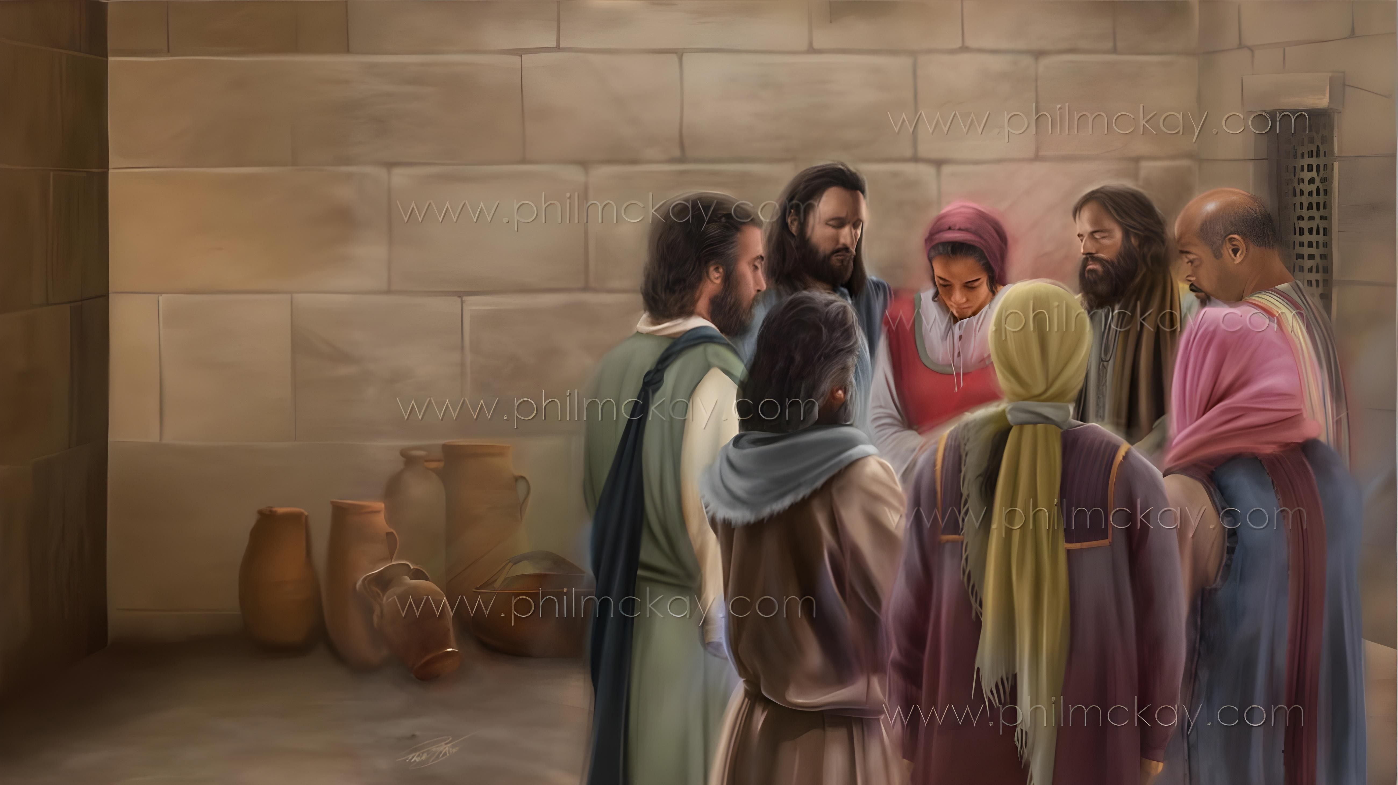
IZIZATHU ZOKUBONGA lOKUTHANDAZA
Isifundo sesibili kuZibandlela ilanga letshumi ku2026

Slide 2


“Sileqiniso ngalokhu: lowo oqale umsebenzi omuhle kini uzawuqeda kuze kube lusuku lukaJesu Kristu.” AmaFilipi 1:6 NKJV

Slide 3

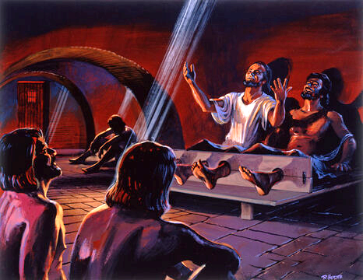
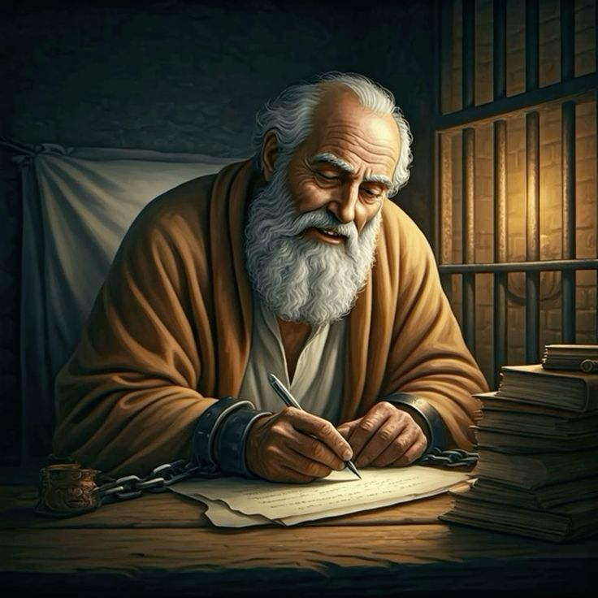







Lezi bezingezikhathi ezilula kuPaul. Bekungaba lula ukuzinikela ukudangala ngenxa yokulahlekelwa yinkululeko yakhe.
Ngalokho, njengoba engekho esithembisweni esinzima sasePhilippi, uPaul wathola izizathu zokubonga waziveza kubafowabo labodadewabo ePhilippi laseColossae
Ukuvalelwa kwakhe ejele akuzange kumvimbe ekuqhubekeni lokuxhumana noBaba wakhe, lasekuthandazeleni abanye ngokuthandaza
Izizathu zokubonga lokuthandaza encwadini yamaFilipi:
Izizathu zokubonga (AmaFilipi 1:3-8)
Izicelo zemithandazo (AmaFilipi 1:9-11)
Ukubonga lokuthandaza ezikhathini ezinzima (AmaFilipi 1:12-18)
Izizathu zokubonga lokuthandaza encwadini yamaKolosi:
Izizathu zokubonga (AmaKolose 1:3-8)
Izicelo zemithandazo (AmaKolose 1:9-12)

Slide 4
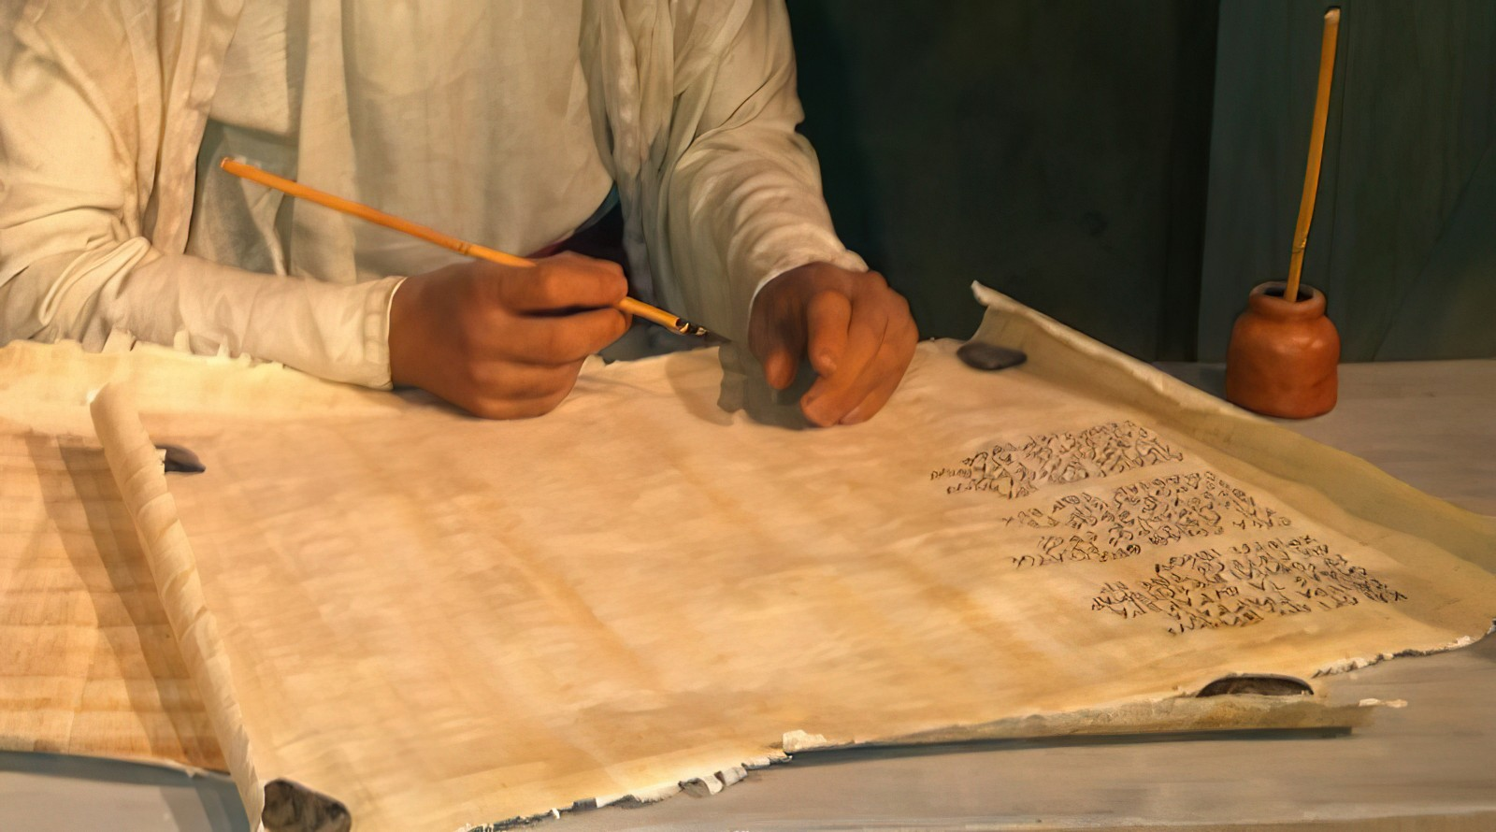
Izizatho Zokubonga lokuthandaza Encwadini YabaseFilippi

Slide 5


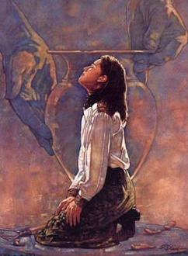
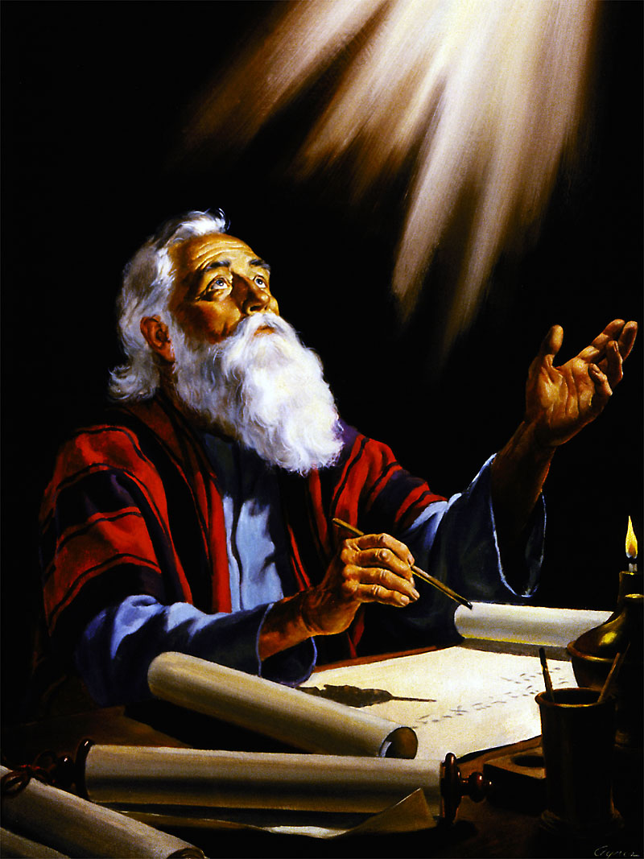
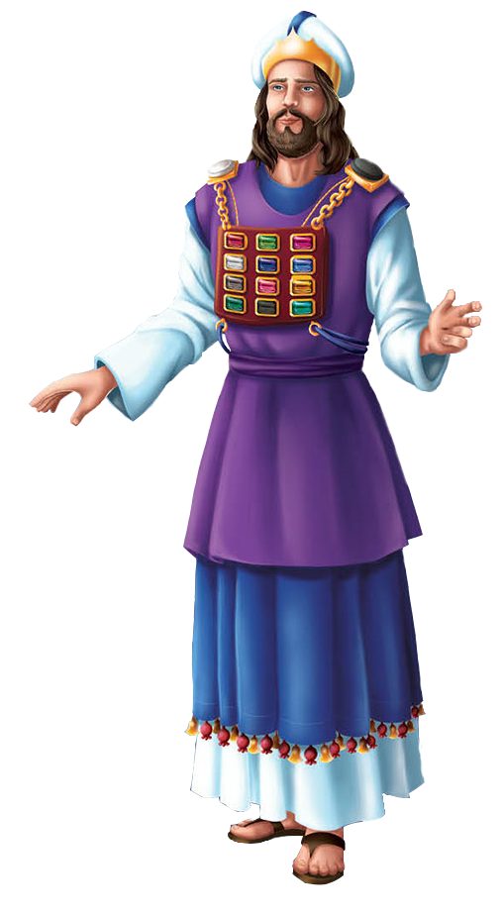
IZIZATHO ZOKUBONGA
ukuzethemba ngalokhu, ukuthi lowo owaqala umsebenzi omuhle kini uyowuqhubekisela ekupheleni kuze kube lusuku lukaKristu Jesu” (Filiphisi 1:6)“
UPawulu uqala incwadi yakhe ngokubonga uNkulunkulu ngabakholwayo eFiliphini (Fil. 1:3), ababemthanda kakhulu (Fil. 1:8).
Njengezikhathi lapho umpristi ophakemeyo egqoke ibheqe lakhe lesifuba, eduze lenhliziyo yakhe, amagama ezizwe zika-Israyeli abhalwe emadwaleni lapho emi phambi kukaNkulunkulu, uPawulu wayephethe “enhliziyweni yakhe” ilunga ngalinye lebandla lapho emi phambi kukaNkulunkulu emithandazweni ukuze abaxhumanise (Fil. 1:7).
Ukubonga kwakhe kwakuhlanganisa ukuthi amaFiliphisi ahlala ethembekile kuvangeli, lokuthi uNkulunkulu wayelungisisa bona nsuku zonke (Fil. 1:5-6).
Isizathu sesithathu sokubonga kwakuyikuthi amaFiliphisi ayesaba laye “ezibopho zami, lasekuzivikeleni lasekuqiniseni kwevangeli” (Fil. 1:7).

Slide 6


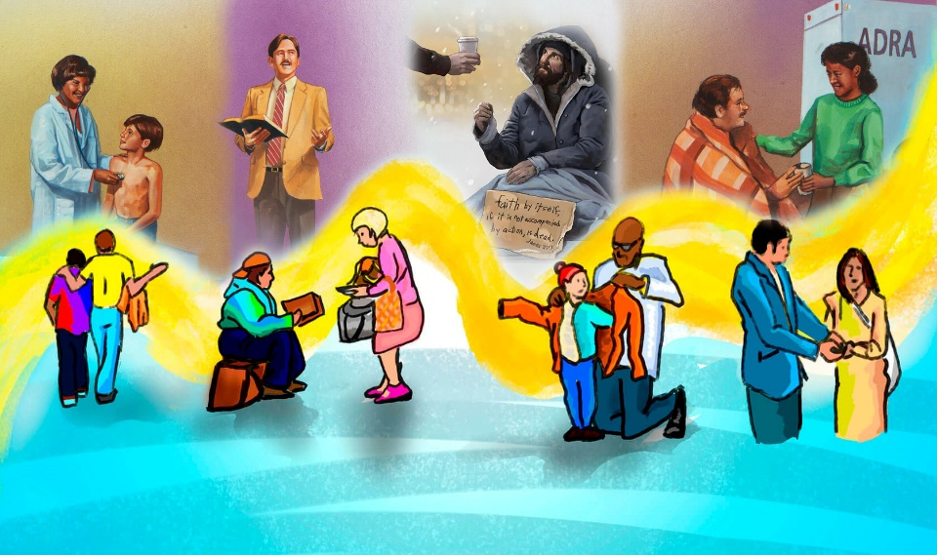
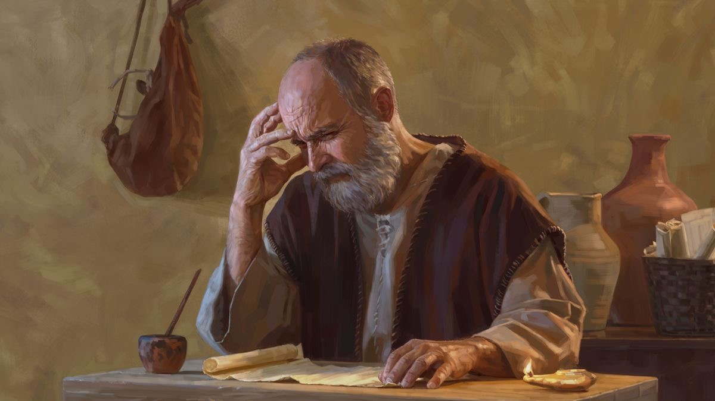
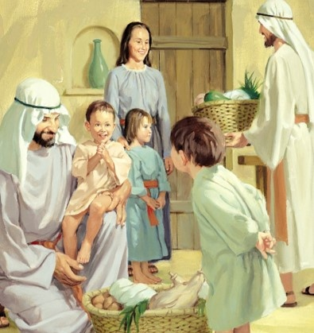
IZICELO ZOMTHANDAZO
“Futhi lo ngumthandazo wami: ukuthi uthando lwakho lungakhula kakhulu kakhulu ekwazini lasekujuleni kokubona, ukuze ukwazi ukuhlukanisa okuhle kakhulu futhi ube mhlophe ngaphandlekokufanisa, ngosuku lukaKristu, ugcwele izithelo zolulimeko okuza ngoJesu Kristu—ekubongeni lasekudumeni kukaNkulunkulu.” (Filipi 1:9-11 NIV)
Singacabanga ngokufuqwa kukaPaul ekuthandazeni njenge “sizathu esihlotshanisiwe” (Filipi 1:9-11 NIV):
Sengathi uthando lungakhula kuwe
Lokhu kuyokwenza ube lolwazi olukhulu
Uzokwazi ukuhlukanisa okuhle kakhulu
Uzoba ngcwele futhi ube ngowesimilo esihle
Uzoveza izithelo ngoJesu Kristu
Lokhu kuzoletha udumo lokudumisa kuNkulunkulu
Senzeni ukuthi uthando lwethu “lukhule kakhulu langaphezulu”? Kungani kubalulekile kangaka empilweni yobuKristu?

Slide 7
UKUPHA UKUBONGA LOKUPHILA EZIKHATHINI ZOBUNZIMA

Slide 8

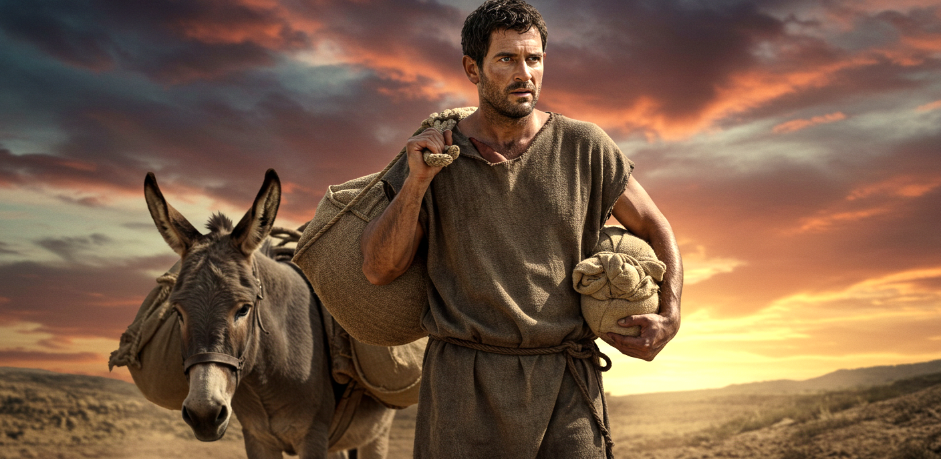
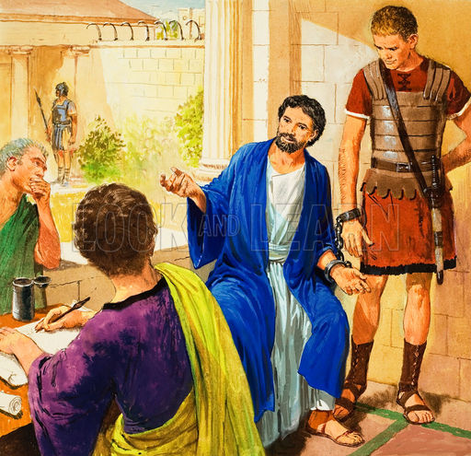
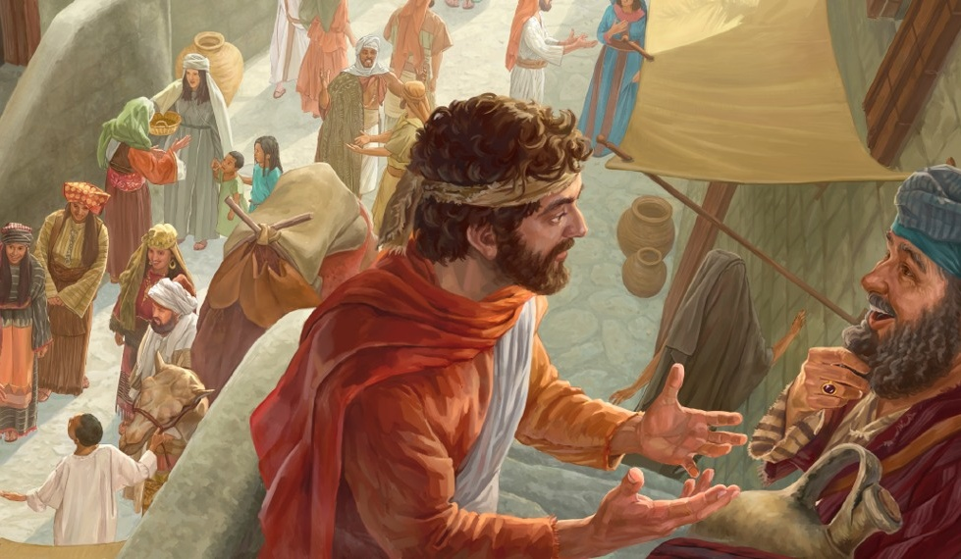
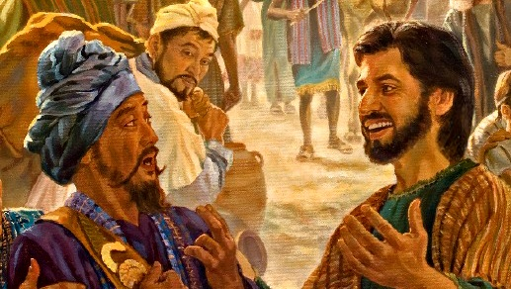
ITHUBA LOKUVIKELA IVANGELi
"Manje ngiyathanda ukuba lazi, bazalwane, ukuthi okwenzekileyo kimi kuye kwaholela ekuthuthukiseni ivangeli. (Filipi 1:12)“
Lapho abaseFilipi besizwa ukuthi uPawulu ubotshiwe eRoma, bakhathazeka kakhulu, futhi bathumela u-Epaphrodito ngosizo lompostoli (Fil. 4:18).
Kulokuba akhathazeke, uPawulu wabonga uNkulunkulu ngokubotshwa kwakhe. Kungani ubonga? Ngoba ngale ndlela wakwazi ukutshumayela kubani, ngaphandle kwalokho, wayengeke afinyelele (Phil. 1:13).
Ngaphezu kwalokho, ukubona isimo senhliziyo se-mpostoli, abanye abafowabo abathembekileyo bagqugquzelwa, futhi baqala ukufundisa izindaba ezinhle ngaphandle kokubheka ubunzima obuhambisana nakho (Flp. 1:14).
Abanye, becabanga ukuthi ukukhuluma ngokusobala ngezindaba ezinhle kuzoletha ubunzima kuPhawuli, labo basize –ngokungafuni– ekusabalaliseni kwazo (Flp. 1:15-18).

Slide 9
Izizatho Zokubonga Lokuthandaza Encwadini YamaKolose

Slide 10


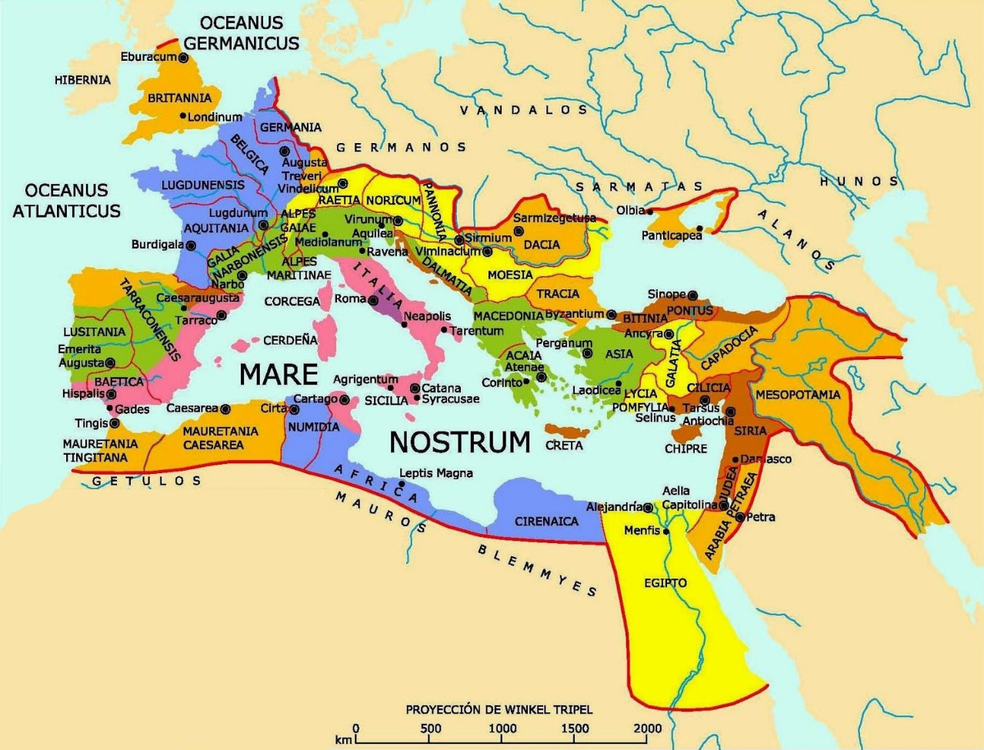
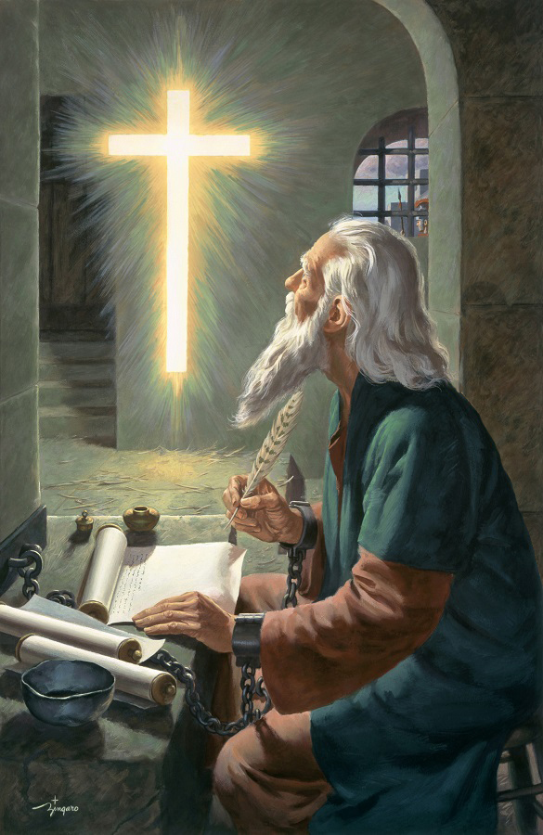

IZIZATHO ZOKUBONGA
“Sihlale sibonga uNkulunkulu, uBaba weNkosi yethu uJesu Kristu, lapho sithandazela kini. (Kolosayi 1:3)“
Siphinda amazwi ka-1 Korinte 13:13, uPaulu ubonga uNkulunkulu ngoba amaKolosayi alezi zimiso ezintathu zobuKristu: ukukholwa, ithemba, nothando (Kol. 1:4-5).
Lezi zimiso zivezwa “kuKristu uJesu”, zithinta ubudlelwano bethu “labahlanzekileyo bonke”, futhi sezidluliselwe kithi nge “gama langempela levangeli”.
UPaulu ugcizelela ukuthi le vangelini ayikhulunywanga kuphela kubo abakwaKolosayi, kodwa “kulo lonke izwe” (Kol. 1:6) ... futhi kungakapheli iminyaka engu-30 kuphela!
Amandla kaNkulunkulu, adluliselwa ngevangeli ngomsebenzi woMoya oNgcwele, kwenza iBhayibheli libe “ligama lokuphila” (Fil. 2:16). Lokhu kutsho ukuthi, ngokwamukela ivangeli, silempilo engapheliyo lesipho sohlanga “esigcinwe kini ezulwini” (Kol. 1:5).

Slide 11



IZICELO ZOMTHANDAZO
“Ngalesi sizathu, kusukela ngosuku sizwe ngalo ngawe, asikaze sekele ukukukhuleka. Sihlala sicela uNkulunkulu akugcwalise ngolwazi lwemvelo yakhe ngokuhlakanipha lokwazi konke okumnika umoya.” (KwabaseKolose 1:9)
Isicelo sokukhuleka sikaPhawuli sihlanganisa izinto ezinengi ezinhle kwabeKholose (Kol. 1:9-11):
Kungakhula ulwazi ngoNkulunkulu, kuzakwenza bathole ukuhlakanipha lokuqonda ngokomoya
Baphile njengabantwana bakaNkulunkulu, bemjabulisa ngazo zonke izindlela
Baliswe izithelo futhi bakhule olwazini
Baqiniswe ngamandla kaNkulunkulu ukuze babekezelele
Lomkhuleko wenziwa “bebonga ngenjabulo kuBaba” (Kol. 1:12).
Kulezindlela ezine uNkulunkulu asebenza ngazo ukwenza umkhuleko kaPhawuli ube impumelelo kithi:
IBhayibheli (IHubo 119:105)
Umoya wokubekezela (Isambulo 19:10), ivezwe ngu-Ellen G. White
Ukuholwa nguNkulunkulu ngokuhlakanipha (Kol. 4:3)
UMoya oNgcwele (Is. 30:21)

Slide 12

“Impilo yethu kumele ibotshwe ndawonye lempilo kaKristu; kumele sihlale sithola kuye, sithathe, Isinkwa Esiphilayo esehla ezulwini, sikhupha emthonjeni ongapheliyo, osipha njalo izibusiso zalo ezinothileyo. Uma sigcina iNkosi ngaphambi kwethu njalo, sivumela izinhliziyo zethu ukuphuma ngokubonga lokudumisa kuye, sizoba lokutsha okuqhubekayo empilweni yethu yokholo. Imithandazo yethu izothatha isimo sengxoxo loNkulunkulu njengoba sikhuluma lomngane. Uzoziveza izimfihlo Zakhe kithi ngokwakhe. Kanengi kuza kithi umuzwa ojabulisayo wokuba khona kukaJesu. Kanengi inhliziyo zethu ziyatsha phakathi kwethu njengoba esondela ukuze ahlanganyele lathi njengoba esenza loHezekhu. Lapho lokhu kuyimvelo yeqiniso yesipiliyoni somKristu, kubonakala empilweni yakhe ubuqotho, ukufaneleyo, ukuthobeka.
EGW (Christ’s Object Lessons, p. 129)

